Slide 1
M7 vs M8 vs M9
Detailed Architecture & Technical Differences
Physics-Informed Slot-Attention Psi-Neural Network
M7 - Baseline Psi-NN (Wide MLP, fixed R, k*=6)
M8 - Efficient Psi-NN (Bottleneck MLP, learnable R, physics loss, k*=5)
M9 - SwiGLU Psi-NN (Gated MLP, learnable R, physics loss, k*=5)
Teacher M6: 56,646 params | M7: 55,770 | M8: 45,486 | M9: 45,502
Best R2: M9 = 0.9915
PFE - M7 / M8 / M9 Detailed Comparison

Slide 2
Model Overview
Three generations of Psi-NN
M7 - Baseline Psi-NN
M8 - Efficient Psi-NN
M9 - SwiGLU Psi-NN
Wide slot MLP 64->128->64
16,512 MLP params
Fixed relation matrix R (buffer)
k* = 6 prototypes
Full 3-stage pipeline (A->B->C)
R2 = 0.9897
Params = 55,770
Compression = 1.5%
Bottleneck MLP 64->48->64
6,256 MLP params (-62%)
Learnable relation matrix (logits->softmax)
k* = 5 prototypes
Physics-monotonic loss (KL, KR dec / KLR inc)
R2 = 0.9882
Params = 45,486
Compression = 19.7%
SwiGLU gated MLP (hidden=32)
6,272 MLP params (gated)
Learnable R (same as M8)
k* = 5 (reuses M8 discovery)
Skips Stage A & B entirely
R2 = 0.9915 (BEST)
Params = 45,502
Compression = 19.7%
PFE - M7 / M8 / M9 Detailed Comparison

Slide 3
Psi-NN Architecture (common to all versions)
Forward pass: Input -> Embedding -> SlotAttention -> SlotMLP -> Relation Reconstruction -> Output
1. Input Embedding
2. Slot Attention
3. Slot MLP (per slot)
4. Relation Matrix R
5. Output Head
Linear(8, 64)
8 soil/load features
-> 64-dim hidden
>
K slots: 1 initial + k* proto
3 iterations
dot-product + softmax attn
>
M7: Wide 128
M8: Bottleneck 48
M9: SwiGLU 32
>
Reconstruct 21 slots
from k* prototypes
M7: fixed / M8-9: learned
>
Linear(64, 3)
-> KL, KR, KLR
x 21 time steps
Detailed Forward Pass:
h = Linear_embed(x) # (B, 64) input embedding
slots = SlotAttention(h, slots_init) # (B, 1+k*, 64) iterative attention
slots = SlotMLP(slots) # (B, 1+k*, 64) per-slot transform
initial_slot = slots[:, 0, :] # (B, 64) initial condition slot
proto_slots = slots[:, 1:, :] # (B, k*, 64) prototype slots
drop_slots = R @ proto_slots * scale # (B, 20, 64) reconstructed via relation matrix
all_slots = cat(initial_slot, drop_slots) # (B, 21, 64) full 21 time steps
output = cumsum(OutputHead(all_slots)) # (B, 21, 3) KL, KR, KLR curves
PFE - M7 / M8 / M9 Detailed Comparison

Slide 4
M7 - Baseline Psi-NN Architecture
Wide MLP, fixed relation matrix, k*=6 prototypes
Model Components
Component | Params | % of Total
Input Embedding | 576 | 1.0%
Slot Init (7x64) | 448 | 0.8%
Slot Attention | 20,864 | 37.4%
Slot MLP (wide) | 16,512 | 29.6%
Scale + Output | 215 | 0.4%
Relation R (fixed) | 0 (buffer) | 0%
TOTAL | 55,770 | 100%
Input Embedding: Linear(8, 64) -> 512 + 64 = 576 params
Slot Init: 7 learnable vectors (1 initial + 6 proto) -> 7x64 = 448 params
Slot Attention: K/Q/V projections (64->64) + GRU(64,64) + LayerNorm
-> 3x(64x64+64) + GRU(8320) + 2xLN(128) = 20,864 params
Slot MLP: Linear(64,128) -> GELU -> Linear(128,64) -> 16,512 params
Scale factors: 20 learnable -> 20 params
Output Head: Linear(64,3) -> 195 params
Relation Matrix R (Fixed)
Shape: (20, 6) - maps 6 prototypes -> 20 drop-slots
Computed once in Stage B via inverse-distance weighting
R[i,j] = (1/d_ij) / Sum_j(1/d_ij) where d = euclidean distance
Registered as buffer (not updated during Stage C)
Stays frozen throughout training - no gradient flow
Key Observations:
MLP uses 29.6% of all params -> main compression target
Slot Attention is the largest block (37.4%)
k*=6 discovered by Stage B (silhouette-based)
Fixed R means structure is locked after discovery
Compression vs M6: only 1.5%
PFE - M7 / M8 / M9 Detailed Comparison

Slide 5
M8 - Efficient Psi-NN Architecture
3 upgrades: bottleneck MLP, learnable R, physics-monotonic loss
Model Components (3 changes vs M7)
Component | Params | Delta vs M7
Input Embedding | 576 | --
Slot Init (6x64) | 384 | -64 (fewer protos)
Slot Attention | 20,864 | --
Slot MLP (bottleneck) | 6,256 | -10,256 (-62%)
Relation R (learnable) | 100 | +100 (new)
Scale + Output | 215 | --
TOTAL | 45,486 | -10,284 (-18.4%)
Input Embedding: Linear(8, 64) -> 576 params (same)
Slot Init: 6 learnable vectors (1 initial + 5 proto) -> 6x64 = 384 params
Slot Attention: same architecture -> 20,864 params (same)
Slot MLP: Linear(64,48) -> GELU -> Linear(48,64) -> 6,256 params (-62%)
^ CHANGE 1: Bottleneck dim 48 instead of 128
Relation R: (20, 5) learnable logits -> softmax -> 100 params
^ CHANGE 2: End-to-end learnable relation matrix
Scale + Output: same -> 215 params
CHANGE 3: Physics-Monotonic Loss
New loss terms added to Stage C objective:
L_rel_entropy (weight 0.02): sharpens R via softmax entropy
= -Sum R_soft * log(R_soft) -> encourages crisp assignments
L_physics_mono (weight 0.2): enforces physical behavior
KL(t) >= KL(t+1) -> lateral stiffness degrades
KR(t) >= KR(t+1) -> rocking stiffness degrades
KLR(t) <= KLR(t+1) -> cross-coupling increases
Penalty = ReLU(violation)^2 averaged over time steps
Impact of Changes:
MLP shrinks from 29.6% -> 13.8% of total params
Learnable R adapts structure during training
Physics loss produces physically meaningful curves
k*=5 (discovered by M8 Stage B)
Net compression vs M6: 19.7%
PFE - M7 / M8 / M9 Detailed Comparison

Slide 6
M9 - SwiGLU Psi-NN Architecture
Gated linear unit replaces GELU MLP; reuses M8 discovery
Model Components (1 change vs M8)
Component | Params | Delta vs M8
Input Embedding | 576 | --
Slot Init (6x64) | 384 | --
Slot Attention | 20,864 | --
Slot MLP (SwiGLU) | 6,272 | +16 (gate weight)
Relation R (learnable) | 100 | --
Scale + Output | 215 | --
TOTAL | 45,502 | +16 (+0.04%)
Input Embedding: Linear(8, 64) -> 576 params (same)
Slot Init: 6 learnable vectors (1 initial + 5 proto) -> 384 params (same)
Slot Attention: -> 20,864 params (same)
Slot MLP: SwiGLU(hidden=32) -> 6,272 params (+16 vs M8)
^ CHANGE: Gated activation replaces plain GELU
gate = SiLU(W_gate * x) # learned gate signal
value = W_value * x # learned value signal
output = W_out(gate . value) # element-wise gating
Relation R: learnable (20,5) -> 100 params (same as M8)
Training Strategy: Skip Stages A & B
M9 does NOT retrain Stage A (student distillation)
M9 does NOT redo Stage B (K-means clustering)
Instead loads M8 psi_discovery.json artifacts:
k* = 5, silhouette = 0.6490
relation_matrix_init (20x5)
centroids (5x64)
Only runs Stage C (2500 epochs) with SwiGLU model
-> 3x faster total training time vs M7/M8
Why SwiGLU is Better:
Gating = learned attention over feature dimensions
Each feature can be amplified or suppressed independently
More expressive than GELU at same parameter budget
Used in LLaMA, PaLM, Mistral (state of the art)
Result: R2 = 0.9915 (best of all)
PFE - M7 / M8 / M9 Detailed Comparison

Slide 7
Slot MLP Evolution: The Core Difference
From wide GELU -> bottleneck GELU -> SwiGLU gating
M7: Wide MLP
h = GELU( W1 * x + b1 )
out = W2 * h + b2
W1: (64, 128) = 8,192
b1: 128
W2: (128, 64) = 8,192
b2: 64
Total: 16,512 params
M8: Bottleneck MLP
h = GELU( W1 * x + b1 )
out = W2 * h + b2
W1: (64, 48) = 3,072
b1: 48
W2: (48, 64) = 3,072
b2: 64
Total: 6,256 params (-62%)
M9: SwiGLU Gated MLP
gate = SiLU( W_g * x + b_g )
value = W_v * x + b_v
out = W_o * (gate . value) + b_o
W_g: (64,32)=2048 b_g: 32
W_v: (64,32)=2048 b_v: 32
W_o: (32,64)=2048 b_o: 64
Total: 6,272 params
>
>
Property | M7 (Wide) | M8 (Bottleneck) | M9 (SwiGLU) | Winner
Architecture | 2-layer FFN | 2-layer FFN (narrow) | 3-weight gated | M9
Hidden dim | 128 | 48 | 32 (dual-branch) | --
Activation | GELU | GELU | SiLU gate x linear | M9
Params | 16,512 | 6,256 | 6,272 | M8 (-16)
Expressiveness | High (brute force) | Medium (compressed) | High (gated selection) | M9
Feature gating | No | No | Yes (element-wise) | M9
PFE - M7 / M8 / M9 Detailed Comparison

Slide 8
Slot Attention Mechanism (Shared Across All Versions)
Iterative competitive binding - 3 iterations per forward pass
SlotAttention(input_embed, slots_init, num_iter=3):
slots = slots_init # (B, 1+k*, 64)
for _ in range(3): # 3 iterations
q = W_Q(LayerNorm(slots)) # query from slots
k = W_K(input_embed) # key from input
v = W_V(input_embed) # value from input
attn = softmax(q * kT / sqrt(64)) # attention weights
updates = attn * v # weighted aggregation
slots = GRU(updates, slots) # recurrent update
return slots
Parameters (identical in M7/M8/M9):
W_Q, W_K, W_V: Linear(64, 64) -> 3 x (64x64 + 64) = 12,480
GRU(64, 64): -> 8,320 params
LayerNorm: 2 x 128 = 256 params
TOTAL Slot Attention: 20,864 params
What Slot Attention Does
Competitively binds input features to slots
Each slot specializes on a subset of input info
Iterative refinement (3 passes) improves binding
GRU maintains slot memory across iterations
Result: structured decomposition of input
Slot Configuration
M7: 1 initial + 6 prototype = 7 slots, 448 params
M8: 1 initial + 5 prototype = 6 slots, 384 params
M9: 1 initial + 5 prototype = 6 slots, 384 params
PFE - M7 / M8 / M9 Detailed Comparison

Slide 9
Relation Matrix R: Fixed vs Learnable
How k* prototypes reconstruct 21 time-step slots
M7: Fixed Relation Matrix
Reconstruction Formula (both methods):
proto_slots = SlotMLP(SA_output[:, 1:, :]) # (B, k*, 64)
R_soft = softmax(R_logits, dim=1) # (20, k*)
drop_slots = R_soft @ proto_slots # (B, 20, 64)
drop_slots = drop_slots * scale.unsqueeze(-1) # learned scale
all_21 = cat(initial_slot, drop_slots, dim=1) # (B, 21, 64)
R shape: (20, 6) - maps 6 prototypes -> 20 drop-slots
Computed once after Stage B K-means clustering
R[i,j] = (1/dist(centroid_j, slot_i)) / Sum_j(1/dist(...))
Registered as nn.Buffer -> NOT updated in Stage C
Drawback: cannot adapt to training signal
If discovery was suboptimal, R is locked with errors
Property | M7 | M8 / M9
R type | Fixed buffer | Learnable logits
Shape | (20, 6) | (20, 5)
# Params in R | 0 | 100
Updated in Stage C? | No | Yes (gradient)
Initialization | Inverse-distance | Inverse-distance
Entropy regularization | None | L_rel = 0.02x
M8/M9: Learnable Relation Matrix
R stored as logits: (20, 5) parameter tensor -> 100 params
R_soft = softmax(R_logits, dim=1) along prototype axis
Gradients flow through R during Stage C training
Initialized from M8 Stage B inverse-distance weights
L_rel_entropy (0.02x) sharpens soft assignments
= -Sum R_soft * log(R_soft + eps) -> pushes toward one-hot
Benefit: R adapts to minimize reconstruction error end-to-end
PFE - M7 / M8 / M9 Detailed Comparison

Slide 10
Loss Functions: Complete Comparison
M8/M9 add physics and entropy regularization to the M7 baseline
M7 Stage C Loss (4 terms):
L = L_distill + L_seq + 5 * L_initial + L_shape
L_distill = MSE(pred, teacher_pred) # match teacher output
L_seq = MSE(delta_pred, delta_teach) # match temporal differences
L_initial = MSE(pred[:,0], teacher[:,0]) # emphasize t=0 accuracy
L_shape = MSE(curvature_pred, curv_t) # match curve shape
Loss Term | Weight | M7 | M8/M9 | Purpose
L_distill | 1.0 | Yes | Yes | Match teacher
L_seq | 1.0 | Yes | Yes | Temporal diffs
L_initial | 5.0 | Yes | Yes | t=0 accuracy
L_shape | 1.0 | Yes | Yes | Curve shape
L_rel_entropy | 0.02 | No | Yes | Sharpen R
L_physics_mono | 0.2 | No | Yes | KL/KR dec KLR inc
M8/M9 Stage C Loss (6 terms):
L = L_distill + L_seq + 5 * L_initial + L_shape
+ 0.02 * L_rel_entropy
+ 0.2 * L_physics_mono
L_rel_entropy = -Sum R_soft * log(R_soft + eps)
-> Sharpens relation matrix assignments
L_physics_mono = mean( ReLU(violation)^2 )
-> KL(t+1) <= KL(t), KR(t+1) <= KR(t), KLR(t+1) >= KLR(t)
-> Enforces physical monotonicity of stiffness curves
Physics Monotonicity Explained:
KL (lateral stiffness): must degrade over load cycles
KR (rocking stiffness): must degrade over load cycles
KLR (cross-coupling): must increase over load cycles
Violation penalty = ReLU(pred(t+1) - pred(t))^2 for KL/KR
This ensures outputs are physically plausible
PFE - M7 / M8 / M9 Detailed Comparison

Slide 11
Training Pipeline: 3 Stages
M9 skips Stages A & B by reusing M8 artifacts
Stage A: Student Distillation
-----------------------------
Goal: Train student to mimic M6 teacher
Student: full 21-slot attention model
Epochs: 2,000
Optimizer: AdamW(lr=0.001, wd=0.005)
LR scheduler: ReduceLROnPlateau(p=80)
Loss: MSE distillation
Output: trained student weights
M7: Yes | M8: Yes | M9: SKIP
Stage B: Structure Discovery
-----------------------------
Goal: Find k* prototypes from 20 drop-slots
Method: K-means (k=2..10)
Selection: best silhouette score
M7 result: k*=6, sil=0.5934
M8 result: k*=5, sil=0.6490
Output: centroids, R_init, k*
Saved in psi_discovery.json
M7: Yes | M8: Yes | M9: SKIP
Stage C: Structured Training
-----------------------------
Goal: Train compact Psi-model with k* slots
Epochs: 2,500 (early stop patience=200)
Optimizer: AdamW(lr=0.001, wd=0.005)
LR scheduler: ReduceLROnPlateau(p=80)
Loss: full multi-objective (see loss slide)
Output: pile_model.pth + comparison.json
M7: Yes | M8: Yes | M9: Yes (only stage)
Aspect | M7 | M8 | M9
Stage A (distillation) | 2,000 epochs | 2,000 epochs | SKIPPED (reuses M8)
Stage B (clustering) | K-means k=2..10 | K-means k=2..10 | SKIPPED (reuses M8)
Stage C (training) | 2,500 epochs | 2,500 epochs | 2,500 epochs
Total epochs | ~4,500+ | ~4,500+ | ~2,500
Effective speedup | 1x | 1x | ~2-3x faster
PFE - M7 / M8 / M9 Detailed Comparison

Slide 12
Training Hyperparameters
Optimizer, scheduler, early stopping, and loss weights
Hyperparameter | M7 | M8 | M9
Optimizer | AdamW | AdamW | AdamW
Learning rate | 0.001 | 0.001 | 0.001
Weight decay | 0.005 | 0.005 | 0.005
LR Scheduler | ReduceLROnPlateau | ReduceLROnPlateau | ReduceLROnPlateau
Scheduler patience | 80 epochs | 80 epochs | 80 epochs
Scheduler factor | 0.5 | 0.5 | 0.5
Early stopping | patience=200 | patience=200 | patience=200
Max epochs (Stage C) | 2,500 | 2,500 | 2,500
Slot attention iters | 3 | 3 | 3
Slot dimension | 64 | 64 | 64
MLP hidden dim | 128 (wide) | 48 (bottleneck) | 32 (SwiGLU)
L_initial weight | 5.0 | 5.0 | 5.0
L_rel_entropy weight | -- | 0.02 | 0.02
L_physics_mono weight | -- | 0.2 | 0.2
k* (prototypes) | 6 | 5 | 5
PFE - M7 / M8 / M9 Detailed Comparison

Slide 13
Parameter Breakdown by Component
Where the parameters live in each model
Component Size (params):
Embedding: 576 (all models)
Slot Init:
M6: 21x64 = 1,344
M7: 7x64 = 448 (1+6 protos)
M8/M9: 6x64 = 384 (1+5 protos)
Slot Attention: 20,864 (all)
(3x Linear(64,64) + GRU + LN)
Slot MLP (THE key difference):
M6/M7: 16,512 (wide 128)
M8: 6,256 (bottleneck 48)
M9: 6,272 (SwiGLU 32)
Relation R:
M7: 0 (fixed buffer)
M8/M9: 100 (learnable logits)
PFE - M7 / M8 / M9 Detailed Comparison

Slide 14
Accuracy Comparison (Overall)
Higher R2 and lower RMSE indicate better fit
R2 (higher = better)
RMSE in billions (lower = better)
PFE - M7 / M8 / M9 Detailed Comparison

Slide 15
Per-Variable Performance (R2 and RMSE)
KL, KR, KLR across all model versions
Model | KL R2 | KR R2 | KLR R2 | KL RMSE | KR RMSE (x1e9) | KLR RMSE (x1e9)
M6 (Teacher) | 0.9768 | 0.9634 | 0.9690 | 97.9M | 51.53 | 1.92
M7 | 0.9910 | 0.9807 | 0.9860 | 61.1M | 37.39 | 1.29
M8 | 0.9888 | 0.9780 | 0.9845 | 68.1M | 39.91 | 1.36
M9 | 0.9895 | 0.9842 | 0.9865 | 65.8M | 33.89 | 1.27
Observations:
KR (rocking stiffness) is the hardest variable across all versions
M9 achieves the best KR R2 (0.9842) and KLR R2 (0.9865)
M7 has slightly better KL R2 (0.9910 vs 0.9895) but worse on KR and KLR
All students surpass the M6 teacher on every variable
SwiGLU gating appears most beneficial for the harder variables (KR, KLR)
PFE - M7 / M8 / M9 Detailed Comparison

Slide 16
M9 Worst-Case Scenario Diagnostics
From scenario_analysis.json - identifying edge cases
Global metrics: Avg Curve MAPE = 2.372% | Avg Curve R2 = 0.98292 | Test scenarios = 204
Worst scenario: ID=56 Avg MAPE=34.35% Avg R2=0.1195
Interpretation:
204 test scenarios evaluated
Average MAPE = 2.372% (excellent)
Only worst scenario exceeds 30% MAPE
Most scenarios are well below 5% MAPE
Possible mitigations:
Add training data near worst-case params
Ensemble with M7/M8 for edge cases
Flag high-uncertainty scenarios in webapp
PFE - M7 / M8 / M9 Detailed Comparison

Slide 17
Complete Technical Differences Summary
Every architectural and training difference at a glance
Feature | M7 | M8 | M9
Slot MLP type | Wide FFN | Bottleneck FFN | SwiGLU (gated)
MLP hidden dim | 128 | 48 | 32 (dual branch)
MLP params | 16,512 | 6,256 | 6,272
MLP activation | GELU | GELU | SiLU gate x linear
Feature gating | No | No | Yes (element-wise)
Relation matrix R | Fixed buffer | Learnable logits | Learnable logits
R parameters | 0 | 100 | 100
k* prototypes | 6 | 5 | 5 (reused from M8)
Physics mono loss | No | Yes (0.2x) | Yes (0.2x)
Entropy reg on R | No | Yes (0.02x) | Yes (0.02x)
Stages executed | A + B + C | A + B + C | C only
Total params | 55,770 | 45,486 | 45,502
Compression vs M6 | 1.5% | 19.7% | 19.7%
Overall R2 | 0.9897 | 0.9882 | 0.9915 *
Overall RMSE (x1e9) | 21.60 | 23.06 | 19.58 *
PFE - M7 / M8 / M9 Detailed Comparison

Slide 18
Decision Matrix & Recommendation
M9 is the best overall candidate for deployment
Criterion | M7 | M8 | M9 | Winner
Best R2 | 0.9897 | 0.9882 | 0.9915 | M9 *
Smallest model | 55,770 | 45,486 | 45,502 | M8 (-16)
Fastest training | ~4,500ep | ~4,500ep | ~2,500ep | M9 *
Physics-aware | No | Yes | Yes | M8/M9
MLP expressiveness | Medium | Low | High | M9 *
Learns R end-to-end | No | Yes | Yes | M8/M9
Verdict
M9 wins on accuracy (R2=0.9915)
M9 wins on training speed (skip A/B)
M9 wins on expressiveness (SwiGLU)
M8 wins on minimal size (-16 params)
Both M8/M9 enforce physics
-> Recommend M9 for deployment
Recommended Next Steps
Deploy M9 as primary model | Monitor KR edge cases via /diagnosis | Optional: tune k* around 4-6 | Optional: add data for worst scenarios | Consider ensemble M8+M9 for production robustness
PFE - M7 / M8 / M9 Detailed Comparison

Slide 19
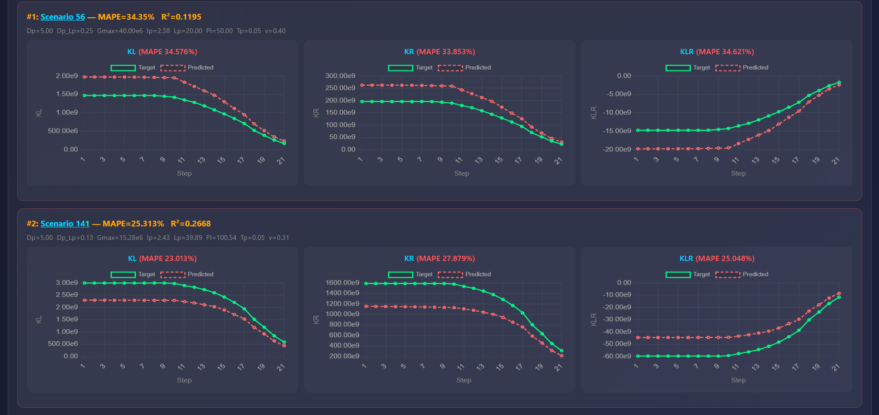

Slide 20
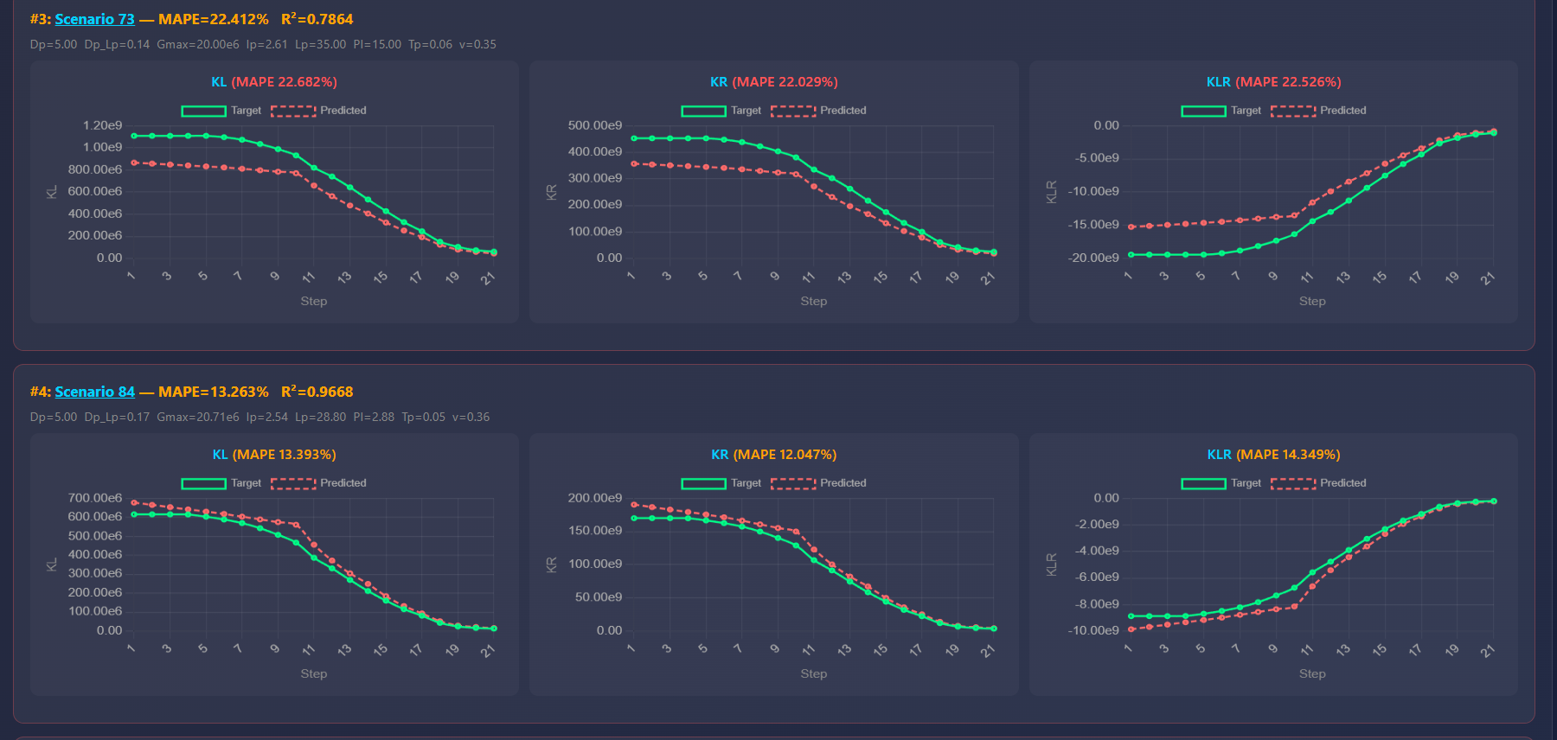

Slide 21
Executive Summary
Evolution: M7 (baseline) -> M8 (efficient) -> M9 (SwiGLU, best)
Key Architectural Changes:
MLP: Wide 128 -> Bottleneck 48 -> SwiGLU 32 (16,512 -> 6,256 -> 6,272 params)
Relation R: Fixed -> Learnable (100 params, gradient-optimized)
Physics: None -> Monotonic loss (KL dec KR dec KLR inc, weight=0.2)
k* prototypes: 6 -> 5 -> 5 (M9 reuses M8 discovery)
Performance:
M7: R2=0.9897, 55,770 params, 1.5% compression
M8: R2=0.9882, 45,486 params, 19.7% compression
M9: R2=0.9915, 45,502 params, 19.7% compression <- BEST
Why M9 Wins:
- SwiGLU gating is more expressive than GELU at same parameter budget
- Skips Stages A & B -> 2-3x faster training
- Best R2 (0.9915) with near-minimal parameter count
- Physically meaningful outputs via monotonic regularization
PFE - M7 / M8 / M9 Detailed Comparison

