Slide 1
M7 vs M8 vs M9
Master Technical Analysis with Full Architecture Drawings
M7 Baseline
Parameters: 55,770
M8 Efficient
Parameters: 45,486
M9 SwiGLU
Parameters: 45,502
This deck explains model evolution, why M9 architecture matters, and how each design choice impacts accuracy, compression, and robustness.
PFE | M7-M8-M9 Master Analysis

Slide 2
Executive Snapshot
What changed from M7 to M8 to M9
M7 Core
M8 Core
M9 Core
- Wide slot MLP: 64 -> 128 -> 64
- Fixed relation matrix
- k*=6 prototypes
- R2=0.9897
- Params=55,770
- Bottleneck MLP: 64 -> 48 -> 64
- Learnable relation matrix
- Physics monotonic loss
- k*=5 prototypes
- R2=0.9882
- Params=45,486
- SwiGLU gated MLP (hidden=32)
- Learnable relation matrix (same principle as M8)
- Full A/B/C retraining in latest run
- k*=5 prototypes
- R2=0.9891
- Params=45,502
PFE | M7-M8-M9 Master Analysis

Slide 3
Problem and Outputs
Predict pile stiffness degradation across 21 steps
Input Features (8)
PI, Gmax, v, Dp, Tp, Lp, Ip, Dp/Lp
Model sees one scenario and predicts full time response.
Data:
- 1019 scenarios
- Train 815
- Test 204
Psi-NN Core
Slot attention
Per-slot MLP
Relation matrix R
Output head
Differences between M7/M8/M9 happen here.
Outputs (3 x 21)
KL: lateral stiffness
KR: rocking stiffness
KLR: coupling stiffness
Targets:
- High R2
- Low RMSE / MAE
- Physically consistent trends
PFE | M7-M8-M9 Master Analysis

Slide 4
M7 Architecture (Drawn)
Baseline structured model
M7
M7 Notes
Input (8)
Soil + pile features
- Strong baseline accuracy
- High MLP parameter cost
- Relation matrix cannot adapt after initialization
- Best in this snapshot by pure R2 but weak compression
Embedding 8->64
Feature lift
Slot Attention
1 initial + 6 prototype slots
Slot MLP
64->128->64 (GELU)
Fixed Relation Matrix
20x6, frozen
Output Head
64->3 then cumsum
Total 55,770
PFE | M7-M8-M9 Master Analysis

Slide 5
M8 Architecture (Drawn)
Efficiency upgrades + learnable structure
M8
M8 Upgrades
Input (8)
Same data interface
- MLP parameter drop by about 62% versus M7 MLP block
- Learnable relation matrix allows end-to-end adaptation
- Physics-aware loss improves physical plausibility
- Compression jumps to 19.7% vs M6
Embedding 8->64
Same
Slot Attention
1 initial + 5 prototypes
Slot MLP
64->48->64 bottleneck
Learnable R
20x5 logits->softmax
Output + Physics
KL/KR down, KLR up
Total 45,486
PFE | M7-M8-M9 Master Analysis

Slide 6
M9 Architecture (Drawn)
SwiGLU gating replaces plain MLP
M9
M9 Intent
Input (8)
Same
- Keep M8 compactness while increasing representational power
- SwiGLU gating selects informative channels per slot
- Maintains learnable relation matrix and physics constraints
- Strong KL and KLR improvements in latest full retrain
Embedding 8->64
Same
Slot Attention
1 initial + 5 prototypes
SwiGLU MLP
gate/value branches, hidden=32
Learnable R
20x5 logits->softmax
Output + Physics
same constraints
Total 45,502
PFE | M7-M8-M9 Master Analysis

Slide 7
Side-by-Side Architecture Map
Pipeline is shared, key differences highlighted
M7
M8
M9
Slot MLP
Slot MLP
Slot MLP
64->128->64
64->48->64
SwiGLU hidden=32
R matrix
R matrix
R matrix
fixed
learnable
learnable
k*
k*
k*
6 prototypes
5 prototypes
5 prototypes
R2 0.9897
R2 0.9882
R2 0.9891
PFE | M7-M8-M9 Master Analysis

Slide 8
Learnable Relation Matrix (logits -> softmax)
From fixed mixing to trainable prototype routing
Definition
R_logits is a trainable tensor with shape (20, k*).
Each row corresponds to one reconstructed drop slot.
Conversion to valid weights
R_soft = softmax(R_logits, dim=1)
This ensures each row sums to 1.
Reconstruction
drop_slots = R_soft @ prototype_slots
Why this matters
- Gradients update routing weights
- Matrix can adapt to data and loss
- Better than frozen heuristic weights
Visual pipeline
prototype slots (k* vectors) -> R logits -> row softmax -> weighted sum -> 20 drop slots
In M7: R is fixed. In M8/M9: R is learned.
Observed in M9 full retrain
- k* = 5
- Learned R max-per-row average = 1.000
- Sparsity (<0.05 entries): 80/100
Interpretation: routing becomes highly selective.
PFE | M7-M8-M9 Master Analysis

Slide 9
SwiGLU Gated MLP
How M9 increases expressiveness without large parameter growth
SwiGLU equation
gate = SiLU(W_gate x)
value = W_val x
out = W_out (gate * value)
Mechanism
- gate branch controls importance per dimension
- value branch carries content
- element-wise multiplication acts as dynamic filter
• The gate learns WHICH features to propagate (selective filtering)
• Used in state-of-the-art LLMs: LLaMA, PaLM, Mistral
• Same parameter count as M8 bottleneck (6,272 ≈ 6,256)
• But provably more expressive due to multiplicative gating
M9 keeps ALL M8 improvements:
Learnable relation matrix (softmax logits)
Physics-monotonic loss + entropy regularisation
Same training pipeline (A → B → C)
x (64)
Gate path: SiLU(W_gate x)
Value path: W_val x
Element-wise gate * value
W_out -> output (64)
Parameter comparison of slot MLP block
M7 wide: 16,512
M8 bottleneck: 6,256
M9 SwiGLU: 6,272
PFE | M7-M8-M9 Master Analysis

Slide 10
09 SwiGLU vs GELU MLP — Schematic Comparison
M7: Standard GELU MLP
M8: Bottleneck MLP
M9: SwiGLU MLP
64 → 128 → 64 (16,576 params)
64 → 48 → 64 (6,256 params)
Gate + Value parallel (6,272 params)
Input x ∈ ℝ⁶⁴
Input x ∈ ℝ⁶⁴
Input x ∈ ℝ⁶⁴
↓
↓
↙
↘
W₁ · x + b₁
Linear 64→128
W₁ · x + b₁
Linear 64→48
W_gate·x
W_val·x
↓
↓
↓
↓
GELU(·)
Activation
GELU(·)
Activation
SiLU(·)
↓
↓
↘
Dropout(0.1)
Regularisation
Dropout(0.1)
Regularisation
gate ⊙ value
↓
↓
↓
W₂ · h + b₂
Linear 128→64
W₂ · h + b₂
Linear 48→64
Dropout(0.1)
↓
↓
↓
W_out → ℝ⁶⁴
Output ∈ ℝ⁶⁴
Output ∈ ℝ⁶⁴
Output ∈ ℝ⁶⁴

Slide 11
Parameter Comparison
Compression vs representation trade-off
Model | Params | Compression vs M6 | MLP core
M7 | 55,770 | 1.5% | Wide MLP 64->128->64
M8 | 45,486 | 19.7% | Bottleneck MLP 64->48->64
M9 | 45,502 | 19.7% | SwiGLU gated MLP (hidden=32)
Interpretation
M8/M9 remove about 10.3k parameters versus M7.
M9 keeps M8-size efficiency while adding gating expressiveness.
PFE | M7-M8-M9 Master Analysis

Slide 12
Accuracy and Error Rate
R2 higher is better, RMSE/MAE lower is better
Model | R2 | RMSE | MAE | Error rate (1-R2)
M7 | 0.9897 | 2.160e+10 | 3.176e+09 | 0.0103
M8 | 0.9882 | 2.306e+10 | 3.314e+09 | 0.0118
M9 | 0.9891 | 2.219e+10 | 3.329e+09 | 0.0109
PFE | M7-M8-M9 Master Analysis

Slide 13
Per-Variable Performance
KL, KR, KLR detailed view
Model | KL R2 | KR R2 | KLR R2 | KL RMSE | KR RMSE | KLR RMSE
M7 | 0.9910 | 0.9807 | 0.9860 | 6.106e+07 | 3.739e+10 | 1.292e+09
M8 | 0.9888 | 0.9780 | 0.9845 | 6.811e+07 | 3.991e+10 | 1.360e+09
M9 | 0.9905 | 0.9796 | 0.9860 | 6.259e+07 | 3.842e+10 | 1.290e+09
Key observations
Error-rate takeaway
- M9 has the best KL and KLR R2 among M7/M8/M9 in this run
- KR remains the hardest target and dominates RMSE scale
- Absolute R2 differences are small between M7 and M9
- M9 advantage is efficiency + architectural scalability
PFE | M7-M8-M9 Master Analysis

Slide 14
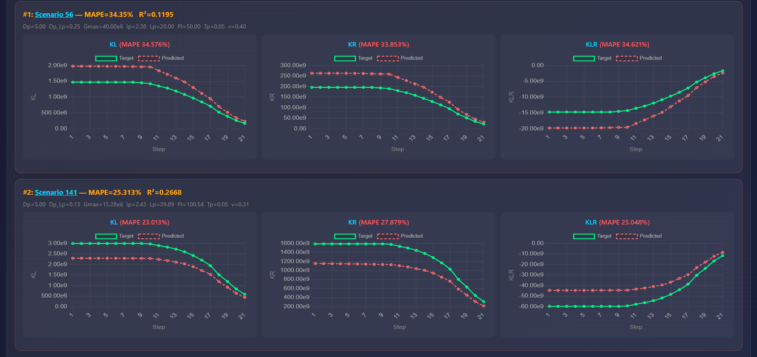

Slide 15
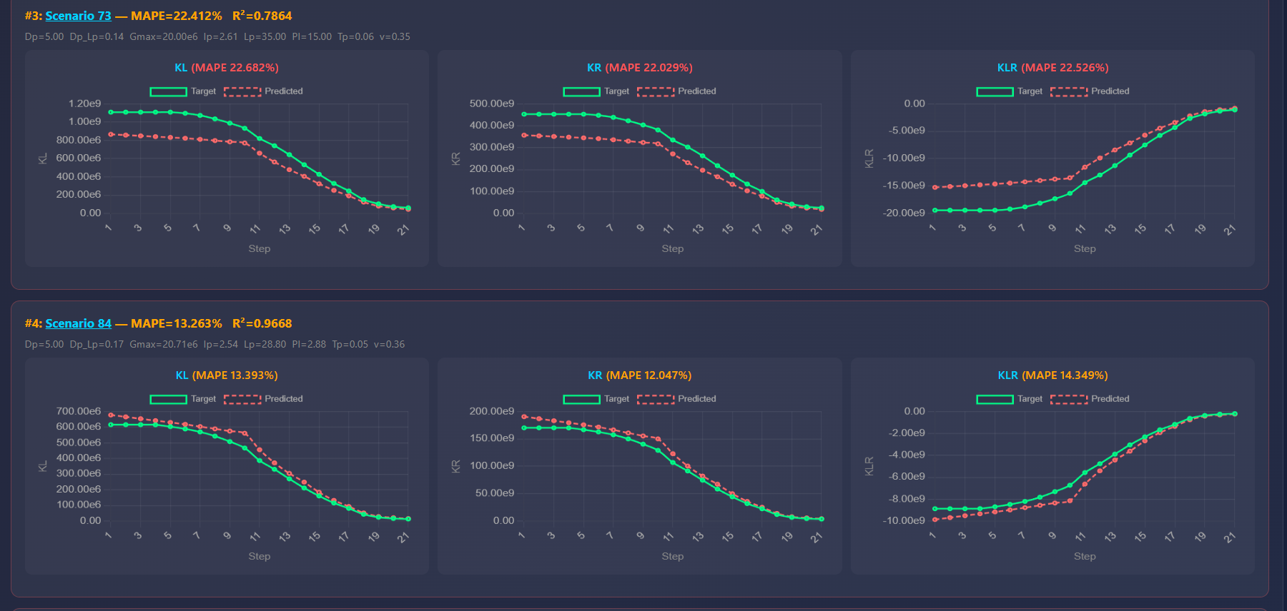

Slide 16
Training Pipeline
M9 full retraining: Stage A -> Stage B -> Stage C
Stage A: Distillation
Train SwiGLU student from teacher
Early stopped at epoch 1118
Student R2: 0.9885
Stage B
Cluster slots
k*=5
Silhouette=0.673
Stage C: Structured M9
Train final Psi model
Early stopped at epoch 572
Final R2: 0.9891
Item | M7 | M8 | M9 (latest)
A/B/C pipeline | Yes | Yes | Yes
k* discovered | 6 | 5 | 5
Relation matrix | Fixed | Learnable | Learnable
MLP type | Wide GELU | Bottleneck GELU | SwiGLU gated
PFE | M7-M8-M9 Master Analysis

Slide 17
M9 + Cross-Attention Adapter (Stage D)
An optional decoder-style extension inspired by the SCm→WTm encoder-decoder coupling in the research paper.
Adapter Architecture (Schematic)
How It Works
Input x → M9 Encoder (FROZEN)
1. The entire M9 base model is FROZEN (no gradients).
2. A new set of learnable "decoder queries" is created.
3. These queries attend to the frozen M9 slot states via cross-attention.
4. A learnable gate (sigmoid) controls how much adapter output is mixed in.
5. Only the adapter's parameters are trained (~18,241 trainable).
Key Metrics:
Total params: 63,743
Trainable params: 18,241 (adapter only)
Base R²: 0.9891 (frozen M9)
Adapter R²: 0.9881
💡 The adapter allows extending M9 without modifying the base model —
useful for domain adaptation or multi-task scenarios.
↓
Frozen Slot States S_f ∈ ℝ²¹ˣ⁶⁴
↓
Learned Decoder Queries Q
↓
Cross-Attn(Q, K=S_f, V=S_f)
↓
LayerNorm(Q + Attn_out)
↓
σ(gate) · decoded + S_f
↓
Output Heads → Final Prediction

Slide 18
M9 Cross-Attention Adapter
2) Decoder-style cross-attention
Q in R^(B x 21 x 64): learned decoder queries (trainable)
K=V=S_f in R^(B x 21 x 64): frozen slot states
A = softmax((Q K^T) / sqrt(64)), CA = A V
Q in R^(B x 21 x 64): trainable decoder queries. These are learnable vectors that ask: what information should be extracted at each step?
K = V = S_f in R^(B x 21 x 64): frozen slot states from base M9. This is the fixed memory bank. The adapter reads from it, but does not change it.
A = softmax((Q K^T) / sqrt(64)): attention weights. For each query, the model computes similarity with all frozen slots, then softmax converts scores into normalized importance weights.
CA = A V: retrieved context. The model takes a weighted combination of frozen slot values using A, producing the context used for correction.
Intuition: Q = questions, S_f = memory, A = where to look, CA = what is retrieved.
Code-level view of queries, attention weights, fusion, and prediction
1) 1) Frozen encoder slots from base M9
S_f in R^(B x 21 x 64) are produced by the frozen M9 core.
No base M9 weights are updated in this branch.
S_f with shape (B, 21, 64) is the representation produced by the original M9 branch. B is batch size, 21 is the sequence length (time steps), 64 is latent feature width. Frozen means this branch is not updated during adapter training, so M9 keeps its original knowledge unchanged.
The adapter does not rebuild M9. It reads M9’s slot memory and learns only a correction on top.
3) Fusion used in code: decoded = LN(Q + CA), gate = sigmoid(g), adapted_slots = LN(S_f + gate * decoded), then output heads predict KL/KR/KLR over 21 steps.
Frozen slots S_f
Cross-attn: Attn(Q,K,V)
Gated fusion + LN
Predictions
Model | R2 | RMSE | MAE | Trainable Params
Base M9 | 0.9891 | 2.219e+10 | 3.329e+09 | 0 (frozen experiment branch)
M9 + Cross-Attn Adapter | 0.9881 | 2.313e+10 | 3.541e+09 | 18,241
PFE | M7-M8-M9 Master Analysis

Slide 19
M9 Robustness Analysis
Scenario-level diagnostics
Global quality
Worst-case signal
- Avg curve MAPE: 2.372%
- Median MAPE: 1.359%
- Avg curve R2: 0.98292
- P95 MAPE: 6.281%
- Test scenarios: 204
- Worst scenario id: 56
- Worst avg MAPE: 34.35%
- Worst avg R2: 0.1195
- Use uncertainty flag for extreme edge cases
Interpretation
Most scenarios are very accurate.
A small tail of hard scenarios drives peak error.
This pattern is common in compact physics-informed models.
PFE | M7-M8-M9 Master Analysis

Slide 20
Recommendation and Best-Model View
Decision using accuracy, compression, and architecture maturity
Criterion | M7 | M8 | M9
Overall R2 | 0.9897 | 0.9882 | 0.9891
Compression vs M6 | 1.5% | 19.7% | 19.7%
Learnable relation matrix | No | Yes | Yes
Gated MLP | No | No | Yes
Scalability for future tuning | Medium | High | Highest
Best practical choice
M9
Why:
- near-top accuracy
- major compression
- learnable routing
- SwiGLU expressiveness
- strongest foundation for next tuning round
Next tuning to beat current R2
- Increase Stage C patience and lower LR for finer convergence
- Run 3-5 seeds and keep best checkpoint
- Augment hard scenarios from the top error tail
PFE | M7-M8-M9 Master Analysis

Slide 21
Closing Summary
M9 architecture value in one page
M7 -> M8 -> M9 evolution
M7 established the baseline structured Psi-NN.
M8 introduced compactness and learnable relation routing.
M9 adds SwiGLU gated slot MLP on top of that structure.
Learnable relation matrix (logits -> softmax)
lets the model learn prototype-to-time-step assignment end-to-end.
SwiGLU gated MLP
improves expressive filtering at almost identical parameter budget.
Current full-retrain M9: R2=0.9891, params=45,502.
This is a strong compact model and a solid base for final hyperparameter optimization.
PFE | M7-M8-M9 Master Analysis

