Slide 1
M6 — Pile Stiffness Degradation Prediction
Slot-Attention Transformer · Physics-Informed · LSTM-Free
Architecture · Fine-tuning Strategy · MLP vs LSTM · Efficiency · Error Metrics
✓ Predict KL, KR, KLR over 21 steps
✓ 64.1% fewer parameters than M5
✓ Hard-coded monotonicity guarantees
PFE Project | April 2026

Slide 2
Problem & Goal
Predicting pile-soil stiffness degradation under cyclic loading
Given 8 geotechnical input features, predict 3 stiffness quantities over 21 cyclic loading steps
INPUT (8 features) PI, Gmax, ν, Dp, Tp, Lp, Ip, Dp/Lp
M6 MODEL (Slot-Attention Transformer)
OUTPUT (21 × 3) KL(t), KR(t), KLR(t) for t = 1 … 21
21 Learnable Slots
Physics Constraints
Cumulative Sum
Signed Log Scale
One slot per degradation step — temporal structure without RNN
ΔKL, ΔKR ≤ 0 | ΔKLR ≥ 0 (hard-coded monotonicity)
K(t) = K⁰ + Σ Δₙ — error never resets
Handles mixed-sign targets (KLR < 0, KL/KR > 0)
Stiffness quantities: KL = lateral | KR = rotational | KLR = cross-coupling (always < 0, increases toward 0 under loading)

Slide 3
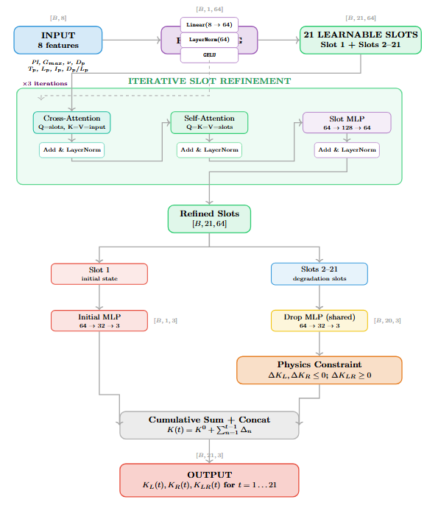
Architecture Overview
M6 — SlotAttentionDegradation (LSTM-free, physics-constrained)
Physics Constraint −|Δ| for KL,KR ; +|Δ| for KLR

Slide 4
Fine-Tuning Strategy
How M6 was trained from scratch and what was changed from M5
① Initial Loss Weighting ×5
② Shape Loss (Huber on Δ)
• MSE on Slot 1 (initial K⁰) multiplied by 5.0
• Penalises changes in consecutive drops: Huber(Δₜ − Δₜ₋₁)
• Any error in K⁰ propagates forward via cumulative sum
• Encourages smooth degradation curves, not zigzag predictions
• Forces the model to anchor the trajectory correctly first
• Huber norm: robust to large isolated errors (vs pure L2)
• M5 used ×3 — M6 raises to ×5 (LSTM no longer corrects drift)
③ Gradient Clipping & Scheduler
④ Weight Decay & Normalisation
• Gradient clip = 2.0 (M5: 1.0) — relaxed to let early gradients flow
• Weight decay = 0.005 (M5: 0.01) — reduced to prevent over-regularisation
• ReduceLROnPlateau: patience 80 (M5: 100) — faster adaptation
• RobustScaler on targets: median/IQR instead of mean/std
• Early stopping patience 200 epochs (M5: 300)
• Signed log transform preserves sign of cross-coupling term KLR
Total loss = MSE_overall + 5.0 × MSE_initial + λ_shape × ShapeLoss

Slide 5
MLP vs LSTM Decoder
Why M6 replaced the LSTM with a direct per-slot MLP
M6 — Per-Slot MLP
M5 — LSTM Decoder (removed in M6)
• Slots 2–21 as input
• Input: aggregated slot vector
Each slot vector [64-dim] goes independently into the shared MLP
Mean of all 21 slots → single [64-dim] context vector
• Single forward pass
• 2-layer LSTM unrolled 20 steps
64 → 32 → 3 (GELU activation) — all 20 slots in parallel
Hidden state hₜ = LSTM(hₜ₋₁, context) — sequential
• No hidden state
• Decoder cross-attention
No sequential dependency between slots at decoding time
Each LSTM step attends back to all refined slots
• Temporal structure from attention
• Positional embeddings
3 rounds of cross + self-attention encode temporal order
Learnable pos_embed added to LSTM inputs for step identity
• Physics applied after MLP
• h₀, c₀ projections
−|output| for KL, KR ; +|output| for KLR
Separate MLPs to initialise LSTM hidden & cell states
• Cumsum reconstructs trajectory
• 101,312 extra parameters
K(t) = K⁰ + Σ Δₙ → absolute stiffness values
seq_decoder + decoder_cross_attn + h0_proj + c0_proj + pos_embed
Key insight: self-attention already encodes temporal order through slot position — LSTM adds sequential decoding overhead but the ordering is already captured

Slide 6
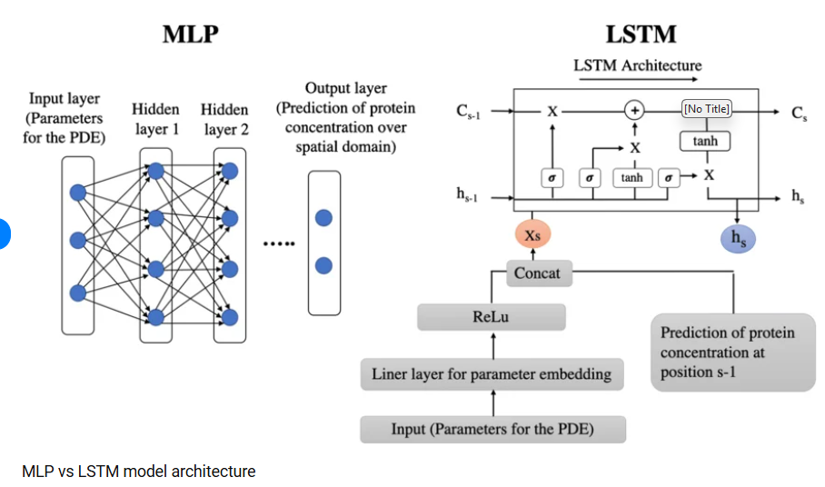
MLP vs LSTM Decoder
Why M6 replaced the LSTM with a direct per-slot MLP

Slide 7
Efficiency Gains
M6 vs M5 — measured on identical hardware (CPU, batch=32)
157,958 → 56,646
632.7 KB → 231.2 KB
11.38 ms → 9.07 ms
Parameters
Model File Size
Inference Time (CPU)
64.1% FEWER
63.5% SMALLER
1.25× FASTER
Where did 101,312 parameters go?
Module Removed
Parameters
Purpose
seq_decoder (LSTM 2-layer)
66,176
Entire sequential decoder — largest chunk
decoder_cross_attn
16,640
Cross-attention between LSTM steps and slots
h0_proj + c0_proj
16,640
Linear projections to initialise LSTM hidden/cell state
pos_embed (learnable)
1,280
One embedding vector per step (20 × 64)
TOTAL REMOVED
100,736
TOTAL ADDED (3rd iteration reuses existing layers)
+0
Zero new params — only extra compute
The 3rd refinement iteration reuses the SAME cross-attention + self-attention + MLP layers — zero parameter cost, only extra forward-pass compute (~10 ms).

Slide 8
Accuracy vs. Efficiency Trade-off
Full metric comparison M5 ↔ M6
M5 is more accurate on all metrics — M6 trades some accuracy for 64% fewer parameters and stronger physics guarantees.
Target
Metric
M5
M6
Δ (M6 − M5)
Overall
R²
0.9913
0.9804
−0.0109
Overall
RMSE
1.98 × 10¹⁰
2.98 × 10¹⁰
+51%
Overall
MAE
2.98 × 10⁹
3.33 × 10⁹
+12%
KL
R²
0.9907
0.9768
−0.0139
KL
RMSE
6.21 × 10⁷
9.79 × 10⁷
+58%
KR
R²
0.9838
0.9634
−0.0204
KR
RMSE
3.42 × 10¹⁰
5.15 × 10¹⁰
+51%
KLR
R²
0.9882
0.9690
−0.0192
KLR
RMSE
1.18 × 10⁹
1.92 × 10⁹
+63%
Slot 1→21
R² trend
0.9908→0.9968
0.9811→0.9809
M5 improves; M6 flat
Slot 1→21
RMSE trend
2.40×10¹⁰→2.69×10⁹
3.45×10¹⁰→6.57×10⁹
Both decrease (magnitudes shrink)
KR has the largest RMSE gap — rotational stiffness benefits most from LSTM's sequential context. KLR R² gap is large because the new +|Δ| constraint changes the output distribution.

Slide 9
Error Metrics
R², RMSE, MAE — definitions, properties, and how to read them
R² (Coefficient of Determination)
RMSE (Root Mean Square Error)
MAE (Mean Absolute Error)
R² = 1 − Σ(y−ŷ)² / Σ(y−ȳ)²
RMSE = √[ (1/n) Σ(y−ŷ)² ]
MAE = (1/n) Σ|y−ŷ|
• Range: −∞ to 1.0 (1.0 = perfect fit)
• Same physical units as the target (N, N·m…)
• Same units as target, always ≥ 0
• Scale-free: comparable across variables
• Always ≥ 0 (squares → never negative)
• Robust to outliers (no squaring)
• Negative R² → model worse than predicting the mean
• Penalises large errors heavily (squared term)
• For same target: MAE ≤ RMSE always
• Best metric for slot-to-slot comparison
• Large values here reflect large stiffness magnitudes (10¹⁰)
• Easier to interpret physically

Slide 10
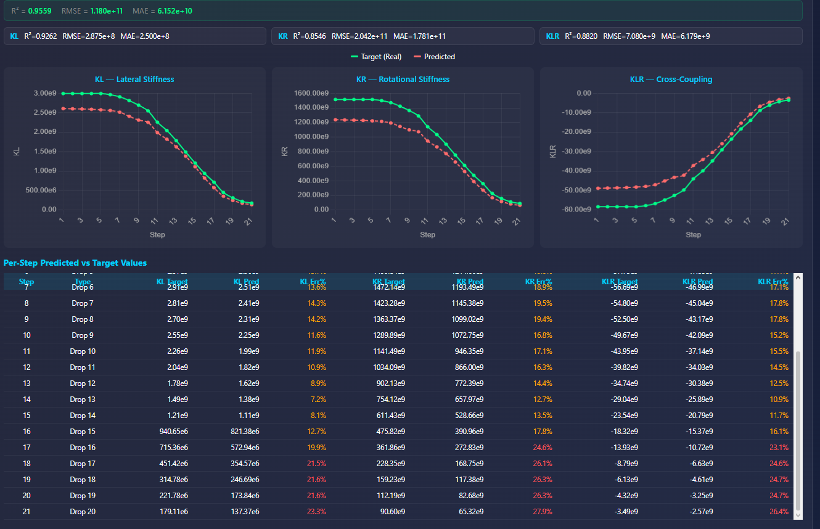
Understanding Errors Across 21 Slots
Why per-slot RMSE/MAE increase ≠ worst accuracy — use R²
Use R² for slot comparison
• R² is scale-normalised — measures how much better the model is than predicting the mean
• For M5: Slot R² improves 0.9908 → 0.9968 ↑ (LSTM adds sequential context as trajectory progresses)
• For M6: Slot R² stays flat 0.9811 → 0.9809 → (no sequential memory — each slot predicted independently)
• This flat profile is M6's signature trade-off — uniform quality, no improvement over trajectory
Webapp: Percentage Error per Step — the most interpretable metric
Err% = |ŷ − y| / |y| × 100
Scale-independent: a 10% error at Slot 1 and Slot 21 are equally meaningful — unlike RMSE which is dominated by early-slot magnitudes.
■ < 5% Green (excellent)
■ 5–20% Orange (acceptable)
■ > 20% Red (poor)
Summary: which metric to use when?
Metric
Properties
Best used for
R²
Scale-free, 0–1
Slot-to-slot comparison, variable comparison, headline accuracy
RMSE
Physical units, ≥ 0
Absolue error magnitude; dominated by early slots / large-magnitude variables
MAE
Physical units, ≥ 0
Same as RMSE but more robust; physical interpretation
Err%
Percentage, ≥ 0
Webapp display; best for per-step human-readable quality check

Slide 11
M6 — Summary
Simpler · Faster · Physics-Guaranteed · LSTM-Free
Architecture
21 learnable slots · 3× refinement (cross-attn → self-attn → MLP) · per-slot MLP prediction
vs M5
Removed LSTM decoder (101,312 params) · Added 3rd iteration · Added KLR sign constraint
Efficiency
64.1% fewer parameters · 63.5% smaller file · 1.25× faster inference
Accuracy
R² 0.9804 (vs 0.9913) · All three targets accurately predicted · KR largest gap
Physics
ΔKL ≤ 0, ΔKR ≤ 0, ΔKLR ≥ 0 hard-coded · Monotonicity structurally guaranteed
Metrics
R² best for slot comparison (scale-free) · RMSE/MAE in physical units (always ≥ 0)
M6 = M5 − LSTM + stronger constraints + 3 attention iterations

