Slide 1

Intro to Probability

Slide 2
Experiments and Events

Slide 3
Learning Objectives
Be able to recognize what a sample space is
Be able to recognize that an event is a subset of the sample space

Slide 4
Data scientists run experiments
Experiments
are performed following a specific process or set of rules
can be run many times and have multiple possible outcomes

Slide 5
Data scientists run experiments
Experiments
are performed following a specific process or set of rules
can be run many times and have multiple possible outcomes
The sample space is the set of all possible outcomes of an experiment

Slide 6
Data scientists run experiments
Experiments are performed following a specific process or set of rules
Experiments are run many times and have multiple possible outcomes
The sample space is the set of all possible outcomes of an experiment
An event is a set of outcomes of an experiments
An event is a subset of the sample space

Slide 7
Data scientists run experiments
Experiments are performed following a specific process or set of rules
Experiments are run many times and have multiple possible outcomes
The sample space is the set of all possible outcomes of an experiment
An event is a set of outcomes of an experiments
An event is a subset of the sample space

Slide 8
Example Experiment: Dice Rolling
Suppose a data scientist wants to record the results of rolling a six-sided die.
The sample space is {1, 2, 3, 4, 5, 6}.
The event for rolling an even number is {2, 4, 6}
The event for rolling an odd number is {1, 3, 5}

Slide 9
Sets and Venn Diagrams

Slide 10
Learning Objectives
Be able to distinguish if sets are joint or disjoint via Venn diagrams
Be able to identify the union and intersection of two sets via Venn diagrams

Slide 11
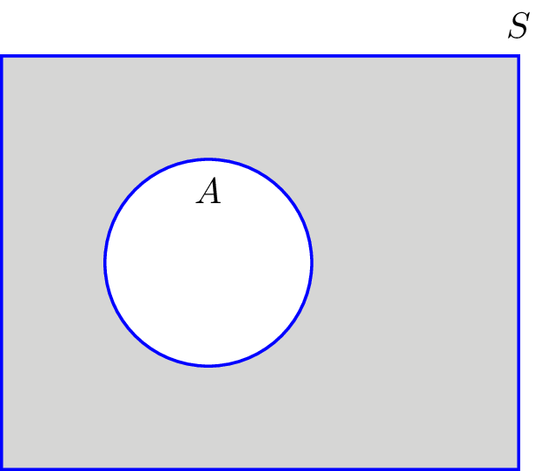
Venn diagrams are used to visualize sets
Denote the sample space as S.
A is an event in the sample space
A is a subset of S
The sample space not contained within A, i.e. S - A, is the complement of A.
Example: Let S represent a coin flip. If A represents heads, then the complement of A represents not heads, i.e. tails.

Slide 12
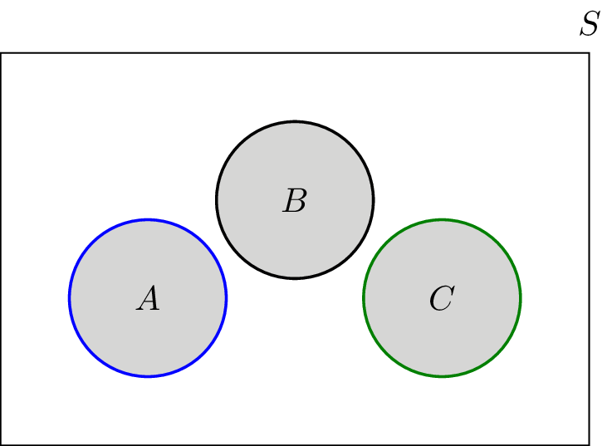
Disjoint sets do not have any shared elements
Let S be the result of a six-sided die roll
Let A represent the dice rolls {1, 2}
Let B represent the dice rolls {3, 4}
Let C represent the dice rolls {5, 6}
A, B, and C are disjoint
Sets that have shared elements (overlap) are called joint sets.

Slide 13
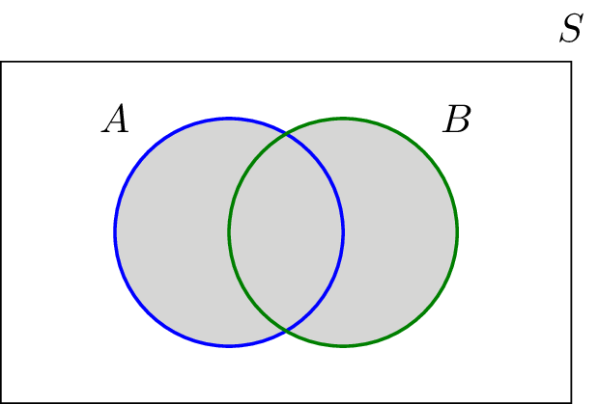
The union of joint sets contains all elements in either set
Let S be the result of a six-sided die roll
Let A represent an even number roll, i.e. {2, 4, 6}
Let B represent a die roll less than 4, i.e. {1, 2, 3}
Then the A U B is {1, 2, 3, 4, 6} and the complement of A U B is {5}

Slide 14
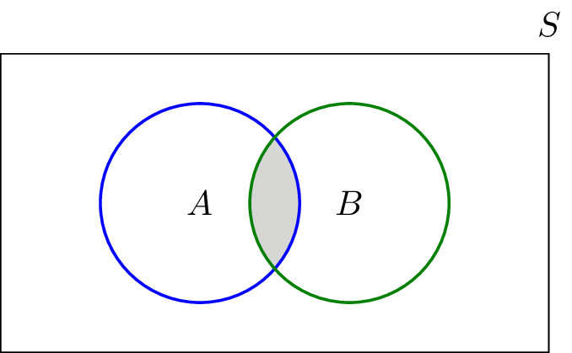
The intersection of joint sets contains all elements in both sets
Let S be the result of a six-sided die roll
Let A represent an even number roll, i.e. {2, 4, 6}
Let B represent a die roll less than 4, i.e. {1, 2, 3}
Then the intersection of A and B is {2}

Slide 15
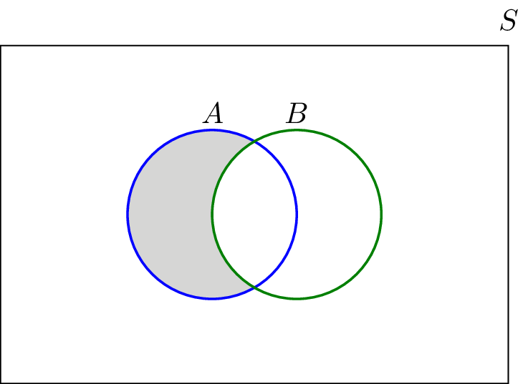
The difference of joint sets, A - B, contains the elements of A that are not in B
Let S be the result of a six-sided die roll
Let A represent an even number roll, i.e. {2, 4, 6}
Let B represent a die roll less than 4, i.e. {1, 2, 3}
Then A - B is {4, 6}

Slide 16
Probability and Unions of Events

Slide 17
Learning Objectives
Recognize that probabilities only consists of numbers between 0 and 1
Be able to calculate probabilities for unions of joint and disjoint events

Slide 18
What is probability?
The probability of an event A happening is
P(A) = Number of ways event A can happen / Total number of possible outcomes
Probabilities fall between 0 and 1.

Slide 19
Probability for Unions of Events
Given two events A and B, the probability of either happening, i.e. their union is
P(A or B) = P(A) + P(B) - P(A U B)

Slide 20
Probability Exercise: Rolling Odd or Even
Given a fair six-sided die:
Let A represent rolling an odd number, i.e. {1, 3, 5}
Then P(A) = 3/6 = ½
Let B represent rolling an even number, i.e. {2, 4, 6}
Then P(B) = 3/6 = ½
Note that A and B are disjoint of each other
Then P(A and B) = 0
Then the probability of rolling an odd or even number is simply
P(A or B) = P(A) + P(B) - P(A and B) = ½ + ½ + 0 = 1

