Slide 1
SMART SECURITY
DOOR LOCK SYSTEM
Project Documentation · 3-Phase Development
Phase 1: Tinkercad Prototype | Phase 2: Wokwi Simulation | Phase 3: Real Implementation

Slide 2
Project Overview
A progressive 3-phase development of an Arduino-based smart door lock, starting from a basic prototype and evolving into a fully-featured real-life security system.
01
02
03
Basic Prototype
Full Simulation
Real Implementation
Tinkercad
Wokwi + Arduino Mega
Arduino UNO
Simple button-controlled lock with servo motor, LED indicators, and auto-lock timer. Built on Arduino UNO.
Advanced system with RFID, 4×4 keypad, LCD display, EEPROM, multi-user roles, lockout & admin menu.
Physical build with RFID RC522, 3×4 keypad, LCD 16×2, buzzer, servo & full feature parity on live hardware.

Slide 3
Phase 1
Basic Prototype — Tinkercad (Arduino UNO)
Concept validation with a minimal component set

Slide 4
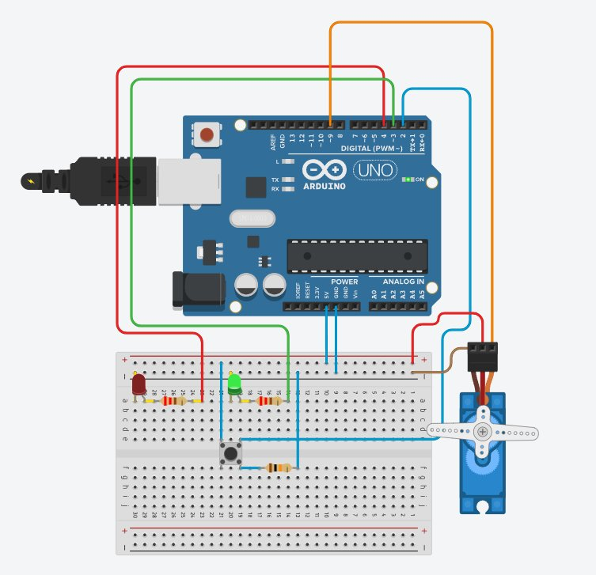
Phase 1 — Circuit Diagram (Tinkercad)
🟦 Arduino UNO
Main microcontroller
🔵 Push Button
Pin 2 — Lock trigger
🔴 Red LED
Pin 4 — Locked state
🟢 Green LED
Pin 3 — Unlocked state
⚙️ Servo Motor
Pin 9 — Door bolt (0°/90°)

Slide 5
Phase 1 — How It Works
1
System Start
Arduino initialises — servo moves to 0° (LOCKED), Red LED turns ON.
2
Button Press Detected
A LOW→HIGH transition on Pin 2 triggers the unlock sequence.
3
Door Unlocked
Servo rotates to 90°, Red LED OFF, Green LED ON. Serial log: 'Door unlocked!'
4
Auto-Lock (3 s)
After 3 000 ms the system automatically re-locks — servo to 0°, Red LED ON.
5
Manual Re-lock
A second button press while unlocked immediately re-locks the door.

Slide 6
Phase 1 — Code Highlights
// Key constants & objects
const int BUTTON_PIN = 2; const int GREEN_LED = 3;
const int RED_LED = 4; const int SERVO_PIN = 9;
Servo doorLock; bool isLocked = true;
const int AUTO_LOCK_DELAY = 3000; // 3 seconds
// Unlock → wait → auto-lock sequence
if (isLocked) {
isLocked = false; updateLockState();
delay(AUTO_LOCK_DELAY); // door stays open 3 s
isLocked = true; updateLockState(); // auto-lock
}
// updateLockState() — drives LEDs + servo
doorLock.write(isLocked ? 0 : 90); // 0°=LOCKED 90°=UNLOCKED

Slide 7
Phase 2
Full Simulation — Wokwi (Arduino Mega)
RFID · PIN Keypad · LCD · EEPROM · Multi-user · Admin Menu

Slide 8
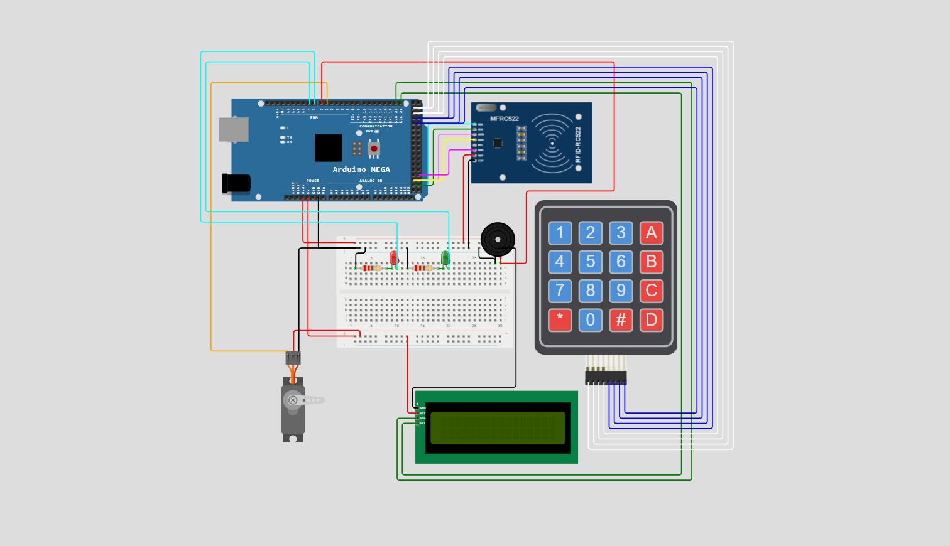
Phase 2 — Simulation Circuit (Wokwi)
Components
▸ Arduino Mega 2560
▸ MFRC522 RFID Reader (SPI)
▸ 4×4 Matrix Keypad
▸ LCD 16×2 (I2C, 0x27)
▸ Servo Motor (Pin 6)
▸ Buzzer (Pin 7)
▸ Red LED (Pin 5) + Green LED (Pin 4)

Slide 9
Phase 2 — Key Features
🪪
🔢
👥
🔒
RFID Auth
PIN Entry
4 User Roles
Lockout System
Scan registered cards for instant access by UID matching.
4–8 digit PIN via 4×4 keypad; # to confirm, * to clear.
Admin · User (×2) · Guest — each with unique PIN & card.
6 failed attempts triggers 30 s lockout with alarm sound.
🛡️
💾
🚨
🔇
Admin Override
EEPROM Persist
Panic Code
Silent Mode
Admin PIN unlocks the system even during lockout.
PINs, UIDs, lockout state saved across power cycles.
Entering '911' activates an emergency alarm sequence.
Admin can mute all buzzer sounds via the menu.

Slide 10
Phase 2 — System State Machine
SYS_IDLE
6 fails
SYS_LOCKED
ADMIN_LOGIN
ADMIN_MENU
ROLE_SELECT
USER_EDIT
* Admin PIN
1 PIN
CHANGE_PIN
State transitions respond to keypad input, RFID scans, and timeout events.

Slide 11
Phase 3
Real-Life Implementation — Arduino UNO
Physical hardware build with full feature parity

Slide 12
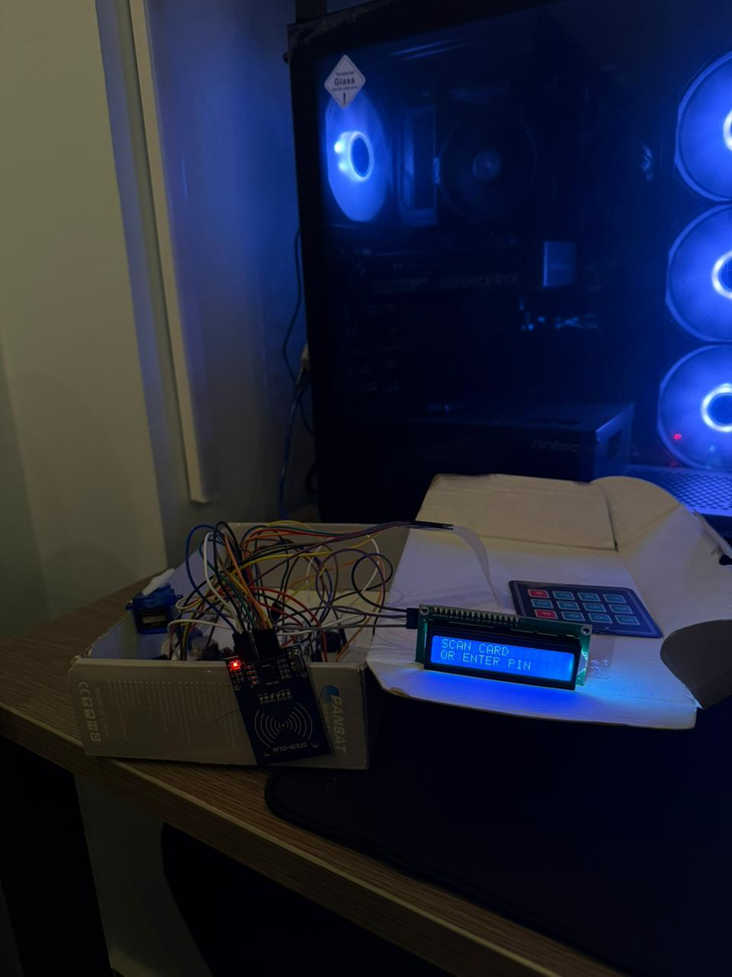
Phase 3 — Real-Life Build
Hardware Pin Map
Arduino UNO
Main controller
RFID RC522
SS=10, RST=9 (SPI)
3×4 Keypad
Rows: 2,3,8,A0 | Cols: A1,A2,A3
LCD 16×2 (I2C)
Address 0x27
Servo Motor
Pin 6 — 90°=locked, 0°=open
Buzzer
Pin 7 — tones & alarm
Red LED
Pin 5 — denied / locked
Green LED
Pin 4 — granted / open

Slide 13
Phase 3 — UNO Adaptations vs Mega
Feature | Phase 2 (Mega) | Phase 3 (UNO) | Notes
Keypad | 4×4 (16 keys) | 3×4 (12 keys) | A–D keys removed; * and # retained
Pin-out | Dedicated ports (22–29) | Analog pins A0–A3 used | UNO pin shortage workaround
Servo motion | Instant write() | Smooth ramp loop | ±2° steps for realistic door motion
LCD icons | No custom chars | Lock / Unlock icons | lcd.createChar() byte arrays
Card menu | Not present | Full 2-option card menu | Set card, remove card per user
User select | Direct key to user | Role → User two-step | Extra state SYS_USER_SELECT
Flash strings | Normal strings | F() macro used | Saves SRAM on 2 KB UNO

Slide 14
Phase 3 — Code Highlights
// Smooth servo motion — unique to Phase 3 (UNO)
void openDoor() {
doorServo.attach(SERVO_PIN);
for (int p = LOCK_POS; p >= UNLOCK_POS; p -= 2) {
doorServo.write(p); delay(10); // gradual unlock
} delay(200); doorServo.detach();
}
// F() macro — saves precious 2 KB SRAM on UNO
show(F("SCAN CARD"), F("OR ENTER PIN"));
// RFID card override during lockout (new in Phase 3)
if (uidBelongsToAdmin(uid, size)) {
clearLockout(); show(F("RFID OVERRIDE"), F("LOCK CLEARED"));
}

Slide 15
Phase Comparison
Feature | Phase 1 | Phase 2 | Phase 3
Microcontroller | Arduino UNO | Arduino Mega | Arduino UNO
Auth Method | Push Button | RFID + PIN | RFID + PIN
Display | Serial Monitor | LCD 16×2 (I2C) | LCD 16×2 (I2C)
Keypad | None | 4×4 Matrix | 3×4 Matrix
Users | Single | 4 (Admin/User/Guest) | 4 (Admin/User/Guest)
EEPROM | No | Yes | Yes
Lockout | No | Yes (30 s) | Yes (30 s)
Admin Menu | No | Yes | Yes
Panic Code | No | Yes (911) | Yes (911)
Card Assign | No | No | Yes (via menu)
Smooth Servo | No | No | Yes (ramp)
Platform | Tinkercad | Wokwi | Real Hardware

Slide 16
Project Conclusions
✅ Phase 1 validated the core lock/unlock mechanic with minimal components.
✅ Phase 2 proved the full security architecture in a risk-free virtual environment.
✅ Phase 3 demonstrated real-world feasibility on limited Arduino UNO hardware.
✅ EEPROM persistence ensures settings survive power loss.
✅ Role-based access, lockout, admin override & panic mode provide layered security.
🔮 Future work: WiFi/BLE remote unlock, camera integration, mobile app control.
Smart Security Door Lock System · 3-Phase Arduino Project

