Slide 1


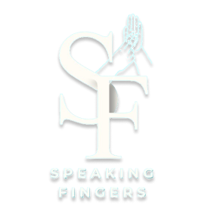
Department of Computer Science 2023-2024
Under Supervision of
Dr. Eman Ebrahim

Slide 2
Team Members:-
Youssif Hassan Mohamed Allam
Nada Emad Mahmoud Hassan
Mahmoud Ramadan Abdelwahab
Eman Nasr Elsayed Yahya
Wijdan Mostafa Mohamed Hussien
Shaimaa Hamedo Abosrea’a Hussien
Fares Samy Mohamed Eid
Mostafa Khaled Ahmed Kamal
Sohaila Ezzat Youssef Attia
Rawan Emad Mohamed Swilam

Slide 3
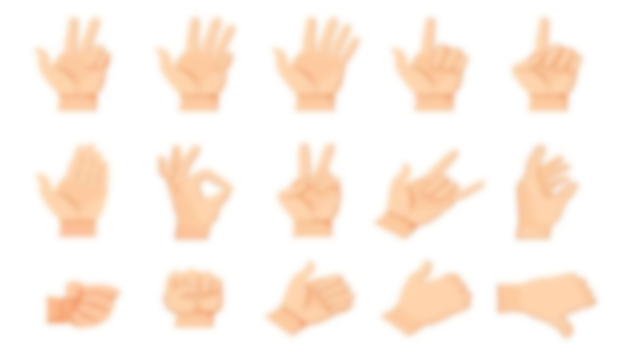
PROBLEM DEFINITIONS:-
Sign language is used by 70 million people around the world and there’s a lack in communication between deaf and dump community and our community..
Sign language encompasses the movement of the arms and hands as a means of communication for people with hearing disabilities.

Slide 4
THE IMPORTANCE OF OUR PROJECT:-
An automated sign recognition system requires two main courses of action: the detection of particular features and the categorization of particular input data.
A vision-based system by applying CNN for the recognition of Arabic hand sign-based letters and translating them into Arabic speech is proposed in our project.
The proposed system will automatically detect hand sign letters and speaks out the result with the Arabic language with a deep learning model.
After recognizing the Arabic hand sign-based letters, the outcome will be fed to the text into the speech engine which produces the audio of the Arabic language as an output.
This system gives 97% accuracy to recognize the Arabic hand sign-based letters which assures it as a highly dependable system.

Slide 5
PROJECT OBJECTIVES
The main goal of our project is when we launch the application and the website, it achieves the target of our project (text or sign language will be translated to Arabic sound).
The website and app will help normal people to communicate with deaf and dump.
Helps us understand their action by converts it to Arabic sound
Disable people can easily communicate with outside world.
Expected Outcome : Make communication between - Disable people and the rest of human beings easy

Slide 6
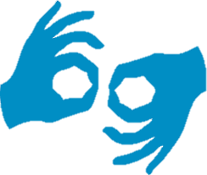
DATASETS

Slide 7
ArSL2018 Dataset
Table . Input Arabic Alphabet Sign classes with their labels and number of images.
# | Letter name in English Script | Letter name in Arabic script | # of Images | # | Letter name in English Script | Letter name in Arabic script | # of images
1 | Alif | أَلِف)أ) | 1672 | 17 | Zā | ظَاء)ظ) | 1723
2 | Bā | بَاء) ب) | 1791 | 18 | Ayn | عَين)ع) | 2114
3 | Tā | أتَاء) ت) | 1838 | 19 | Ghayn | غَين)غ) | 1977
4 | Thā | ثَاء) ث) | 1766 | 20 | Fā | فَاء)ف) | 1955
5 | Jīm | جِيمْ) ج) | 1552 | 21 | Qāf | قَاف) ق) | 1705
6 | Hā | حَاء) ح) | 1526 | 22 | Kāf | كَاف)ك) | 1774
7 | Khā | خَاء) خ) | 1607 | 23 | Lām | لاَمْ)ل) | 1832
8 | Dāl | دَالْ) د) | 1634 | 24 | Mīm | مِيمْ)م) | 1765
9 | Dhāl | ذَال) ذ) | 1582 | 25 | Nūn | نُون)ن) | 1819
10 | Rā | رَاء) ر) | 1659 | 26 | Hā | هَاء)ه) | 1592
11 | Zāy | زَاي) ز) | 1374 | 27 | Wāw | وَاو)و) | 1371
12 | Sīn | سِينْ) س) | 1638 | 28 | Yā | يَا) ئ) | 1722
13 | Shīn | شِينْ) ش) | 1507 | 29 | Tāa | ة)ة) | 1791
14 | Sād | صَادْ)ص) | 1895 | 30 | Al | ال)ال) | 1343
15 | Dād | ضَاد)ض) | 1670 | 31 | Laa | ﻻ)ﻻ) | 1746
16 | Tā | طَاء)ط) | 1816 | 32 | Yāa | يَاء) يَاء) | 1293

Slide 8
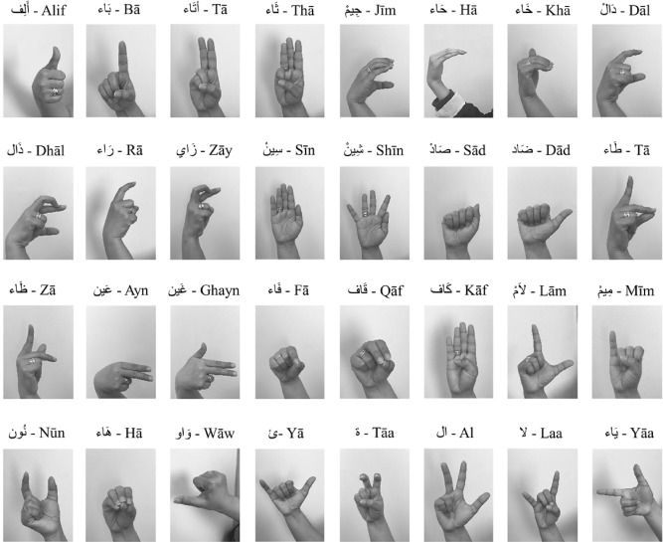
Representation of the Arabic Sign Language for Arabic Alphabets

Slide 9
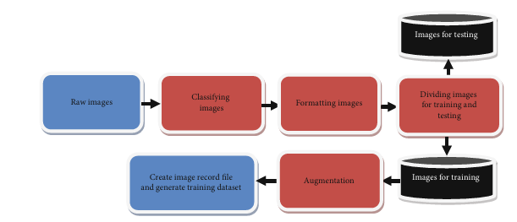
RGB ARABIC ALPHABET SIGN LANGUAGE (AASL) DATASET IMAGE DATASET
It is RGB dataset contain 21868 label images
Data split
TRAIN | TEST | VALID
19496 | 1384 | 988
Preprocessing

Slide 10
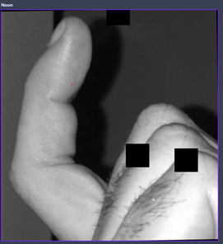
Augmentations
Outputs per training example: 1
Rotation: Between -4° and +4°
Cutout: 3 boxes with 10% size each
Example of images in data set :

Slide 11
Classes
# | Letter name in English Script | Letter name in Arabic script | # of Images | # | Letter name in English Script | Letter name in Arabic script | # of images
1 | Alef | أَلِف)أ) | 2800 | 17 | Thal | ظَاء)ظ) | 136
2 | Beh | بَاء) ب) | 343 | 18 | Ayn | عَين)ع) | 251
3 | The | أتَاء) ت) | 397 | 19 | Ghain | غَين)غ) | 627
4 | Thā | ثَاء) ث) | 2168 | 20 | Feh | فَاء)ف) | 975
5 | Jeem | جِيمْ) ج) | 217 | 21 | Qāf | قَاف) ق) | 426
6 | Hā | حَاء) ح) | 398 | 22 | Kāf | كَاف)ك) | 186
7 | Khah | خَاء) خ) | 96 | 23 | Lām | لاَمْ)ل) | 513
8 | Dal | دَالْ) د) | 476 | 24 | Meem | مِيمْ)م) | 3060
9 | Thāl | ذَال) ذ) | 881 | 25 | Noon | نُون)ن) | 164
10 | Reh | رَاء) ر) | 266 | 26 | Hah | هَاء)ه) | 210
11 | Zain | زَاي) ز) | 478 | 27 | Wāw | وَاو)و) | 155
12 | Seen | سِينْ) س) | 464 | 28 | Teh_Marbuta | ة)ة) | 156
13 | Sheen | شِينْ) ش) | 296 | 29 | Al | ال)ال) | 2077
14 | Sād | صَادْ)ص) | 698 | 30 | Laa | ﻻ)ﻻ) | 1598
15 | Dād | ضَاد)ض) | 88 | 31 | Yeh | يَاء) يَاء) | 160
16 | Tā | طَاء)ط) | 1105

Slide 12
CNN MODEL

Slide 13
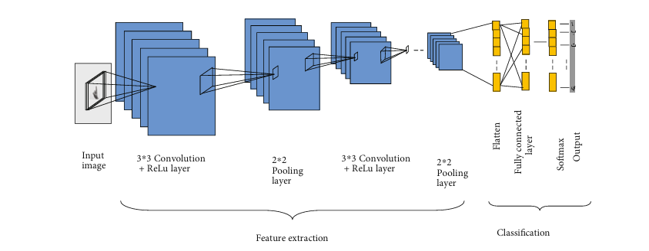

Slide 14
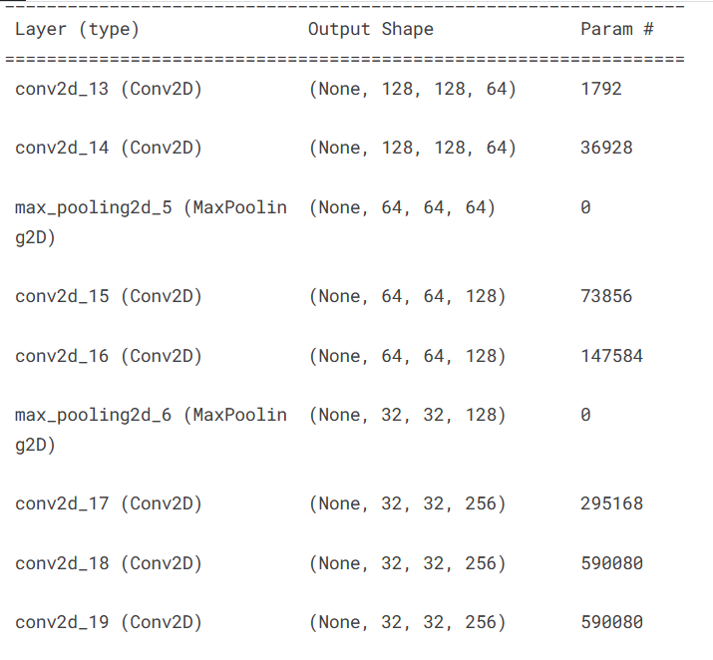
MODEL ARCHITECTURE

Slide 15
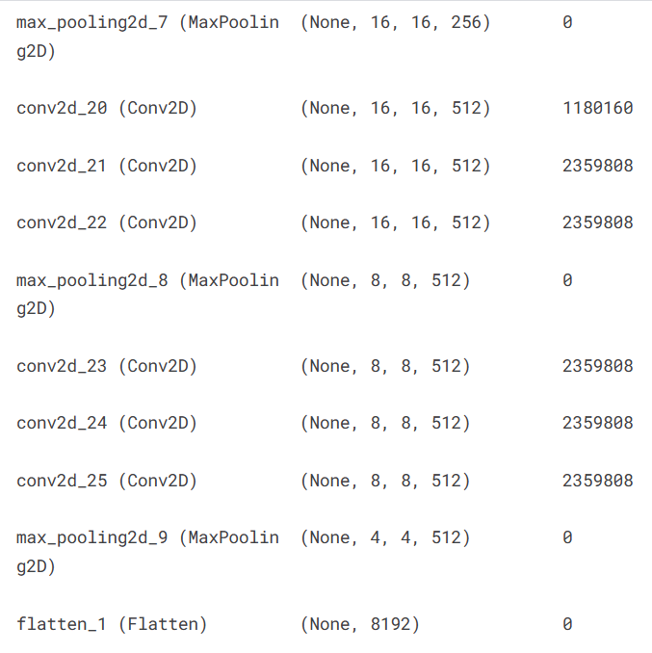
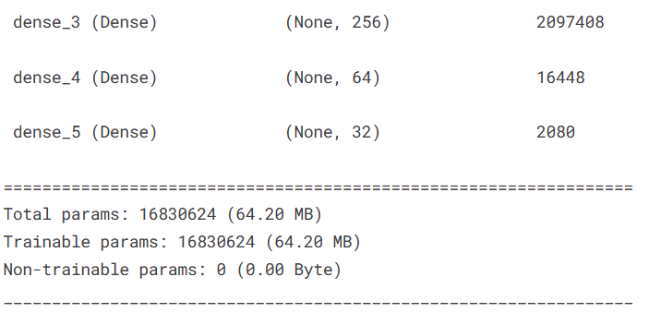

Slide 16
Results from the (CNN) model:
Results from the Convolutional Neural Network (CNN) model for the Sign Language Recognition project were highly encouraging, achieving an accuracy of 97% on the test dataset. The model was trained on a dataset of 54,049 images with 32 classes representing different sign language gestures. To enhance the model's performance, data augmentation techniques were applied during training.

Slide 17
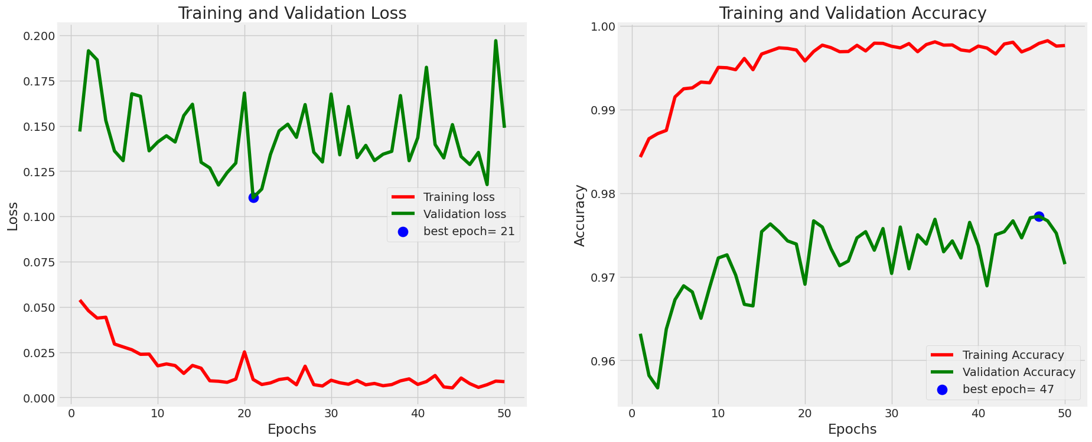
Training Result :
Training Loss = 0.0087 Validation Loss = 0.1489 | Training Accuracy = 0.9977 Validation Accuracy = 0.9715
Training model and plot history of accuracy and losses with the best epoch in both of them.

Slide 18
Testing Result :
Accuracy: 0.9715078630897317
Precision: 0.9715078630897317
F1 Score: 0.9715078630897317
Sensitivity: 0.9715078630897317
Specificity: 1.0

Slide 19
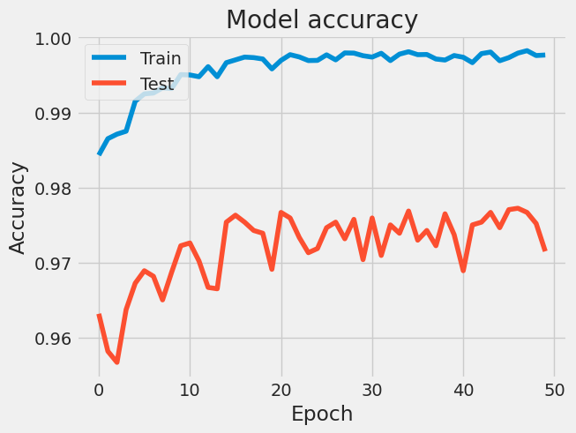
Training Accuracy = 0.9977
Testing Accuracy = 0.9715

Slide 20
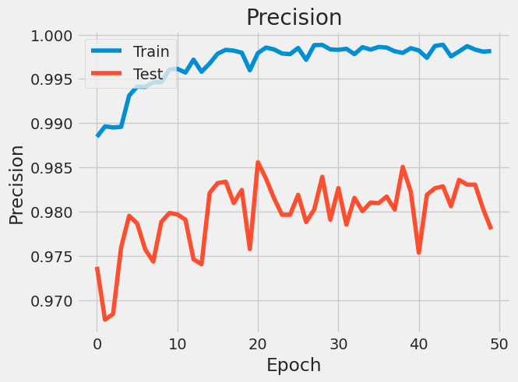
Training & Validation precision values

Slide 21
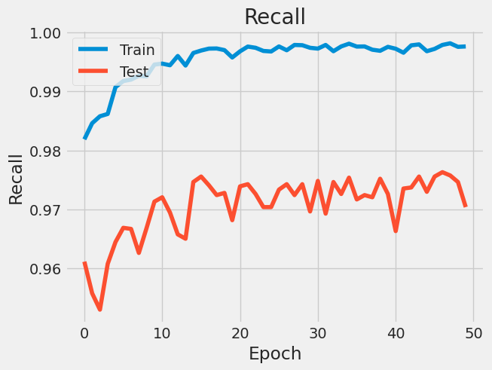
Plot training & validation recall values

Slide 22
Confusion Matrix :
The confusion matrix revealed that the model performed well across all 32 classes, with accuracy ranging from 95% to 97.15% for individual classes. The precision and recall scores were calculated for each class, demonstrating an average precision of 0.978 and an average recall of 0.97.

Slide 23
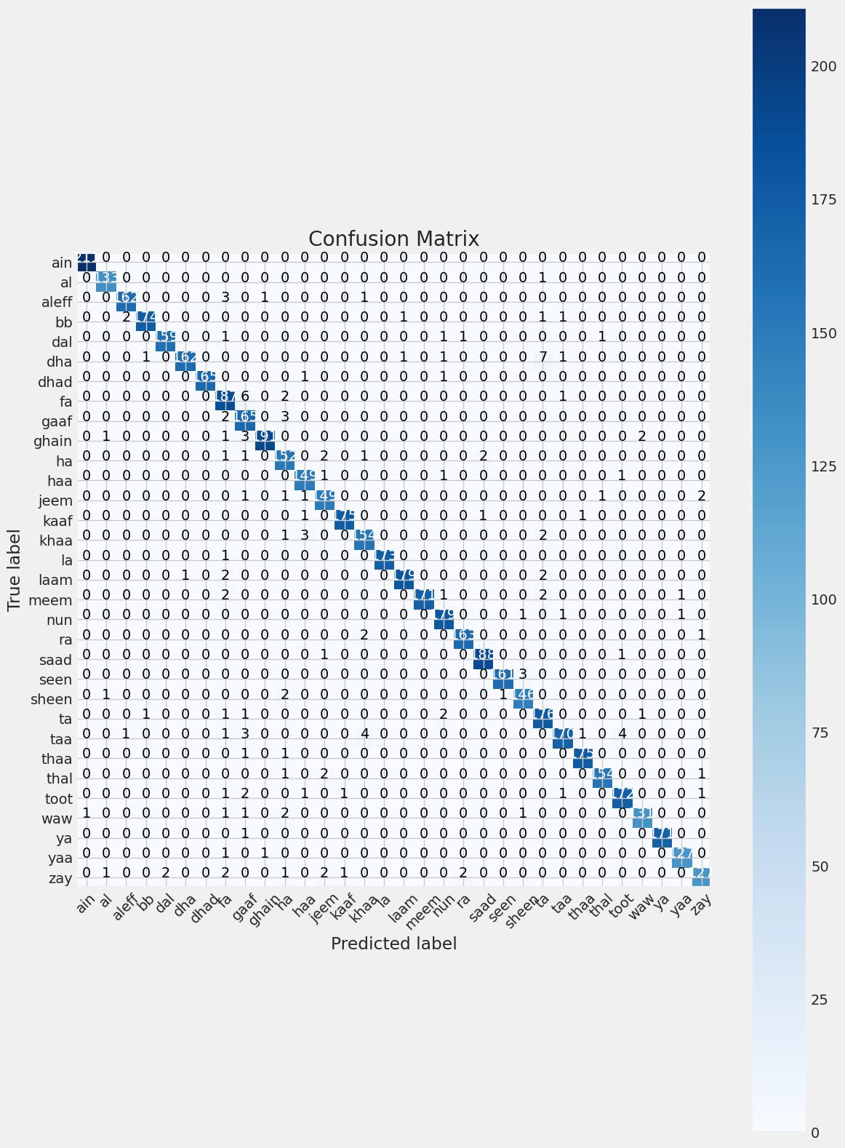
Confusion matrix (without normalization)

Slide 24
YOLO Model Results

Slide 25
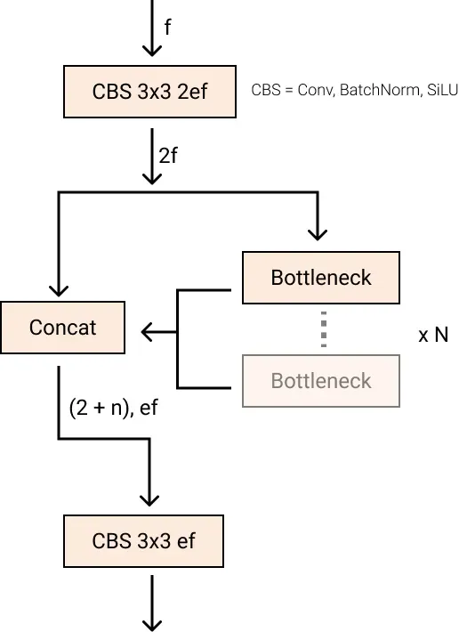
New Convolutions

Slide 26
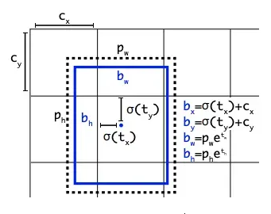
Anchor Free Detection
YOLOv8 is an anchor-free model. This means it predicts directly the center of an object instead of the offset from a known anchor box.

Slide 27
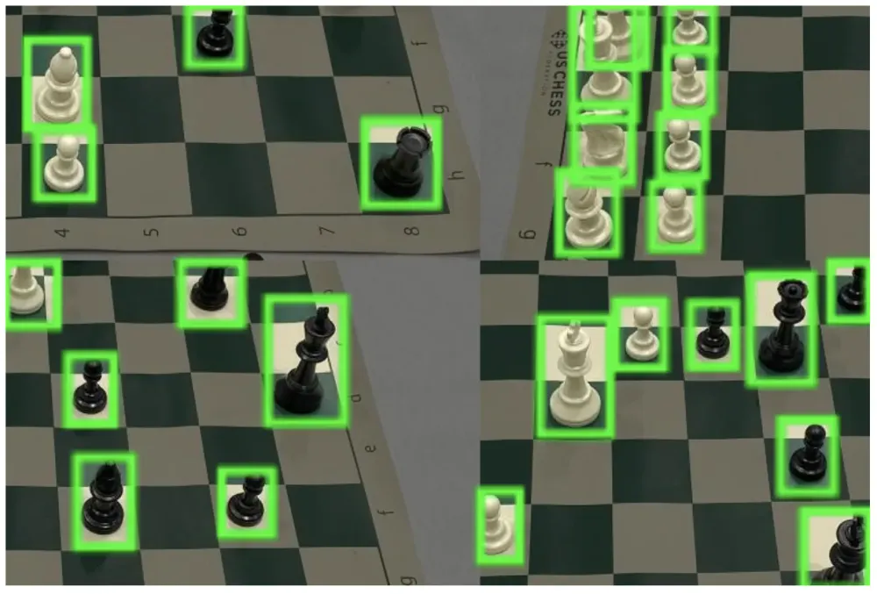
Closing the Mosaic Augmentation

Slide 28
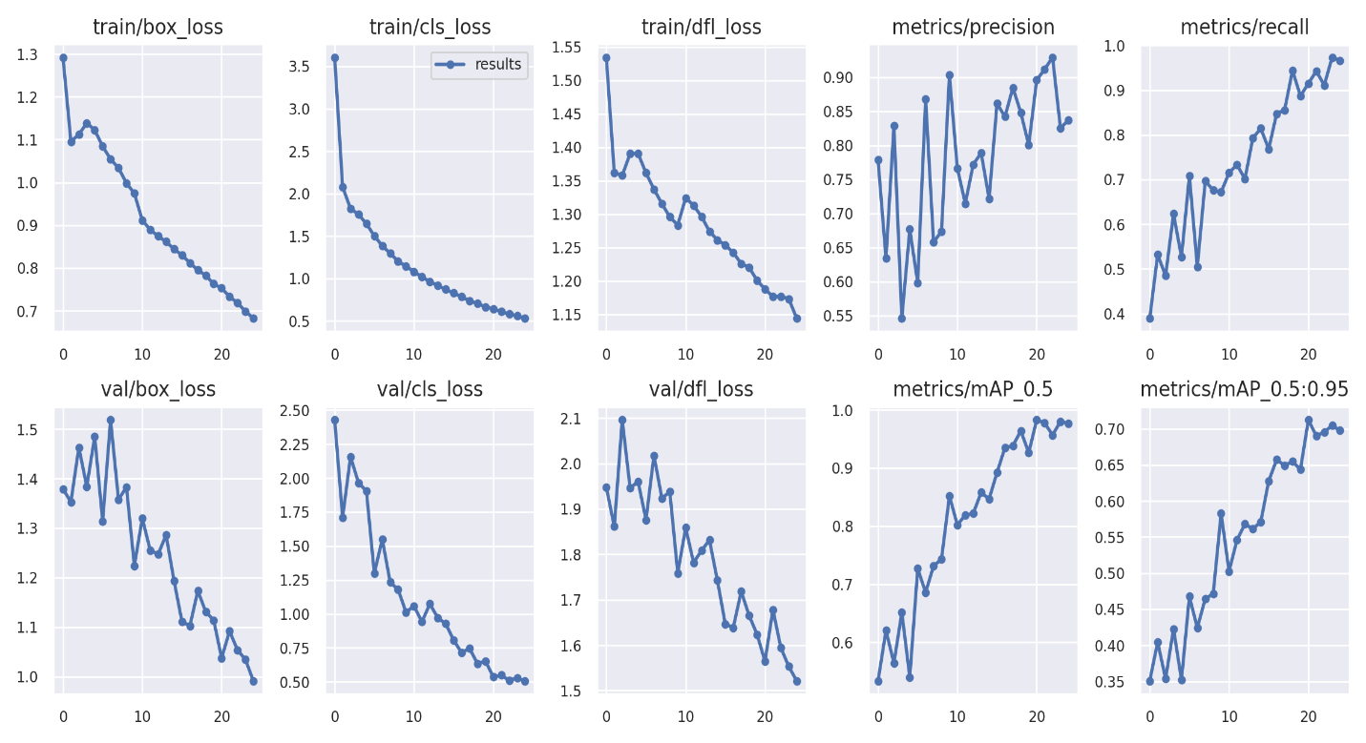
Metrics

Slide 29
Yolo Model Results
Class | P | R | mAP50
Ain | 0.896 | 0.915 | 0.983
Al | 0.658 | 0.967 | 0.917
Alef | 0.848 | 1 | 0.991
Beh | 0.972 | 1 | 0.995
Dad | 0.977 | 1 | 0.995
Dal | 0.973 | 1 | 0.995
Feh | 0.933 | 1 | 0.995
Ghain | 0.668 | 1 | 0.886
Hah | 0.977 | 1 | 0.995
Heh | 1 | 0.819 | 0.995
Jeem | 1 | 0.824 | 0.995
Kaf | 0.852 | 1 | 0.995
Khah | 0.931 | 1 | 0.995
Laa | 1 | 0.714 | 0.995
Lam | 0.939 | 1 | 0.995
Meem | 0.819 | 0.84 | 0.896
Noon | 1 | 0.792 | 0.995
Qaf | 0.791 | 1 | 0.995
Reh | 0.976 | 1 | 0.995
sad | 0.976 | 1 | 0.995
seen | 0.788 | 1 | 0.995
sheen | 0.768 | 1 | 0.995
tah | 0.653 | 1 | 0.995
teh | 1 | 1 | 0.995
Teh_Marbuta | 1 | 0 | 0.995
Thal | 0.62 | 0 | 0.995
Theh | 0.8 | 0 | 0.995
Waw | 1 | 0 | 0.995
Yah | 0.78 | 0 | 0.995
Zah | 0.9 | 0 | 0.995
Zain | 0.933 | 1 | 0.995

Slide 30
Screens Design

Slide 31
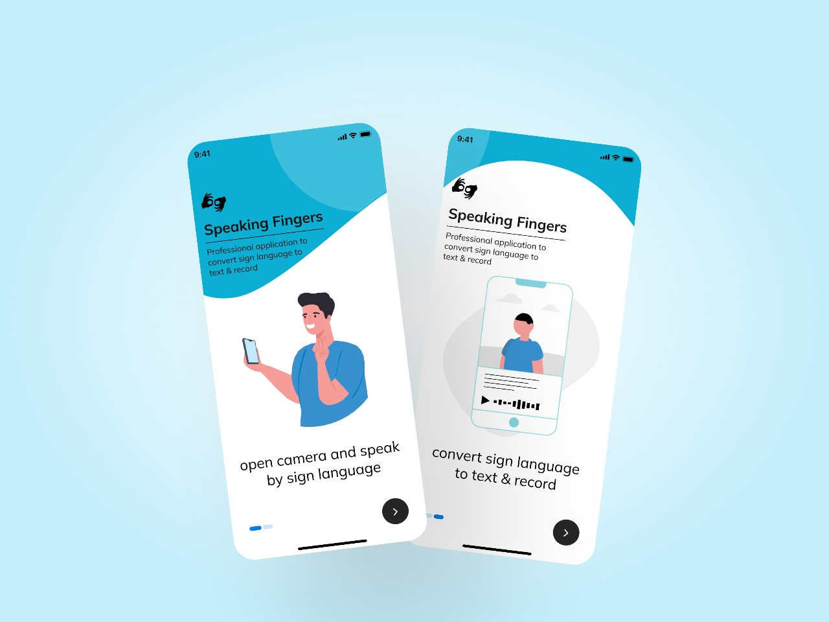
MobileDesign
Onboarding

Slide 32
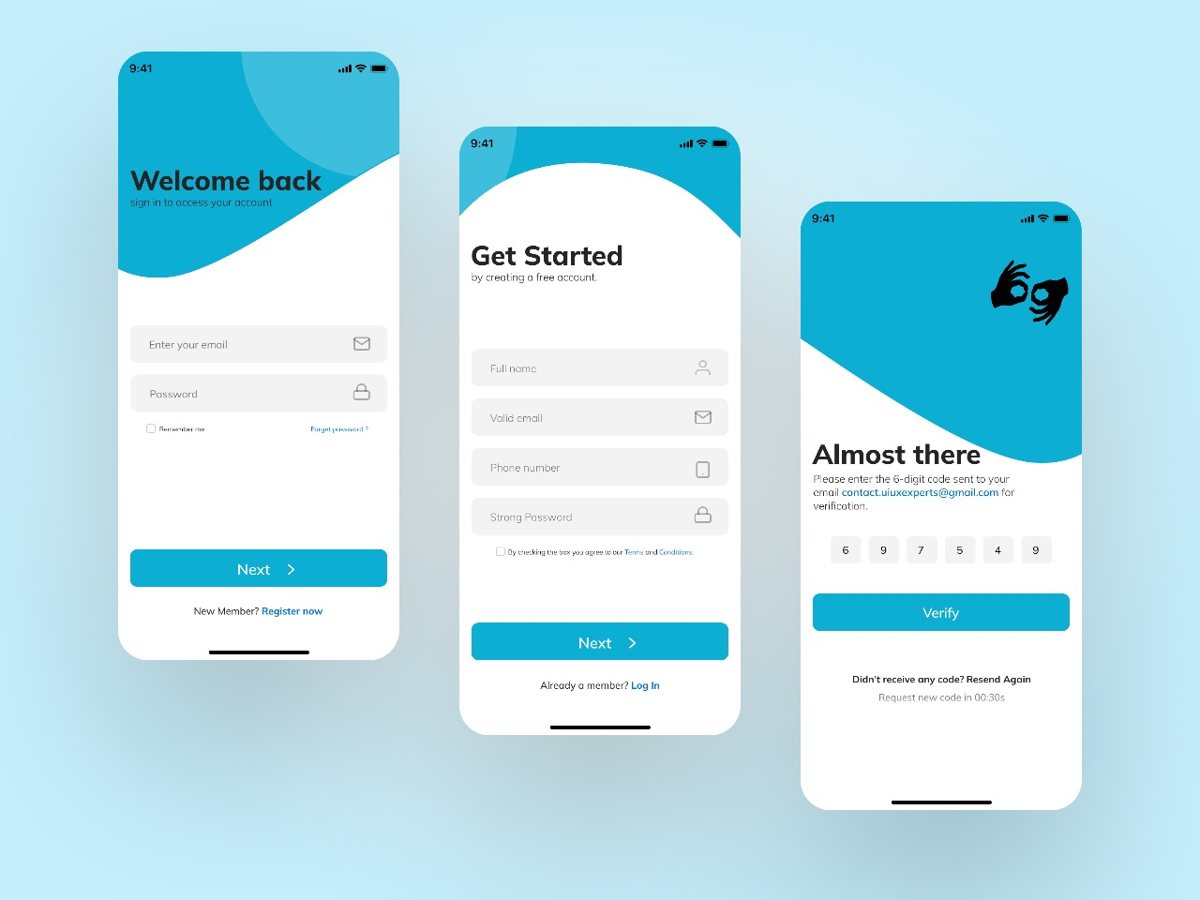
MobileDesign
Welcome pages

Slide 33
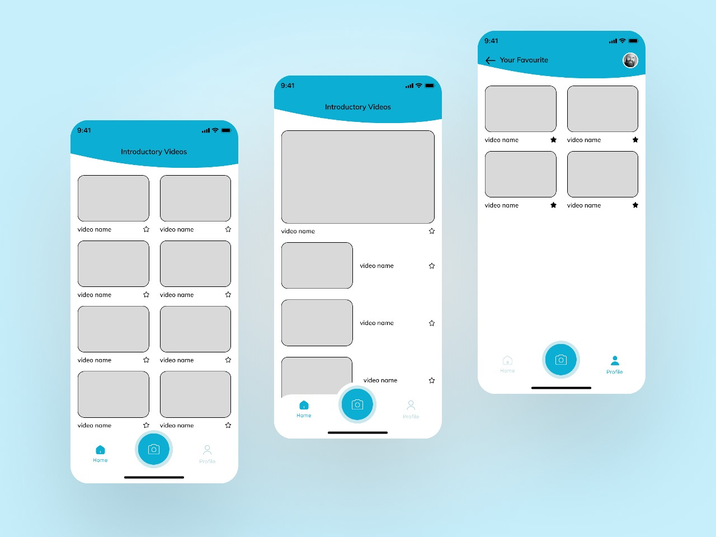
MobileDesign
Videos

Slide 34
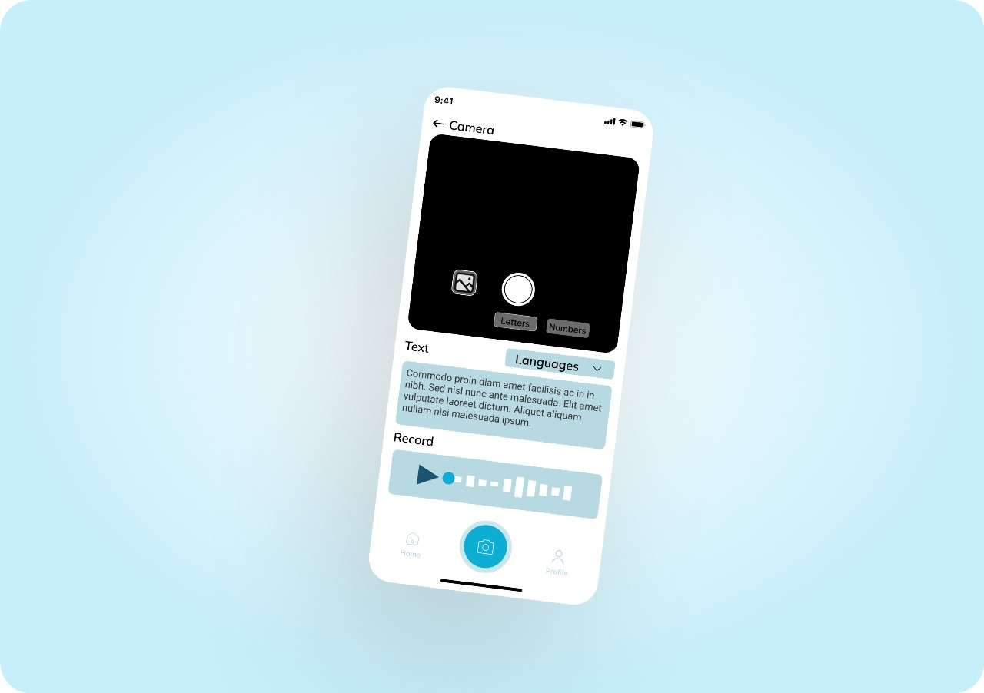
MobileDesign
Camera

Slide 35
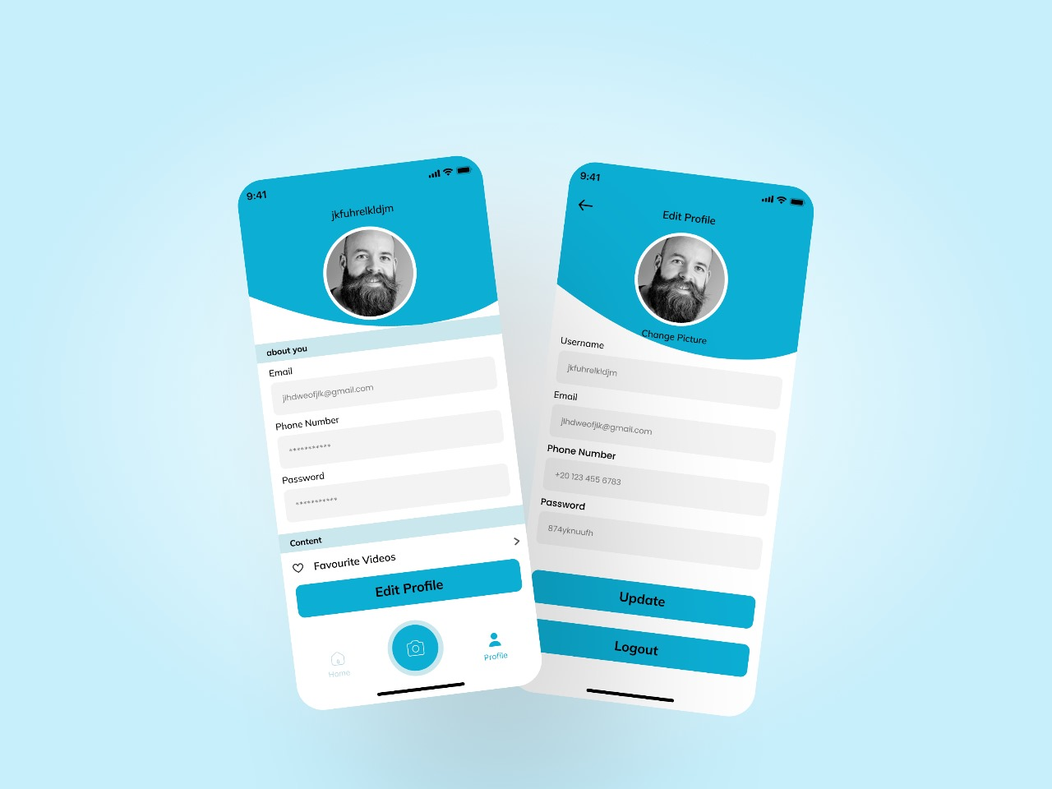
MobileDesign
Profile pages

Slide 36
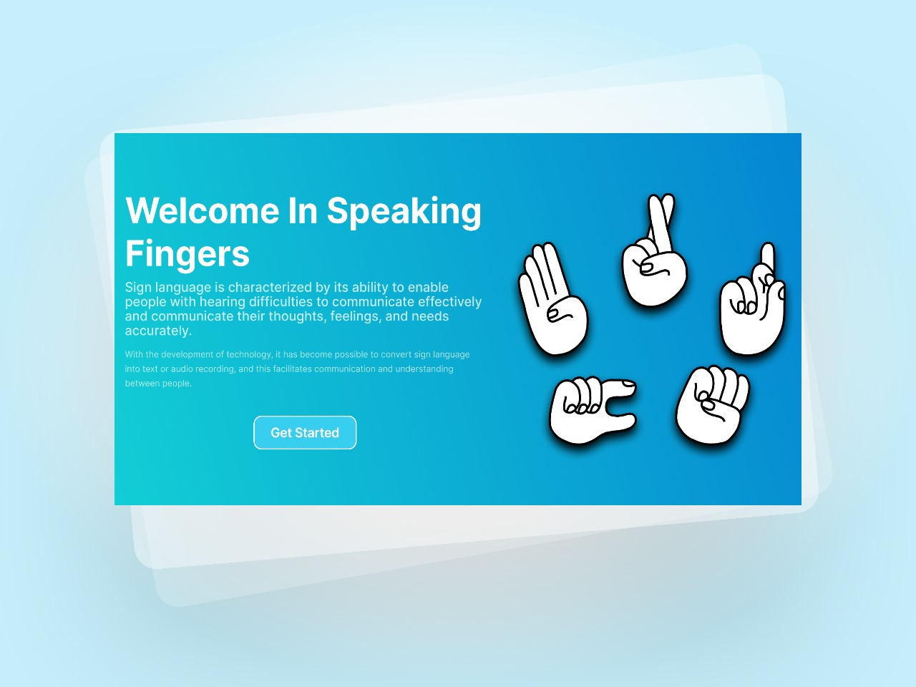
Web
Design
Welcome page

Slide 37
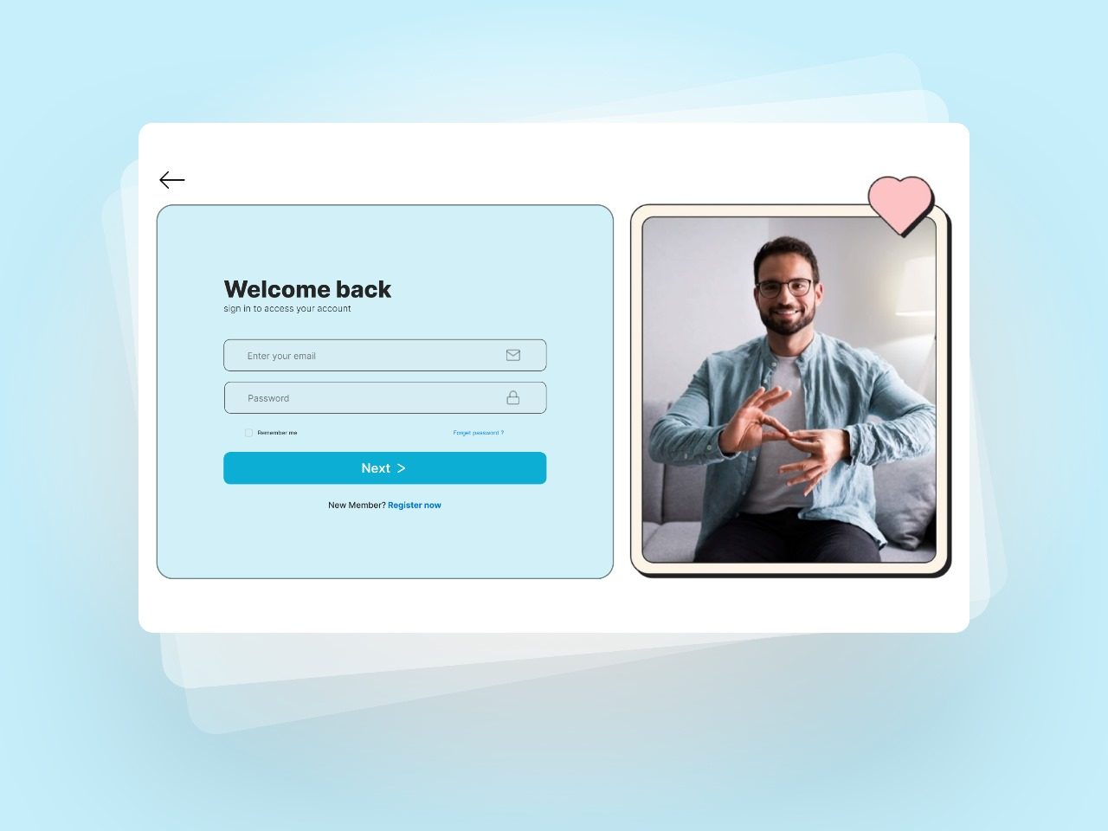
Web
Design
Login

Slide 38
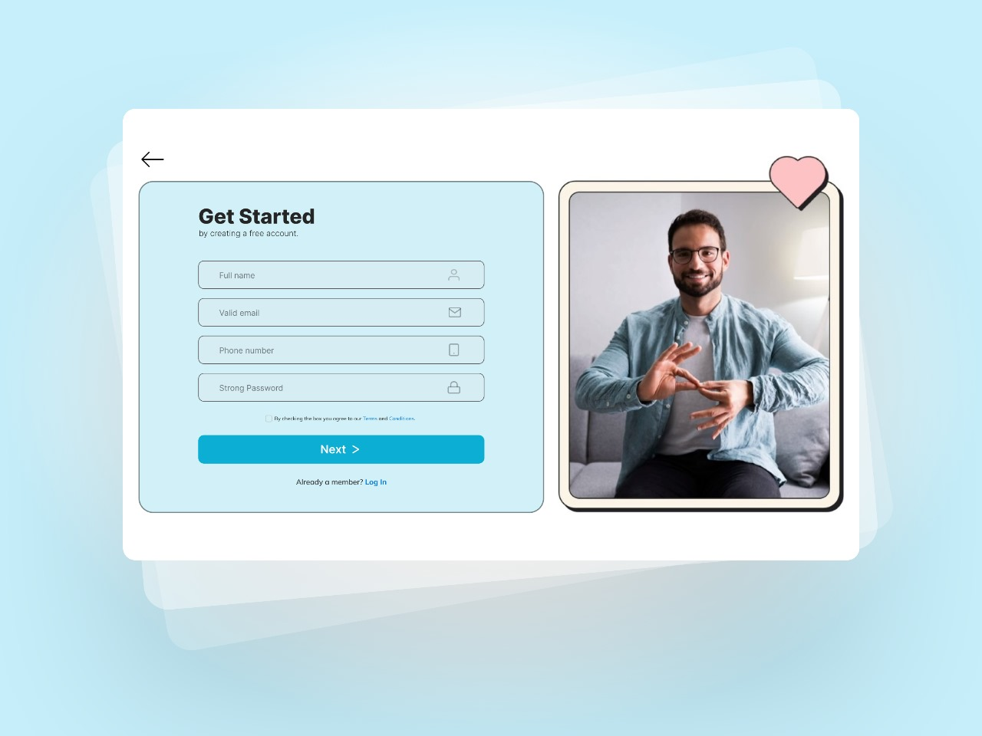
Web
Design
Signup

Slide 39
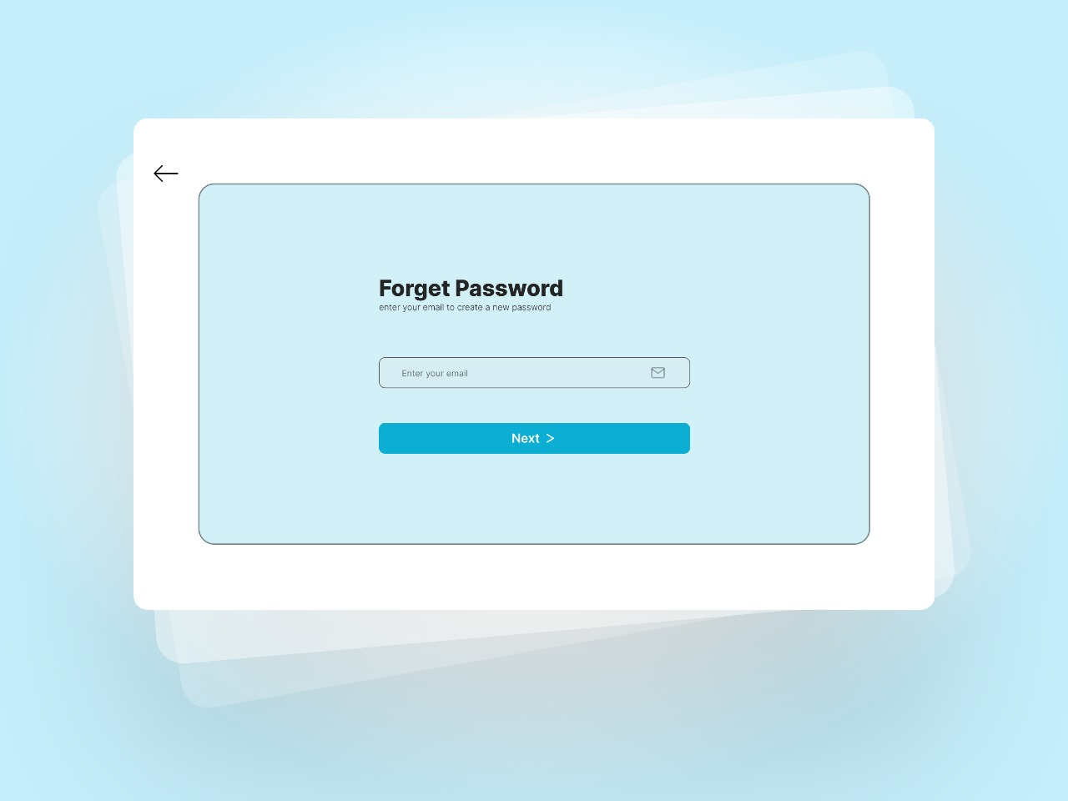
Web
Design
Otp

Slide 40
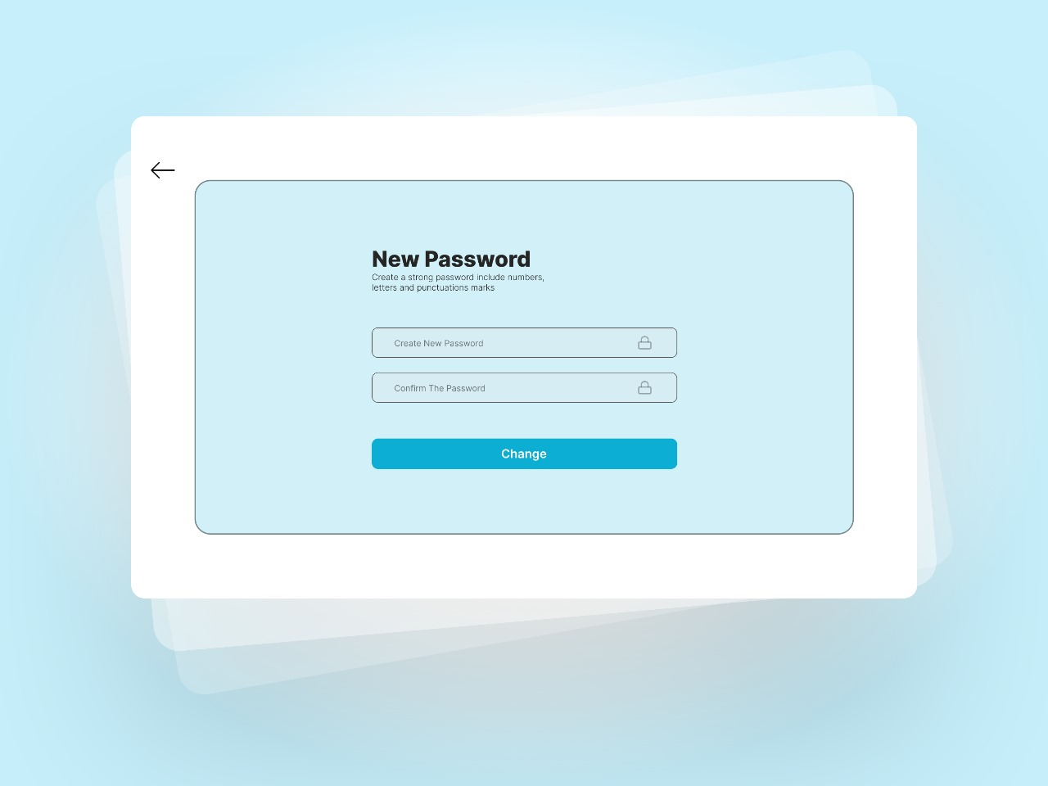
Web
Design
Otp

Slide 41
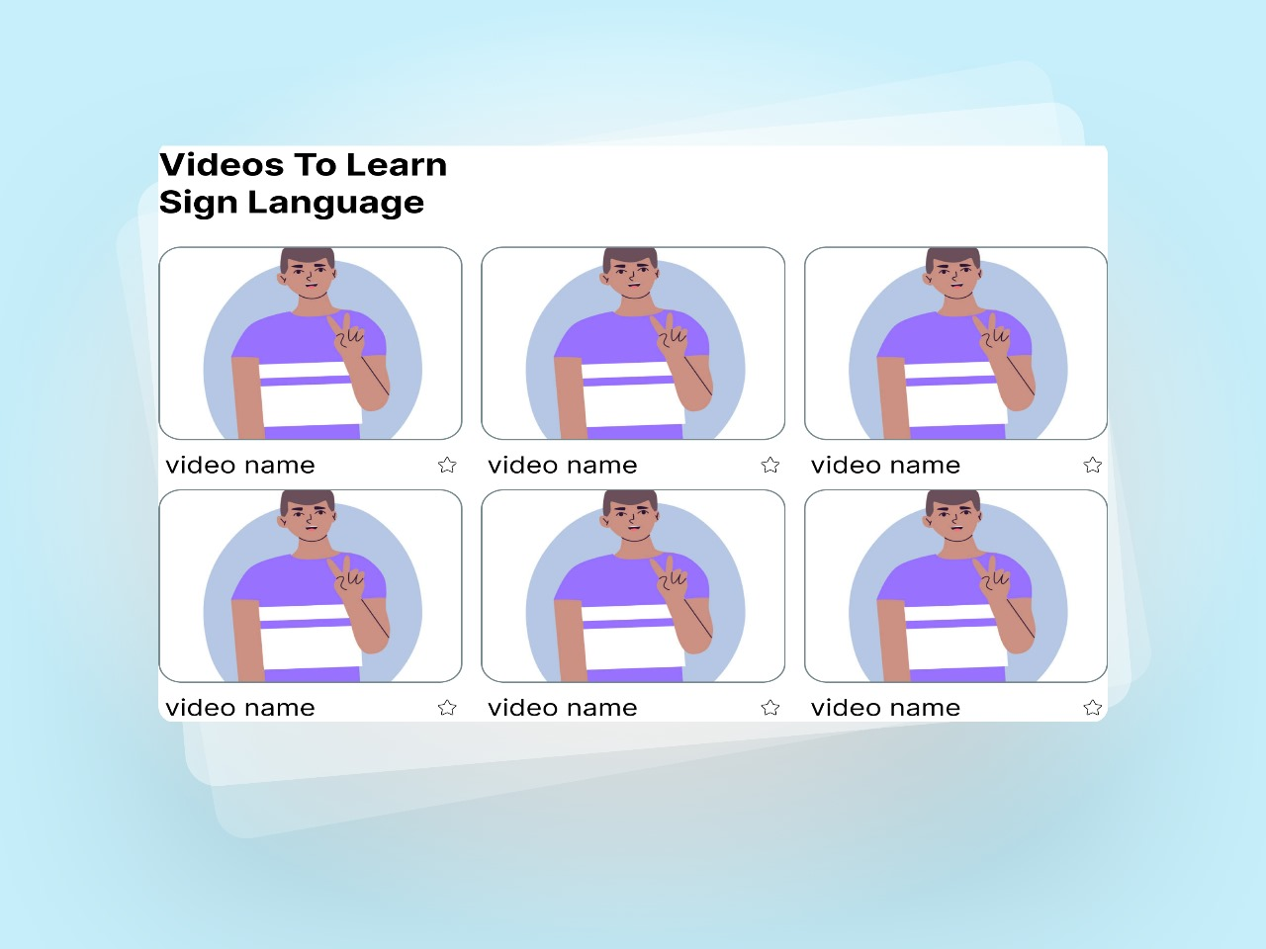
Web
Design
Videos to learn sign language

Slide 42
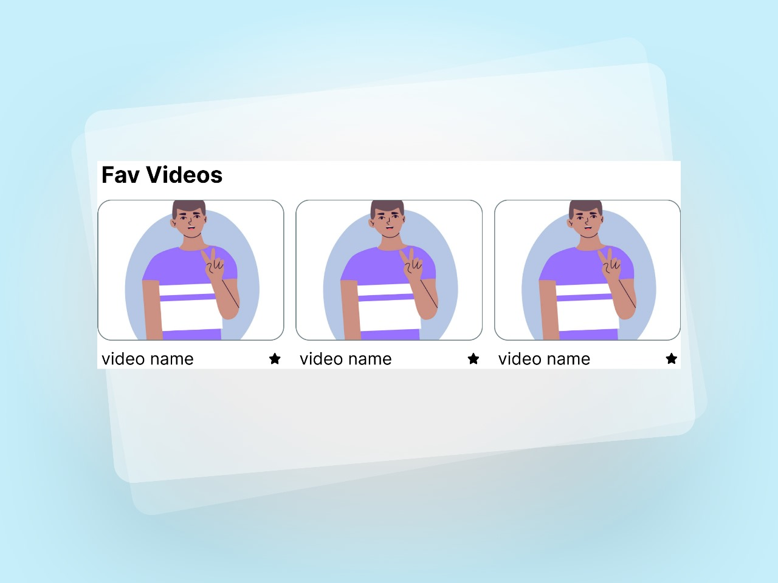
Web
Design
FAV Videos

Slide 43
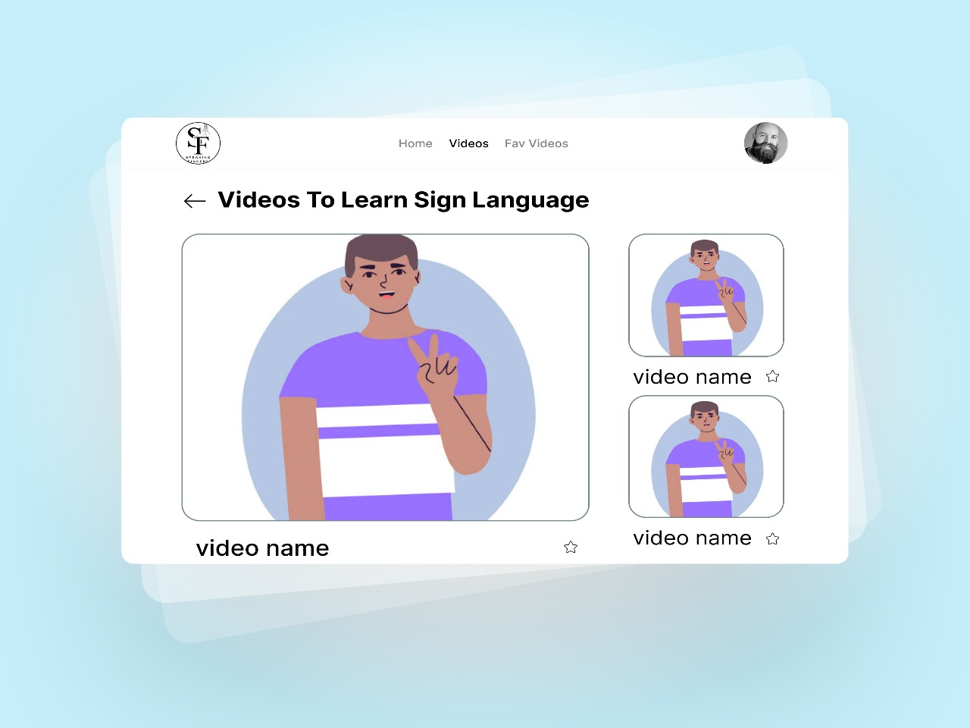
Web
Design
Videos

Slide 44
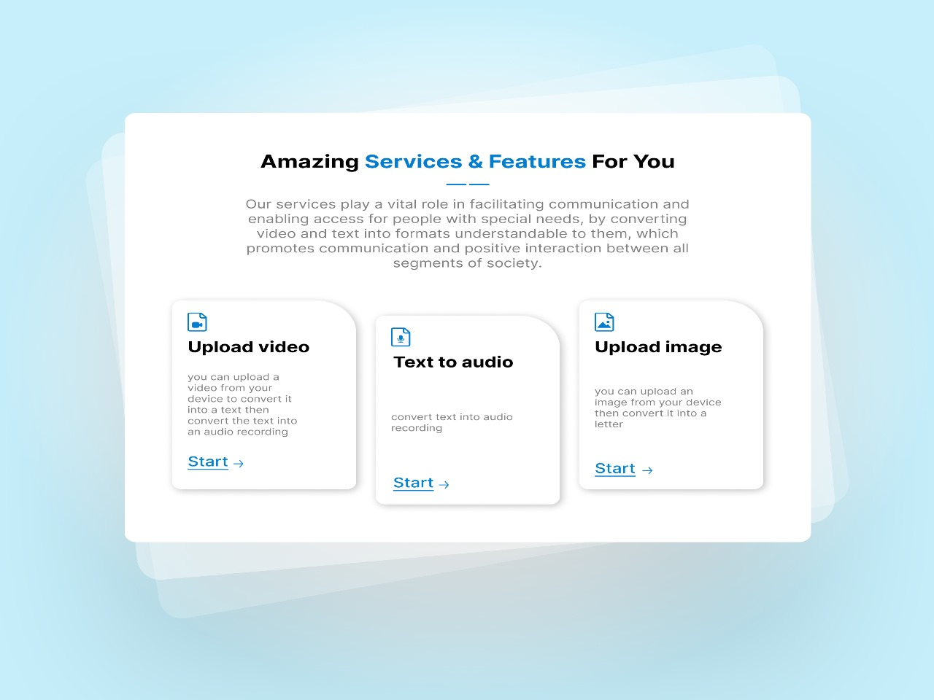
Web
Design
Our Services

Slide 45
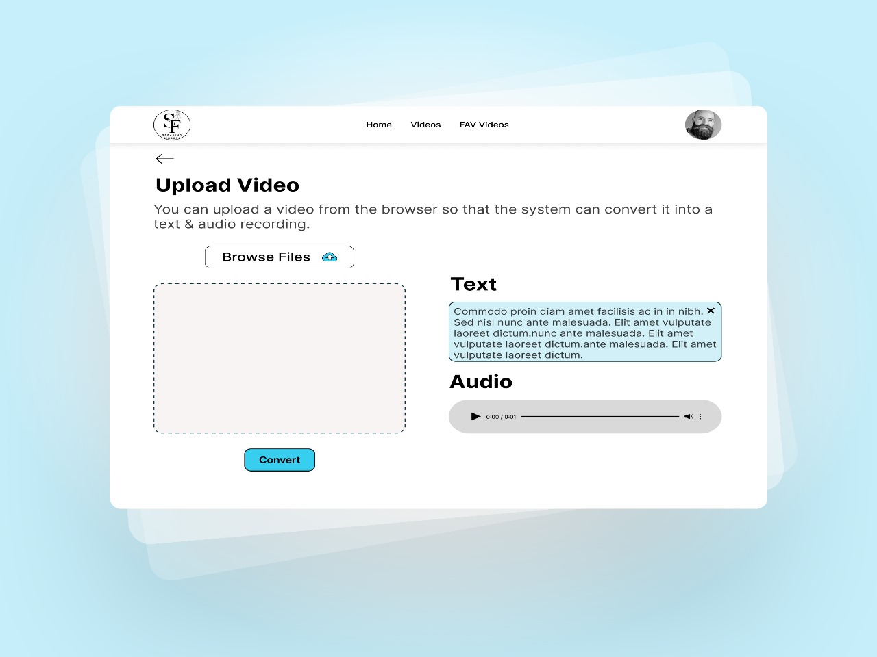
Web
Design
Upload Video

Slide 46
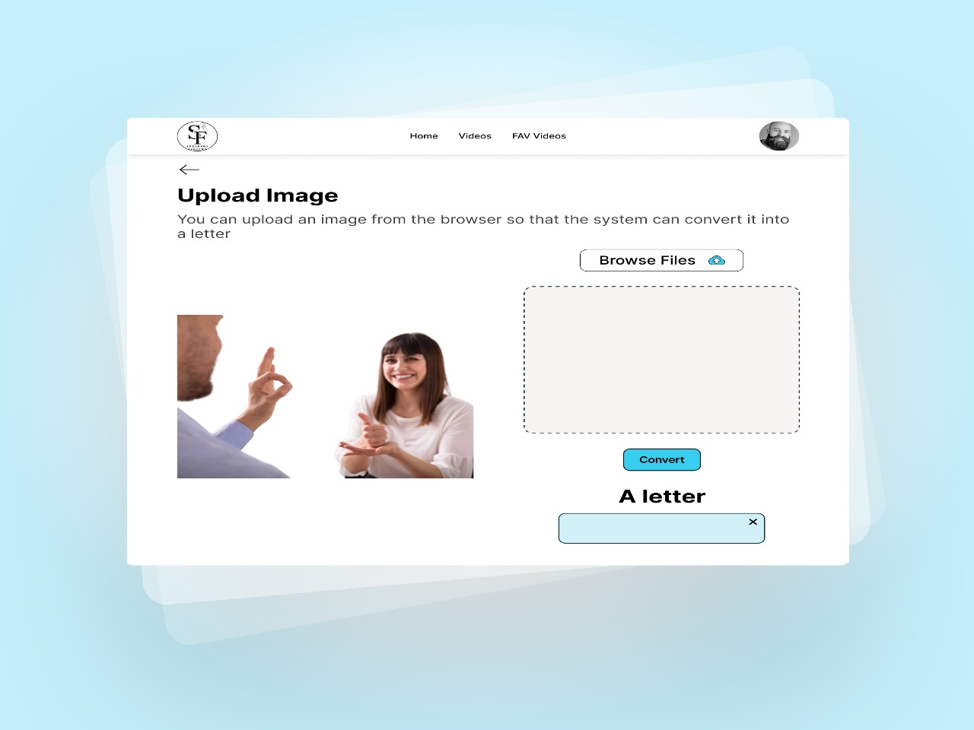
Web
Design
Upload Image

Slide 47
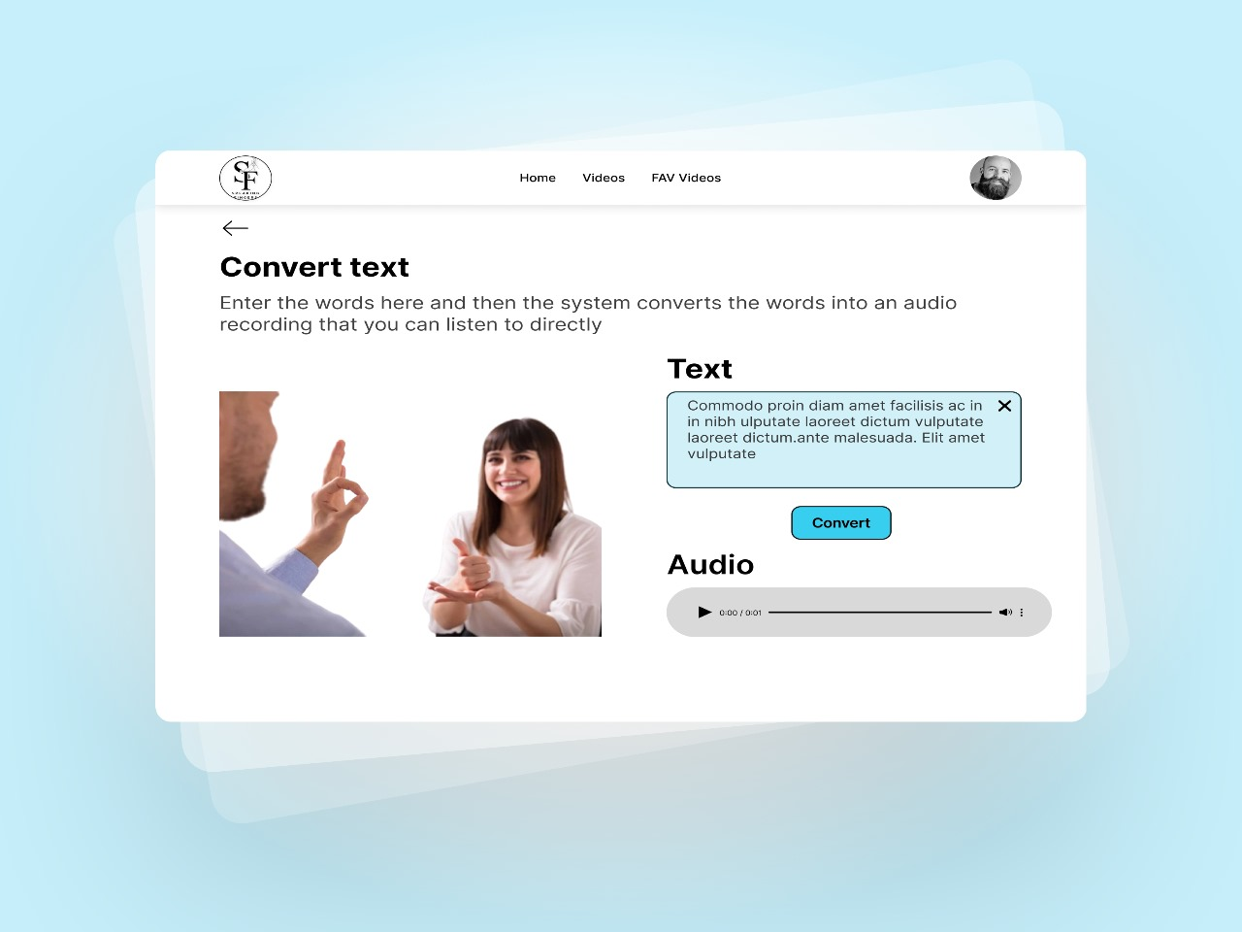
Web
Design
Convert Text

Slide 48
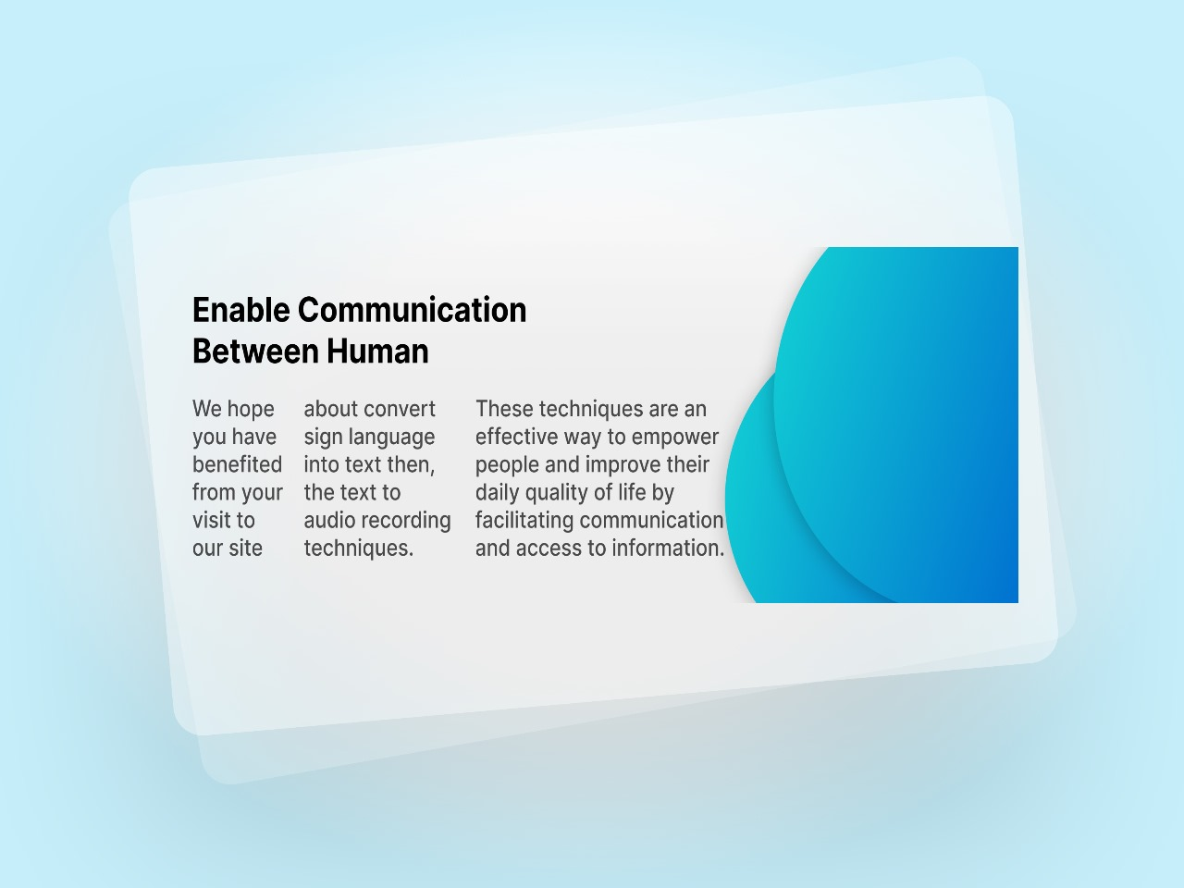
Web
Design
About Us

Slide 49
Admin panel

Slide 50
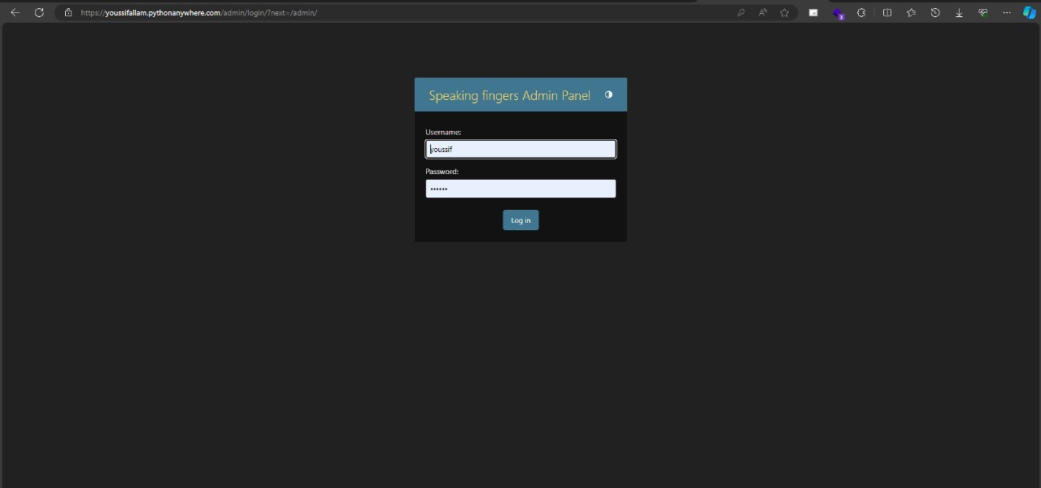

Slide 51
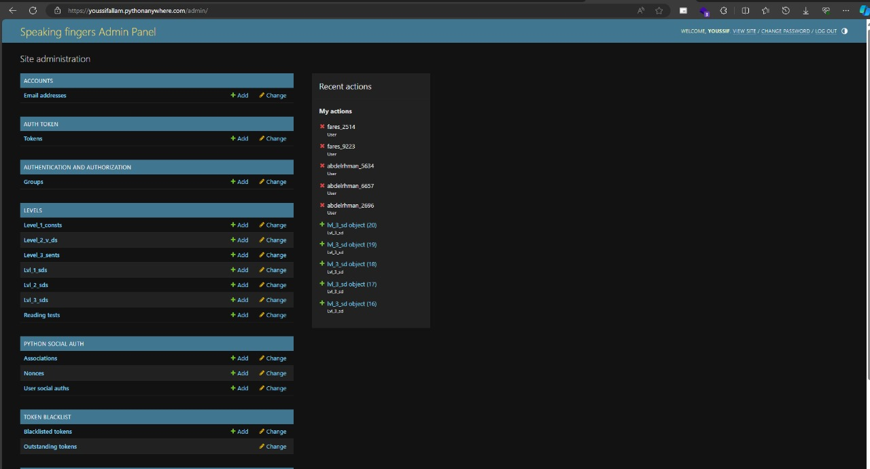

Slide 52
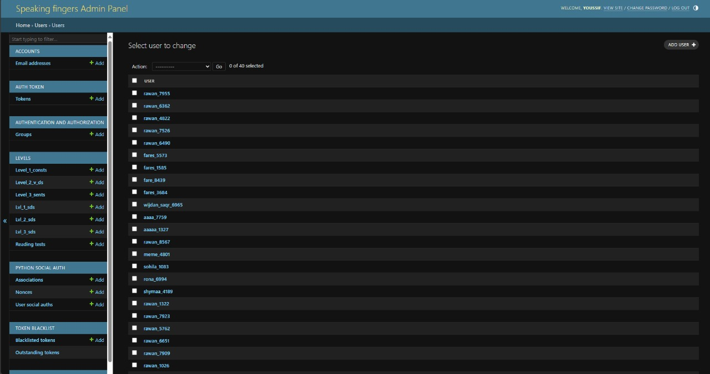

Slide 53
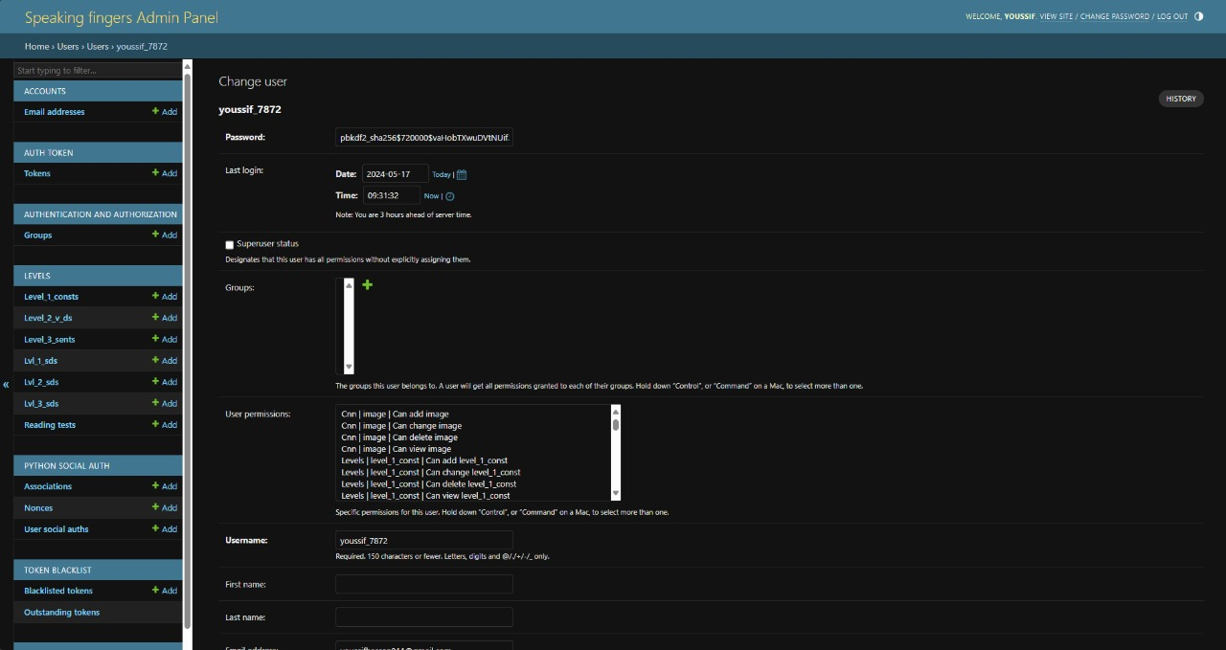

Slide 54
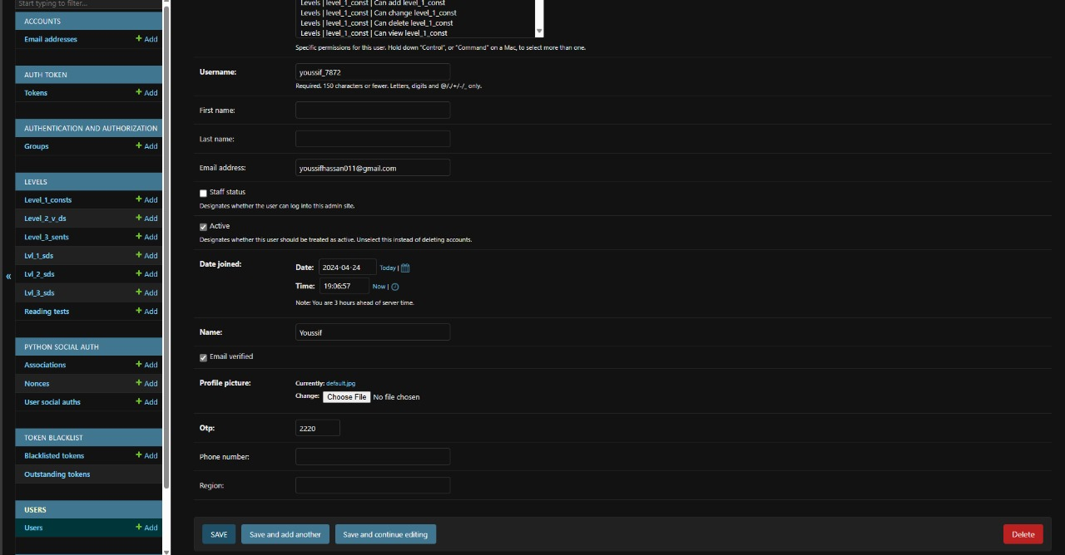

Slide 55
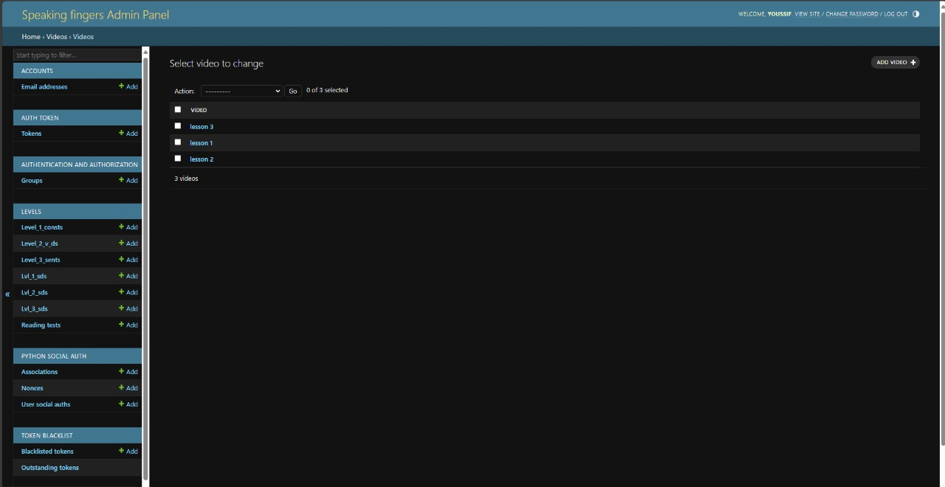

Slide 56
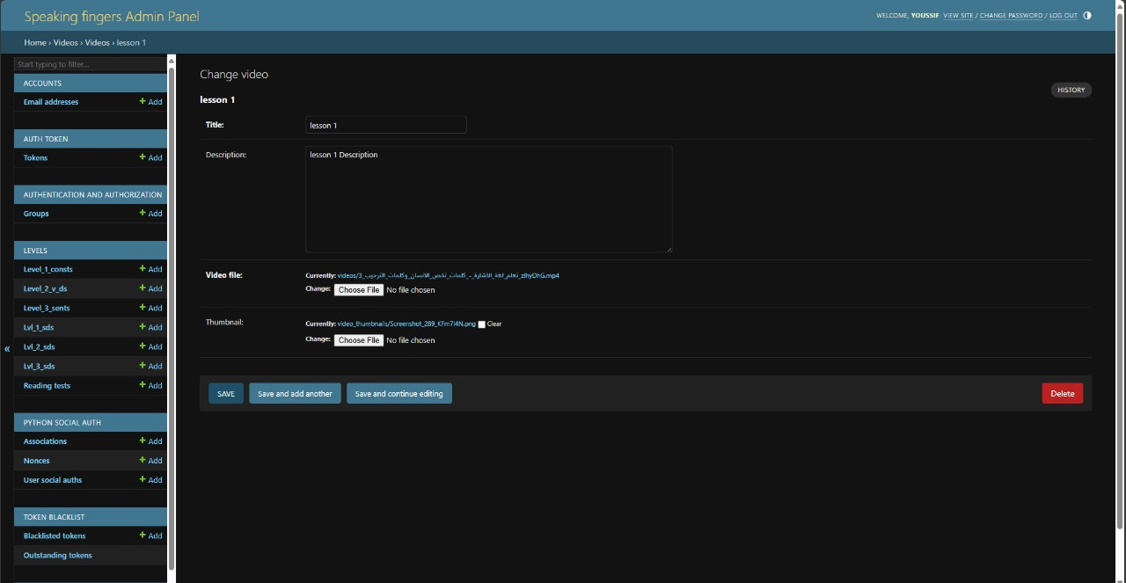

Slide 57

