Slide 1

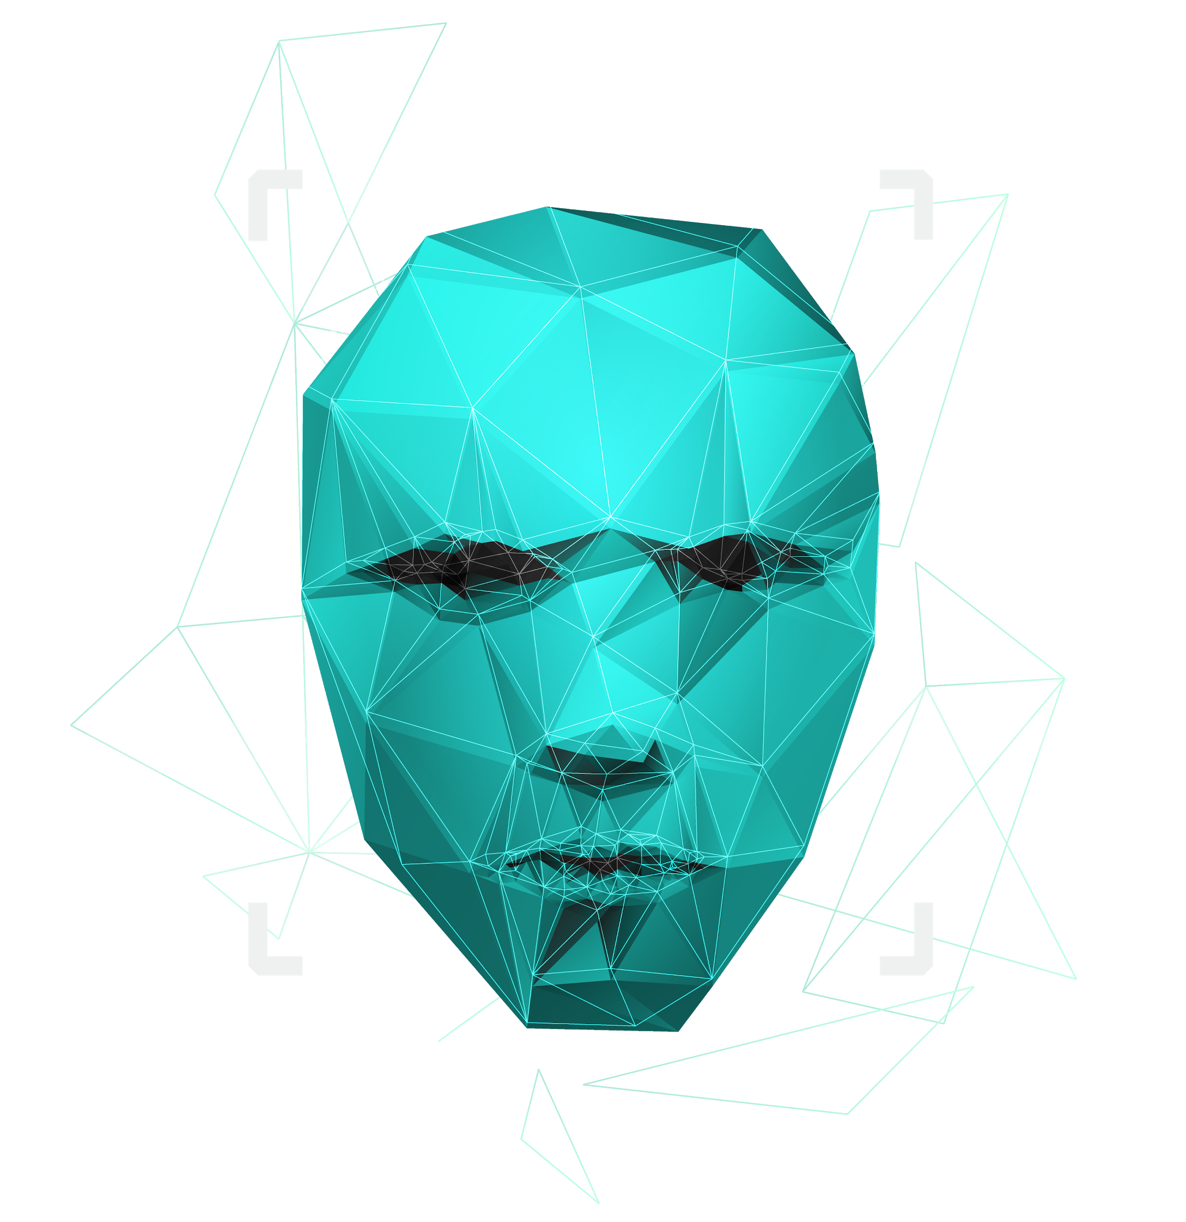
Paternity testing using genetics
Team Members: Youssif Assem, Mohamed Moataz, Kareem Ehab, Mohamed Akram, Ahmed Gamal
Supervised by : Dr. Ashraf Abdelraouf & Eng. Ahmed Hazem

Slide 2

Agenda
Introduction
Motivation
Problem Statement
Similar system
System Overview
Derivables
Time Plan
Supportive document (Dataset)
Live Demo`

Slide 3

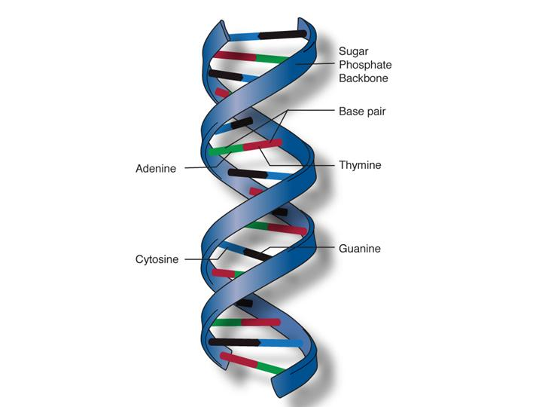
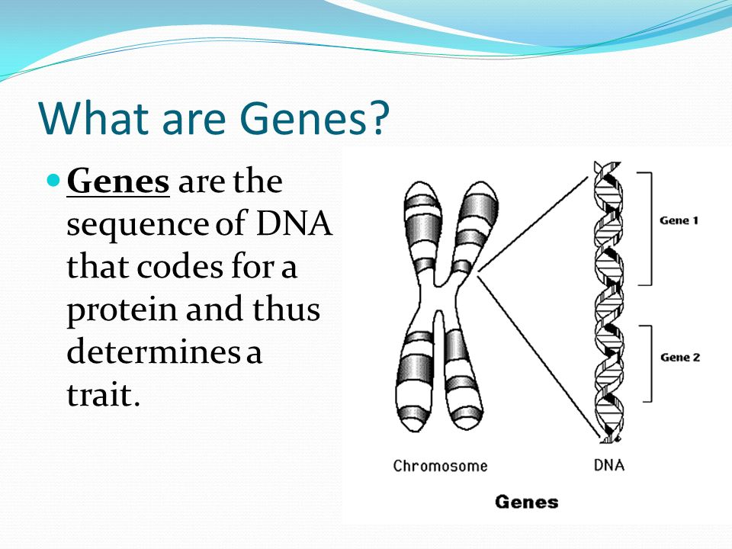
Introduction
DNA
DNA molecules allow some of our characteristics to be passed down from our generation to the next (our children)
Genes →Genes are passed from parents to offspring and contain the information needed to specify traits(qualities). Genes contains a subset of the DNA and this subset is (A, T, C, G).
1

Slide 4
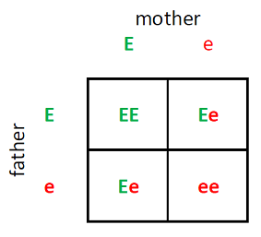
Introduction
What is an RSnumebr?
It is a reference number to the gene we have that consists of two alleles (one from the father and the other from the mother).
What is an Alleles ? It is a two characters represents the gene sequence repeats of characters one from father and another one from mother
EX:
RsNumber | Father | Mother | Child1 | Child2 | Child3
rs3131972 | AG | GG | AG | GG | GG
2

Slide 5
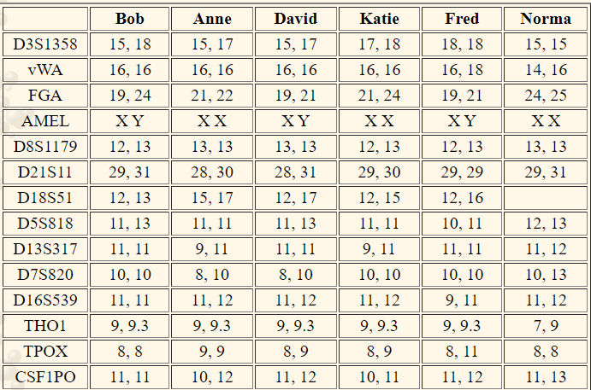
Introduction
Whole genome
It is the whole DNA sequence that a human have in their system.
Each number in the Table represents the repeats of nucleotide.
Ex:
ATCGATCGATCGATCGATCGATCGATCGATCGATCGATCG
3

Slide 6
Motivation
Our goal is to create a system for proving the paternity between father, mother, and child using whole genome. We apply short tandem repeats algorithm that counts the number of repeats for a specific nucleotide on the whole DNA sequence. In addition, we aim to make the paternity test for father and child using the rs number. And create a new approach that if we found a child in the street we make the DNA test for him/her and get the most family accurate family this child maybe related to using Mendelian's law rules.

Slide 7


Problem Statement
Some parents suffer from the process of paternity testing when they are being sued for child custody.
A lot of time when a crime happens, some DNA would be left at the crime scene and would take some time to be processed and eventually lead us to the one who committed that crime.
Why can’t we have a system that could potentially prove this in less time and be accessible to everyone.
4

Slide 8
Similar System
(Jiˇrı Drábek. “Validation of software for calculating the likelihood ratio for parentage and
kinship”. In: Forensic Science International: Genetics 3.2 (2009), pp. 112–118.)
J. Dra ́bek proposed a method to validate software for calculating the likelihood ratio in
parentage/kinship scenarios when it comes to two programs (paternity index and families). They
used their study on seven different test cases in paternity and calculated the error rate and success
rate in each of those cases. The seven chosen cases were proved to be thorough but They had some
incorrect likelihoods believed to be caused by the software or improper use of the software during
the testing phase.
5

Slide 9
Similar System
(Stefania Vai, Carlos Eduardo G Amorim, Martina Lari, et al. “Kinship determination in
archeological contexts through DNA analysis”. In: Frontiers in Ecology and Evolution 8
(2020), p. 83.) Stefania et al. suggested a study to further explore DNA analysis and kinship relations
between individuals. Their case studies were the archaeological and anthropological analyses of
burial sites and skeletal remains. They show using multiple case studies in their research that only
genetic analysis can provide a sound and a confirmed determination of kinship. They describe the
different molecular strategies for kinship estimation from the classic PCR-based methods to Next
Generation Sequencing (NGS).
6

Slide 10
Similar System
Masataka Takamiya. “R scripts for kinship testing”. In: Journal of Iwate Medical Assiocia-
tion 73.5 (2021), pp. 189–201.)
Masataka .T~ They suggested a method using R script for statistical analysis of genetic data for kinship testing. The used methods involve algorithms with the R language considering its flexibility with calculations and statistical power, and also for conditional probability analysis based on the Bayes theorem. Standard paternity trio cases and other test cases were conducted, and scripts were constructed for each different test case. DNA profiling was used to find the allele frequencies of tested loci to establish links among DNA profiles of individuals.
7

Slide 11
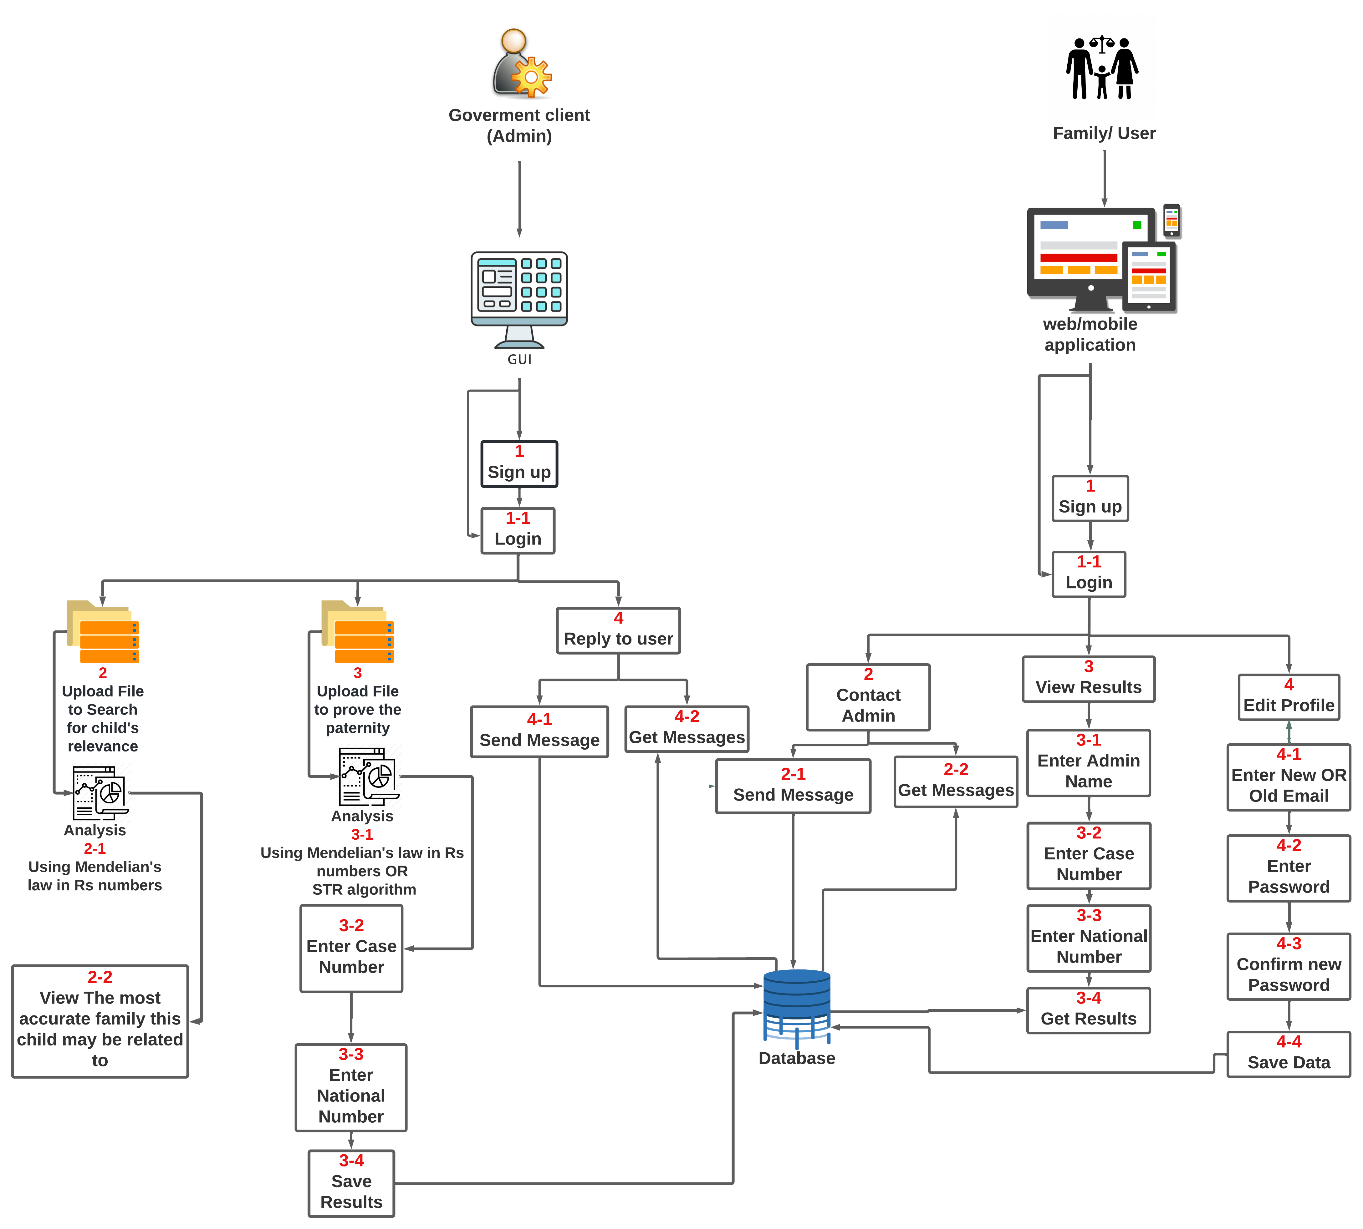
System overview
8

Slide 12
Deliverables
Collect a useful dataset containing snippets of altered genes OR the entire genome of family.
Make a mobile/web app that allows anyone from the family to display the results of the test.
Create a web or python GUI for court or laboratory to upload the test data for a father and child or for a child from the street.
Prove the paternity and return a result as a probability for the normal/admin user.
Deploy our software in the marketplace.
9

Slide 13
TIME PLAN
13/1/2022
Enhance everything we implemented so far
Whole genome processing from the sources we gathered
By the end of January
Potentially add Whole genome in our system based on the information we gathered
By the end of February
Implement at least 60 % of the GUI application and mobile application
Before the end of Februrary
Start by the end of February
Prove that if is at least a relevance or kinship degree
10

Slide 14
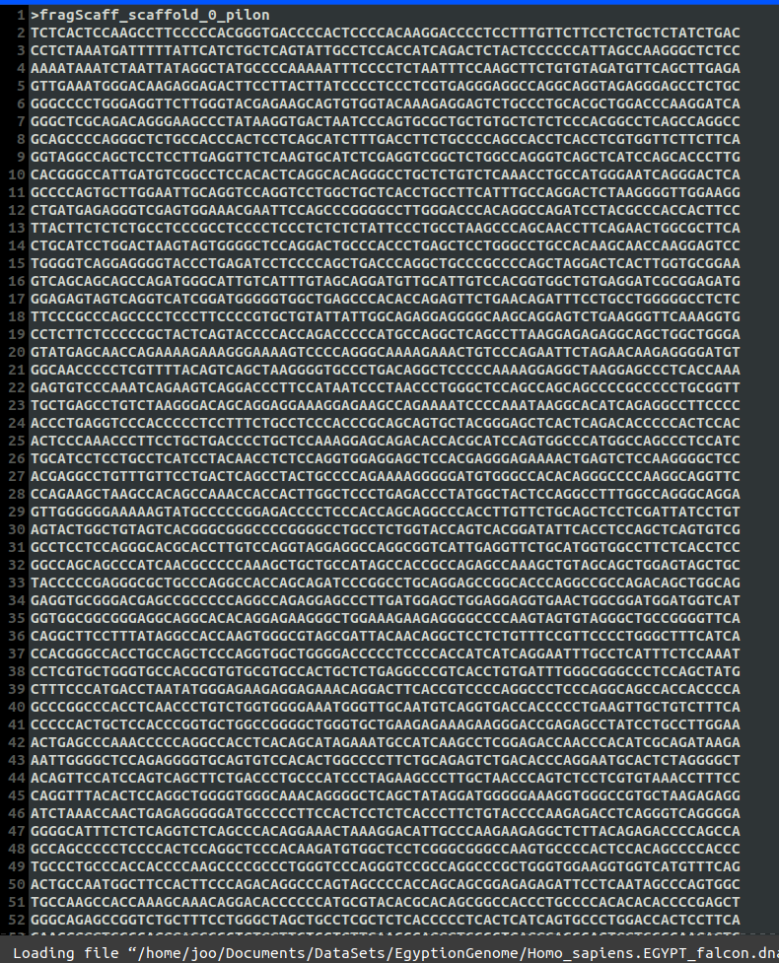
supportive documents (dataset)
In the whole genome the process to determine paternity is somewhat different There are specific locations (IDs) or the right terminology (locus, loci) in the whole genome every location and is in a specific chromosome For each of these locations, there exists a specific repeat that we are looking for ex: D7S280 --> GATA counting the number of those repeats for each location is the goal and then comparing it with the number of repeats in the mother and father
11

Slide 15
Live Demo
12

Slide 16
THANK You!
Do you have any questions? ☺

