Slide 1
Genetics
Youssif Assem Mohamed Moataz Kareem Ehab Ahmed Gamal

Slide 2
Agenda
Introduction
Motivation
Problem Statement
Similar Systems
System Overview
Deliverables
Time plan
Supportive Documents
Live Demo
References

Slide 3
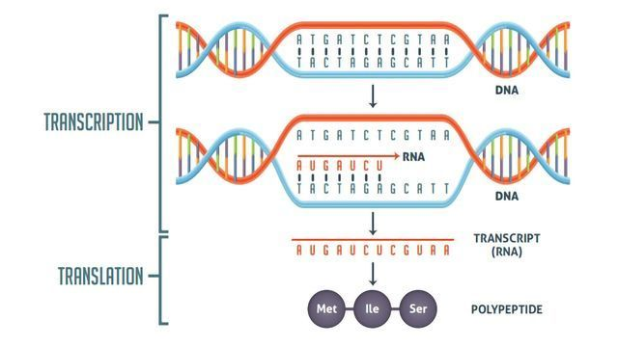
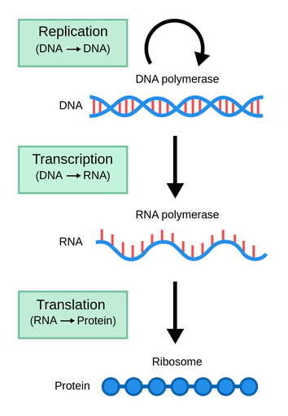
What is DNA

Slide 4
Mutations
Mutations
Genes
Chromosomes

Slide 5
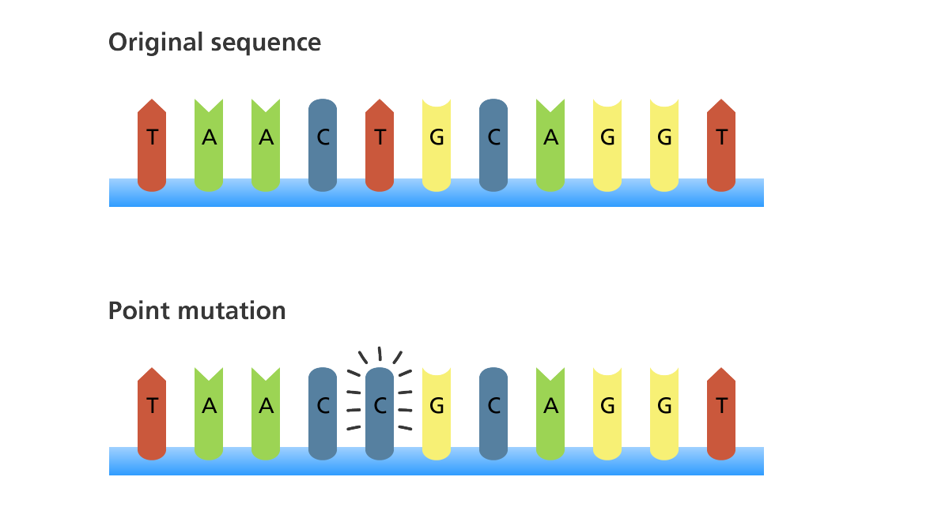
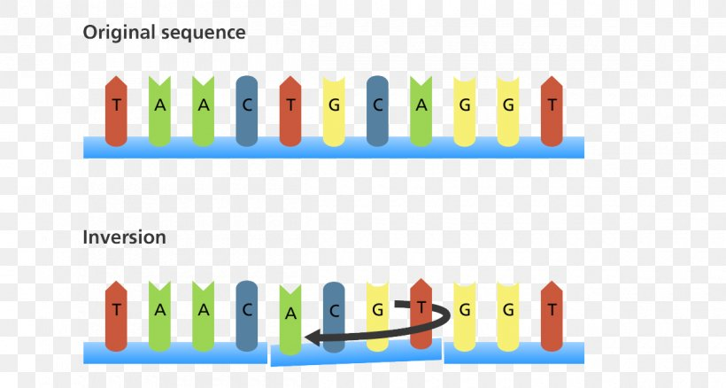
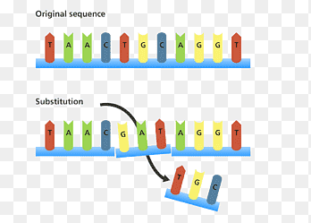
Genes Mutation
Point mutation
Inversion
Substitution

Slide 6
Alleles and Genes
rs1896295 | rs4671393 | rs10195871 | rs7565301
Normal T|T | Normal A|A | Normal A|A | Normal G|G
Carrier T|C | Carrier A|C A|G A|T | Carrier A|G A|T | Carrier G|A G|T
Diseased C|C | Diseased C|C | Diseased G|G | Diseased A|A T|T
Gene Name BCL11A | Gene Name BCL11A | Gene Name BCL11A | Gene Name BCL11A
Chromosome no 11 | Chromosome no 11 | Chromosome no 11 | Chromosome no 2

Slide 7
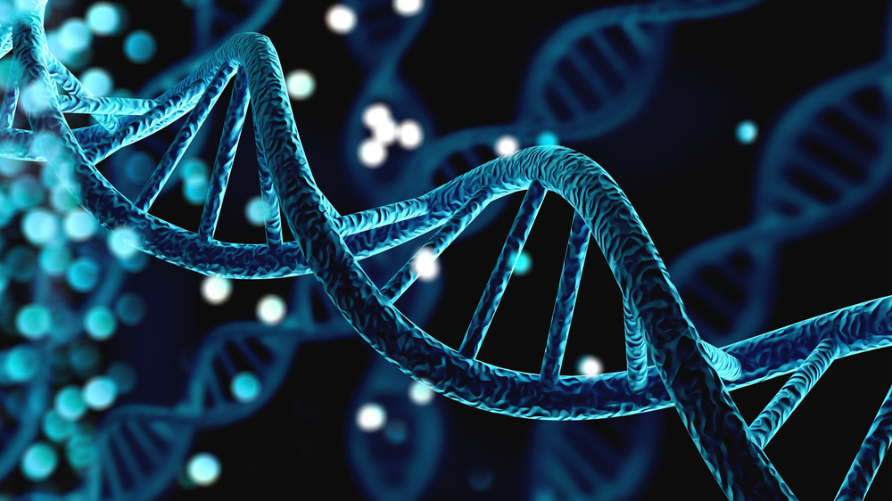
Motivation
Our target is the people who suffer from genetic disorders whether or not they were carriers to the mutated genes of the that specific disease
Their children may or may not inherit the same mutated gene from them and that is our main objective to hopefully help them detect those diseases in an early stage so some of those disorders can be treated professionally and hopefully won't be a problem then

Slide 8

Problem Statement
People are carrying genetic diseases can unwillingly transfer it to their children without both parents knowing
Some genetic diseases may not appear in an early stage and can be hard to treat when it is too late and it won’t be detected until the mutated gene appears and start attacking this child

Slide 9
Similar Systems
A paper in 2020 entitled ‘Early Prediction of Heart Disease Using PCA and Hybrid Genetic Algorithm with k-Means’ proposed a system that can detect heart disease in an early stage and had an accuracy of 94.06%.
Another paper in 2020 entitled ‘Early Detection of Alzheimer’s Disease Based on Single Nucleotide Polymorphisms (SNPs) Analysis and Machine Learning Techniques’ proposed a system that can predict the biomarkers in (AD) by detecting the SNPs and they had an accuracy of 97.97% % 95.88%.
Another paper in 2014 entitled ‘Early detection of type II Diabetes Mellitus with random forest and classification and regression tree (CART)’ proposed a system to detect type II diabetes using a ML to train a dataset.

Slide 10
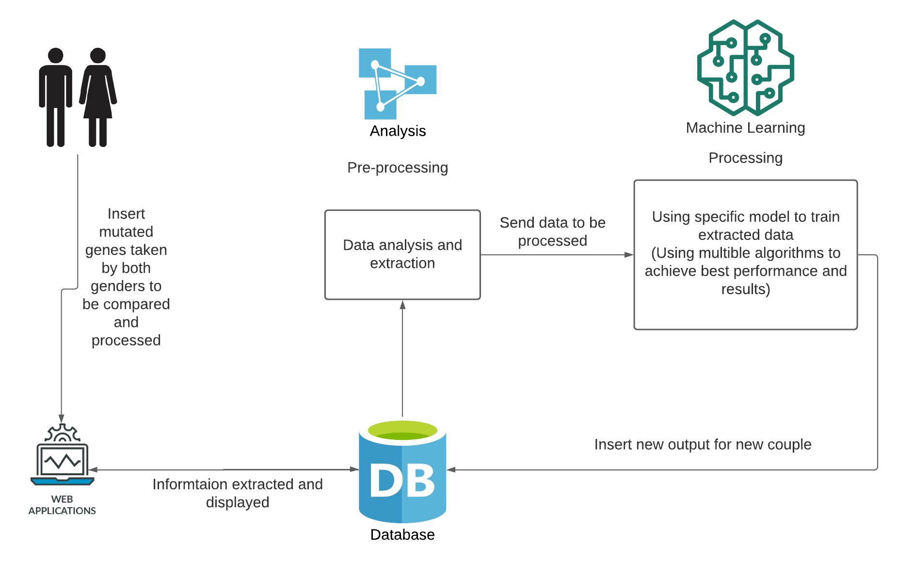
System Overview

Slide 11
Deliverables
Collect a useful dataset containing snippets of altered genes OR the entire genome of patients with genetic diseases.
Make a system that allows anyone to enter their entire genome or snippets of mutated genes.
Create a robust model for predicting genetic illnesses in future generations.
Deploy our software in the marketplace.

Slide 12
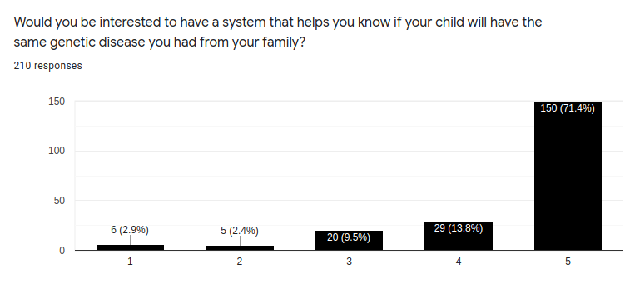
Supportive Documents SURVEY
we collected (210) responses in two days some people from Saudi Arabia, Dubai. Here is our statistics.

Slide 13
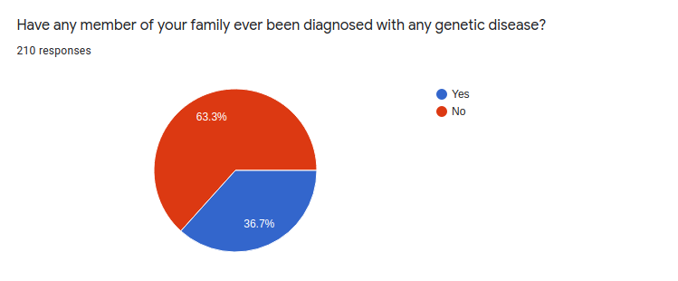
Supportive Documents (cont.) SURVEY

Slide 14
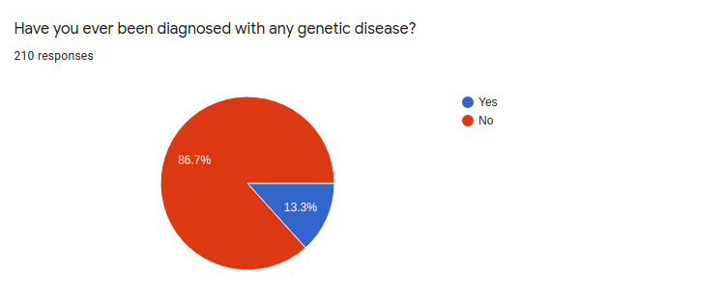
Supportive Documents (cont.) SURVEY

Slide 15
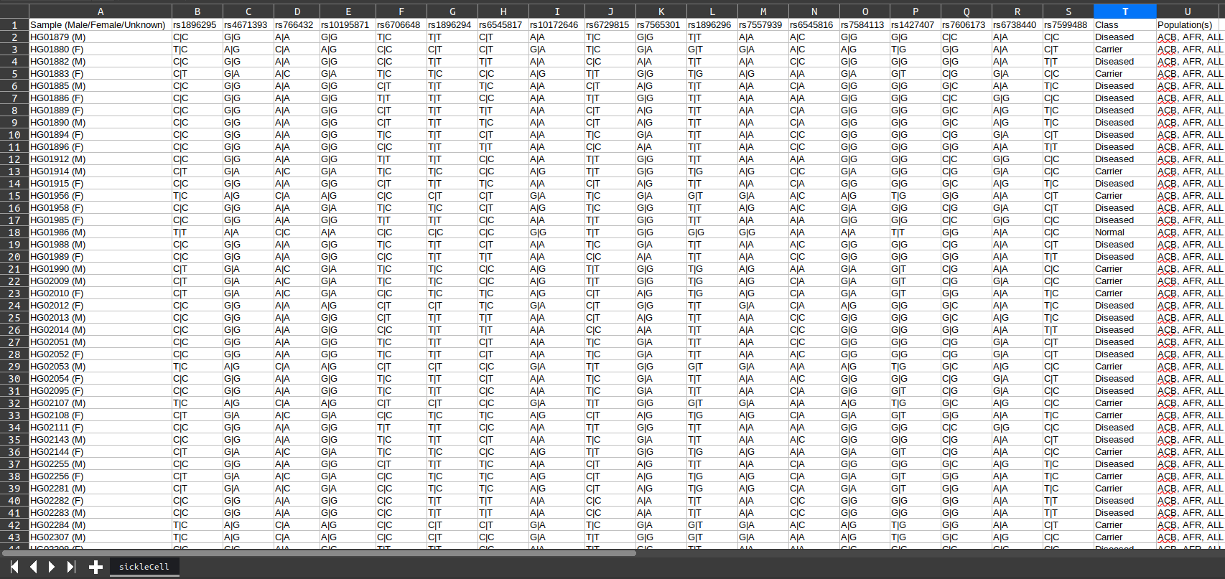
Data Set

Slide 16
Plan away (To Do)
Cross between males and each female in the data set.
Decide which male can marry which female.
Make the same steps on European data.
Make the cross between African and European people.
Create the same steps for other diseases.
Explore more about whole genome.

Slide 17
Live Demo

Slide 18
Thank You! :)
Any Questions?

Slide 19
References
https://ieeexplore.ieee.org/abstract/document/7005947
https://ieeexplore.ieee.org/abstract/document/9325640
https://ieeexplore.ieee.org/abstract/document/9392655
https://www.ncbi.nlm.nih.gov/books/NBK22266/
https://pubmed.ncbi.nlm.nih.gov/27022141/
https://pubmed.ncbi.nlm.nih.gov/33100714/https://pubmed.ncbi.nlm.nih.gov/27022141/
https://www.ncbi.nlm.nih.gov/snp/rs7565301

