Slide 1
Genetics
Kareem ehab and Ahmed Gamal

Slide 2
Problem we are solving
Proof of parentage, Some parents suffer from the process of paternity testing when they are being sued for child custody.
People get sick from time to time, As they have to make lab Tory test to determine what kind of diagnose or disease they suffer from where the results takes a lot of time to come out

Slide 3
System overview
Our system compares compares the whole exome in every child with the whole exome in parents.
Our system predicts the disease by taking from whole exome of father and the whole exome of mother and predict the upcoming disease for the new generations.

Slide 4
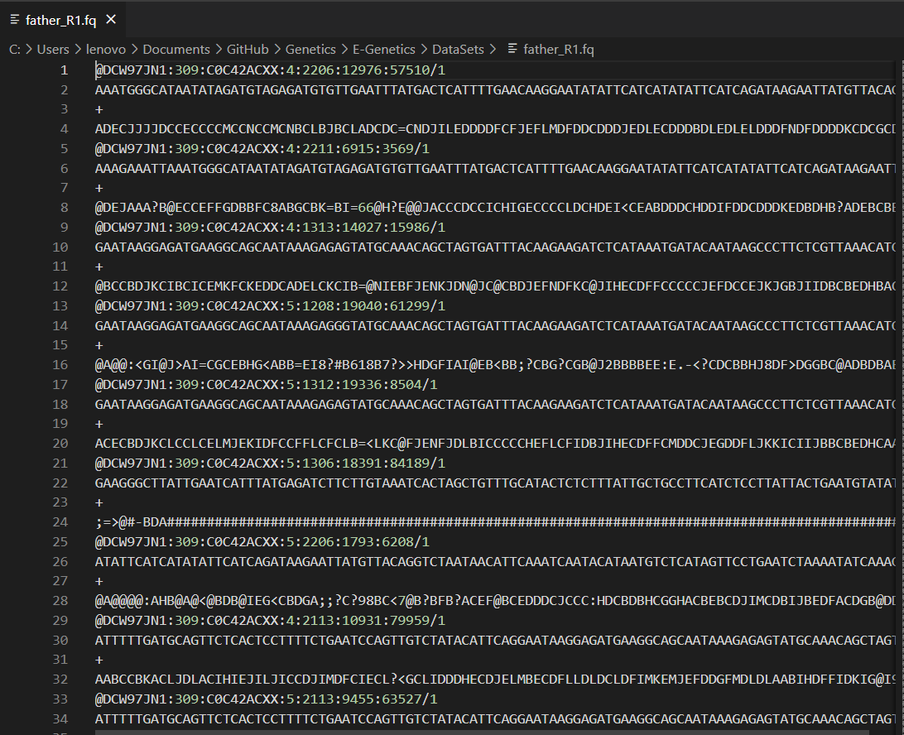
dataset

Slide 5
THANK YOU

