Slide 1
Genetics
Kareem Ehab, Mohamed Moataz, Youssif Assem, Ahmed Gamal

Slide 2
Agenda
Introduction
Motivation
Problem Statement
Similar Systems
System Overview
Deliverables
Time plan
Supportive Documents
Live Demo
References

Slide 3
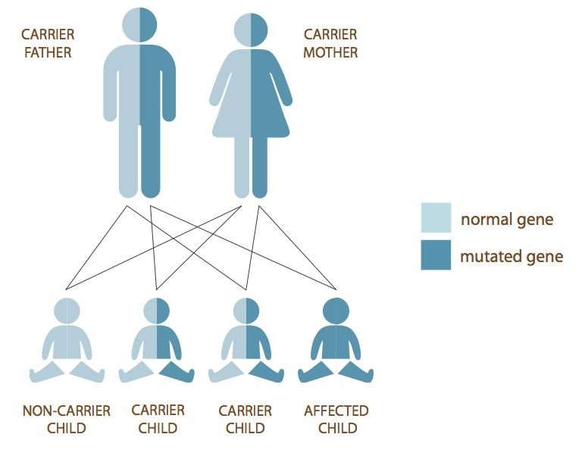
Introduction
DNA contains genes and every gene converts to a protein, this protein leads to create a function that affects the body
Both Parents may carry a gene and may be inactive (Carriers)
Every gene represents a number of letters (A, T, C, G)
Any changes of the order those letters leads to the actual protein to be changed which leads to the disease appearing.

Slide 4
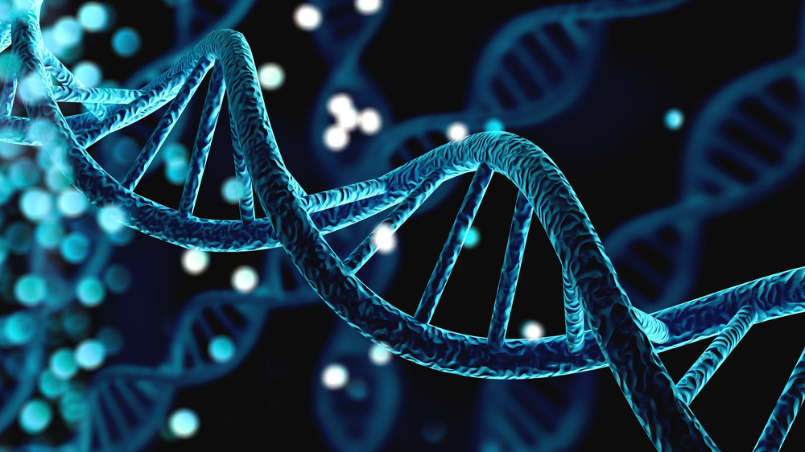
Motivation
Our target is the people who suffer from genetic disorders whether or not they were carriers to the mutated genes of the that specific disease
Their children may or may not inherit the same mutated gene from them and that is our main objective to hopefully help them detect those diseases in an early stage so some of those disorders can be treated professionally and hopefully won't be a problem then

Slide 5
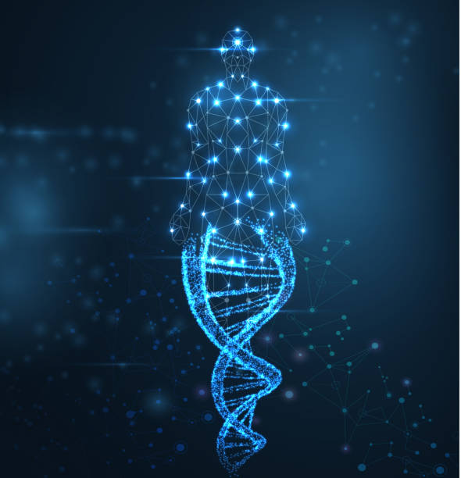
Problem Statement
People are carrying genetic diseases can unwillingly transfer it to their children without both parents knowing
Some genetic diseases may not appear in an early stage and can be hard to treat when it is too late and it won’t be detected until the mutated gene appears and start attacking this child

Slide 6
Similar Systems
A paper in 2020 entitled ‘Early Prediction of Heart Disease Using PCA and Hybrid Genetic Algorithm with k-Means’ proposed a system that can detect heart disease in an early stage and had an accuracy of 94.06%.
Another paper in 2020 entitled ‘Early Detection of Alzheimer’s Disease Based on Single Nucleotide Polymorphisms (SNPs) Analysis and Machine Learning Techniques’ proposed a system that can predict the biomarkers in (AD) by detecting the SNPs and they had an accuracy of 97.97% % 95.88%.
Another paper in 2014 entitled ‘Early detection of type II Diabetes Mellitus with random forest and classification and regression tree (CART)’ proposed a system to detect type II diabetes using a ML to train a dataset.

Slide 7
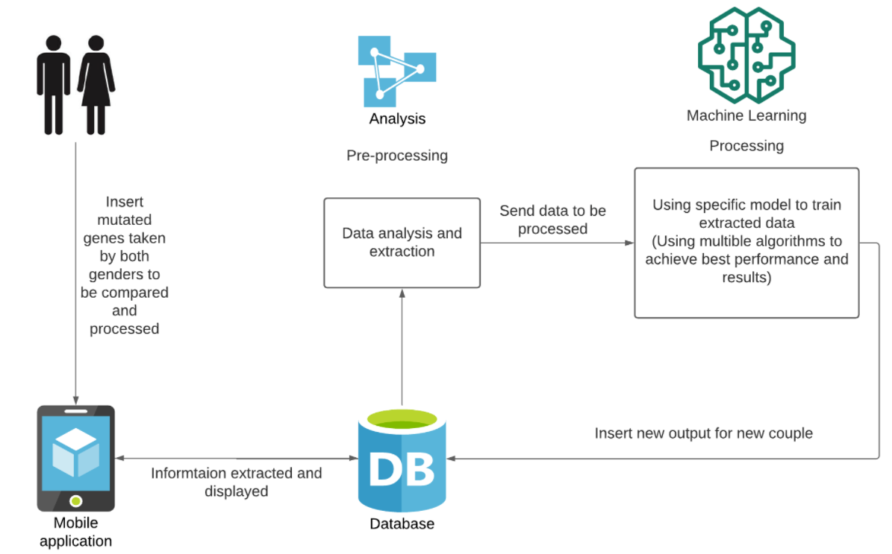
System Overview

Slide 8
Deliverables
Collect a useful dataset containing snippets of altered genes OR the entire genome of patients with genetic diseases.
Make a system that allows anyone to enter their entire genome or snippets of mutated genes.
Create a robust model for predicting genetic illnesses in future generations.
Deploy our software in the marketplace.

Slide 9



Tasks and Timeplan
To do
Collect new dataset
Finish Pre-processing the dataset
Planning the first image to the interface and GUI

Slide 10
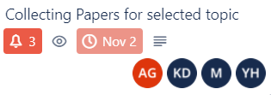
Tasks and Timeplan (cont.)
Doing
collecting papers

Slide 11
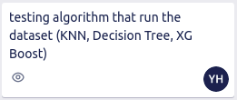
Tasks and Timeplan (cont.)
Testing
testing several algorithms to run the dataset (KNN, Decision tree, XGBoost)

Slide 12




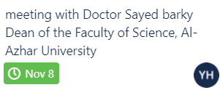

Tasks and Timeplan (cont.)
Done
Meeting with several doctors to help with the dataset

Slide 13
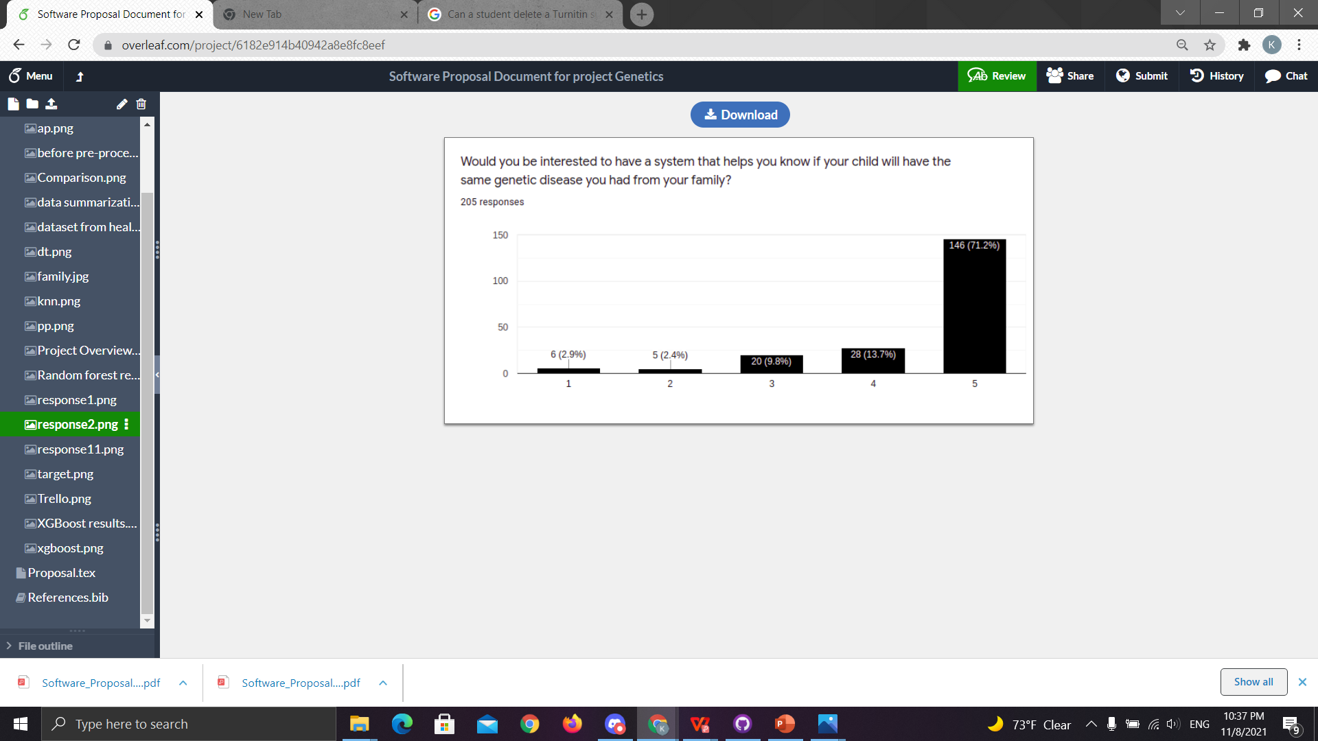
Supportive Documents SURVEY
we collected (205) responses in two days some people from Saudi Arabia, Dubai. Here is our statistics.

Slide 14
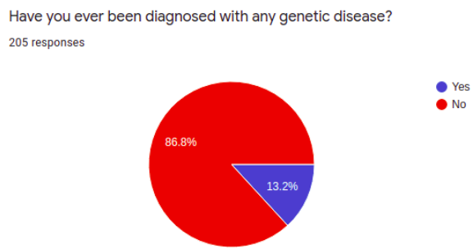
Supportive Documents (cont.) SURVEY

Slide 15
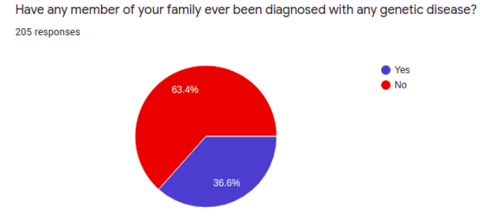
Supportive Documents (cont.) SURVEY

Slide 16
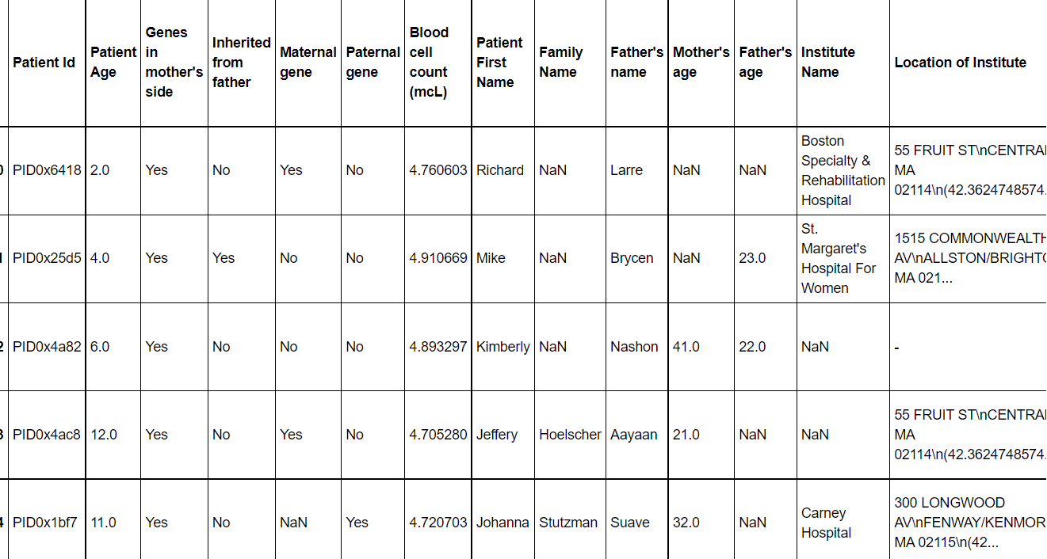
Supportive Documents (cont.) DATASET

Slide 17
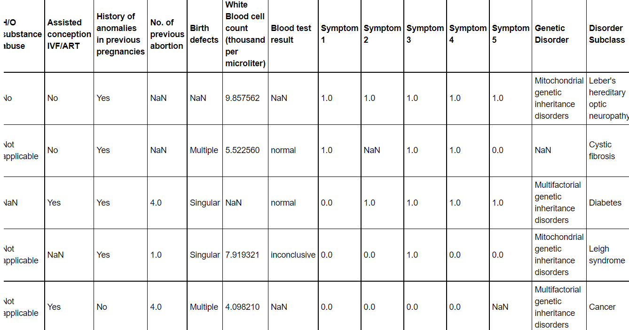
Supportive Documents (cont.) DATASET

Slide 18
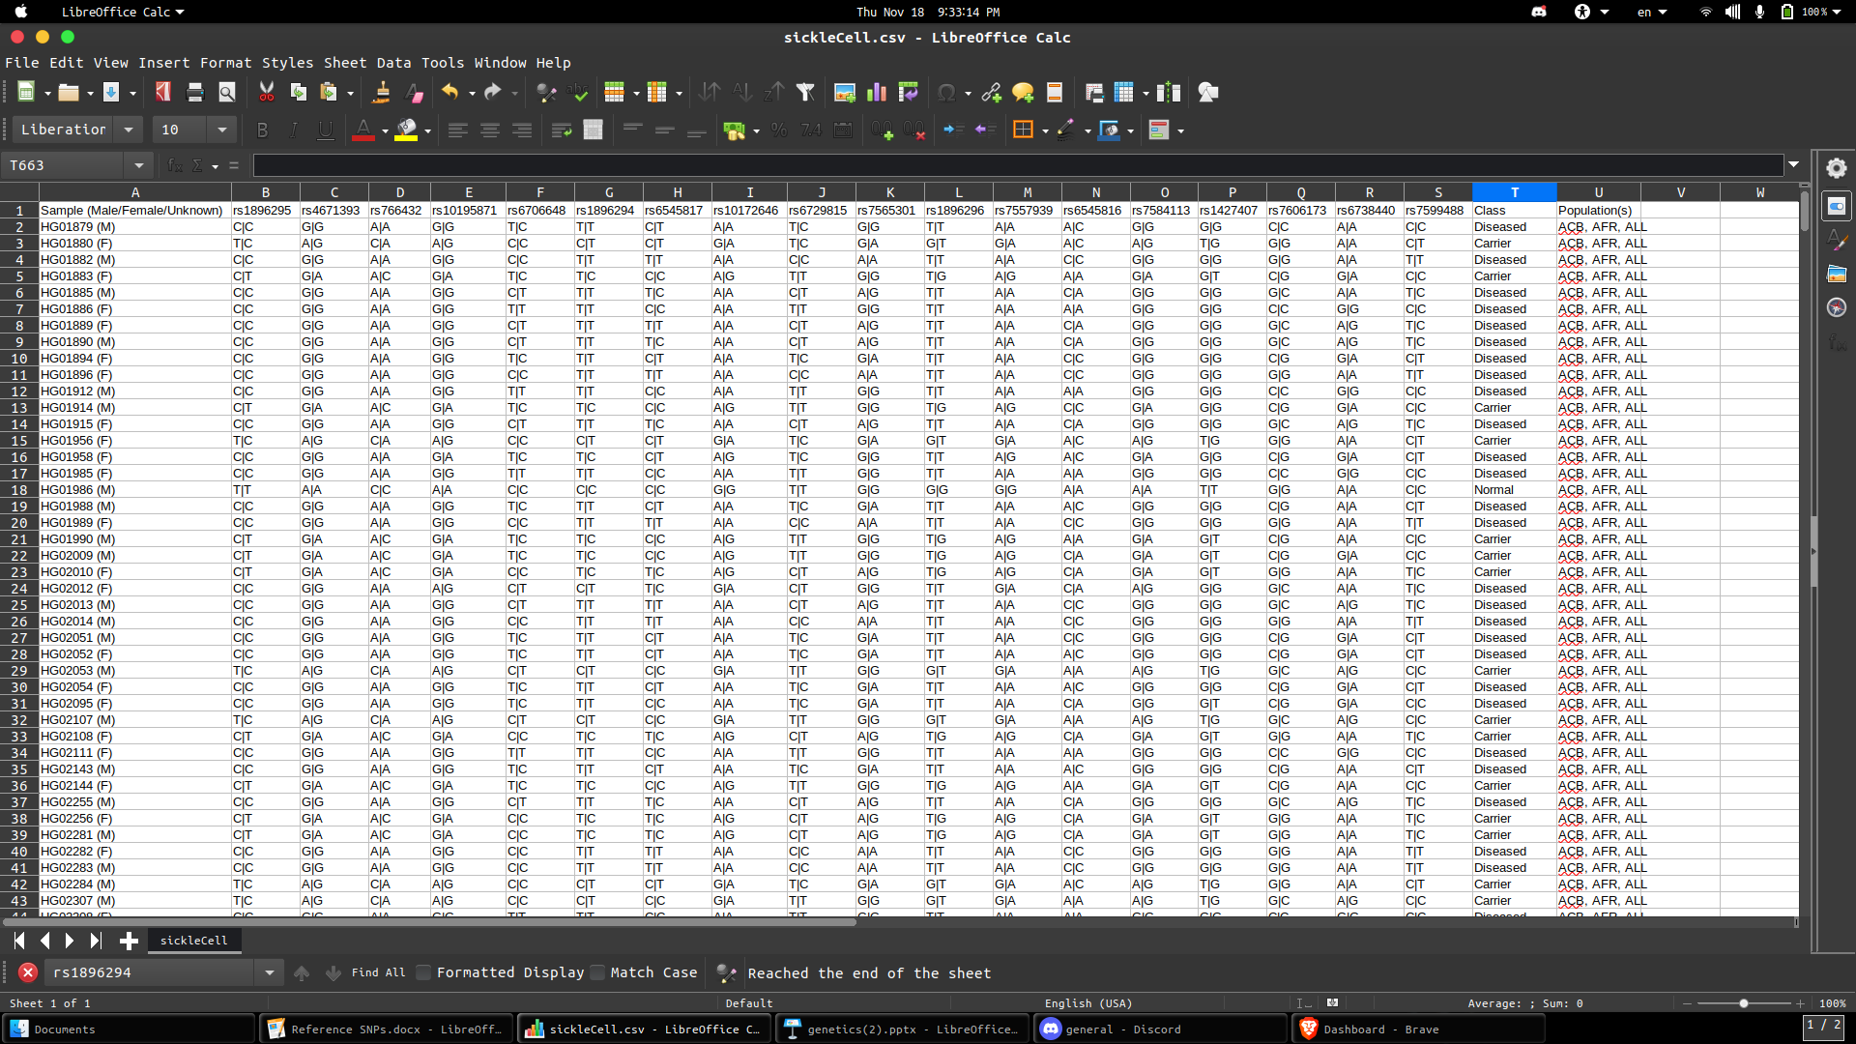
New DATASET

Slide 19
Live Demo

Slide 20
Any Questions?
Thank You! :)

Slide 21
References
https://ieeexplore.ieee.org/abstract/document/7005947
https://ieeexplore.ieee.org/abstract/document/9325640
https://ieeexplore.ieee.org/abstract/document/9392655

