Slide 1

Paternity Testing Using Genetics
1
Youssif Assem, Kareem Ehab, Mohamed Moataz, Mohamed Akram, Ahmed Gamal Supervised By : Dr. Ashraf Abdel Raouf, Eng. Ahmed Hazem, Eng. Mahmoud El Sahhar

Slide 2
Agenda
2
Introduction
Related Work
Problem Statement
System Overview
Approach
Dataset
Experiments/Results
Contributions
Achievements
Customer Feedback
Demo

Slide 3
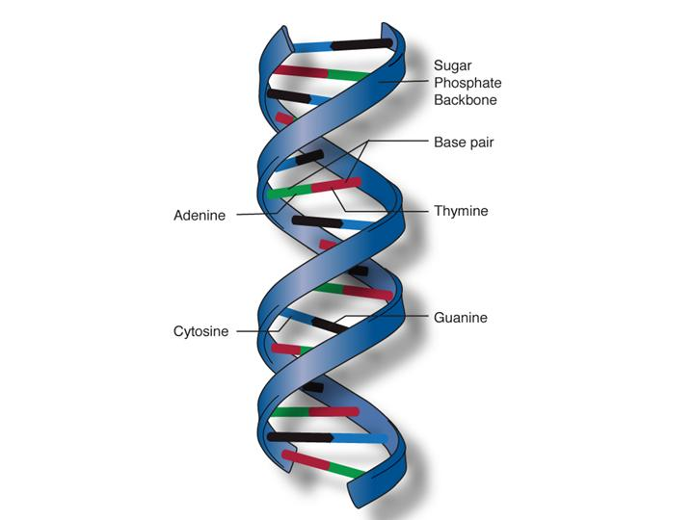
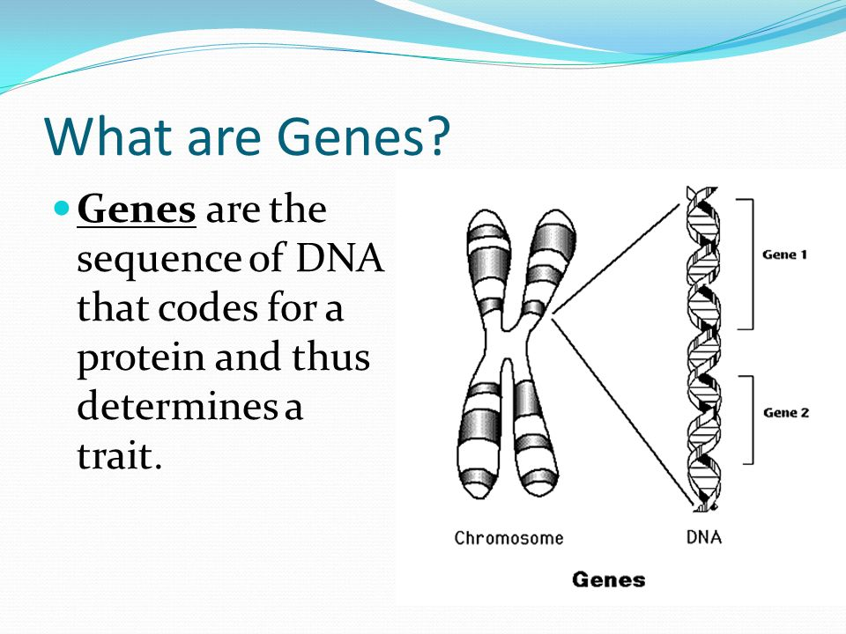
Introduction
2
DNA
DNA molecules allow some of our characteristics to be passed down from our generation to the next (our children)
Genes → Genes are passed from parents to offspring and contain the information needed to specify traits(qualities). Genes contains a subset of the DNA and this subset is (A, T, C, G).

Slide 4
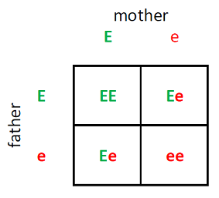
Introduction
4
What is an Rs number ?
It is a unique reference number to the gene we have that consists of two alleles (one from the father and the other from the mother).
What are Alleles ?
Each allele consists of two characters that represent the gene sequence repeats of characters (one from father and another one from mother)
RsNumber | Father | Mother | Child1 | Child2 | Child3
rs3131972 | AG | GG | AG | GG | GG

Slide 5
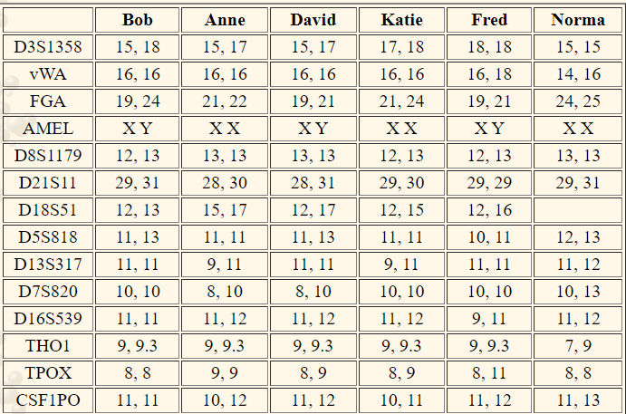
Introduction
5
What is our whole genome ?
It is the whole DNA sequence that a human have in their system.
It consists of the four nucleotides which can be represented in four characters (A,C,T,G).
Each number in the Table represents the repeats of nucleotide.
Ex:
ATCGATCGATCGATCGATCGATCGATCGATCGATCGATCG

Slide 6
Related Work
6
There are multiple systems that are similar to ours such:
Masataka .T. in a paper entitled “R scripts for kinship testing” proposed a method using R scripts to determine paternity because of its strong statistical power and used many test cases in their study including the trio case (mother, alleged father, child)
Andrzej .D et in a paper entitled “Confirmation of Paternity despite Three Genetic Incompatibilities at Chromosome 2” proposed a study to confirm the determination of kinship analysis using rs numbers between the data of (mother, alleged father, child)

Slide 7

Problem Statement
6
There are many homeless children in the street, in orphanages, and we don’t know what family they are related to. Many families lose their children and they can’t find them again. On the other hand, numerous fathers deny the paternity of their children. So, we aim to create a system that will solve these different problems by applying Mendelian’s law on rs numbers and applying the STR algorithm on the whole genome. So we can have a system that could save time from the exhausting procedures in child custody cases

Slide 8
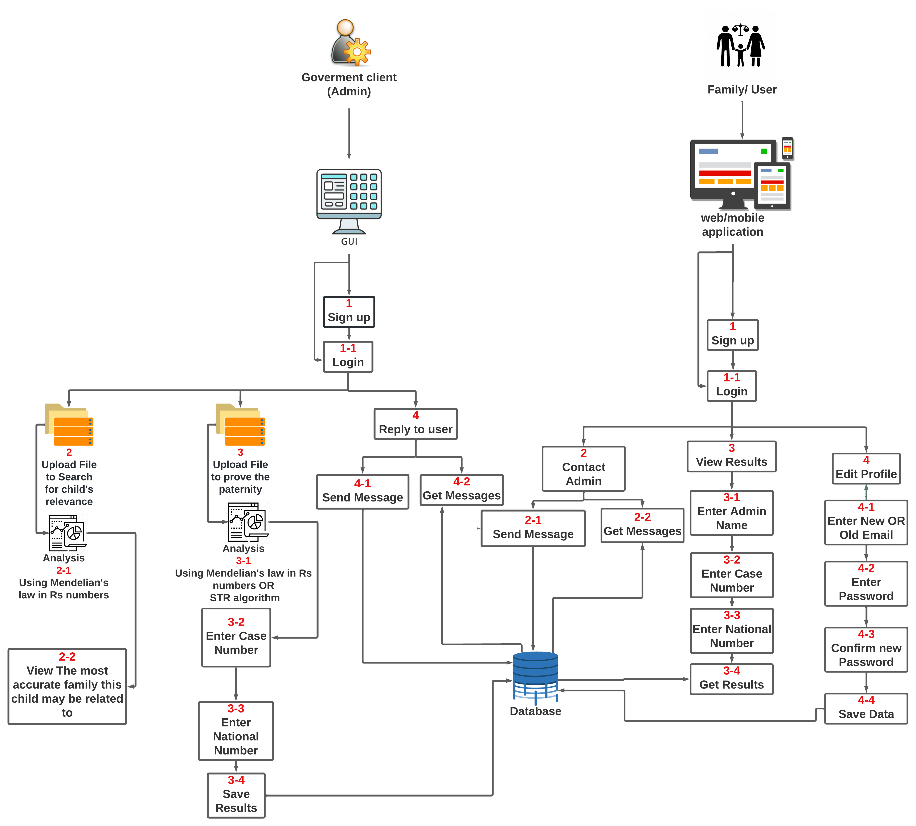
System Overview
8

Slide 9
Approach
9
Our system can be divided into three approaches that works with dynamic programming:
Applying Mendelian's Law to prove paternity to find whether or not the child is related to the targeted father or not by comparing different rs numbers with each other and collect a final probability
For the relevance part we use the same method but compare the child with other people from other families using rs numbers to collect the highest probability possible to determine whether or not the child is a relative to this family member or not
Third approach is by using short tandem repeat algorithm to count the repeated nucleotides in the whole exome in each member of the family (mother, father , child) and compare them with each other

Slide 10
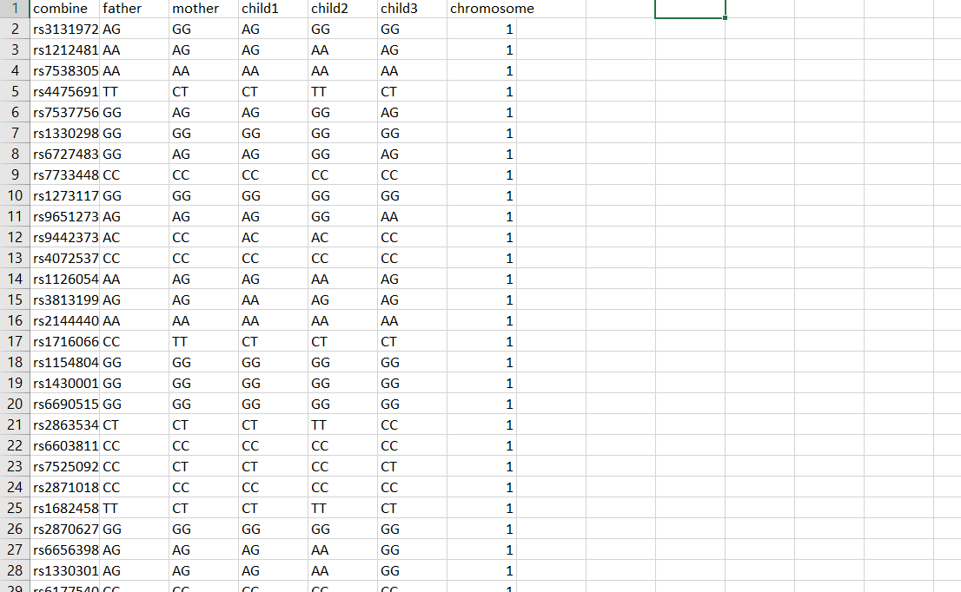
Dataset
10
Our dataset has over 100000 instances of Rs numbers and consists of 6 main features showing both alleles for every family member and the number of chromosome for each instance
The dataset was collected from Kaggle
Our dataset name: Family of five
https://www.kaggle.com/datasets/zusmani/family-genome-dataset

Slide 11
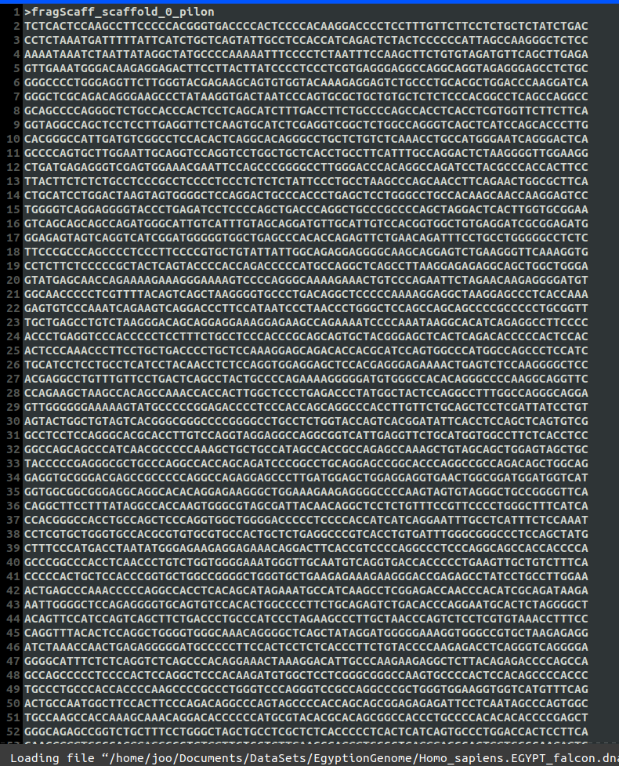
Dataset
11
In the whole exome the process to determine paternity is somewhat different There exists a specific repeat that we are looking for ex: D7S280 --> GATA counting the number of those repeats and then comparing it with the number of repeats in the mother and father

Slide 12
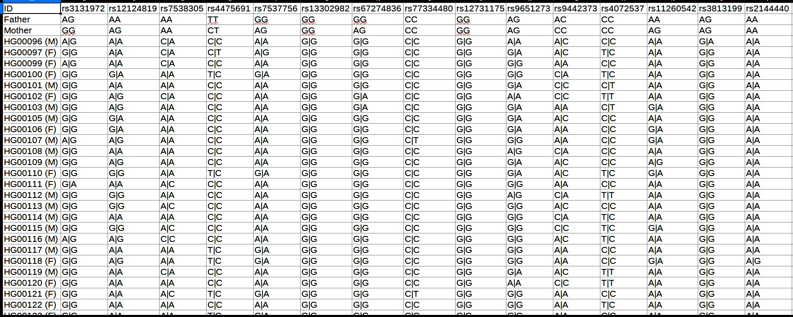
Dataset
<number>
The second dataset we are using contains 40 rs numbers for over 2000 different people.
The use of this dataset is to find out the highest probability that we can acquire from those people when comparing each one of those alleles to the child.
The highest probability = Highest similarity that the targeted child is indeed related to this member of this family which means this child is a relative to this member of the family

Slide 13
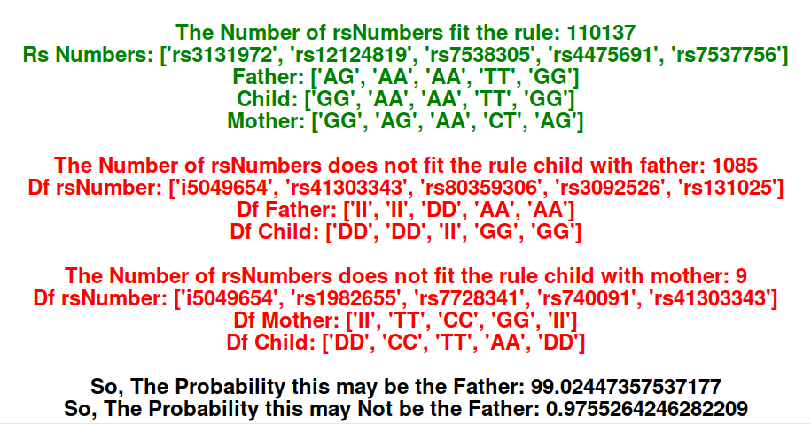
Experiments and results
<number>
With the first approach in the system we compared more than 10000 rs numbers using Mendalian’s law between the three children and the father and collected a final probability proving he is the true father for three children.
Green Color → Represents the rs numbers and alleles that apply the Mendelian's law which means (child's alleles are indeed inherited from father and mother)
Red Color → Represents the rs numbers and alleles that doesn’t apply the Mendelian’s law which means (child's alleles aren't inherited from father and mother)
Black Color → Represents the probability of how much this child may be related to this father.

Slide 14
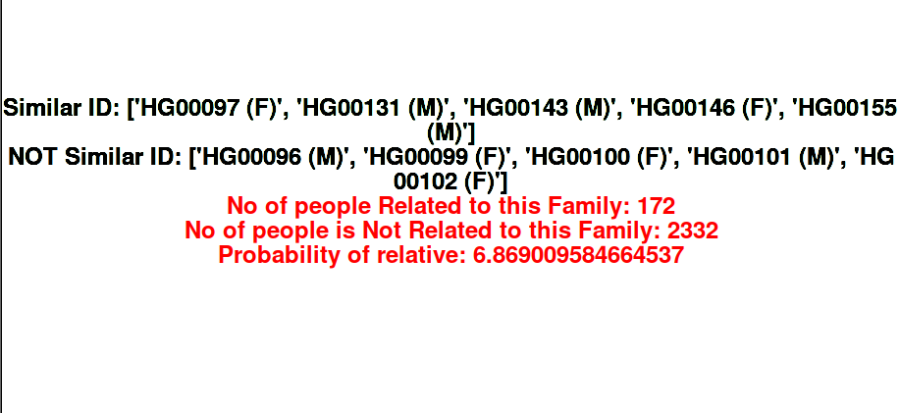
Experiments and results
<number>
With the next approach that is used for relevance and kinship analysis we collected 40 rs numbers from more than 2000 families and comparing the those rs numbers with a random child (that may be an orphan or homeless) using Mendalian’s law to collect the highest probability possible to determine a relevancy between a child and a specific family or relative
Black Color → IDs of children that are related and not related to the family
Red Color → Represents the statistics of how many people from the dataset are related to the child, how many people are not related to the child

Slide 15
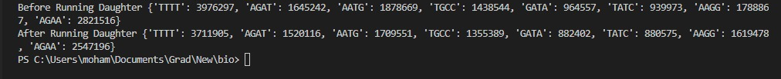
Experiments and results
<number>
With our approach we use short tandem repeats to prove paternity by counting both the repeats of the child and father and comparing them with each other to deliver a final probability to prove whether or not this is the true father or not

Slide 16
Contributions
<number>
We managed to propose a new approach for paternity testing using rs numbers and whole exome and inherit a new way to prove relevancy between different parents and orphaned/homeless children to help them find their true parents or even a relative of their actual family.
We successfully managed to be a part of IEEE conference (2nd International Mobile, Intelligent, and Ubiquitous Computing Conference) with our research paper entitled:
An optimized approach for Paternity Testing using rs numbers and whole genome

Slide 17
Achievements
<number>
We have accomplished many achievements throughout the project’s timeline such
We have also managed to finish the project’s requirements and milestones on time which are:
Prove paternity testing by rs numbers using Mendelian's law of inheritance.
Prove relevance and kinship analysis using rs numbers
Prove paternity by counting short tandem repeats in the whole exome
We have also successfully managed to publish our research paper on the IEEE website DOI: 10.1109/MIUCC55081.2022.9781722

Slide 18
Customer Feedback
<number>

Slide 19
Demo
<number>

Slide 20
<number>
Thank You
Any Questions ? ☺

