Slide 1
Genetics
Youssif Assem, Mohamed Moataz

Slide 2
AGENDA
Introduction
Problem Statement
Our Objectives
System Overview
Use-case Diagram
Functional Requirements
Non-Functional Requirements
Class Diagrams
Data Design (Database & Dataset)
Live Demo

Slide 3
Introduction
What is an rsNumebr?
It is a reference number to the genotype we have that consists of two alleles (one from the father and the other from the mother).
EX:
RsNumber Genotype
Rs983612 AA

Slide 4
Introduction (cont.)
Meanings of whole genome and whole exome.
It is the whole DNA sequence that a human have in their system.
It is a part of the whole genome and makes up only 1.5% of it and it may reveal information about family relationships (ex: paternity test)

Slide 5
Problem Statement
Some parents suffer from the process of paternity testing when they are being sued for child custody.
A lot of time when a crime happens, some DNA would be left at the crime scene and would take some time to be processed and eventually lead us to the one who committed that crime.
Why can’t we have a system that could potentially prove this in less time and be accessible to everyone.

Slide 6
Our Objectives
Make an automated system to accurately prove parentage of someone by their rsnumbers and their genotypes.
The same system could apply to other platforms such

Slide 7
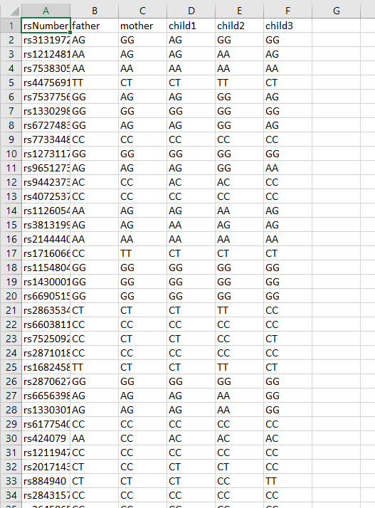
System overview
Our system compares every allele in every child with the alleles in both parents in the same rs number.
Our system can detect whether or not that’s there child or not.
We aim that the user can input their alleles and our app can tell them which gene belong to whom.

Slide 8
Use-cases diagram

Slide 9
Functional requirements

Slide 10
Non functional requirements

Slide 11
Class diagrams

Slide 12
Data design (database & dataset)

Slide 13
Live demo

Slide 14
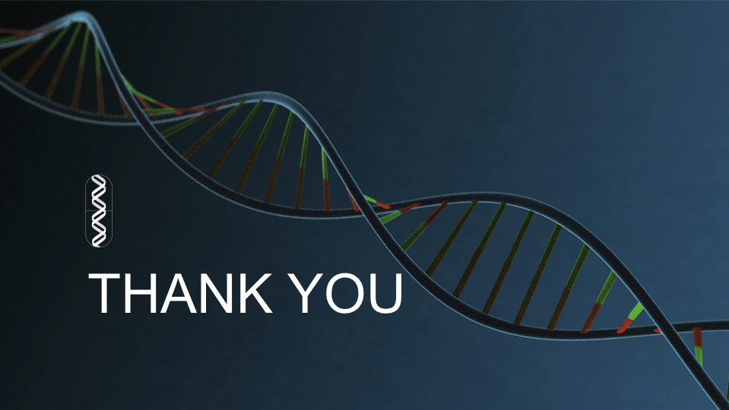
ANY QUESTIONS ? ☺

