Slide 1
Genetics
Youssif Assem Mohamed Moataz Kareem Ehab Ahmed Gamal
<number>

Slide 2
Agenda
Introduction
Motivation
Problem Statement
Similar Systems
System Overview
Deliverables
Time plan
Supportive Documents
Live Demo
References
<number>

Slide 3
Genetics
Genetics → Is a project that will predict the genetic diseases that will appear in the new generations(offspring). In addition it can also help us prove the parentage of anyone. Both can be done by studying the genes in someone's body (system).
Genes →Genes are passed from parents to offspring and contain the information needed to specify traits(qualities). Genes contains a subset of the DNA and this subset is (A, T, C, G).
<number>

Slide 4
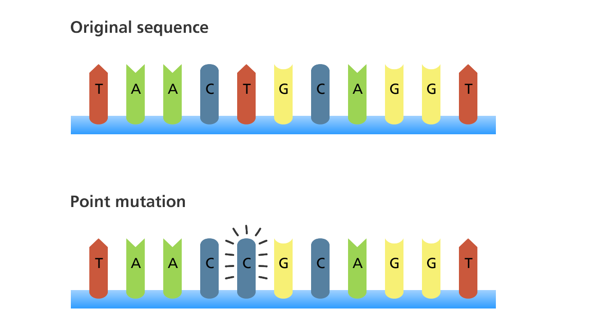
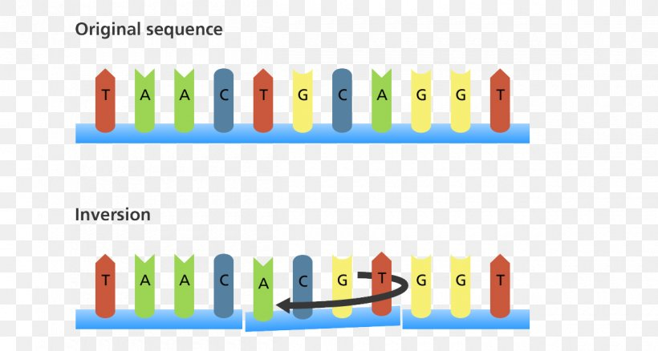
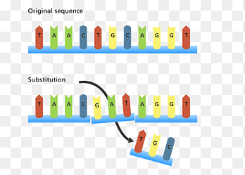
Genes Mutation
Point mutation
Inversion
Substitution
<number>

Slide 5
Alleles and Genes
rs1896295 | rs4671393 | rs10195871 | rs7565301
Normal T|T | Normal A|A | Normal A|A | Normal G|G
Carrier T|C | Carrier A|C A|G A|T | Carrier A|G A|T | Carrier G|A G|T
Diseased C|C | Diseased C|C | Diseased G|G | Diseased A|A T|T
Gene Name BCL11A | Gene Name BCL11A | Gene Name BCL11A | Gene Name BCL11A
Chromosome no 11 | Chromosome no 11 | Chromosome no 11 | Chromosome no 2
<number>

Slide 6
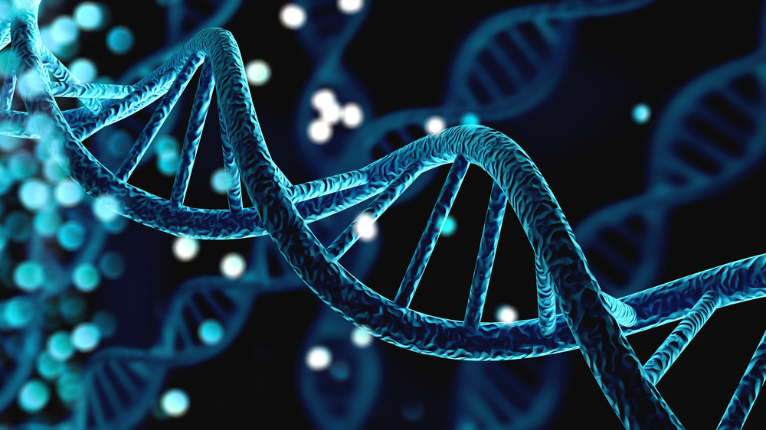
Motivation
Our target is to help people who suffer from genetic disorders whether or not they were carriers to the mutated genes of the that specific disease.
Their children may or may not inherit the same mutated gene from them and that is our main objective to hopefully help them detect those diseases in an early stage so some of those disorders can be treated professionally and hopefully won't be a problem then.
<number>

Slide 7
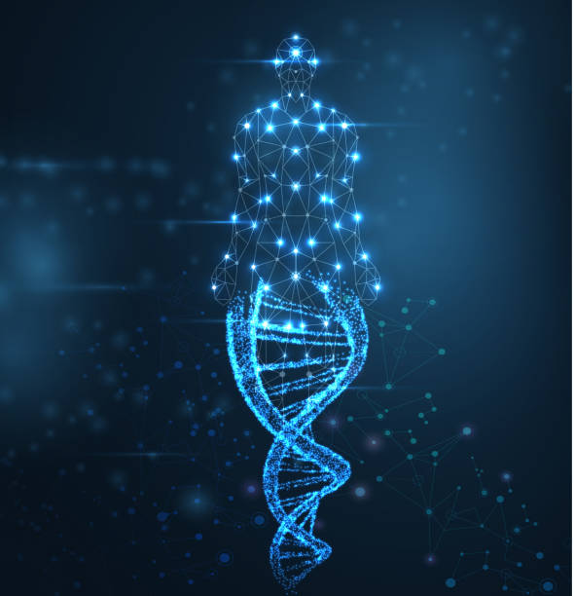
Problem Statement
People are carrying genetic diseases can unwillingly transfer it to their children without both parents knowing
Some genetic diseases may not appear in an early stage and can be hard to treat when it is too late and it won’t be detected until the mutated gene appears and start attacking this child
<number>

Slide 8
Similar Systems
Paper by Md. Touhidul Islam LA (3) in 2020 entitled ‘Early Prediction of Heart Disease Using PCA and Hybrid Genetic Algorithm with k-Means’ proposed a system that can detect heart disease in an early stage and had an accuracy of 94.06%.
Another paper by Hala Ahmed LA (2) in 2020 entitled ‘Early Detection of Alzheimer’s Disease Based on Single Nucleotide Polymorphisms (SNPs) Analysis and Machine Learning Techniques’ proposed a system that can predict the biomarkers in (AD) by detecting the SNPs and they had an accuracy of 98.1%, 97.97% % 95.88%, 83%.
Another paper by Mira Kania Sabariah, MT LA (1) in 2014 entitled ‘Early detection of type II Diabetes Mellitus with random forest and classification and regression tree (CART)’ proposed a system to detect type II diabetes using a ML to train a dataset, achieved accuracy of 83.8%.
<number>

Slide 9
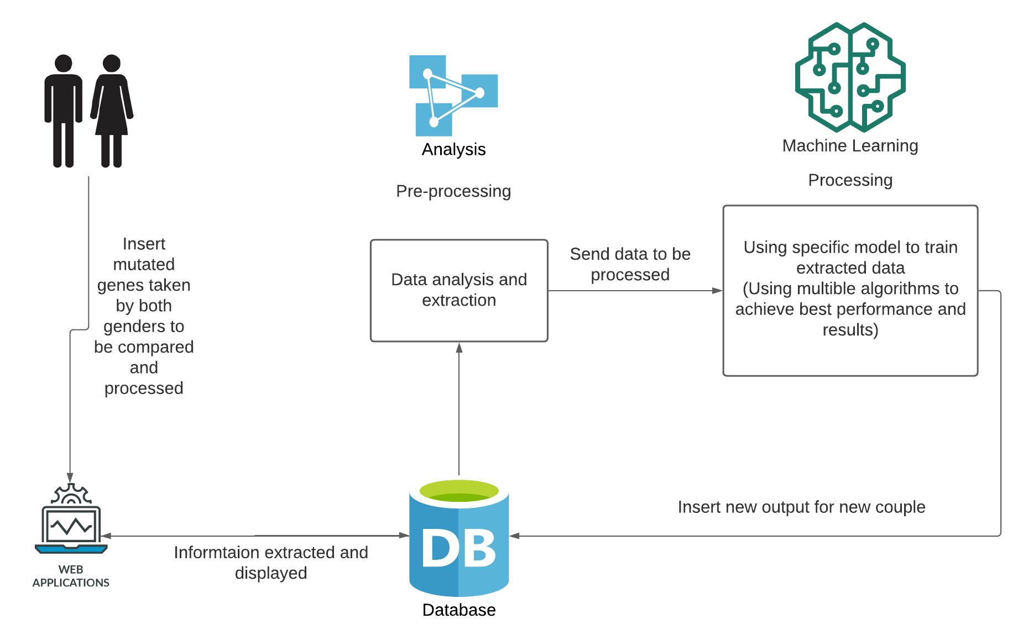
System Overview
<number>

Slide 10
Deliverables
Collect a useful dataset containing snippets of altered genes OR the entire genome of patients with genetic diseases.
Make a system that allows anyone to enter their entire genome or snippets of mutated genes.
Create a robust model for predicting genetic illnesses in future generations.
Deploy our software in the marketplace.
<number>

Slide 11
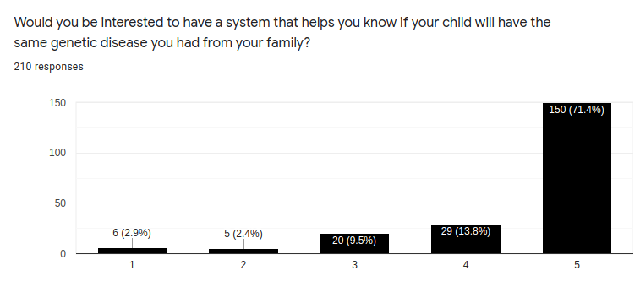
Supportive Documents SURVEY
we collected (210) responses in two days some people from Saudi Arabia, Dubai. Here is our statistics.
<number>

Slide 12
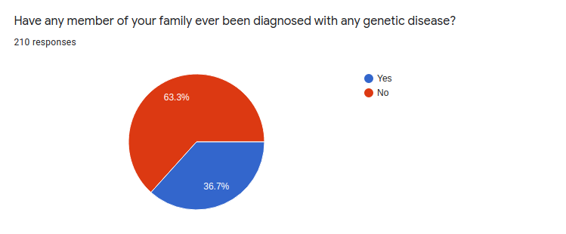
Supportive Documents (cont.) SURVEY
<number>

Slide 13
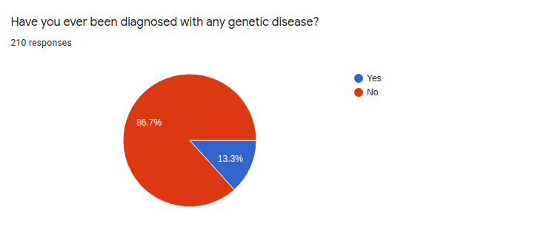
Supportive Documents (cont.) SURVEY
<number>

Slide 14
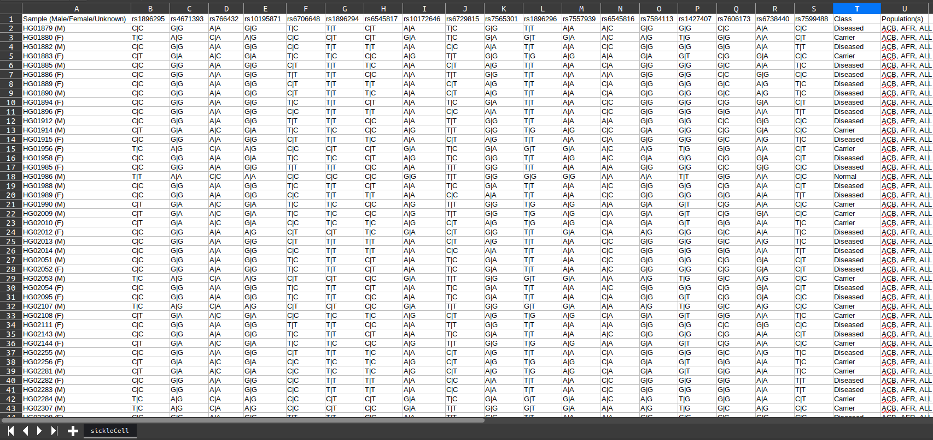
Data Set
<number>

Slide 15
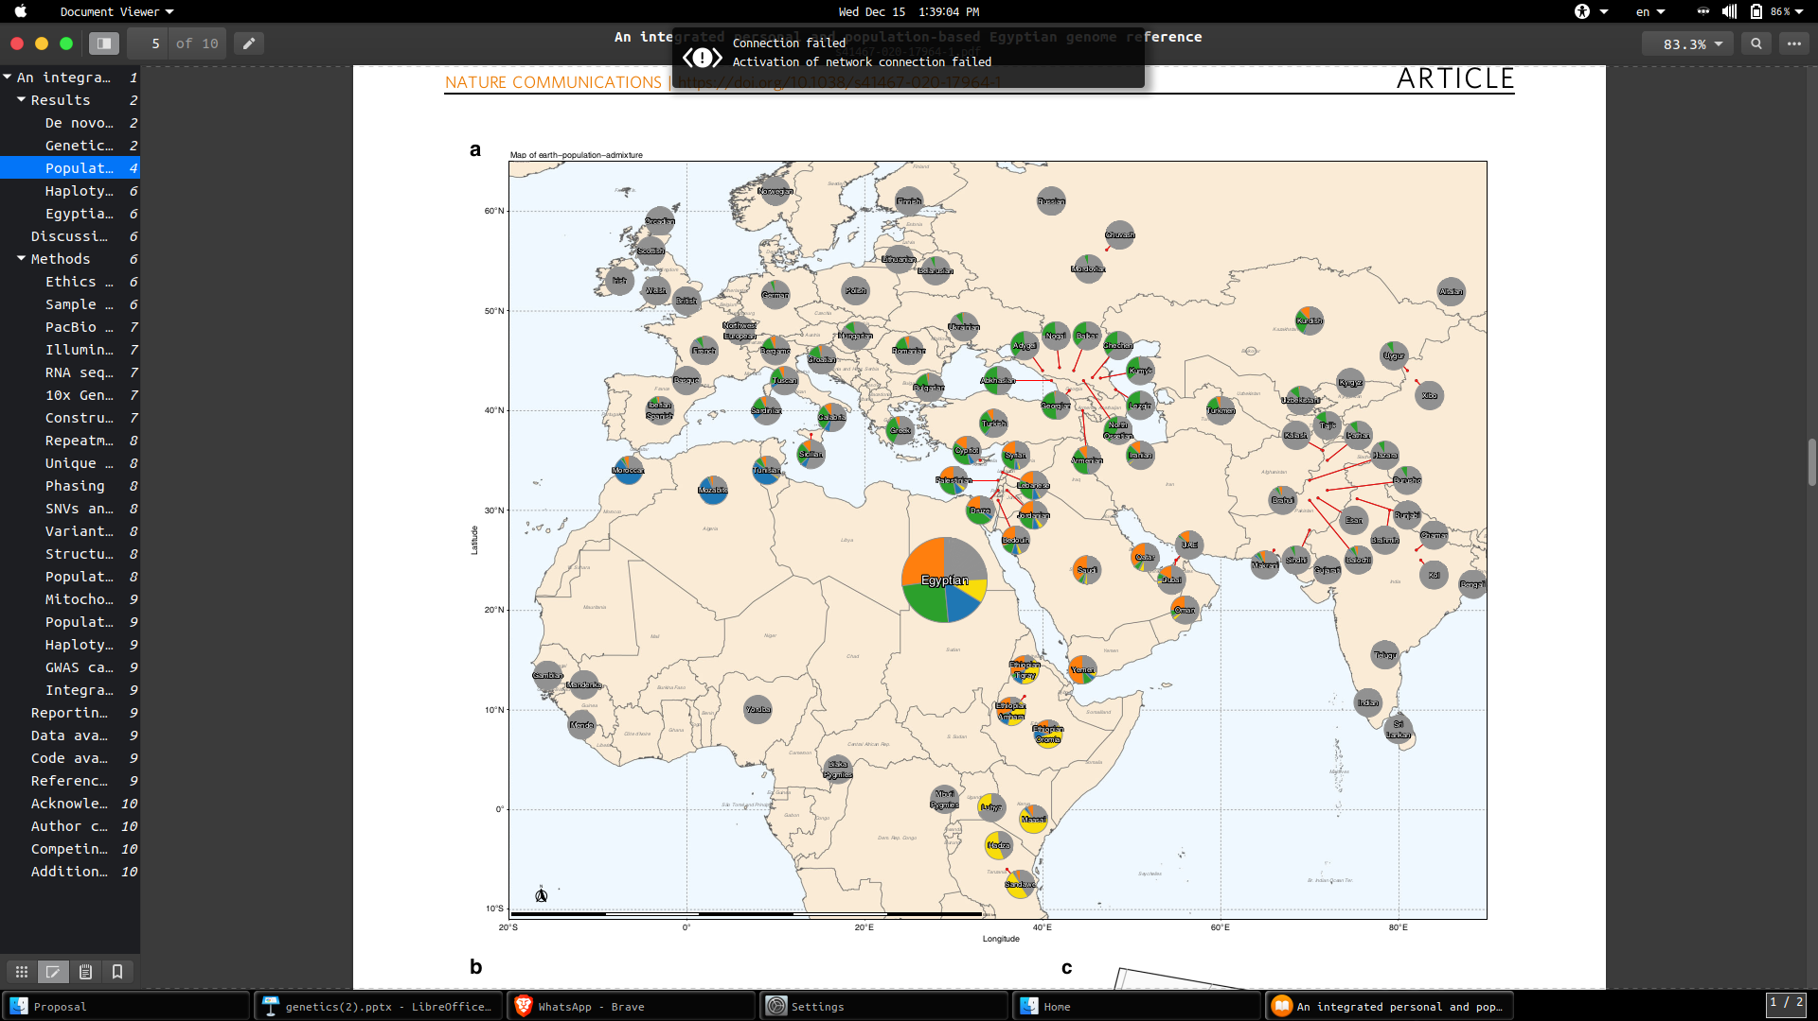
Plan away (To Do)
Cross between males and each female in the data set.
Decide which male can marry which female.
Make the same steps on European data.
Make the cross between African and European people.
Create the same steps for other diseases that are similar to sickle cell like Thalassemia.
Explore more about whole genome for creating the proof of parentage.
Include the Egyptian genome seeing that our genome has been affected by other races throughout centuries.
<number>

Slide 16
Live Demo
<number>

Slide 17
Thank You! :)
Any Questions? :)
<number>

Slide 18
References
1-https://ieeexplore.ieee.org/abstract/document/7005947
2- https://ieeexplore.ieee.org/abstract/document/9325640
3- https://ieeexplore.ieee.org/abstract/document/9392655
https://www.ncbi.nlm.nih.gov/books/NBK22266/
https://pubmed.ncbi.nlm.nih.gov/27022141/
https://pubmed.ncbi.nlm.nih.gov/33100714/https://pubmed.ncbi.nlm.nih.gov/27022141/
https://www.ncbi.nlm.nih.gov/snp/rs7565301
https://www.ensembl.org/Homo_sapiens/Phenotype/Locations?db=core;ph=75099;r=2:60494405-60495405;v=rs6706648;vdb=variation;vf=18440112https://www.nature.com/articles/s41467-020-17964-1
<number>

