Slide 1

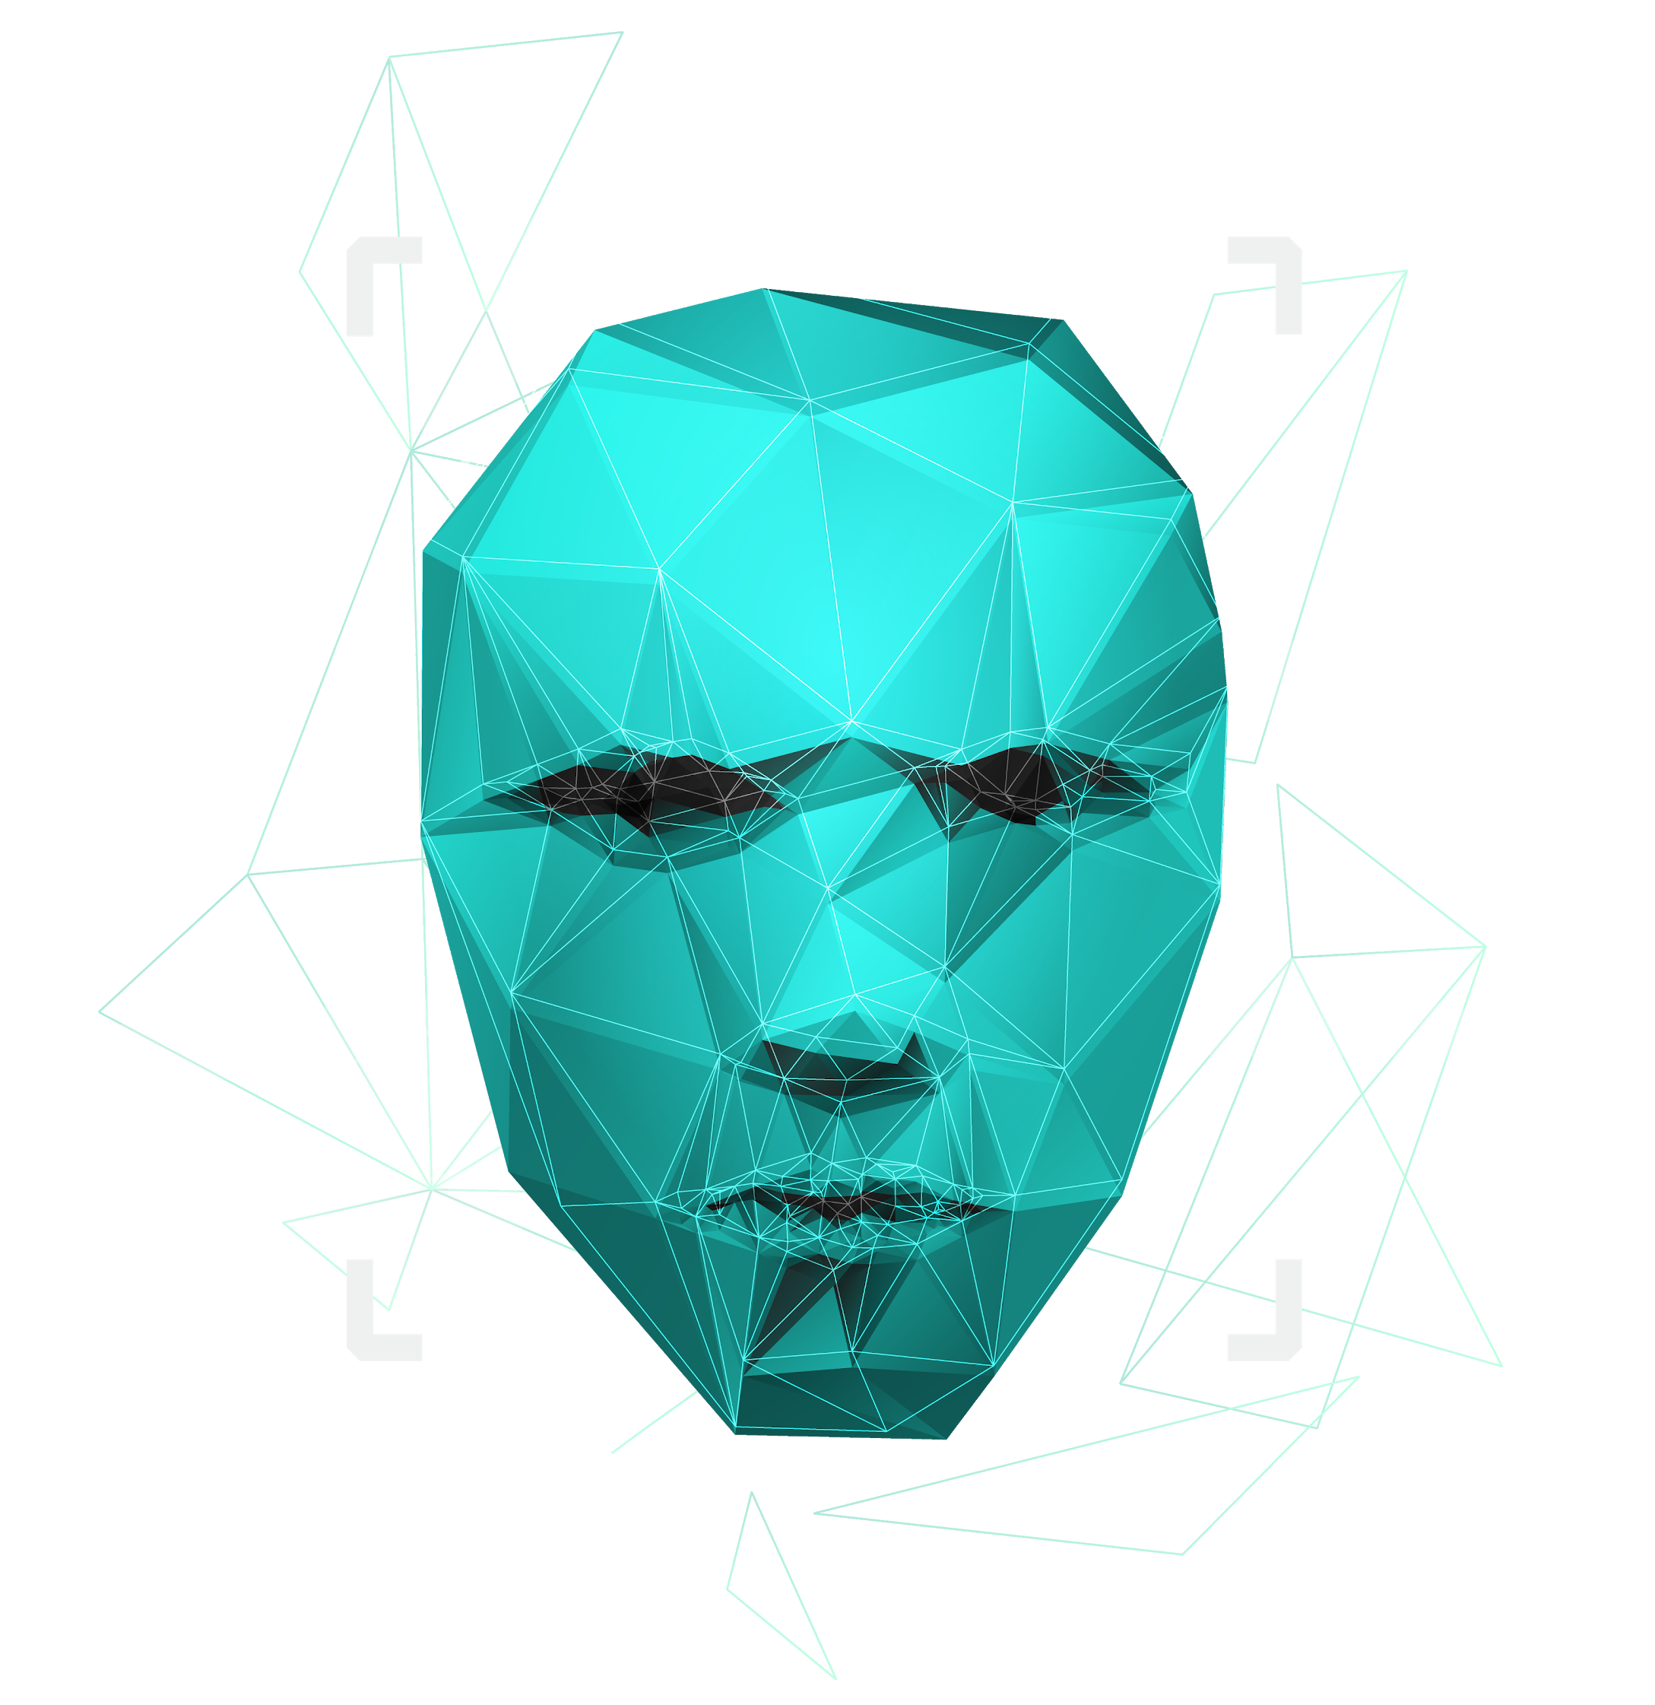
Paternity testing using genetics
Team Members: Youssif Assem, Mohamed Moataz, Kareem Ehab, Mohamed Akram, Ahmed Gamal
Supervised by : Dr. Ashraf Abdelraouf & Eng. Ahmed Hazem

Slide 2

Agenda
System Overview
Tasks done
Relevance part
Short tandem repeat part
Web application
GUI enhancing
Research paper document
Other documents (SRS , SDD , Proposal)
Errors and bugs fixes

Slide 3
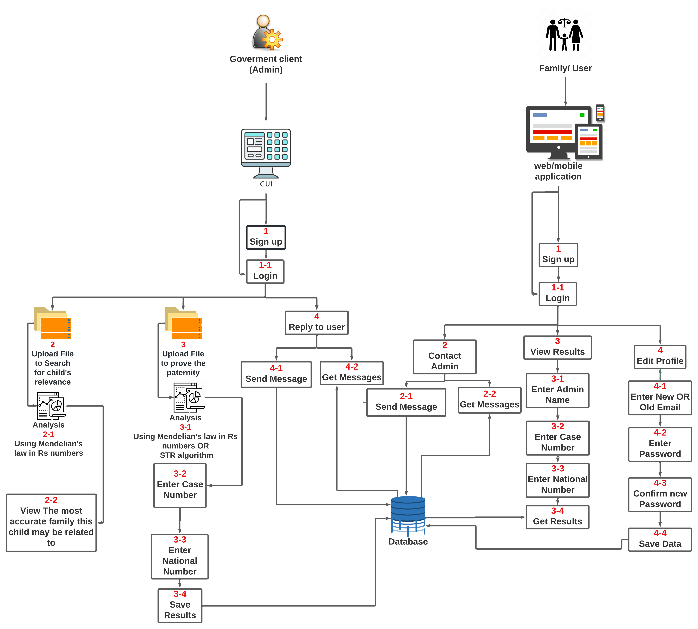
System overview
1

Slide 4
Relevance Part From : 12/3/2022 To: 28/4/2022
We collected new data containing 40 rs numbers from 2045 different people that will be used in obtaining the relevance final result (Ensemble , Kaggle)
Implement the structure of code for the relevance part
Comparing different families with one person to find out the best and highest result and displaying it for the user to see as it would be the most relevant family assigned to that person
Enhancing the final results
2

Slide 5
Short Tandem Repeat Part From : 15/3/2022 To : 13/5/2022
Counting number of repeats for each repeat in the whole genome for each member of the family
Optimizing code to increase performance for the run time
Comparing the data from fasta (file extension) with data from csv (file extension for excel)
Enhance the final results by firstly comparing our results with actual results from papers to test the work
Organizing files for short tandem repeat and for better navigation around the code
3

Slide 6
Web Application From : 20/3/2022 To : 28/3/2022
Start implementing Flask web application to be connected with our system
Create and enhance web application using flutter
Remove file from code to increase the performance and connect the system’s backend to our web application
For flutter, we removed file from code to increase performance and also created a dictionary data structure to remove all lists in the code
Enhance the dataset
4

Slide 7
GUI Enhancing 28/4/2022
Enhancing web application and mobile application UI design
Created splash screen for web application and mobile application and enhancing both
5

Slide 8
Research Paper Document From : 23/3/2022 To : 28/4/2022
Removed some reference papers from related work section and fixing document
Enhancing sudo code in proof of concept section
Redraw system overview diagram
Optimizing paternity code and experimental results section and enhancing conclusion section
Edit and add screenshots with clear description and add tables with also much information to explain all of them
Fixing multiple writing mistakes and pattern problems
Overall fixing and enhancing multiple sections in the paper based on supervisor and TA’s notes
6

Slide 9
Other Documents (SRS , SDD , Proposal) From : 30/4/2022 To : 5/5/2022
Update all three documents (Proposal, SRS, SDD)
Update diagrams, figures, tables and modifying system overview in all three papers
Rewriting functional and non functional requirements, user characteristics
Remaking presentations for all three documents
Rewriting proposal document from beginning
7

Slide 10
Errors and Bugs fixes 10/5/2022
Solve problems in code to enhance short tandem repeat algorithm results with the csv file
Overall fix multiple bugs and errors in structure of code
8

Slide 11
Web page link → http://cscgp.miuegypt.edu.eg/graduation-projects-2021-2022/genetics/
8

Slide 12

TIME PLAN
Try to collect whole genome family and apply the paternity test on, and collect rs numbers for relevance analysis
13/1/2022
Enhance everything we implemented so far
12/3/2022
Whole genome processing from the sources we gathered
By the end of January
Get the STR for each chromosome and compare between father and child
Start of April
Potentially add Whole genome in our system based on the information we gathered
By the end of February
Get relevance between new child and all fathers we have using rs numbers and whole genome
Middle of April
Implement at least 60 % of the GUI application and mobile application
Before the end of Februrary
Start by the end of February
Prove that if is at least a relevance or kinship degree
End of April
Finish the prototype of our system
9

Slide 13
THANK You!
Do you have any questions? ☺

