Slide 1

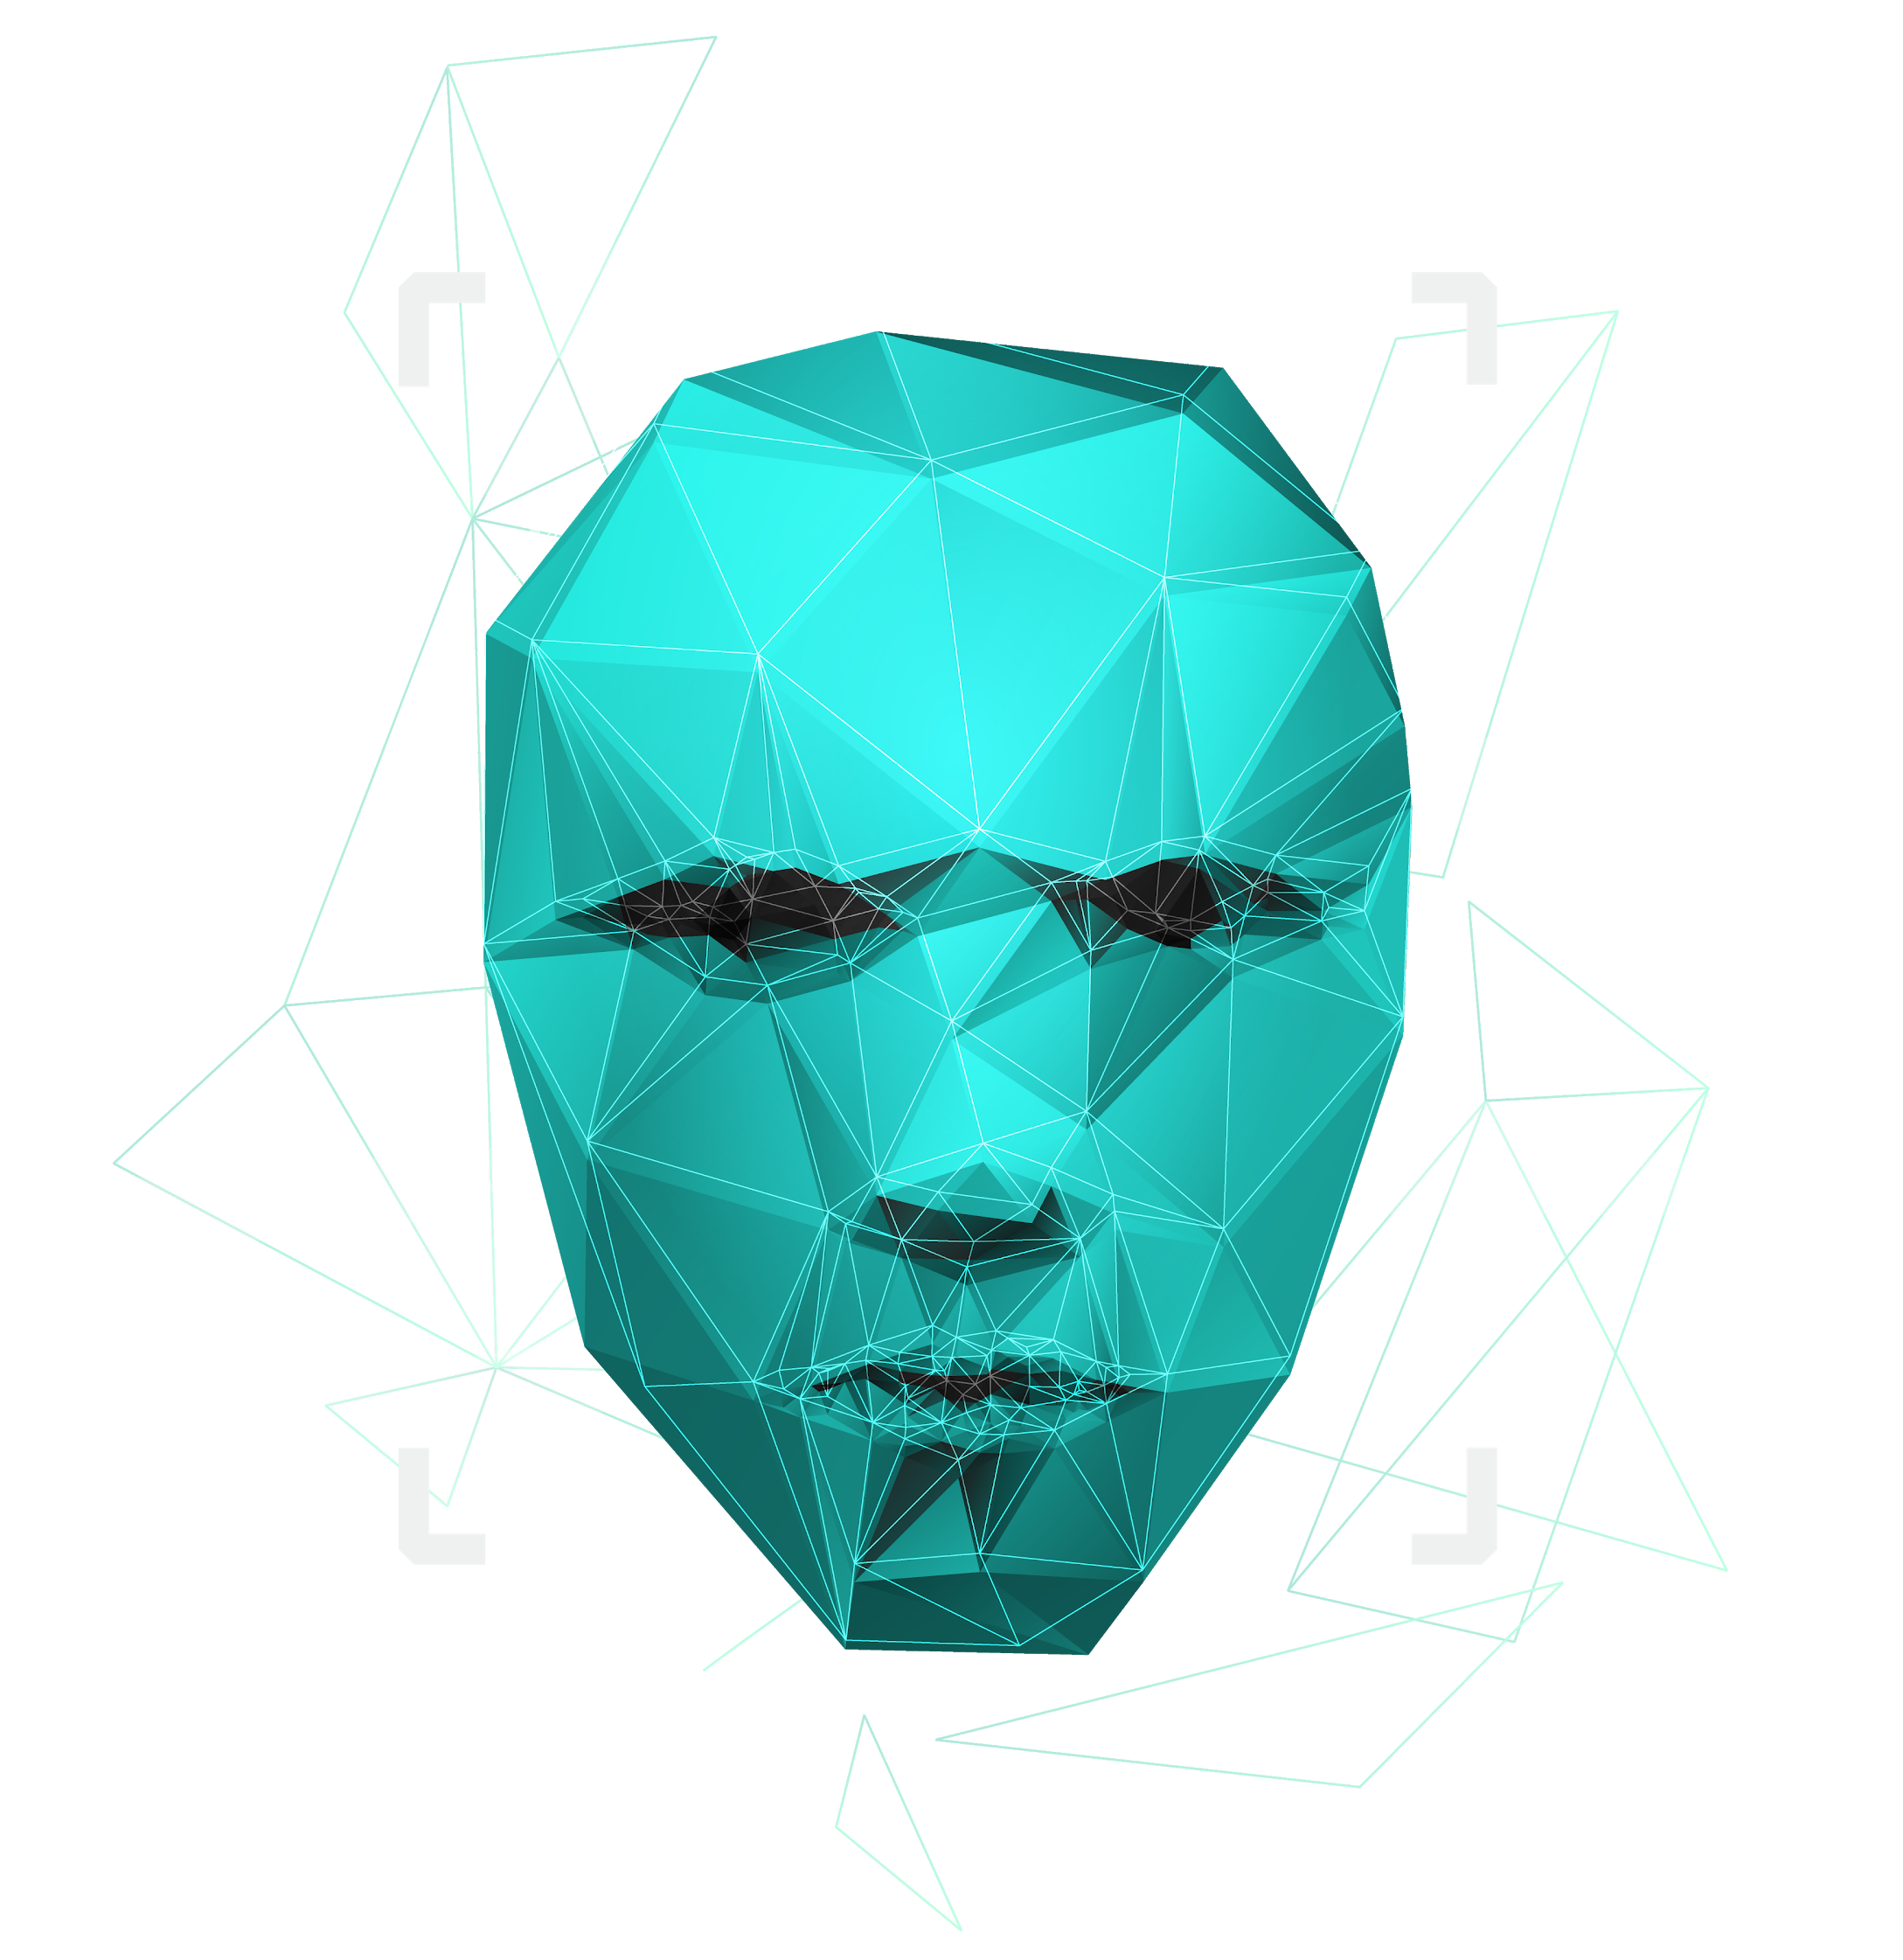
Paternity testing using genetics
Team Members: Youssif Assem, Mohamed Moataz, Kareem Ehab, Mohamed Akram, Ahmed Gamal
Supervised by : Dr. Ashraf Abdelraouf & Eng. Ahmed Hazem

Slide 2

Agenda
System Overview
Tasks done

Slide 3
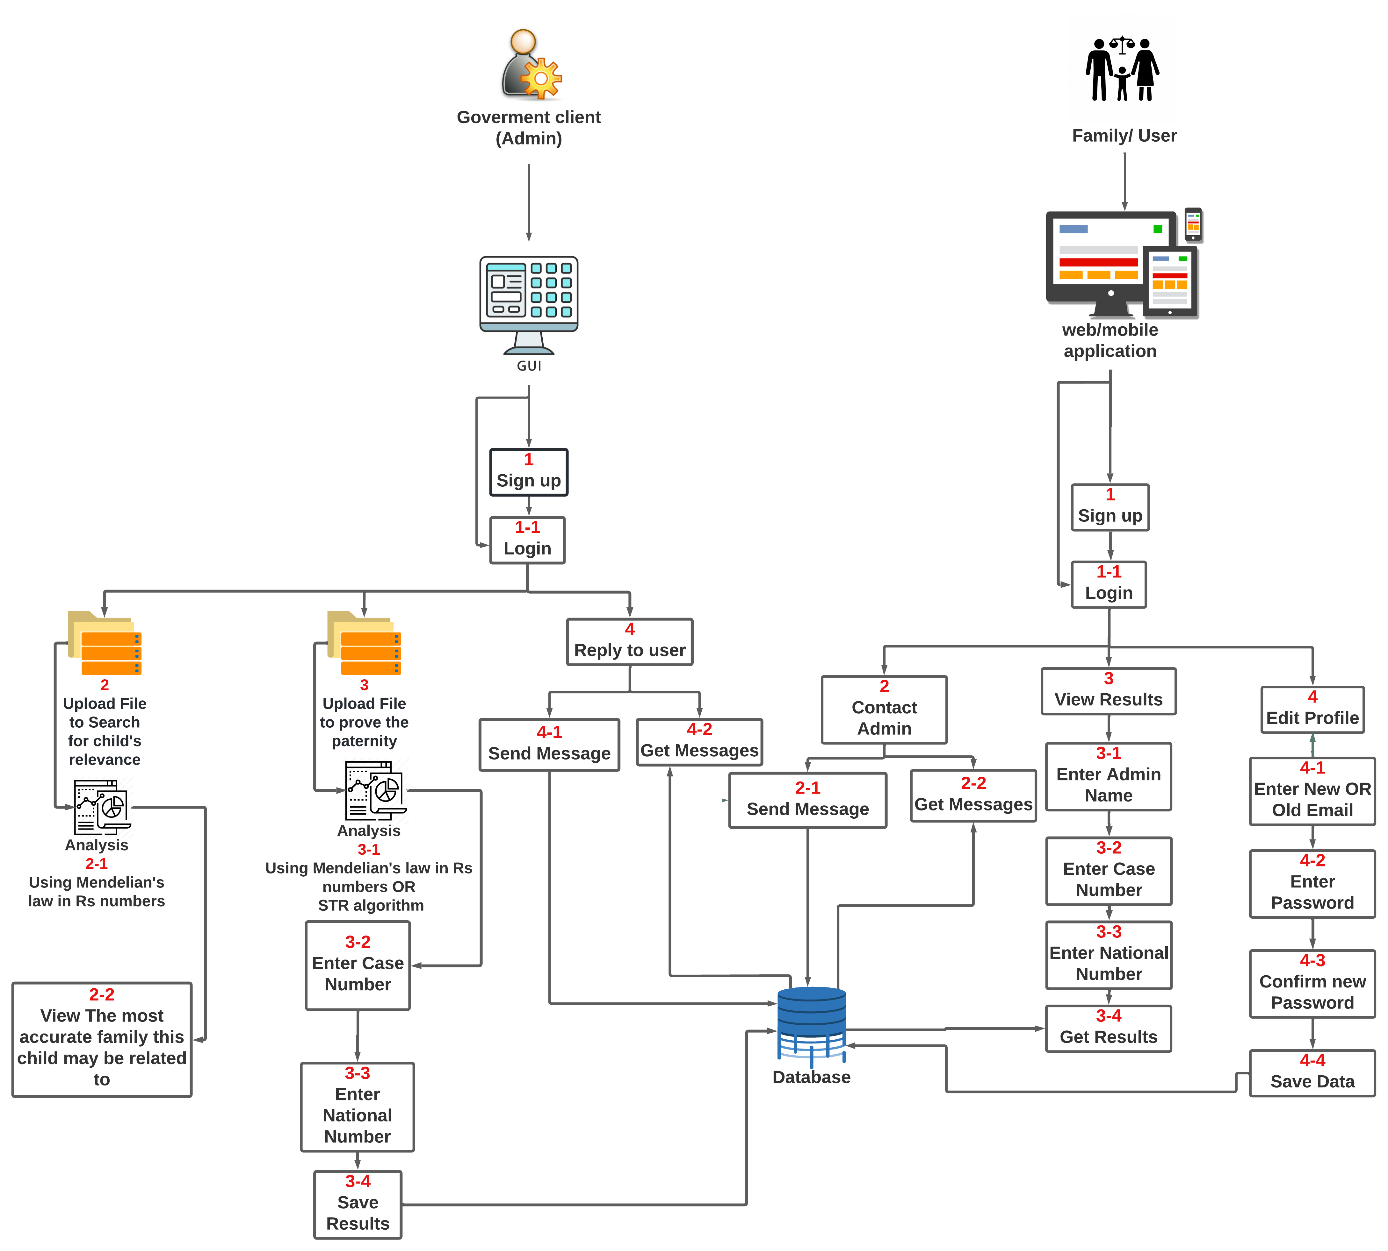
System overview
7

Slide 4
Tasks 12/3/2022
Collecting 40 Rs-numbers data from Ensemble site.
For the relevance part of our system. We obtained this data to searched for how many people from 2045 people will be relevant to the father from Kaggle data.
11

Slide 5
Tasks 15/3/2022
Implement Relevance Code (with relevance)
Try to start built the structure of the code.
Short Tandem Repeats/ comparing data from fasta with data from csv.
Comparing input fasta file to the csv file that contains the short tandem repeats.
11

Slide 6
Tasks 16/3/2022
Research Paper
Removed some reference papers from related work section in the research paper and fixing document based on Eng. Ahmed's notes
11

Slide 7
Tasks 17/3/2022
Relevance Code.
Solve problems in relevance code to enhance the final results.
Short Tandem Repeat Code
Solve problems in code to enhance STR algorithm results with the csv file.
11

Slide 8
Tasks 19/3/2022
Research paper
Revising document and enhancing the sudo code in proof of concept section in the research paper.
11

Slide 9
Tasks 20/3/2022
Flask Website
Try to create the website using flask to connect with the project.
Create Website using flutter
remove file from code to increase the performance and connect the backend of the project with the Website (backend, Frontend). Finally Solving some errors and bugs in the system.
11

Slide 10
Tasks 21/3/2022
Website design
Enhance the Website design and solving issues.
Short tandem repeat code
Comparing results with actual results from papers to test the work.
11

Slide 11
Tasks 23/3/2022
Flutter Website
Add web that enhanced and linked it with the project, Solving errors in database. And solving issues in the flask Website.
Update the paternity code
To enhance the performance create a (dictionary data structure) and remove all lists in the code.
11

Slide 12
Tasks 24/3/2022
Relevance code.
We found after applying the code we had created that 172 persons from 2045 is relevant to the father from kaggle.
Research paper.
fixed references, title, abstract and removed some issues based on Dr. Ashraf's notes in the research paper.
11

Slide 13
Tasks 26/3/2022
Flutter Website
updating in UI desgin of mobile/web.
Research paper
Wrote introduction and background, fixed related work section and enhance to proof of concept section, wrote dataset description, fixed figures in paper and updated system overview.
11

Slide 14
Tasks 28/3/2022
Research paper
Wrote the relevance sudo code in paper and optimized the paternity code and experimental results. And enhanced abstract, introduction, fixed authors in related work section, wrote and enhacnced conclusion section
Website and Mobile flutter
Create a splash screen for both and enhance it.
11

Slide 15
Tasks 5/4/2022
10/4/2022
Research paper
Enhanced all comments in a research paper according to doctor Ashraf comments.
Update abstract according to Eng. Ahmed comments and add more information, Update the background diagram according to ENg. Ahmed comments, Update system overview title, Update the title of report screen, Update the methodology, Update table in methodology and call it, call figure system architecture in system description section.
11

Slide 16
Tasks 15/4/2022
19/4/2022
Research paper
Add height for system-over view photo to be zoomed in more, Add device information and update the experimental result according to comments, rewriting the dataset description with the write way to represent our dataset, Add screen shots of the related work systems according to comments. Update comments with doctor Ashraf on introduction, and solve mistakes of the paper
11

Slide 17
Tasks 28/4/2022
Research paper
rewriting the proposed approach and experimental results according to comments of doctor Taragy.
Code
worked on GUI add whole genome report, add relevance result. In addition, worked on the short tandem repeat files.
11

Slide 18
Tasks 30/4/2022
Documents
Update SRS comments and diagrams, update SDD to last update and update figures. fixing images and table potions in SRS and SDD, modifying the system overview in SRS and SDD ,rewriting functional requirements and non functional requirements ,rewriting user characteristics , redesigning SRS presentation. Wrote conclusion in SDD and resolved notes.
11

Slide 19
Tasks 4/5/2022
8/5/2022
Presentation and Research paper
Update all doctor Taragy comments in IEEE document. Re draw system Overview again according to doctor Taragy comments, Create the paper presentation.
Conference presentation
Make Rehearsal for presentation
11

Slide 20
Tasks 9/5/2022
Graduation project Website
Add images and SRS, SDD documents and linked pages in the Website
Link → http://cscgp.miuegypt.edu.eg/graduation-projects-2021-2022/genetics/
Documents
Update all documents with last update and re creating diagrams.
11

Slide 21
Tasks 10/5/2022
Research paper
Writing the sudo code of STR algorithm.
Proposal document
rewriting proposal document (Abstract , system Overview , similar system , sportive documents, background ,Objectives , scope , problem statement , stockholders
11

Slide 22

TIME PLAN
Try to collect whole genome family and apply the paternity test on, and collect rs numbers for relevance analysis
13/1/2022
Enhance everything we implemented so far
12/3/2022
Whole genome processing from the sources we gathered
By the end of January
Get the STR for each chromosome and compare between father and child
Start of April
Potentially add Whole genome in our system based on the information we gathered
By the end of February
Get relevance between new child and all fathers we have using rs numbers and whole genome
Middle of April
Implement at least 60 % of the GUI application and mobile application
Before the end of Februrary
Start by the end of February
Prove that if is at least a relevance or kinship degree
End of April
Finish the prototype of our system
18

Slide 23
THANK You!
Do you have any questions? ☺

