Slide 1
Genetics
Youssif Assem, Mohamed Moataz, Kareem Ehab, Ahmed Gamal

Slide 2
AGENDA
Introduction
Problem Statement
Our Objectives
System Overview
Use-case Diagram
Functional Requirements
Non-Functional Requirements
Class Diagrams
Data Design (Database & Dataset)
Live Demo

Slide 3
Introduction
What is an rsNumebr?
It is a reference number to the gene we have that consists of two alleles (one from the father and the other from the mother).
EX:
RsNumber | Father | Mother | Child1 | Child2 | Child3
rs3131972 | AG | GG | AG | GG | GG

Slide 4
Introduction (cont.)
Whole genome
It is the whole DNA sequence that a human have in their system.
Whole exome
It is a part of the whole genome and makes up only 1.5% of it and it may reveal information about family relationships (ex: paternity test)

Slide 5
Problem Statement
Some parents suffer from the process of paternity testing when they are being sued for child custody.
A lot of time when a crime happens, some DNA would be left at the crime scene and would take some time to be processed and eventually lead us to the one who committed that crime.
Why can’t we have a system that could potentially prove this in less time and be accessible to everyone.

Slide 6
Our Objectives
Make an automated system to accurately prove parentage of someone by their rsNumbers and their genotypes.
Add another part to enter the user’s whole genome or whole exome.
We aim to have the application accessible by everyone by an online web application.
We aim that the user can see which alleles contributed to being wrong that led to prove wrong parentage.

Slide 7
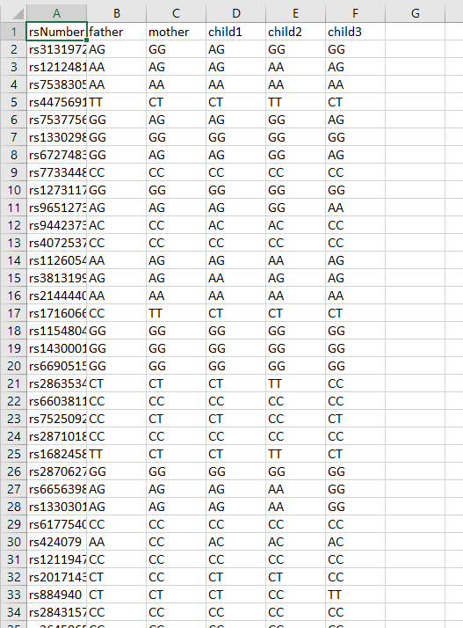
System overview

Slide 8
Use-cases diagram
The system can accept files from the user containing their genotypes.
The system can save the user’s data (genotypes) (results)
The user can input their genotypes and get a report showing which genotypes contribute to the paternity test.
The user can see which alleles are different if it was proven wrong.

Slide 9
Functional requirements
Check(child, parent)
getWrong()
getResults()
wholeGenome(file)
wholeExome(file)
rsNumbers(allelesData)

Slide 10
Non functional requirements
Security
Availability
Scalability
Performance

Slide 11
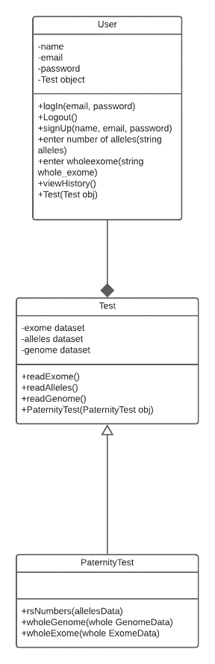
Class diagrams

Slide 12
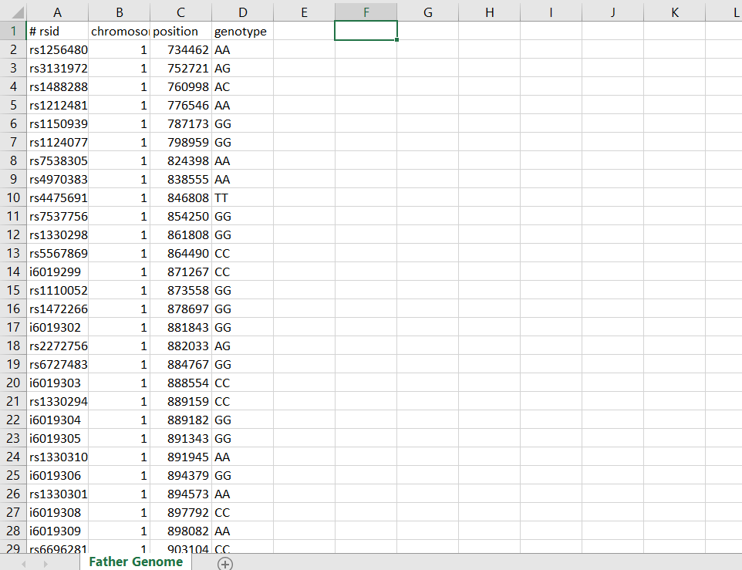
Data design (database & dataset)

Slide 13
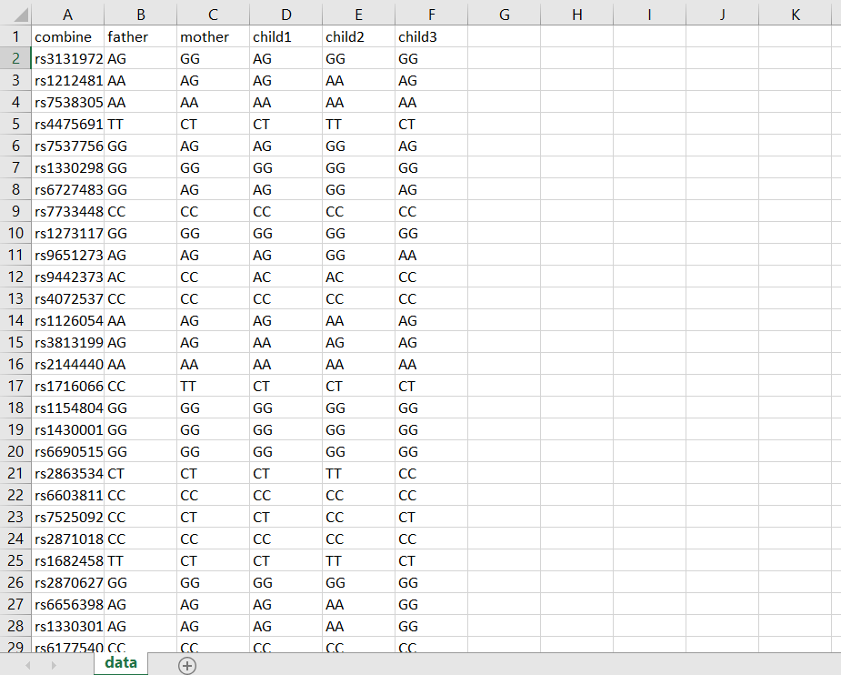
Data design (database & dataset) (cont.)

Slide 14
Live demo

Slide 15

ANY QUESTIONS ? ☺

