Slide 1
Genetics
Youssif Assem, Mohamed Moataz

Slide 2
Problem we are solving
Some parents suffer from the process of paternity testing when they are being sued for child custody.
A lot of time when a crime happens, some DNA would be left at the crime scene and would take some time to be processed and eventually lead us to the one who committed that crime.
Why can’t we have a system that could potentially prove this in less time and be accessible to everyone.

Slide 3
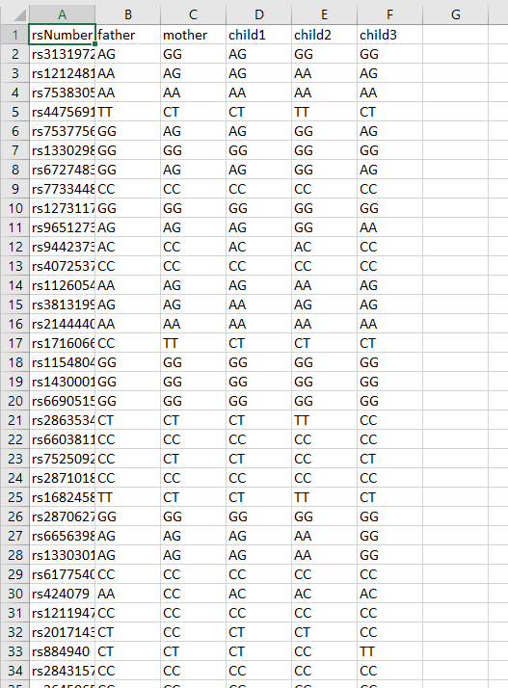
System overview
Our system compares every allele in every child with the alleles in both parents in the same rs number.
Our system can detect whether or not that’s there child or not.
We aim that the user can input their alleles and our app can tell them which gene belong to whom.

Slide 4
