Slide 1

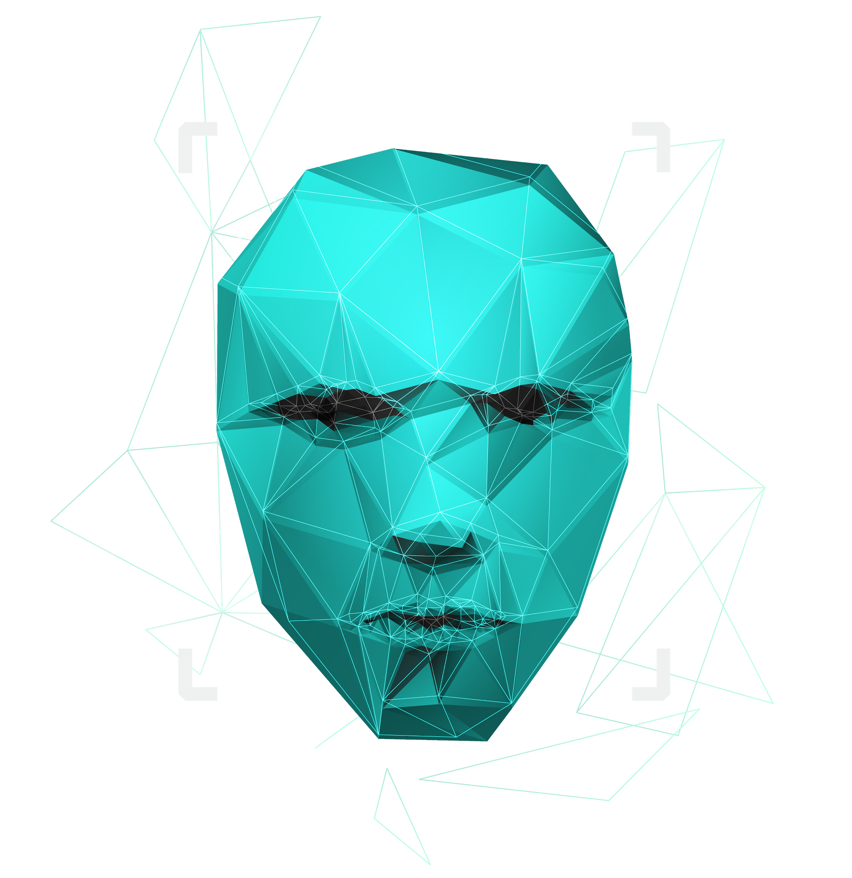
Paternity testing using genetics
Team Members: Youssif Assem, Mohamed Moataz, Kareem Ehab, Mohamed Akram, Ahmed Gamal
Supervised by : Dr. Ashraf Abdelraouf & Eng. Ahmed Hazem

Slide 2

Agenda
Introduction
Problem Statement
Objectives
System Overview
Use Cases
Functional & Non functional Requirements
Class Diagram
Data design (Database & Dataset)
Live Demo`

Slide 3

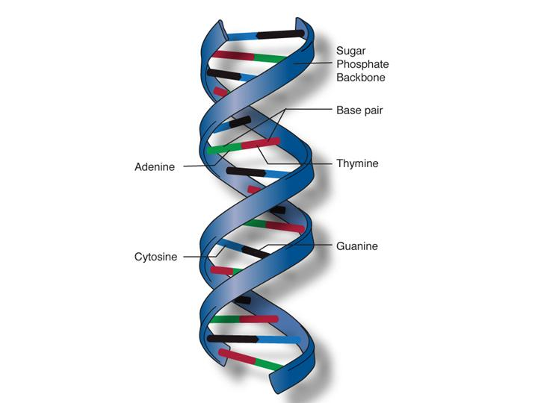
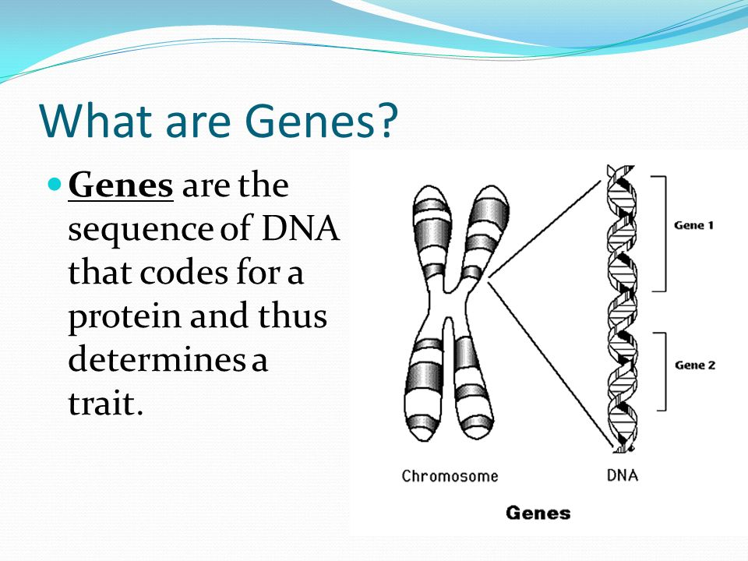
Introduction
DNA
DNA molecules allow some of our characteristics to be passed down from our generation to the next (our children)
Genes →Genes are passed from parents to offspring and contain the information needed to specify traits(qualities). Genes contains a subset of the DNA and this subset is (A, T, C, G).
1

Slide 4
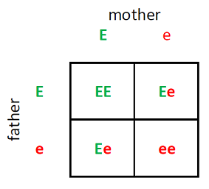
Introduction
What is an RSnumebr?
It is a reference number to the gene we have that consists of two alleles (one from the father and the other from the mother).
What is an Alleles ? It is a two characters represents the gene sequence repeats of characters one from father and another one from mother
EX:
RsNumber | Father | Mother | Child1 | Child2 | Child3
rs3131972 | AG | GG | AG | GG | GG
2

Slide 5
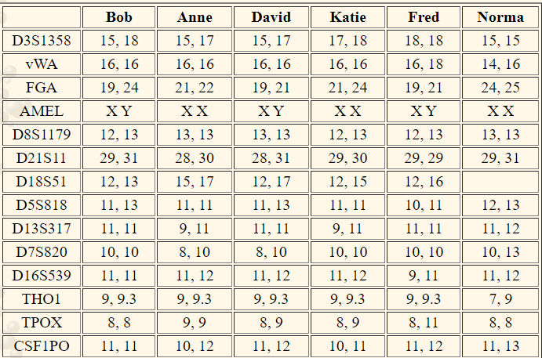
Introduction
Whole genome
It is the whole DNA sequence that a human have in their system.
Each number in the Table represents the repeats of nucleotide.
Ex:
ATCGATCGATCGATCGATCGATCGATCGATCGATCGATCG
3

Slide 6


Problem Statement
Some parents suffer from the process of paternity testing when they are being sued for child custody.
A lot of time when a crime happens, some DNA would be left at the crime scene and would take some time to be processed and eventually lead us to the one who committed that crime.
Why can’t we have a system that could potentially prove this in less time and be accessible to everyone.
4

Slide 7
Our Objectives
Enhance the short tandem repeat method in the whole genome
Implement relevance and kinship through rs numbers
Enhance and implement the mobile application and web application
Implement relevance and kinship through whole genome
Enhance report of whole genome results
5

Slide 8
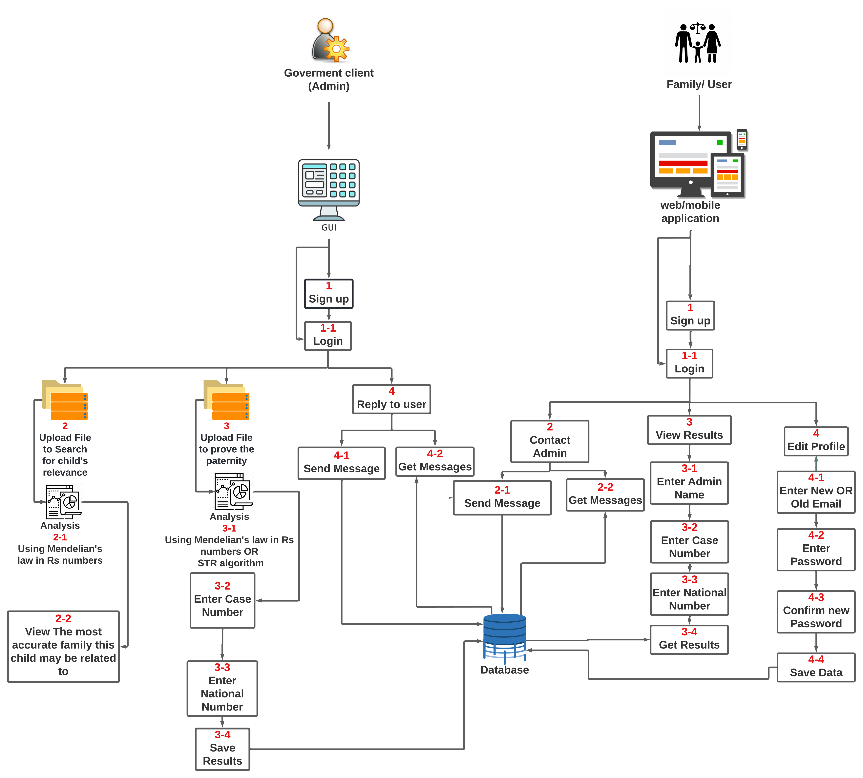
System overview
6

Slide 9
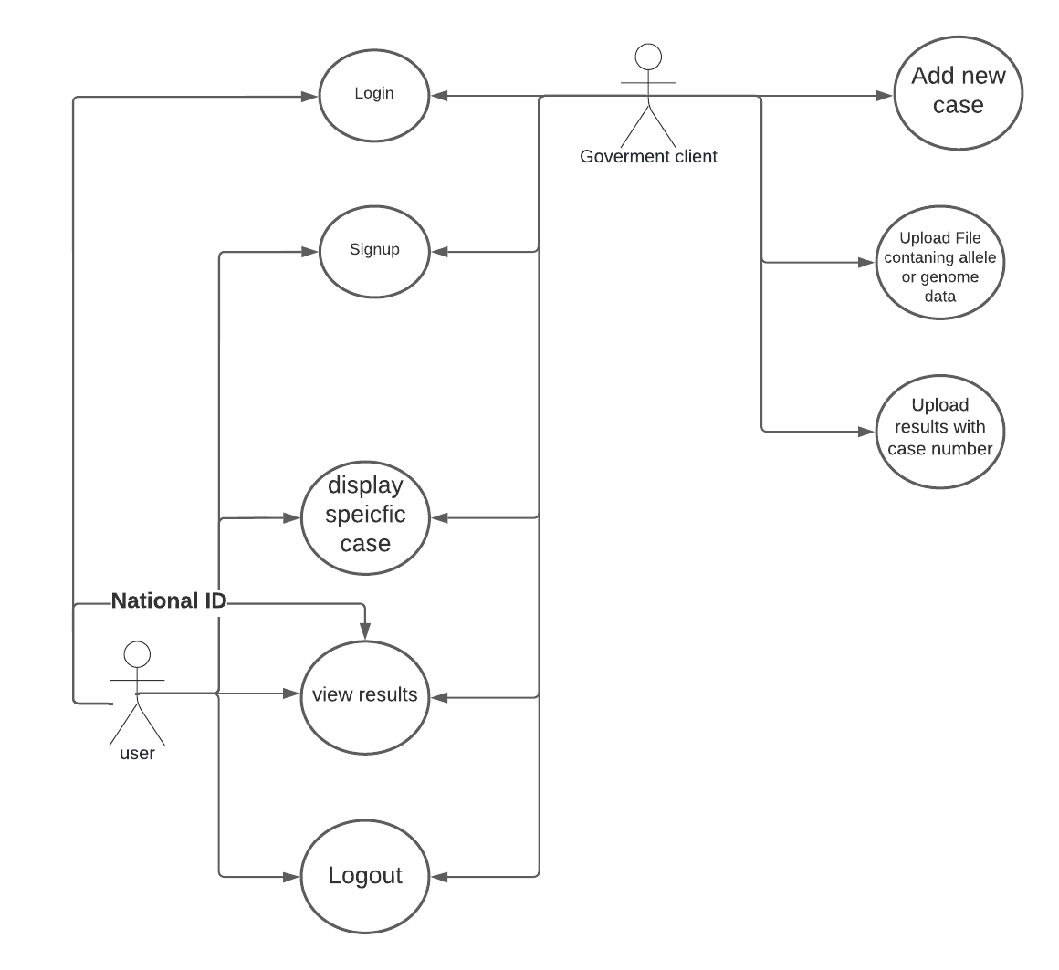
Use Case Diagram:
The system can accept files from the user containing their genotypes.
The system can save the user’s data (genotypes) (results)
The user can input their genotypes and get a report showing which genotypes contribute to the paternity test.
The user can see which alleles are different if it was proven wrong.
Rewrite this part
8

Slide 10
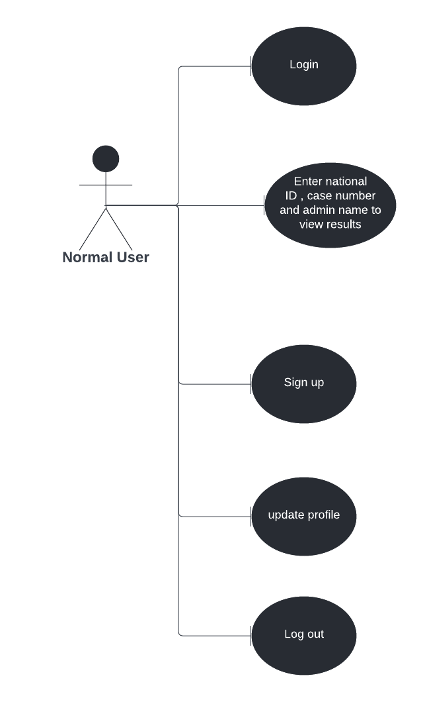
Functional requirements
9

Slide 11
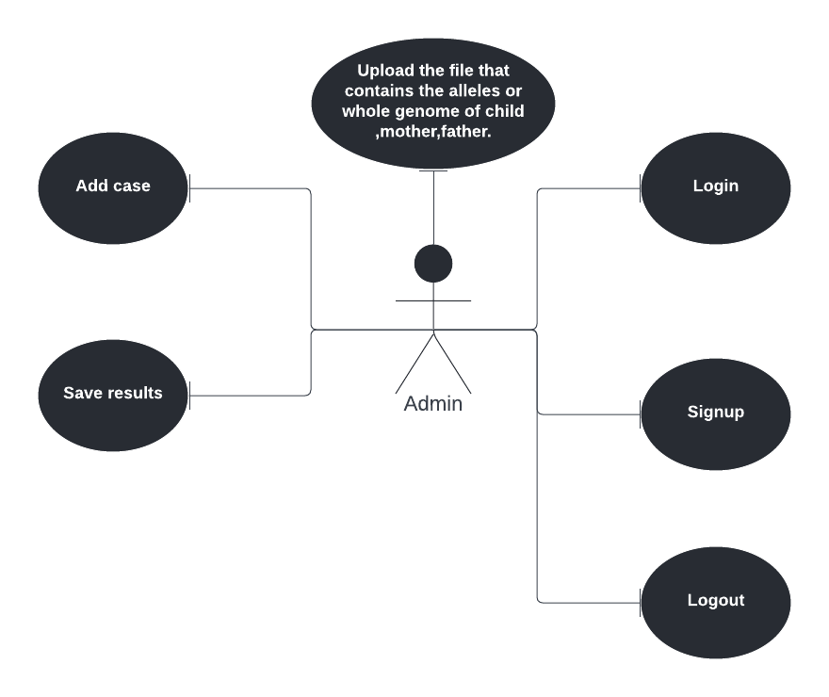
Functional requirements

Slide 12
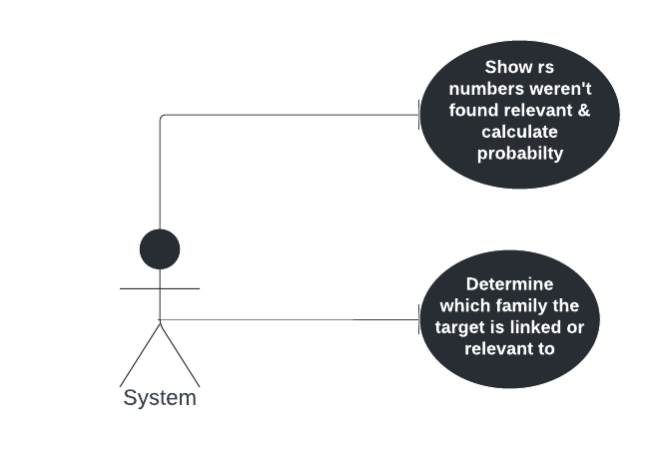
Functional requirements
9

Slide 13
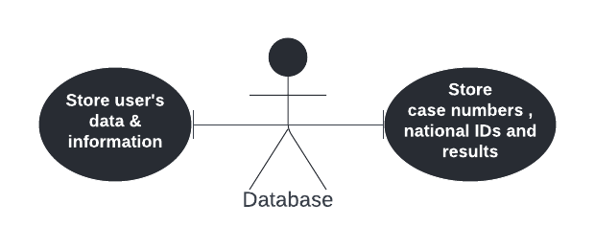
Functional requirements
10

Slide 14
Functional requirements
Check(child, parent)
getWrong()
getResults()
wholeGenome(file)
wholeExome(file)
rsNumbers(allelesData)
11

Slide 15
Functional requirements
Security
Availability
Scalability
Performance
12

Slide 16
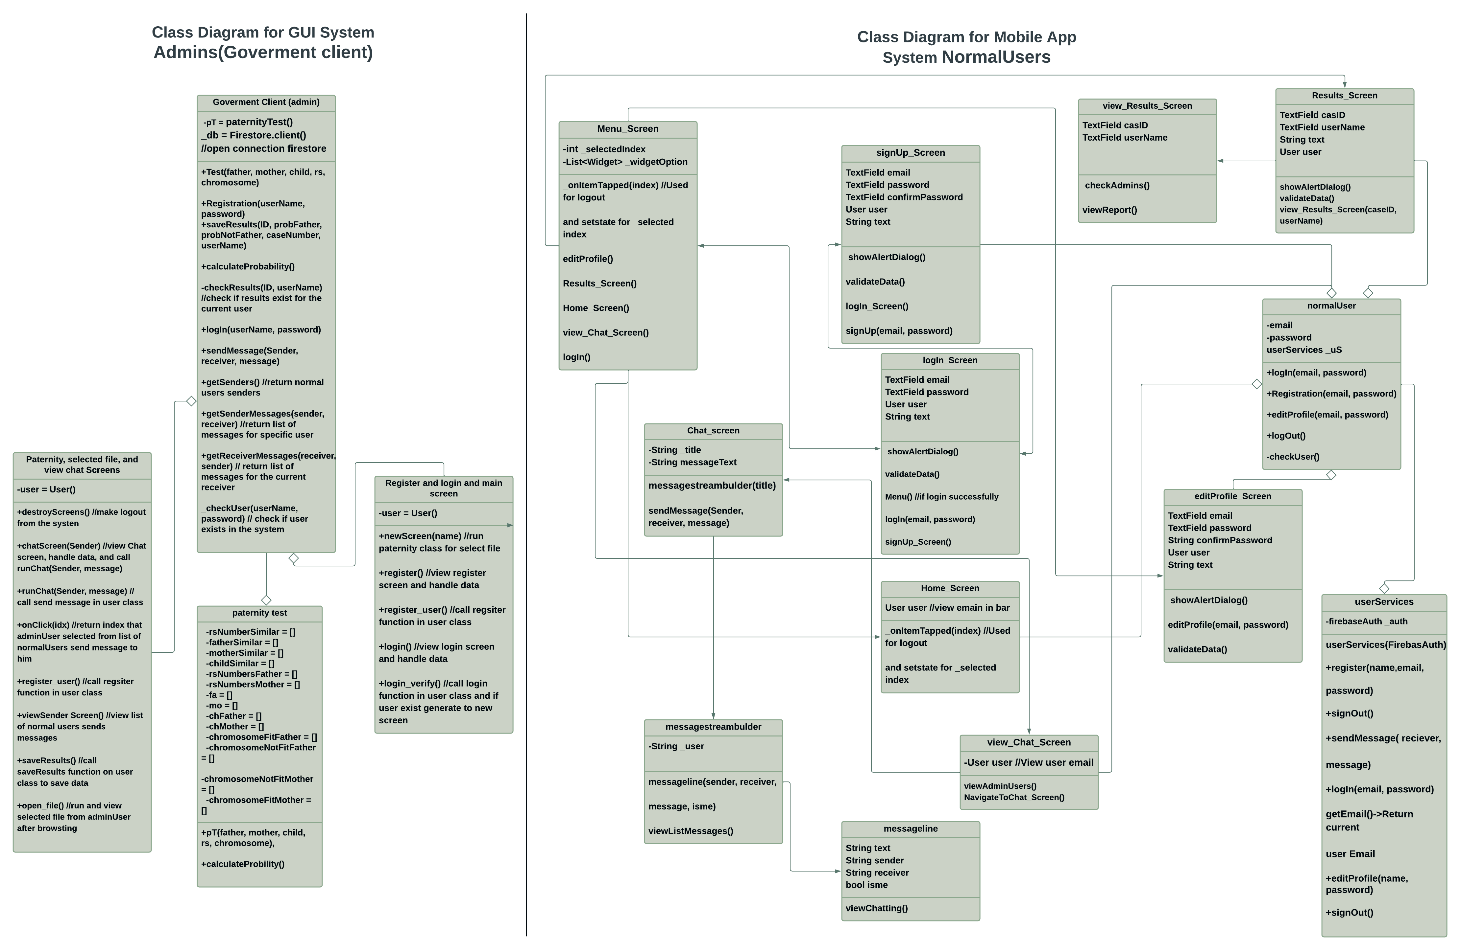
Diagrams
Class diagram:
13

Slide 17
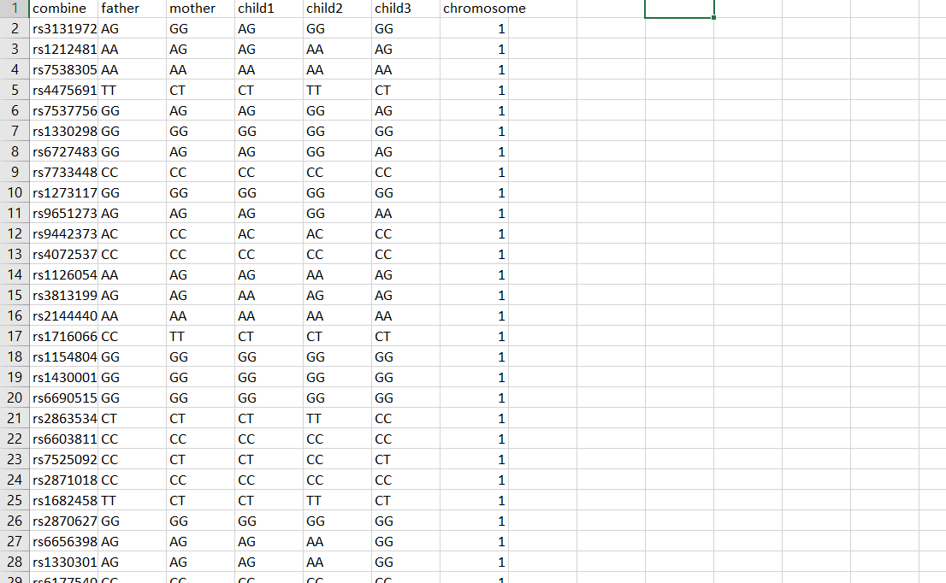
Dataset Used:
Our dataset has over 100000 instances of Rs numbers and consists of 6 main features showing both alleles for every family member and the number of chromosome for each instance
14

Slide 18
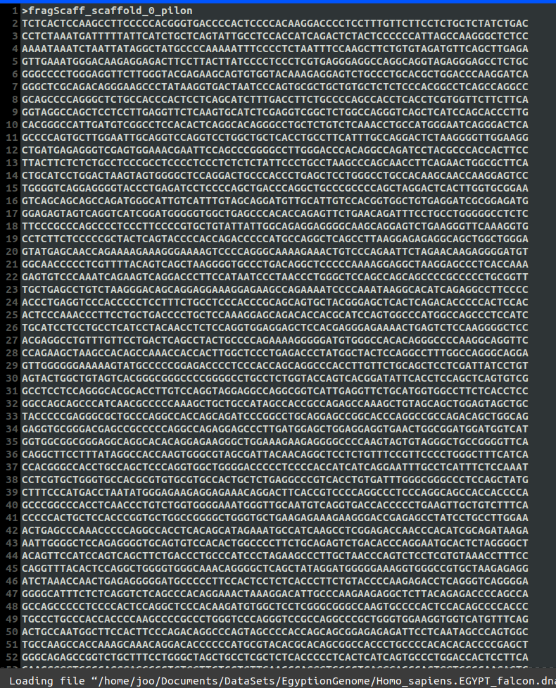
Dataset Used
In the whole genome the process to determine paternity is somewhat different There are specific locations (IDs) or the right terminology (locus, loci) in the whole genome every location and is in a specific chromosome For each of these locations, there exists a specific repeat that we are looking for ex: D7S280 --> GATA counting the number of those repeats for each location is the goal and then comparing it with the number of repeats in the mother and father
15

Slide 19
TIME PLAN
13/1/2022
Enhance everything we implemented so far
Whole genome processing from the sources we gathered
By the end of January
Potentially add Whole genome in our system based on the information we gathered
By the end of February
Implement at least 60 % of the GUI application and mobile application
Before the end of Februrary
Start by the end of February
Prove that if is at least a relevance or kinship degree
16

Slide 20
Live Demo
https://drive.google.com/file/d/1CCrENZUZtcn9dRaEpCdubUcRlW9RRIYB/view?usp=sharing
19

Slide 21
THANK You!
Do you have any questions? ☺

