Slide 1

MA7FZTY
Done By:Ganna Ayman, Rola Wafi, Kareem Ehab, Youssif Assem, Mohamed Moataz
Supervised by: Dr. Hossam Rahman Mahmoud Haider

Slide 2
Agenda
Introduction
Problem Statement
Objective
System overview
Use Case Diagram
Class Diagram

Slide 3
Introduction
Ma7fzy is an app that will help people to save their money change.
It allows individuals to transfer remaining money electronically from one account to another.
People lose money daily because they don’t find money change easily.

Slide 4
Problem Statement
People lose money daily because shops don’t usually have change and it ends up on people losing small change everywhere.
Though this may be considered the "old-fashioned way" when it comes to transferring money, using cash can be extremely practical in some circumstances.
Sometimes its hard getting the remaining money in cash which is really annoying.
A lot of people don’t like to carry a lot of money with them because they are exposed to stolen.

Slide 5
Objective
Create a mobile/web app which helps people save remaining money change.
Saves time & money.
Overcome the problem of lost money due to the change problems.
Enhance the process of money transfer in Egypt and avoids interacting with cash that can spread germs.

Slide 6
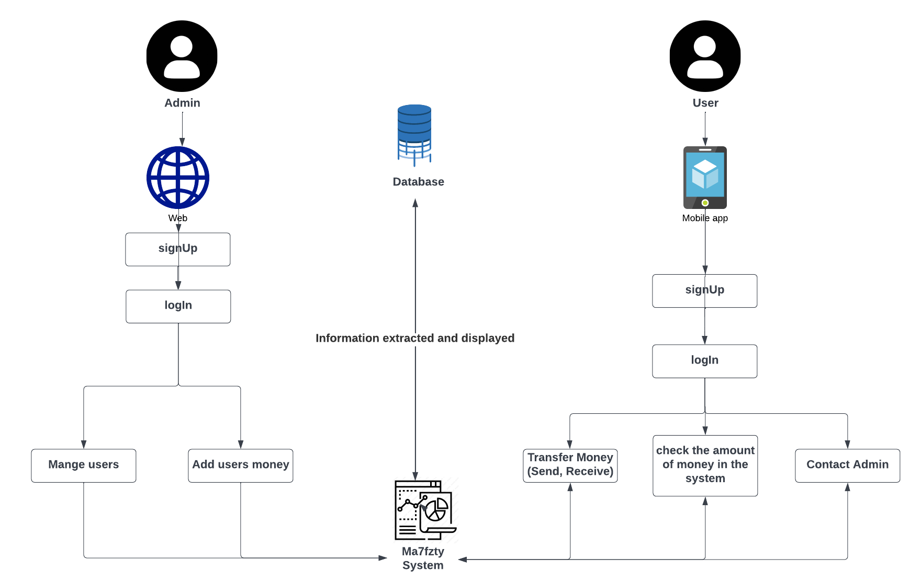
System overview

Slide 7
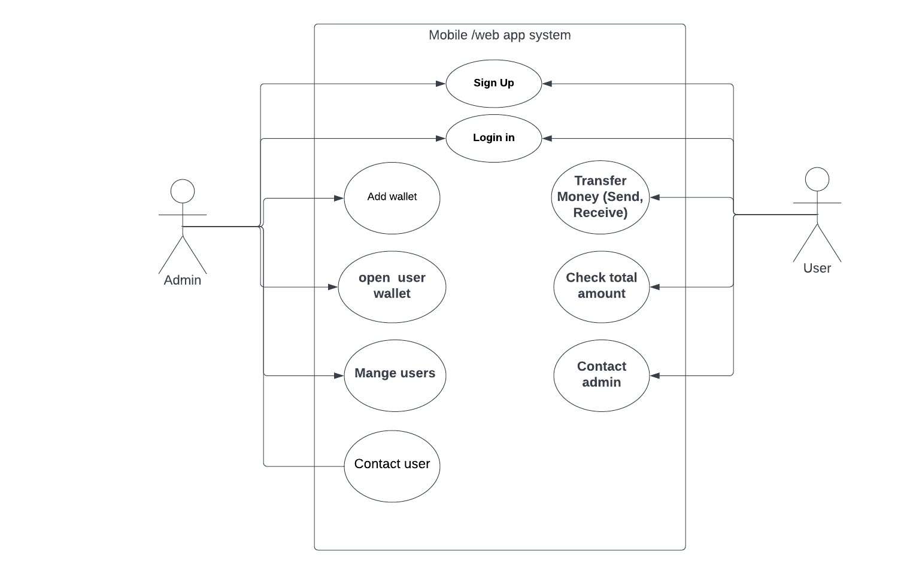
Use Case Diagram

Slide 8
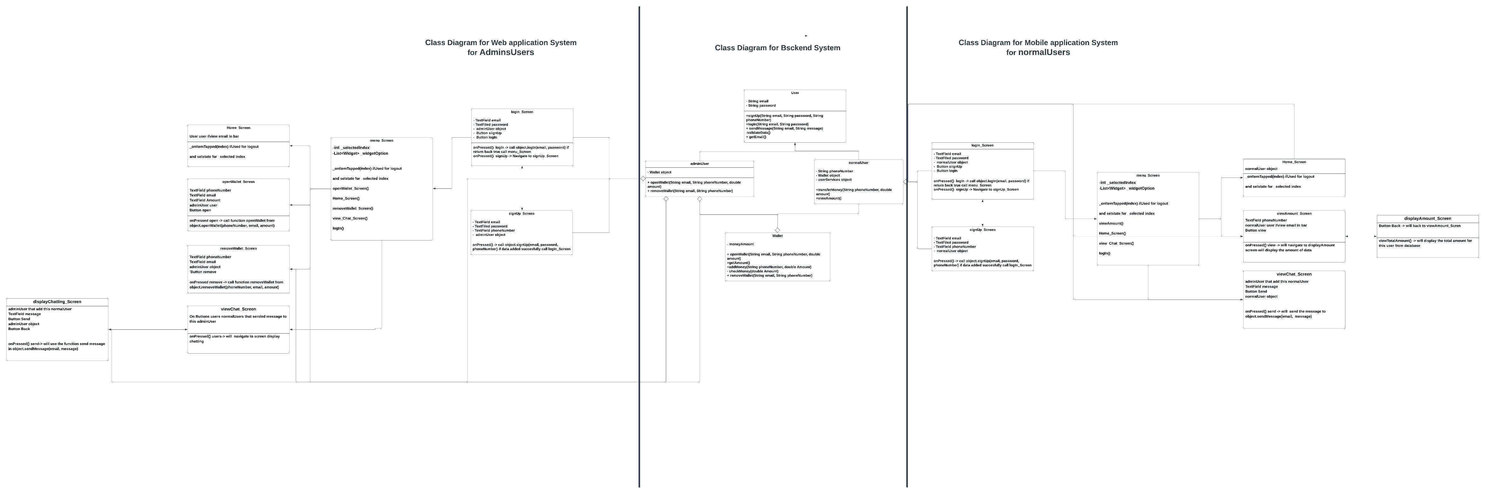
Class Diagram

Slide 9
Experiment
Mobile/web application
Transferring money easily
managing two users transferring money to the same user B at the same time by parallel
Managing User transferring money and at the same time receiving money.
Making sure that the money transferred or received correctly
Using consumer and provider to manage transferring and receiving money.

Slide 10
Expected results
Mobile/web application.
Transferring money easily.
Making sure if user A and user C transferred money to user B at the same time, User be must revive the transferred amount correctly. This will be done by provider and consumer.

Slide 11


Any Question
Any Question

