Slide 1

MA7FZTY
Ganna Ayman, Rola Wafi, Kareem Ehab, Youssif Assem, Mohamed Moataz
Supervised by: Dr. Hossam happy, Mahmoud Haider

Slide 2
Agenda
Introduction
Problem Statement
Objective
System overview
Use Case Diagram
Class Diagram

Slide 3
Introduction
Ma7fzy is an app that will help people to save their money.
Users can transfer money between them selves easily.
People lost a lot of money because they don’t find change.

Slide 4
Problem Statement
People lost a lot of money because of they don’t have change or they lost a lot of money because of it is very small.
A lot of people don’t like to carry a lot of money with them because they are exposed to stolen.

Slide 5
Objective
Create a mobile/web app that will help people to save their money.
Overcome the problem of lost money due to the change problems.
Enhance the process of money transfer in Egypt.

Slide 6
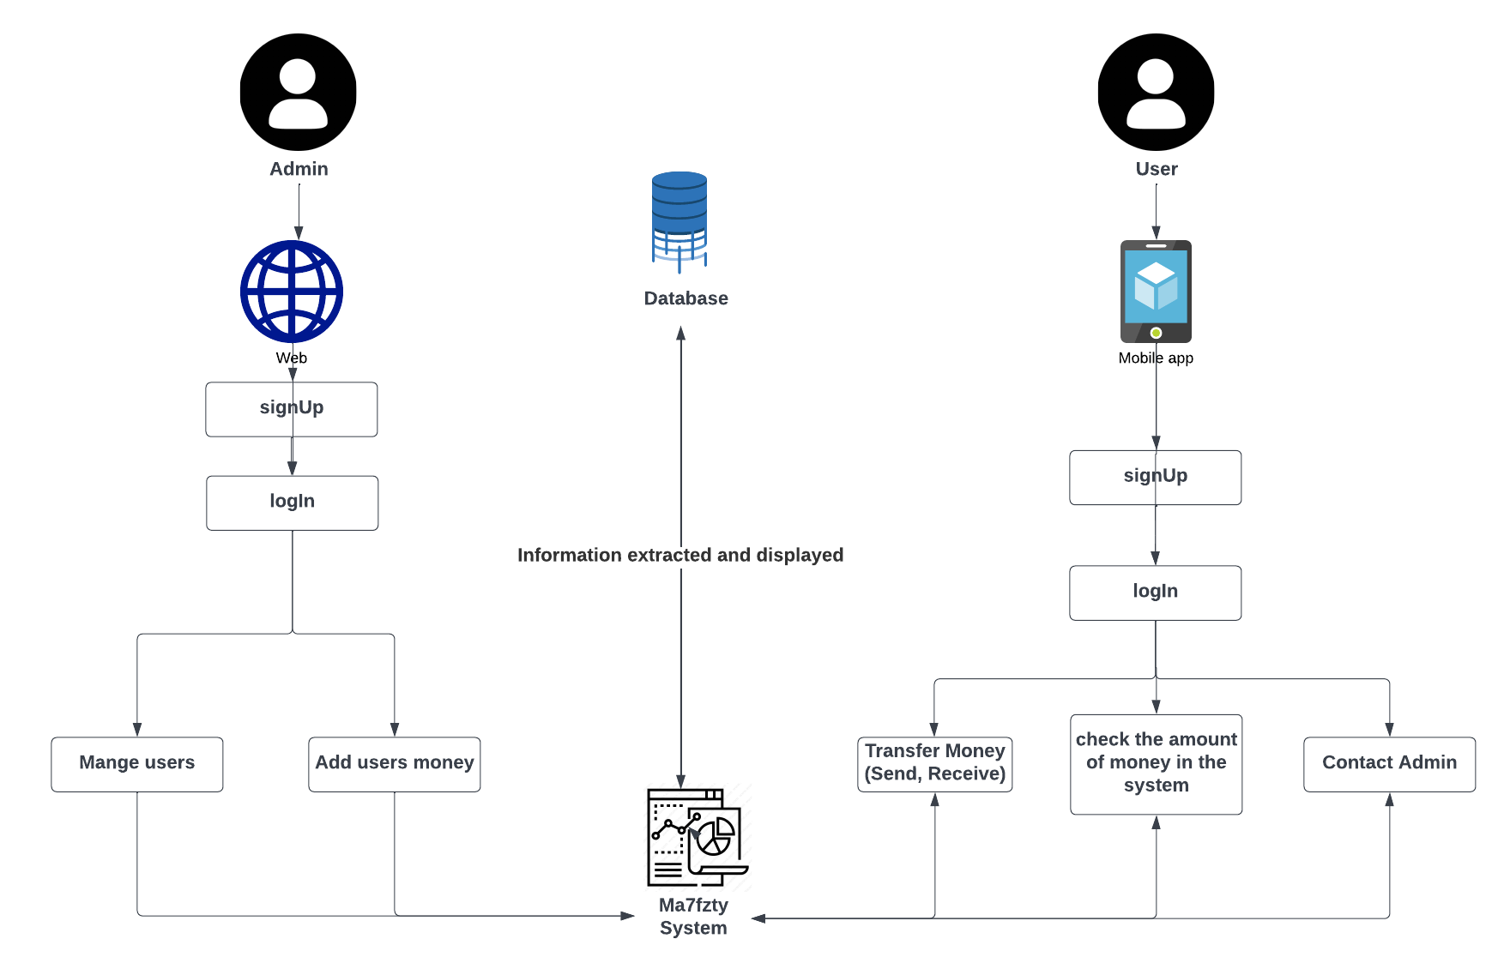
System overview

Slide 7
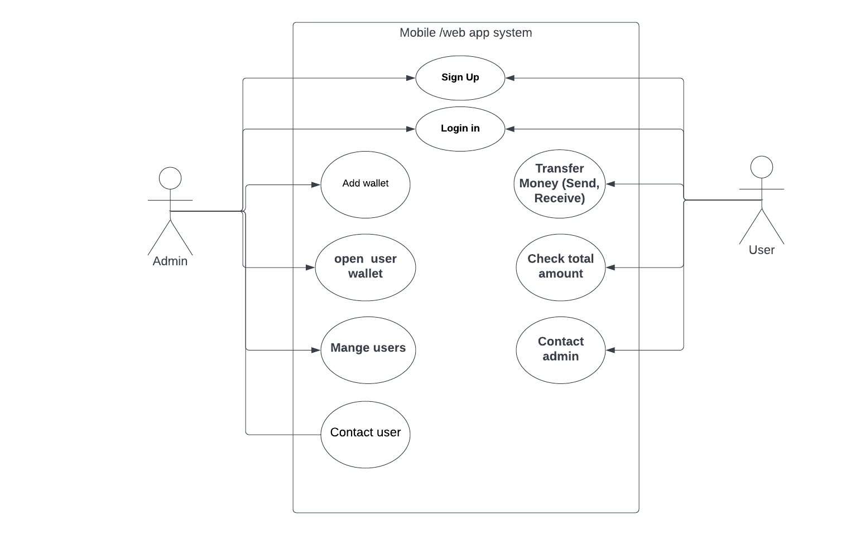
Use Case Diagram

Slide 8
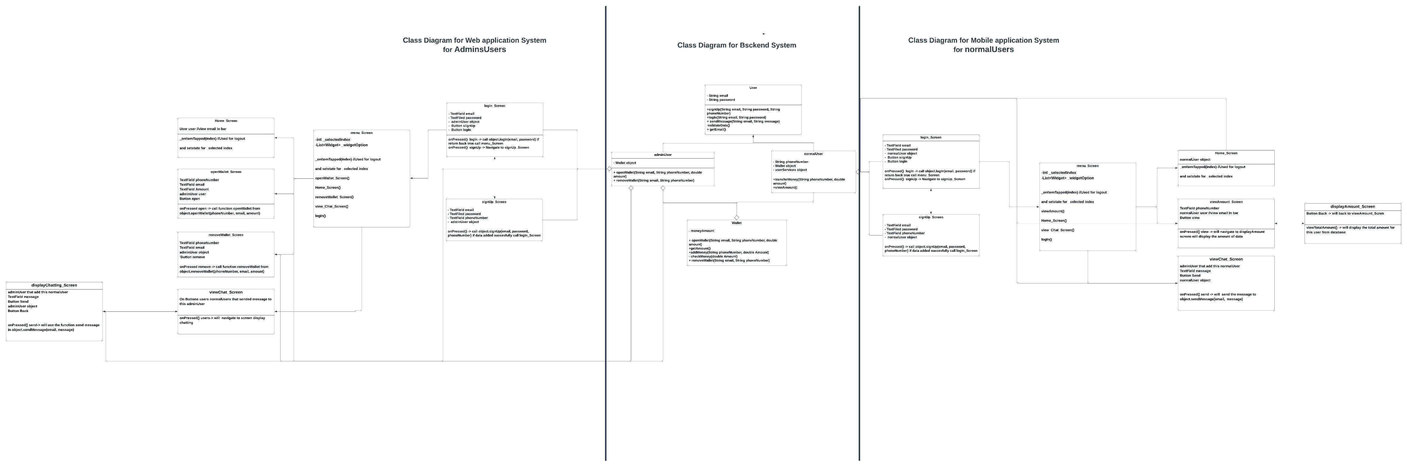
Class Diagram

Slide 9
Thank You
Happy ? AnyQuestion ?!

