Slide 1

MA7FZTY
Done By:Ganna Ayman, Rola Wafi, Kareem Ehab, Youssif Assem, Mohamed Moataz
Supervised by: Dr. Hossam Rahman Mahmoud Haider

Slide 2
Agenda
Introduction
Problem Statement
Objective
System overview
Use Case Diagram
Class Diagram
Experiment Cases
Experiment Algorithms
Results

Slide 3
Introduction
Ma7fzty is an application that will help people to save their money change.
It allows individuals to transfer remaining money electronically from one account to another.
People lose money daily because they don’t find money change easily.
1
2
3

Slide 4
Problem Statement
People lose money daily because shops don’t usually have change and it ends up on people losing small change everywhere.
Though this may be considered the "old-fashioned way" when it comes to transferring money, using cash can be extremely practical in some circumstances.
Sometimes its hard getting the remaining money in cash which is really annoying.
A lot of people don’t like to carry a lot of money with them because they are exposed to stolen.

Slide 5
Objective
To develop an application with high speed application and ensure money transferring is secure and done with out any problems
Saves time & money.
Overcome the problem of lost money due to the change problems.
Enhance the process of money transfer in Egypt and avoids interacting with cash that can spread germs.
Create a mobile/web app which helps people save remaining money change.

Slide 6
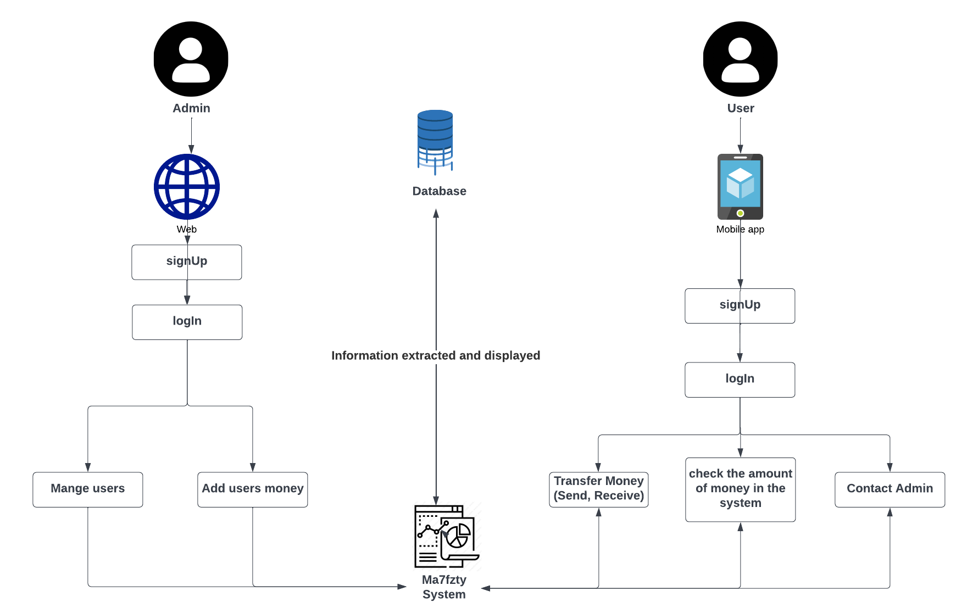
System overview

Slide 7
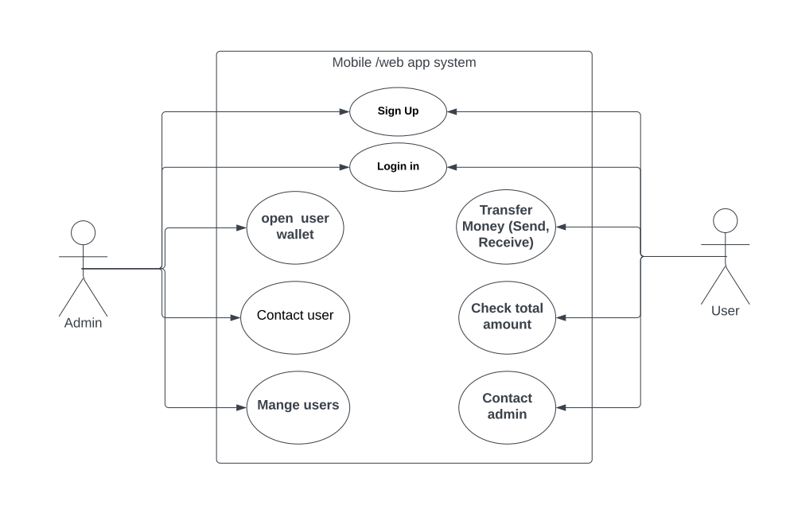
Use Case Diagram

Slide 8
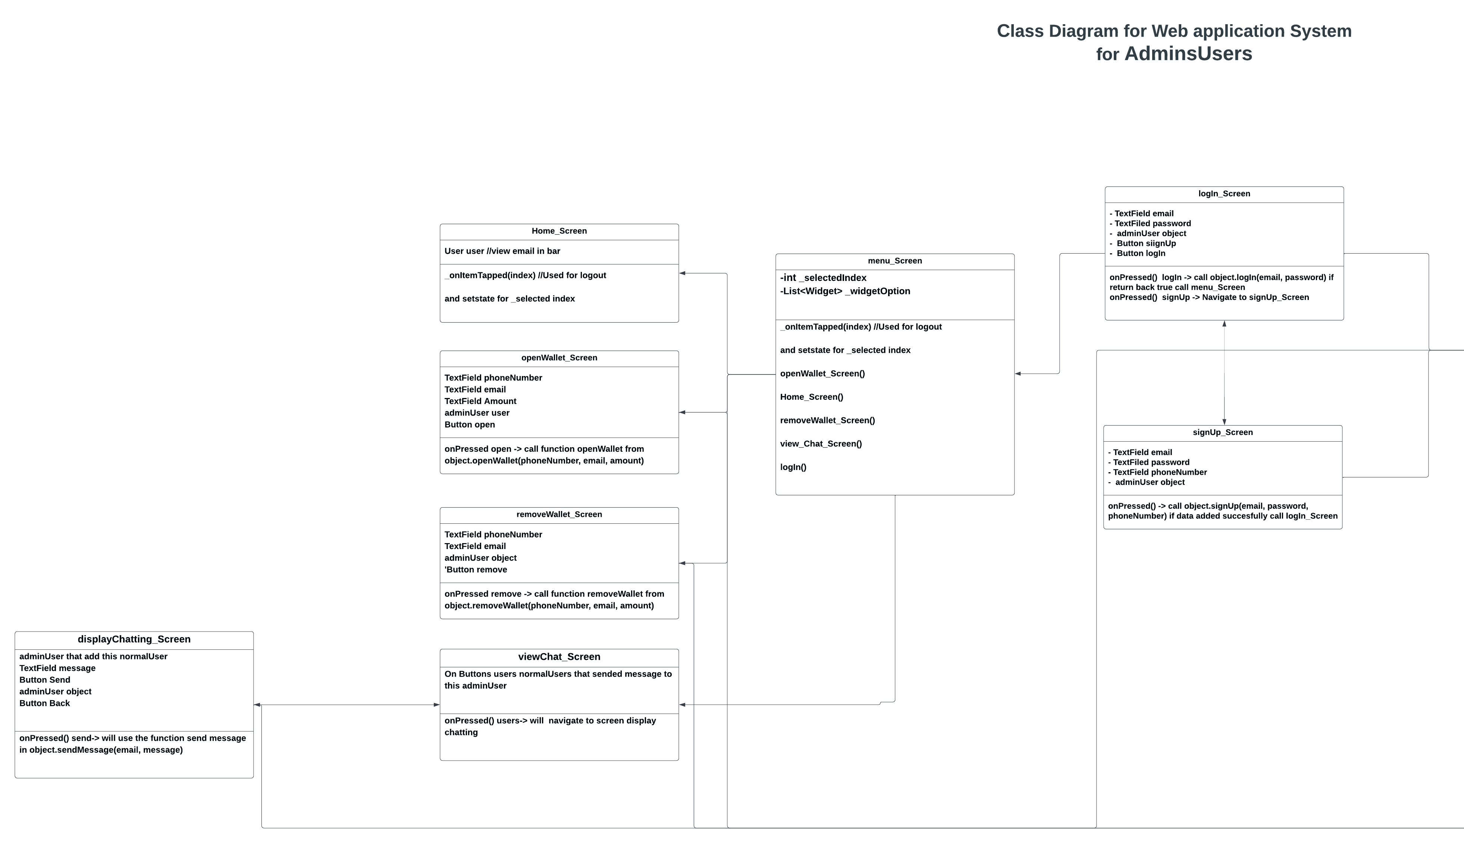
Class Diagram

Slide 9
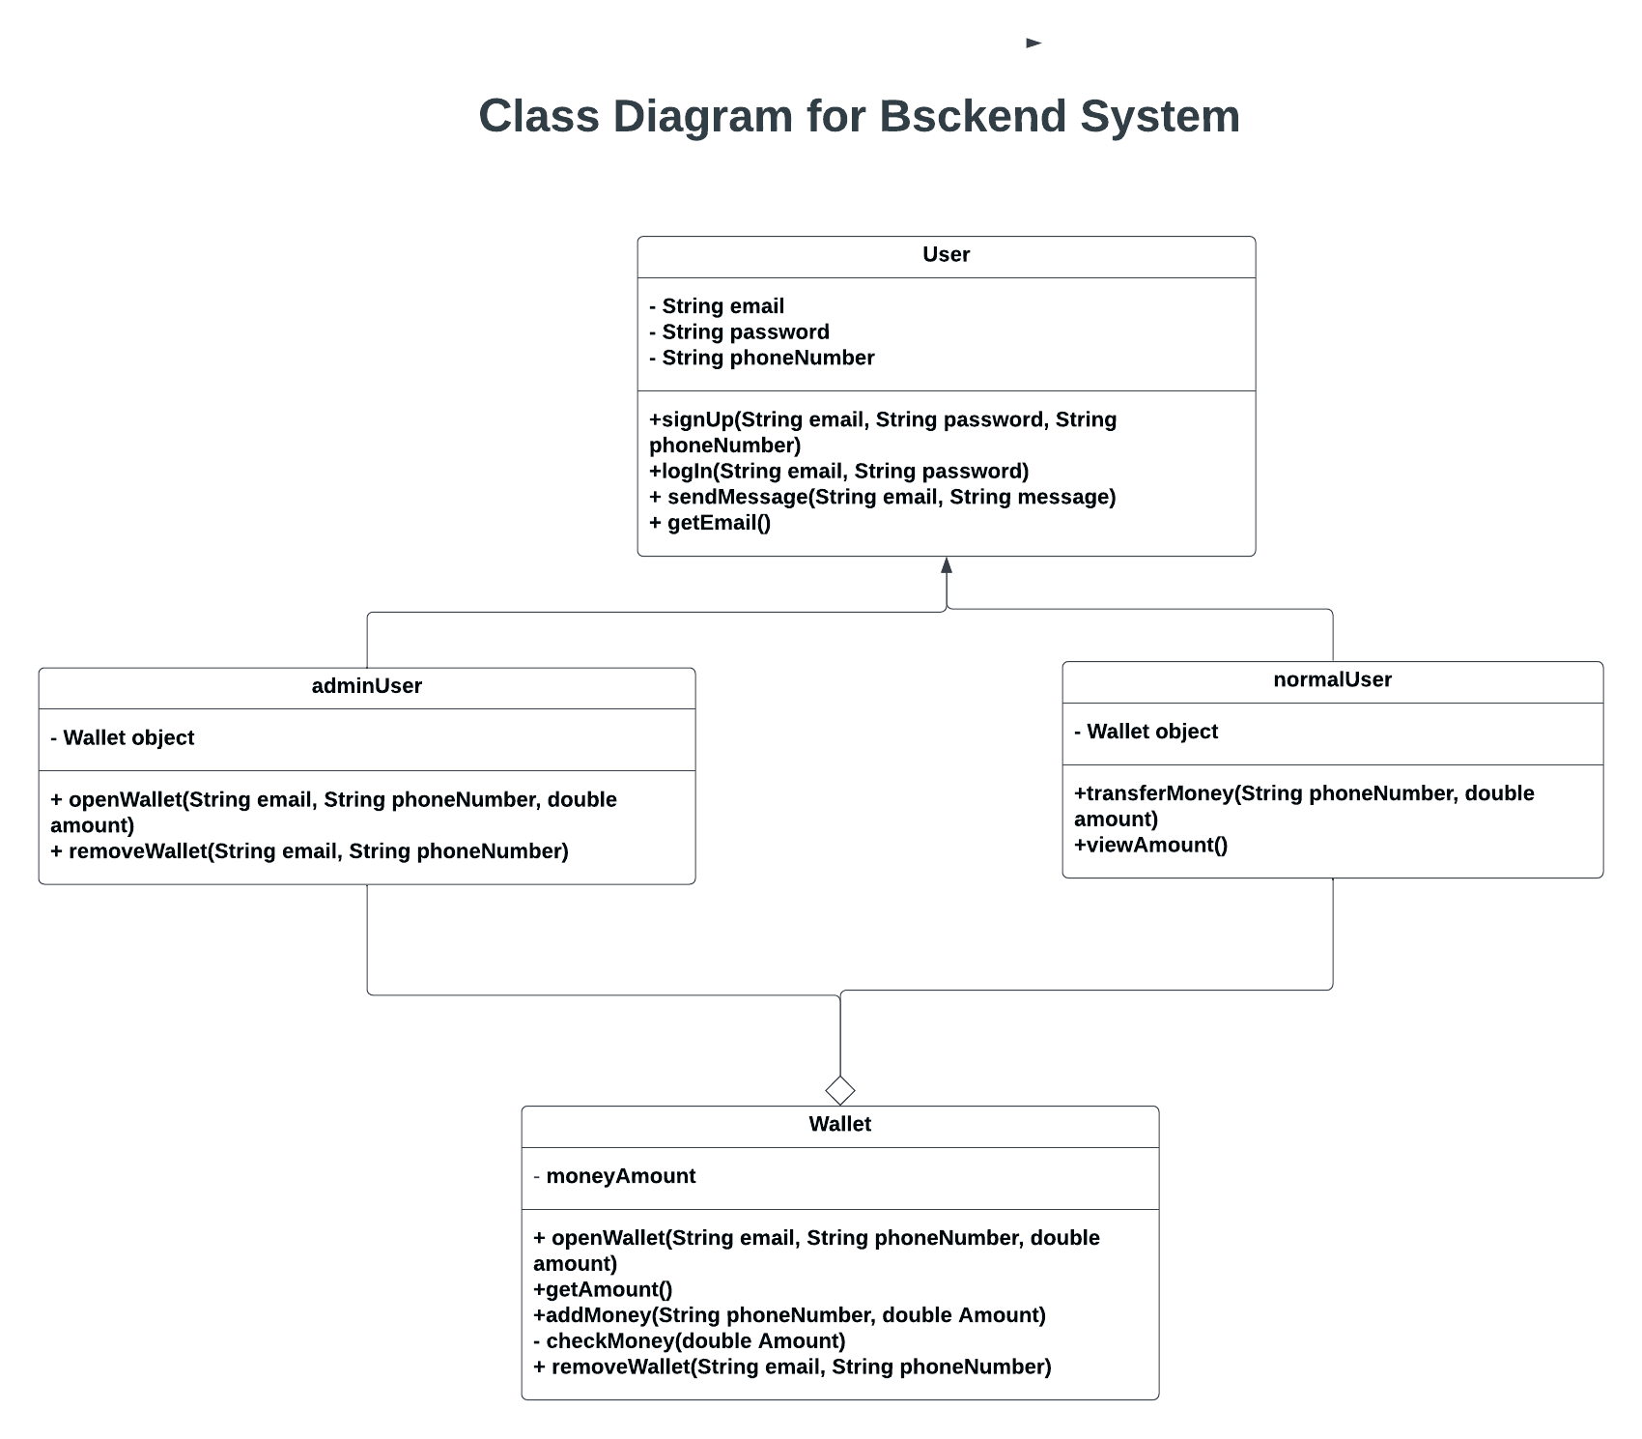
Class Diagram

Slide 10
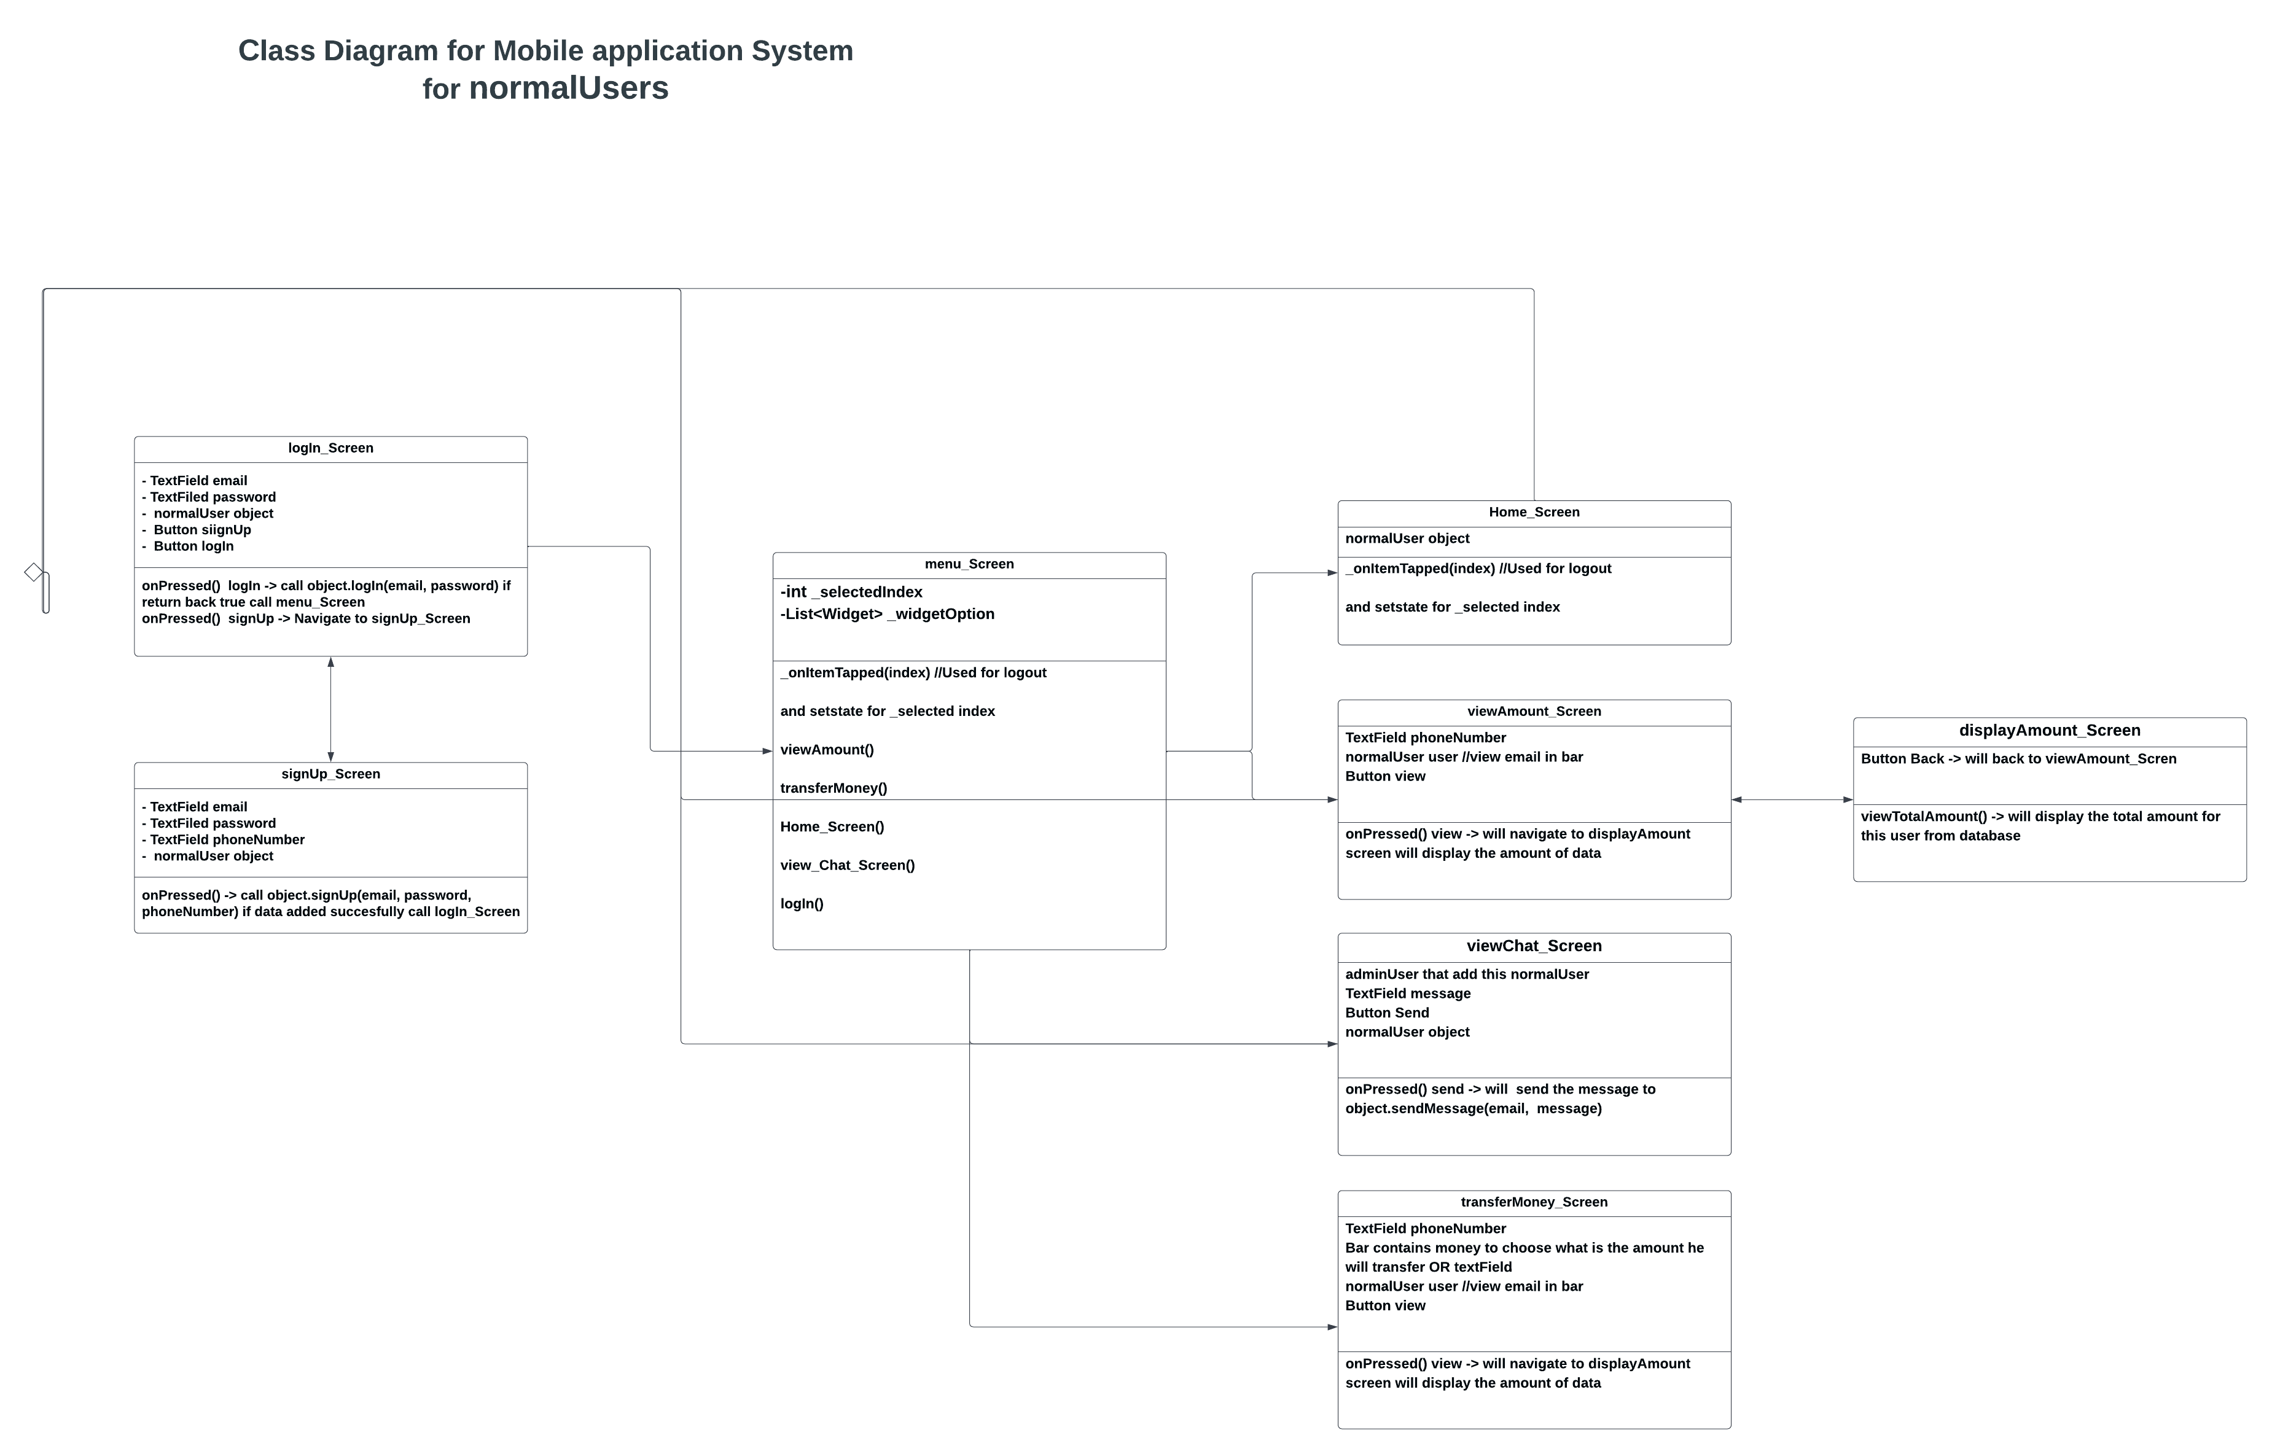
Class Diagram

Slide 11
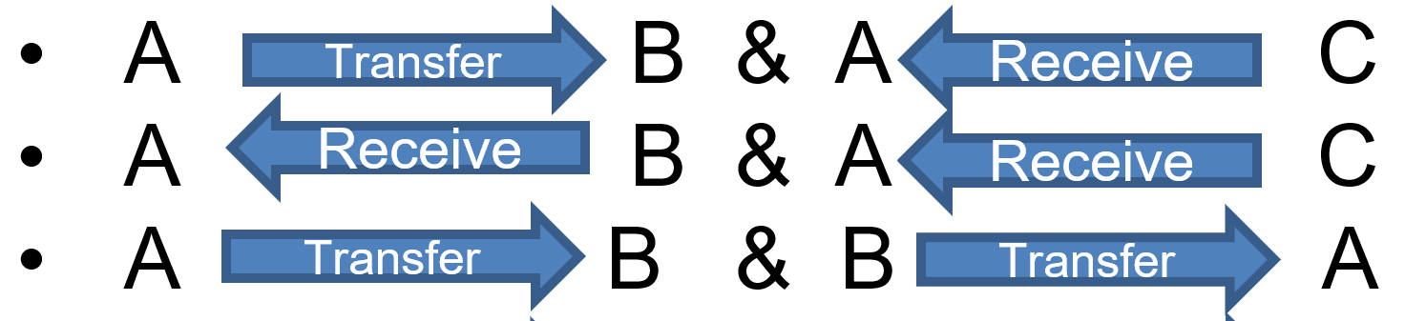
Experiment Cases
User A transfers money to user B, and at the same time user C transfers money to user A .
User
A B & A C
A B & A C
A B & B A
A B & C B
A B & C D
A B & C D
Transfer
Receive
Receive
Receive
Receive
Transfer
Transfer
Transfer
Transfer
Transfer
Transfer
Receive
Receive

Slide 12
Experiment & Results
Algorithms(Python implementation):
1. Trying to run the code sequentially :
The expected results is:-
Long time to execute all the operations
Can’t run two process at the same time
2. Applying different parallel algorithms:
Multithreading:
The expected results:-
users can access the system concurrently with out waiting for the other users to finish operations.
B. Producer Consumer:
The expected results:-
Users will share data easily with out causing data race or receiving incorrect data.
C.MPI
The expected results:-
In case of failure of the Producer Consumer algorithm, MPI will be used since it substitute the shared buffer with a distrubuted memory for each process.

Slide 13
Expected results
Mobile/web application.
Transferring money easily.
Making sure if user A and user C transferred money to user B at the same time, User be must revive the transferred amount correctly. This will be done by provider and consumer.
1
2
3

Slide 14


Any Question
Any Question

