Slide 1




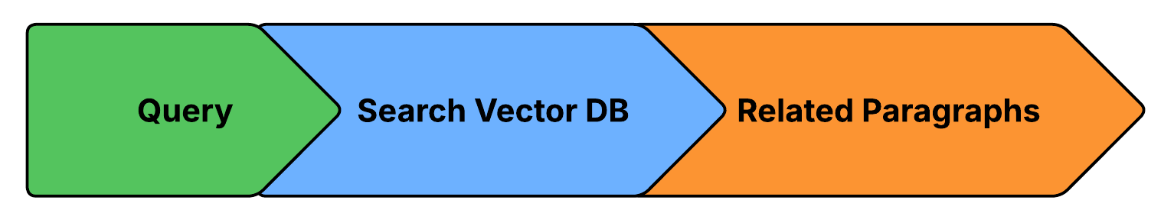
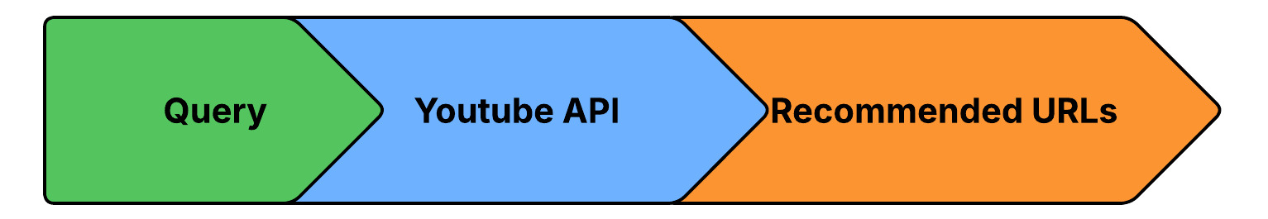
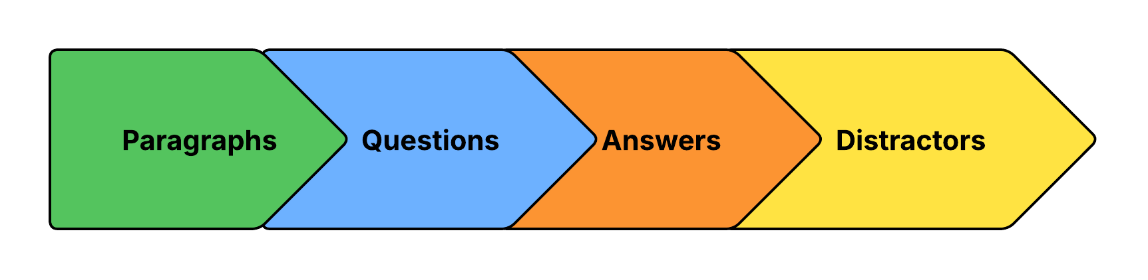
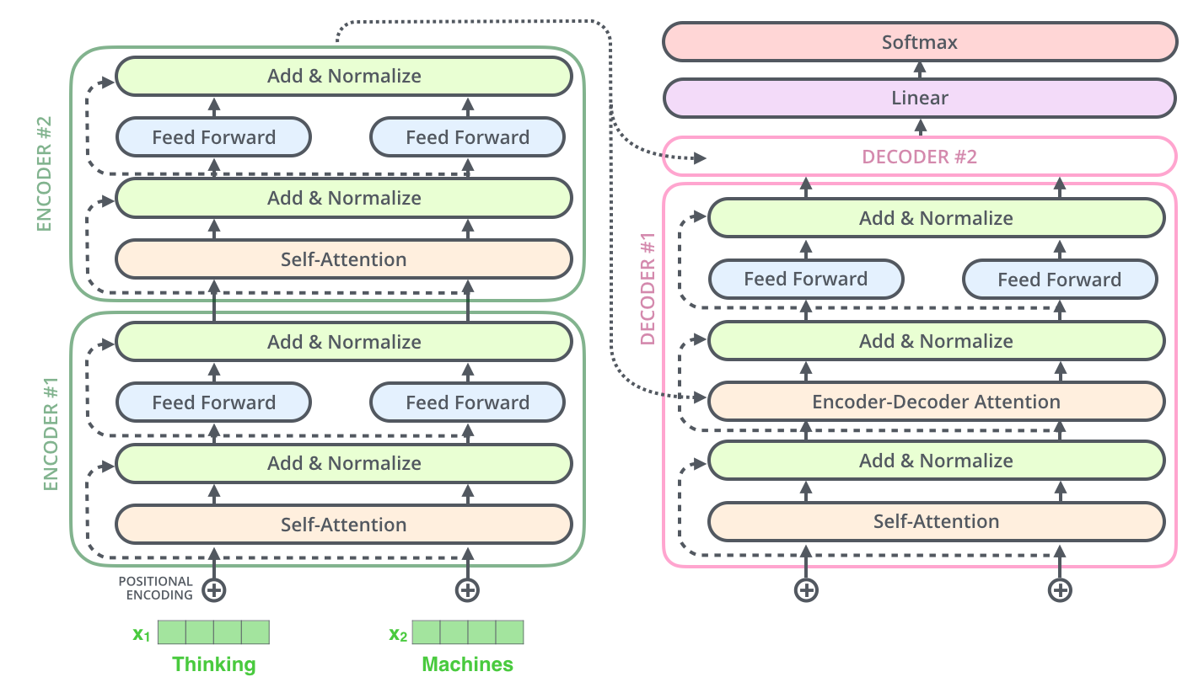
Arabic Learning Management
System (LMS) mobile application
By: Nour Ehab, Nouran Ayman, Noureen Ashraf,
Yosra Nabil, Yassmen Ashraf, Youstina Ehab
Supervised by: Prof. Dr. Sally Saad, TA. Mohammad Essam
Computer Science Department, Faculty of Computer and Information Sciences - Ain Shams University
Introduction
Results
Our project presents an AI-based Learning Management System (LMS) mobile application designed to transform Arabic-language education. The system caters to two types of end users: Teachers and Students. The teacher’s role includes uploading educational materials in the form of PDFs, and using the system’s automated question generation feature to create assignments and exams. Teachers can also view their students' exam grades to assess their performance.
For students, the system provides the ability to take exams with questions intelligently tagged based on the curriculum. After completing exams, students can view their grades for each assessment. Additionally, the system recommends learning resources tailored to their weaknesses, helping them improve their understanding of the subject matter.
By streamlining exam creation, grading, and performance review, this AI-powered LMS enhances the teaching and learning experience for both educators and students in Arabic-based education.
Table I: Results of Youtube API:
Table II: Results of FAISS Vector Database
Model | Accuracy
Multilingual-E5-large-instruct | 87.18%
Multilingual-E5-large paraphrase-multilingual-mpnet-base-v2 | 83.50%
paraphrase-multilingual-mpnet-base-v2 | 62.63%
paraphrase-multilingual-MiniLM-L12-v2 | 55.55%
distiluse-base-multilingual-cased-v2 | 40.18%
Model | Accuracy
Multilingual-E5-large-instruct | 87.46%
Multilingual-E5-large | 84.59%
paraphrase-multilingual-MiniLM-L12-v2 | 72.43%
paraphrase-multilingual-mpnet-base-v2 | 67.34%
distiluse-base-multilingual-cased-v2 | 42.70%
Table III: Results of Question Generation Model Training:
Fig.1. Traditional vs. AI-enhanced Systems
Model | BERTScore | BLUE-4 | METEOR
AraBART mT5 AraT5 | 0.85905 0.83607 0.87333 | 0.21653 0.17535 0.21653 | 0.38785 0.39472 0.47012
Methods
Our AI-powered Arabic Learning Management System (LMS) is built as a mobile application using Flutter for the frontend and FAST API for the backend, featuring a three-layer architecture (UI, AI logic, and database). The system leverages fine-tuned AraT5 transformer models trained on Arabic-SQuAD and custom EKB datasets to enable advanced natural language processing capabilities. Key features include automatic generation of Arabic multiple-choice questions (MCQs), personalized learning recommendations with 87% accuracy, and comprehensive performance dashboards. The technical stack utilizes PyTorch and Hugging Face for NLP tasks, with Python and MongoDB handling backend operations and data management.
Table IV: Results of Question Answering Model Training:
Model | Precision | Recall | F1-Score
AraBART mT5 AraT5 | 0.85905 0.6434 0.9037 | 0.21653 0.7402 0.9121 | 0.38785 0.39472 0.8890
AraT5 demonstrates the best overall performance and is the most suitable for Arabic educational question-related tasks.
Fig.2. Explore Topics Pipeline
Fig.3. Extra Resources Pipeline
Conclusions
Fig.4. QG/QA Pipeline
The system demonstrates the potential of deep learning models for enhancing Arabic educational content. It supports personalized learning through automated question generation and performance tracking, offering a scalable solution for Arabic-language education.
Bibliography
Nakhleh S, Mustafa AM, Najadat H. AraT5GQA: Arabic Question Answering model using automatic generated dataset. In2024 15th International Conference on Information and Communication Systems (ICICS) 2024 Aug 13 (pp. 1-5). IEEE.
M. Abbas, M. U. Riaz, A. Rauf, M. T. Khan and S. Khalid, "Context-aware Youtube recommender system," 2017 International Conference on Information and Communication Technologies (ICICT), Karachi, Pakistan, 2017, pp. 161-164, doi: 10.1109/ICICT.2017.8320183.
S. Qin, R. Menezes and M. Silaghi, "A Recommender System for Youtube Based on its Network of Reviewers," 2010 IEEE Second International Conference on Social Computing, Minneapolis, MN, USA, 2010, pp. 323-328, doi: 10.1109/SocialCom.2010.53.
Fig.5. T5 Architecture

