Slide 1
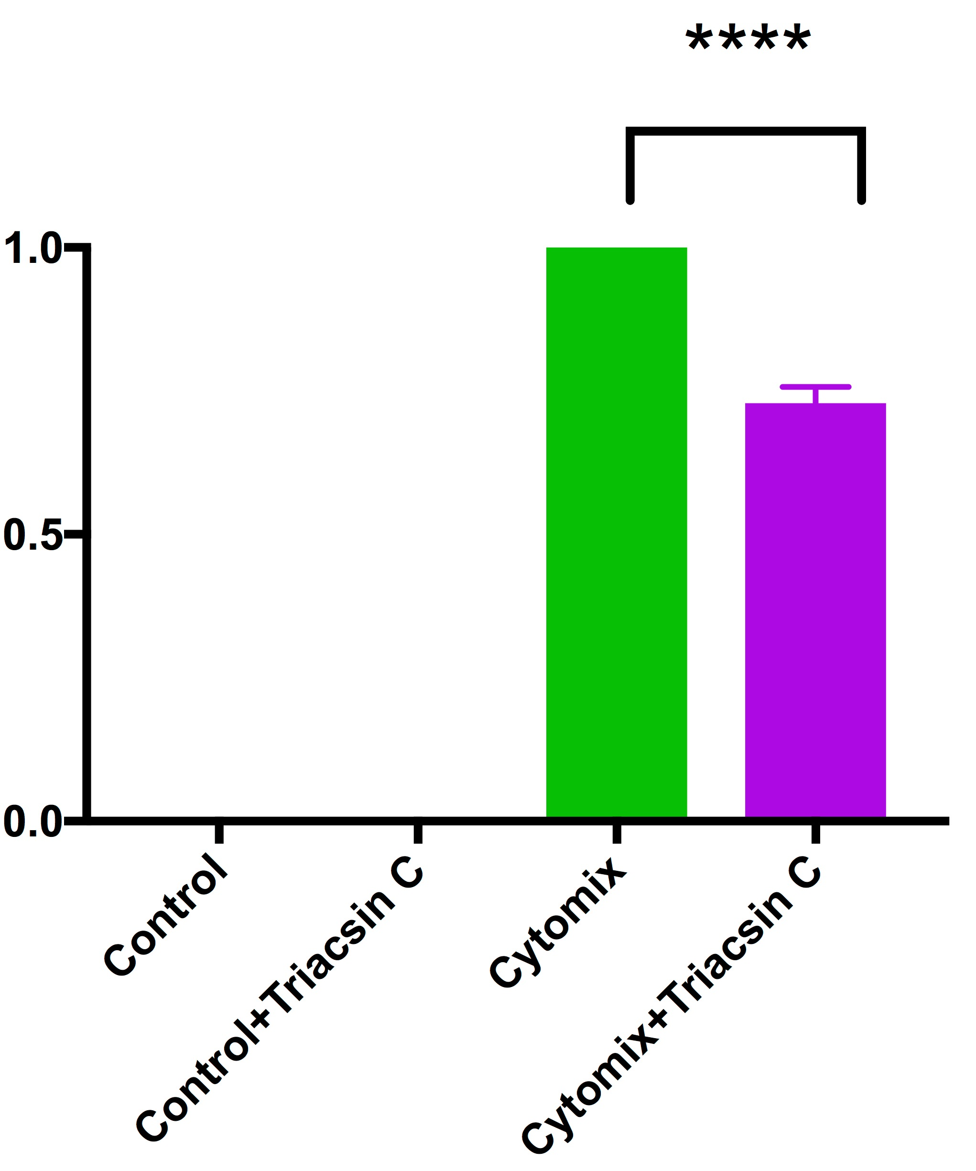
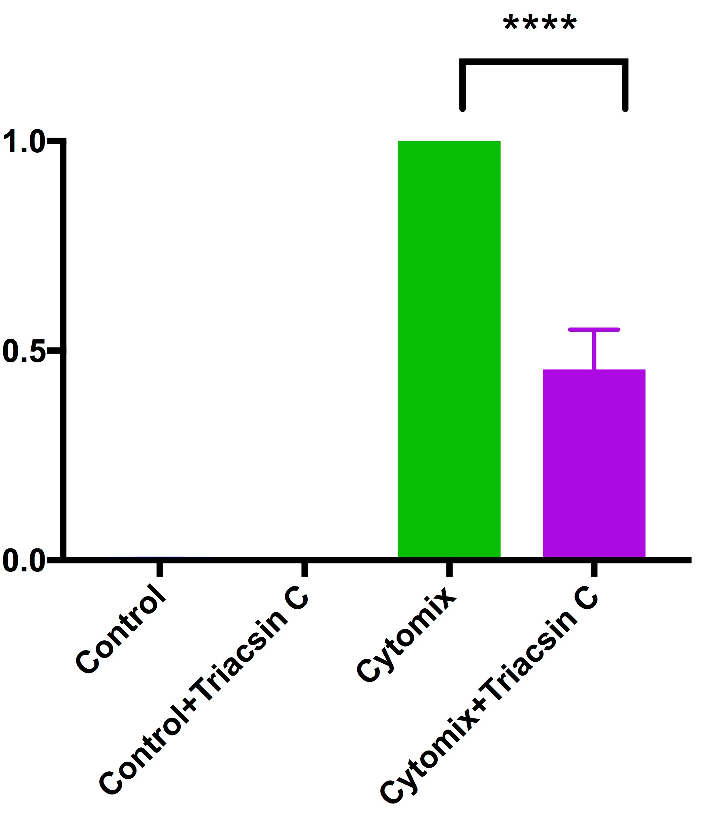
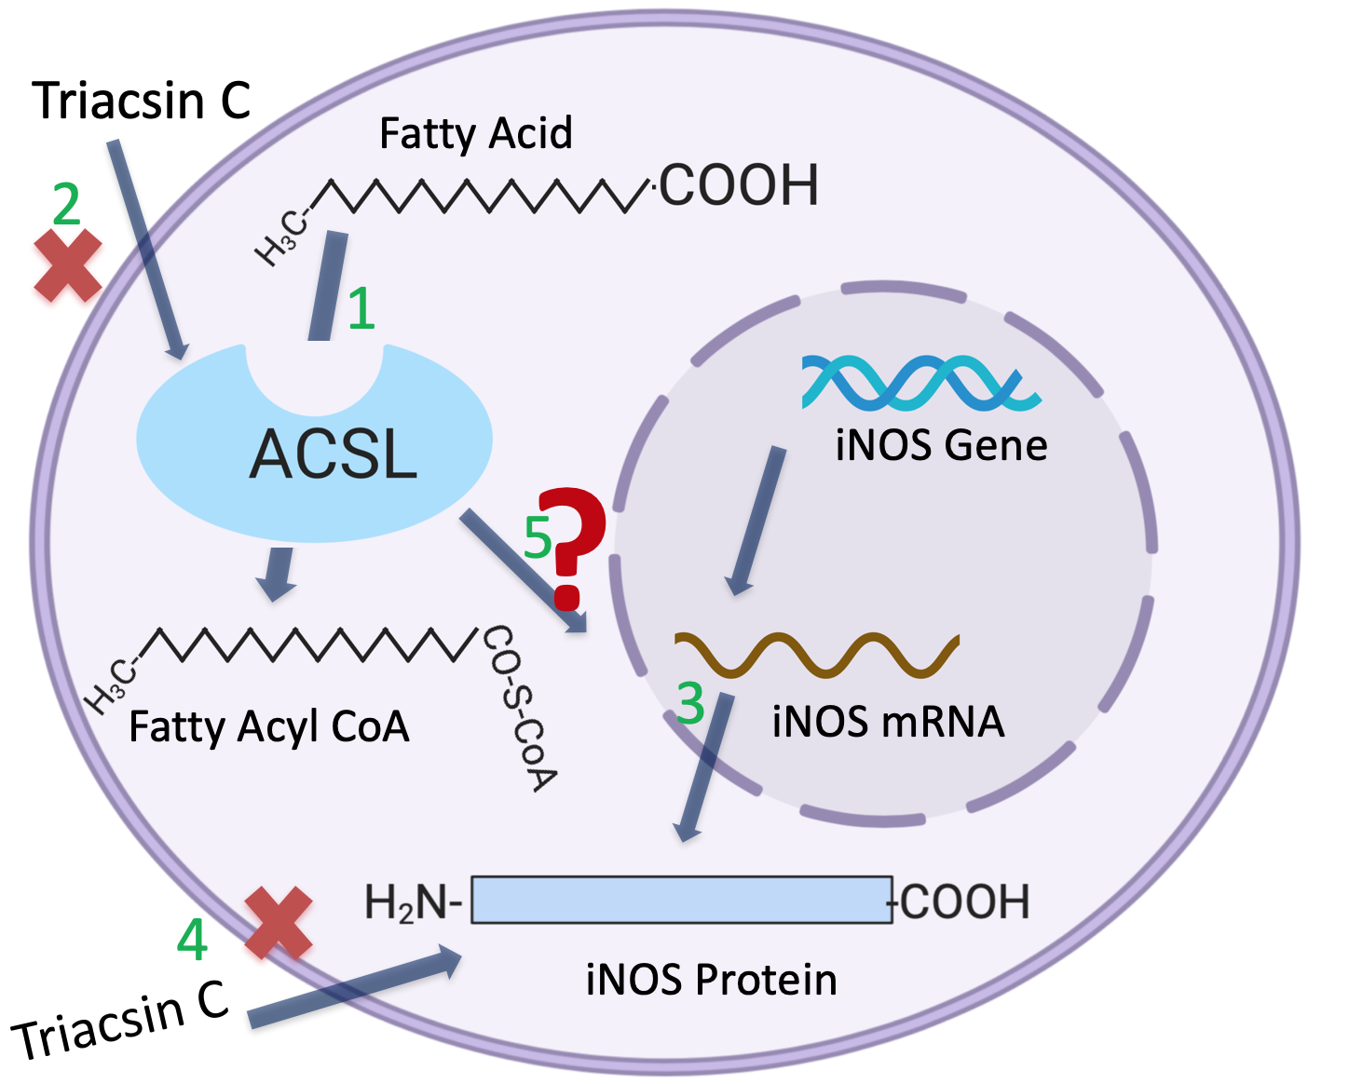
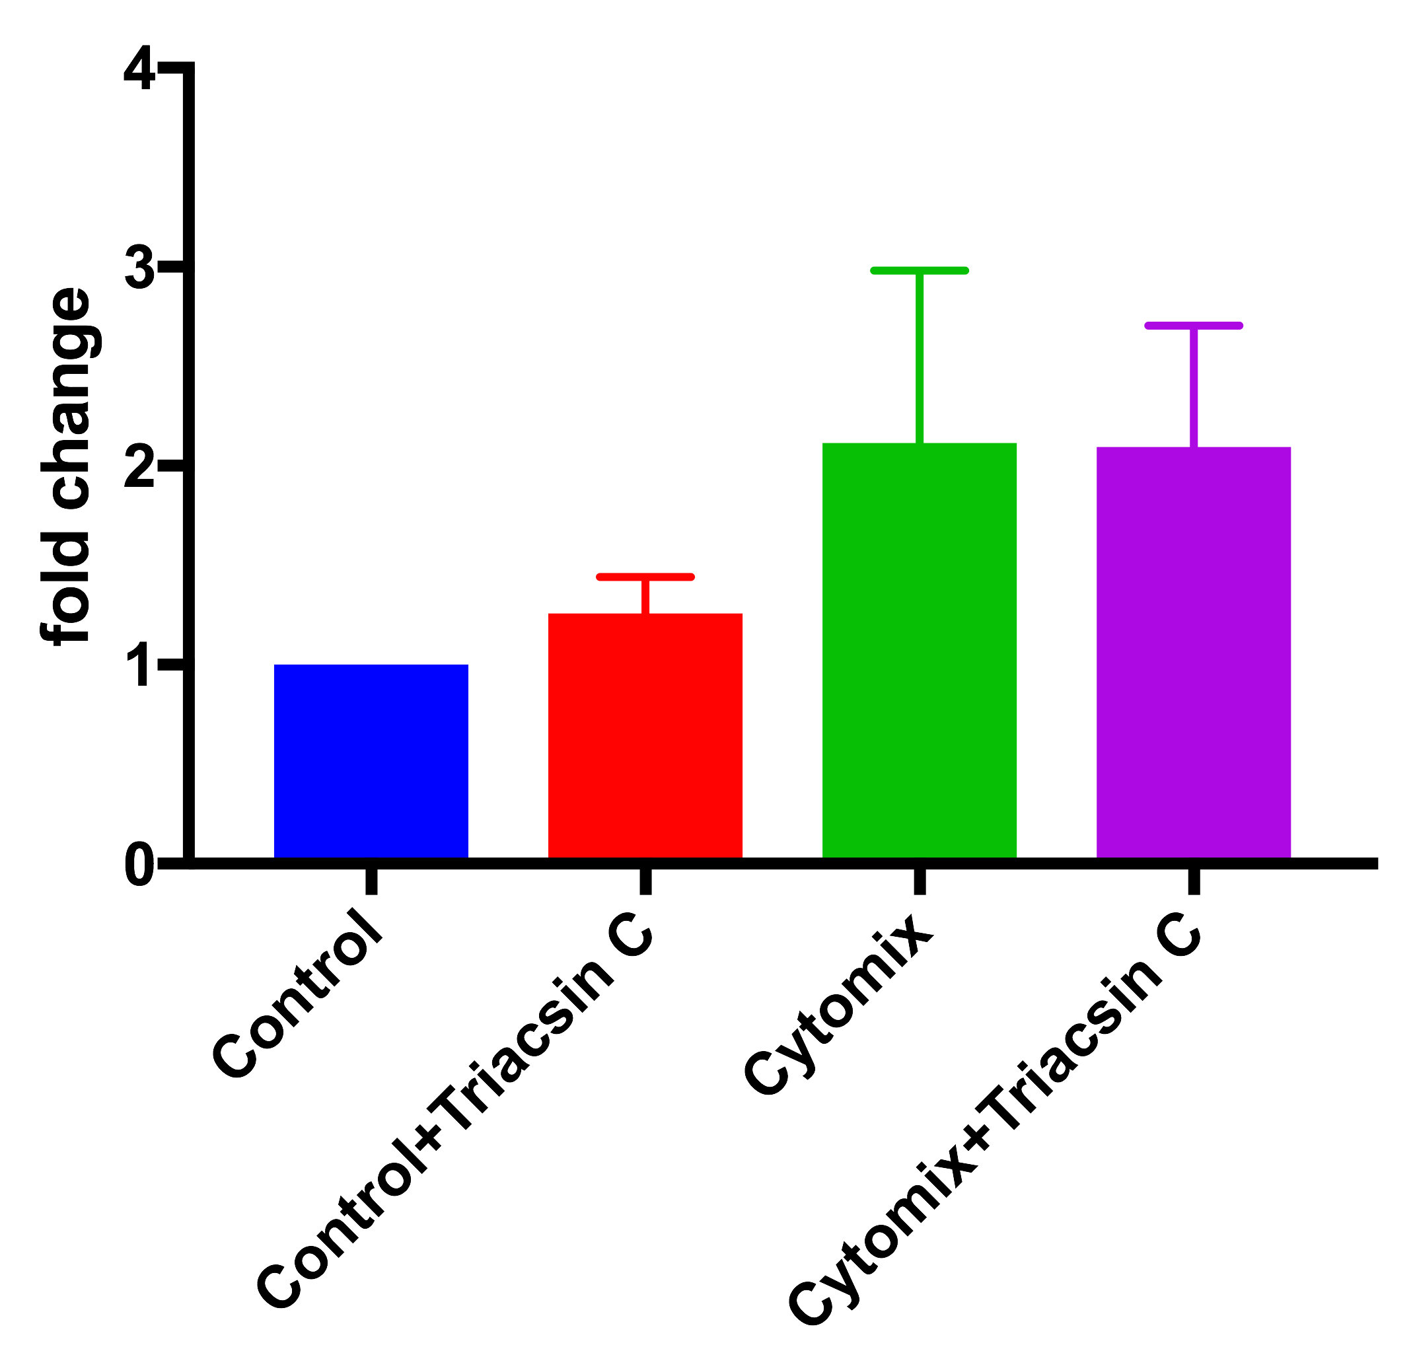
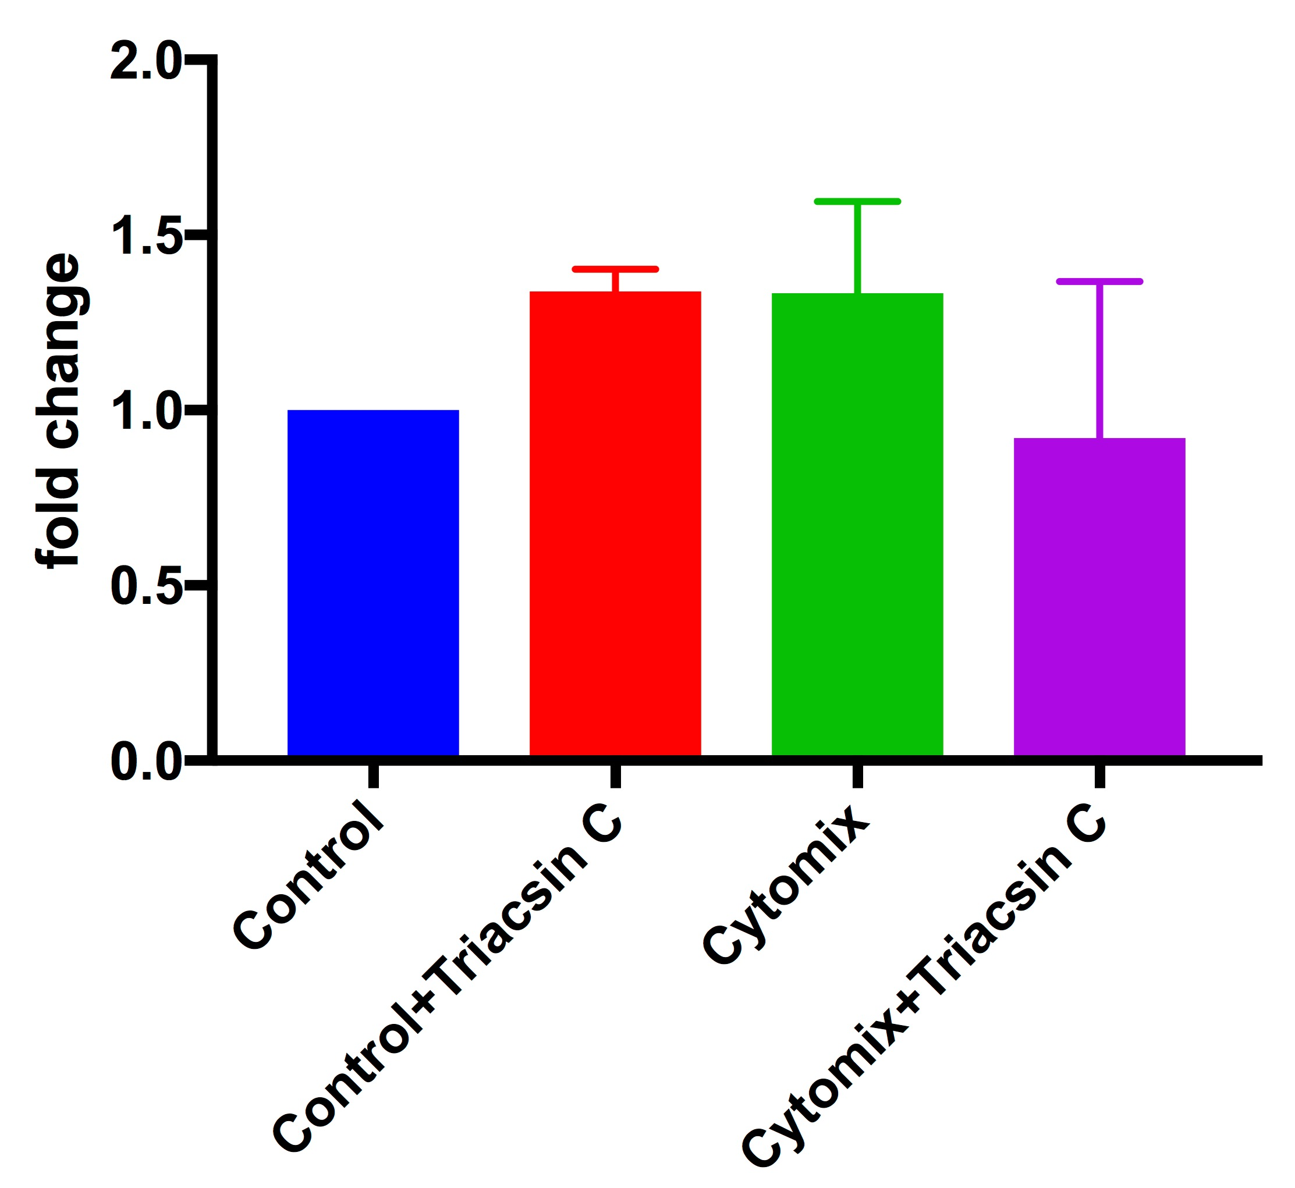
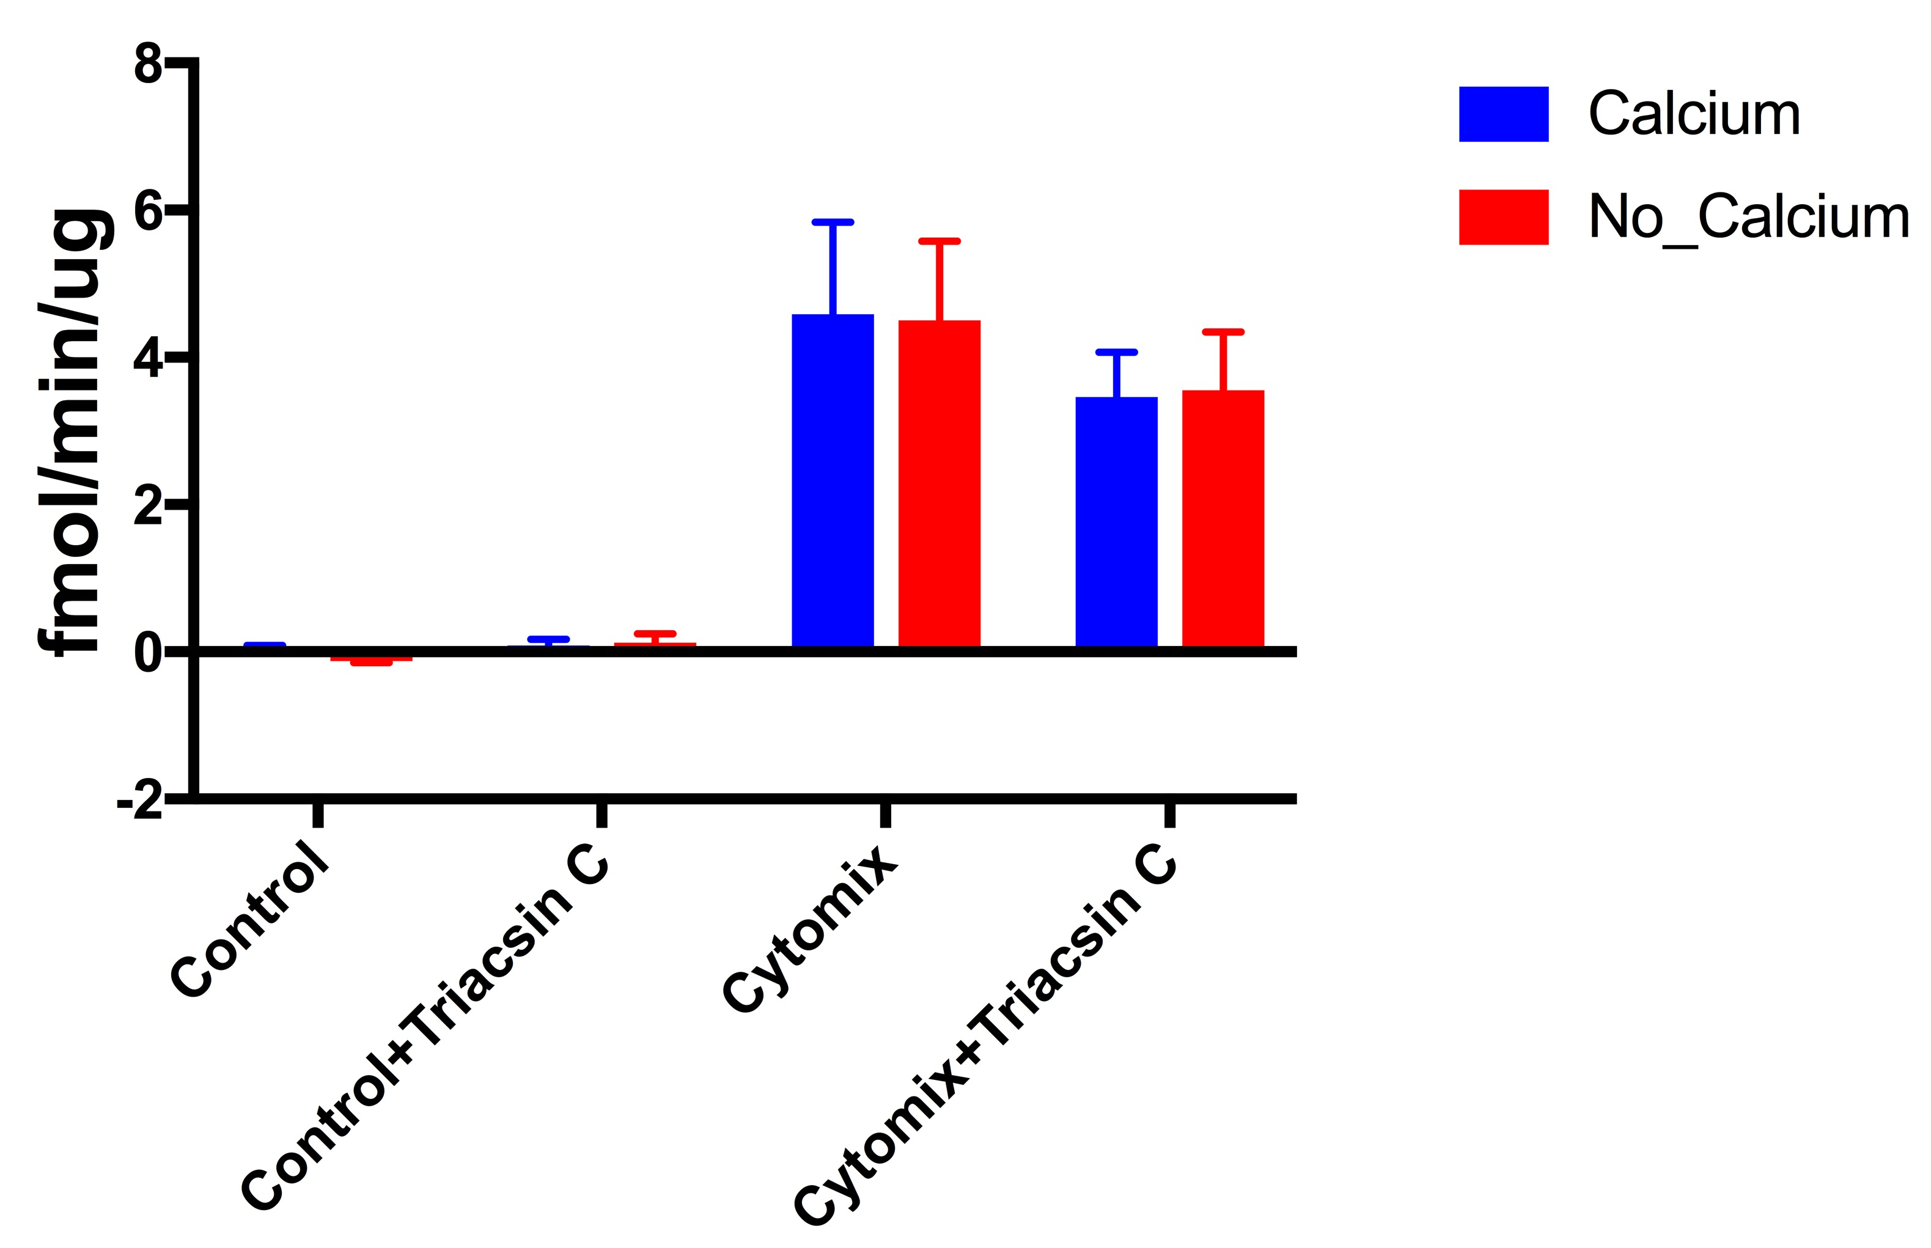
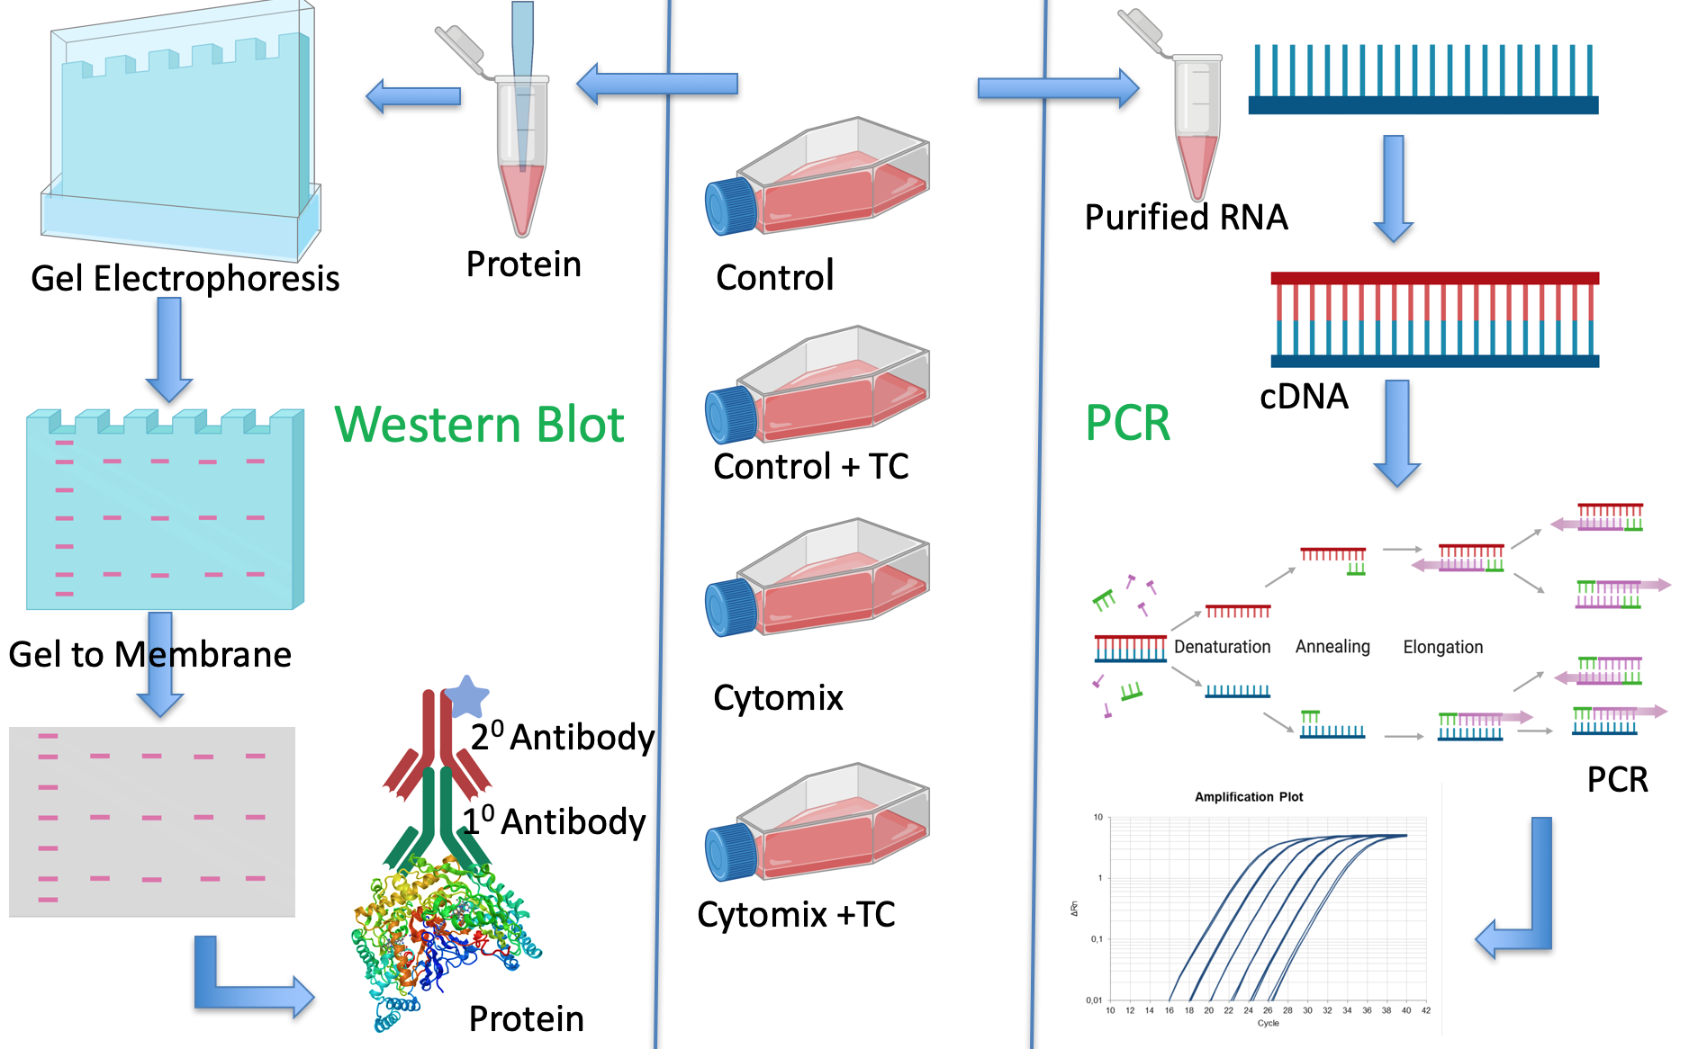
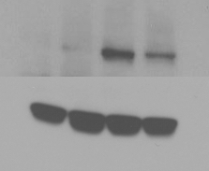



Inhibition of Long Chain Fatty Acyl CoA Synthetase Modulates Inducible Nitric Oxide Synthase Expression
Md Yousuf Ali, Margaret Weis
Department of Pharmaceutical Sciences, Texas Tech University Health Sciences Center , Amarillo, TX
T0930-10-64
Email: Yousuf.ali@ttuhsc.edu
Phone: 806-437-3297
PURPOSE
Stroke kills about 140,000 Americans each year and is the leading cause of long-term disability. Eighty- seven percent of all stroke is ischemic stroke. Nitric oxide (NO), synthesized by nitric oxide synthase (NOS), has a dual role in the ischemic condition. Endothelial nitric oxide synthase (eNOS) derived NO regulates vascular tone in a way that it considered neuroprotective. In contrast, inducible nitric oxide synthase (iNOS) expression increases from 12 hours after the onset of ischemic stroke and can last for 1 week. When iNOS is induced, it can produce 100 to 1000 times more NO than eNOS, concentrations that are neurotoxic, leading to neuronal cell death. Our lab has published that Triacsin C, a fungal metabolite which inhibits long chain fatty acyl CoA synthetase (ACSL), decreases eNOS palmitoylation and increases eNOS derived NO without upregulating eNOS transcription in cultured human coronary endothelial cells. In addition, Triacsin C reduces the infarct volume and inhibits iNOS expression in the mouse middle cerebral artery occlusion (MCAO) model of stroke. In the current study, we wanted to see whether iNOS expression is modulated by ACSL activity.
Results
Cont’d Method
RNA Isolation and RT-PCR:
Cells were stimulated with cytokine mixture (cytomix) (TNFα, 60 ng/mL; IL-1β, 2 ng/mL; IFNγ, 100 units/mL) in the presence or absence of 5μM Triacsin C for 24 hours. RNA was extracted following the RNeasy Plus Mini Kit (Qiagen) instructions. The concentration and purity of RNA were determined spectrophotometrically. Twenty μl first strand cDNA was synthesized from 1 μg total RNA for each sample using Superscript III First-Strand (Invitrogen). One μl cDNA was amplified using SYBR Green PCR Master Mix (Applied Biosystems) in the CFX96 Touch Real-Time PCR Detection System (BioRad). The expression level in fold change was determined by the comparative threshold cycle method (2^{–ΔΔCt}) with β-actin as the control gene.
NOS Catalytic Activity:
Total nitric oxide synthase activity was measured by conversion of [¹⁴C] arginine to [¹⁴C] citrulline. C6 astrocytoma cells were grown to confluence under standard conditions, then challenged with cytokine mixture in the presence or absence of Triacsin C following previously mentioned groups. After 24 hours, cells were processed for assay. Activity was assayed by mixing 10 μl of cell homogenate and 40 μl of NOS assay cocktail. After 10 min at 37 ⁰C, the reaction was terminated by adding 400 μl of stop solution (50 mM HEPES, pH 5.5, 5 mM EDTA). The unreacted substrate was removed by Dowex 50WX8 (100-200 mesh) ion-exchange resin chromatography. Product formation was calculated as fmol product/min/ μg protein.
Western Blotting:
bEnd.3 cells were grown to confluence under standard conditions, then challenged with cytokine mixture in the presence or absence of Triacsin C following previously mentioned groups. After 24 hours, cells were washed with ice-cold PBS buffer and protein extracted using RIPA buffer. Proteins were separated by 4-20% Tris-Glycine gel and transferred to a PVDF membrane then probed with an antibody against iNOS. After blots were visualized, membrane was stripped and re-probed for alpha actin as a loading control.
Fig. 1: iNOS Gene Expression in C6 Astrocytoma Cells.
Cytomix stimulated iNOS expression in the presence of Triacsin C was 72.9 ± 1.96 % of cytomix group ( p = 0.0001, n = 3 independent experiments)
Fig. 4: iNOS Gene Expression in bEnd.3 Cells.
Cytomix stimulated iNOS expression in the presence of Triacsin C was 45.6 ± 6.7 % of cytomix group ( p = 0.0001, n = 6 independent experiments)
Fig. 2: nNOS Gene Expression in C6 Astrocytoma Cells.
No significant differences between any groups.
Conclusions
ACSL inhibition with Triacsin C reduced cytokine-stimulated iNOS mRNA expression in both C6 astrocytoma and bEnd.3 cells.
ACSL inhibition with Triacsin C reduced cytokine-stimulated iNOS catalytic activity in C6 astrocytoma cells.
ACSL inhibition with Triacsin C reduced cytokine-stimulated iNOS protein expression in bEnd.3 cells.
No change has been observed in nNOS mRNA expression in any group compared to the control in C6 astrocytoma cells.
No change has been observed in eNOS mRNA expression in any group compared to the control in bEnd.3 cells.
Fig. 5: eNOS Gene Expression in bEnd.3 Cells.
No significant differences between any groups.
Methods
Ctr Ctr+TC Cyto Cyto+TC
Acknowledgements
Research Funding Support: Department of Pharmaceutical Sciences, Texas Tech University Health Sciences Center, Amarillo, TX
iNOS
⍺-actin
Fig. 6: iNOS protein Expression in bEnd.3 Cells.
Cytomix stimulated iNOS expression in the presence of Triacsin C was reduced.
Yousuf.Ali@ttuhsc.edu
Margaret.Weis@ttuhsc.edu
yousufali.net
Fig. 3: NOS Catalytic Activity in C6 Astrocytoma Cells.
No significant difference in the presence of calcium or absence of calcium group; suggest that measured activity is from iNOS activity. Triacsin C reduced cytomix stimulated iNOS activity.

