Slide 1
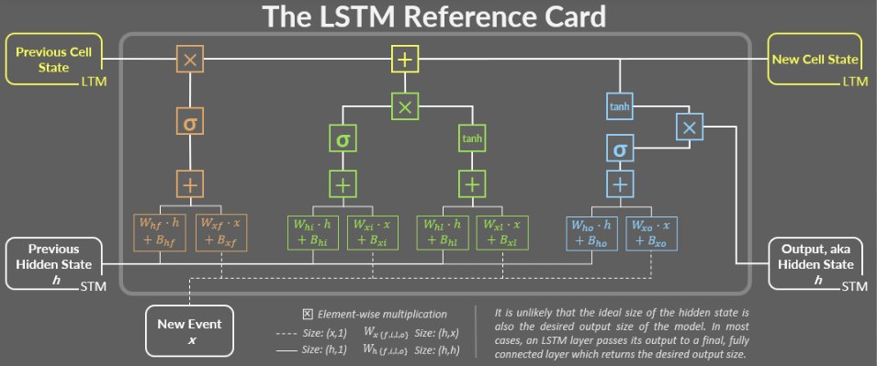
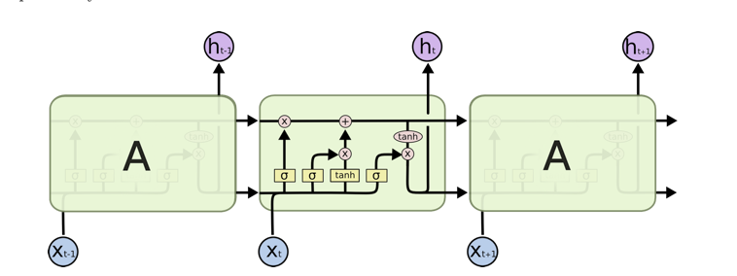
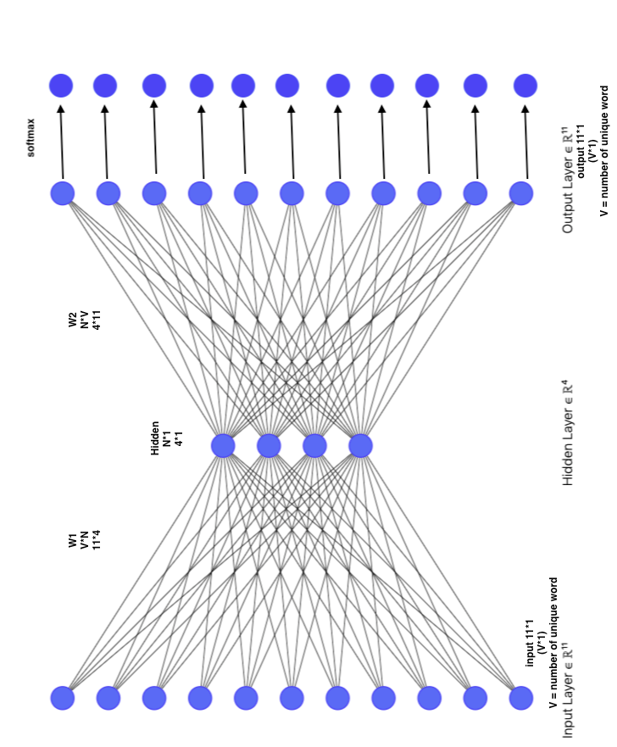
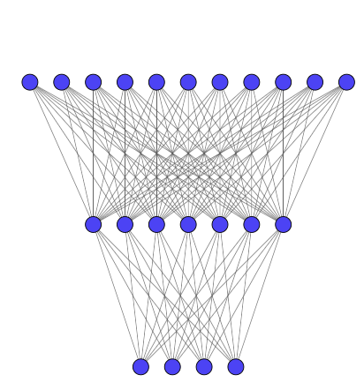
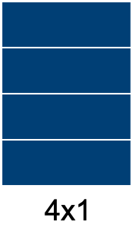
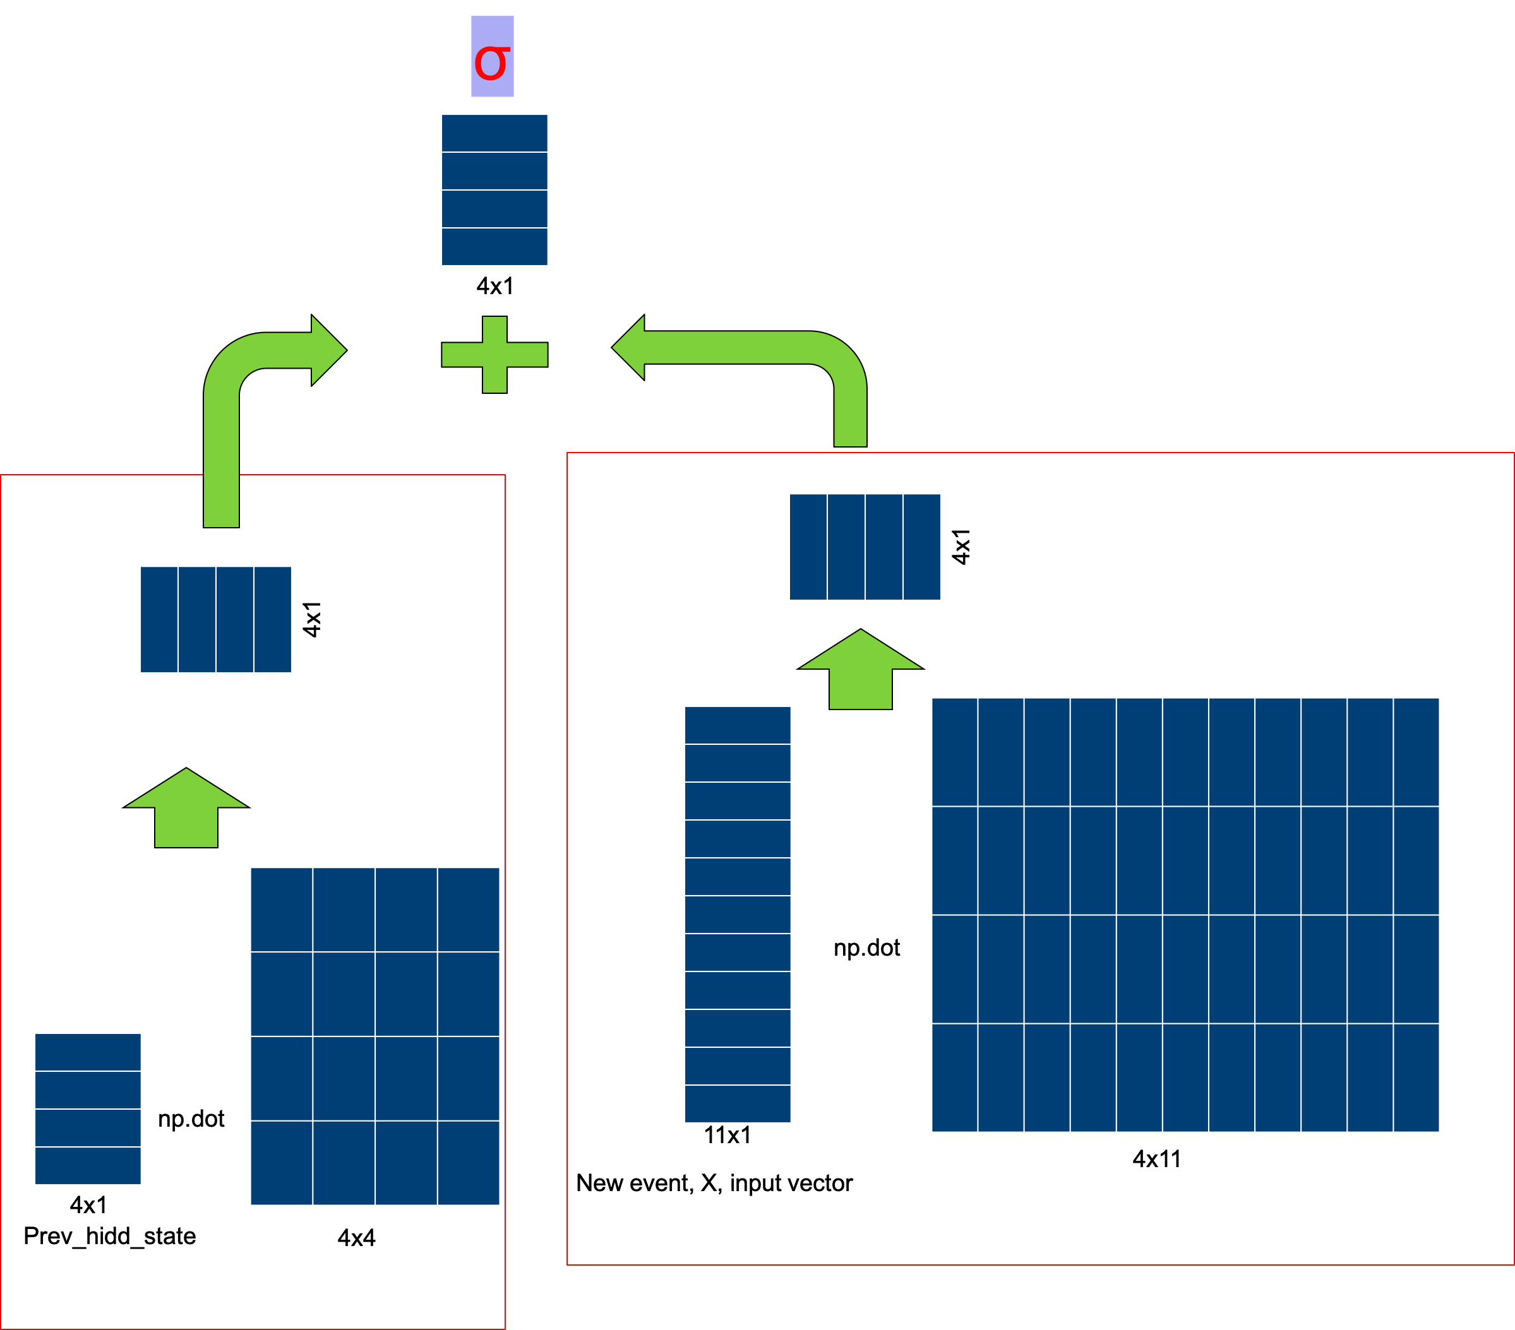
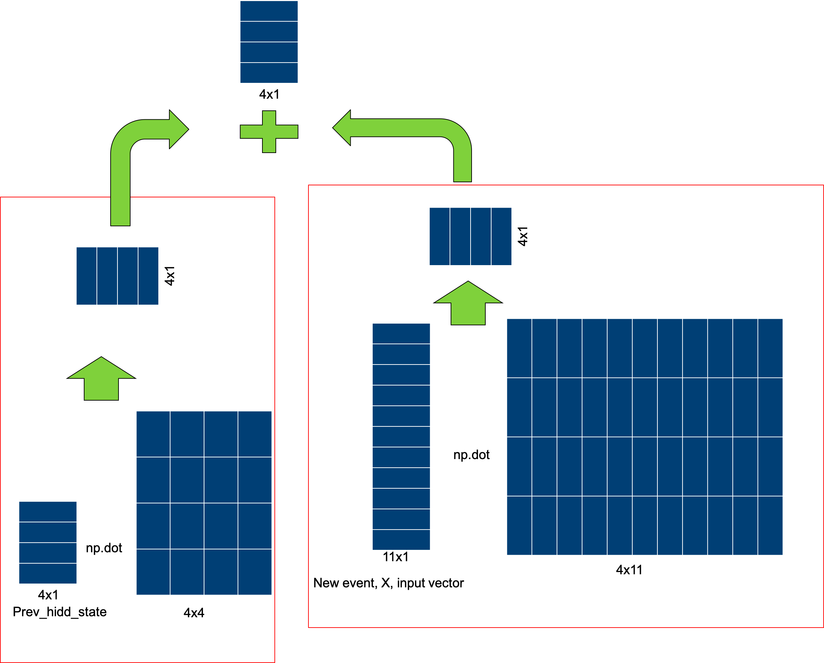
Forget gate
Prediction
Forget gate+
Learn gate or input gate = remember gate or new cell state/ new long term memory
New cell state
Previous cell state or
Long term memory
tanh
Prev_cell_state/
Long term memory
New hidden state
/ output
Use gate/
Forget gate
Learn gate or input gate
tanh
Previous hidden state or
short term memory/output
Notes:
bias omitted for simplicity

Slide 2
Prediction
New cell state
tanh
Prev_cell_state
New hidden state
tanh
Notes:
bias omitted for simplicity

Slide 3
Prediction
3
New cell state
tanh
Prev_cell_state
New hidden state
tanh
Notes:
bias omitted for simplicity

Slide 4
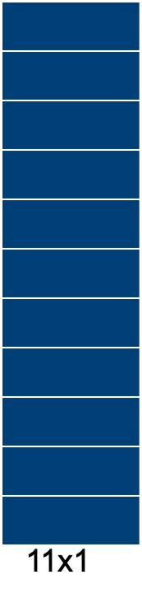
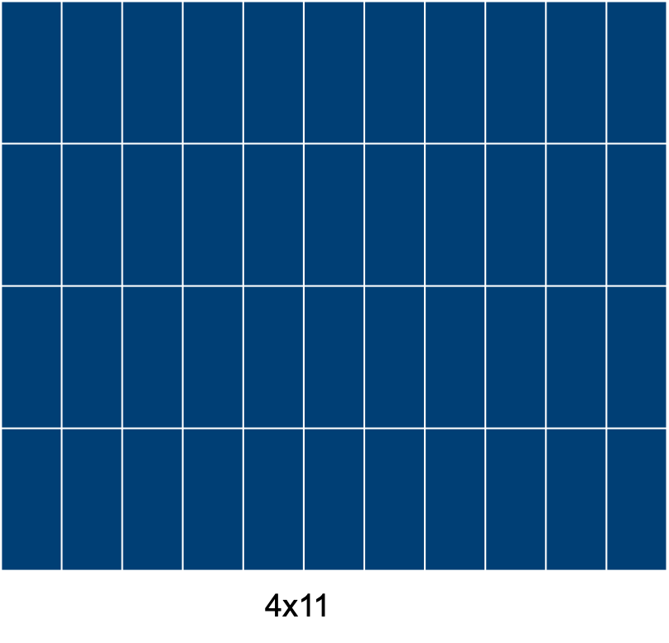
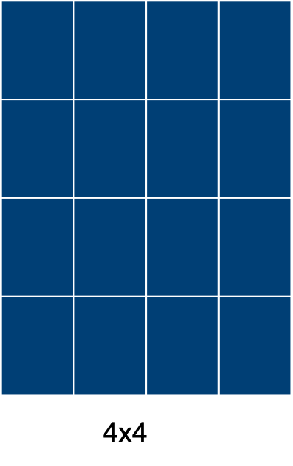

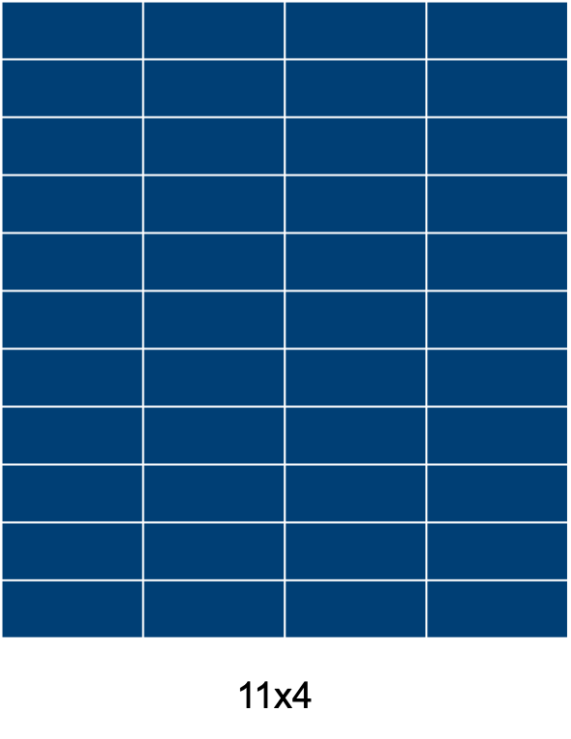
11x4
4x11
4x4
np.dot
σ
np.dot
New event, X, input vector
Prev_hidd_state

