Slide 1
Base R

Slide 2
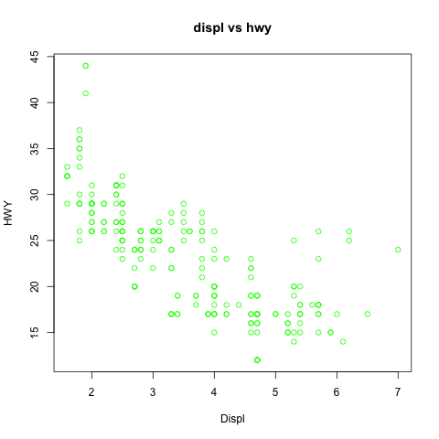
plot,
col- color
type- ’l’, ‘p’, ‘b’, line type
pch – plotting character or symbol
cex – character expansion (size)
lwd – line width of character/symbol
If we add line here,
lty – line type – dashed, solid
main, main title
cex.main
col.main
font.main
fg, foreground color
ylab, y label
axis
cex.axis
col.axis, axis color
font.axis
cex.lab
col.lab
font.lab
label
xlab, x label
sub, sub title here, cex.sub, col.sub, font.sub

Slide 3
 | inside plot- line | axis | labels (x and y both) | main | sub title
character expansion/size | cex | cex.axis | cex.lab | cex.main | cex.sub
color | col | col.axis | col.lab | col.main | col.sub
Font style- bold,italic | font | font.axis | font.lab | font.main | font.sub
 | type |  | xlab ylab | main | sub
Plotting character/symbol | pch
Line width | lwd
Font family | Family (change all text)
 | lty

Slide 4
plot,
col- color
type- ’l’, ‘p’, ‘b’, line type
pch – plotting character or symbol
cex – character expansion (size)
lwd – line width of character/symbol
If we add line here,
lty – line type – dashed, solid
Par(bg=‘gray’), background color gray/white
main, main title
cex.main
col.main
font.main
fg, foreground color
ylab, y label
axis
cex.axis
col.axis, axis color
font.axis
cex.lab
col.lab
font.lab
label
xlab, x label
sub, sub title here, cex.sub, col.sub, font.sub

Slide 5
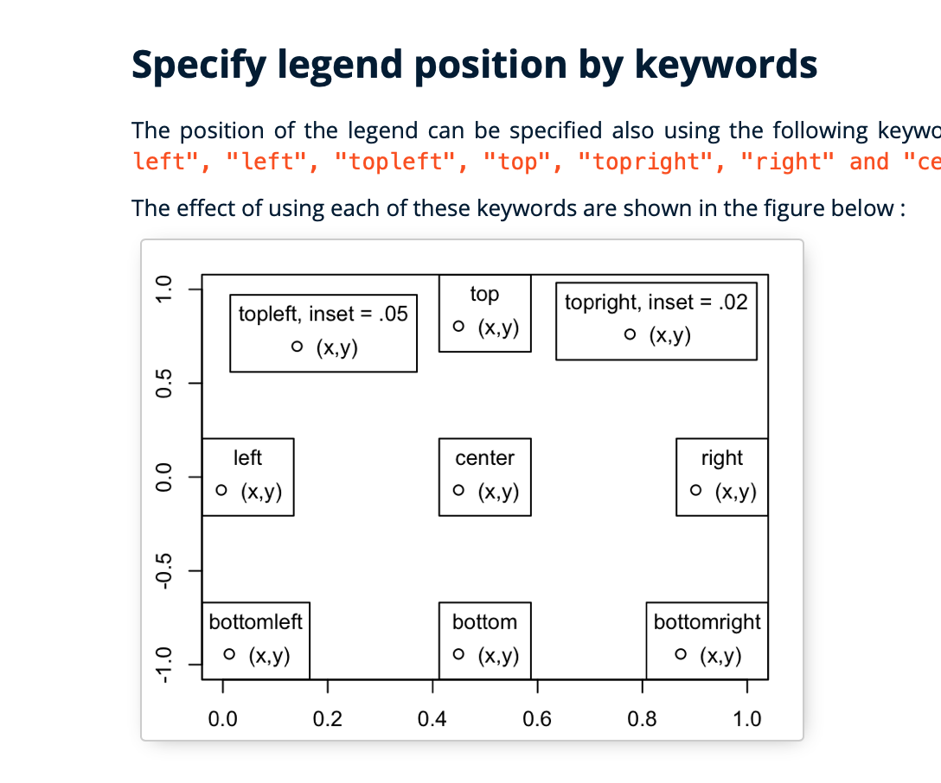
For outside the plot
par(mar=c(5.1, 4.1, 4.1, 8.1),
xpd=TRUE)
legend("right",inset = c(-0.3,0),
legend = levels(df$class),
col = color, pch=16)

Slide 6
