Slide 1
T20 World Cup’22

Slide 2
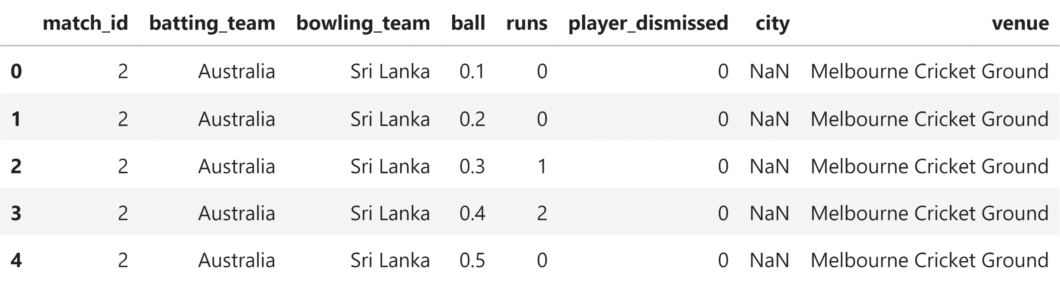
Data Literacy
Entries of each match in the tournament
match_id distinguish each entry for specific match
ball tells the number of deliveries including extras.
runs state the runs scored for that delivery
Venue is the name of Cricket Stadium

Slide 3
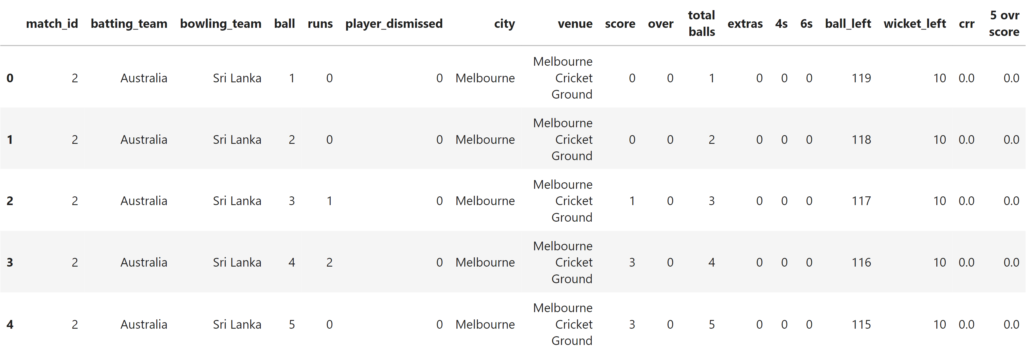
Data Transformation
Transforming the data under supervision of Domain expert
Unique Features are kept unchanged
Ball number and over count created
Score tells total runs made till that ball
Extras and boundries
Current Run Rate calculation

Slide 4
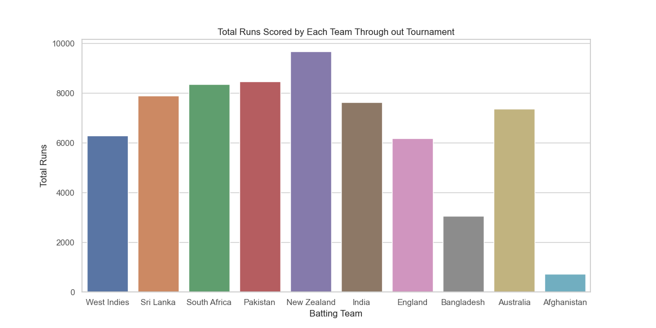
Insights of the tournament

Slide 5
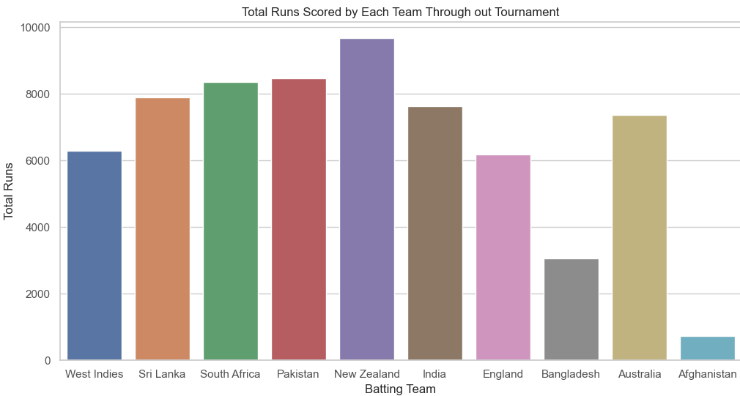
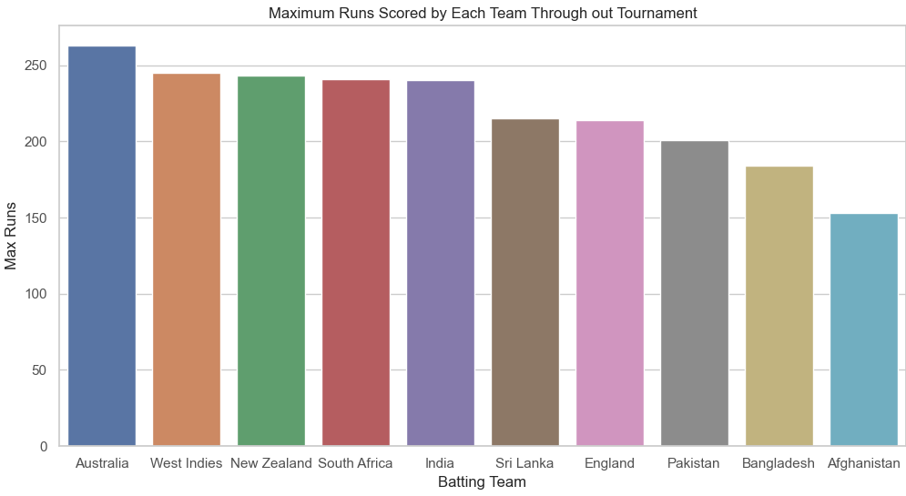
Runs Comparison
1
2
6
New Zealand had been the highest scorer of the
tournament
But Australia had largest scored in a match
Many teams did not score large numbers but had good aggregate total
Take aways:
to better understand scoring:
boundaries
run rate
fall of wickets
1
2
8

Slide 6
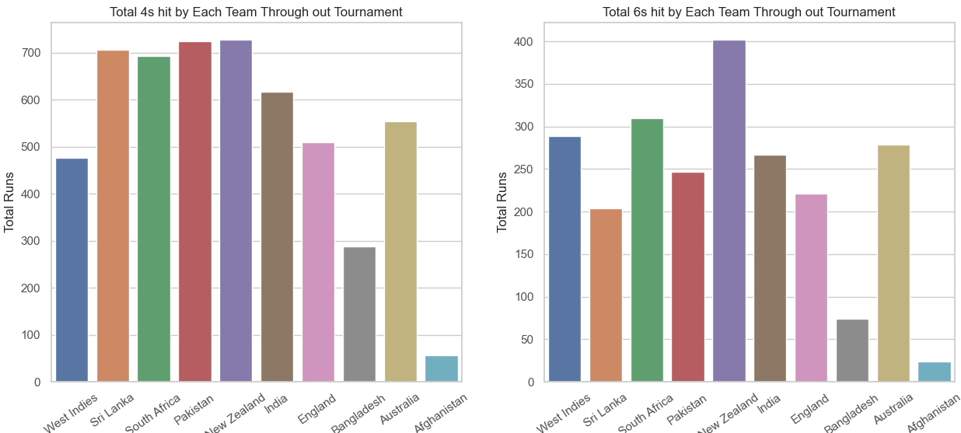
Boundaries
4s have almost similar count for many teams comapred to 6s
West Indies is the 3rd highest scorer by 6s but 7th highest scorer of the tournament
Take aways:
boundaries depend on player’s strength and stamina
2
1
1
3
2
6

Slide 7
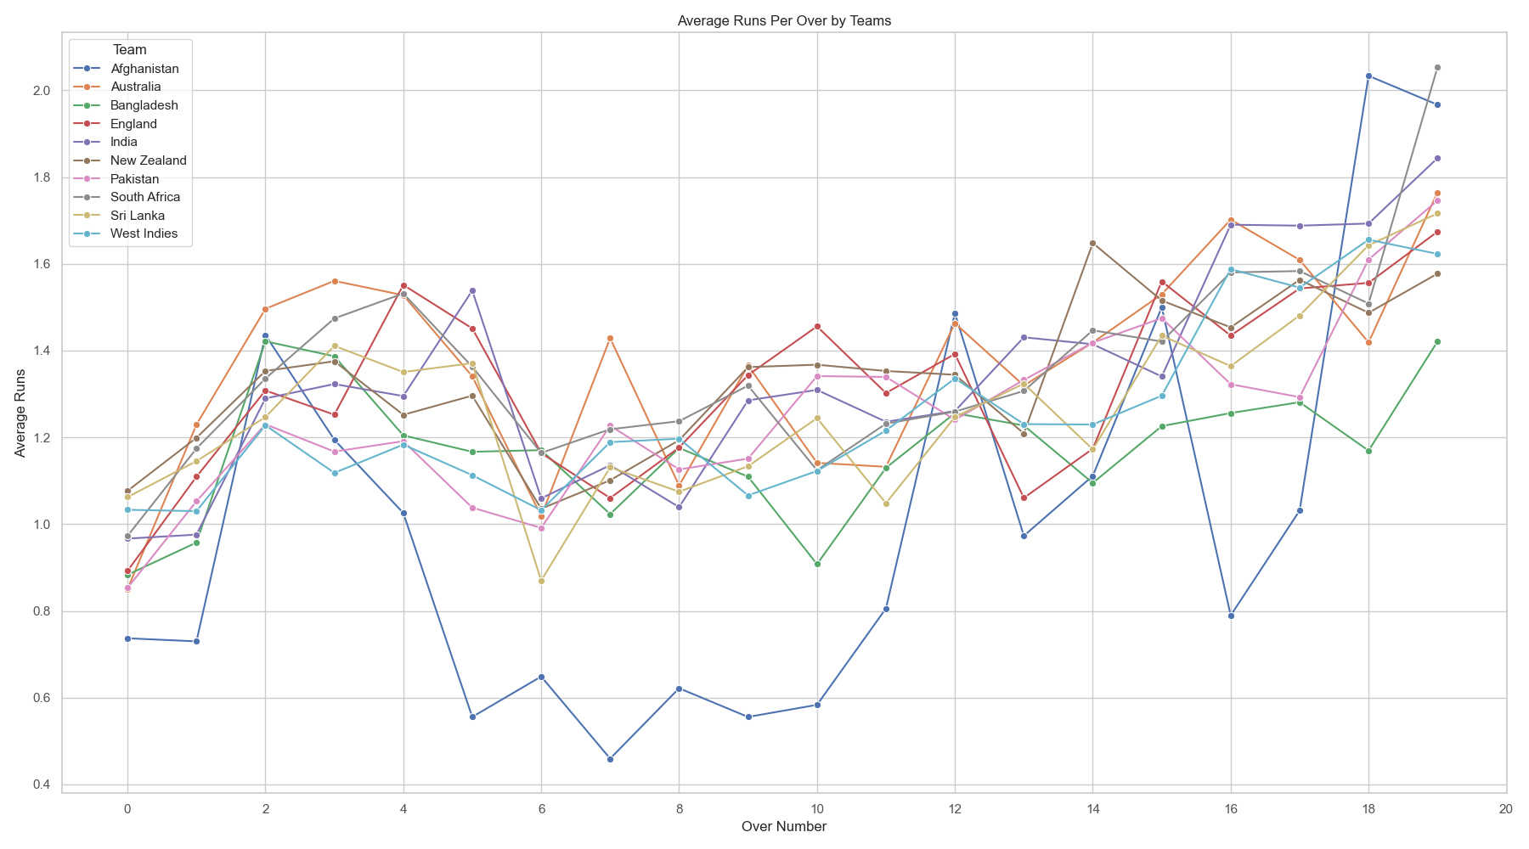
aggressive innings
Early boundaries
Aggressive innings
Dip in boundaries
cautious innings
Early Overs (0-5)
Middle Overs(6-15)
Death Overs (16-20)

Slide 8
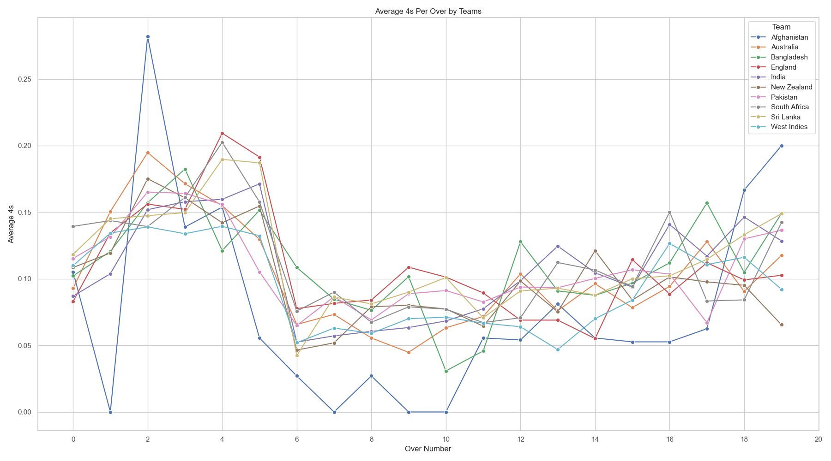
Early boundaries
Aggressive innings
Dip in boundaries
cautious innings
aggressive innings
Early Overs (0-5)
Middle Overs (6-15)
Death Overs (16-20)

Slide 9
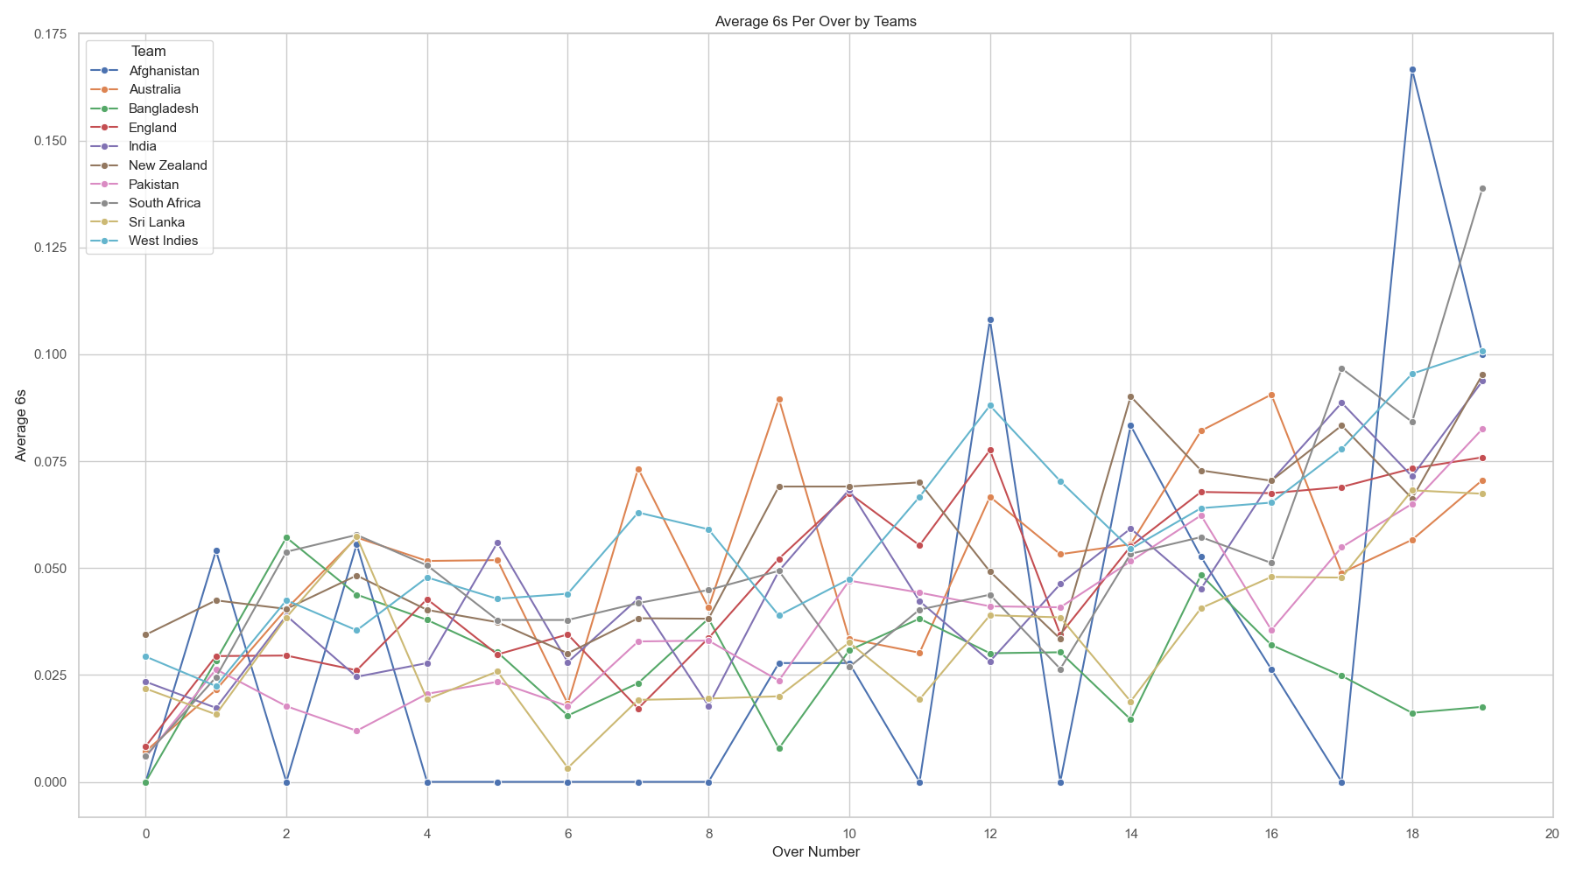
Early boundaries
Aggressive innings
Dip in boundaries
cautious innings
aggressive innings
Early Overs (0-5)
Middle Overs (6-15)
Death Overs (16-20)

