Slide 1

Course
CS4037: Introduction to Cloud Computing
Personalized Study Planner on the Cloud
Instructor
Sir Muhammad Sudais
Group Members
Saad Ahmed (22K4345)
Muhammad Huzaifa (22K4223)
Muhammad Yousuf (22K4457)
Murtaza Johar (22K4508)
Haseeb Mujtaba (22K4307)
Ali Raza Shaikh (22K4313)
Hunain Memon (22K5014)
Ali Asif (21K-4570)
Utilizing Microsoft Azure Services

Slide 2

Enhancing Student Productivity through Cloud-Native Organization
Problem Statement
Solution Overview
Students face challenges in managing diverse study materials, schedules, and deadlines across multiple platforms, leading to fragmented workflows and reduced productivity.
A centralized, web-based application to plan, organize, and track academic progress effectively, integrating all study resources in one accessible platform.
The Cloud Imperative
Academic Context
Leveraging Microsoft Azure to ensure high availability, scalability, and robust security for a global user base, enabling seamless access from any device.
A practical demonstration of core cloud computing principles and service integration, providing hands-on experience with enterprise-grade technologies.

Slide 3
Core Objectives: Demonstrating Cloud Proficiency and System Resilience
01. Technical Deployment
Design and deploy a full-stack web application using Azure App Service, demonstrating proficiency in cloud platform selection and configuration for production environments.
02. Service Integration
Practical application and integration of five or more core Azure services spanning compute, storage, database, security, and monitoring domains.
03. Scalability & Resilience
Implementing an architecture capable of supporting 100+ concurrent users with a 99.95% uptime Service Level Agreement (SLA), ensuring reliability and performance under load.
04. Security Implementation
Utilizing Azure Active Directory (AAD) for secure authentication and implementing role-based access control (RBAC) to protect user data and application resources.

Slide 4

A Three-Tiered, Serverless-Augmented Cloud Architecture
🎨
⚙️
💾
Presentation Layer
Application Layer
Data Layer
Frontend user interface
Business logic and events
Persistence and storage
Technologies
Components
Databases
Next.js 16
▸
API Routes
▸
Azure Cosmos DB
▸
React 19
▸
Azure Functions
▸
User schedules
▸
Tailwind CSS
▸
NextAuth.js
▸
Storage
Infrastructure
Features
Azure Blob Storage
▸
Azure App Service
▸
Schedule management
▸
Study resources
▸
Modern, responsive UI
▸
Daily reminders
▸
User Requests
→
Processing
→
Data Persistence

Slide 5

Azure Services (I): Compute and Data Foundation
Azure App Service
Azure Functions
Managed Platform for Web Applications
Serverless Event-Driven Computing
Provides fully managed Platform-as-a-Service (PaaS) for hosting the Next.js application, ensuring high availability and automatic scaling based on demand.
Enables serverless, event-driven tasks such as sending automated daily study reminders via email, without managing infrastructure.
Time-triggered execution for scheduled tasks
▸
Production-ready hosting with built-in security
▸
Pay-per-execution pricing model
▸
Auto-scaling to handle 100+ concurrent users
▸
Seamless integration with other Azure services
▸
Integrated monitoring and diagnostics
▸
Azure Cosmos DB
Implementation Decision
Globally Distributed NoSQL Database
Why Cosmos DB Over SQL Database
Chosen for its multi-model, globally distributed database capabilities, offering low-latency access to user schedules and tasks from anywhere in the world.
While the original proposal suggested Azure SQL Database, Cosmos DB was selected for flexibility and scalability, allowing the data model to evolve without complex migrations in a modern web app context.
Multi-region replication for high availability
▸
Flexible schema for evolving data models
▸
Guaranteed low-latency performance
▸

Slide 6

Ensuring Data Integrity and Secure Access
🔐
🔑
Authentication & Identity
Secrets Management
Azure Active Directory
Environmental Variables
Implemented via NextAuth.js for enterprise-grade identity management, providing secure single sign-on (SSO) authentication and role-based access control (RBAC) for user authorization.
Essential for securely storing sensitive configuration data such as database connection strings, API keys, and credentials, preventing exposure in source code repositories.
📦
📊
Unstructured Data Storage
Monitoring & Observability
Azure Blob Storage
Azure Monitor & Insights
Utilized for cost-effective, massive-scale storage of unstructured data, specifically student-uploaded study resources including PDFs, notes, and images with secure access control.
Tracks application performance, errors, and user activity for proactive maintenance. Application Insights provides detailed telemetry for debugging and optimization.

Slide 7
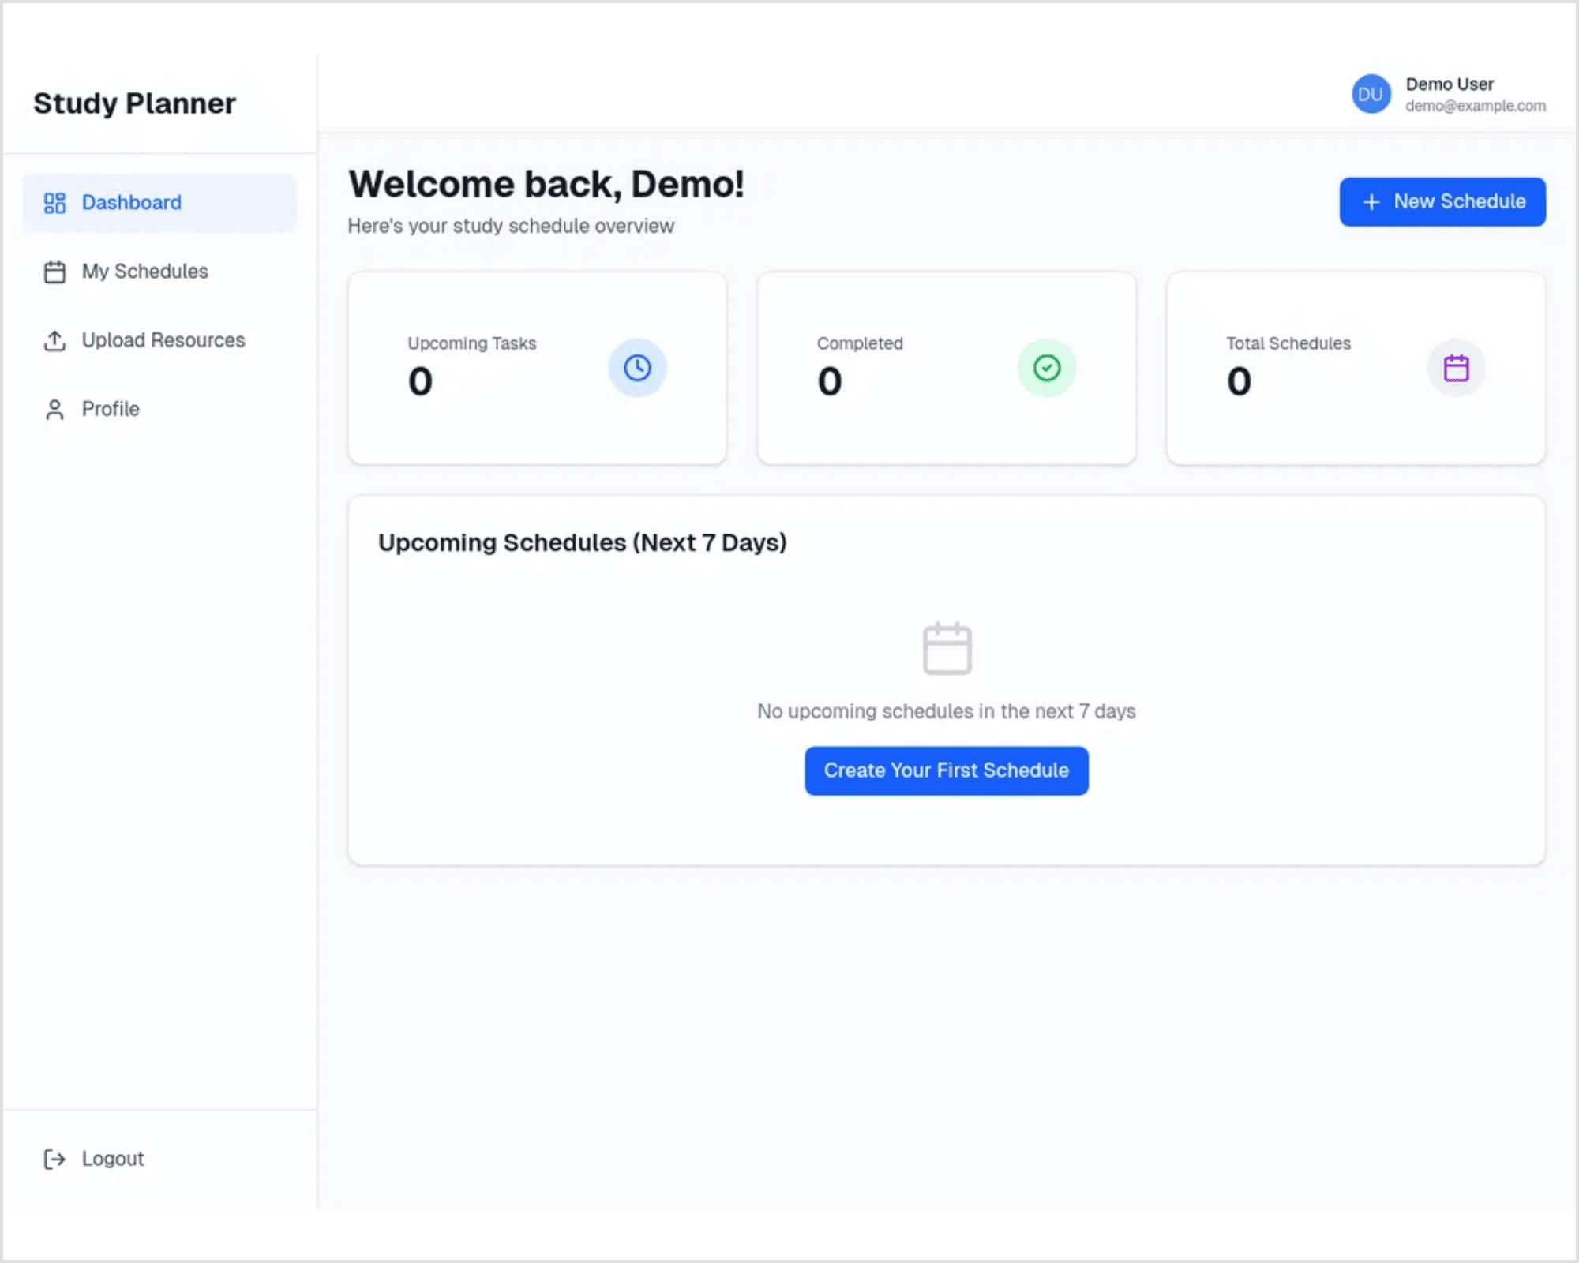
Intuitive Schedule Management for Optimized Study Flow
Dashboard Overview
Provides a quick, statistical summary of upcoming tasks, completed tasks, and total schedules at a glance.
CRUD Operations
Full functionality to Create, Read, Update, and Delete personalized study schedules with ease.
Modern UI/UX
Clean, responsive design built with Next.js and Tailwind CSS, inspired by modern productivity tools like Notion and Linear.

Slide 8

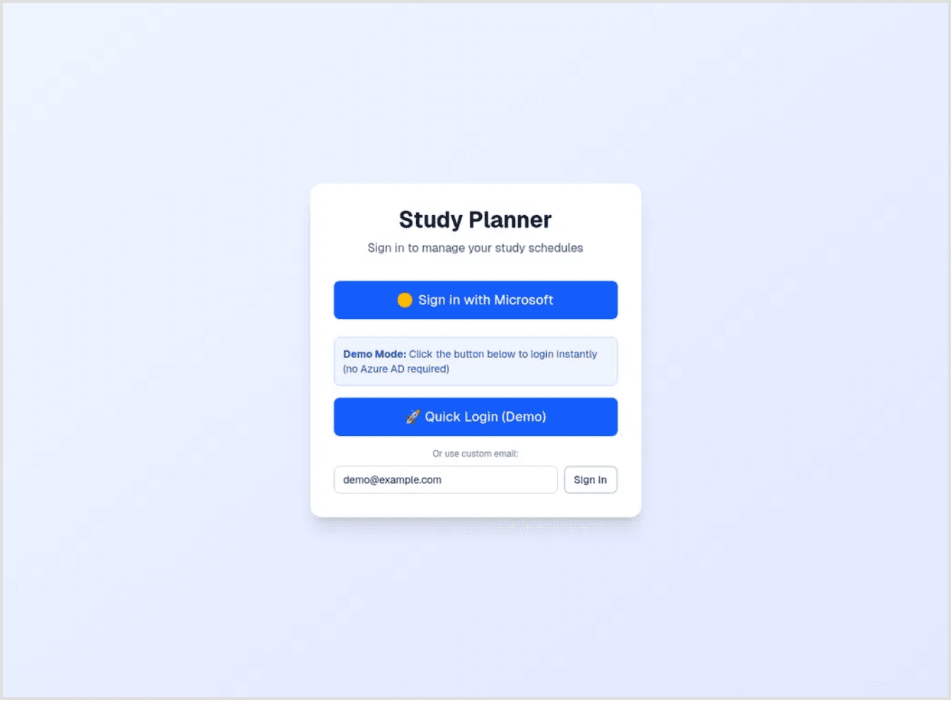
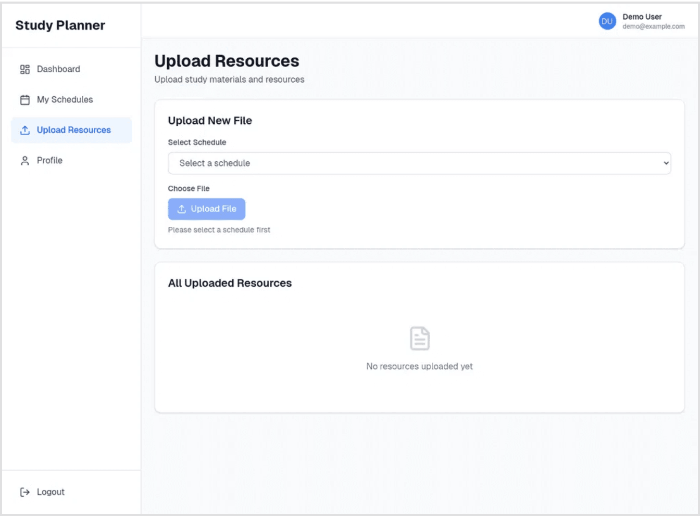
Centralized Resources and Enterprise-Grade Security
Resource Upload
Centralized Material Management
Students can upload and associate study materials (PDFs, notes, images) directly with their schedules, stored securely in Azure Blob Storage for reliable, scalable access.
Secure Access
SAS Token Protection
Resources are managed with secure access signatures (SAS) to ensure only authorized users can view or download their files, maintaining data privacy and integrity.
Azure AD Login Interface
Authentication
Azure AD Integration
The primary authentication method leverages Microsoft's identity platform, ensuring user data is protected by enterprise-grade security standards and single sign-on capabilities.
Resource Upload Interface

Slide 9

Meeting Enterprise Standards: Scalability, Performance, and Availability
Scalability
Availability
100+
99.95%
Concurrent Users
Service Level Agreement
Auto-scale on Azure App Service handles peaks without slowing users.
Redundant Azure regions keep the application responsive and accessible.
Performance
Cost Management
Optimized
Efficient
Next.js & Low-Latency Access
Resource Optimization
Next.js SSR/SSG and low-latency Cosmos DB ensure a fast, responsive user experience.
Right-size with scaling rules, leverage Blob Storage, and monitor with Azure Monitor.
Implementation Strategies
Auto-Scaling
Global Distribution
Scale on CPU and memory to stay fast during peaks.
Cosmos DB multi-region replication keeps data close to users.
Monitoring & Alerts
Load Balancing
Application Insights and Azure Monitor surface issues in real time.
Built-in load balancing spreads traffic across instances.

Slide 10

Modern Development Stack for a High-Performance Application
Frontend Framework
Styling Framework
Next.js 16 with React 19
Tailwind CSS 4
Next.js provides server-side rendering (SSR) and static site generation (SSG) capabilities, enhancing performance and enabling search engine optimization (SEO).
Utility-first CSS framework enabling rapid, consistent styling without writing custom CSS, ensuring a cohesive design system across the application.
Chosen for its production-ready features, built-in API routes, and seamless integration with modern React patterns for building scalable applications.
Provides a comprehensive set of pre-built utilities, reducing development time and ensuring design consistency with minimal CSS overhead.
React 19 for component-based UI development
▸
Responsive design utilities for mobile-first development
▸
TypeScript for type-safe component development
▸
Dark mode support and customizable theme configuration
▸
Authentication Library
Language & Type Safety
NextAuth.js
TypeScript
Flexible, secure authentication layer that abstracts the complexity of Azure AD integration, providing session management and user authorization.
Strongly typed superset of JavaScript, catching errors at compile-time rather than runtime, improving code quality and maintainability.
Reduces runtime errors, improves IDE support and code documentation, making the codebase more robust and easier to refactor.
Simplifies OAuth/OIDC flows, supports multiple providers, and includes built-in security best practices for production applications.
Additional Tools & Libraries
Supporting Technologies
Axios: HTTP client for API communication with Azure backend services
▸
React Hook Form: Lightweight form state management with minimal re-renders
▸
Zod: TypeScript-first schema validation for form inputs and API responses
▸

Slide 11

Summary of Achievements and Roadmap for Enhancement
✓ Key Achievements
→ Future Enhancements
Deployment
API Management
Full-Stack Cloud Application
Azure API Management
Successfully deployed a production-ready, cloud-native study planner application on Microsoft Azure with modern frontend and scalable backend architecture.
Implement Azure API Management to secure, govern, and monitor backend API endpoints, enabling rate limiting, authentication policies, and API versioning.
DevOps Pipeline
Technical Skills
Azure DevOps CI/CD
Azure Service Integration
Establish a complete Continuous Integration/Continuous Deployment (CI/CD) pipeline using Azure DevOps for automated testing, building, and deployment workflows.
Demonstrated practical proficiency in integrating multiple Azure services including App Service, Functions, Cosmos DB, Blob Storage, and Active Directory.
Architecture
Advanced Features
Scalable & Secure Design
Machine Learning Integration
Implemented a three-tiered architecture supporting 100+ concurrent users with enterprise-grade security, monitoring, and 99.95% availability SLA.
Explore Azure Machine Learning for intelligent study recommendations and predictive analytics based on user behavior and academic patterns.
Best Practices
Infrastructure
Cloud Computing Principles
Infrastructure as Code
Applied core cloud computing concepts including scalability, resilience, security, cost optimization, and infrastructure-as-code principles.
Implement Infrastructure as Code (IaC) using Azure Resource Manager (ARM) templates or Terraform for reproducible, version-controlled infrastructure deployment.

Slide 12

Project Repository
github.com/Murtaza445/studyplanner
Live Demo
studyplanner-umber.vercel.app
Thank You
Course
CS4037: Introduction to Cloud Computing
Personalized Study Planner on the Cloud
Team Members
Saad Ahmed (22K4345)
Muhammad Huzaifa (22K4223)
Muhammad Yousuf (22K4457)
Murtaza Johar (22K4508)
Haseeb Mujtaba (22K4307)
Ali Raza Shaikh (22K4313)
Hunain Memon (22K5014)
Ali Asif (21K-4570)
Questions & Discussion

