Slide 1

WELCOME

Slide 2
SECTIONAL VIEWS - I
The purpose of drawing a sectional view
1) If the object is simple, the dotted lines will be very few. However, if it is complex, there will be too many dotted lines. It will be difficult to interpret each and every dotted line. Hence a sectional view is drawn to avoid excessive dotted lines.
2) A sectional view clearly shows the internal details of the object.

Slide 3
SECTIONAL VIEWS - STEPS
The object is imagined to be cut by a cutting plane.
The part of the object, in-between the observer and the cutting plane, is imagined to be discarded.
The view of the remaining object is drawn and it is called a sectional view.
Thus, there can be a sectional front view, a sectional top view or a sectional side view.

Slide 4
SECTIONAL VIEWS - STEPS
4) Section lines OR hatching lines are drawn in those areas, where the material is cut.
5) The other views are unaffected by the use of the cutting plane.
6) The cutting plane is shown as a centre line and the ends are made thicker.
7) The position of the cutting plane should be shown on the appropriate view.

Slide 5
SECTION LINES (or HATCHING LINES)
1) Section lines should be shown in the area where the material of the object is cut.
2) Section lines should be thin, medium dark, at 45⁰ to the horizontal, and spaced uniformly about 2 or 3 mm apart, as shown below.
45⁰
2 OR 3 mm

Slide 6
SPECIAL RULES - I
Thin plates, which are used to give additional strength to the object, are called RIBS (or WEBS). They may be triangular, rectangular etc.
If a rib is cut longitudinally, (i.e. dividing the thickness), the section lines are not shown in the rib area.
If a rib is cut perpendicularly (or at right angles to its thickness), section lines are shown in the cut portion (cut area) of the rib.

Slide 7
THE RIB IS CUT LONGITUDINALLY, HENCE SECTION LINES ARE NOT SHOWN IN THE RIB AREA.
Rib
X
SECTIONAL F.V. ALONG “X”.
THE RIB IS CUT AT RIGHT ANGLES TO ITS PLANE (PERPENDICULARLY). HENCE SECTION LINES ARE SHOWN IN THE CUT PORTION OF THE RIB.

Slide 8
SPECIAL RULES - II
4) Many machine parts such as nuts, bolts etc. are not shown in section, if the cutting plane passes through their axes. Such parts are – bolts, nuts, studs, spindles, shafts, cotters, keys, rivets, set screws etc.
5) However, if they are cut perpendicular to their axes, then the section lines are shown in the cut surface.

Slide 9
SOLVED PROBLEMS
The slides hereafter, show some objects. Their sectional views are constructed step by step. Brief notes are introduced at several places. The same principles should be used to solve additional questions on this topic.

Slide 10
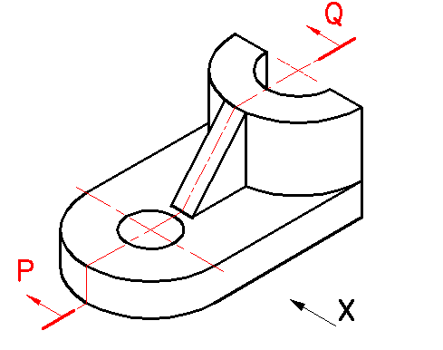
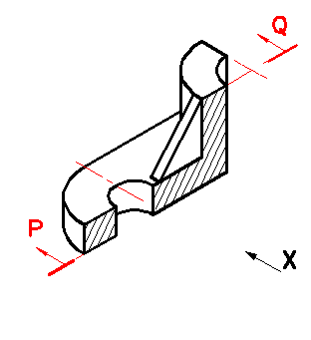
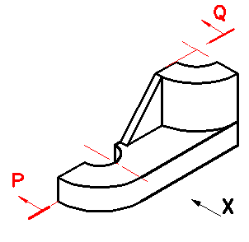
1051
THE OBJECT IS CUT ALONG P - Q. AND THE TWO PARTS WILL LOOK LIKE THIS------
RIB
LET US DRAW IT
DRAW SECTION LINES IN THE AREA WHEREVER THE MATERIAL IS CUT.
THE RIB IS CUT LONGITUDINALLY
HENCE DO NOT SHOW SECTION LINES IN THE RIB AREA.
THE PART OF THE OBJECT INBETWEEN THE OBSERVER AND THE CUTTING PLANE IS DISCARDED.
THE VIEW OF THE REMAINING OBJECT WILL BE CALLED A SECTIONAL FRONT VIEW.
THIS PART IS DISCARDED
SECTIONAL FRONT VIEW IS READY.

Slide 11
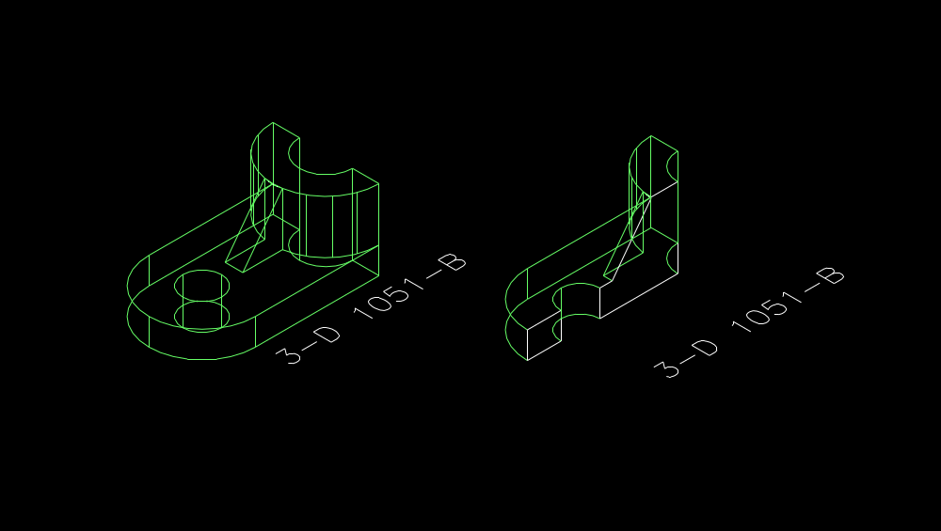
3-D 1051-B

Slide 12
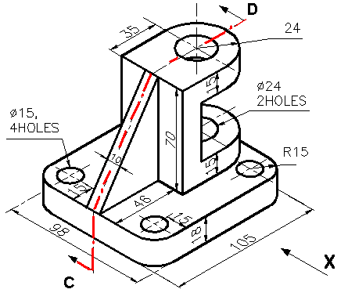
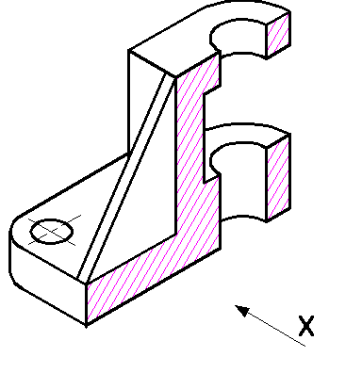
1052
The remaining object looks like this-------
The object is cut along P-Q. The part of the object in-between the observer and the cutting plane is discarded.
Hence, do not show section lines in the rib area.
Rib is cut longitudinally.
Draw the front view along “X’.
Rib
Sectional front view is ready.

Slide 13
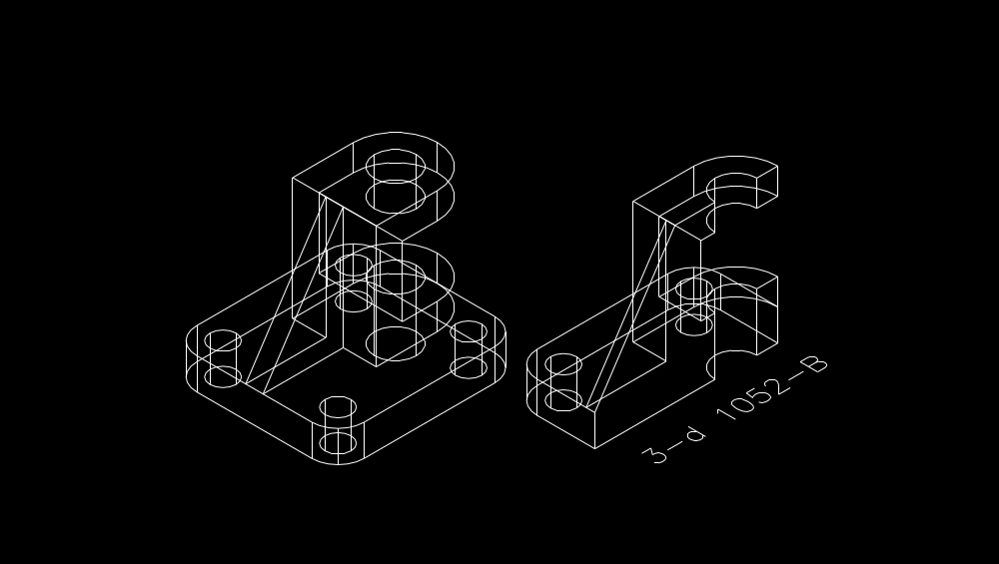
3-D 1052-B

Slide 14
THANK YOU

