Slide 1





Contents
Name：Group 2
Date： 2023.2.12
Introduction
Project Description
Experiment Setup
Result Demonstration/Analysis
Performance Improvement / Future work (optional)
Conclusion

Slide 2
Introduction (introduce our group members)
Name
HONG CHANG
LIU YANGSEN
ZHAO CHENGKAI
CHE AO
YANG YIHUI
SUN YANGQING
CHEN ZHENGYUANZHAI XUANRAN

Slide 3
Project Description
Context: Potential Population Issues
Overpopulation, population aging, migration, etc.
Objective
To predict future populations and find out methods to increase the accuracy of the model.
Methodology: Linear Regression (Simple & Multivariate)
Result: Visualizations, Metrics, etc.
Conclusion

Slide 4
Experiment Setup
a.Year-Population Plot
Using scatterplot and matplotlib functions such as title,xlabel and so on.
b. Model Fitting
from sklearn.linear_model import LinearRegression
Using LinearRegression,fit and predict functions.
c. Best-Fit Line and Model Evaluation
1.Print data points and regression lines using seaborn and matlab functions
2.Calculate MSE and $R^{2}$ by calling the function in sklearn.metrics
d. Prediction
Using predict function from LinearRegression
e. Analyze the results to get the population growth pattern
f. Enhancement
Apply multivariate linear regression to optimize the model

Slide 5
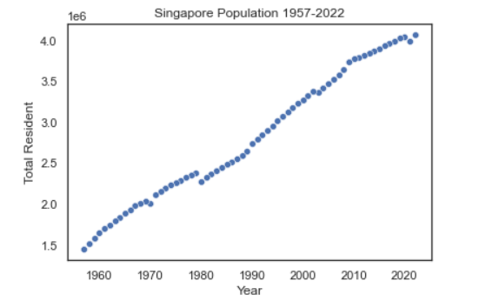
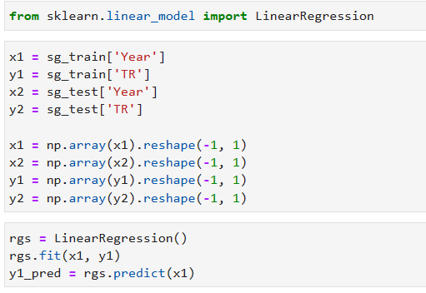
Result Demonstration/Analysis - Singapore
Graph the total population vs year
Use linear regression to build an estimator

Slide 6
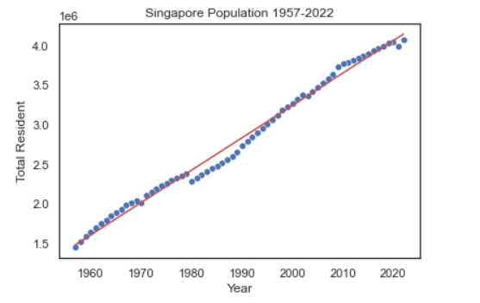



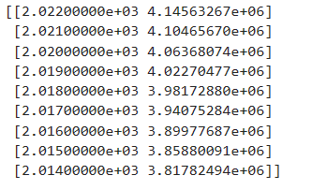

Result Demonstration/Analysis - Singapore
Performance metrics:
The slope and y-intercept of the best fit line
The R2 coefficient for the best fit line
The MSE and prediction of the estimator on the training and test data

Slide 7
Result Demonstration/Analysis - Singapore
Prediction for 2030 and 2050
Year | Population
2030 | 4.473440e+06
2050 | 5.292960e+06
In the linear regression model, the growth rate is a constant.
It may not accurately reflect the long-term (for example,>100 years) population growth trend.

Slide 8
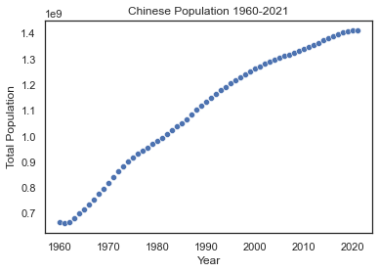
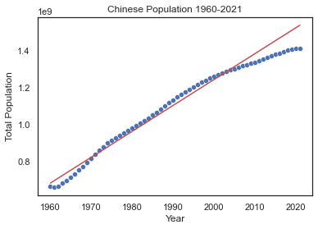

Result Demonstration/Analysis - China
Graph the total population vs year
Linear Regression Result

Slide 9



Result Demonstration/Analysis - China
Performance metrics:
The R2 coefficient for the best fit line
The MSE of Training and Testing phase

Slide 10
Result Demonstration/Analysis - China
Prediction for 2030 and 2050
Year | Population
2030 | 1.664692e+09
2050 | 1.944828e+09
This prediction is not reasonable.
The population growth pattern of China is reaching the end of logistic pattern

Slide 11
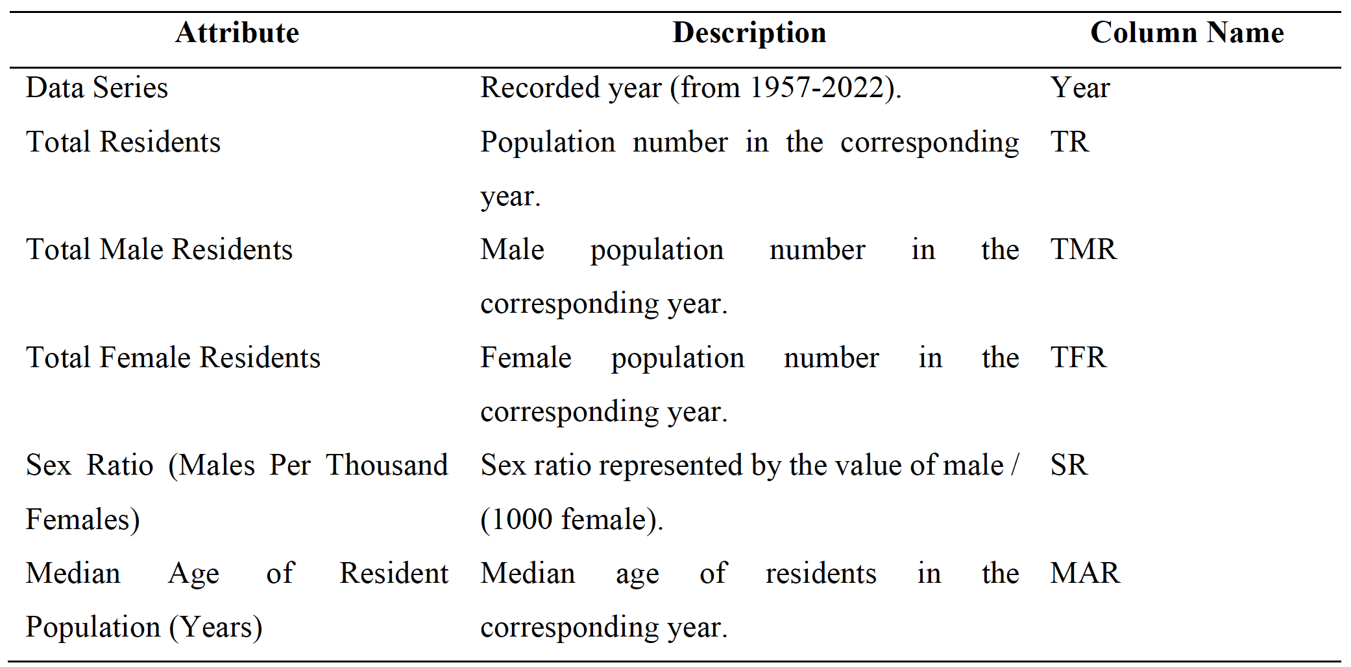
Performance Improvement / Future work (optional)
Dataset Dimensional Ascending
Empirically select potential attributes from the source dataset provided by Singapore's official department.

Slide 12
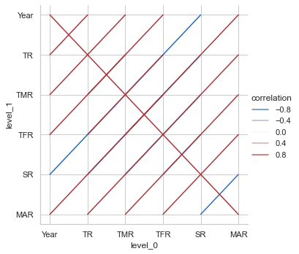
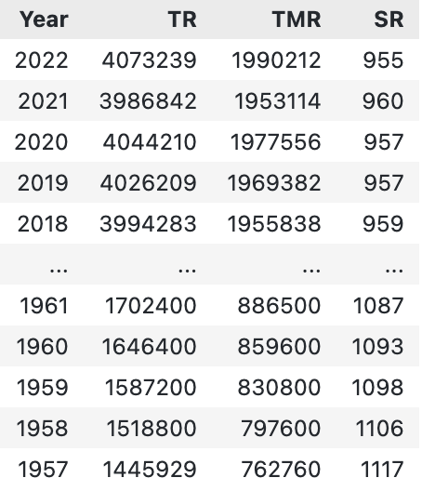
Performance Improvement
Data Pre-processing - Correlation Analysis for Attributes
TMR and SR have the greatest positive influence on TR because the correlation coefficients between these attributes and TR are equal to 1, thus, they are used in the formal training

Slide 13
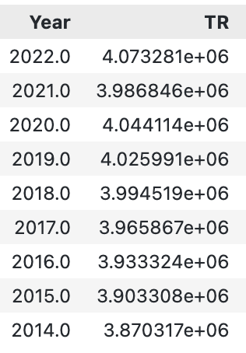
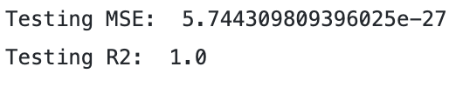
Performance Improvement
Performance Metrics for Multivariate Linear Regression
Metrics for multivariate linear regression:
Metrics for simple linear regression

Slide 14
Conclusion
Objective Fulfillment
Grounded in model evaluation methods such as 𝑅^2 score and mean squared error, we have discovered that multivariate linear regression has a great improvement on prediction.
Result
According to the improvement we found, the key factor we changed is the dimension of the dataset. Thus, it is crucial to continuously monitor and update population projections as new data becomes available and to consider the potential impact of unanticipated events and emerging trends.

