Slide 1
KasFlex
66 → 0
Verified agentic energy management for greenhouse horticulture
limit violations,
unverified vs verified
An AI plans a day of greenhouse energy use. A deterministic checker verifies it
against grid, asset and crop limits. A person approves it.
We measure what that verification is worth.
runs offline in under a second
MVP status review · 5 September 2026
Tahir Abbas · Wageningen University & Research
4TU.NIRICT · WUR · TU Delft · TU/e · UT
Notes:
Opening line: this project exists to answer one question - what is safety verification actually worth, in euros and in violations. Everything else is machinery for producing that number.

Slide 2
What we committed to, and where it stands
4TU.NIRICT community project · demonstrator budget EUR 5,000
From the proposal: “a reproducible digital twin prototype, benchmark scenarios for grid-aware agentic AI, and an open repository that can be directly reused by NIRICT researchers.”
Built
Built
Built
Reproducible prototype
Benchmark scenarios
Open repository
Runs end to end offline. Same seed, same result, byte for byte. 107 tests, 94% coverage.
Six experimental conditions run unattended from one command, writing structured records.
Apache-2.0, CITATION.cff, codemeta.json, data provenance, architecture and usage docs.
The demonstrator exists. What it does not yet have is validated physics — that is stage 1, and it is the next thing.
Notes:
Anchor to what was promised. All three headline deliverables exist as working software, not as a plan. Then be first to name the gap - validated physics - before they ask.

Slide 3
The measurement that decides this project
Same scenario, same planner, three simulated days. The only difference is whether the checker runs.
Checker disabled
Checker enabled
EUR 11,602
EUR 10,498
Operating cost
per day, 5 ha greenhouse
66
0
Limit violations
grid, battery, buffer, crop
Unverified, the planner breaks limits 66 times and still costs more. Verified, it is caught every time and control falls back to the conventional baseline.
Apparatus, not findings: the greenhouse model is not yet validated and the planner here is a deliberately constraint-blind fixture. The numbers show the measurement works.
Notes:
This is the slide. Say: the point is not that the numbers are good, it is that we can produce them at all. Nobody in this space measures what verification is worth - they assert it.

Slide 4
It runs. Here, now, with no network.
No API key, no downloads, no cloud. A demo that cannot fail is itself a claim about the engineering.
1
It says why, not just no
$ kasflex verify --plan bad_plan.json Plan rejected: 56 constraint violation(s). - [electrical/battery.state_of_charge] hour 00: -8473.68 kWh against a limit of 200.00 kWh. Discharge less in this hour, or charge earlier in the day. $ kasflex experiment --days 3 ai-unverified 11601.63 66 violations
ai-verified 10498.15 0 violations
Every rejection names the constraint, the hour, the value asked for and the value allowed — enough for the planner to fix it.
2
The table fills itself
Six conditions across three days, unattended, in under a second.
3
Real physics on demand
One flag swaps the built-in model for GreenLight-Gym2, the validated Wageningen greenhouse simulator.
Total demo time: under 60 seconds.
Notes:
Run it live if the room allows. Command 1 is the money shot - a grid engineer immediately recognises that rejection format as the thing they would need. Command 2 fills the table from the previous slide.

Slide 5
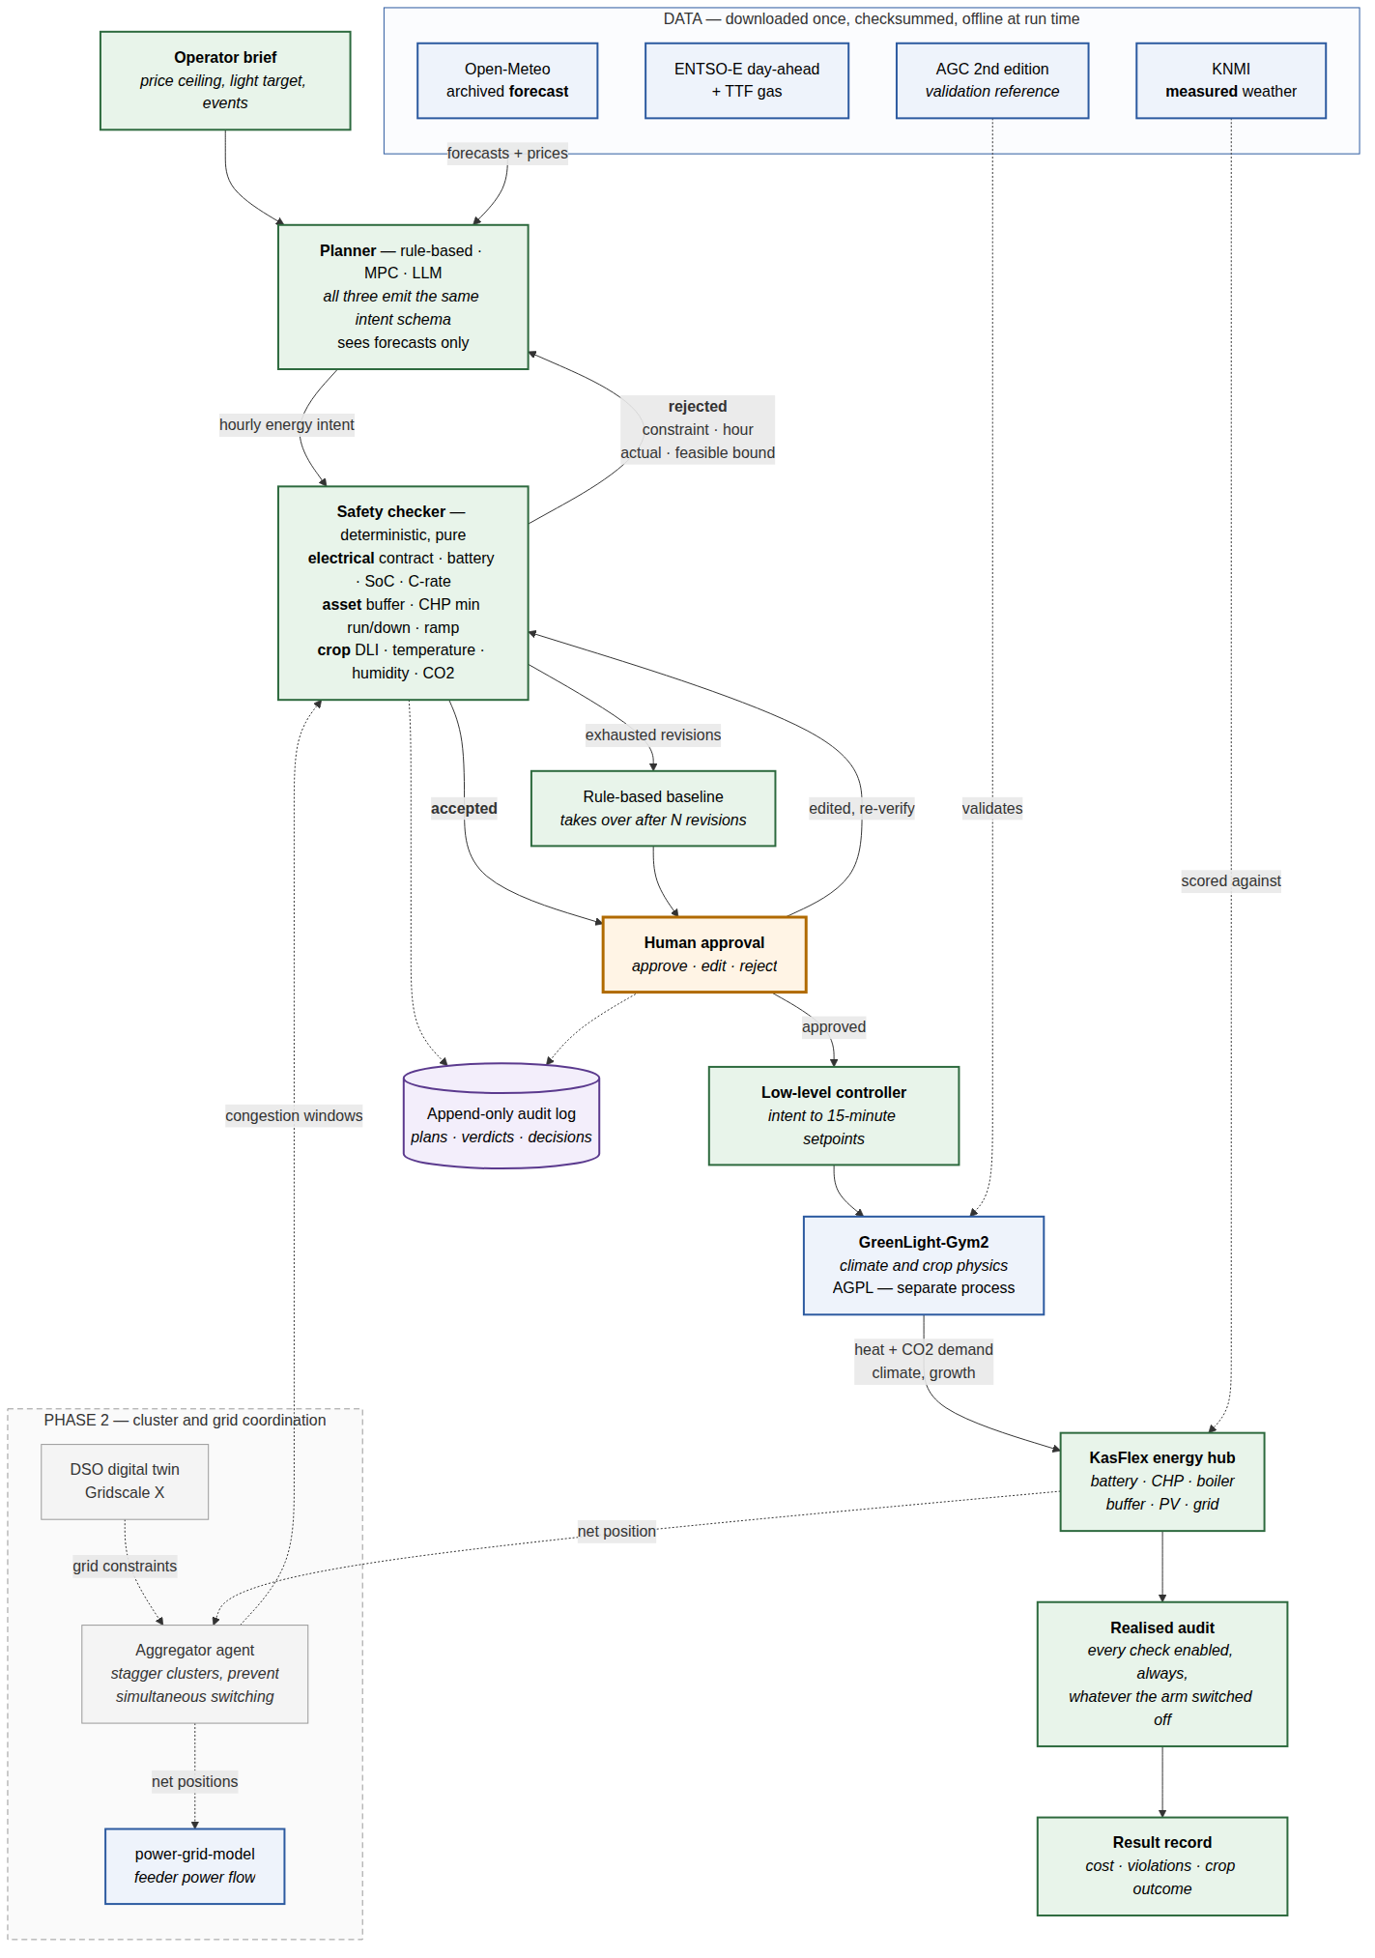
One idea, and it is a small one
The checker sits between the planner and the equipment.
Not beside it.
In the Alliander proposal the safety layer sits alongside the agents and validates what they did. Here it sits in the path: no plan reaches equipment without a verdict from deterministic code that has no dependency on the AI.
That turns “our system is safe” from a claim into a number we can publish.
We did not build
greenhouse physics, or power flow
We wrapped
GreenLight-Gym2 (WUR) and power-grid-model (the Dutch DSO tool)
We added
prices, the energy hub, the intent language, the checker, human approval, the harness
Full diagram in the repository
Notes:
Do not walk through the diagram box by box. Make the one point - the checker is in the path, not beside it - and move on. The diagram is there to show it exists.

Slide 6
Three things we checked first
Each of these would have cost weeks if we had found it later.
1
The Wageningen simulator is AGPL-licensed
Linking it into our code would have forced the whole project copyleft — including for any industry partner. We run it in a separate process instead, so our core stays Apache-2.0 and reusable. Worth asking Bart van Laatum whether a licence exception exists.
2
The greenhouse and grid libraries cannot share an environment
They require conflicting versions of a core dependency. Installing both silently downgrades the grid solver by two years — nobody would notice, and the power-flow results would not be reproducible. The same process split removes the problem.
3
We do not need to fork the simulator
It already exposes the extension points for real electricity prices and Dutch weather. This was the largest risk to the schedule and it is now retired — a subclass, not a fork.
All three verified against the actual packages on 4 September 2026, not inferred from documentation.
Notes:
This is the diligence slide. It says: this is engineering, not slideware. Keep it brief unless asked - the detail is in docs/DECISIONS.md.

Slide 7
What is real, and what is not
Working today
Not yet real
GreenLight-Gym2 driven end to end, producing correct heat demand
Safety checker: 13 limits, each individually switchable and tested
Rule-based baseline that never proposes an unsafe plan
Grid power flow verified against power-grid-model
Human approval, plan editing, append-only audit log
107 tests, 94% coverage, no network access anywhere
The greenhouse model is not validated against measurements — stage 1
Prices and weather are synthetic, not ENTSO-E and KNMI — stage 3
The AI planner has not been run against live models — stage 4
No MPC reference yet, so we cannot bound the headroom — stage 5
No browser interface for growers — stage 6
The code enforces this distinction: every result records whether the model was validated, and the tool prints a warning when it was not. No unvalidated figure can be published by accident.
Notes:
Volunteering the gaps first is the credibility move. It also sets up the asks on the last slide - each gap maps to something I need.

Slide 8
Build order, cut from the bottom
If time or money runs short, stages 5 to 7 go. The checker and human approval never go: they carry the research contribution.
0
Skeleton running end to end
Done
1
Validate against Autonomous Greenhouse Challenge measurements
Next
2
Safety checker
Done
3
Real ENTSO-E prices and Dutch weather
Partly
4
Language-model planner against live models
Partly
cut
from
here
down
5
MPC reference controller
To do
6
Browser interface for growers
To do
7
Greenhouse cluster on a congested feeder
Adapter built
Stage 7 is the bridge to Alliander and the KIC bid: it is optional for this demonstrator and central to the follow-on.
Notes:
The cut-from-the-bottom design is the risk answer. We committed to a demonstrator, and the demonstrator survives even if the ambitious parts do not.

Slide 9
What I need from you
Four decisions, in rough order of how much they block.
1
Sign-off on the licensing split
2
Who does the validation work
Apache-2.0 core with the AGPL simulator isolated in its own process. I would like WUR's view, and an introduction to Bart van Laatum about a possible exception.
Stage 1 needs someone to reconcile the Autonomous Greenhouse Challenge data against the model. Roughly four to six weeks. A research assistant or an MSc project would fit.
3
Release the data budget and an ENTSO-E account
4
A scope call on the cluster work
EUR 1,500 is already allocated for data curation in the proposal. I need it released, plus an institutional ENTSO-E Transparency Platform account.
Do we build the multi-greenhouse grid scenario now as a demonstrator showpiece for Alliander, or hold it as the centrepiece of the KIC bid?
Repository: branch claude/power-grid-mvp-plan-ye6xq2 · full plan in docs/MVP_PLAN.md
Notes:
End on the asks, not on a summary. Each one maps to a gap named on the 'what is not real' slide, so the sequence should already feel earned.

