Slide 1
RADOS Reliable and Autonomic Distributed Object Store
Youxu Chen

Slide 2
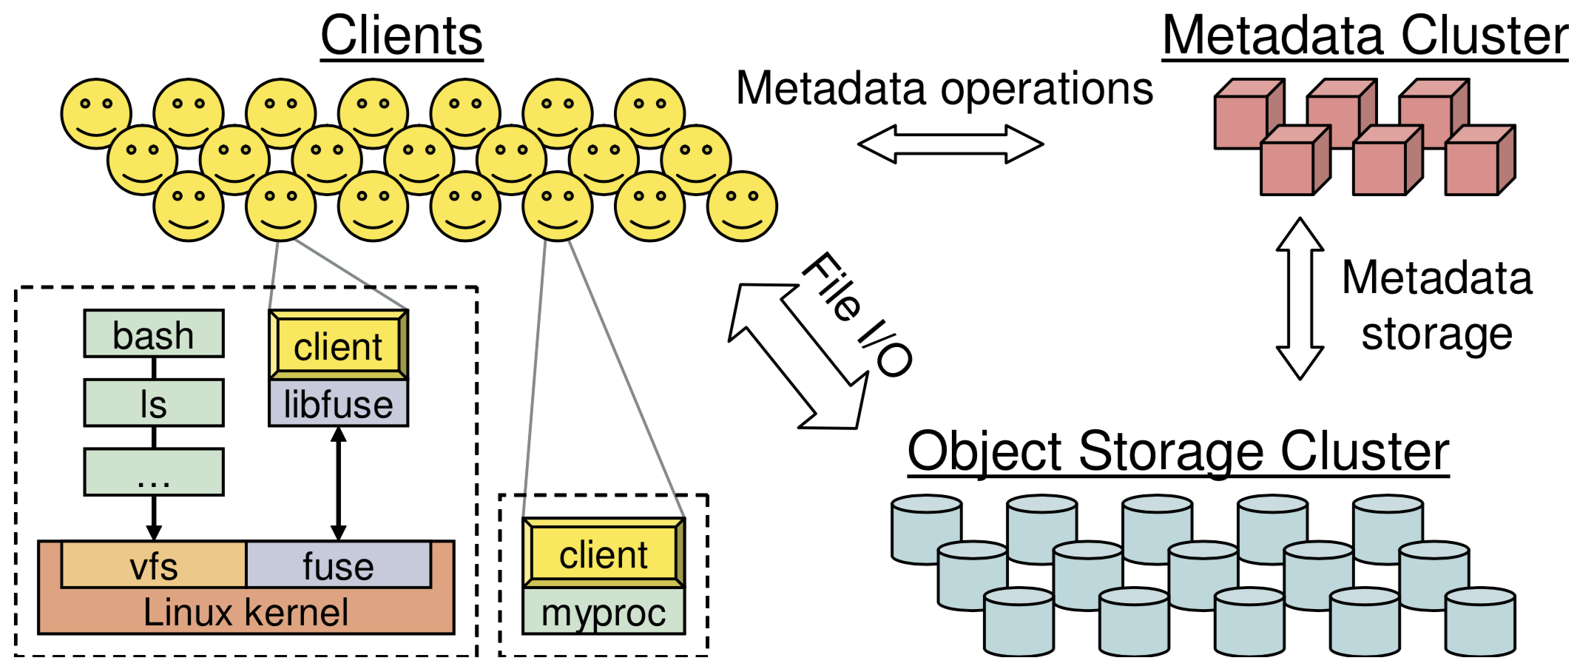
Ceph
A Scalable, High-Performance Distributed File System
Intro
Object storage
Block device
Filesystem

Slide 3
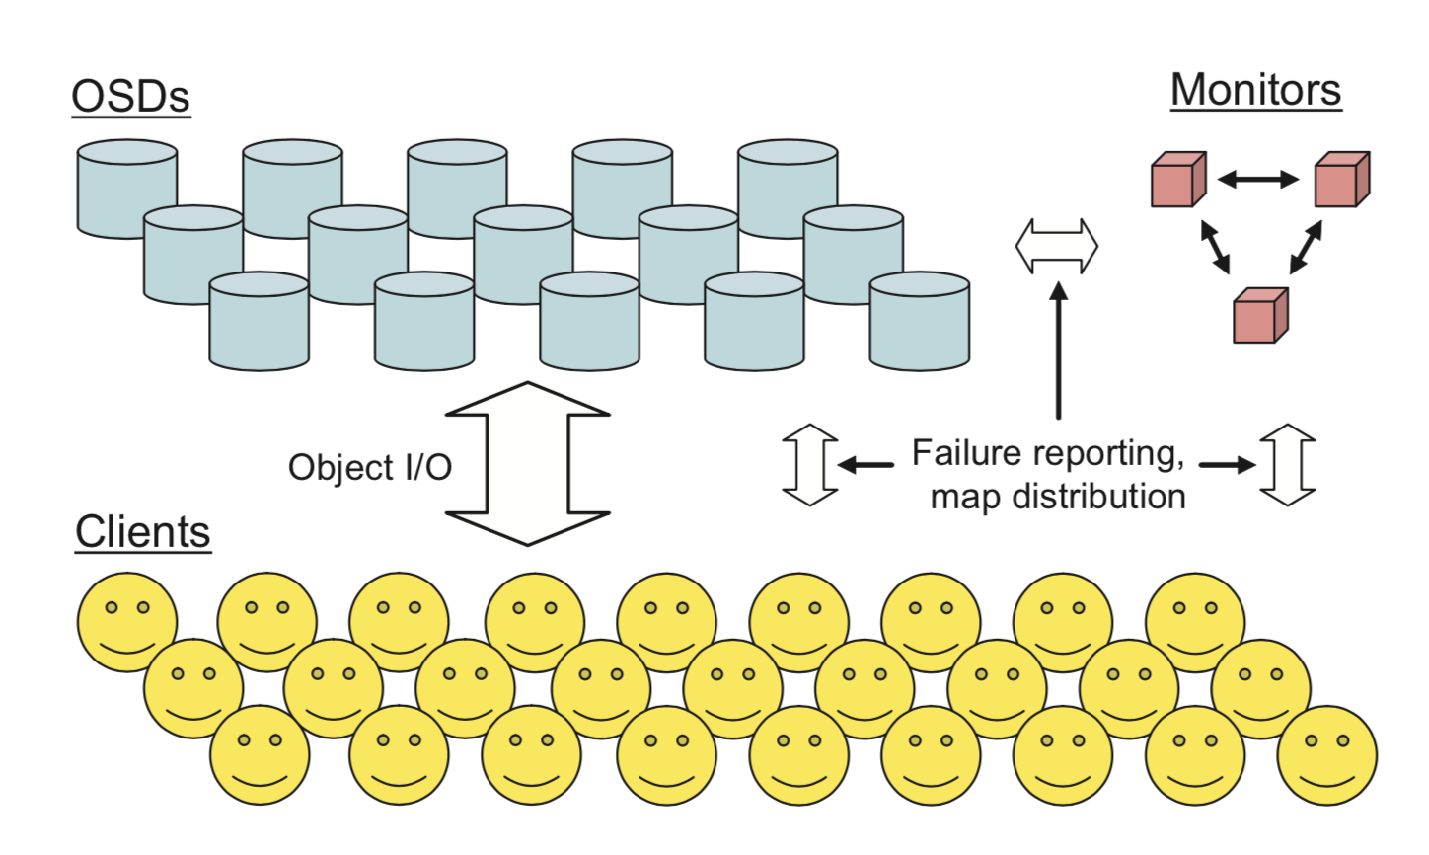
RADOS - Architecture
Components
Monitor
OSD
Client
Deployment
Rados Block Device
Rados GateWay
Ceph FS

Slide 4
Monitor
Maintain maps of the cluster state
Monitor map
OSD map
Placement Group(PG) map
CRUSH map
Paxos service
Leader aggregates map update
Lease-mechanism
epoch | Map version
in/out | OSD contains PG?
up/down | OSD is reachable?
m | Number of PGs(2^{k}-1)
crush | CRUSH rules
leader
Active mon
Active mon

Slide 5
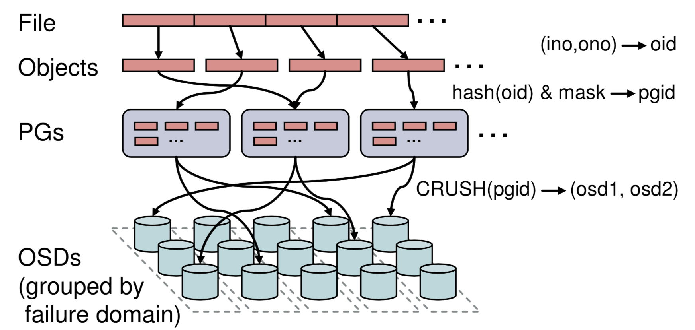
Data placement
Two-phase mapping
Object --> PG
Hash
PG --> OSDs
CRUSH
src/osd/OSDMap.cc
Object_locator_to_pg
Pg_to_osds
Why?
Independent PG mapping when OSD adds/removes
Pool
Notes:
How clients choose target OSD?-Osdc.cc/_calc_target()
1.Calculate target pgid
2.Primary pg?
3.Acting osds
4.Rand, best or primary? According to flag

Slide 6
Data placement
Pool A – replica.2
Pool B – replica.3
Pool
PG
Object
OSD

Slide 7
I/O flow
RBD
RGW
Ceph FS
enqueue
Thread
pool
process
WorkQueue
Thread
pool
process
dequeue
PG
PG
PG

Slide 8
ThreadPool and WQ
OpWQ
ops from client & OSD
op_tp
PeeringWQ
Peering tasks & pg map
Handle ops and subops
CommandWQ
Commands
command_tp
RecoveryWQ
Recovery tasks
Handle commands
SnapTrimWQ
Snap trimming
recovery_op
Handle recovery tasks
ScrubTrimWQ
Primary scrub path
ScrubFinalizeWQ
Primary scrub finalize
disk_tp
Handle disk intensive tasks
RepScrubWQ
Replica scrub path
RemoveWQ
Removes old pg dirs

Slide 9
I/O flow
Client read/write a file
Receiving a request and insert to session’s waiting list
Client
OSD
Slicing files to objects
Process request from waiting list and insert into PG’s queue
Worker thread dequeues op and process
Encapsulate operations and send to corresponding OSD
Get objectcontext and opcontext and encapsulate ops into a transaction
Receiving reply
Read(async/sync) or write(also to replicas) , submit transaction and reply to client

Slide 10
I/O flow
Client read/write a file
Receiving a request and insert to session’s waiting list
Client
OSD
Slicing files to objects
Process request from waiting list and insert into PG’s queue
(pg->osdservice->pg = osd->shardedwq)
Worker thread dequeues op and process
Encapsulate operations and send to corresponding OSD
Get objectcontext and opcontext and encapsulate ops into a transaction
Receiving reply
Read(async/sync) or write(also to replicas) , submit transaction and reply to client

Slide 11
Function flow
Client
OSD
ll_write
client/Client.cc
send_op
osdc/Objecter.cc
ms_fast_dispatch
osd/OSD.cc
OSDservice::ShardedOpWQ::_enqueue
osd/OSD.cc
OSD::ShardedOpWQ::_process
osd/OSD.cc
eval_repop
osd/ReplicatedPG.cc
_write
client/Client.cc
_op_submit
osdc/Objecter.cc
dispatch_session_waiting
osd/OSD.cc
queue_op
osd/PG.cc
PGQueueable::run
osd/OSD.h
start_async_reads
Issue_repop
Write_trunc
osdc/Filer.h
op_submit
osdc/Objecter.cc
dispatch_op_fast
osd/OSD.cc
enqueue_op
osd/OSD.cc
OSD::dequeue_op
osd/OSD.cc
execute_ctx
osd/ReplicatedPG.cc
sg_write_trunc
osdc/Objecter.h
write_trunc
osdc/Objecter.h
handle_op
osd/OSD.cc
get_pg_or_queue_for_pg
osd/OSD.cc
do_request
osd/ReplicatedPG.cc
do_op
osd/ReplicatedPG.cc

Slide 12

Problem
RBD
RGW
Ceph FS
Strong consistency: order
enqueue
Goal: based on actor model to support async order and improve parallelism with data consistency
Thread
pool
process
WorkQueue
Thread
pool
process
dequeue
PG
PG
PG

Slide 13
EC in Ceph

Slide 14
EC
Coding granularity
Slice one object into k chunks and compute m parity chunks(k,m)
object
parity
chunk
chunk
OSD
stripe

Slide 15
I/O flow
Write object
Send write op to primary OSD
Primary OSD slice and compute with EC
Send sub-op to slave OSDs
Support append and overwrite
Read object
Send read op to primary OSD
Primary OSD send sub-op to slave OSDs which just store data chunks
object
Primary OSD
Slave OSDs
object
Primary OSD
Slave OSDs

Slide 16
Problem
Partial-stripe update
Extra read op
Write amplification
Goal: optimize partial-stripe update based on parity logging, parity caching or elastic striping
A
B’
C
P₁’
P₂’
A
A
C
B
C
P₁
P₂

Slide 17
Cache Tier in Ceph

Slide 18
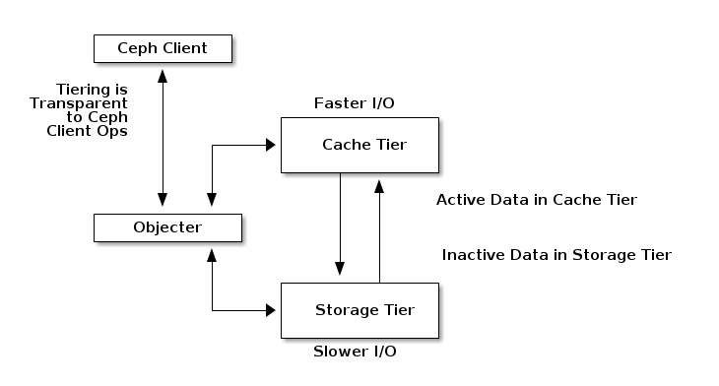
What is cache tier?
Active/inactive data decoupling to provide better I/O performance
Client-transparent caching
Cache tier
Cache pool
SSD or faster devices
Storage tier
Storage pool
usually HDD
Cache agent
Source:http://docs.ceph.com/docs/master/rados/operations/cache-tiering/

Slide 19
Cache mode
Writeback(default)
Clients write to cache tier and receive an ACK from cache tier
Read from cache tier first if cache hits, else read from storage tier to cache tier and resides then send to clients
Readproxy
Read requests send to cache tier, cache tier read from storage tier and abort caching
Write requests benefit writeback mode
Forward
All requests redirect to storage tier
Readonly
Write to storage tier directly and read from cache tier if cache hits, else read from storage tier and resides then send to clients
Readforward
Read requests redirect to storage tier and write requests benefit writeback mode

Slide 20
Problem
Small I/O update
Object size– 4MB(default)
Extra read op
Merge small update
Evict new object
Goal
Combine small I/O into large one
Evict with no extra read op
Cache tier
Storage tier

Slide 21
Cache tier deployment
Creating a cache tier
Add a hot-storage pool to a cold-storage pool
ceph osd tier add cold-storage hot-storage
Set cache mode of hot-storage pool
ceph osd tier cache-mode hot-storage writeback
Direct all client traffic from the storage pool to the cache pool
ceph osd tier set-overlay cold-storage hot-storage
Configuring a cache tier
ceph osd pool set {cachepool} {key} {value}
Detailed keys please search from the above hyper-link
Removing a cache tier
please search from the above hyper-link

