Slide 1
RADOS Reliable and Autonomic Distributed Object Store
Youxu Chen

Slide 2
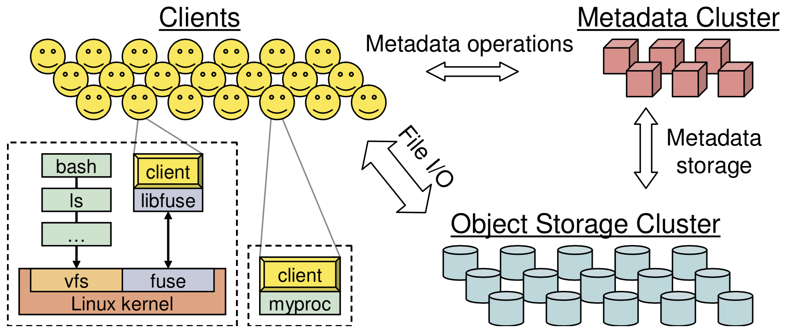
Ceph
A Scalable, High-Performance Distributed File System
Intro
Object storage
Block device
Filesystem

Slide 3
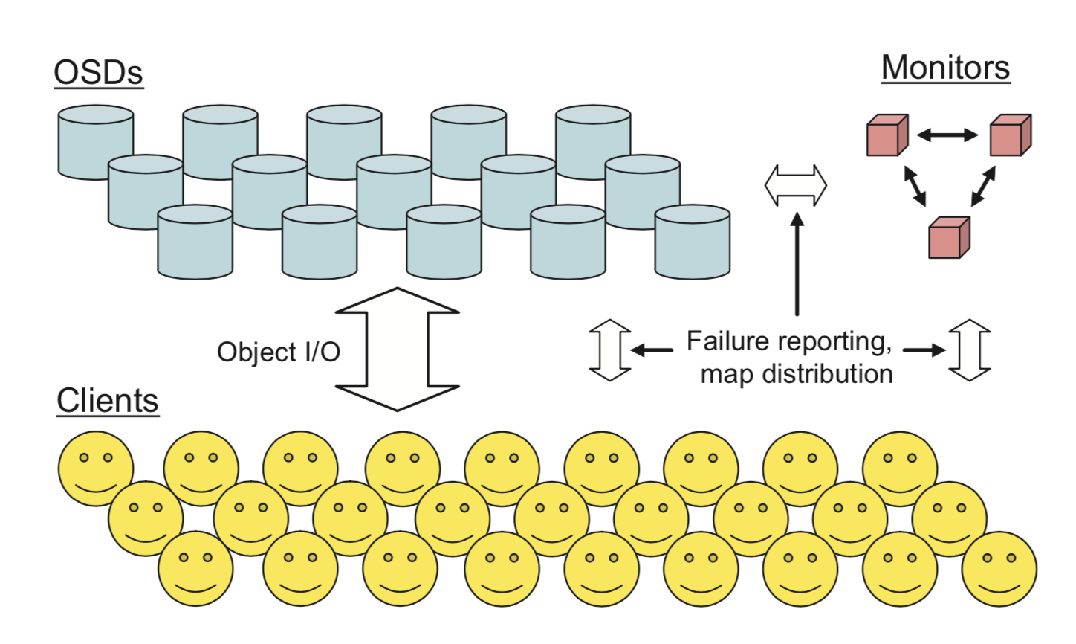
Architecture - RADOS
Components
Monitor
OSD
Client
Deployment
Rados Block Device
Rados GateWay
Ceph FS

Slide 4
Monitor
Maintain maps of the cluster state
Monitor map
OSD map
Placement Group(PG) map
CRUSH map
Paxos service
Leader aggregates map update
Lease-mechanism
epoch | Map version
in/out | OSD contains PG?
up/down | OSD is reachable?
m | Number of PGs(2^{k}-1)
crush | CRUSH rules
leader
Active mon
Active mon

Slide 5
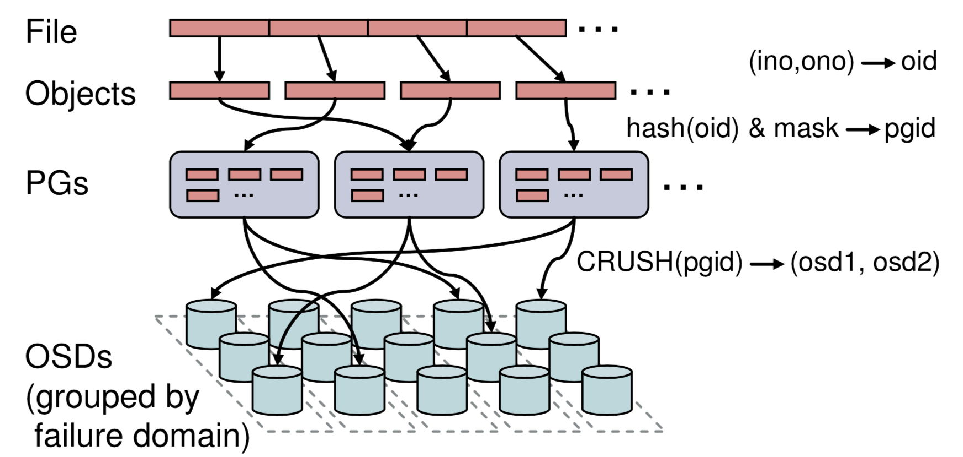
Data placement
Two-phase mapping
Object --> PG
Hash
PG --> OSDs
CRUSH
src/osd/OSDMap.cc
Object_locator_to_pg
Pg_to_osds
Why?
Independent PG mapping when OSD adds/removes
Pool
Notes:
How clients choose target OSD?-Osdc.cc/_calc_target()
1.Calculate target pgid
2.Primary pg?
3.Acting osds
4.Rand, best or primary? According to flag

Slide 6
Pool – PG – OSD
Pool
PG
Create pool with #PG
CRUSH rule is configurable to keep dynamic load-balance
OSD

Slide 7
IO flow
Threadpools(src/osd/OSD.h:class OSD)
osd_tp
osd_op_tp
recovery_tp
disk_tp
command_tp
Workqueue(src/osd/OSD.h:class OSD)
OpWQ
PeeringWQ
RecoveryWQ
CommandWQ
…
RBD
RGW
Ceph FS
enqueue
WorkQueue
Thread
pool
dequeue
process
PG
PG
PG

Slide 8
IO flow
Client read/write a file
Receiving a request and insert to session’s waiting list
Client
OSD
Slicing files to objects
Process request from waiting list and insert into PG’s queue
(pg->osdservice->pg = osd->shardedwq)
Worker thread dequeues op and process
Encapsulate operations and send to corresponding OSD
Get objectcontext and opcontext and encapsulate ops into a transaction
Receiving reply
Read(async/sync) or write(also to replicas) , submit transaction and reply to client

Slide 9
Function flow
Client
OSD
ll_write
client/Client.cc
send_op
osdc/Objecter.cc
ms_fast_dispatch
osd/OSD.cc
OSDservice::ShardedOpWQ::_enqueue
osd/OSD.cc
OSD::ShardedOpWQ::_process
osd/OSD.cc
eval_repop
osd/ReplicatedPG.cc
_write
client/Client.cc
_op_submit
osdc/Objecter.cc
dispatch_session_waiting
osd/OSD.cc
queue_op
osd/PG.cc
PGQueueable::run
osd/OSD.h
start_async_reads
Issue_repop
Write_trunc
osdc/Filer.h
op_submit
osdc/Objecter.cc
dispatch_op_fast
osd/OSD.cc
enqueue_op
osd/OSD.cc
OSD::dequeue_op
osd/OSD.cc
execute_ctx
osd/ReplicatedPG.cc
sg_write_trunc
osdc/Objecter.h
write_trunc
osdc/Objecter.h
handle_op
osd/OSD.cc
get_pg_or_queue_for_pg
osd/OSD.cc
do_request
osd/ReplicatedPG.cc
do_op
osd/ReplicatedPG.cc

