Slide 1



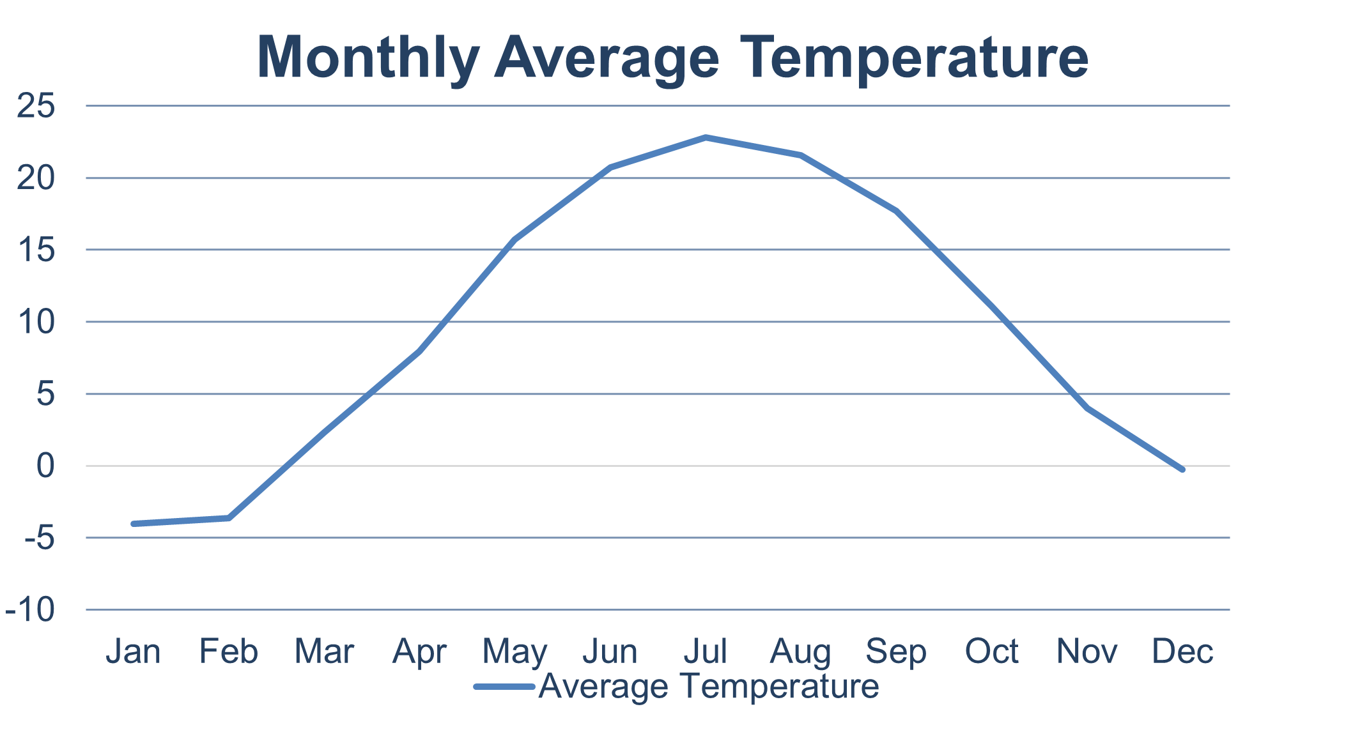
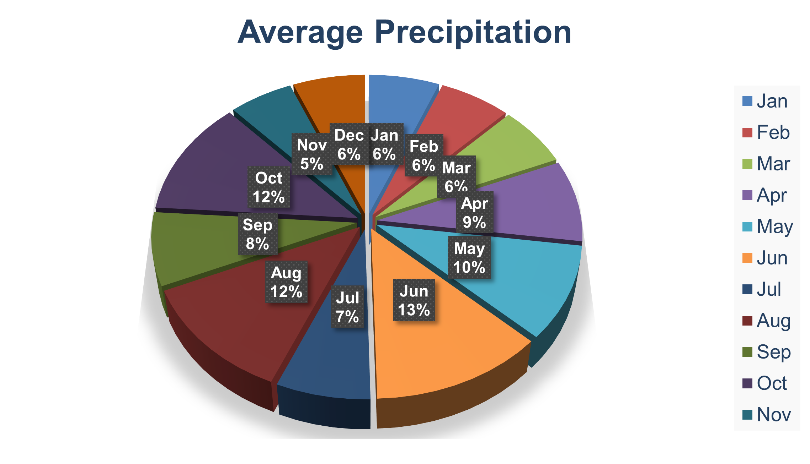
Lansing Weather Analysis 2012~2022
The highest temperature in the Great Lansing area is 39.1 Cº.
The lowest temperature in the Great Lansing area is -25.6 Cº.
The average annual rainy day in the Great Lansing area is 195 days.
Reference:
https://support.apple.com/zh-cn/guide/iphone/iph4305794fb/ios
https://www.usclimatedata.com/

