Slide 1
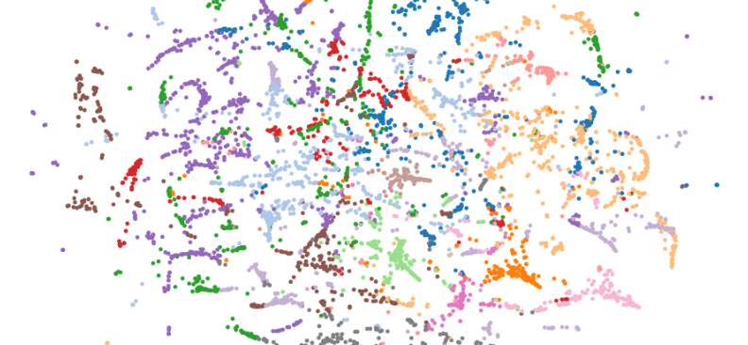
Debiasing word embeddings
Man is to computer programmer as woman is to homemaker?
Ivan Yovchev – Davide Barbieri – Andras Csirik – Balint Hompot 01.31.2019.

Slide 2
Outline
Bias in word embeddings
Removing gender bias
Results after debiasing
Searching for remaining bias
Conclusions

Slide 3
The problem with word embeddings
Increaing popularity of task automation
Increasing application of NLP methods
Scalability of automated processes
Hiring employees
Evaluating applications
Granting loans
Etc.
Many rely on word embeddings
Embeddings encode word knowledge, including bias
One unfair application can affect many lives
We need to address bias in word embeddings to ensure fair applications

Slide 4
World knowledge is also world bias
Original text
Engineering Phd. student
Wanted association
Engineering postgrad student
Unwanted association
Male Phd. student

Slide 5
Project outline
Replicate:
Removing gender bias in word embeddings
Man is to Computer Programmer as Woman is to Homemaker? Debiasing Word Embeddings
Tolga Bolukbasi, Kai-Wei Chang, James Zou, Venkatesh Saligrama, Adam Kalai, 2016
Running debiasing on both word2vec and Glove
Performance assesment on word embeddings benchmark, following:
How to evaluate word embeddings? On importance of data efficiency and simple supervised tasks
Stanisław Jastrzebski, Damian Leśniak, Wojciech Marian Czarnecki
Quantitative assesment of debiasing following:
Lipstick on a Pig: Debiasing Methods Cover up Systematic Gender Biases in Word Embeddings But do not Remove Them
Hila Gonen, Yoav Goldberg, 2019
Searching for the remaining bias
Extension:

Slide 6
Outline
Bias in word embeddings
Removing gender bias
Results after debiasing
Searching for remaining bias
Conclusions

Slide 7
Intuition
Identify gender subspace
Neutralize words
Equalize with respect to word pairs
Select gender defining word pairs (“he”-”she”)
Calculate gender defining subspace
Find words that should be gender neutral
Ensure that their projection on the gender space is 0
Define pairs of equality words (e.g. “grandmother” – “grandfather”)
Ensure that neutral words in equal distance from each word (e.g. “babysit” – “grandma” and “babysit” – “grandpa”)

Slide 8
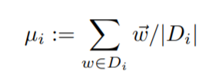
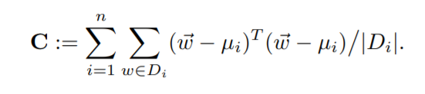
Identify gender subspace
Inputs:
Word sets W
Defining sets D_{1…}
Embeddings w
Projection on space B is noted in subscript (w w_{B})
Output:
Gender subspace B as the first k components of SVD(C)
gender subspace
male
he
man
she
woman
female

Slide 9

Neutralize
Additional input:
Words to neutralize N
Words embeddings w in N
Output:
Neutralized word embeddings in N
gender subspace
engineer

Slide 10
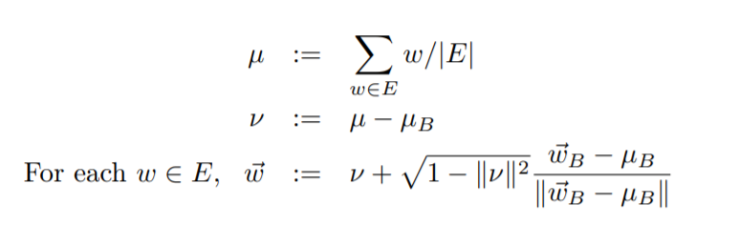
Equalize
Additional inputs:
Equlization reference pairs E_{1…}
Output:
Equalized word embeddings in N
gender subspace
grandpa
babysit
grandma

Slide 11
Outline
Bias in word embeddings
Removing gender bias
Results after debiasing
Searching for remaining bias
Conclusions

Slide 12
Double goal
Maintaining performance
Removing bias

Slide 13
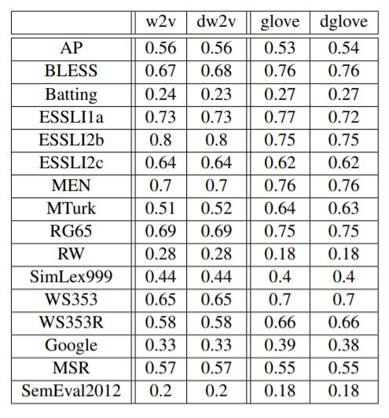
Maintaining performance – word embeddings benchmark
Measuring performance on 4 sets of tasks:
Similarity (e.g. identifying close words)
Analogy (generating analogies as defined by humans)
Sentence analysis (e.g. sentiment)
Retaining word properties (e.g. POS-tagging)
Debiasing did not affect the performance

Slide 14
Double goal
Maintaining performance
Removing bias

Slide 15
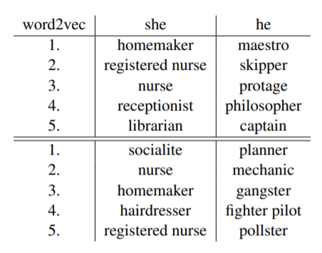
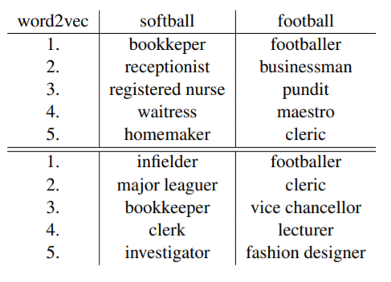
Qualitative debiasing assessment
Direct
Indirect
Before
After

Slide 16
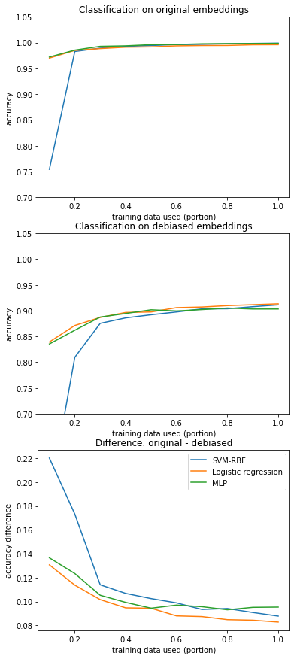
Quantitative debiasing assessment
Select the 2500 most biased female and male words (largest projection)
See if we can classify them as male and female biased words after debiasing
Iteratively increase training size to see if the classification is harder
Classifiers need somewhat more data, but the accuracy is almost as good as without debiasing Bias is hidden, but not removed

Slide 17
Outline
Bias in word embeddings
Removing gender bias
Results after debiasing
Searching for remaining bias
Conclusions

Slide 18
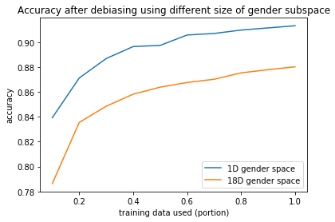
Using larger gender subspace
Original paper uses 1 principal component as most variance is explained by it
Remaining component may contain the remaining bias
We use maximum size (18 components) gender space for projection in neutralization and equalization
With larger gender subspace, classification becomes harder, but the accuracy is still high
The performance on the benchmark is very close, but slightly smaller

Slide 19
Outline
Bias in word embeddings
Removing gender bias
Results after debiasing
Searching for remaining bias
Conclusions

Slide 20
Conclusions
The original results are replicated
Qualitative analysis shows, that the bias still remains
Extending the gender subspace helps, but the bias is still present
To improve, we can further extend the subspace, or search for a non-linear one, but it may hurt the performance
We cannot remove the bias completely in post-processing
Other biases are even harder to remove: race, country of origin etc.
Fair word embeddings should come from fair data

Slide 21
Thank you for your attention
Questions?

