Slide 1





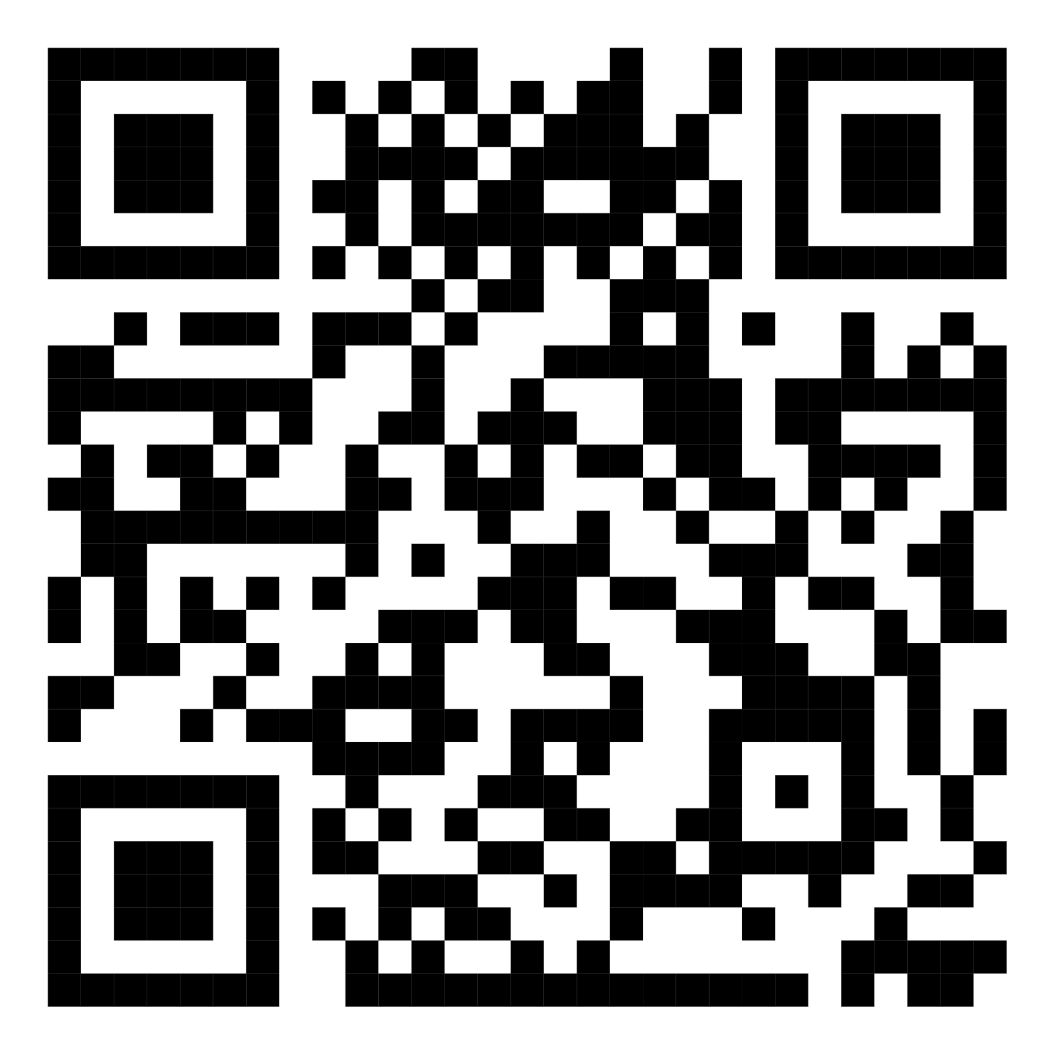
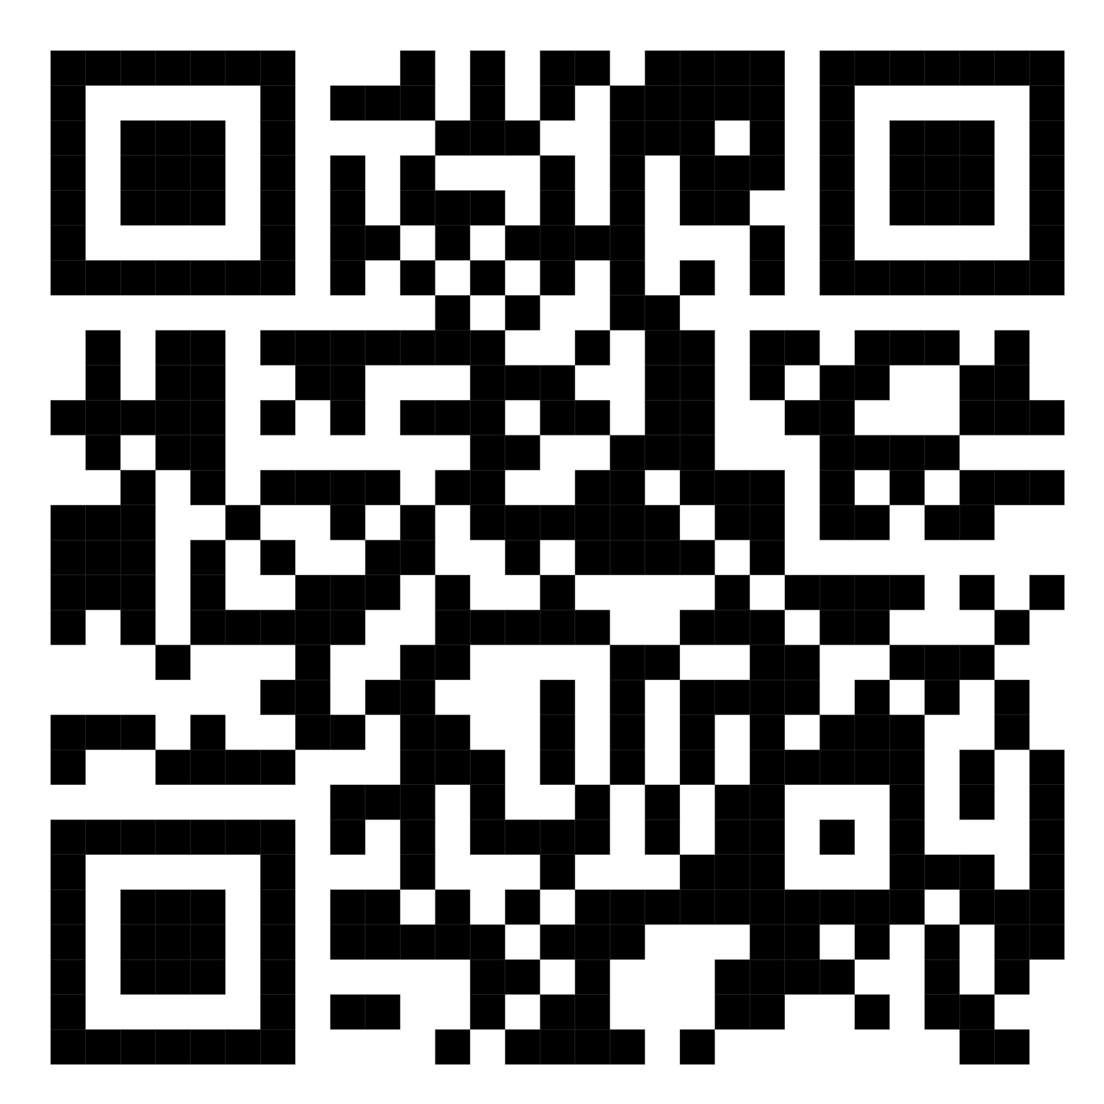
AIoT Coding, Engineering and Entrepreneurial Skills Education for Gifted Students
AI LIGHT
Project ID:P10
Students: 25 Li Kin Man
37 Wong Lam Yeung
40 Yang Yuen Ting
Abstract
Having eyes disease nowadays was hugely popular which is mainly cause by using the phone in the dark environment.
So, we will send a message to the user to remind he/she turn on the light. If not, just help them to turn on. Also, remind them to blink eye if they not do so.
Results/Application
As the result of our “blink eyes”. Although is successful, it is not complete at all because we want to make it as a background app but now we just can do it over the screen.
Objective/Background
Nowadays, many modern people like to use their own phone without light when they are ready to have a sleep. Therefore, in long term it will cause a lot of eyes disease.
Moreover, people often forget to blink eye during watching electronic devices. Their eyes will lack of water and feel dry, that will increase the risk of eye infection in long term.
GitHub Link
YouTube Link
future aspect
In the future, we will continue to improve our program, for example, adding the function of calculating the frequency of blinking and reminding users to blink their eyes when they forget to do so.
Methodology
1. If detected the user uses the phone without the light, send them a message which is about reminding them to turn on the light. If they do not do so, just help them to turn on the light slowly and automatically.
2.Also, we will detect whether users have blinked their eyes or not. If not, just also send a message to remind them. The message will disappear after it detects that the user blinks.
Discussion/Conclusion
In the course, we learned a lot of extracurricular knowledge. Even knowledge that we won't come across at this stage. For example: we encountered a lot of difficulties when writing code, but there are many kindly TAs who helped us a lot, thank you all the supporters very much.

