Slide 1
Computer Science and Medical Research
Session 1
Introduction to Bioinformatics
github.com/Yoyomanzoor/CSMR

Slide 2
Me
Sumeed Manzoor
smanzoor@umich.edu
2nd year grad student at the University of Michigan

Slide 3
You?
School?
Year?
What brought you here?

Slide 4
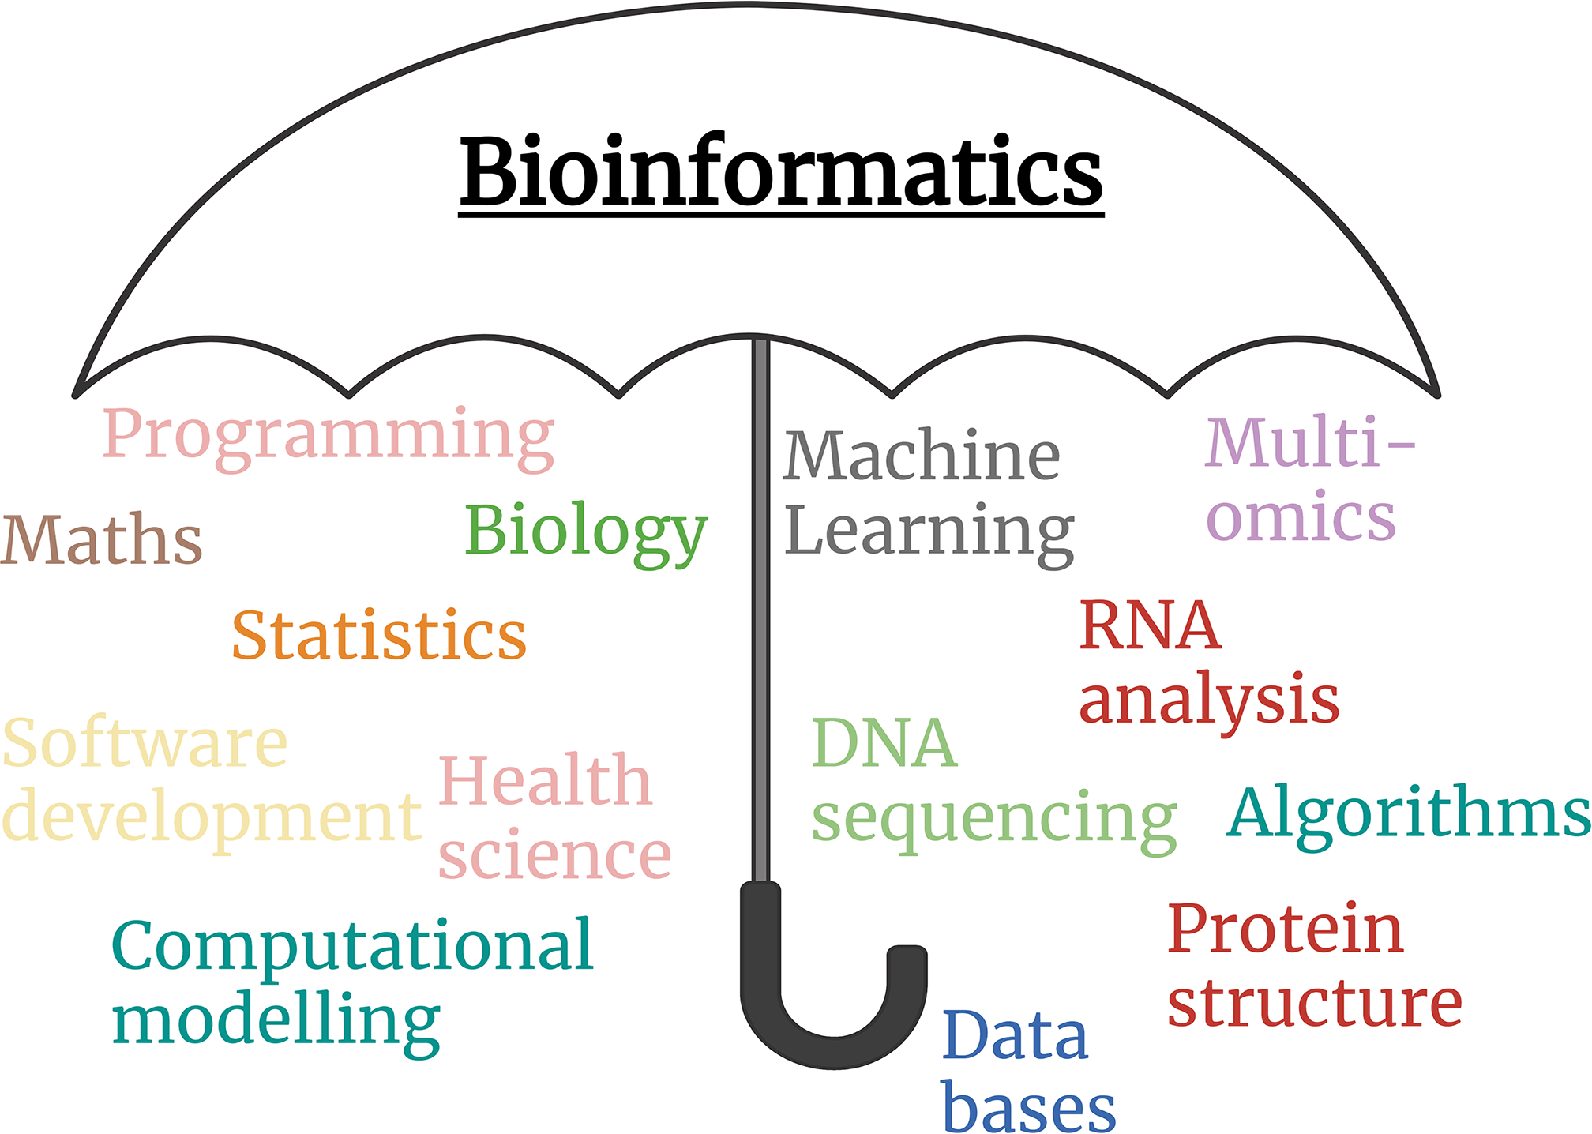
Bioinformatics
https://doi.org/10.1042/bio_2022_136

Slide 5
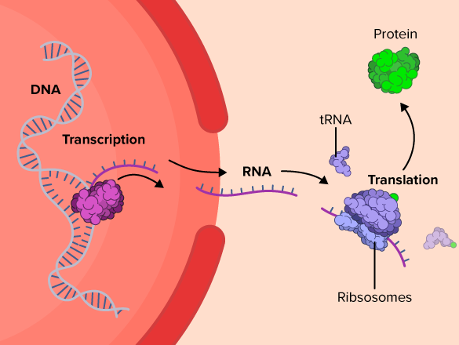
Central dogma

Slide 6
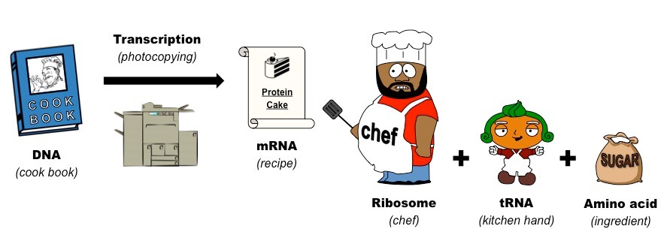
Central dogma

Slide 7
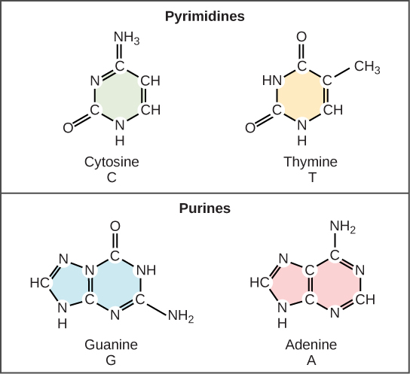

Slide 8
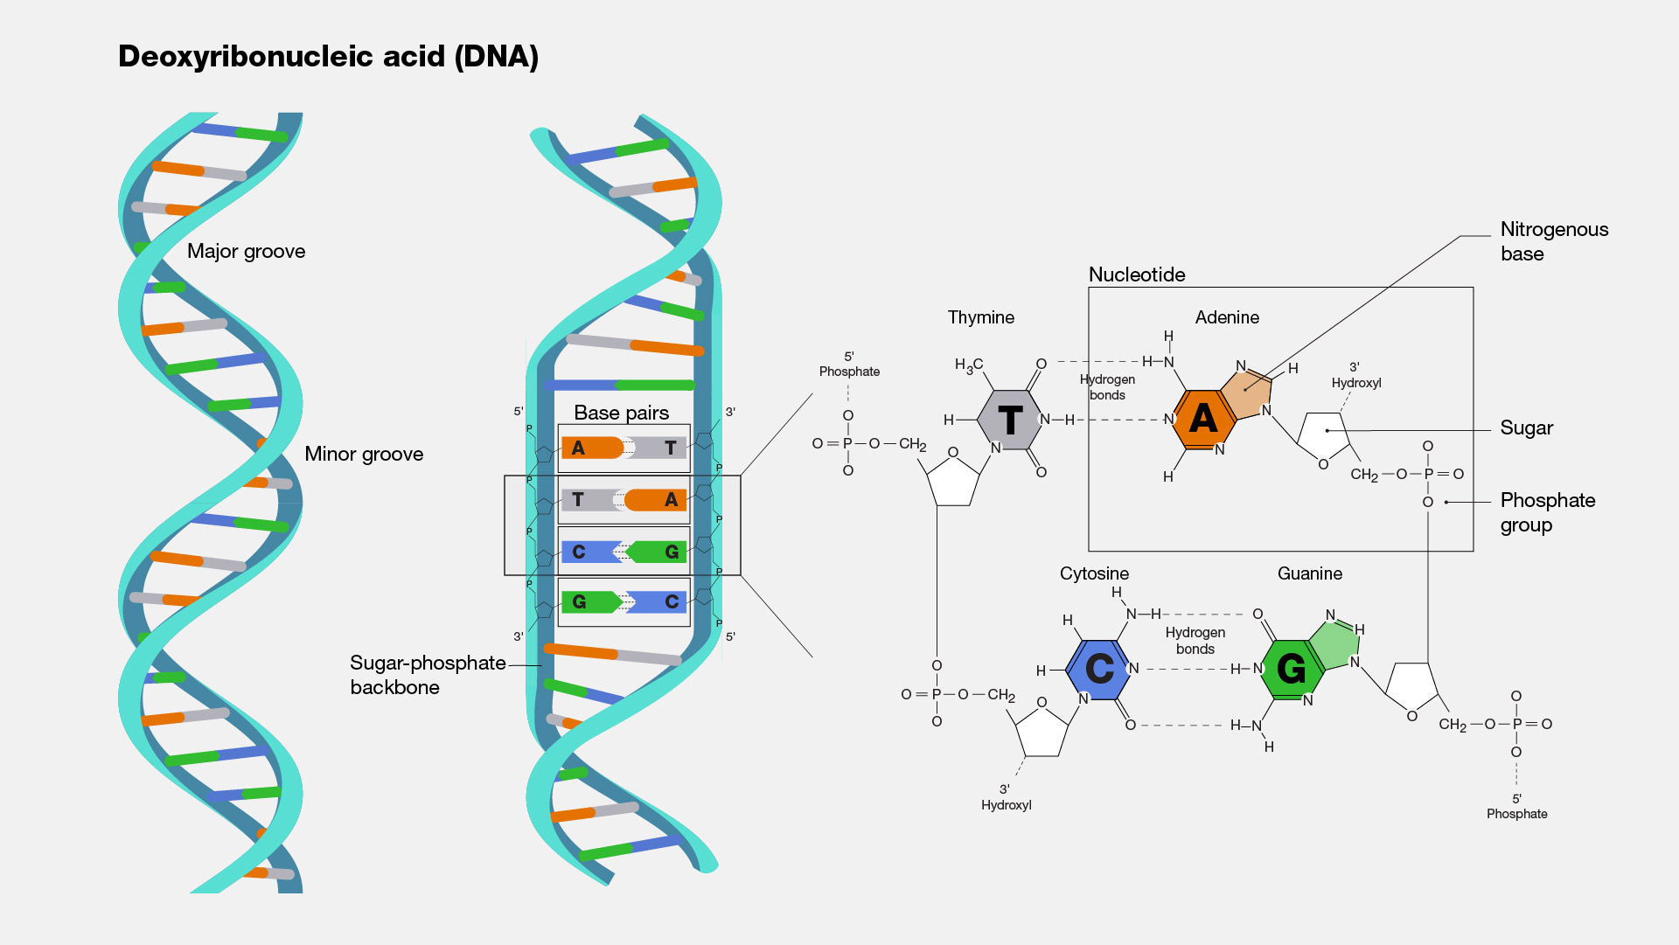
https://www.genome.gov/genetics-glossary/Deoxyribonucleic-Acid

Slide 9
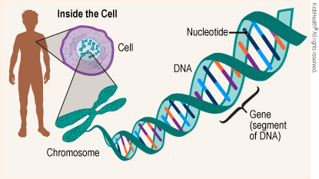
Genes are made of DNA

Slide 10
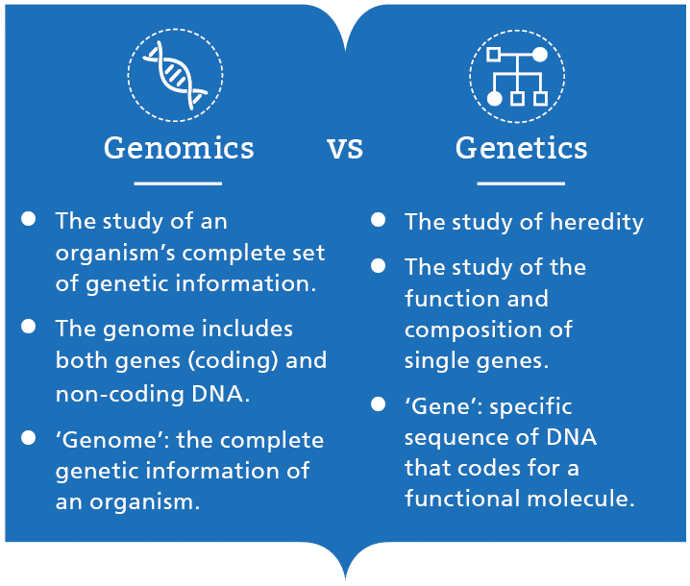

Slide 11
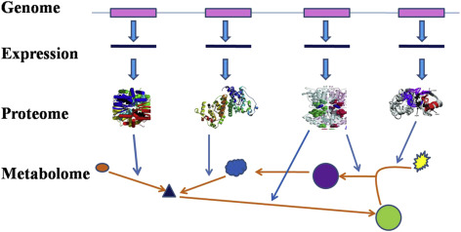

Slide 12
Big Data!
The genome consists of ~3 billion base pairs! That’s a 3.5 gigabyte text file.
There are >45k genes, and ~20k protein coding genes
Enter bioinformatics! We can use computational methods to analyze this data and develop hypotheses, form predictions, and make discoveries

Slide 13
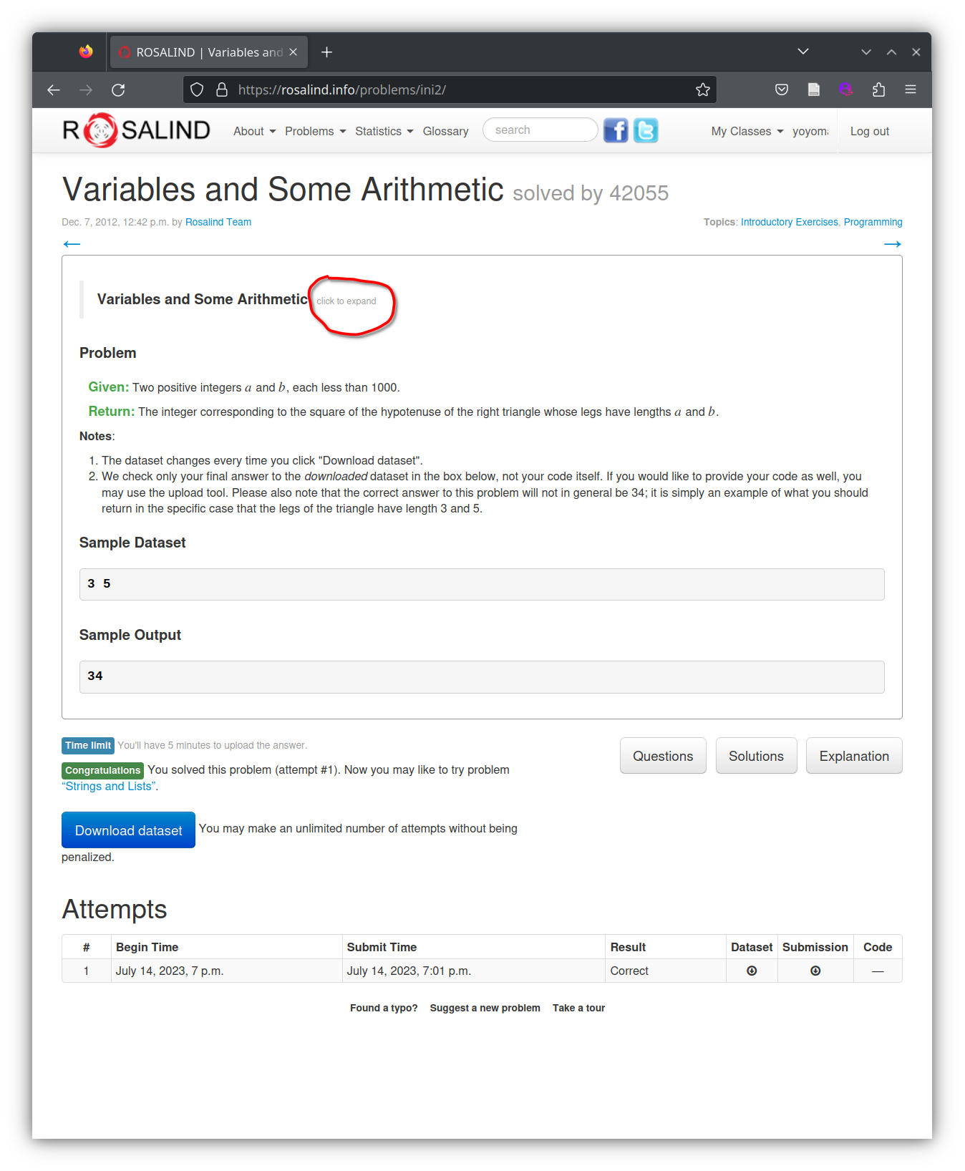
We will use Rosalind
to learn the basics
of Python

Slide 14
Expectations
Be excited! We will first start with learning the tools of bioinformatics and analyzing data, but soon you will be working with real-world data and making scientific discoveries!
I will challenge you to think deeply and broadly to learn this topic. Programming is learned though practice, not lectures!
By the end of this course, I hope that you will be exposed to scientific literature, medical research, and computer science in the context of biology. You will get out what you put in.

