Slide 1
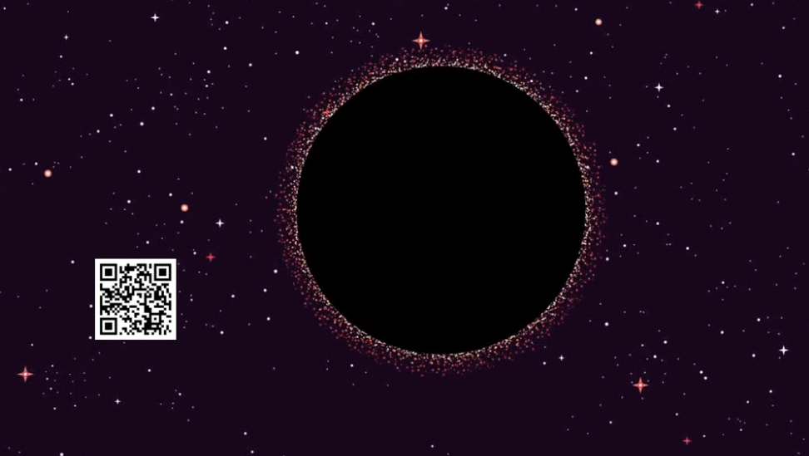
Telemetry

Slide 2

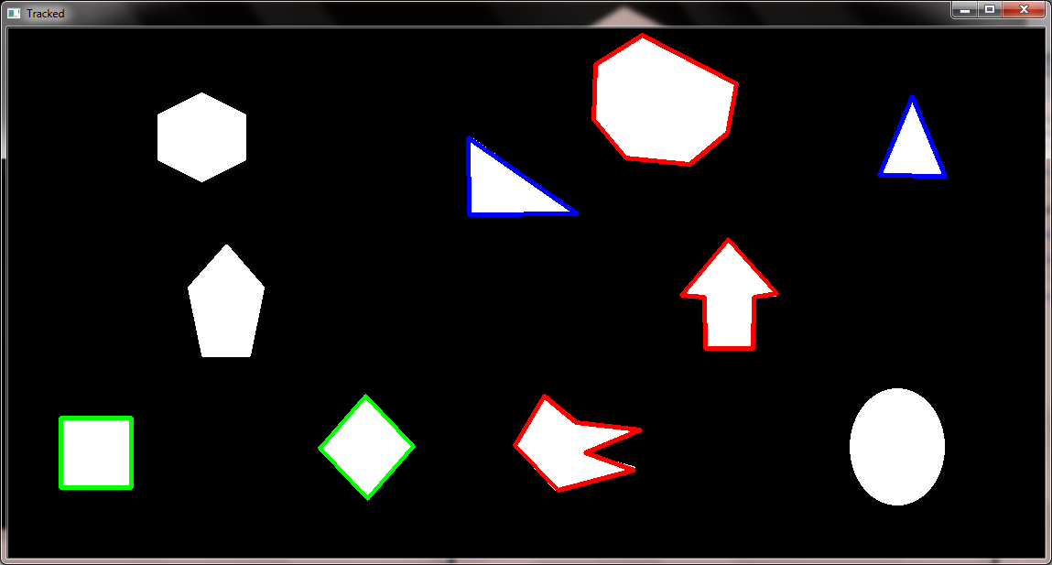
OpenCV, again
Contour detection

Slide 3
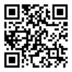
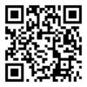

QR, etc
.
.
.
BASE64
string
Python
code

