Slide 1
HANDS-ON
The Intern Program starter
Tasks 2.1 → 2.4 · the ingestion pipeline, on a real document
A ready-to-run RAG environment — LangChain + local open-source models · no API keys · your data never leaves the machine
Notes:
So far that was the concept. This is the actual starter project you clone and run for the Ship Program — the ingestion half, hands-on, on the CIS Controls v8 security guidelines. Numbering: the project splits ingestion into sub-tasks 2.1–2.4 (parse/chunk/embed/store), which maps to the conceptual '2.5 Ingestion' stage — just in implementation detail.

Slide 2
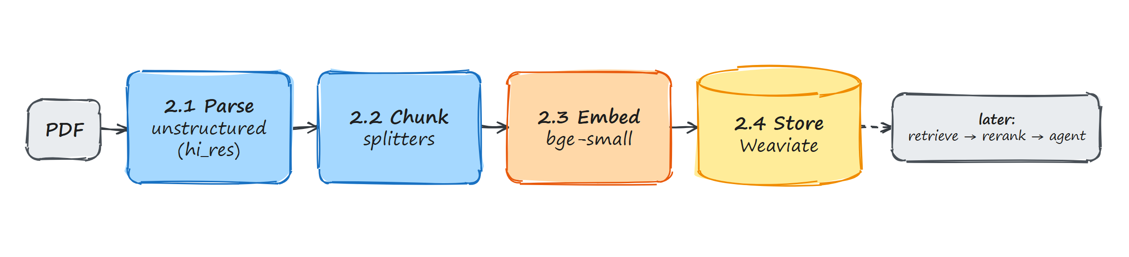
Ingestion in four stages
Stage | What it does | Tool
2.1 Parse | Extract text, tables & images from the PDF | langchain-unstructured (hi_res)
2.2 Chunk | Split into retrieval-sized pieces (char / token / by-title) | langchain-text-splitters
2.3 Embed | Turn chunks into vectors, locally on CPU | BAAI/bge-small-en-v1.5
2.4 Store | Save vectors in a DB you can search by similarity | langchain-weaviate + Weaviate
Local RAG Pipeline · Intern Program
12
Notes:
The notebook walks a real PDF (CIS Controls v8) through these four stages. 2.1 Parse: unstructured hi_res uses OCR + a layout model so it detects tables & images. 2.2 Chunk: by character / token / by-title (structure-aware). 2.3 Embed: same bge-small CPU model. 2.4 Store: Weaviate here instead of Chroma/FAISS — same similarity-search idea. Dashed box = what comes later: retrieve -> rerank -> agent.

Slide 3
Prerequisites
Python 3.12+ Required (requires-python in pyproject.toml)
1
uv Package/env manager — reads pyproject.toml + uv.lock, builds an isolated .venv for you
2
System packages For hi-res PDF parsing: poppler-utils · tesseract-ocr · libgl1
3
Docker Runs Weaviate (recommended over the embedded fallback)
4
Local RAG Pipeline · Intern Program
13
Notes:
uv install: curl -LsSf https://astral.sh/uv/install.sh | sh (Linux/macOS/WSL). System libs (Debian/Ubuntu/WSL): sudo apt-get install -y poppler-utils tesseract-ocr libgl1 — poppler renders PDF pages to images, tesseract OCRs them, libgl1 needed by the layout/vision model. macOS: brew install poppler tesseract. Weaviate via Docker: docker run -p 8080:8080 -p 50051:50051 cr.weaviate.io/semitechnologies/weaviate:1.27.0

Slide 4
Setup & run
From the rag_setup/ directory:
# 1. Install Python deps into an isolated .venv uv sync # 2. Launch Jupyter uv run jupyter lab # or: uv run jupyter notebook
Open notebooks/01_RAG_setup.ipynb, select the project's .venv kernel, run top to bottom
First run is slow (one-time): downloads the embedding model (~130 MB) + layout model, and hi_res parsing takes a few minutes on CPU. Cached afterward.
Local RAG Pipeline · Intern Program
14
Notes:
uv sync reads the lockfile and builds the exact reproducible environment. Pick the project's .venv as the notebook kernel or imports fail. Warn them: the first run looks like it's hanging but it's downloading models and OCR-parsing the PDF; everything caches after the first pass.

Slide 5
Project layout
rag_setup/ ├── data/ # CIS Controls v8 PDF (sample document) ├── notebooks/ │ └── 01_RAG_setup.ipynb # ingestion walkthrough (Tasks 2.1 → 2.4) ├── main.py # placeholder entry point ├── pyproject.toml # dependencies + Python version └── uv.lock # pinned dependency versions
pyproject.toml + uv.lock are the source of truth for the environment — don't hand-edit the .venv.
Local RAG Pipeline · Intern Program
15
Notes:
Everything lives under rag_setup/. The teaching is all in the one notebook; main.py is a placeholder for a real entry point later. pyproject.toml + uv.lock are the source of truth — don't hand-edit the venv.

Slide 6
Key takeaways
RAG = give a small model the right context, not a bigger model
Ingestion quality sets the ceiling — chunk well, embed with a matching model
Retrieve wide + cheap, rerank narrow + precise (two-stage)
Small + local + CPU is a real, practical option — privacy, cost, offline
If you remember one thing: retrieval quality beats model size.
Local RAG Pipeline · Intern Program
17
Notes:
Most RAG failures are bad chunks or bad retrieval, not a too-small LLM. Open the floor for questions.

Slide 7
The small / local stack — all CPU-verified
Stage | Job | Model / tool | CPU footprint
2.5 — embed | text → vector | bge-small-en-v1.5 / nomic-embed-text | ~130–275 MB, fast
2.5 — store | save vectors | Chroma (easy) / FAISS (fast) / Weaviate | local, no GPU
2.5 — sync | avoid re-embedding | LangChain Indexing API | —
2.7 — retrieve | find top-k | as_retriever(k=50) | sub-second
2.7 — generate | write the answer | qwen3:4b / llama3.2:3b via Ollama | 2–3 GB, ~3–6 tok/s
2.6 — rerank | precise re-score | bge-reranker-v2-m3 (cross-encoder) | 568M, ~130 ms/16 pairs
Every model runs CPU-only — no GPU, no cloud. Verified June 2026.
Local RAG Pipeline · Intern Program
18
Notes:
Hand this out / leave it up during Q&A. Everything here has been CPU-verified.

Slide 8
CPU reality check
Embedding & reranking on CPU: fast (sub-second)
Generation on CPU: the slow step — ~3–6 tokens/sec on a modern desktop CPU
Great for: single-query lookups, batch jobs, privacy-sensitive data
Less great for: snappy real-time chat (smaller model, or a GPU later)
Embed + rerank
Generation
sub-second
~3–6 tok/s
Local RAG Pipeline · Intern Program
19
Notes:
Ollama uses CPU automatically when there's no GPU. Be honest: the answer types out at reading speed, not instantly — fine for an internal tool over private docs. Retrieval & reranking stay fast regardless; the bottleneck is only the LLM writing tokens.

Slide 9
Building a Local RAG Pipeline
Ingestion · Retrieval · Reranking
small models · no GPU · no cloud · nothing leaves the machine
Intern Presentation
Notes:
My part covers three stages of a RAG pipeline. Theme: everything is small enough to run locally on a CPU — no GPU, no API keys, no data leaving the machine (privacy, cost, offline). Note on ordering: numbered 2.5/2.6/2.7 but presented in runtime-flow order: Ingestion (2.5) -> Retrieval (2.7) -> Reranking (2.6).

Slide 10
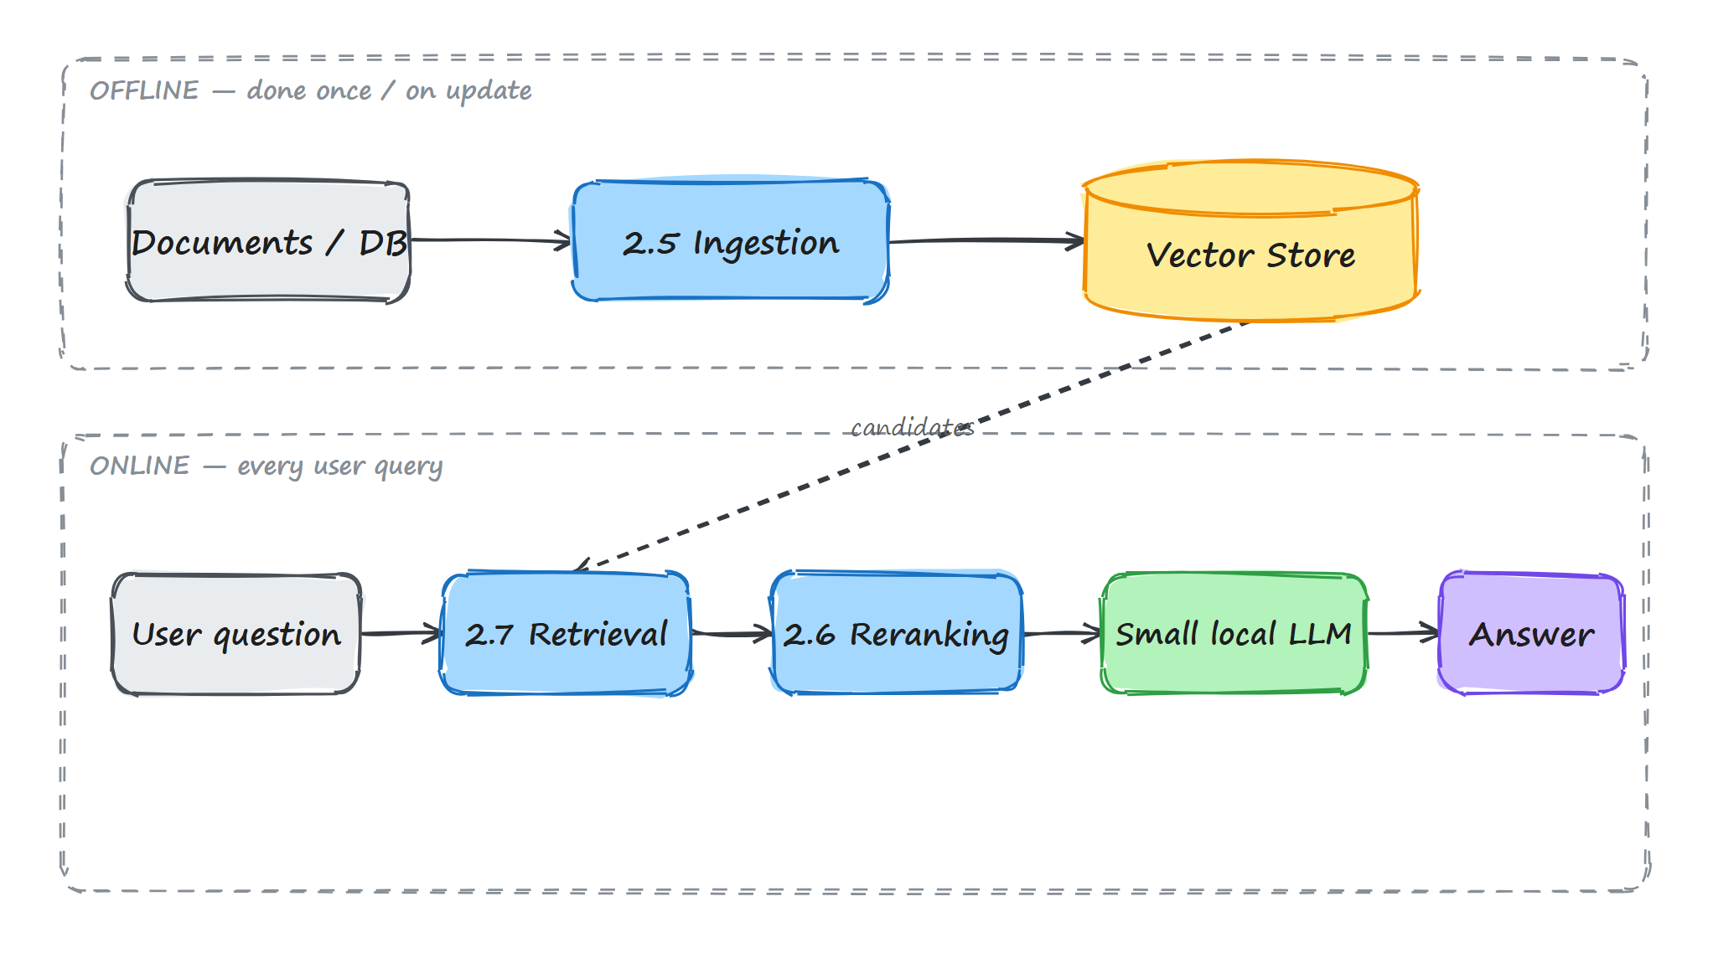
What is RAG — and where do my parts fit?
LLMs don't know your private/internal data and can hallucinate
RAG = retrieve relevant text first, then answer using it
Two phases: offline (build the knowledge base) · online (answer a query)
Local RAG Pipeline · Intern Program
2
Notes:
Offline we prepare the knowledge base once (ingestion). Online, every question goes through retrieval, then reranking, then a small model writes the answer. Retrieval is fast/approximate (find candidates from millions); reranking is slow/precise (re-score a handful). This diagram is the anchor for the whole talk.

Slide 11
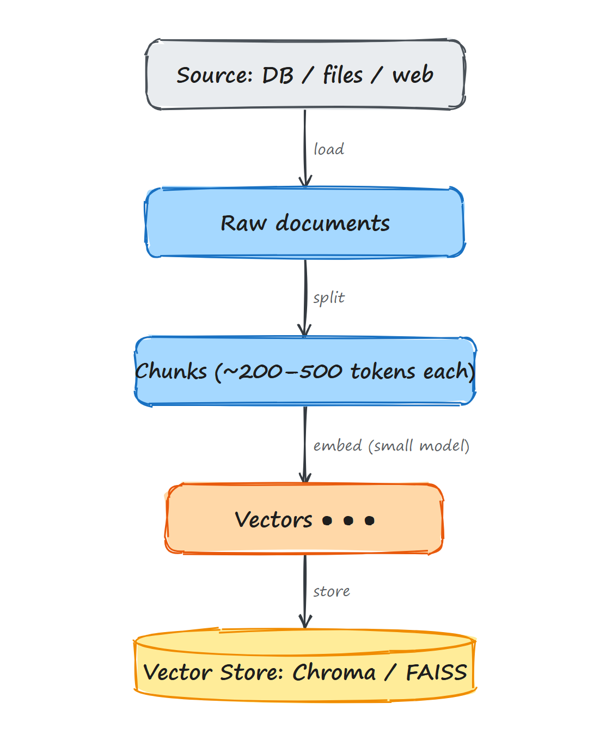
2.5
Ingestion — the goal
Turn raw documents (or DB rows) into searchable vectors
Four steps: Load → Split → Embed → Store
Done once, then re-run only when the source changes
Local RAG Pipeline · Intern Program
3
Notes:
Ingestion is everything before a user asks a question — garbage in, garbage out. For us, 'DB ingestion' means the source is a database: read rows, turn into text docs, then Load -> Split -> Embed -> Store.

Slide 12
2.5
Ingestion — the steps
Load — read from DB / PDFs / web (LangChain document loaders)
docs = DirectoryLoader("./data").load() chunks = RecursiveCharacterTextSplitter( chunk_size=500, chunk_overlap=50 ).split_documents(docs) emb = HuggingFaceEmbeddings( "BAAI/bge-small-en-v1.5") store = Chroma.from_documents( chunks, emb, "./db")
Split — chunk so each vector is ~one idea (RecursiveCharacterTextSplitter)
Embed — convert each chunk to a vector with a small model
Store — save vectors locally in Chroma or FAISS
~200–500 tokens per chunk with ~50 overlap is a good start — overlap stops a sentence being cut in half across chunks.
Local RAG Pipeline · Intern Program
4
Notes:
Why split: embeddings squash a chunk into one vector; too big = mush, too small = fragmented. Why small embed model: we're on CPU; bge-small / nomic-embed embed thousands of chunks in minutes. Chroma = easiest (persists, metadata, one line); FAISS = faster at huge scale. Both local & free.

Slide 13
2.5
Ingestion — keeping it in sync
Source data changes → vectors go stale
Re-embedding everything every time is wasteful
LangChain Indexing API: skips unchanged docs, updates changed, removes deleted
“Ingest once, sync forever.”
Local RAG Pipeline · Intern Program
5
Notes:
In a demo you ingest once and forget. In production the DB keeps changing. The Indexing API tracks what's already stored via hashes, so a daily sync only embeds new & changed rows. People schedule it as a nightly job.

Slide 14
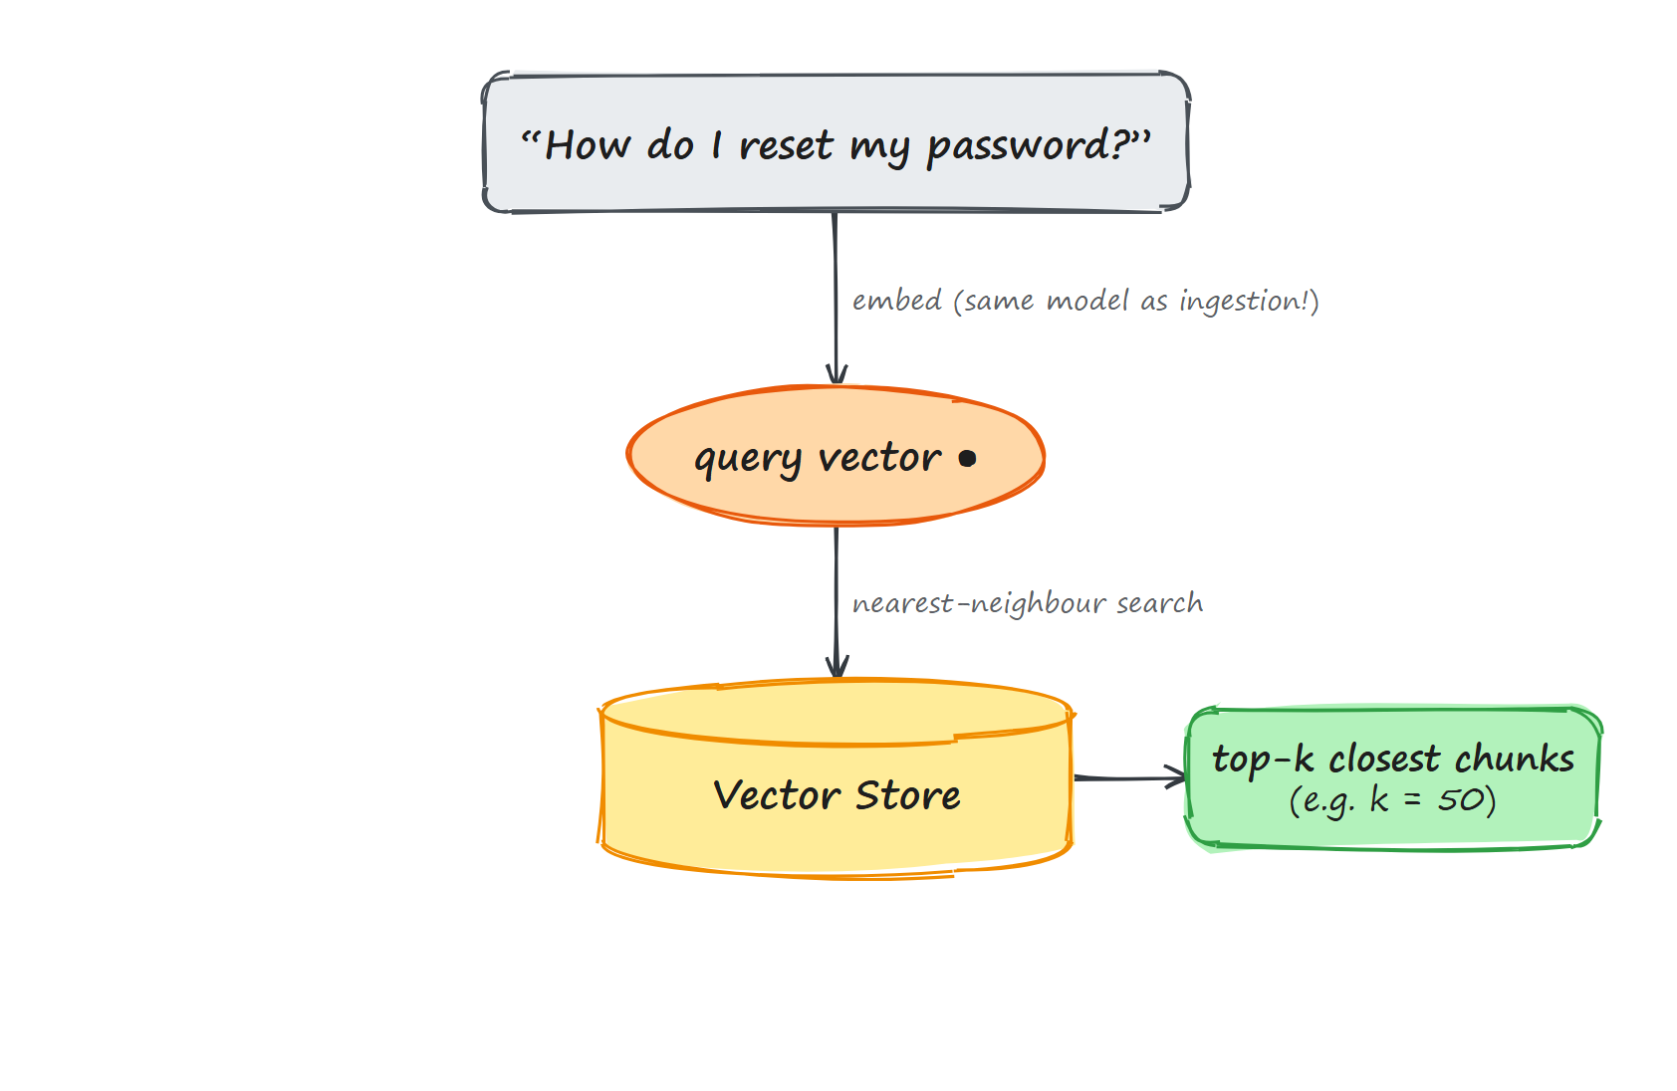
2.7
Retrieval — the goal
At query time: find the chunks most likely to answer the question
Embed the question → compare to stored vectors → return top-k
Fast & approximate — built for scale, not perfection
Local RAG Pipeline · Intern Program
6
Notes:
Critical: embed the question with the SAME model used during ingestion — different models = different vector spaces = meaningless comparison. Nearest neighbours by cosine similarity = similarity, not understanding — that's why reranking exists. Grab a generous top-k (50, not 3): cheaper to over-fetch and filter than to miss the right chunk.

Slide 15
2.7
The small local model that writes the answer
Retrieved chunks + question → prompt → small local LLM → answer
CPU-friendly: Qwen3 (0.6–4B), Llama 3.2 3B, Gemma 3, Phi-4-mini
Run via Ollama or llama.cpp, quantized (Q4) to fit in RAM
Retrieval quality matters MORE than model size — the right 5 chunks beat a huge model with the wrong ones.
Local RAG Pipeline · Intern Program
7
Notes:
On CPU stay in the 1–4B range; Q4 roughly halves memory with little quality loss — a 4B model fits in a few GB. Ollama: `ollama pull qwen3:4b`, serves an OpenAI-compatible localhost endpoint; LangChain talks to it directly. Key reframe: retrieval quality beats model size.

Slide 16
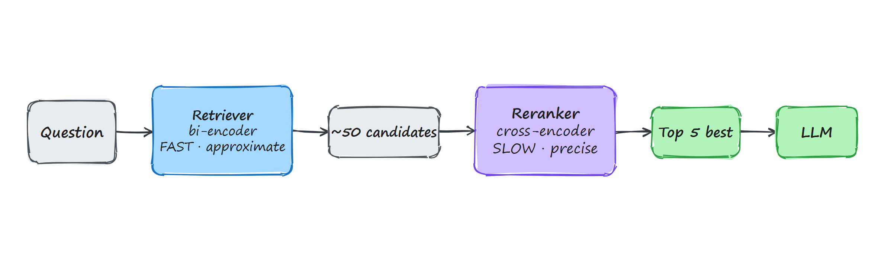
2.6
Reranking — the problem it solves
Vector similarity ≠ true relevance
The retriever's #1 result is often not the best answer
A cross-encoder reads query + chunk together and scores real relevance
Local RAG Pipeline · Intern Program
8
Notes:
Retriever = bi-encoder: embeds query and docs SEPARATELY. Fast (search millions) but can't see how query and a specific doc interact. Cross-encoder: feeds query+chunk through the model TOGETHER -> one relevance score. More accurate but too slow for millions, so only run on the ~50 candidates. Classic two-stage retrieval: retrieve wide & cheap, rerank narrow & expensive.

Slide 17
2.6
Reranking — our model & CPU reality
Model: BAAI/bge-reranker-v2-m3 — 568M params, multilingual, open source
568M
Runs on CPU, no GPU (~130 ms per 16-pair batch)
params
Practical range: rerank 10–30 candidates down to the best 3–5
~130ms
/ 16 pairs
CPU
Tradeoff: reranking adds ~100–500 ms — payoff is cleaner context (fewer hallucinations) and you can send fewer chunks (cheaper, faster generation).
no GPU
Local RAG Pipeline · Intern Program
9
Notes:
bge-reranker-v2-m3 is the standard free local reranker, multilingual. Cross-encoders are slow so rerank only the few dozen the retriever handed over — sub-second on CPU. Code: HuggingFaceCrossEncoder -> CrossEncoderReranker(top_n=5) -> ContextualCompressionRetriever (50 in, top 5 out).

Slide 18
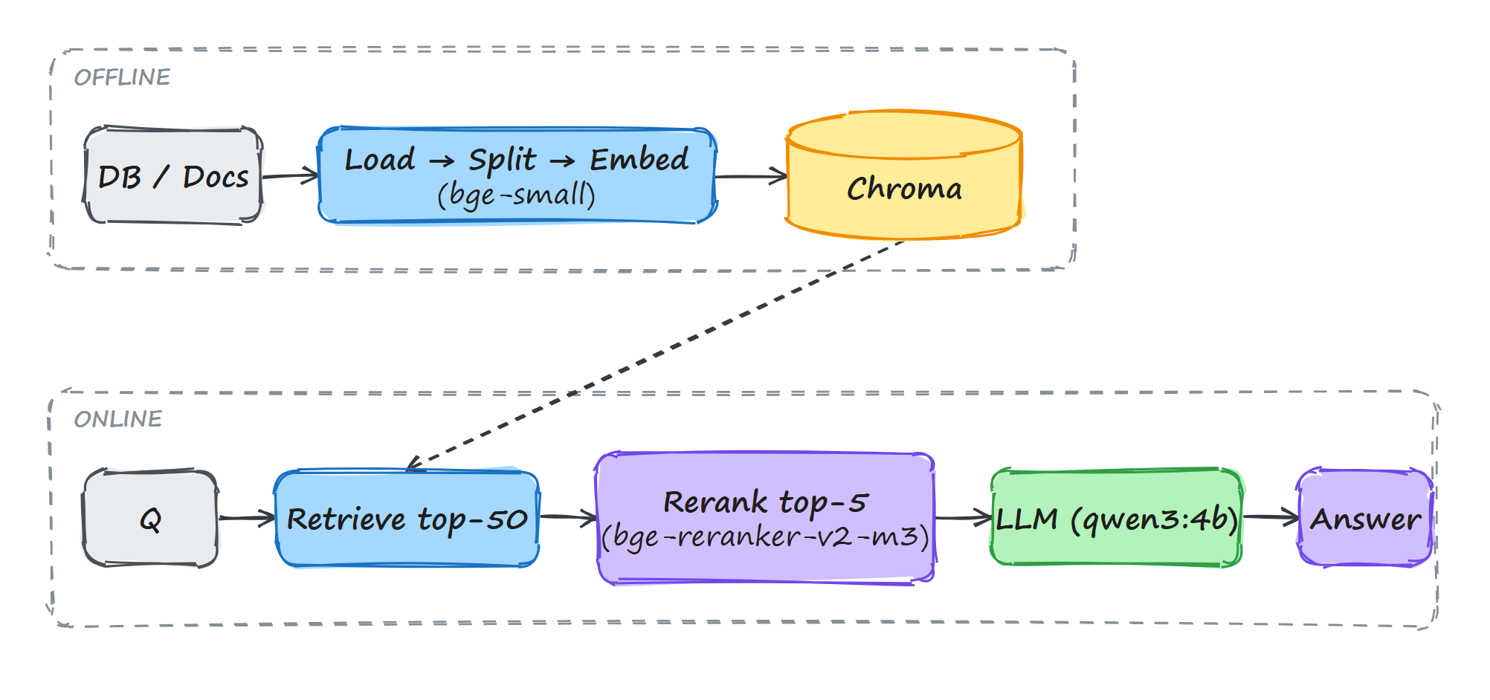
Putting it all together
Offline: Ingest (load → split → embed → store)
Online: Retrieve 50 → Rerank to 5 → Generate
Every component small, local, CPU-only, free
Local RAG Pipeline · Intern Program
10
Notes:
Walk the full loop: prepare the store once; for every question cast a wide net, sharpen with the reranker, let a small model answer from the best 5 chunks. Nothing needs a GPU or the cloud — a genuinely useful private RAG system on a laptop.

Slide 19
Questions?
Why not a bigger LLM? Wrong context → wrong answer, and it won't fit on CPU. RAG fixes context cheaply.
What chunk size? Start ~300–500 tokens, ~50 overlap, then test on real questions.
Always need a reranker? No — add it when plain retrieval returns near-misses. Test with/without.
Same embedding model for ingest & query? Shared vector space, or distances are meaningless.
Embedder vs reranker? Bi-encoder: one vector per text, separate, fast. Cross-encoder: query+doc together, accurate, slow.
Notes:
Prepped Q&A answers — keep this slide up while taking questions.

