Slide 1
AGENT

Slide 2
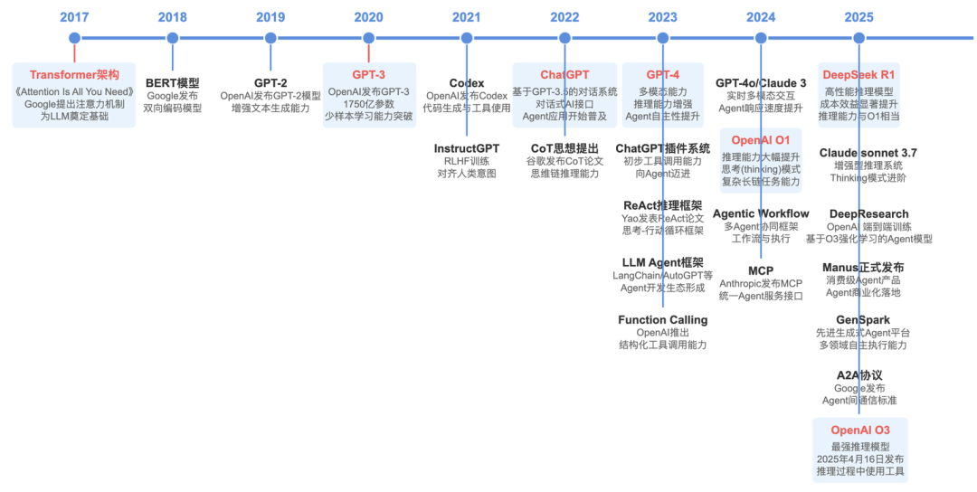
history

Slide 3
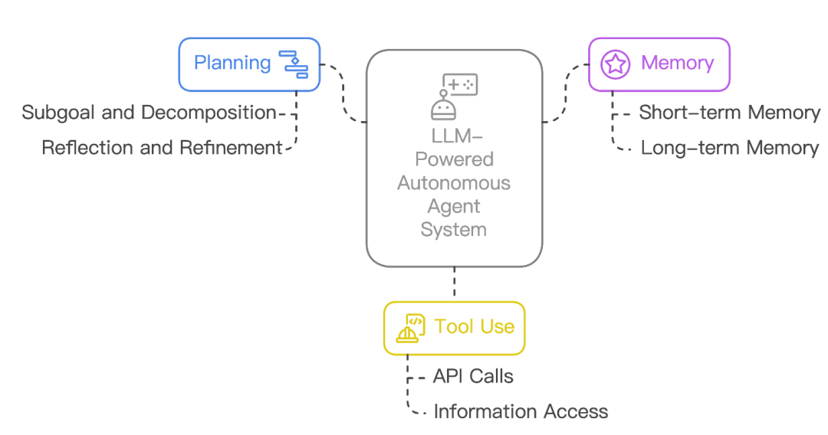
define

Slide 4

AI Vtuber

Slide 5
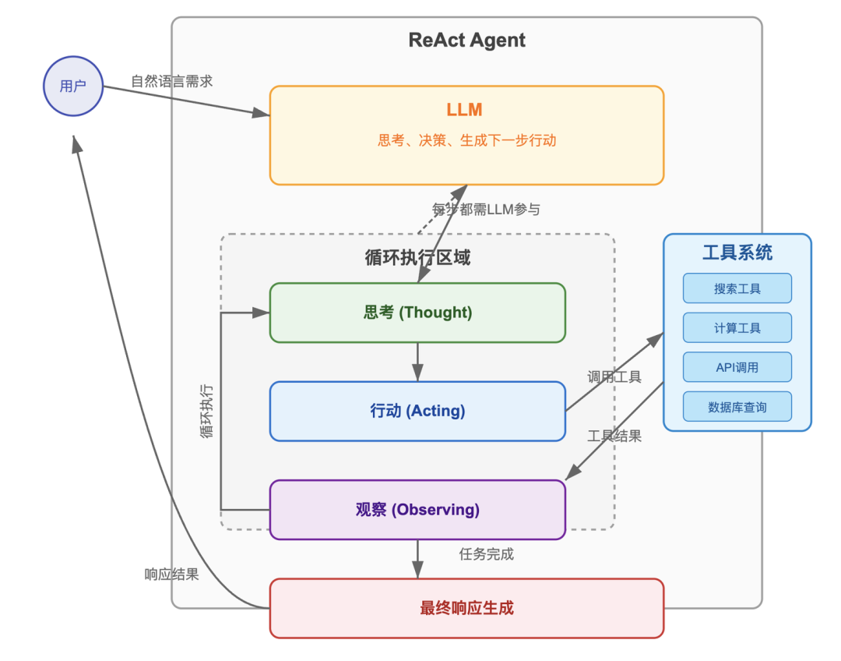
ReAct

Slide 6
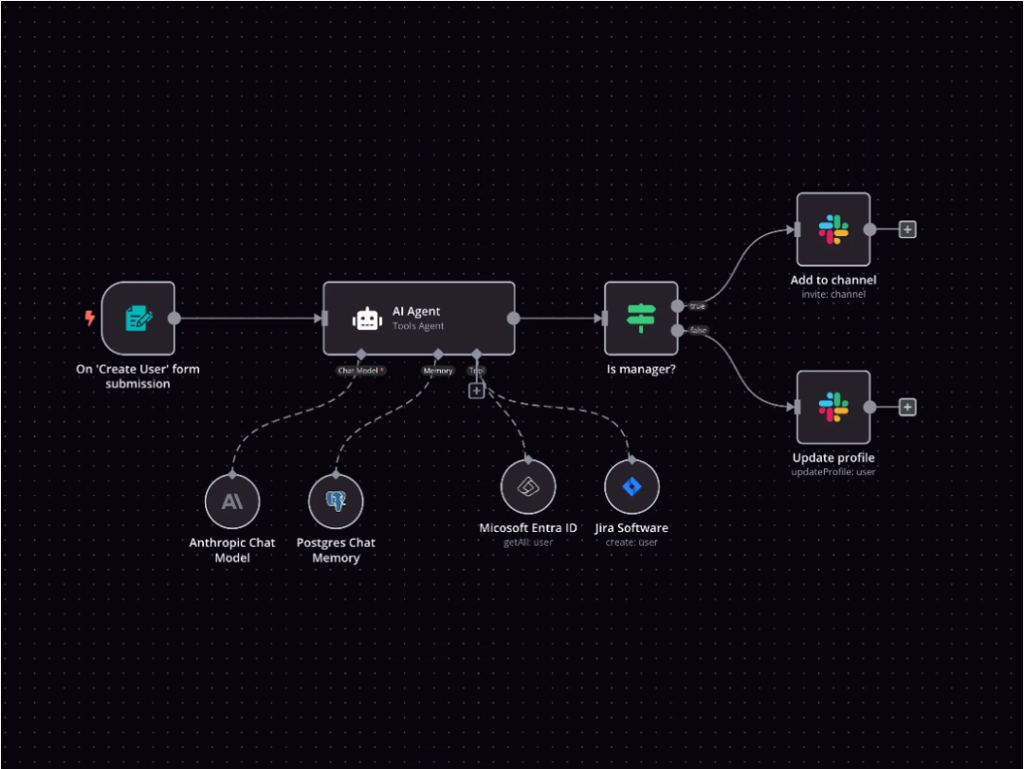
WorkFlow

Slide 7
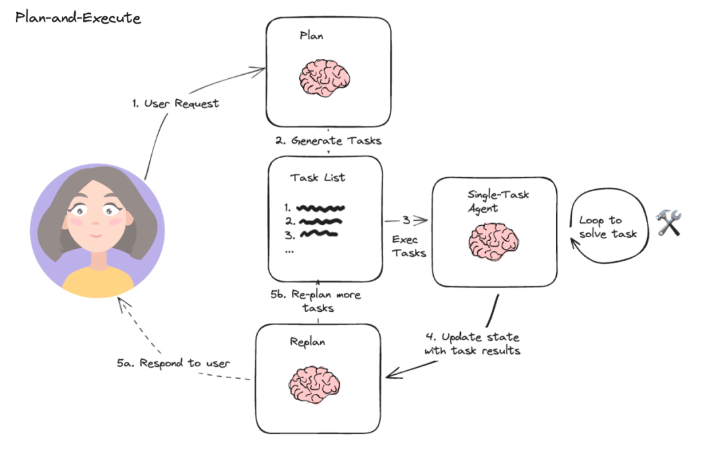
Plan-and-Execute

Slide 8
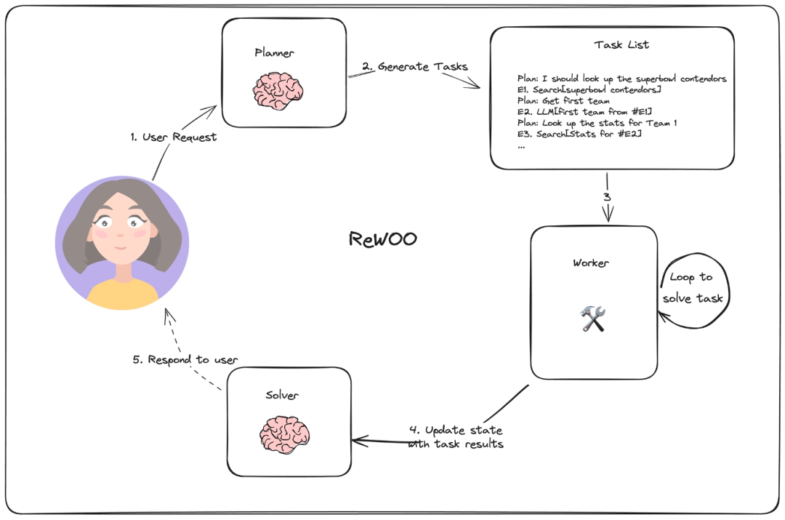
ReWOO

Slide 9
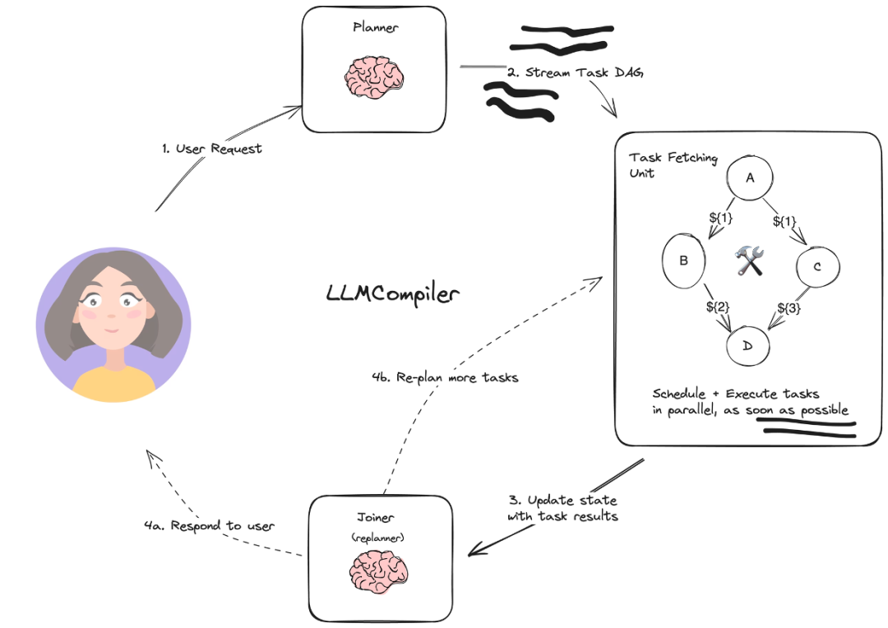
LLMCompiler

Slide 10
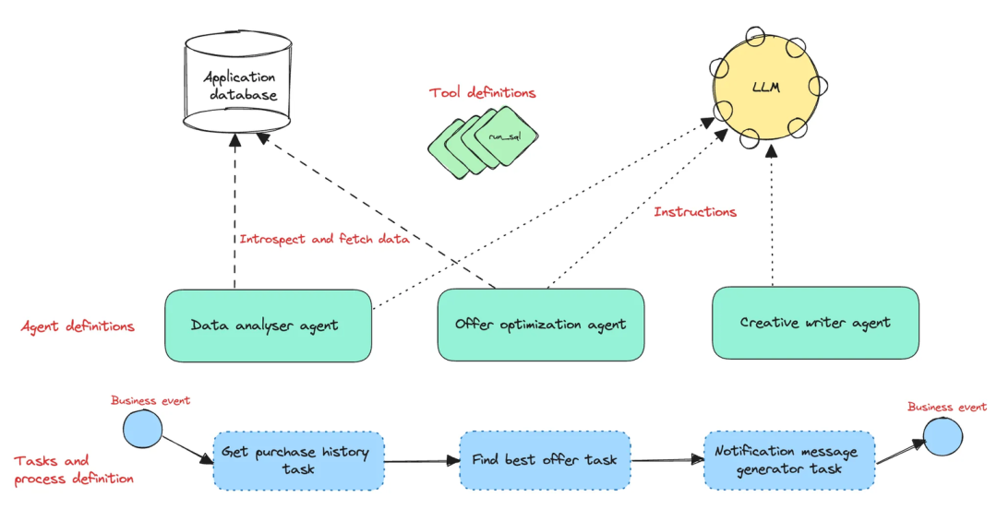
Agentic Workflow
Customer discount recommendation system

Slide 11
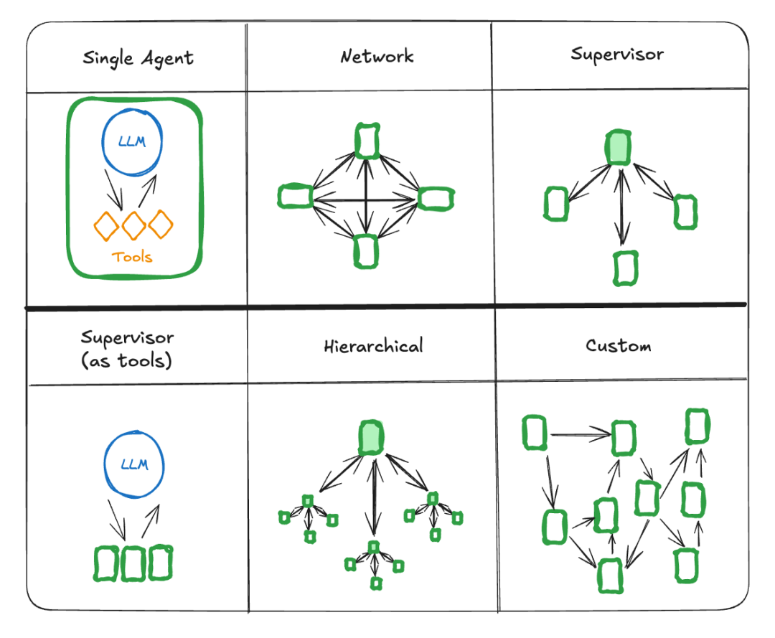
Multi Agent Architecture

Slide 12
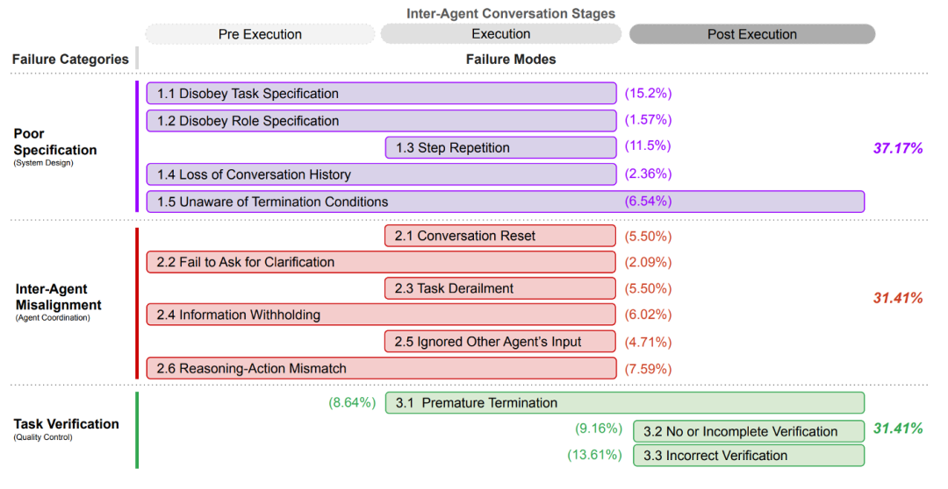
Fail Reason

Slide 13
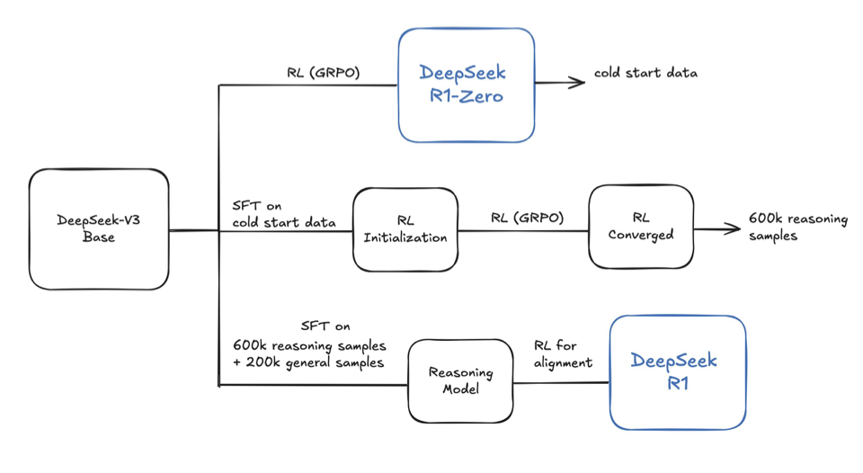
Deepseek R1

Slide 14
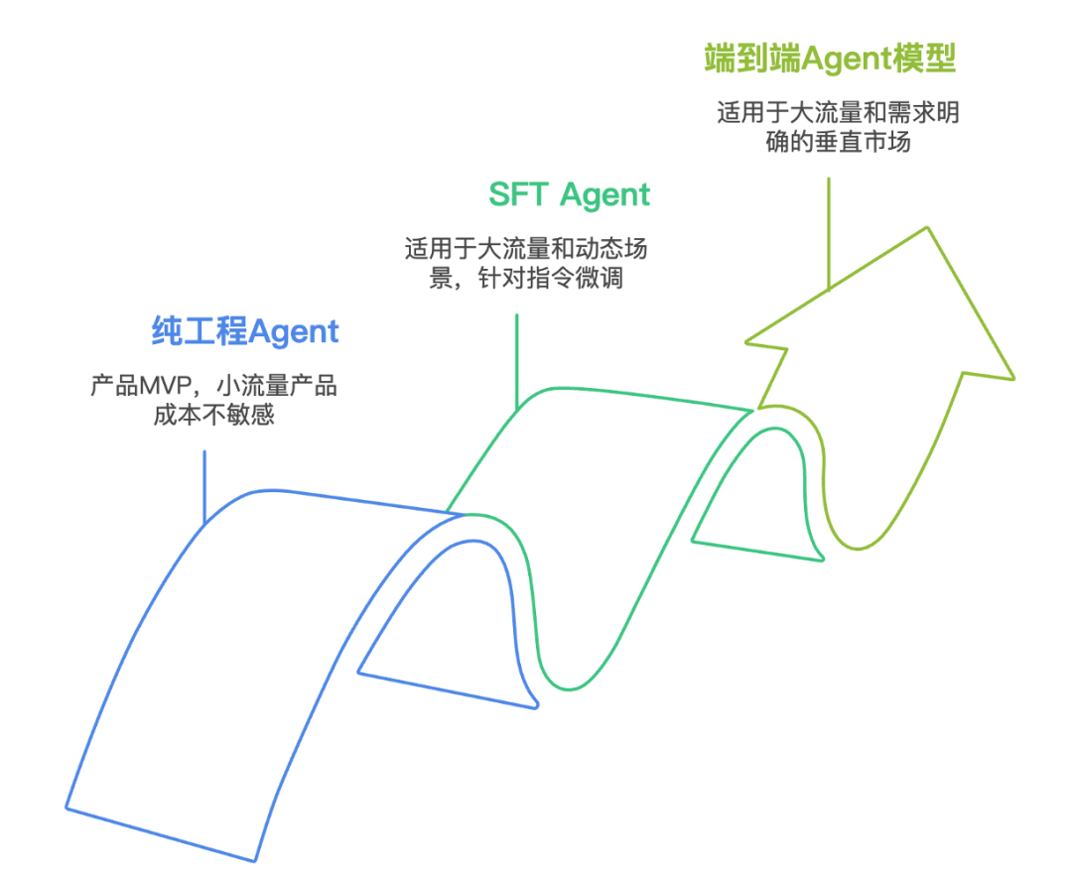
Trending

Slide 15
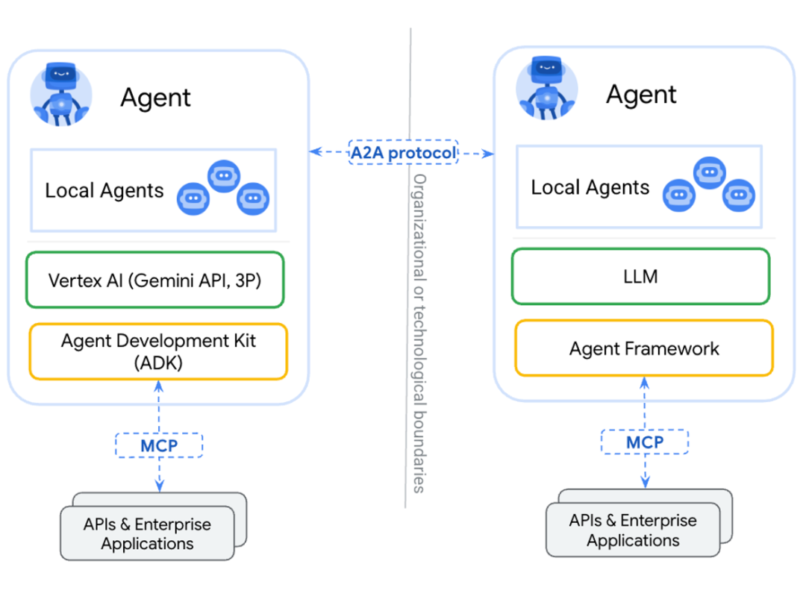
A2A

Slide 16
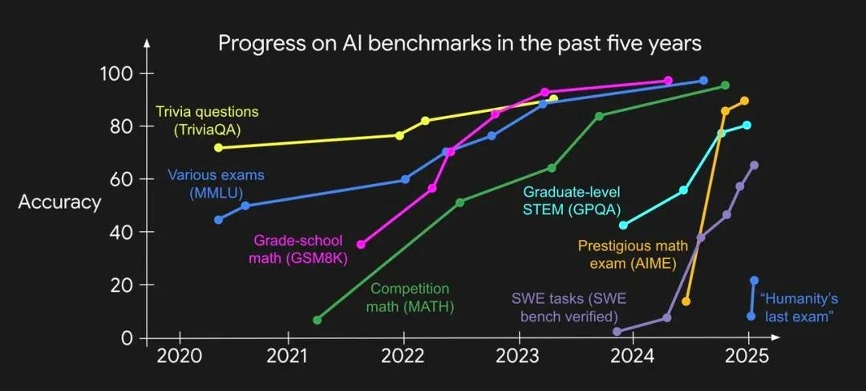
BenchMark Evolution

Slide 17
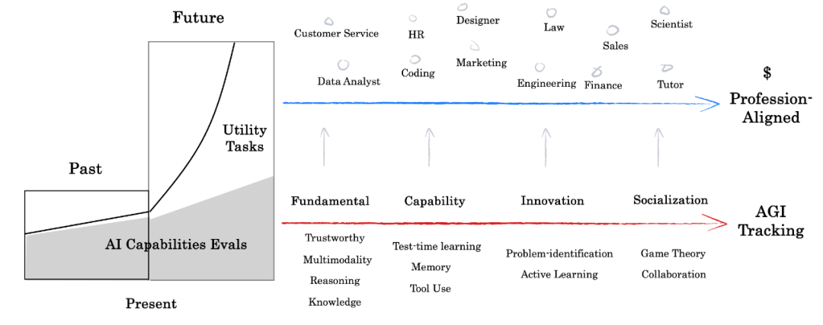
Xbench Evaluation

Slide 18
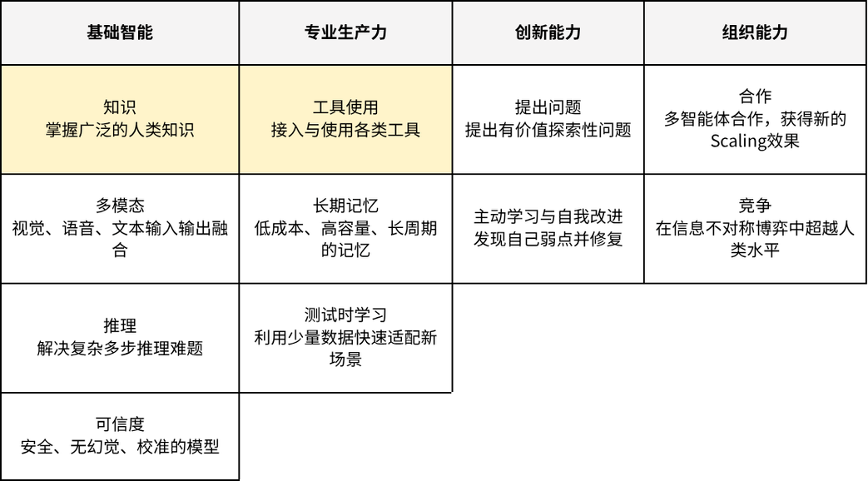
Agent Capacity

Slide 19
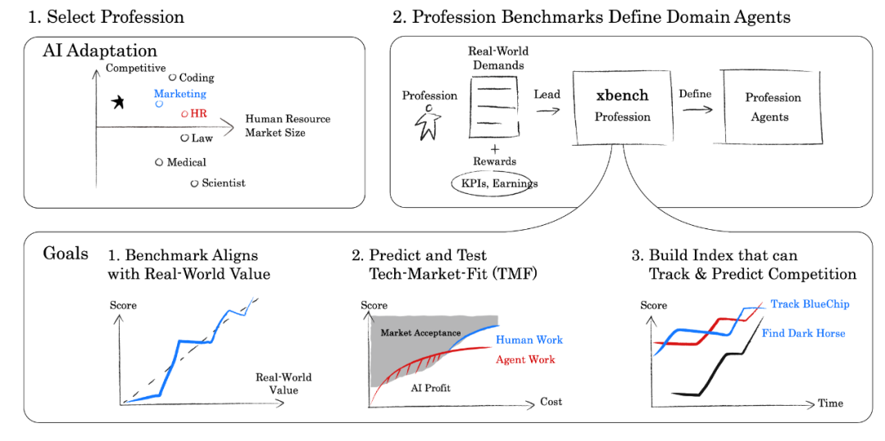
Profession Align

Slide 20
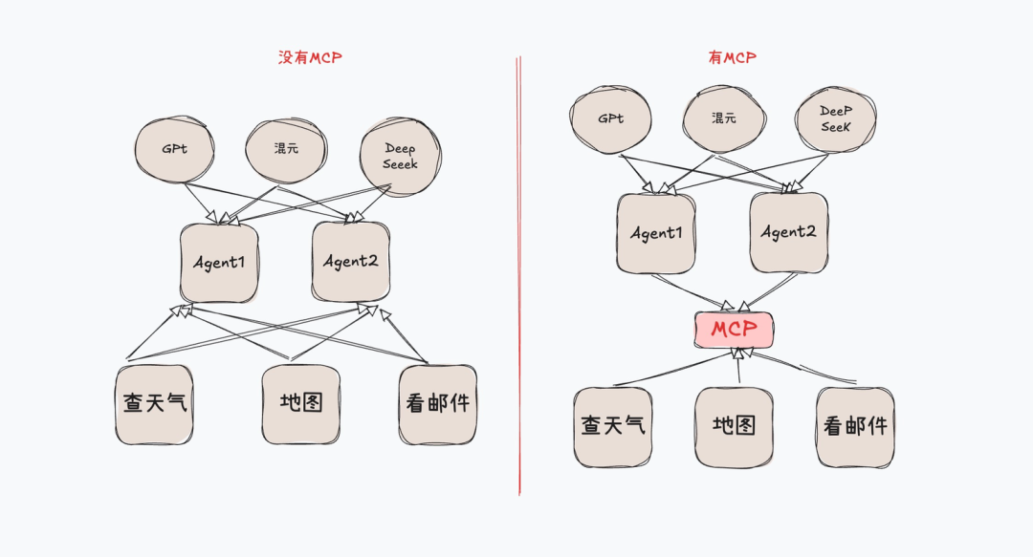
MCP

Slide 21
Practical exercise
step
1. 学习LangGPT仓库，创建一个LangGPT助手
2. 让LangGPT助手生成一个MCP专家(学习MCP的文档)
3. 让MCP专家帮我们实现一个简单的MCP应用
case
1. 官方demo
2. HackerNews接口 Hacker News API

Slide 22

Thanks!
Please keep this slide for attribution

