Slide 1
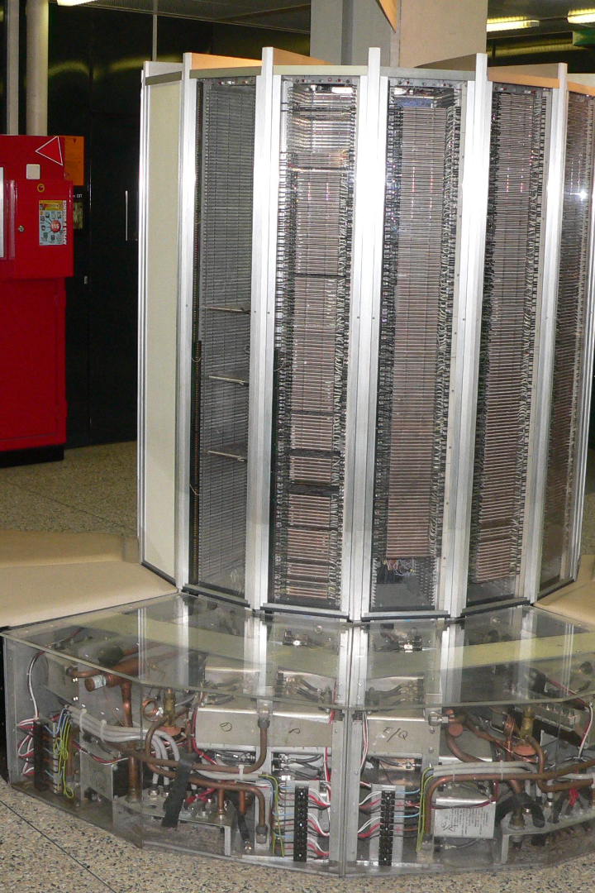

Cray 1: Revolutionizing Scientific Computing
Discover the incredible journey of the legendary Cray 1 supercomputer, renowned for its groundbreaking design, unrivaled speed, and significant impact on scientific computing.
by Maksatbek Yrysbaev

Slide 2
Introduction to Cray 1
Engineering Marvel 🚀
Unprecedented Speed ⚡️
The Cray 1, designed by Seymour Cray, was a milestone in computer architecture, pushing the boundaries of what was thought possible in the 1970s.
With a clock speed of 80 MHz, the Cray 1 was the fastest computer of its time, delivering stunning performance for scientific calculations.
Sophisticated Design 🎨
Redefined Supercomputing 🌐
Sporting a sleek and distinctive C-shaped structure, the Cray 1 showcased the perfect blend of form and function.
The Cray 1 revolutionized the field of high-performance computing, paving the way for modern supercomputers and their use in various scientific domains.

Slide 3
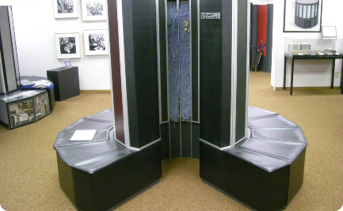
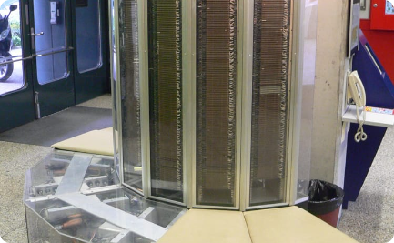
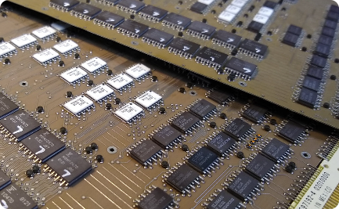
Design and Architecture
Vector Processing
Advanced Cooling
High-Speed Memory
The Cray 1's unique vector processing architecture enabled lightning-fast calculations by performing operations on entire sets of data simultaneously.
Its innovative Freon-based cooling system maintained optimum operating temperatures, ensuring peak performance.
The Cray 1 boasted an impressive memory bandwidth, crucial for handling massive amounts of data with minimal latency.

Slide 4
Technical Specifications
Clock Speed
80 MHz
Record Speed
136 MFLOPS
Word Length
64 bits
Memory Capacity
Up to 8 MB
Weight
5.5 tons

Slide 5

Impact on Scientific Computing
1
Advancing Research 🔬
2
Enhancing Data Analysis 📊
3
Pushing Technological Boundaries 🌐
The Cray 1's immense computational power accelerated scientific breakthroughs in various disciplines, from weather forecasting and astrophysics to nuclear simulations and material science.
By enabling researchers to process vast datasets at unprecedented speeds, the Cray 1 empowered complex data analysis and modeling, contributing to major scientific discoveries.
The Cray 1's technological advancements stimulated further innovations in supercomputing, setting the stage for future generations of high-performance computing systems.

Slide 6

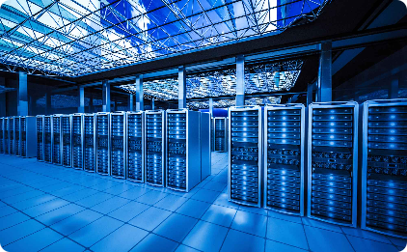
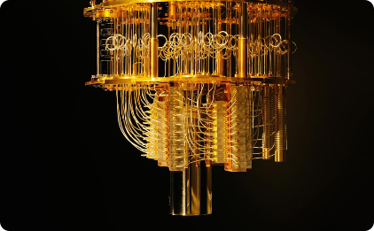
Legacy and Influence in Modern Computing
Continued Evolution
Data Centers of Tomorrow
The Quantum Leap
The Cray 1's legacy lives on in today's supercomputers, which exhibit extraordinary speed, scalability, and efficiency, supporting a wide range of scientific and industrial applications.
The Cray 1's impact serves as a reminder of the exponential growth of computing power, fueling speculation on the potential of quantum computing to revolutionize scientific exploration.
Cray's pioneering work laid the foundation for the development of data centers capable of handling massive computational workloads and facilitating groundbreaking research.

Slide 7
Conclusion and Future Prospects
A Lasting Legacy
Limitless Possibilities
The Cray 1's innovative architecture and remarkable performance cemented its place in the annals of computing history, inspiring future generations of scientists, engineers, and computer enthusiasts.
As computing technology continues to evolve, one can't help but wonder what groundbreaking advancements and discoveries lie on the horizon, waiting to be unleashed.

