Slide 1
Assembly Language and System Programming – Lab13

Slide 2
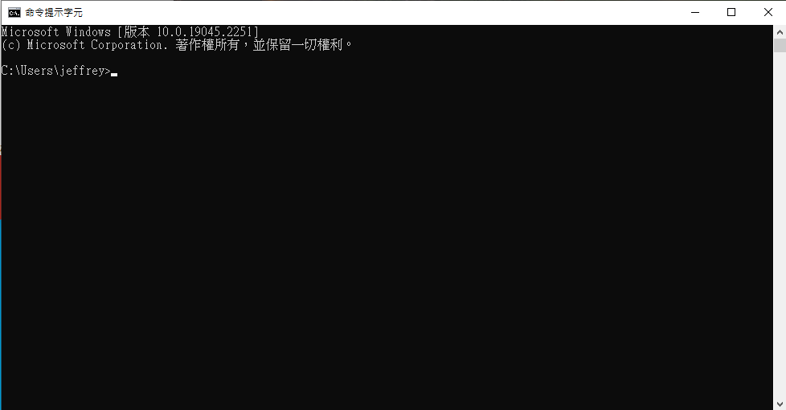
Target
Using keyboard to control the position of the cursor, and the cursor should only move in the specific area.
cursor

Slide 3
Methodology
By calling GetStdHandle to get consoleHandle
SetConsoleCursorPosition: set coordinates
ReadChar: read input
According to the inputs, decide whether the coordinates should be modified.

Slide 4
Implementation
According to your group, there are two different implementations.
The control instruction of the cursor(lookup Keyboard Codes.txt)
Odd number：up、down、left、right
Even number：w、a、s、d
Starting position: last two digits of the first student‘s ID
X = ((last digits mod 79) + 1)
Y = ((last digits mod 24 )+ 1)
If exceeds the range then:
Stay in place
x range: 1~79 , y range: 1~24

Slide 5


Keyboard Codes
 | ↑/↓/←/→ | W/A/S/D
up | White Up Arrow | W
down | White Down Arrow | S
left | White Left Arrow | A
right | White Right Arrow | D

Slide 6
Report
Deadline : 2022/12/13(Tue.)Before 12:00 P.M. (noon)(EEClass)
Each group only needs to submit one report
Pack the following files and compress into .zip file.
Code (lab13_groupX.asm)
Report (lab13_groupX.doc or lab13_ groupX.pdf)
Title
Group、StudentID、Name
Screenshots of Result and Code + Explanation
The report has to clearly explain how the program works.
Thoughts about the lab.
Please must be aware of the file name.

Slide 7
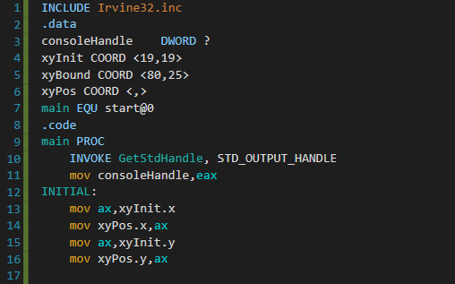
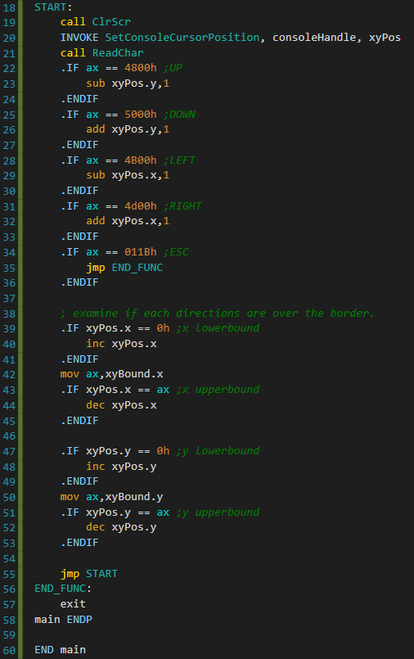
Data pre-set
Read console input and
Move cursor
Origin version from
.docx is reset pos to
xyInit, but in ppt was
asked for stay in place,
So I change the code form
Reset pos to inc/dec pos
Value to make it doesn’t
change.

