Slide 1
Assembly Language and System Programming – Lab10
2022/11/28

Slide 2
Target
GOAL : Copy the first group member's ID to the end of the second member's ID, and print the result.
STR_COPYN PROTO,
SOURCE:PTR BYTE, ; SOURCE STRING ADDRESS
TARGET:PTR BYTE, ; TARGET STRING ADDRESS
MAXCHARS:DWORD ; MAXIMUM NUMBER OF CHARACTERS TO COPY

Slide 3
Coding Steps
STEP1. Set COUNTER (ECX's value).
STEP2. Set the SOURCE and TARGET's address to ESI and EDI.
STEP3. Loop to copy the string.
STEP4. Add a null byte at the end of the string.

Slide 4
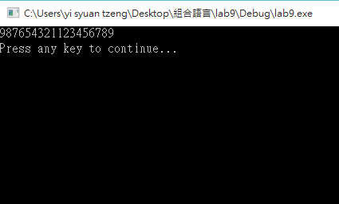
Result
String_1
123456789
987654321123456789
String_2
987654321

Slide 5
Report
Deadline : 2022/11/29(Tue.)Before 12:00 P.M. (12 noon)(EEClass)
Each group only needs to submit one report
Pack the following files and compress it into .zip file.
Code (lab10_groupX.asm)
Report (lab10_groupX.doc or lab10_ groupX.pdf)
Title
Group、StudentID、Name
Screenshots of Result and Code + Explanation
The report has to clearly explain how the program works.
Thoughts about the lab.
Please must be aware of the file name.

Slide 6
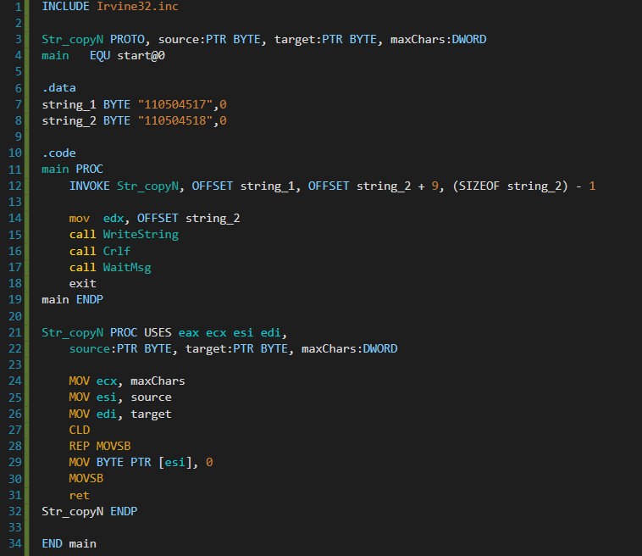
Data pre-set
PROC test
Set loop count to copy length
Set esi as source
Set edi as target
Set direction forward
Repeat copy esi to edi for ecx times
Set esi = 0 as string end
Copy it to edi (string end)
End proc

