Slide 1
A Simple Game Engine CPP-TANK
資電四 110504517 李睿穎

Slide 2
Table of contents
Introduction
System Design
Showcase
Difficulty
Conclusion

Slide 3
Introduction

Slide 4


Introduction
Background
Creating a program that runs is easy, but designing a modular and scalable architecture is a whole different matter.

Slide 5
System Design

Slide 6
System Design
Overview
The quality of the overall architecture design determines its future potential.
App
Math
Caller
Render
Manager
Coord
Event
PolyGraph
Event Invoke
Graph
GameObject
Src Image
Collider
Text
Input
RigidBody
UI
Game Flow

Slide 7
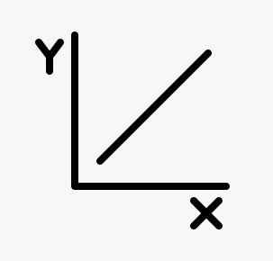



System Design
Math
All computations used in this project, such as vector operations, coordinate transformations, etc.
Math
2D Coord
Polygon
Collide
Color
Convert
Shape
Rotate

Slide 8


System Design
Caller
To make development more flexible, it is necessary to enable more dynamic function execution triggers.
Caller
Start
On Hit
On Dead
Update
Render
Event
Trigger
Game
Object
Destroy

Slide 9



System Design
Render
Extend based on the drawing capabilities of WinForms itself.
Render
Render
Position
Rotation
Scale
View
Camera
Object
Rendering
Object
WinForm
Renderer

Slide 10



System Design
Manager
Construct Managers to control the interaction and triggering between different Sub-Systems.
Manager
Key Table
Flow
Control
Data
Handle

Slide 11
Showcase

Slide 12
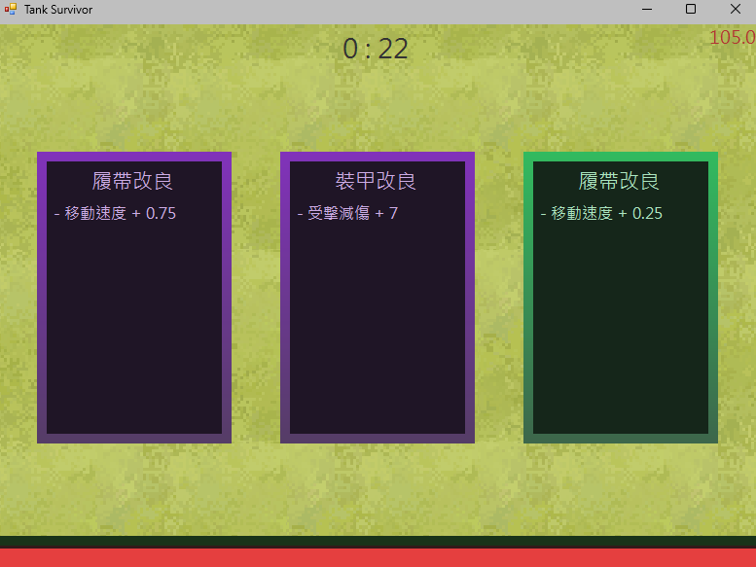
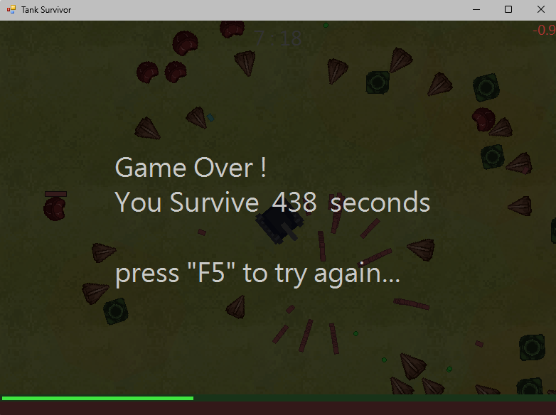
Showcase
Game-Screenshot

Slide 13



Showcase
Game-Monster
Continuously approach the player.
Maintain a certain distance from the player and shoot bullets to attack.
Follow other enemies and heal them.

Slide 14
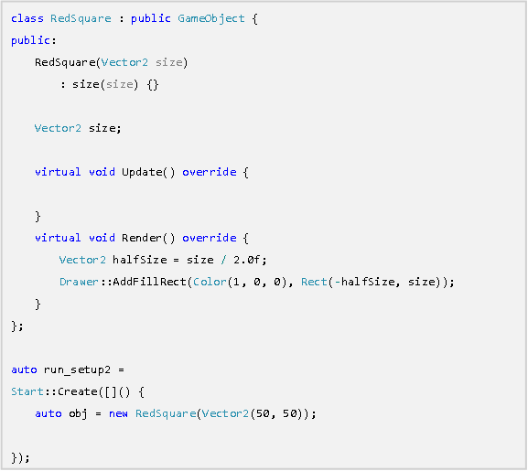
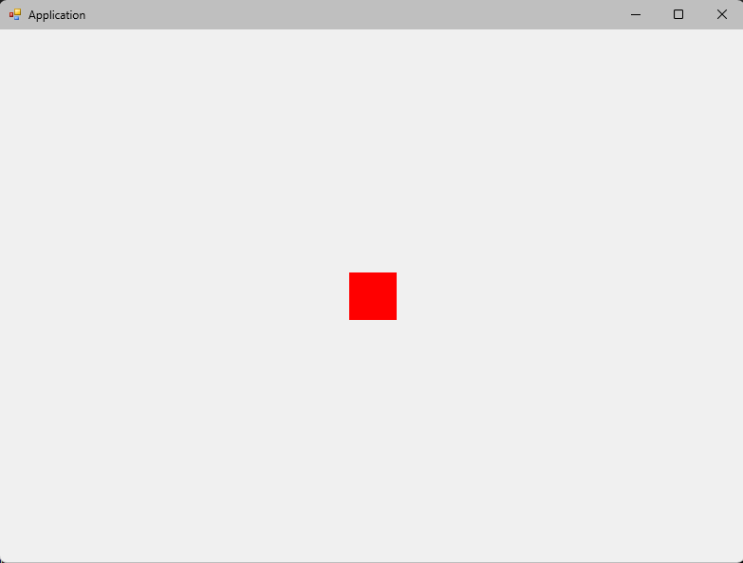
Showcase
Engine-Utils

Slide 15
Difficulty

Slide 16
Difficulty
Life is hard...
Performance issue
Not well design at the beginning
WinForm is Design for C# not C++

Slide 17


Difficulty
We need performance
To handle high computational load, only more efficient algorithms can be implemented.
Algorithm
Flag
Mask
Reduce
Vertices
Screen
Rendering
Merge
Computing

Slide 18



Difficulty
C# vs C++
WinForms C++ uses CLR to bridge C++ and C#, resulting in poor optimization due to various factors.
Problems
Weak Community
Old API
(WPF,UPF)
Mixed
Syntax
etc.

Slide 19
Conclusion

Slide 20




Conclusion
That’s All
A good architecture can indeed significantly accelerate software development.
Implement
Application
Workflow
A Simple
Engine
2D Physics
Simulation
Find out
CLR

Slide 21
Question & Answer
Thanks for listening
資電四 110504517 李睿穎

