Slide 1
Six weeks industrial training
CORE JAVA

Slide 2
Presentation on railway reservation system
PRESENTED BY: YASH KUMAR
ROLL NO: 12201201
BATCH: 3CE8

Slide 3
Introduction
This system is basically concerned with the reservation of railway tickets to the passengers.
In this we are discussing that how the reservation is done.
In this project we are going to include all the entities related to reservation

Slide 4
Cntd….
Stations
Customers
Trains
Forms
Ticket
Fare
Class
Time

Slide 5
Scope & Objectives
Through this system, a practical approach has been taken under study to understand how online reservation system works. This system will include all the necessary fields which are required during online reservation system. This system will be easy to use and can be used by any person. The basic idea behind this project is to save data in a central database which can be accessed by any authorize person to get information and saves time and burden which are being faced by their customers.

Slide 6
Easy to store information and fast accessing of information.
Centralized management reporting & decision support.
Accurate and timely control program.
To make it easy for fast processing and modification.
List of accounts of all customers is available.
Easy retrieval of accounts.
To make the Railway system is interactive.
Quick feed back.

Slide 7
Features
Searching of data is easy
Passengers don’t have to wait for a long time.
Information is accurate
It is a fast process
Data efficiency is more

Slide 8


Slide 9
Java awt
Java AWT (Abstract Window Toolkit) is an API to develop GUI or Window based applications in java.
Java AWT components are platform-dependent i.e. components are displayed according to the view of operating system.
The java.awt.package provides classes for AWT API such as Text Field, Label, Text Area, Radio Button, Check Box, Choice, List etc.
The AWT was designed to provide a common set of tools for graphical user interface design that work on a variety of platforms.

Slide 10
Event Handling
Event Handling is the mechanism that controls the event and decides what should happen if an event occurs.
This mechanism have the code which is known as event handler that is executed when an event occurs.
Java Uses the Delegation Event Model to handle the events. This model defines the standard mechanism to generate and handle the events.
The Delegation Event Model has the following key participants namely:
Source - The source is an object on which event occurs.
Source is responsible for providing information of the occurred event to it's handler.

Slide 11


Slide 12
What is java swing?
Java Swing is a part of Java Foundation Classes (JFC) that is used to create Window-based applications. It is built on the top of AWT(Abstract Windowing Toolkit) API and entirely written in java.
The javax.swing package provides classes for java swing API such as JButton, JTextField, JTextArea, JRadioButton, JCheckBox, JMenu, JColorChooser etc.

Slide 13
GRAPHICAL USER
INTERFACE

Slide 14
Number of Modules in Project
Login Form.
Reservation Form.
Cancellation Form.
PNR Enquiry.
Exit.

Slide 15
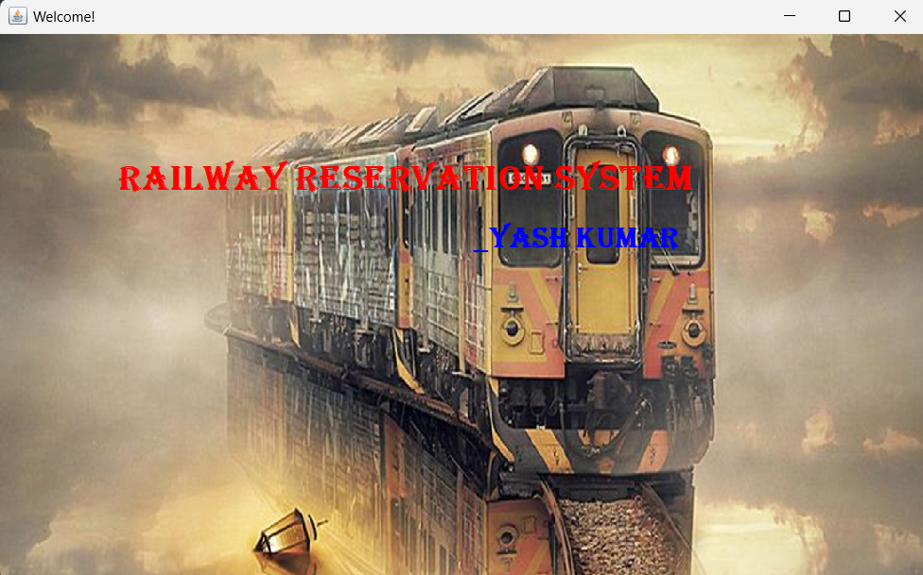
Welcome Screen

Slide 16
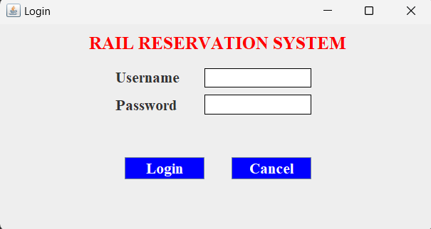
Login Form

Slide 17
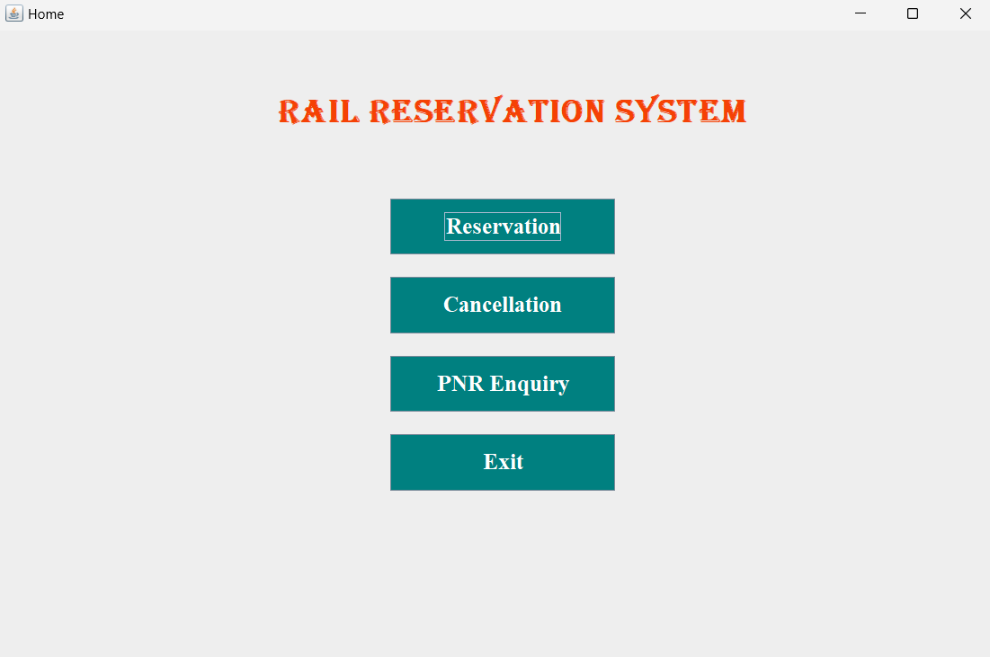
Main Screen

Slide 18
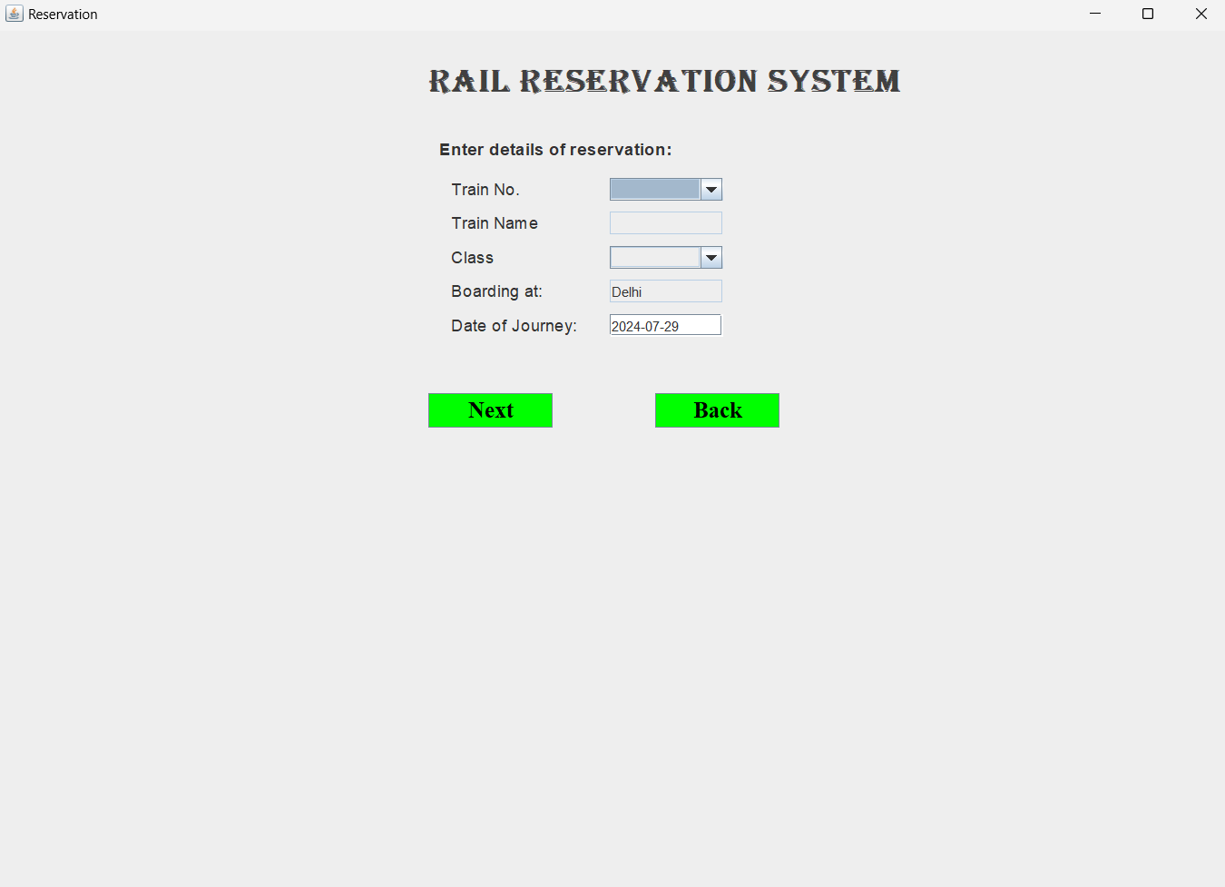
Reservation System

Slide 19
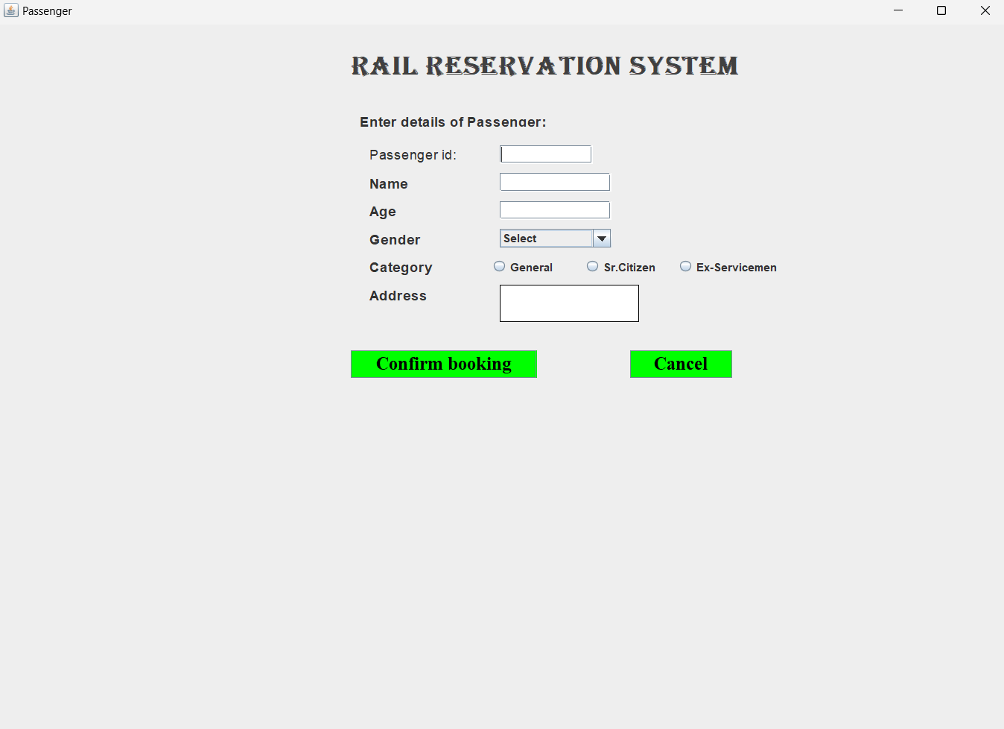
Passenger Form

Slide 20
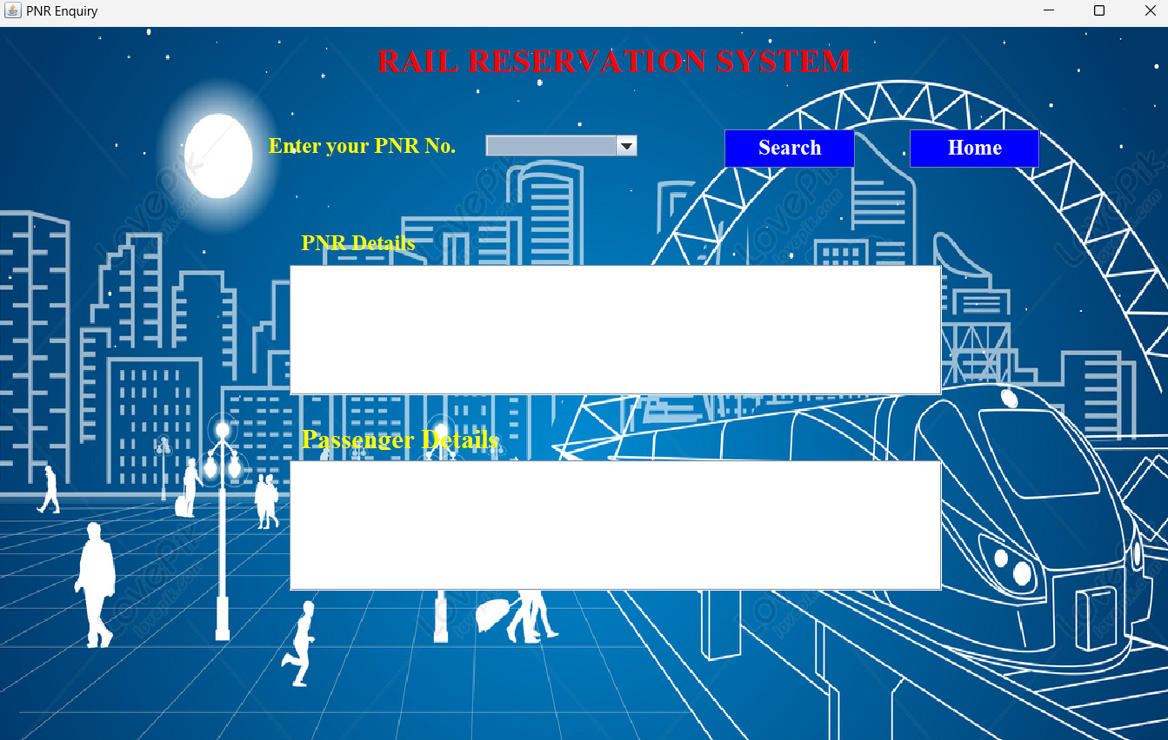
Enquiry Form

Slide 21
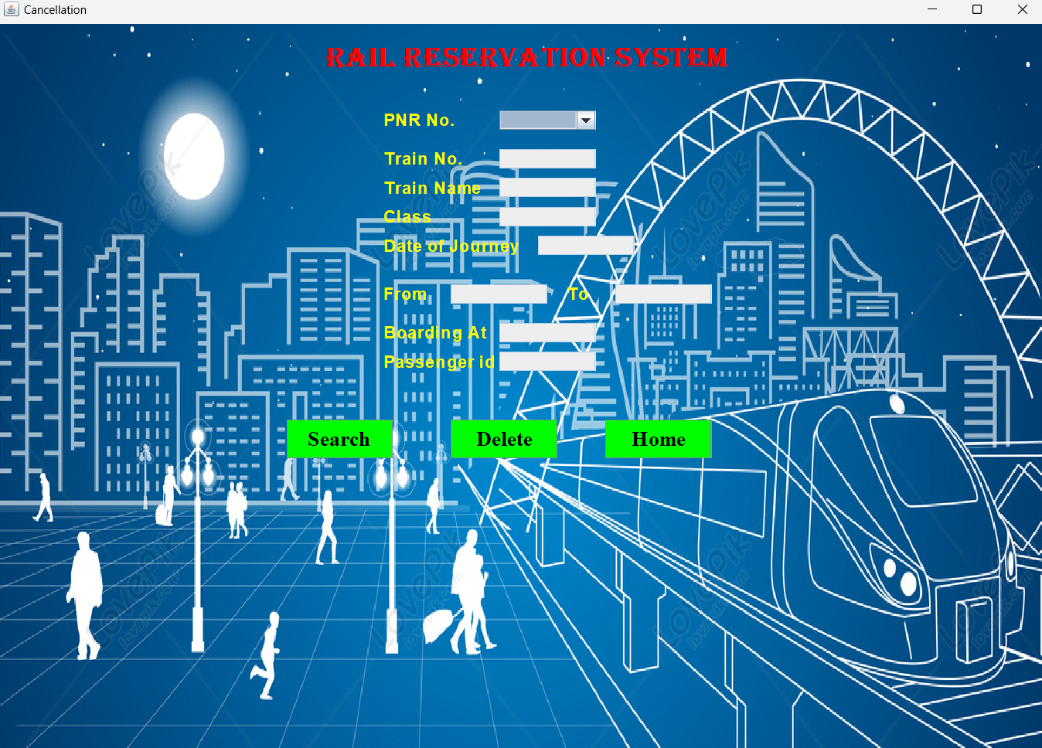
CANCELLATION Form

Slide 22
THANK YOU

