Slide 1
Blackjack-Progress
By a Team Has no Name (Madelynn Cook, Jonathan Taylor, and Yasmine Smith)
CSC 460
Brock Tubre

Slide 2
Contact, TOOLS, & Responsibilities
Form of contact:
DM (Direct Message)
Tools being used:
Microsoft Visual Studios 2017
Microsoft SSM
Github
Draw.io
Figma
Responsibilities:
Madelynn – design, charts
Yasmine – design, front-end code, animations
Jonathan – logic, back-end code

Slide 3
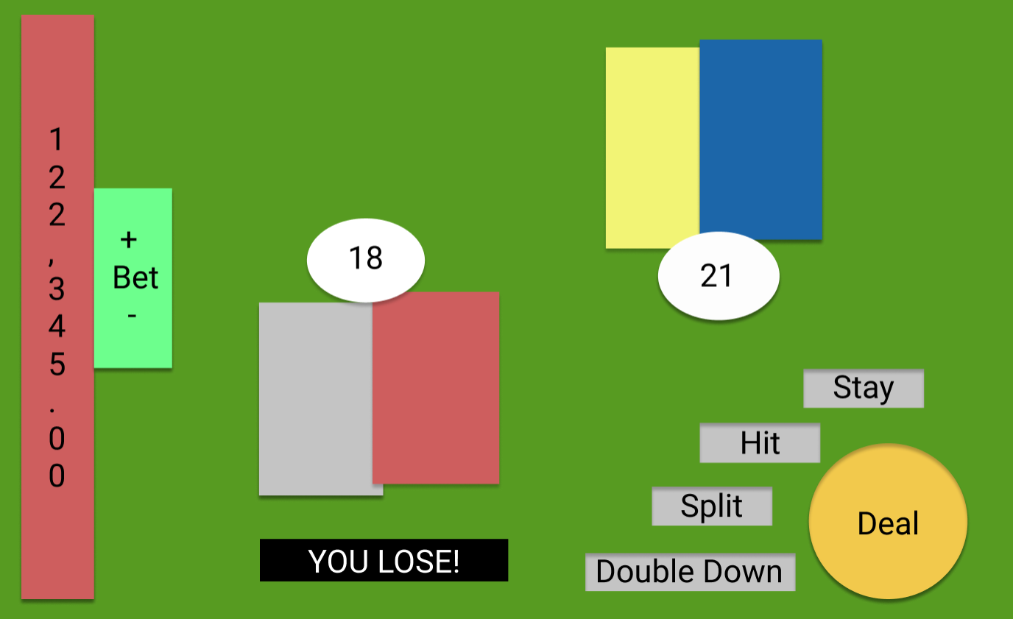
Layout Mock-UP 1

Slide 4
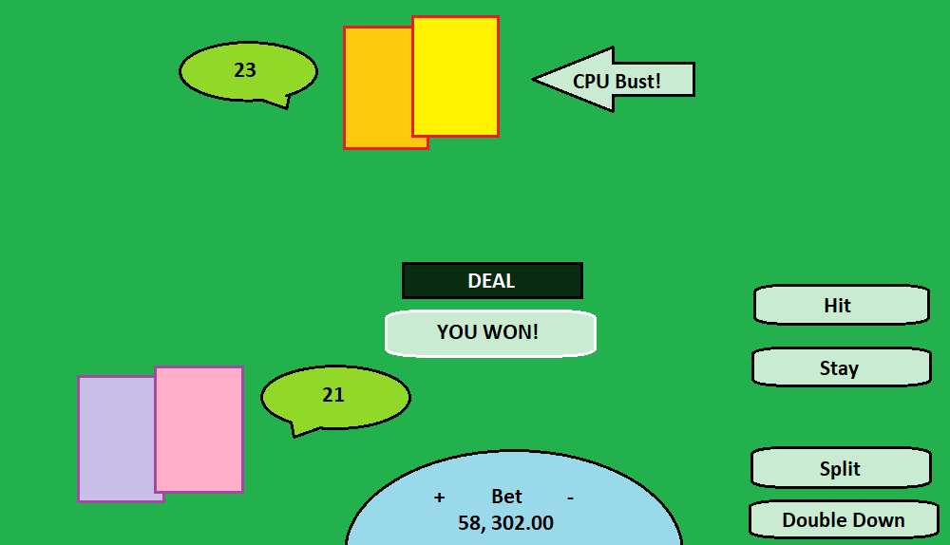
Layout Mock-Up 11

Slide 5
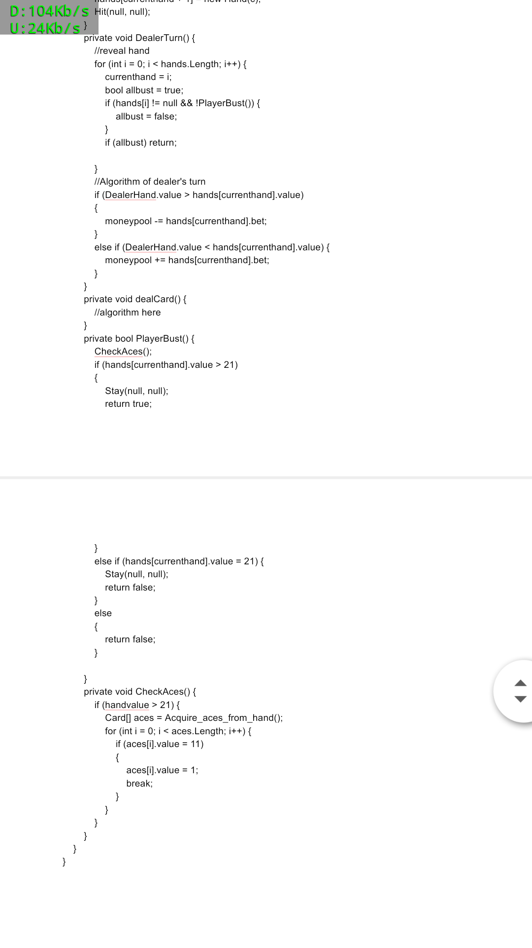
Pseudo-Code

Slide 6
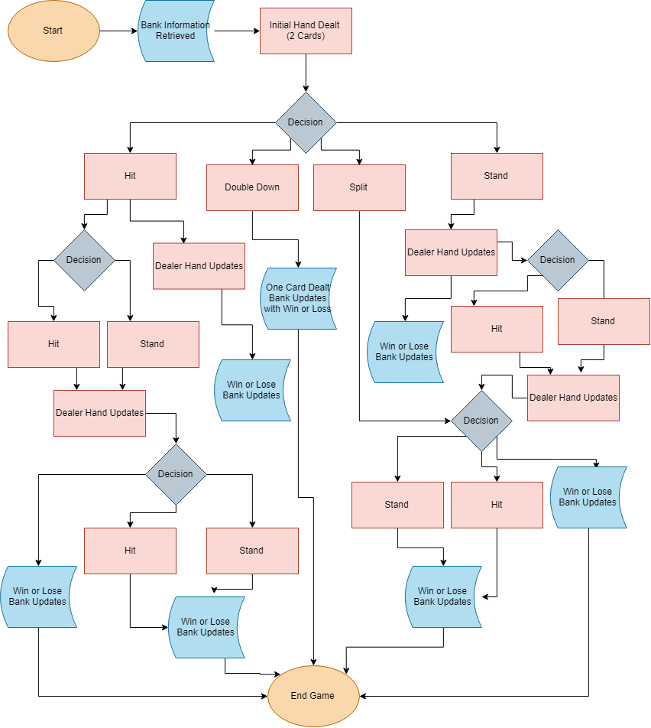
How the Program Works

Slide 7
Blackjack Solution…
https://github.com/Ysmith54/Blackjack.git

Slide 8
That’s IT so Far…
Until next Next Monday ☺

