Slide 1

STUDENT MANAGEMENT SYSTEM

Slide 2

INTRODUCTION
Full Stack Application – Student Management System.
A Student management system is an application that is designed to manage all the Information of a Student.
It includes all of the modules that teachers and staff need to keep track of all student records.
This system completely automates all your Student data

Slide 3
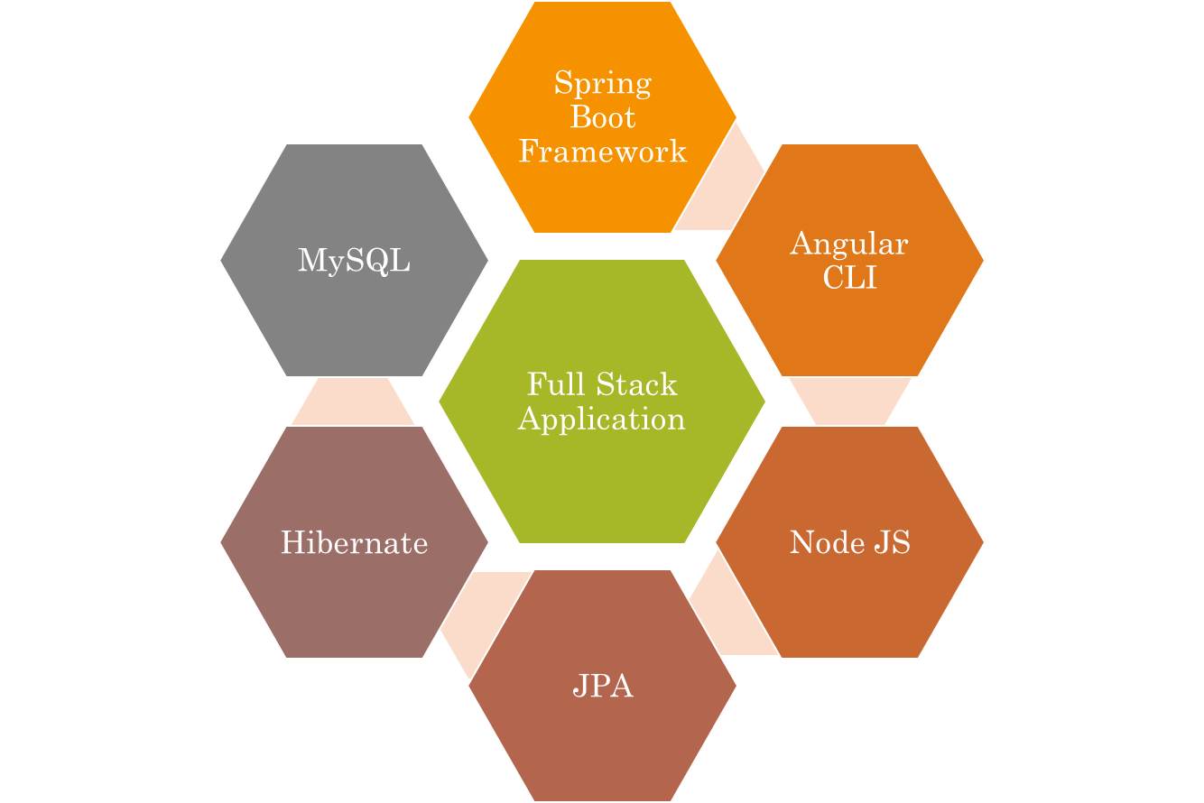
Technologies used.

Slide 4
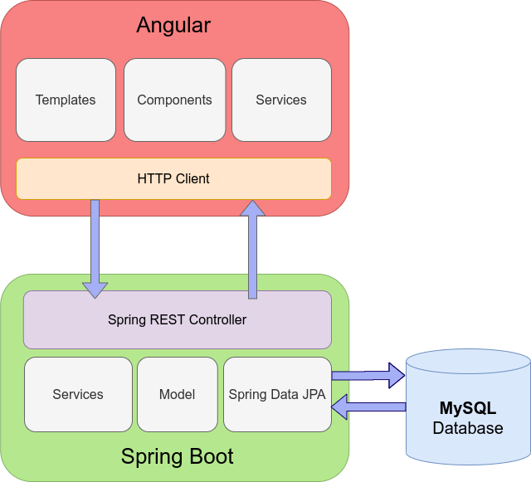


The Architecture of Angular, Spring
& database(MySQL)

Slide 5
Angular JS
Node JS
Frontend
The Architecture of the Project
Spring Boot
Backend
MySQL

Slide 6
CRUD Operations
Update Record
Delete record
Add Record
View Record
CRUD

Slide 7
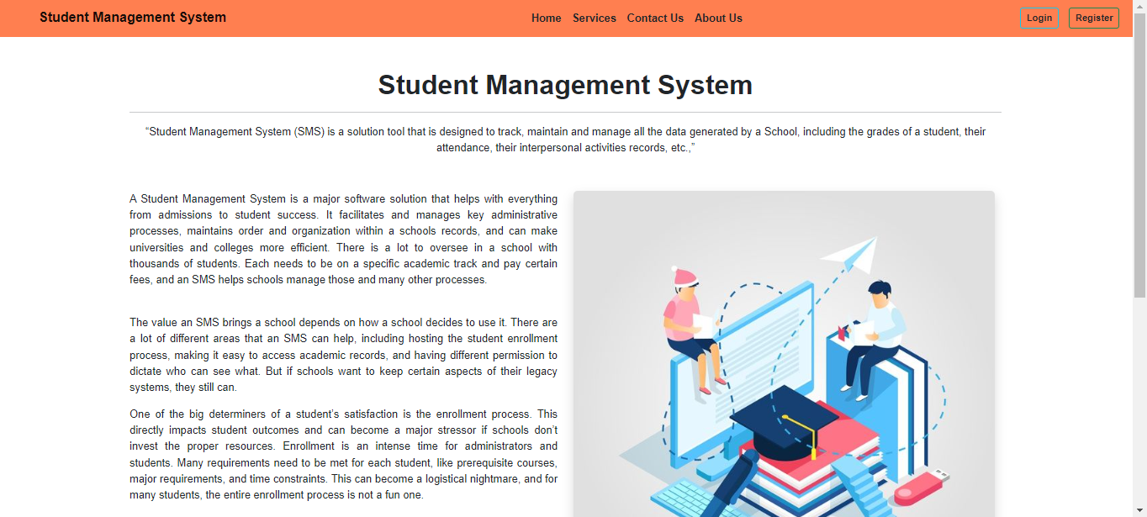
Home Page

Slide 8
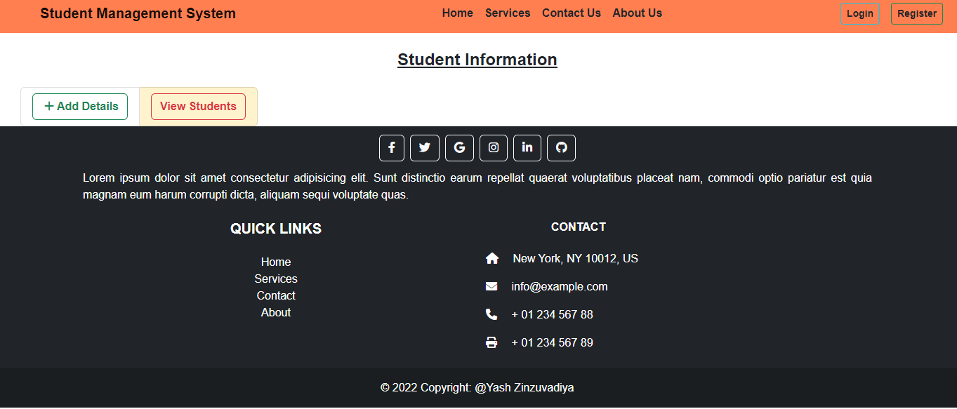
Service Page

Slide 9
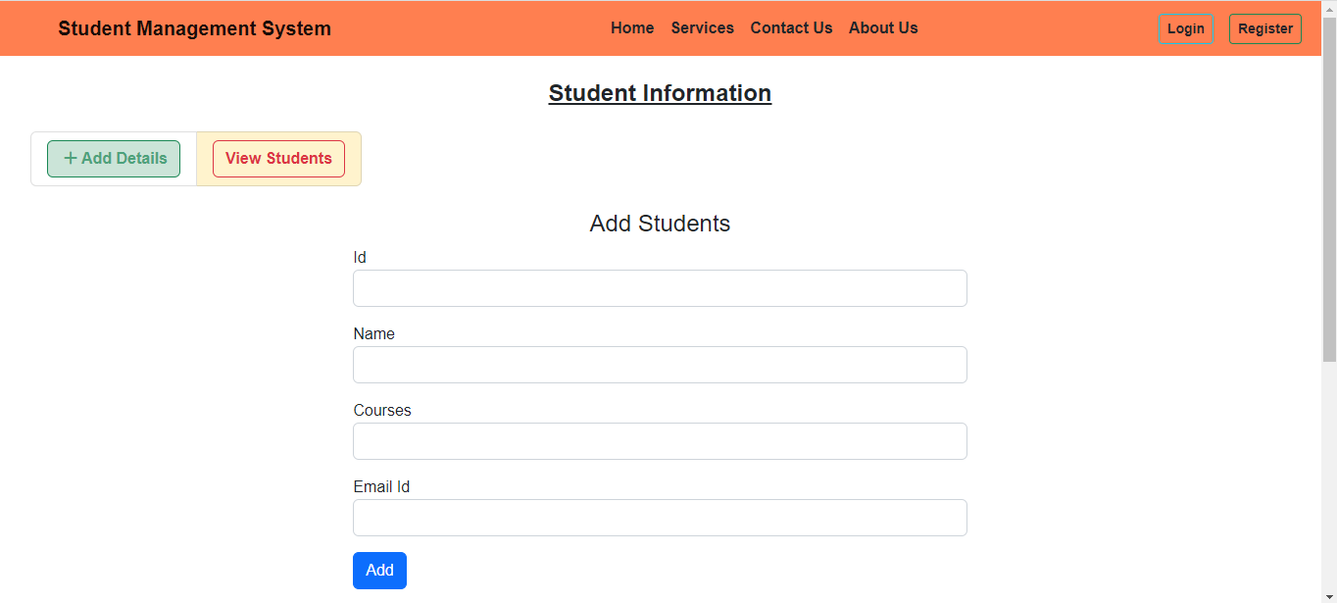
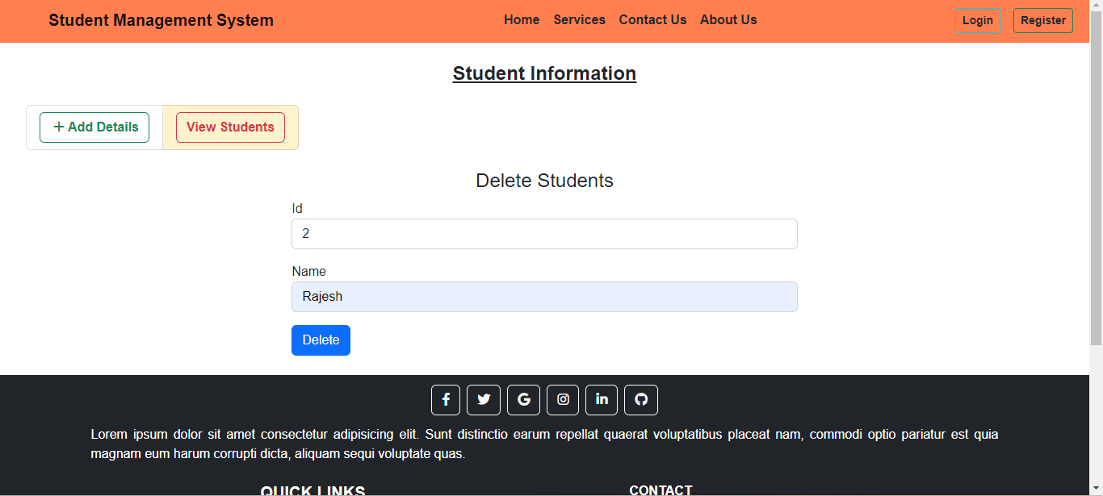
ADD & Delete Page.

Slide 10
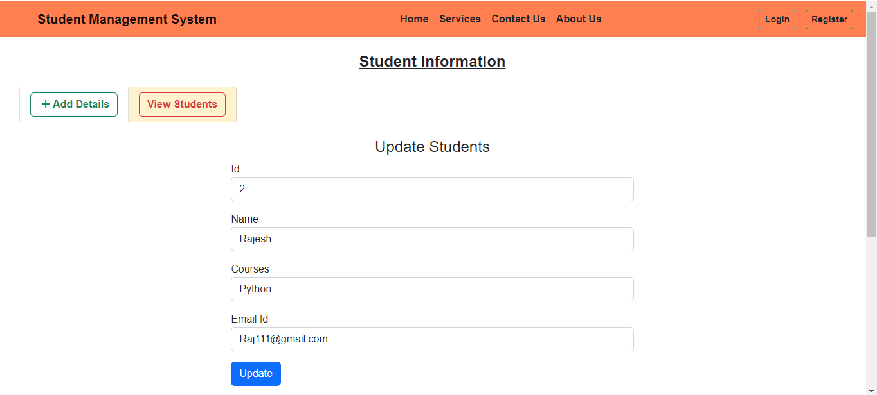
Update Page

Slide 11
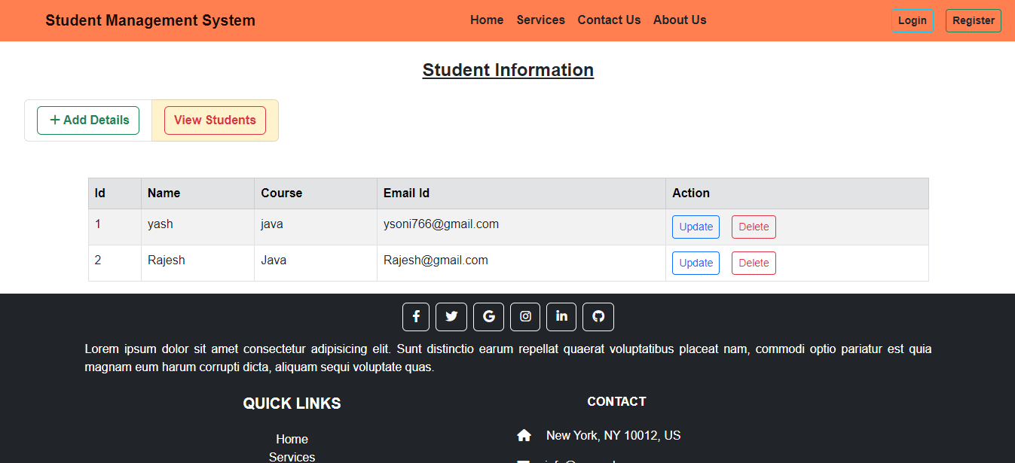
View Record

Slide 12
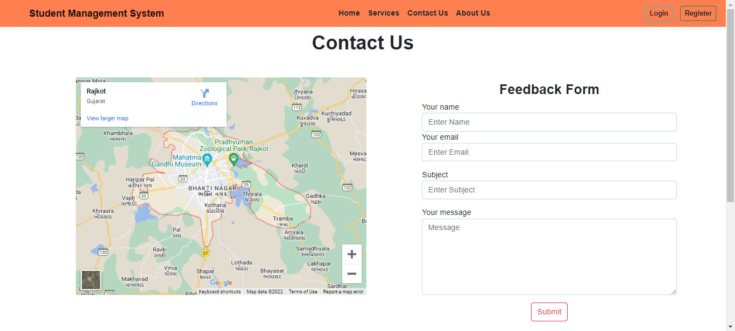
Contact us Page

Slide 13
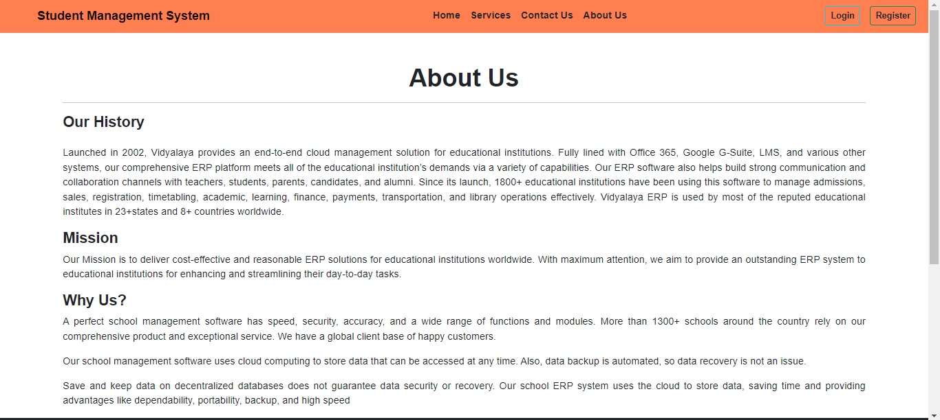
ABOUT us Page

Slide 14
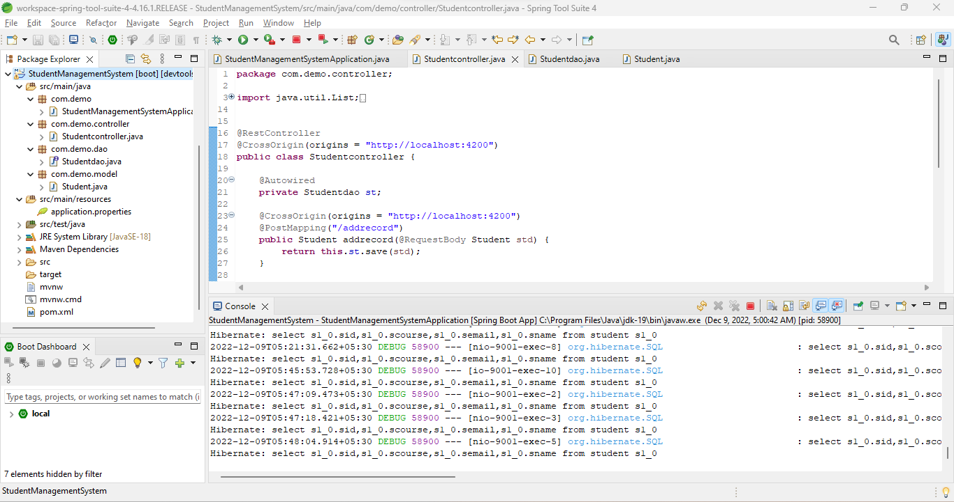
Spring Boot Application

Slide 15
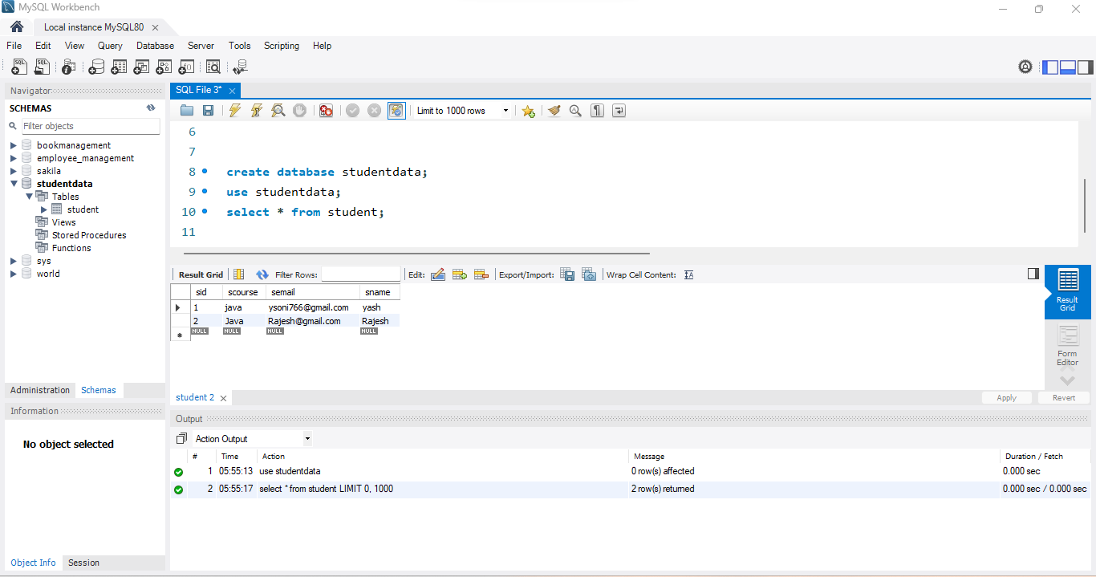
MySQL Code

Slide 16
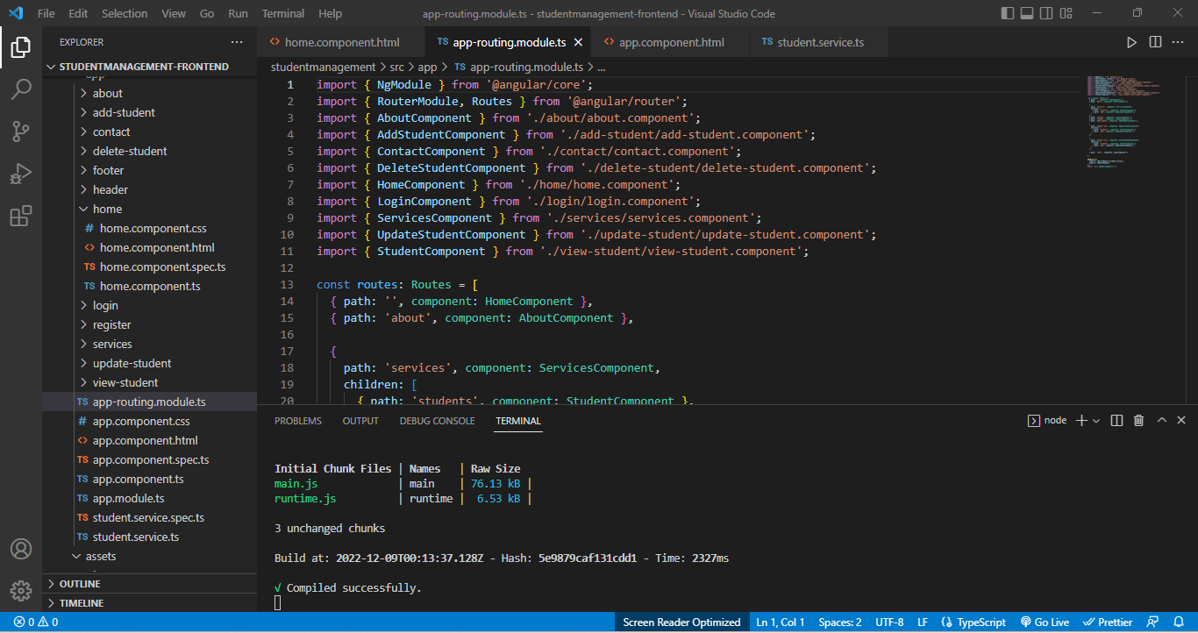
Frontend – Angular JS

Slide 17

GitHub Link

Slide 18


