Slide 1

Project Title -Seasonal Agriculture Performance Analysis
Yedla Sravanthi
Aditya College of Engineering and Technology
AICTE STU ID : STU678b85e34eb41736751198

Slide 2

PROBLEM STATEMENT
Agricultural activities are influenced by seasonal variations in environmental conditions, farming practices, resource availability and market conditions. As a result, agricultural performance may differ from one season to another. However, raw agricultural data does not clearly explain how agricultural performance changes across seasons or what patterns can be observed in different seasonal conditions. The problem is to analyze the given agricultural dataset and investigate seasonal differences in agricultural performance by identifying meaningful patterns, trends, relationships and variations within the available data. .

Slide 3
Project Description
Seasonal Agriculture Performance Analysis is a data
analytics project focused on analyzing agricultural performance across different seasons, geographical regions, crops, farming conditions, resource usage, and economic factors. The project examines Kharif, Rabi, and Zaid seasons using parameters such as rainfall, temperature, soil moisture, water usage, fertilizer usage, crop yield, production, revenue, cost, and profit. The dataset is cleaned and prepared before performing exploratory data analysis, seasonal comparisons, correlation analysis, statistical testing, and visualization. Crop-wise and region-wise performance is also analyzed to identify seasonal variations and unusual patterns. The analysis found that Kharif had the highest average yield and profit, while Zaid had the lowest average profitability and highest loss percentage. Based on these findings, the project provides evidence-based insights and recommendations to support better seasonal agricultural planning.

Slide 4

WHO ARE THE END USERS?
Farmers: Identify profitable seasons, suitable crops, and efficient resource utilization.
Agricultural Planners: Support seasonal planning and optimize resource allocation.
Government Departments: Assist in policy formulation, agricultural schemes, and regional planning.
Researchers: Analyze relationships between environmental conditions, farming practices, yield, and profitability.
Agricultural Stakeholders: Enable data-driven decisions for improving productivity, profitability, and sustainable resource management.

Slide 5

Technology Used
Python – Data analysis and statistical computation
Jupyter Notebook – Development and analysis environment
Pandas – Data cleaning, manipulation, and analysis
NumPy – Numerical and statistical operations
Matplotlib – Data visualization
Seaborn – Statistical charts and heatmaps
SciPy – Statistical analysis, including ANOVA
Microsoft Excel – Dataset storage and initial data handling

Slide 6
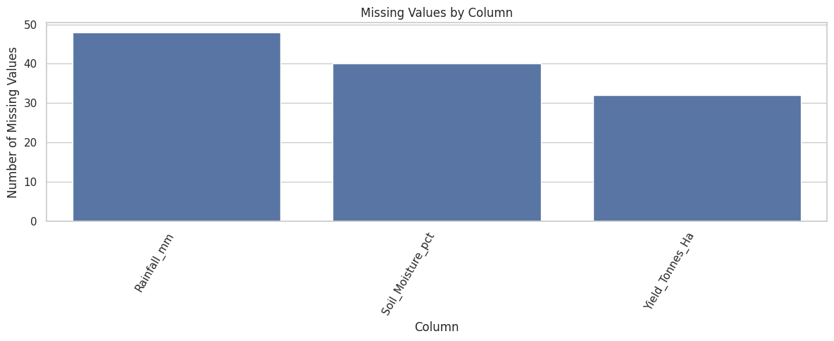
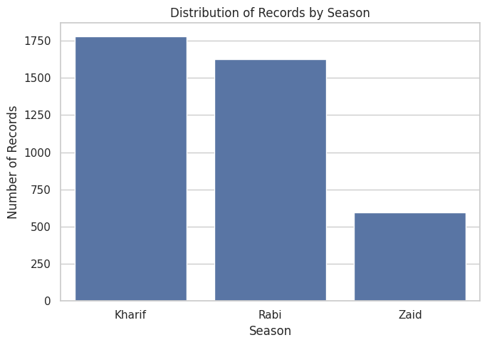
RESULTS

Slide 7
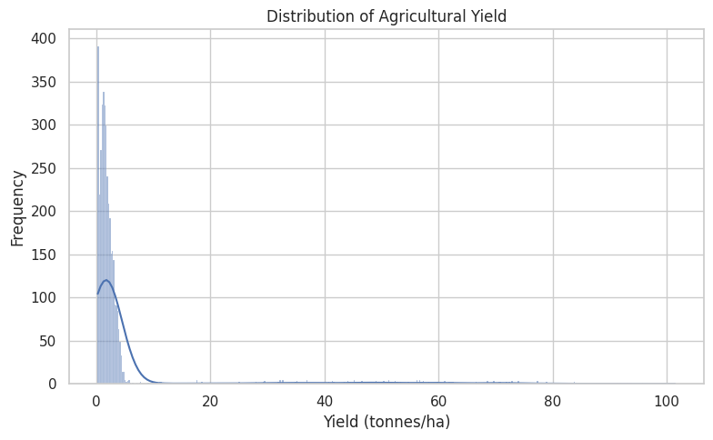
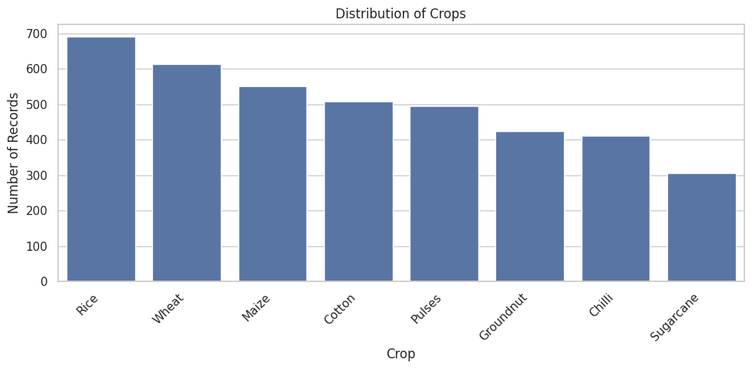
RESULTS

Slide 8
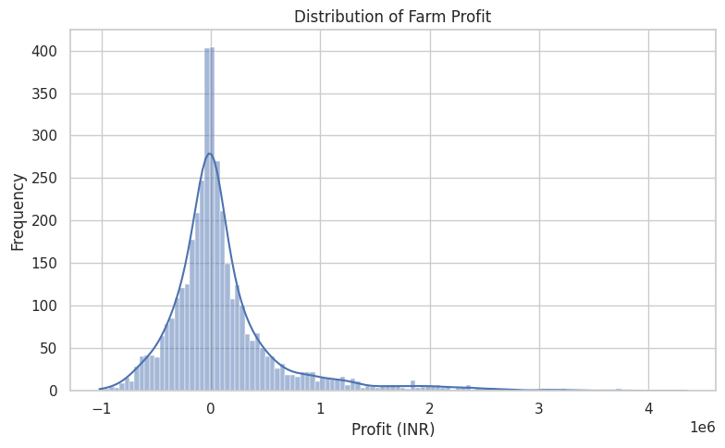
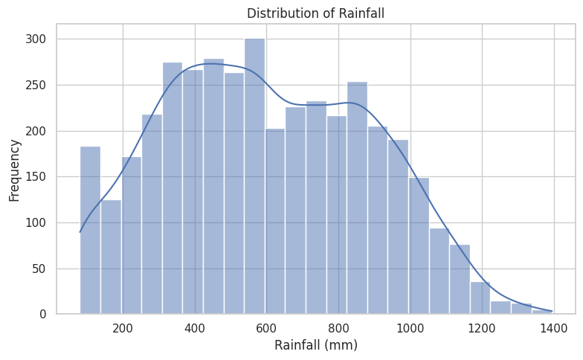
RESULTS

Slide 9
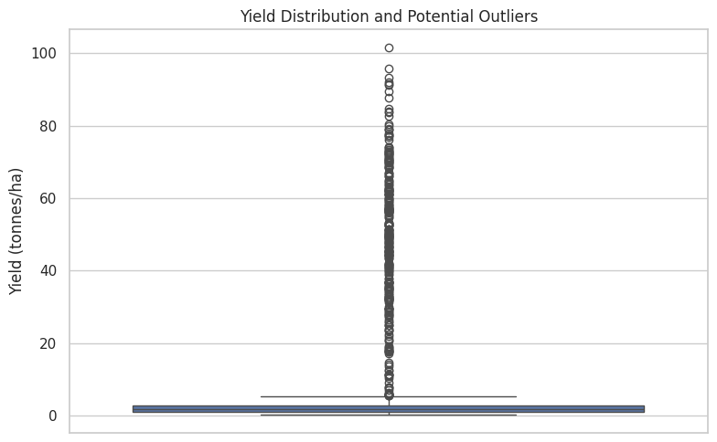
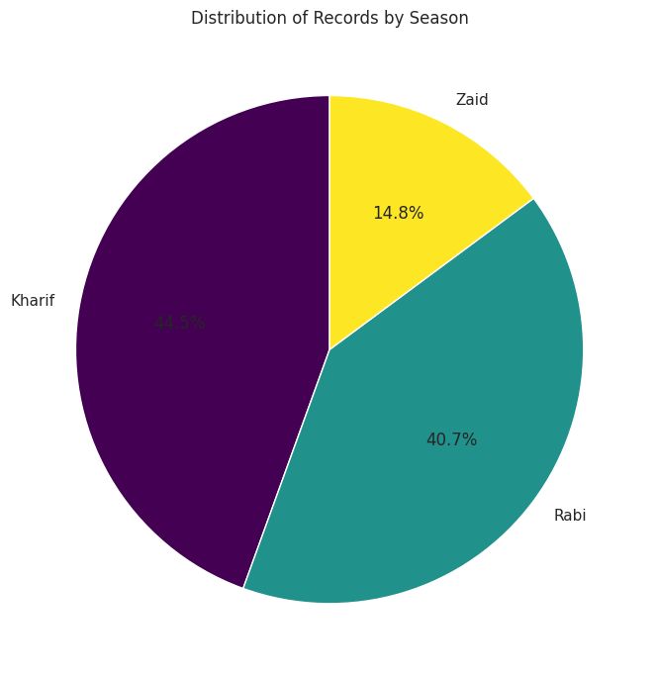
RESULTS

Slide 10
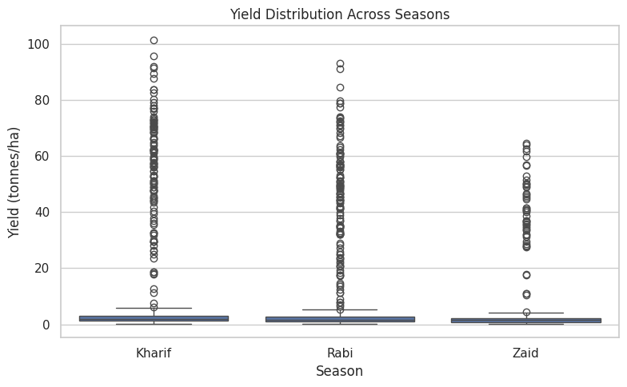
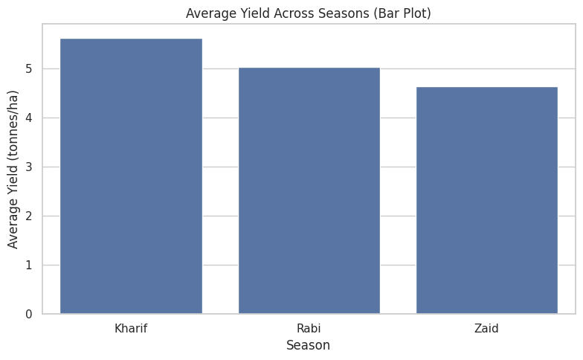
RESULTS

Slide 11
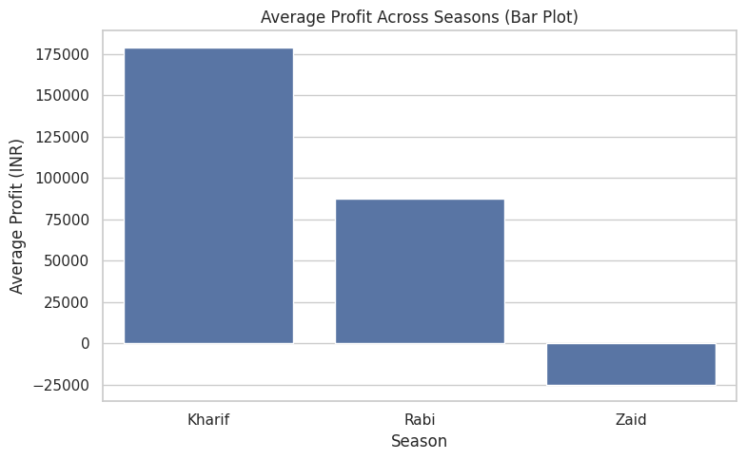
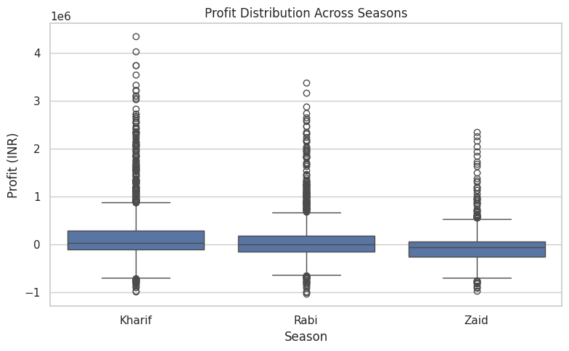
RESULTS

Slide 12
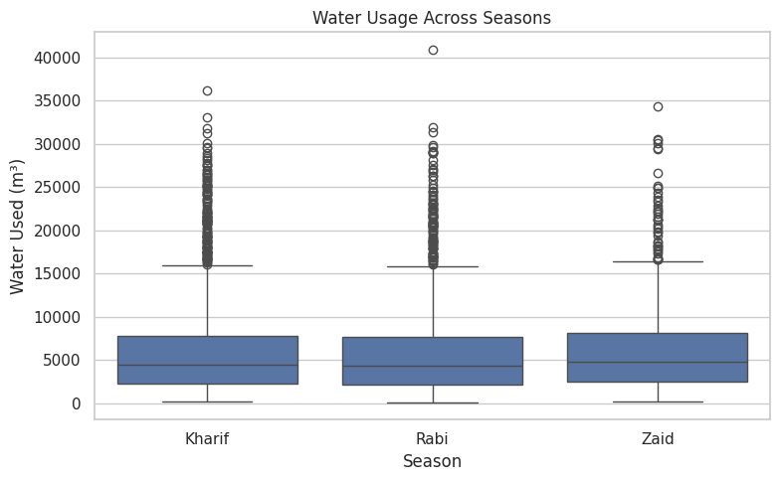
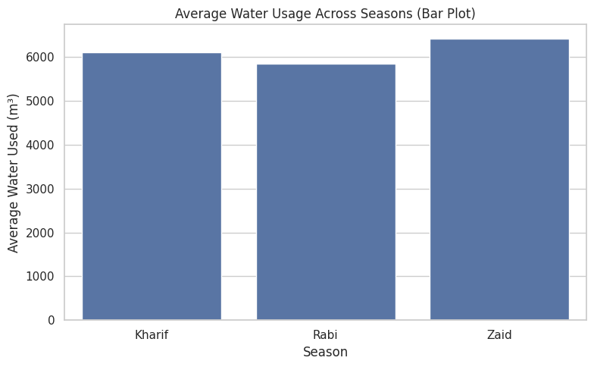
RESULTS

Slide 13
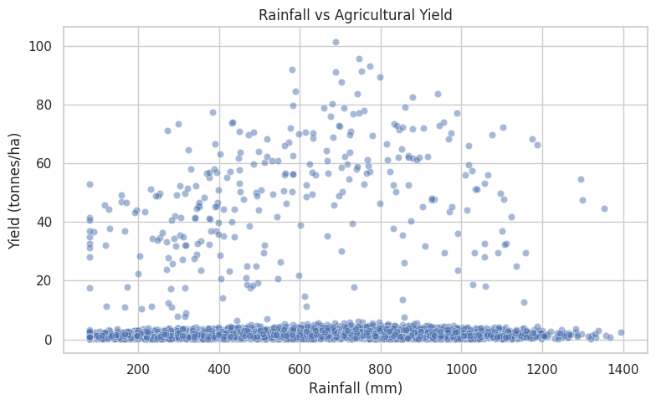
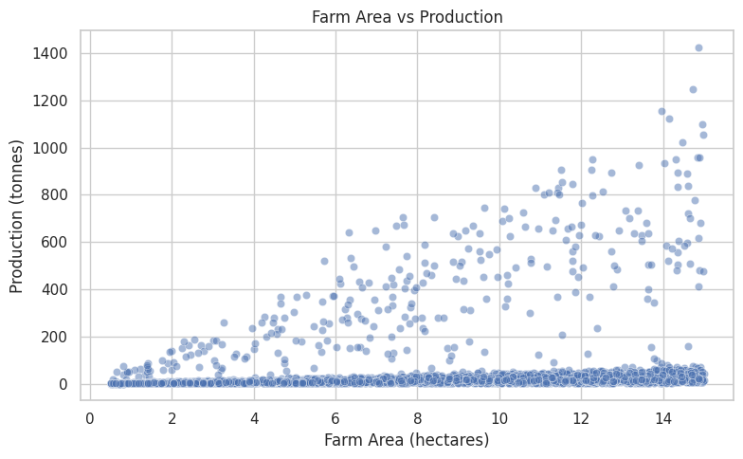
RESULTS

Slide 14
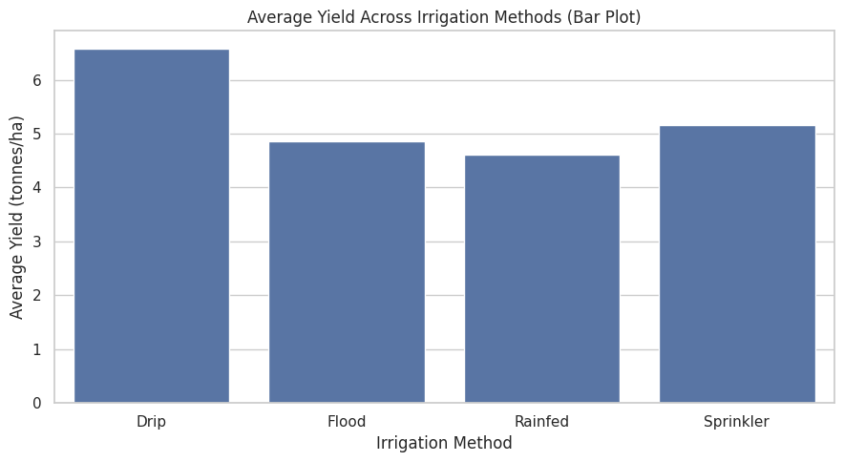
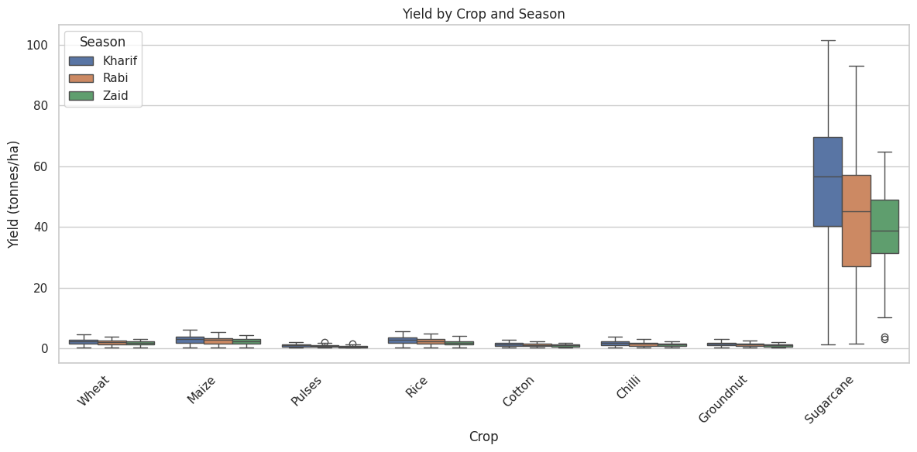
RESULTS

Slide 15
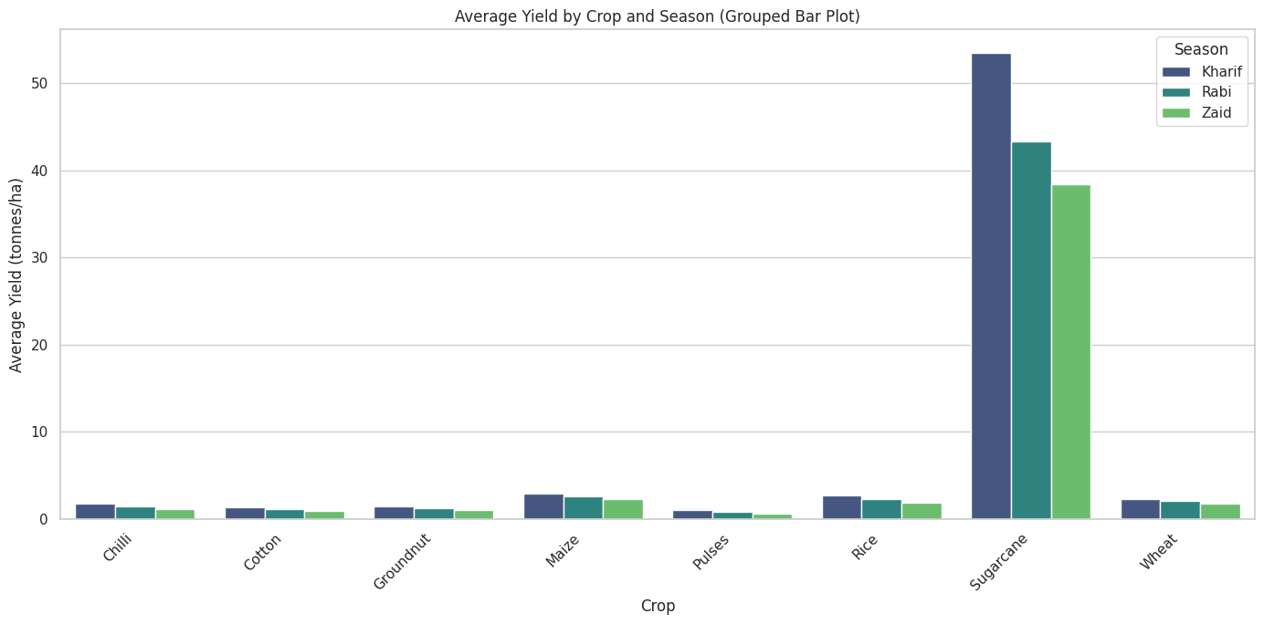
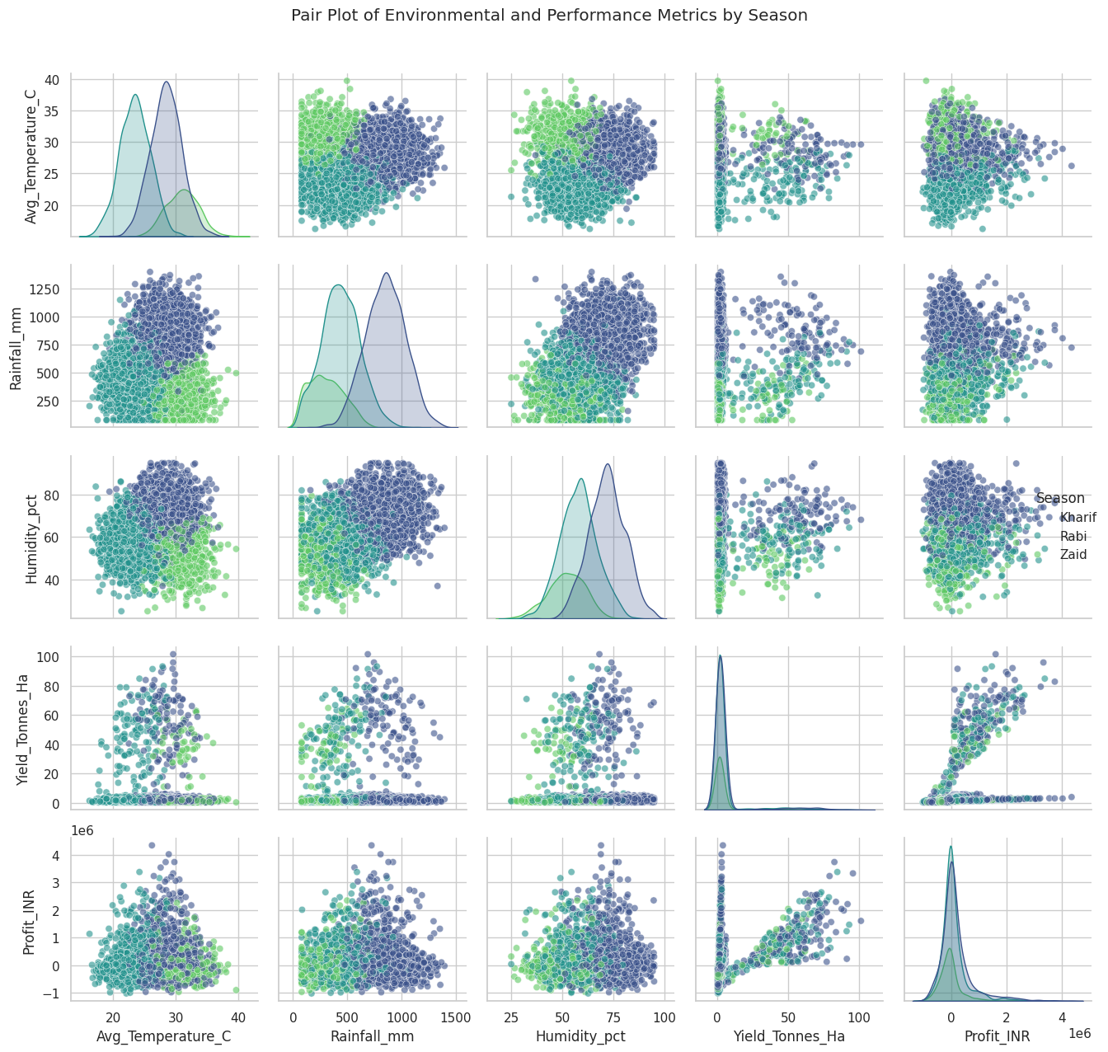
RESULTS

Slide 16
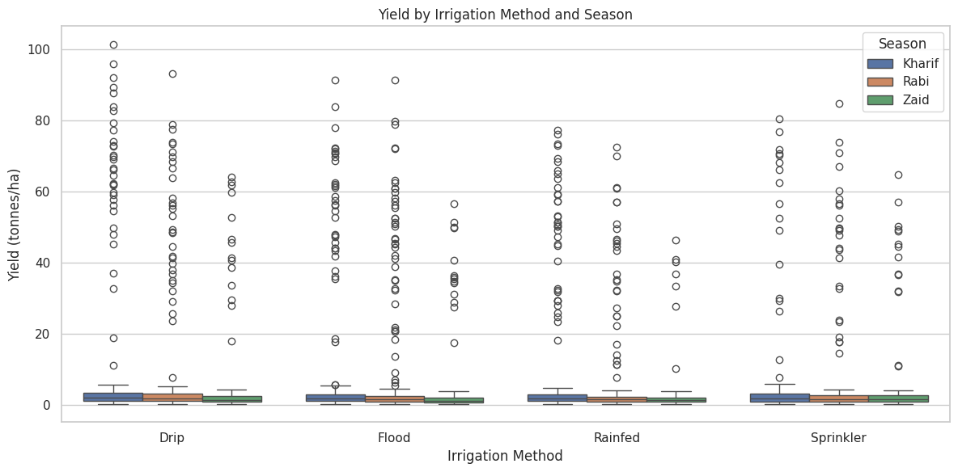
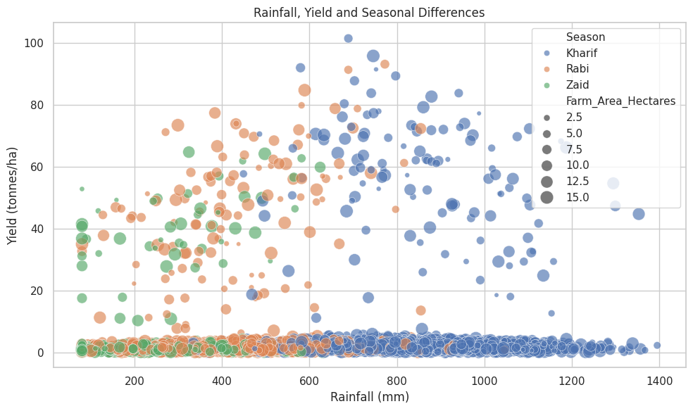
RESULTS

Slide 17
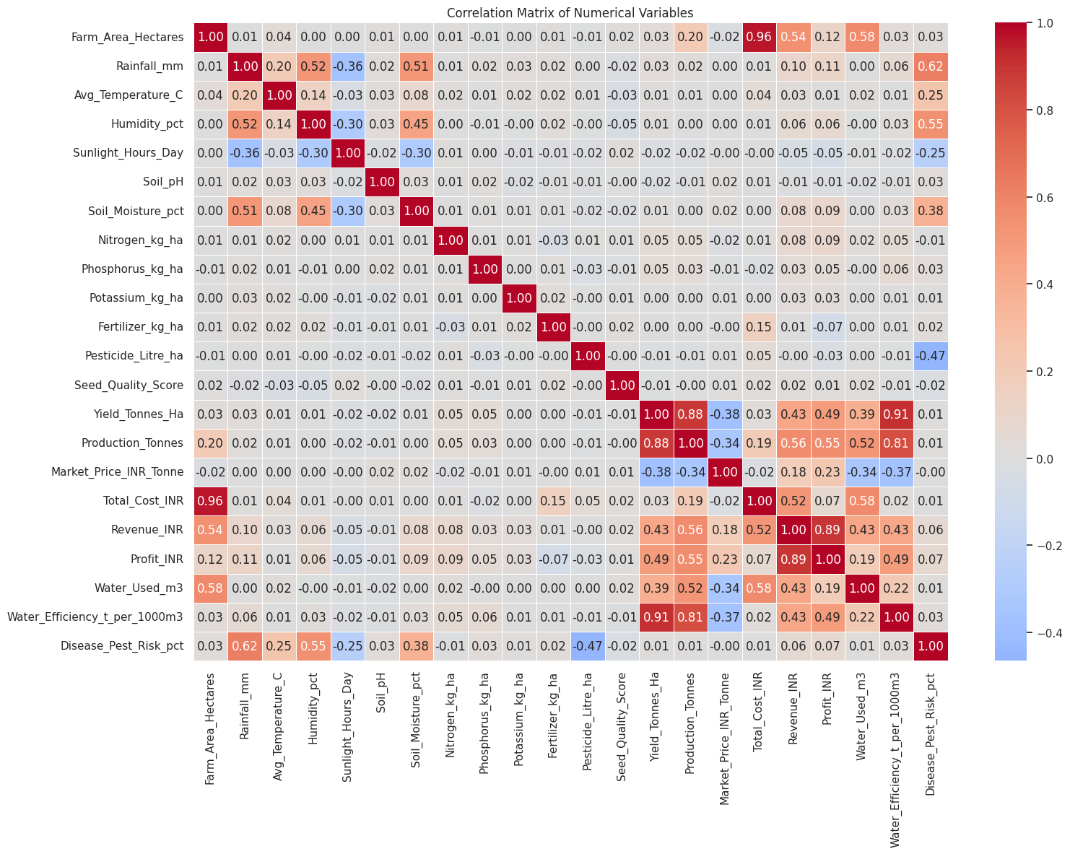
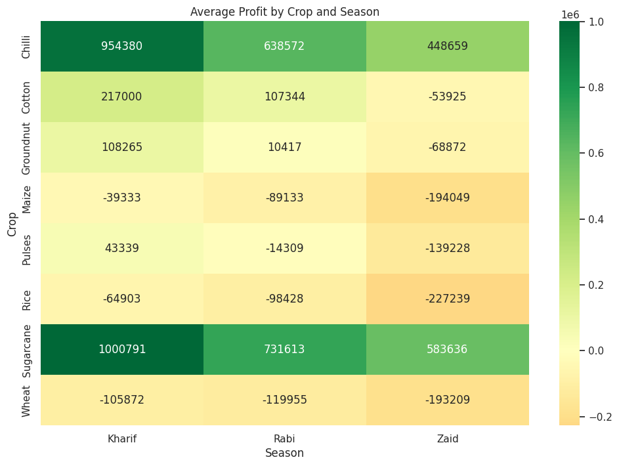
RESULTS

Slide 18
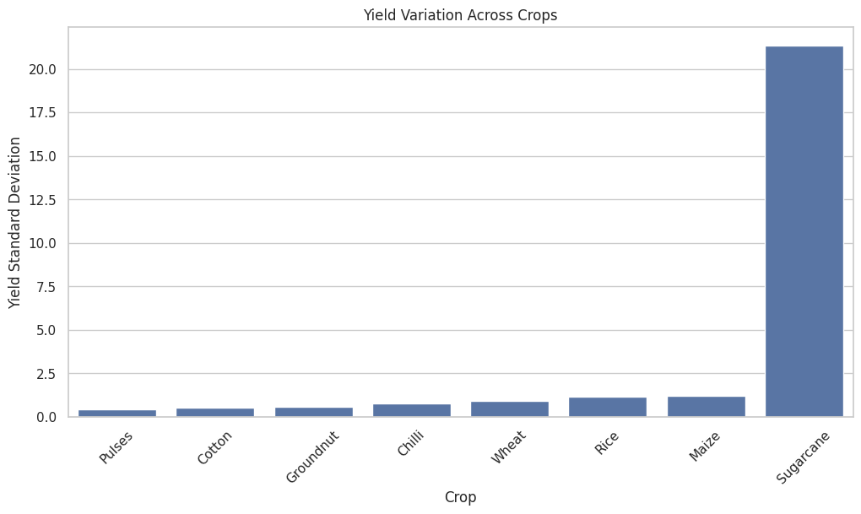
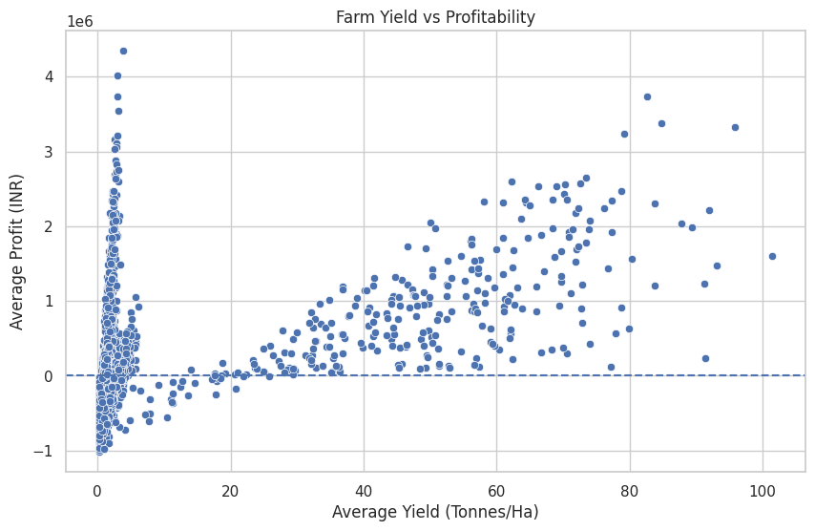
RESULTS

Slide 19
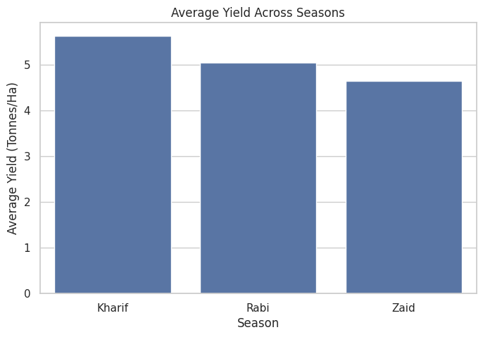
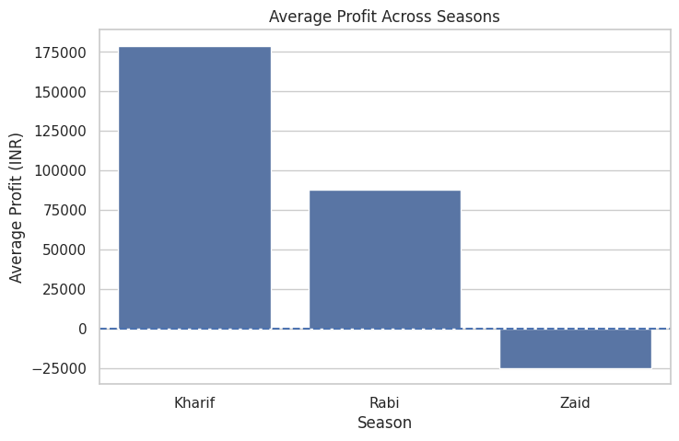
RESULTS

Slide 20
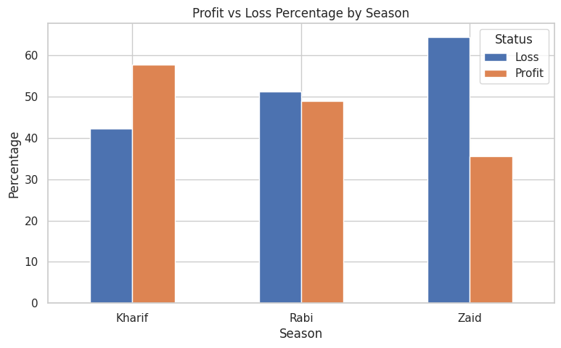
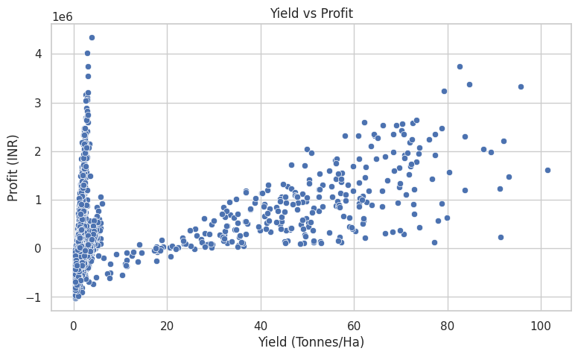
RESULTS

Slide 21
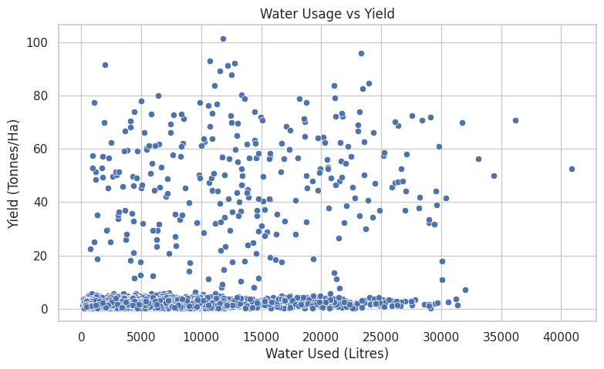
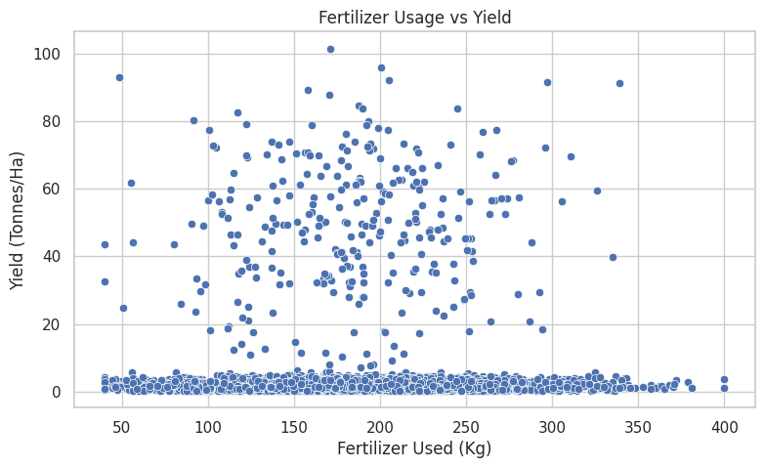
RESULTS

Slide 22
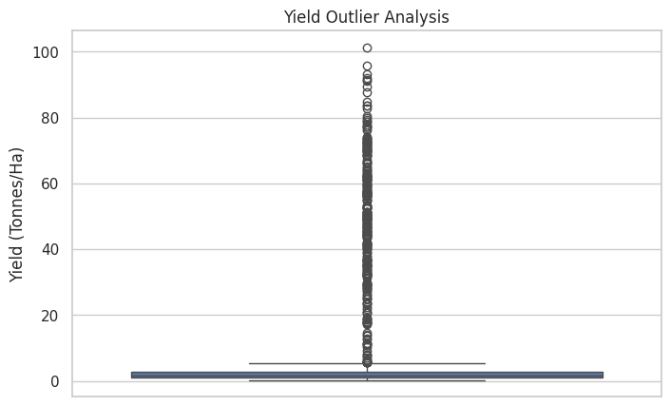
RESULTS

Slide 23
Future scope
Predictive Analysis: Develop machine learning models to predict crop yield and profitability for different seasons.
Weather Integration: Incorporate real-time weather data such as rainfall and temperature for better seasonal forecasting.
Crop Recommendation: Build a recommendation system to suggest suitable crops based on soil, climate, season, and expected profitability.
Resource Optimization: Analyze water and fertilizer usage to improve resource efficiency and support sustainable farming.
Regional Analysis: Expand the system with more regions and historical datasets to identify long-term agricultural trends.
Interactive Dashboard: Develop a user-friendly dashboard for farmers, planners, and policymakers to monitor agricultural performance and make data-driven decisions.

Slide 24

GitHub Link
https://github.com/Ysravanthi15/Seasonal-Agriculture-Performance-Analysis

Slide 25

VOIS Course completion certificate - Course name- Data Visualization

Slide 26

.
.

