Slide 1
Android 2D Game (Journey)
Team members:
Yuchen Jiang 18043763
Moci Xu 18043870
Hao Zhou 19046061
Project Supervisor:
Dr. Martin Johnson

Slide 2


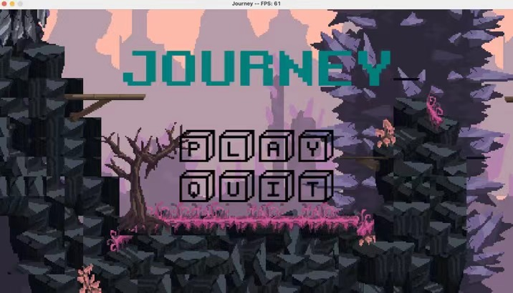
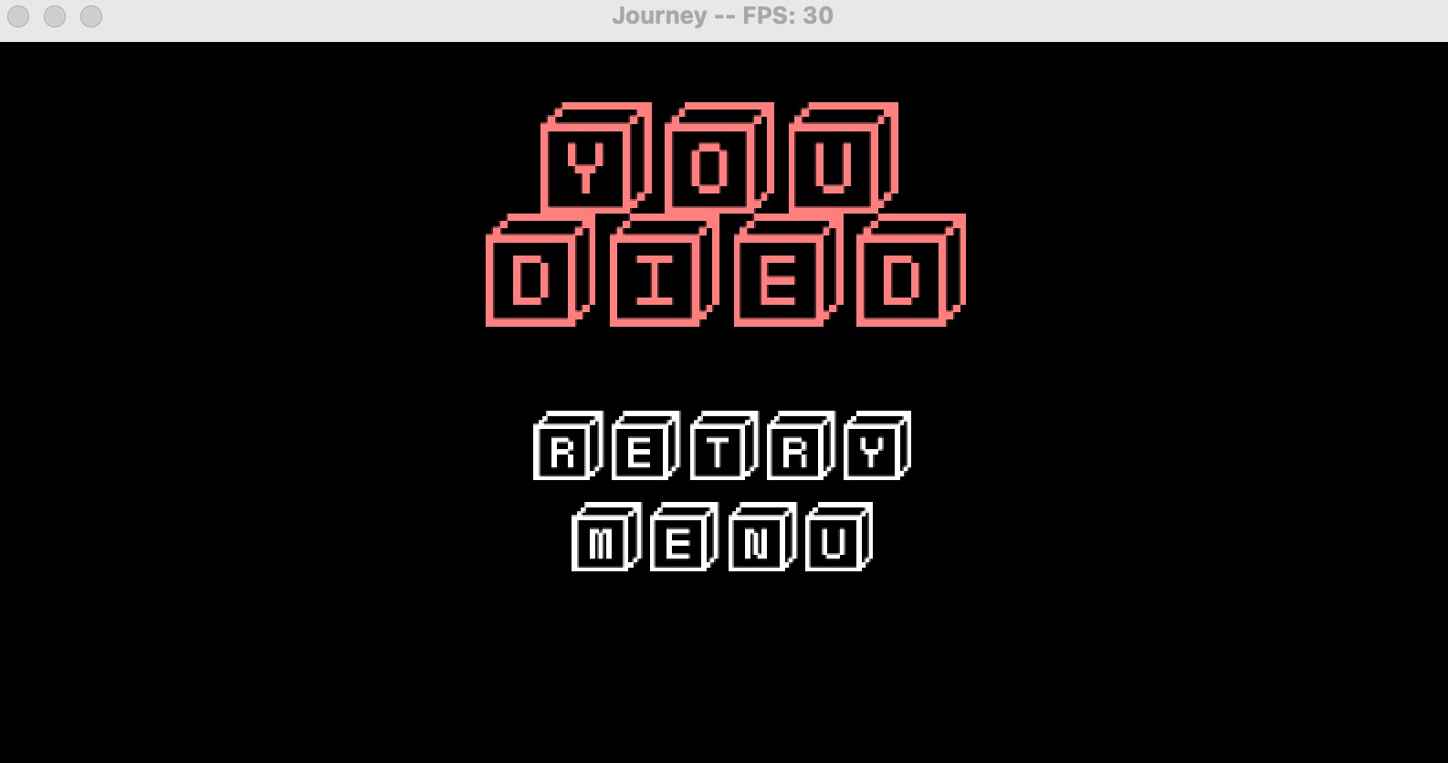
Start and end cover

Slide 3
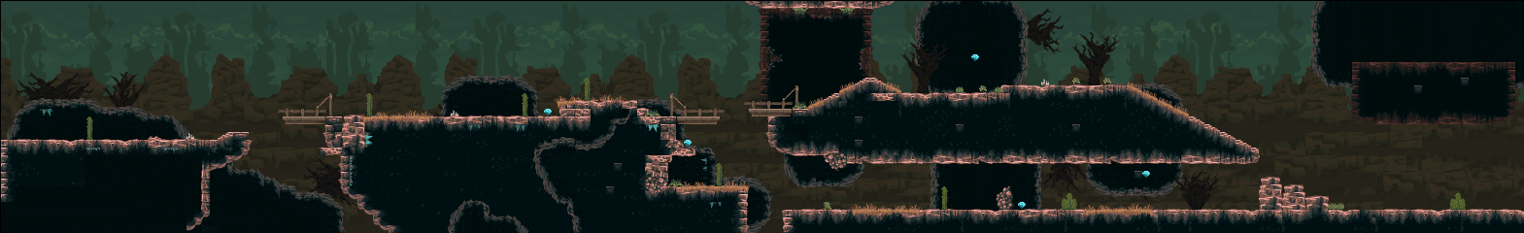
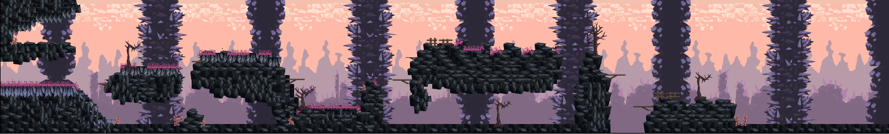
Map

Slide 4
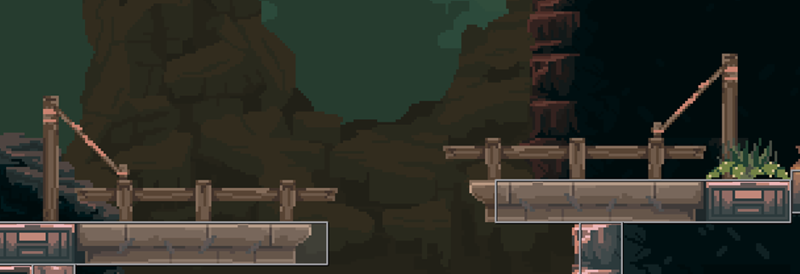
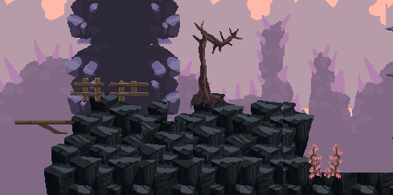

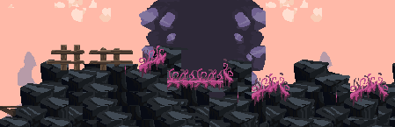
Map

Slide 5
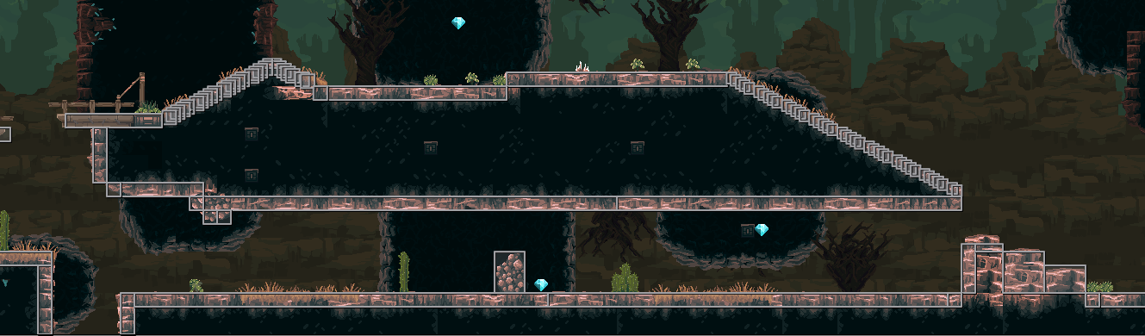
map

Slide 6
show

Slide 7
T H A N K
Y O
U

