Slide 1
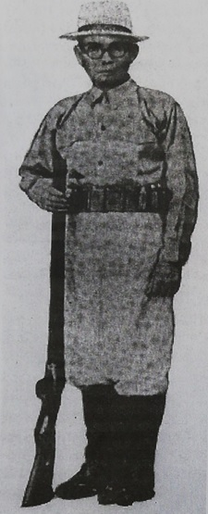
Valentin A. Cruz (Revolutionary Hero of Pasig; 1870 – 1967

Slide 2
Valentin A. Cruz – son of Pasig in whose house in barrio San Nicolas Gat Andres Bonifacio headed a meeting in May 1896 that solidified the movement against Spain. This led to the very first, and successful attack that signaled the start of the Philippine revolution, an event on August 19 of that year now called Nagsabado Sa Pasig.
Valentine A. Cruz – Brigadier General of Bonifacio, leader of Nagsabado, unremembered but by a few, in whose honor no monument has been erected nor a street named after.

Slide 3
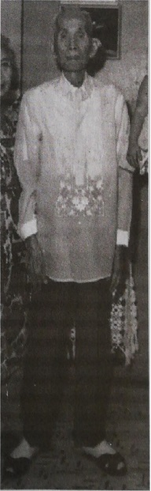
Valentine A. Cruz – whose role in the Revolution the Pasig Historical Society has been attempting to give a shine to, in the writing down of our country’s history.

Slide 4
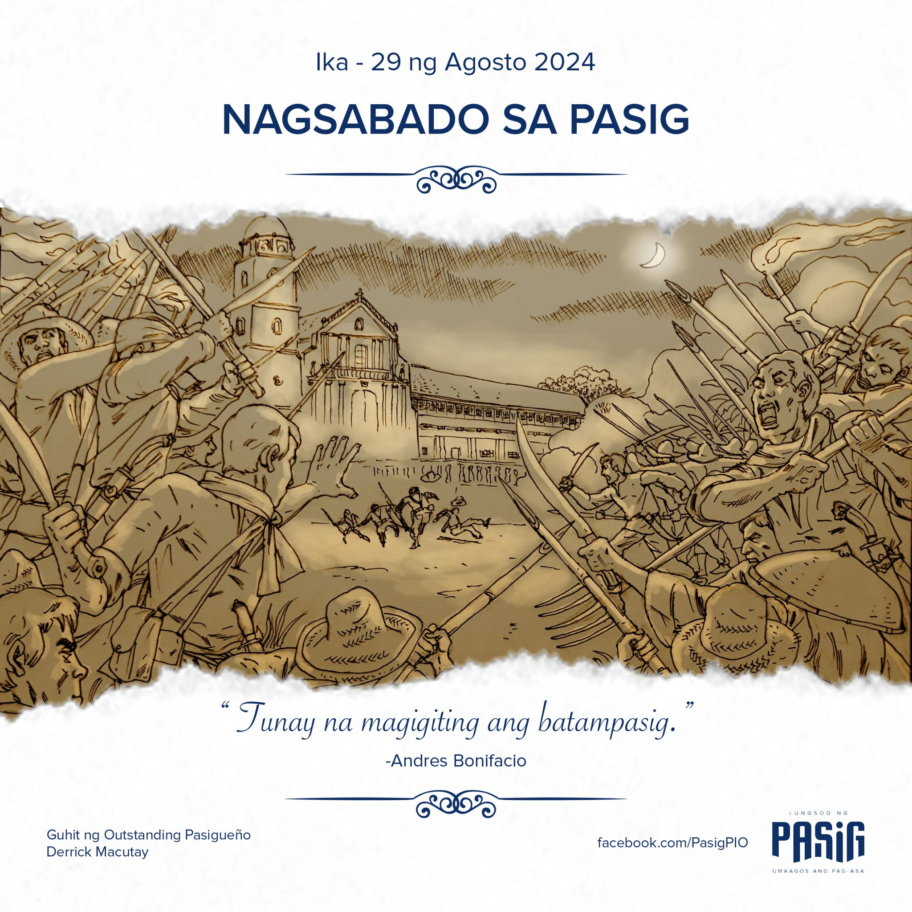
Valentin was accepted into the Katipunan movement in 1895 after passing the trials given by the screening panel headed by Emillio Jacinto. Later he headed the Sangguniang Bayan ng Pasig under the nom de guerre “Gugol.” Account of the Nagsabado which he led was first brought to light by Pasig historian Carlos Tech (†) and caught in writings by Dr. Luciano Santiago and Jose Velasquez, both of Pasig. [See previous Pasig Day souvenir publications].

Slide 5
The following months after Nagsabado, the Spanish regime, in retaliation, rounded up suspects. On November 5, Valentin Cruz was captured, sent to Bilibid prison, and sentenced to banishment in the Marianas. With the signing of Biak na Bato pact in December 1897 the revolutioneros laid down arms.
Amnesty was granted by the Spanish governor general setting free all political prisoners in the Marianas after 16 months of exile. Historian Dr. Santiago continues, “Completely unrepentant, they would fight again the next year in the second phase of the revolution; and later against the American colonizers who initially pretended to be allies.” This is that part of our history referred to by the Americans as “Pacification Campaign of the Philippine Islands” and “Philippine Insurrection,” not even dignifying the conflict as a true-blue war for independence.

Slide 6
Simply this was a struggle between lopsided forces, and on the whole, a David-Goliath affair with Goliath as the winner.
How was Valentin Cruz then? Did he have gaping wounds of the spirit on account of the sad Outcome of the struggles that no independence was won? Did he have marked agonies over the human life expenditure and over the hope which when Closest to victory was thwarted by cruel turns? Did he have nightmares over the blood and gore in the hand-to-hand combats he led? Did the vast loneliness of exile on that desolate island in the Marianas leave him lasting melancholy?

Slide 7
even Apolinario Mabini, brain of the Katipunan, likewise exiled there, groveled over that loneliness. And to while away his time, Mabini wrote minutest instructions over mere trifles to his brother.
Living relatives of Valentin remember him well but grew up not knowing what he had gone through. He spoke nothing about the struggle, donned no revolutionary uniform out of nostalgia, nor mentioned anything about the revolutionary heroes he was abreast with who are now revered by our history books and our celebrations: Andres Bonifacio, Emilio Jacinto, Pio Valenzuela, etc.

Slide 8
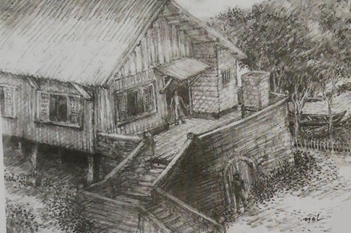
To his young kins he was an ordinary man who displayed none of the combat skills which fed his experiences. What remained of him — or was it really his personality? — was a man taciturn and distant. “At meals you did not talk to him, you waited till he spoke to you”, said one granddaughter.

Slide 9
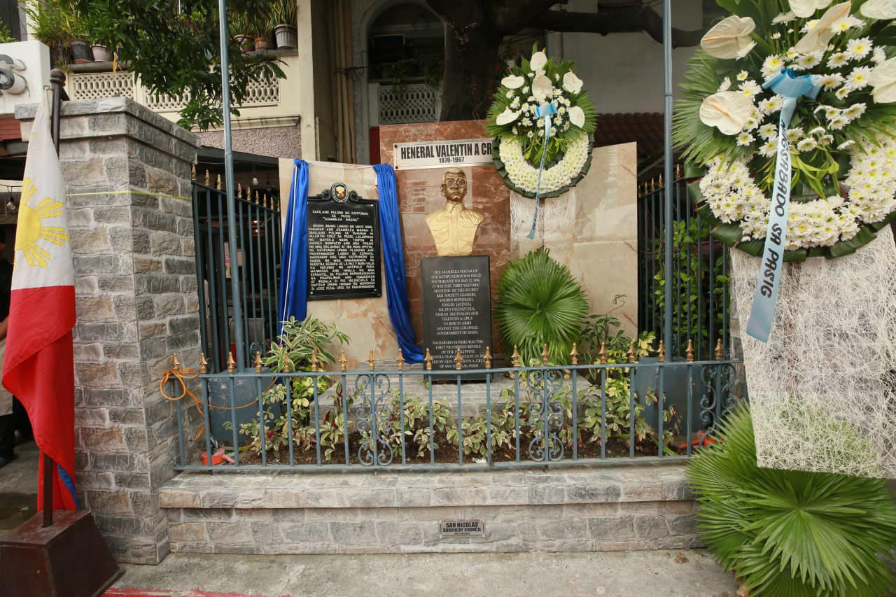
Who was Valentin Cruz?
He was the illegitimate son of a Raymundo, brother of the father of Cipriano Raymundo who would later become a mayor of Pasig. [See story of Cipriano Raymundo in this anniversary souvenir publication]. His mother was Catalina Antonio who later married a Cruz who adopted Valentin, making him a legal Cruz. Subsequently he inherited pieces of real estate property in Pasig because the couple produced no other heirs. He did not have to work for a living, so work he did not.

Slide 10
He married Isidora Alvarez, a pretty lass from Bambang, favored by his parents. Their children are the following:
Manuel (†) the handsome who become a lawyer, married Demetria Santos of Malinao. Children: Francisca (†) married Bienvenido Jose and she worked in treasurer’s office of the Pasig City Hall; civil engineer Augusto (†) married Julita Velasquez of Bulacan and who worked as a Meralco executive; the brilliant Alicia who retired as assistant vice president of Insular Life.
Cristina (†) married army officer Tirso Villa. One daughter later named Cristina.
Maria (†) married Isidro Salvador. Children: Sampaguita Beunaflor (†), Romeo (†), Jaime, Mario, and Aurora. All become teachers except agriculturist Florante and architect Mario, daughter Aurora is presently an officer of Pasig Convention Center. Maria was so active in social and civic functions that she was dubbed, “Everybody’s Grandma.” [See story on Maria’s family, this issue].

Slide 11
Buenaventura (†) married Julita Lati. Children: Analita Orber and Robert who presently works in the audit section of the Pasig City Hall.
Catalina, married Jose Estacio and lives in California
The son Manuel and pharmacist wife had a flourishing trade of various medicines and pomade with several store branches. But she died early

Slide 12
and he suffered a stroke not long after, so that the stores closed down and other businesses they had established, (principally the generator plant that supplied power to Binangonan, Cardona, Tanay and Pililla) had to be put under Valentin’s management. Out in the open landscape of these places, Valentin found kinship with what must have been his longed-for elements.
He took long walks in the hills and mountains and learned to hunt wild game. His family in Pasig would sometimes go aghast with his `naughtiness’ when he would take home meat from his hunts specially during Holy Weeks and Good Fridays when abstinence was observed. . . . for Valentin respected no holidays, and although he could discourse and debate on erudite subjects and religious matters, he maintained his hatred for the friars who had made him suffer.

Slide 13
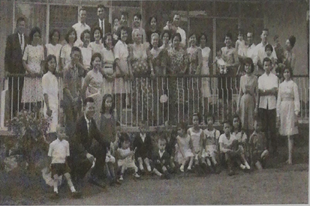
Valentin Cruz descendants at a reunion in the residence of daughter Maria Salvador. December 1964

Slide 14
Upon the death of son Manuel in 1939, the power generator project was found to be bankrupt, having accumulated much in debt. Properties had to be sold. Furious, the relatives of Manuel’s deceased wife sued Valentin in court in behalf of the minor orphans Francisca, Augusto and Alicia, a move that gave occasion to the expression of rage by Valentin.
He banished the family of his late son from his property on which their house stood. The bitterness that arose was partly lessened when Engineer/Businessman Francisco Santana of Pariancillo bought the power plant. Other debts were then paid off. Subsequently, Valentin lost in a swindle a big tract of land in the Rotonda area where now stands the Bliss Housing.

Slide 15
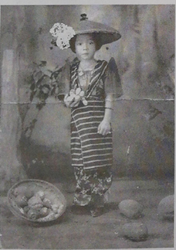
Granddaughter Alicia, one of the orphans of Manuel and Demetria, who became Assistant Vice President of Insular Life

Slide 16
Valentin’s wife Isidora was an excellent housewife with great kitchen skills. She however became afflicted with a neurosis on account of the errant and wondering eyes of Valentin. The grandchildren, for example, if they wanted approval for some request from grandma, would count the days and would time their asking when they predicted grandma would be in a good and positive state.
But she was a kindly woman. She took care as her own and raised an illegitimate daughter brought home by her husband. Valentin also left two sons with his common-law wife. Both sons, whom Valentin had baptized into the Aglipayan sects, still live.

Slide 17
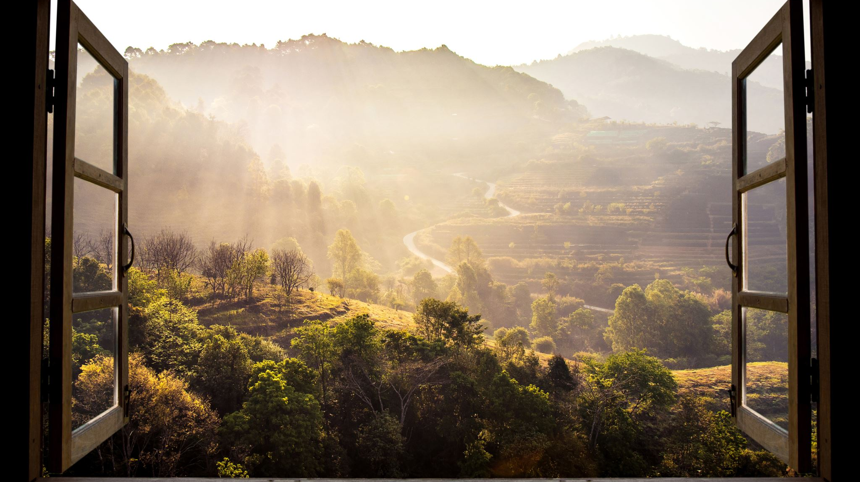
The spirit of freedom experienced in the hills and mountains remained in Valentin all his life. Back in Pasig, the aging Valentin would regularly drink carabao milk early in the morning and would walk long and far around the town, especially in the undisturbed parts like Ugong and Pineda. He died at age 97.
Valentin A. Cruz — a man who at the proper tide rose to the dictate of his star, and lived his humanity as placidly and as violently as the waves.

Slide 18
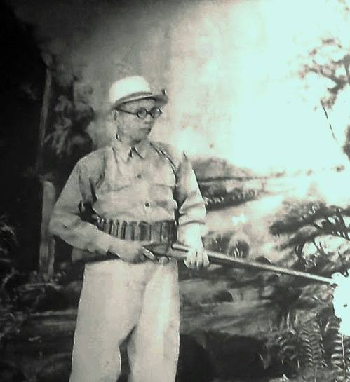
When Mayor Cipriano Raymundo, his biological nephew came to him, “Ti Intin,” he said, “kailangan ng Pasig Central School ang mas malaking lupa.” Without fuss, Valentin granted for the use of the school (now named Pasig Elementary) that piece of land adjoining his property in San Nicolas. Whether money was transferred was not clear but the kins of Valentin tended to believe there was none.

Slide 19
Essay: at least 100 words for each question:
Give 3 reasons why Valentin Cruz should be honored by the City Government as the Best Local Hero in Pasig?
What are the things that we can do as Pasiguenos to commemorate the contributions of Valentin Cruz?
What is the lesson that we can learn from the story of Valentin Cruz?
Send your finish work in our Google Class
Aerial , Font 12, with Margins on both sides, portrait
Deadline ;Until 10 pm

