Slide 1
Real Vector Space
Linear Algebra
Module 5

Slide 2
Overview
In various physical applications there appear certain quantities, such as temperature and speed, which possess only “magnitude”. These can be represented by real numbers and are called scalars.
Other physical quantities are not completely determined until both a magnitude and a direction are specified as such are velocity, force, and acceleration. These quantities are called vectors. For example, the wind movement is usually described by giving the speed and direction, say 20 mph northeast.
In this module we will discuss the notion of vectors, the 2-vectors or the plane and the 3-vectors or the space, along with their properties.

Slide 3
Topic Outline
Vectors in Plane
Vectors in Space
Vector Space and Subspaces
Spanning Sets
Linear Independence

Slide 4
Learning Objectives
At the end of this module, the students will be able
Explain vectors and its components;
Sketch a directed line segment in R² and R³ representing a given vector;
Identify whether a set of vectors belong to a given vector space and subspaces;
Find a vector which is a linear combination or span of the given vector; and
Determine whether a given vectors are linearly independent or linearly dependent.

Slide 5
Vector in plane
Lesson 1

Slide 6
Vectors in the Plane and in 3-Space
Vectors can be represented geometrically as directed line segments or arrows. The direction of the arrow specifies the direction of the vector, and the length of the arrow describes its magnitude.
The tail of the arrow is called the initial point of the vector, and the tip or head of the arrow the terminal point.
initial point terminal point
length of the arrow
Symbolically, we shall denote vectors in lowercase boldface letters such as u, v, w, x, y and z. When discussing vectors, we shall refer to numbers as scalars. For now, all our scalars will be real numbers and will be denoted in lowercase italic letters such as c, d, r, s, and t

Slide 7


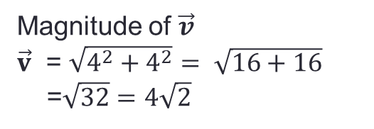

Vectors in the Plane or $R^{2}$
Take for instance an initial point A(1,2) and a terminal point B(5,6). Let vector v a directed line segment from A to B or in symbol, $\vec{v}=AB$.
B(5,6)
$$\vec{v}=AB$$
$\vec{v}=[x_{2}−x_{1},y_{2}−y_{1}$]
$\vec{v}=[5−1, 6−2$]
$\vec{v}=[4,4$]
Magnitude of $\vec{v}$
$\vec{v}$ = $\sqrt{4^{2}+4^{2}}= \sqrt{16+16}$
=$\sqrt{32}=4\sqrt{2}$
A(1,2)

Slide 8
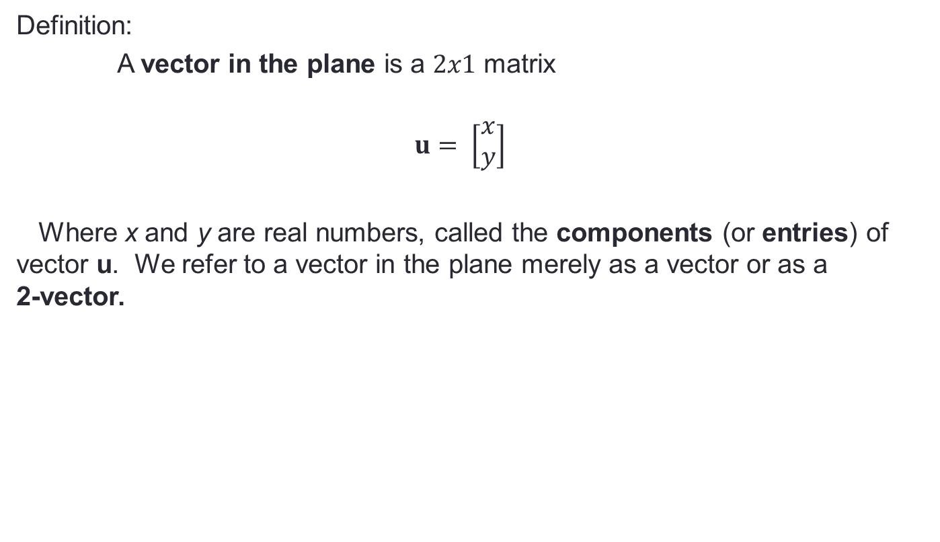
Vectors in the Plane
Definition:
A vector in the plane is a $2x1$ matrix
$$u= \left[\begin{matrix}x \\ y\end{matrix}\right]$$
Where x and y are real numbers, called the components (or entries) of vector u. We refer to a vector in the plane merely as a vector or as a 2-vector.

Slide 9

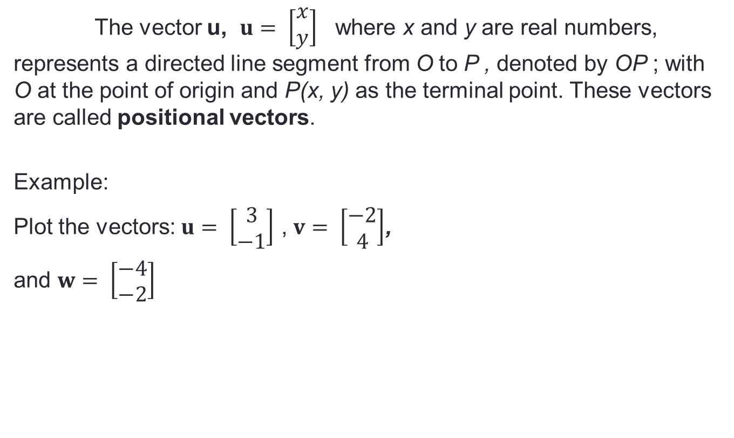


Vectors in the Plane
The vector u, $u= \left[\begin{matrix}x \\ y\end{matrix}\right]$ where x and y are real numbers, represents a directed line segment from O to P , denoted by OP ; with O at the point of origin and P(x, y) as the terminal point. These vectors are called positional vectors.
Example:
Plot the vectors: $u= \left[\begin{matrix}3 \\ −1\end{matrix}\right]$ , $v= \left[\begin{matrix}−2 \\ 4\end{matrix}\right]$,
and $w= \left[\begin{matrix}−4 \\ −2\end{matrix}\right]$
$$v=[−2,4]$$
O
$$u=[3,−1]$$
$$w=[−4,−2]$$

Slide 10
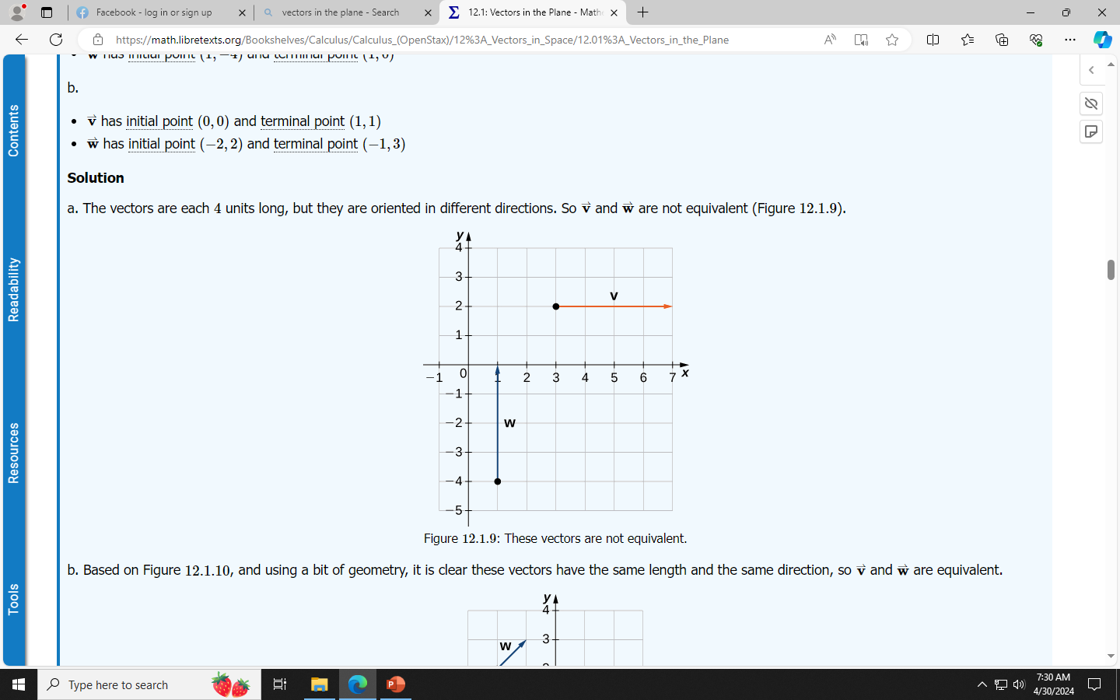
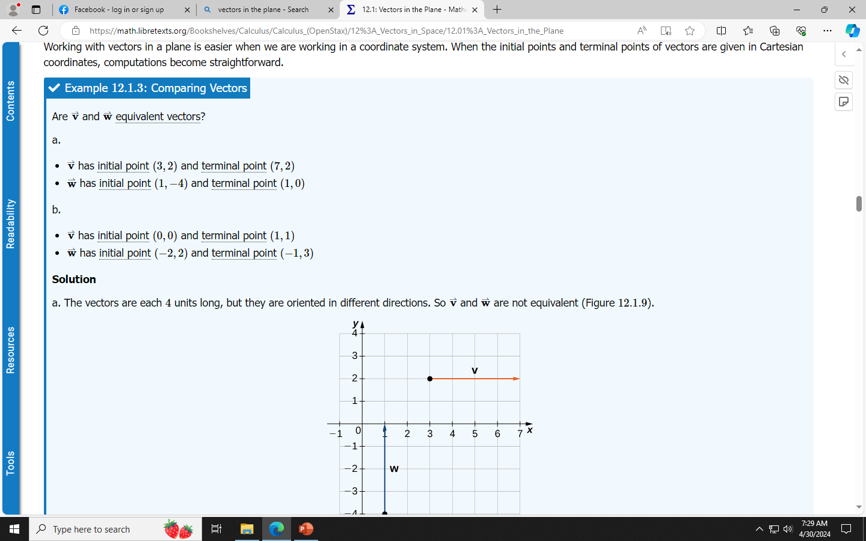
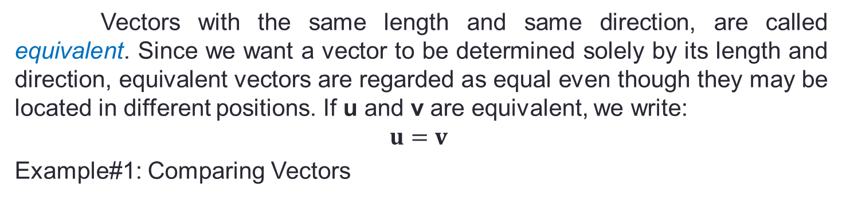
Vectors in the Plane
Vectors with the same length and same direction, are called equivalent. Since we want a vector to be determined solely by its length and direction, equivalent vectors are regarded as equal even though they may be located in different positions. If u and v are equivalent, we write:
$$u=v$$
Example#1: Comparing Vectors

Slide 11
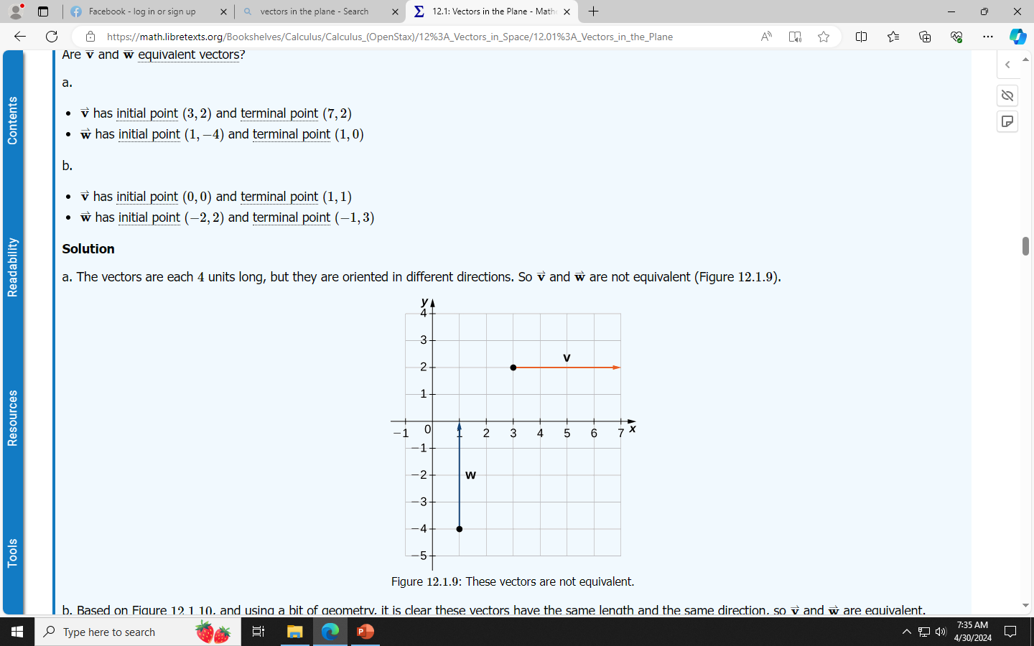
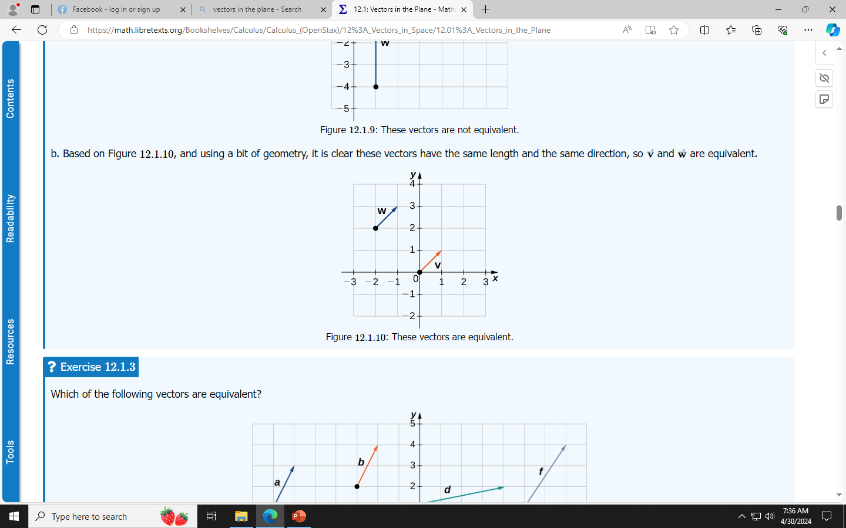
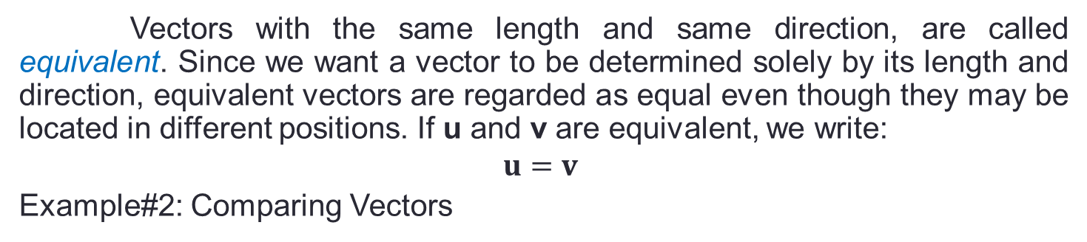
Vectors in the Plane
Vectors with the same length and same direction, are called equivalent. Since we want a vector to be determined solely by its length and direction, equivalent vectors are regarded as equal even though they may be located in different positions. If u and v are equivalent, we write:
$$u=v$$
Example#2: Comparing Vectors

Slide 12
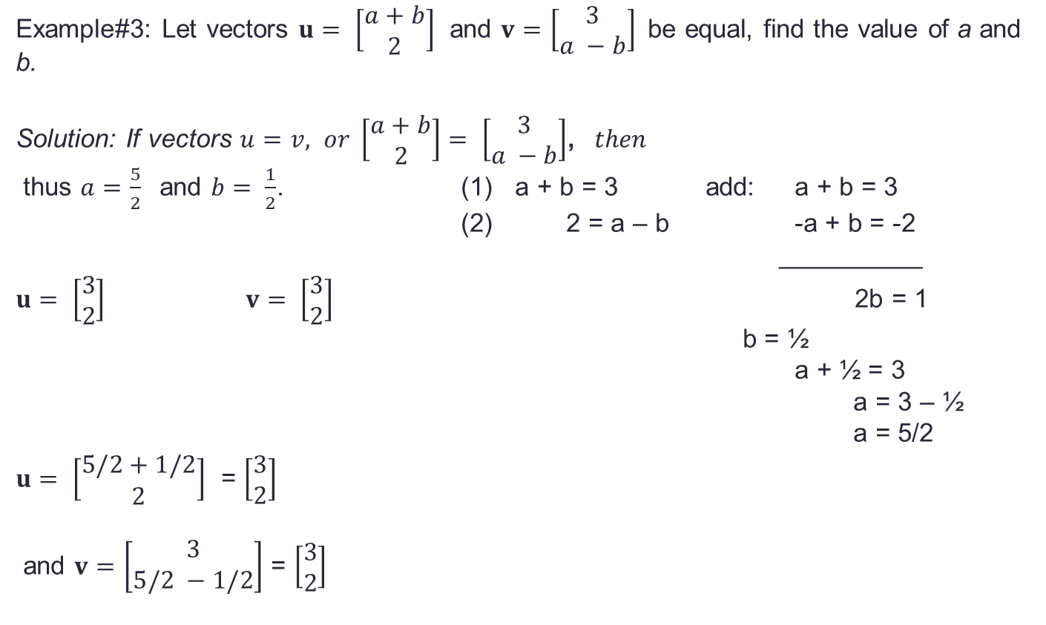
Vectors in the Plane
Example#3: Let vectors $u= \left[\begin{matrix}a+b \\ 2\end{matrix}\right]$ and $v=\left[\begin{matrix}3 \\ a −b\end{matrix}\right]$be equal, find the value of a and b.
Solution: If vectors $u=v, or \left[\begin{matrix}a+b \\ 2\end{matrix}\right]= \left[\begin{matrix}3 \\ a −b\end{matrix}\right]$, $then$
thus $a=\frac{5}{2}$ and $b= \frac{1}{2}$. (1) a + b = 3 add: a + b = 3
(2) 2 = a – b -a + b = -2
__________
$u= \left[\begin{matrix}3 \\ 2\end{matrix}\right]$ $v= \left[\begin{matrix}3 \\ 2\end{matrix}\right]$ 2b = 1
b = ½
a + ½ = 3
a = 3 – ½
a = 5/2
$u= \left[\begin{matrix}5/2+1/2 \\ 2\end{matrix}\right]$ = $\left[\begin{matrix}3 \\ 2\end{matrix}\right]$
and $v=\left[\begin{matrix}3 \\ 5/2 −1/2\end{matrix}\right]$ = $\left[\begin{matrix}3 \\ 2\end{matrix}\right]$

Slide 13
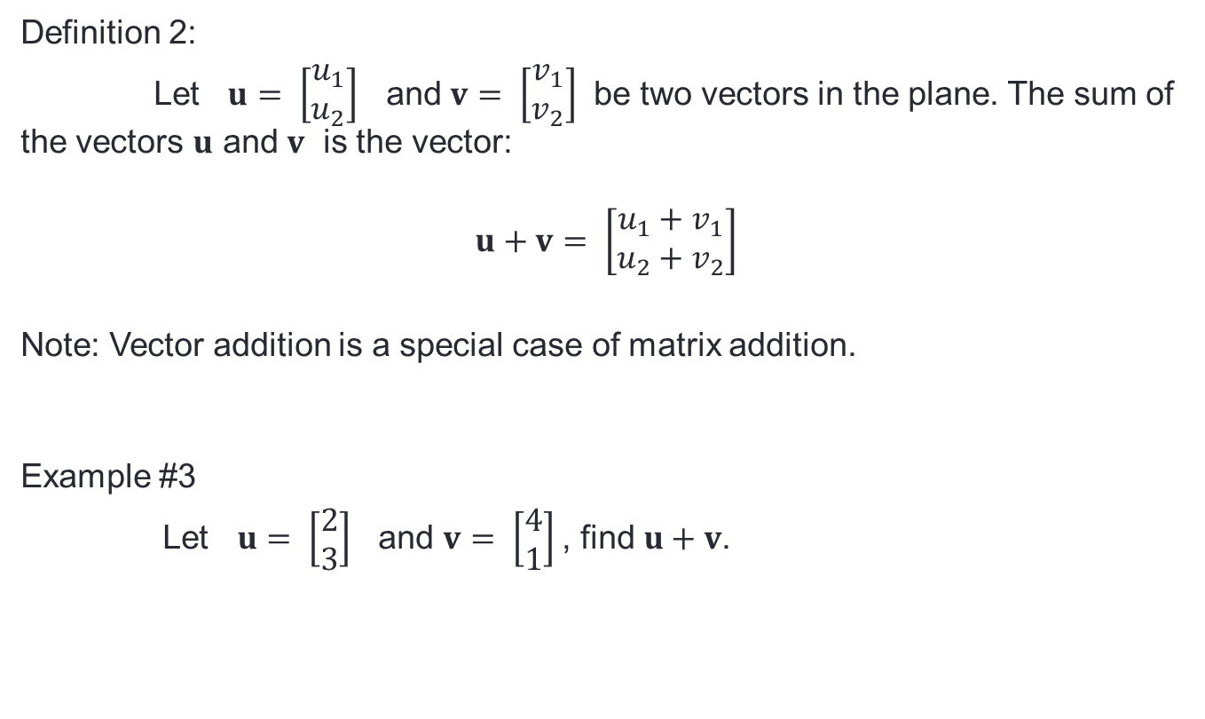
Vectors in the Plane
Definition 2:
Let $u= \left[\begin{matrix}u_{1} \\ u_{2}\end{matrix}\right]$ and $v= \left[\begin{matrix}v_{1} \\ v_{2}\end{matrix}\right]$ be two vectors in the plane. The sum of the vectors $u$ and $v$ is the vector:
$$u+v= \left[\begin{matrix}u_{1}+v_{1} \\ u_{2}+v_{2}\end{matrix}\right]$$
Note: Vector addition is a special case of matrix addition.
Example #3
Let $u= \left[\begin{matrix}2 \\ 3\end{matrix}\right]$ and $v= \left[\begin{matrix}4 \\ 1\end{matrix}\right]$, find $u+v$.

Slide 14

Vectors in the Plane
Solution:
$u+v= \left[\begin{matrix}2+4 \\ 3+1\end{matrix}\right]= \left[\begin{matrix}6 \\ 4\end{matrix}\right]$
To illustrate:
u+v = [6, 4]
u=[2,3]
v =[4,1]

Slide 15

Vectors in the Plane
Example 2:
Let $u=\left[\begin{matrix}3 \\ 1 \end{matrix}\right] and v= \left[\begin{matrix}4 \\ −2\end{matrix}\right], then u+v= \left[\begin{matrix}3+4 \\ 1+(−2)\end{matrix}\right]= \left[\begin{matrix}7 \\ −1\end{matrix}\right]$
To illustrate:
u=[3,1]
u+v=[7,-1]
v=[4,-2]

Slide 16
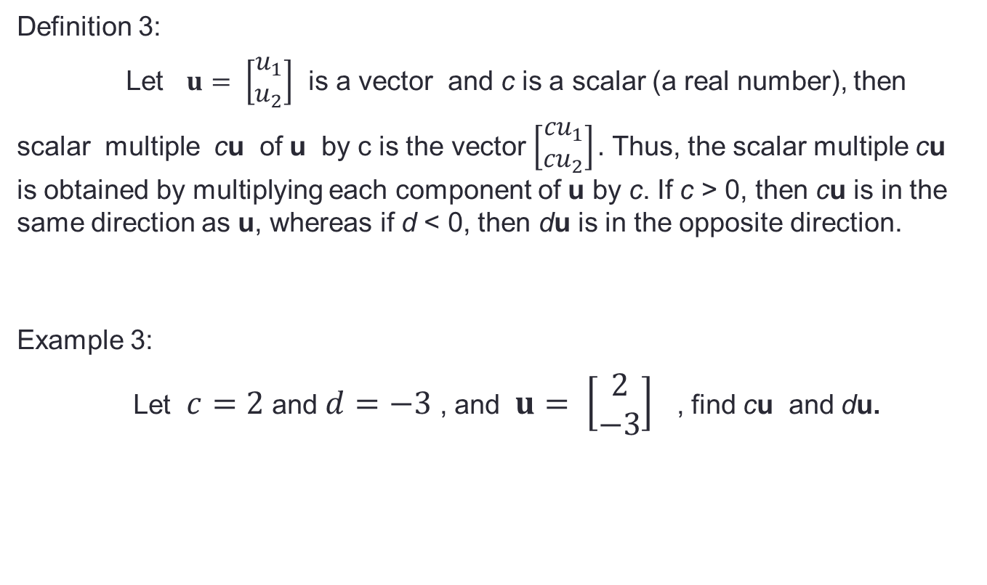
Vectors in the Plane
Definition 3:
Let $u= \left[\begin{matrix}u_{1} \\ u_{2}\end{matrix}\right]$ is a vector and c is a scalar (a real number), then
scalar multiple cu of u by c is the vector $\left[\begin{matrix}{cu}_{1} \\ {cu}_{2}\end{matrix}\right].$ Thus, the scalar multiple cu is obtained by multiplying each component of u by c. If c > 0, then cu is in the same direction as u, whereas if d < 0, then du is in the opposite direction.
Example 3:
Let $c=2$ and $d=−3$ , and $u= \left[\begin{matrix}2 \\ −3\end{matrix}\right]$ , find cu and du.

Slide 17

Vectors in the Plane
Solution:
c$u= \left[\begin{matrix}2(2) \\ 2(−3)\end{matrix}\right]= \left[\begin{matrix}4 \\ −6\end{matrix}\right]$
To illustrate:
u=[2,-3]
2u = [4, -6]
Note: Observe that the size of the original vector doubles since c = 2.

Slide 18

Vectors in the Plane
-3u = [-6, 9]
Solution:
-3$u= \left[\begin{matrix}−3(2) \\ −3(−3)\end{matrix}\right]= \left[\begin{matrix}−6 \\ 9\end{matrix}\right]$
To illustrate:
u=[2,-3]
Note: Observe that the size of the original vector triples but on the opposite direction.

Slide 19
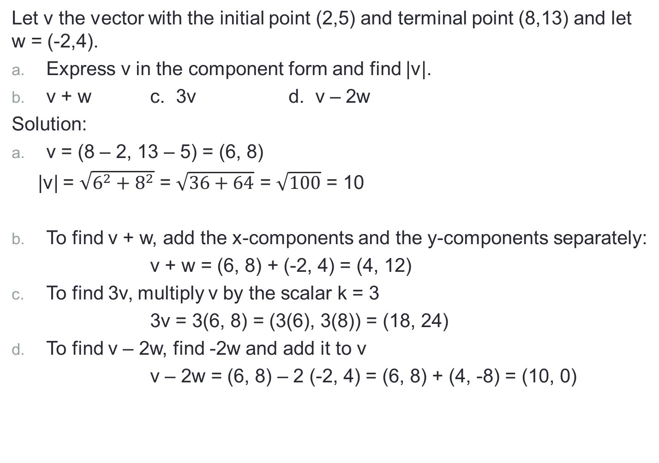
Example 4
Let v the vector with the initial point (2,5) and terminal point (8,13) and let w = (-2,4).
Express v in the component form and find |v|.
v + w c. 3v d. v – 2w
Solution:
v = (8 – 2, 13 – 5) = (6, 8)
|v| = $\sqrt{6^{2}+8^{2}}$ = $\sqrt{36+64}$ = $\sqrt{100}$ = 10
To find v + w, add the x-components and the y-components separately:
v + w = (6, 8) + (-2, 4) = (4, 12)
To find 3v, multiply v by the scalar k = 3
3v = 3(6, 8) = (3(6), 3(8)) = (18, 24)
To find v – 2w, find -2w and add it to v
v – 2w = (6, 8) – 2 (-2, 4) = (6, 8) + (4, -8) = (10, 0)

Slide 20
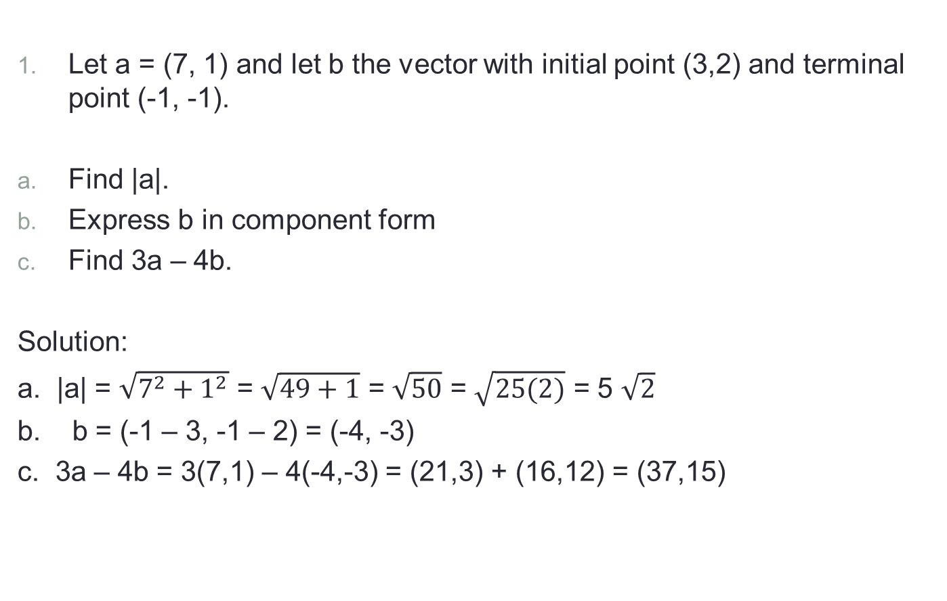
Exercise 1:
Let a = (7, 1) and let b the vector with initial point (3,2) and terminal point (-1, -1).
Find |a|.
Express b in component form
Find 3a – 4b.
Solution:
a. |a| = $\sqrt{7^{2}+1^{2}}$ = $\sqrt{49+1}$ = $\sqrt{50}$ = $\sqrt{25(2)}$ = 5 $\sqrt{2}$
b. b = (-1 – 3, -1 – 2) = (-4, -3)
c. 3a – 4b = 3(7,1) – 4(-4,-3) = (21,3) + (16,12) = (37,15)

Slide 21
Vector in space
Lesson 2

Slide 22
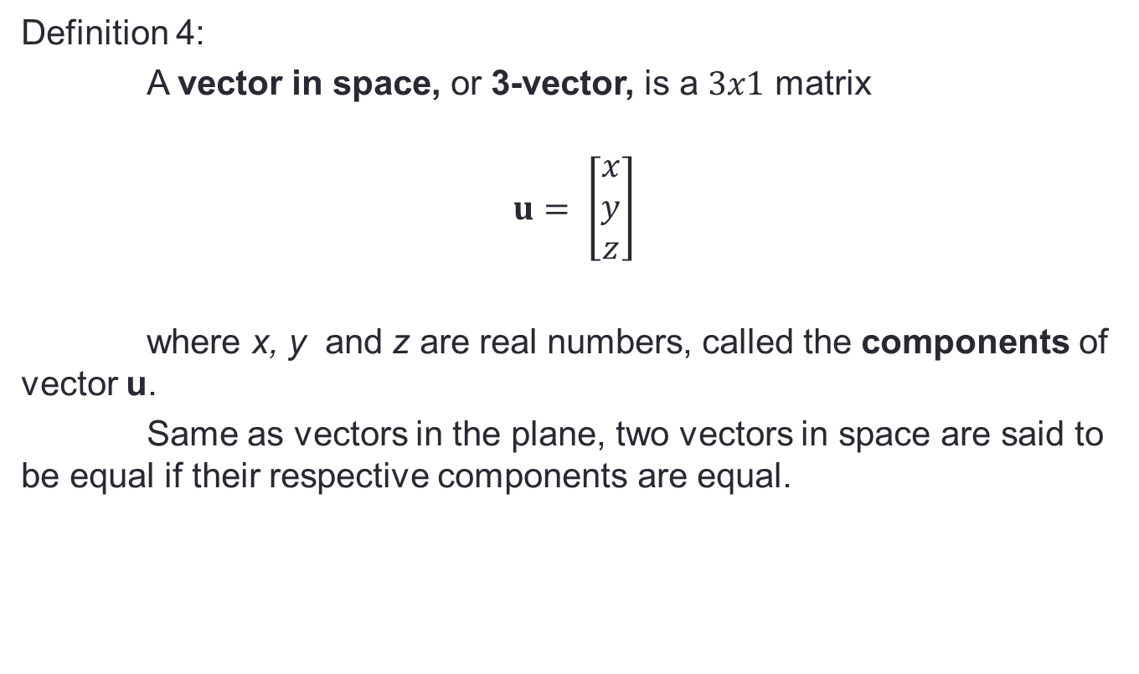
Vectors in Space
Definition 4:
A vector in space, or 3-vector, is a $3x1$ matrix
$$u= \left[\begin{matrix}x \\ y \\ z\end{matrix}\right]$$
where x, y and z are real numbers, called the components of vector u.
Same as vectors in the plane, two vectors in space are said to be equal if their respective components are equal.

Slide 23

Vectors in Space
To plot vectors in space or vector in $R^{3}$ can be presented in xyz-coordinate axes.
z-axis
O(0,0,0)
y-axis
x-axis

Slide 24


Vectors in Space
A good example of a 3-dimension or the xyz-coordinate axis is the corner of a room
z-axis
z-axis
x-axis
y-axis
x-axis
y-axis

Slide 25


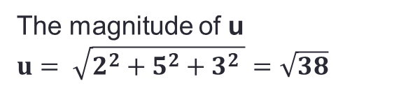
Vectors in Space
Example 1: Plot the vectors: $u= \left[\begin{matrix}2 \\ 5 \\ 3\end{matrix}\right]$
Plotting a 3-dimension vector is like constructing a parallelepiped.
z-axis
$$u= \left[\begin{matrix}2 \\ 5 \\ 3\end{matrix}\right]$$
3
5
y-axis
2
The magnitude of u
$u= \sqrt{2^{2}+5^{2}+3^{2} }=\sqrt{38}$
x-axis

Slide 26


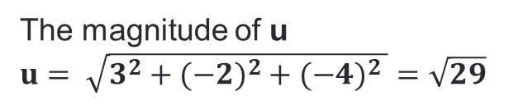
Vectors in Space
Example 1: Plot the vectors: $u= \left[\begin{matrix}3 \\ −2 \\ −4\end{matrix}\right]$
z-axis
The magnitude of u
$u= \sqrt{3^{2}+(−{2)}^{2}+{(−4)}^{2} }=\sqrt{29}$
-2
y-axis
3
$$u= \left[\begin{matrix}3 \\ −2 \\ −4\end{matrix}\right]$$
x-axis
-4

Slide 27
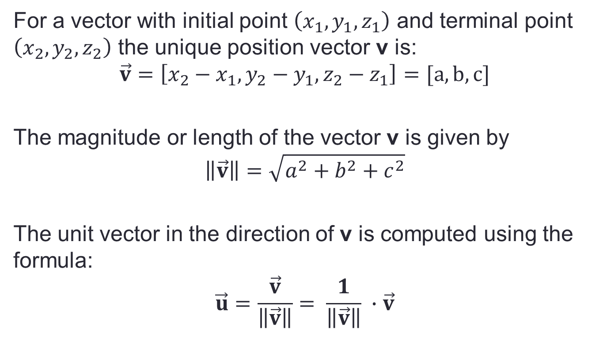
Vectors in Space
For a vector with initial point $\left(x_{1},y_{1},z_{1}\right)$ and terminal point $\left(x_{2},y_{2},z_{2}\right)$ the unique position vector v is:
$$\vec{v}=\left[x_{2}−x_{1},y_{2}−y_{1},z_{2}−z_{1}\right]=[a,b,c]$$
The magnitude or length of the vector v is given by
$$\left\|\vec{v}\right\|=\sqrt{a^{2}+b^{2}+c^{2}}$$
The unit vector in the direction of v is computed using the formula:
$$\vec{u}=\frac{\vec{v}}{\left\|\vec{v}\right\|}= \frac{1}{\left\|\vec{v}\right\|} ∙\vec{v}$$

Slide 28
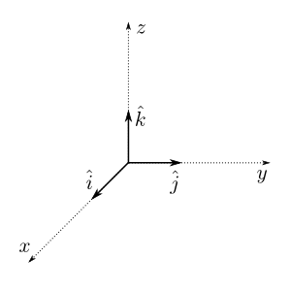
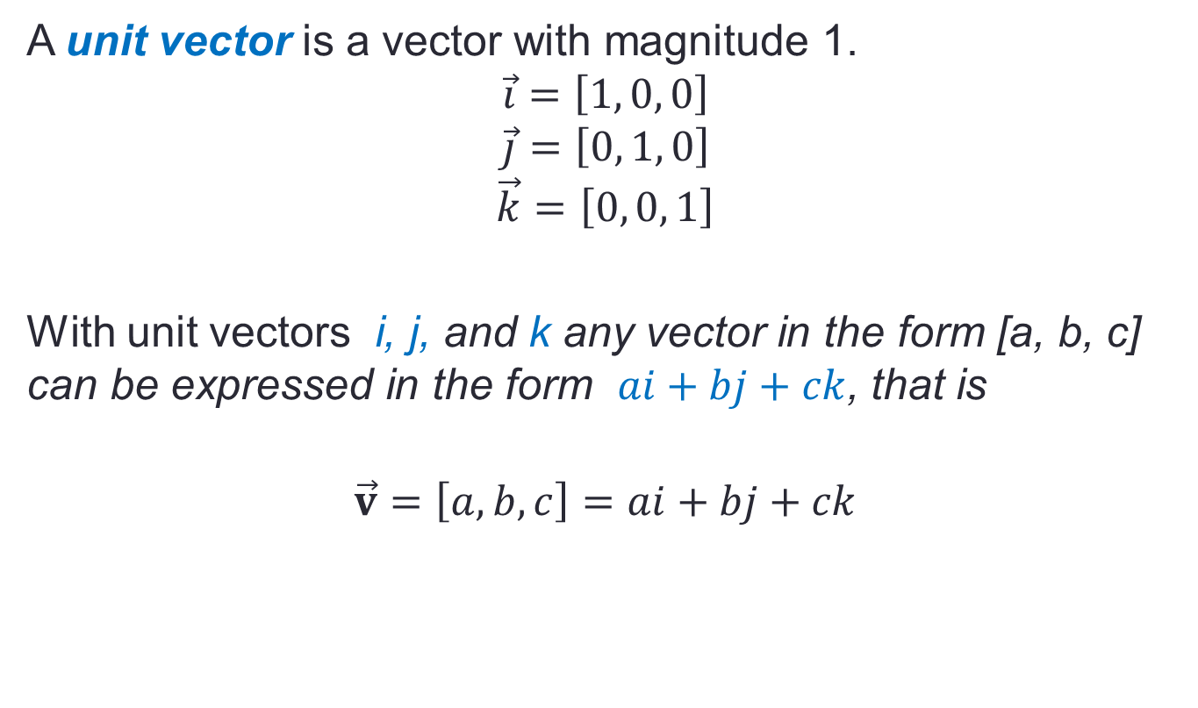
Vectors in Space
A unit vector is a vector with magnitude 1.
$$\vec{i}=\left[1, 0, 0\right]$$
$$\vec{j}=\left[0, 1, 0\right]$$
$$\vec{k}=\left[0, 0, 1\right]$$
With unit vectors i, j, and k any vector in the form [a, b, c] can be expressed in the form $ai+bj+ck$, that is
$$\vec{v}=\left[a, b, c\right]=ai+bj+ck$$

Slide 29
Vectors in Space
Example:
Given a vector in space with initial point (2, 3, -1) and terminal point at (0, 0, 2), determine each of the following:
The position vector;
The vector as linear combination of i, j, and k;
The magnitude or the length of the vector; and
A unit vector in the same direction as the given vector.

Slide 30
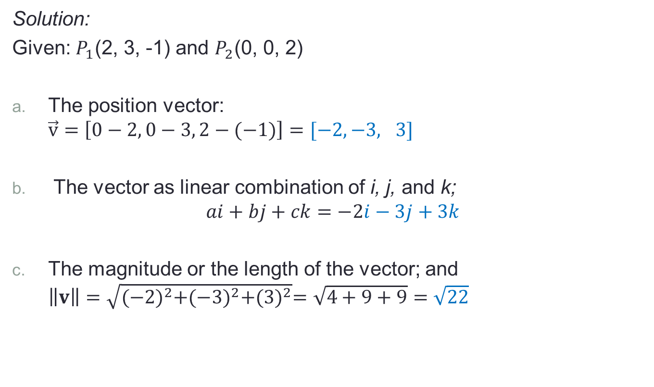
Vectors in Space
Solution:
Given: $P_{1}$(2, 3, -1) and $P_{2}$(0, 0, 2)
The position vector: $\vec{v}=\left[0−2, 0−3, 2−(−1)\right]=[−2,−3, 3]$
The vector as linear combination of i, j, and k; $ai+bj+ck=−2i−3j+3k$
The magnitude or the length of the vector; and $\left\|v\right\|=\sqrt{{(−2)}^{2}+{(−3)}^{2}+{(3)}^{2}}=\sqrt{4+9+9}=\sqrt{22}$

Slide 31
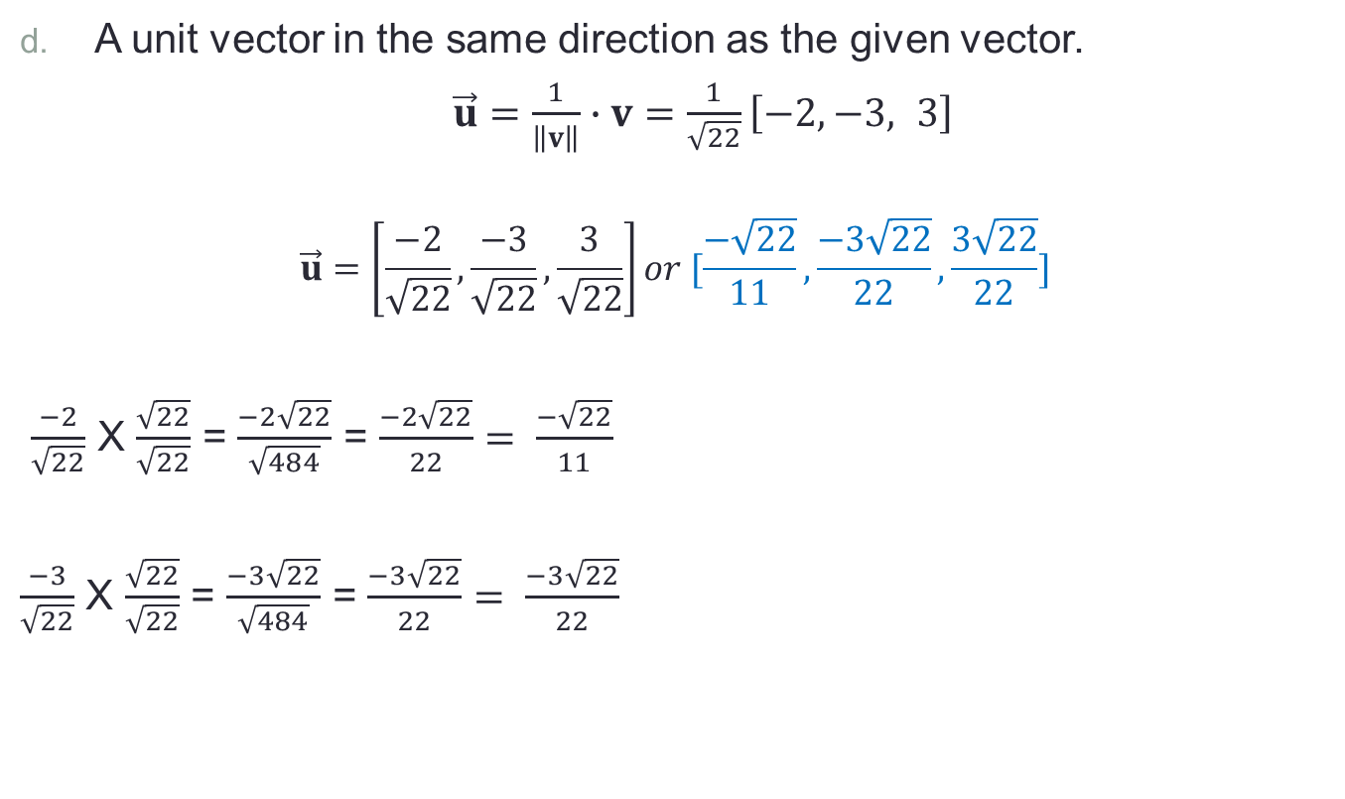
Vectors in Space
A unit vector in the same direction as the given vector.
$\vec{u}=\frac{1}{\left\|v\right\|}∙v=\frac{1}{\sqrt{22}}\left[−2,−3, 3\right]$
$$\vec{u}=\left[\frac{−2}{\sqrt{22}}, \frac{−3}{\sqrt{22}}, \frac{3}{\sqrt{22}}\right]or [\frac{−\sqrt{22}}{11},\frac{−3\sqrt{22}}{22}, \frac{3\sqrt{22}}{22}]$$
$\frac{−2}{\sqrt{22}}$ X $\frac{\sqrt{22}}{\sqrt{22}}$ = $\frac{−2\sqrt{22}}{\sqrt{484}}$ = $\frac{−2\sqrt{22}}{22}= \frac{−\sqrt{22}}{11}$
$\frac{−3}{\sqrt{22}}$ X $\frac{\sqrt{22}}{\sqrt{22}}$ = $\frac{−3\sqrt{22}}{\sqrt{484}}$ = $\frac{−3\sqrt{22}}{22}= \frac{−3\sqrt{22}}{22}$

Slide 32
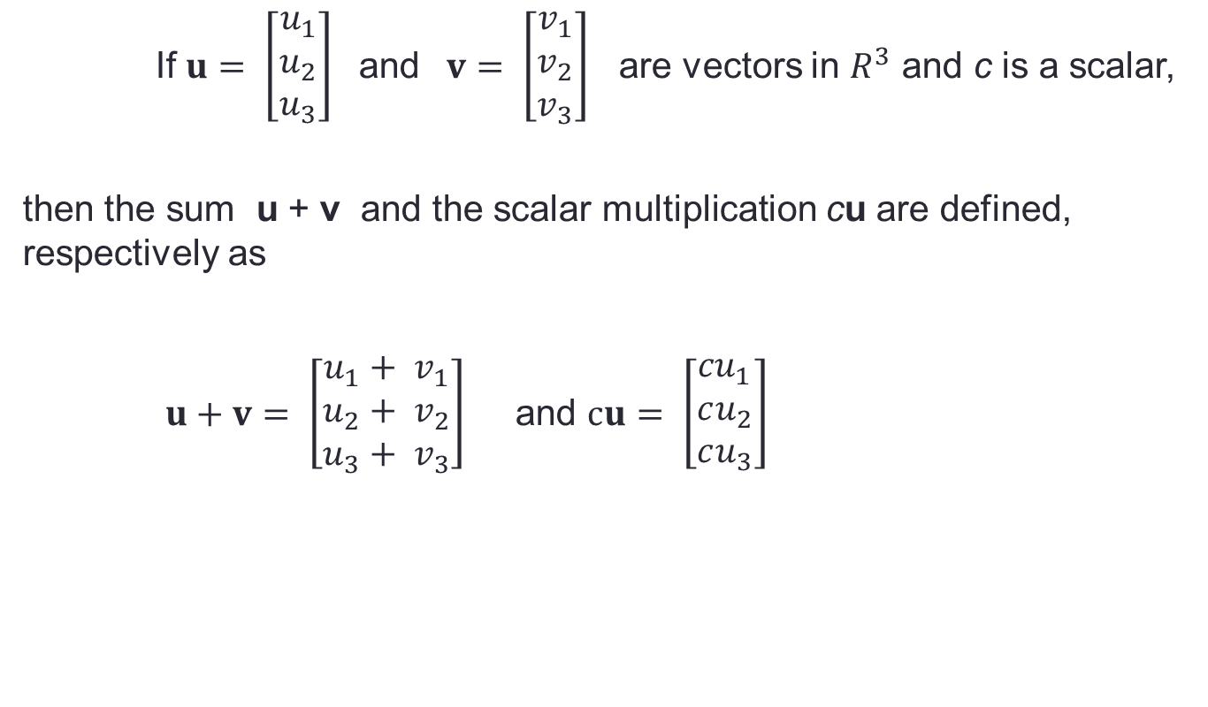
Vectors in Space
If $u= \left[\begin{matrix}u_{1} \\ u_{2} \\ u_{3}\end{matrix}\right]$ and $v= \left[\begin{matrix}v_{1} \\ v_{2} \\ v_{3}\end{matrix}\right]$ are vectors in $R^{3}$ and c is a scalar,
then the sum u + v and the scalar multiplication cu are defined, respectively as
$u+v= \left[\begin{matrix}u_{1}+ v_{1} \\ u_{2}+ v_{2} \\ u_{3}+ v_{3}\end{matrix}\right]$ and $cu= \left[\begin{matrix}{cu}_{1} \\ cu_{2} \\ cu_{3}\end{matrix}\right]$

Slide 33
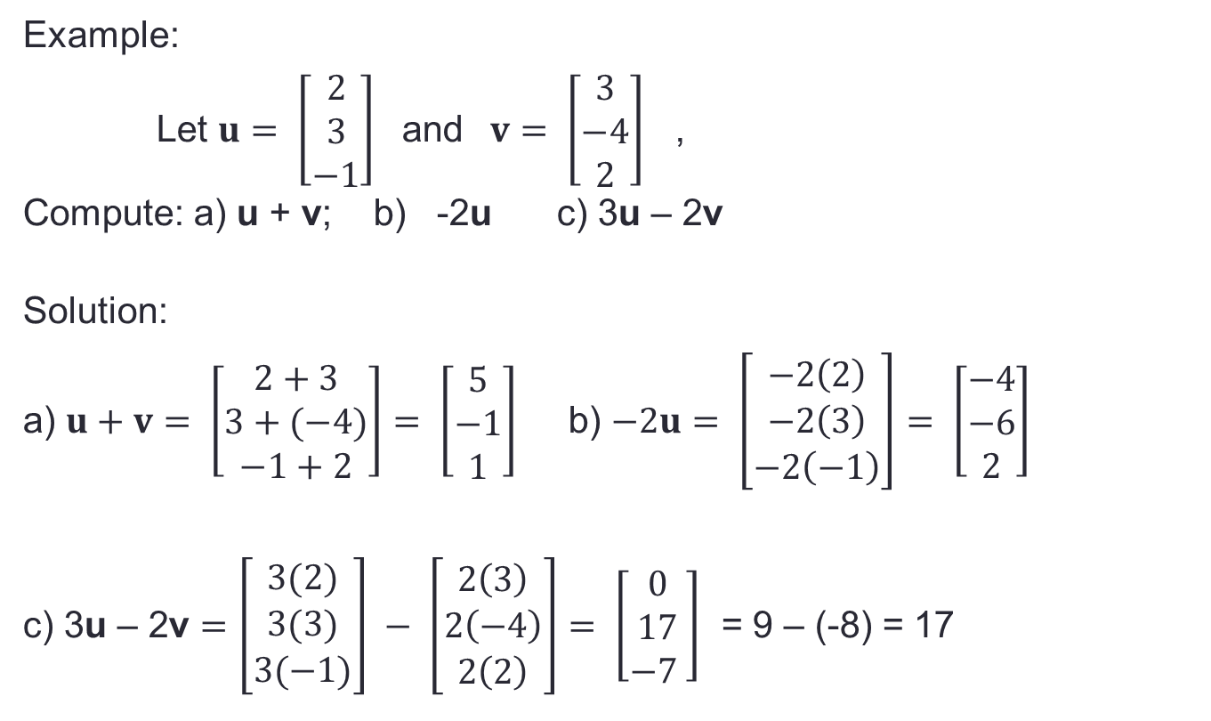
Vectors in Space
Example:
Let $u= \left[\begin{matrix}2 \\ 3 \\ −1\end{matrix}\right]$ and $v= \left[\begin{matrix}3 \\ −4 \\ 2\end{matrix}\right]$ ,
Compute: a) u + v; b) -2u c) 3u – 2v
Solution:
a) $u+v= \left[\begin{matrix}2+3 \\ 3+(−4) \\ −1+2\end{matrix}\right]= \left[\begin{matrix}5 \\ −1 \\ 1\end{matrix}\right]$ b) $−2u= \left[\begin{matrix}−2\left(2\right) \\ −2\left(3\right) \\ −2\left(−1\right)\end{matrix}\right]= \left[\begin{matrix}−4 \\ −6 \\ 2\end{matrix}\right]$
c) 3u – 2v $=\left[\begin{matrix}3(2) \\ 3(3) \\ 3(−1)\end{matrix}\right] − \left[\begin{matrix}2\left(3\right) \\ 2\left(−4\right) \\ 2\left(2\right)\end{matrix}\right]= \left[\begin{matrix}0 \\ 17 \\ −7 \end{matrix}\right]$ = 9 – (-8) = 17

Slide 34
Vectors in Space
Theorem: If u, v, and w are vectors in R² or R³, and c and d are real scalars, then
u + v = v + u
u + (v + w) = (u + v) + w
u + 0 = 0 + u = u
u + (- u) = 0
c(u + v) = cu + cv
(c +d) u = cu + du
c(du) = (cd) u
1u = u

Slide 35
Vector space and subspaces
Lesson 3

Slide 36
Vector Space
Definition:
A vector space is a nonempty set V of objects, called vectors, on which two operations are defined: addition and scalar multiplication, satisfying the ten (10) axioms.
The axioms must hold for all u, v, and w in V and for all scalars c and d.
u + v is in V (Closure Property under Addition)
u + v = v + u (Commutative Property)
u + (v + w) = (u + v) + w (Associative Property of Addition)
There is a vector 0 ( called the zero vector) in V such that u + 0 = u
For each u in V, there is vector –u in V satisfying u + (- u) = 0
cu is in V (Closure Property under Multiplication)
c(u + v) = cu + cv (Left Distributive Property)
(c +d) u = cu + du (Right Distributive Property)
c(du) = (cd) u (Associative Property of Multiplication)
1u = u (Scalar Identity)

Slide 37
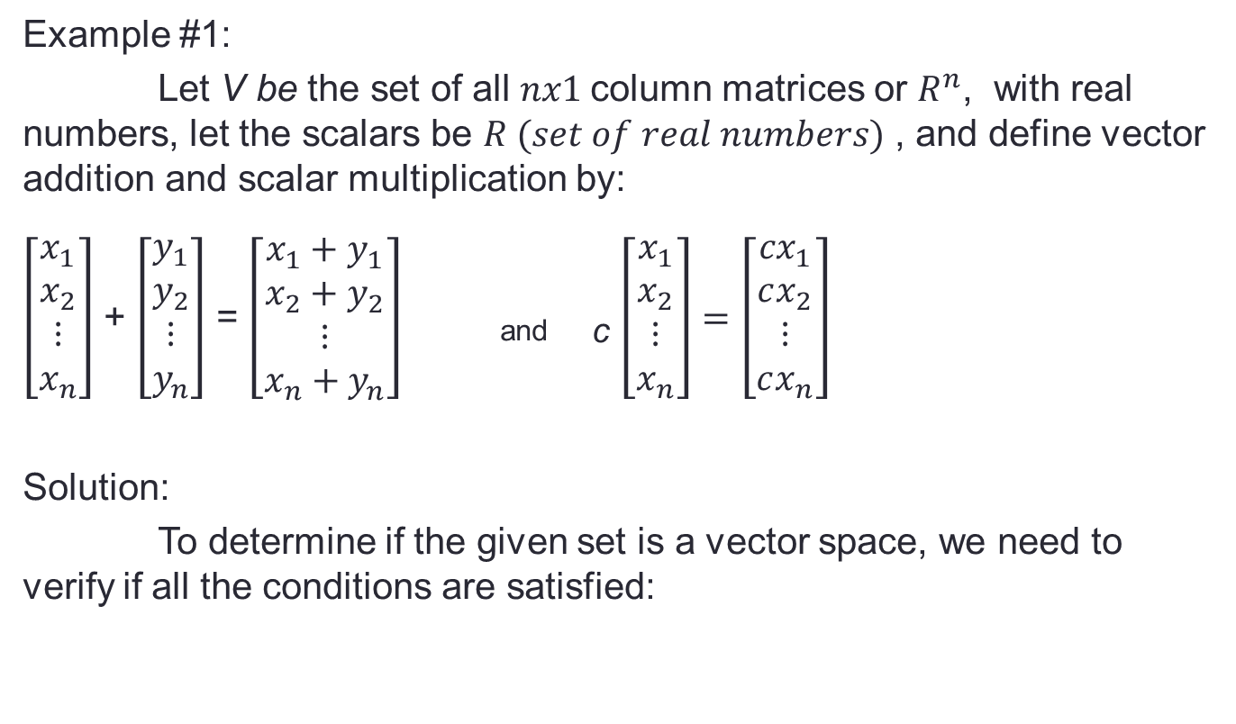
Vector Space Examples
Example #1:
Let V be the set of all $nx1$column matrices or $R^{n}$, with real numbers, let the scalars be $R (set of real numbers)$ , and define vector addition and scalar multiplication by:
$\left[\begin{aligned}\begin{matrix}x_{1} \\ x_{2}\end{matrix} \\ ⋮ \\ x_{n}\end{aligned}\right]$ + $\left[\begin{aligned}\begin{matrix}y_{1} \\ y_{2}\end{matrix} \\ ⋮ \\ y_{n}\end{aligned}\right]$ = $\left[\begin{aligned}\begin{matrix}x_{1}+y_{1} \\ x_{2}+y_{2}\end{matrix} \\ ⋮ \\ x_{n}+y_{n}\end{aligned}\right]$ _{and c} $\left[\begin{aligned}\begin{matrix}x_{1} \\ x_{2}\end{matrix} \\ ⋮ \\ x_{n}\end{aligned}\right]=\left[\begin{aligned}\begin{matrix}{cx}_{1} \\ cx_{2}\end{matrix} \\ ⋮ \\ cx_{n}\end{aligned}\right]$
Solution:
To determine if the given set is a vector space, we need to verify if all the conditions are satisfied:

Slide 38
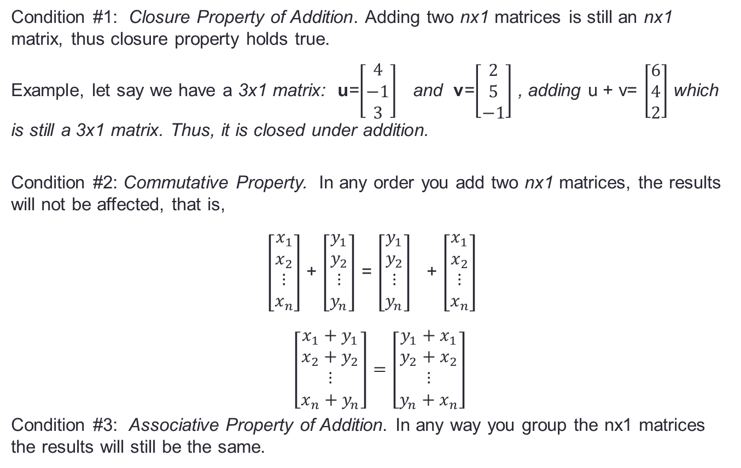
Vector Space Examples
Condition #1: Closure Property of Addition. Adding two nx1 matrices is still an nx1 matrix, thus closure property holds true.
Example, let say we have a 3x1 matrix: u=$\left[\begin{matrix}4 \\ −1 \\ 3\end{matrix}\right]$ and v=$\left[\begin{matrix}2 \\ 5 \\ −1\end{matrix}\right]$ , adding u + v= $\left[\begin{matrix}6 \\ 4 \\ 2\end{matrix}\right]$ which is still a 3x1 matrix. Thus, it is closed under addition.
Condition #2: Commutative Property. In any order you add two nx1 matrices, the results will not be affected, that is,
$\left[\begin{aligned}\begin{matrix}x_{1} \\ x_{2}\end{matrix} \\ ⋮ \\ x_{n}\end{aligned}\right]$ + $\left[\begin{aligned}\begin{matrix}y_{1} \\ y_{2}\end{matrix} \\ ⋮ \\ y_{n}\end{aligned}\right]$ = $\left[\begin{aligned}\begin{matrix}y_{1} \\ y_{2}\end{matrix} \\ ⋮ \\ y_{n}\end{aligned}\right]$ + $\left[\begin{aligned}\begin{matrix}x_{1} \\ x_{2}\end{matrix} \\ ⋮ \\ x_{n}\end{aligned}\right]$
$\left[\begin{aligned}\begin{matrix}x_{1}+y_{1} \\ x_{2}+y_{2}\end{matrix} \\ ⋮ \\ x_{n}+y_{n}\end{aligned}\right]=\left[\begin{aligned}\begin{matrix}y_{1}+x_{1} \\ y_{2}+x_{2}\end{matrix} \\ ⋮ \\ y_{n}+x_{n}\end{aligned}\right]$
Condition #3: Associative Property of Addition. In any way you group the nx1 matrices the results will still be the same.

Slide 39
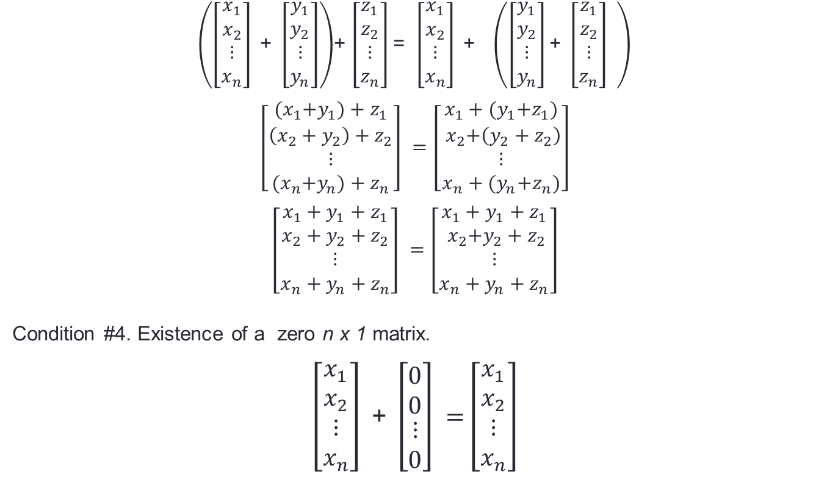
Vector Space Examples
$\left(\left[\begin{aligned}\begin{matrix}x_{1} \\ x_{2}\end{matrix} \\ ⋮ \\ x_{n}\end{aligned}\right]\text{ + }\left[\begin{aligned}\begin{matrix}y_{1} \\ y_{2}\end{matrix} \\ ⋮ \\ y_{n}\end{aligned}\right]\right)$+ $\left[\begin{aligned}\begin{matrix}z_{1} \\ z_{2}\end{matrix} \\ ⋮ \\ z_{n}\end{aligned}\right]$= $\left[\begin{aligned}\begin{matrix}x_{1} \\ x_{2}\end{matrix} \\ ⋮ \\ x_{n}\end{aligned}\right]\text{ + }$ $\left(\left[\begin{aligned}\begin{matrix}y_{1} \\ y_{2}\end{matrix} \\ ⋮ \\ y_{n}\end{aligned}\right]\text{+ }\left[\begin{aligned}\begin{matrix}z_{1} \\ z_{2}\end{matrix} \\ ⋮ \\ z_{n}\end{aligned}\right] \right)$
$\left[\begin{aligned}\begin{matrix}{(x}_{1}+y_{1})+z_{1} \\ \left(x_{2}+y_{2}\right)+z_{2}\end{matrix} \\ ⋮ \\ {(x}_{n}+y_{n})+z_{n}\end{aligned}\right] =$ $\left[\begin{aligned}\begin{matrix}x_{1}+{(y}_{1}+z_{1}) \\ { x}_{2}+\left(y_{2}+z_{2}\right)\end{matrix} \\ ⋮ \\ x_{n}+{(y}_{n}+z_{n})\end{aligned}\right]$
$\left[\begin{aligned}\begin{matrix}x_{1}+y_{1}+z_{1} \\ x_{2}+y_{2}+z_{2}\end{matrix} \\ ⋮ \\ x_{n}+y_{n}+z_{n}\end{aligned}\right] =$ $\left[\begin{aligned}\begin{matrix}x_{1}+y_{1}+z_{1} \\ { x}_{2}+y_{2}+z_{2}\end{matrix} \\ ⋮ \\ x_{n}+y_{n}+z_{n}\end{aligned}\right]$
Condition #4. Existence of a zero n x 1 matrix.
$\left[\begin{aligned}\begin{matrix}x_{1} \\ x_{2}\end{matrix} \\ ⋮ \\ x_{n}\end{aligned}\right]\text{ + }\left[\begin{aligned}\begin{matrix}0 \\ 0\end{matrix} \\ ⋮ \\ 0\end{aligned}\right] =$ $\left[\begin{aligned}\begin{matrix}x_{1} \\ x_{2}\end{matrix} \\ ⋮ \\ x_{n}\end{aligned}\right]$

Slide 40
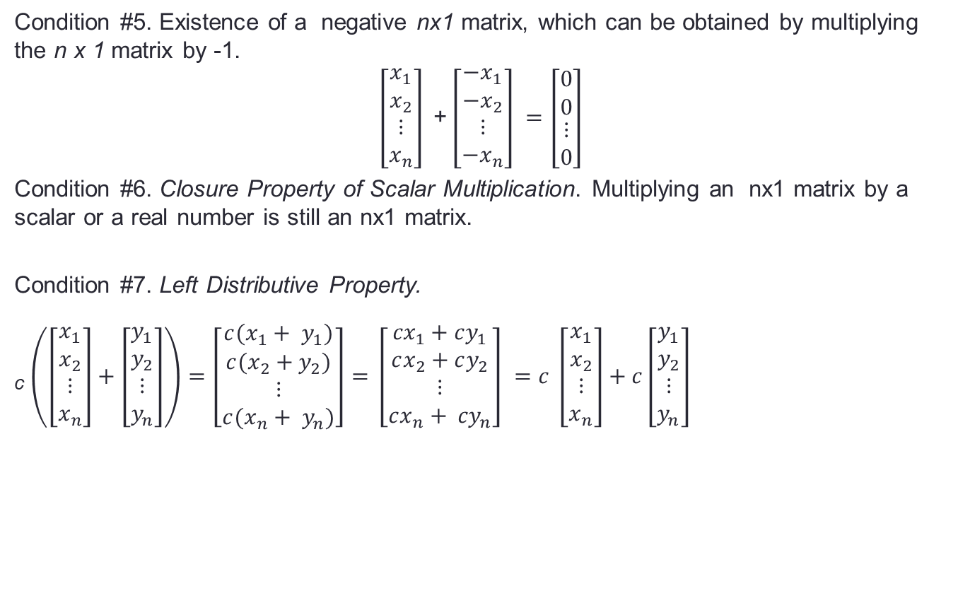
Vector Space Examples
Condition #5. Existence of a negative nx1 matrix, which can be obtained by multiplying the n x 1 matrix by -1.
$$\left[\begin{aligned}\begin{matrix}x_{1} \\ x_{2}\end{matrix} \\ ⋮ \\ x_{n}\end{aligned}\right]\text{ +}\left[\begin{aligned}\begin{matrix}{−x}_{1} \\ {−x}_{2}\end{matrix} \\ ⋮ \\ {−x}_{n}\end{aligned}\right] =\left[\begin{aligned}\begin{matrix}0 \\ 0\end{matrix} \\ ⋮ \\ 0\end{aligned}\right]$$
Condition #6. Closure Property of Scalar Multiplication. Multiplying an nx1 matrix by a scalar or a real number is still an nx1 matrix.
Condition #7. Left Distributive Property.
_{c} $\left(\left[\begin{aligned}\begin{matrix}x_{1} \\ x_{2}\end{matrix} \\ ⋮ \\ x_{n}\end{aligned}\right]+\left[\begin{aligned}\begin{matrix}y_{1} \\ y_{2}\end{matrix} \\ ⋮ \\ y_{n}\end{aligned}\right]\right)=\left[\begin{aligned}\begin{matrix}{c(x}_{1}+ y_{1}) \\ c(x_{2}+y_{2})\end{matrix} \\ ⋮ \\ c(x_{n}+ y_{n})\end{aligned}\right]=$ $\left[\begin{aligned}\begin{matrix}{cx}_{1}+cy_{1} \\ cx_{2}+cy_{2}\end{matrix} \\ ⋮ \\ cx_{n}+ {cy}_{n}\end{aligned}\right] =c \left[\begin{aligned}\begin{matrix}x_{1} \\ x_{2}\end{matrix} \\ ⋮ \\ x_{n}\end{aligned}\right]+c\left[\begin{aligned}\begin{matrix}y_{1} \\ y_{2}\end{matrix} \\ ⋮ \\ y_{n}\end{aligned}\right]$

Slide 41
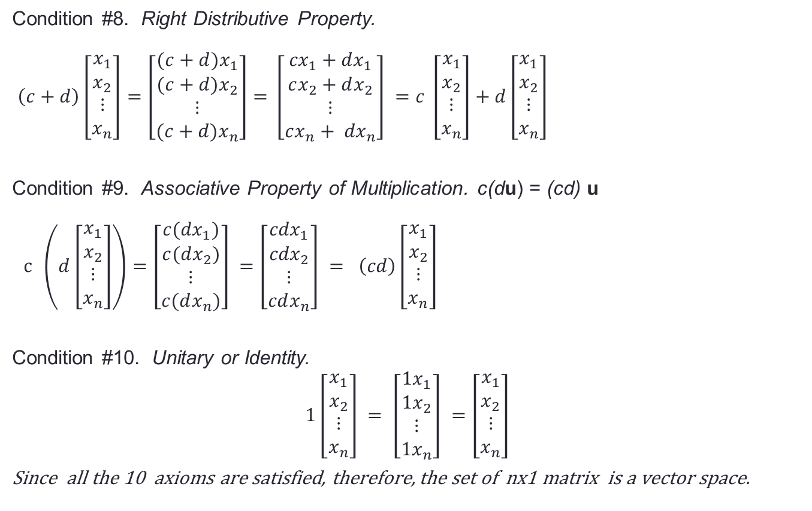
Vector Space Examples
Condition #8. Right Distributive Property.
$\left(c+d\right)\left[\begin{aligned}\begin{matrix}x_{1} \\ x_{2}\end{matrix} \\ ⋮ \\ x_{n}\end{aligned}\right]=\left[\begin{aligned}\begin{matrix}{(c+d)x}_{1} \\ (c+d)x_{2}\end{matrix} \\ ⋮ \\ (c+d)x_{n}\end{aligned}\right]=$ $\left[\begin{aligned}\begin{matrix}{cx}_{1}+dx_{1} \\ cx_{2}+dx_{2}\end{matrix} \\ ⋮ \\ cx_{n}+ {dx}_{n}\end{aligned}\right] =c \left[\begin{aligned}\begin{matrix}x_{1} \\ x_{2}\end{matrix} \\ ⋮ \\ x_{n}\end{aligned}\right]+d\left[\begin{aligned}\begin{matrix}x_{1} \\ x_{2}\end{matrix} \\ ⋮ \\ x_{n}\end{aligned}\right]$
Condition #9. Associative Property of Multiplication. c(du) = (cd) u
$c \left(d\left[\begin{aligned}\begin{matrix}x_{1} \\ x_{2}\end{matrix} \\ ⋮ \\ x_{n}\end{aligned}\right]\right)=\left[\begin{aligned}\begin{matrix}{c(dx}_{1}) \\ c(dx_{2})\end{matrix} \\ ⋮ \\ c(dx_{n})\end{aligned}\right] =\left[\begin{aligned}\begin{matrix}{cdx}_{1} \\ {cdx}_{2}\end{matrix} \\ ⋮ \\ cdx_{n}\end{aligned}\right] = \left(cd\right)\left[\begin{aligned}\begin{matrix}x_{1} \\ x_{2}\end{matrix} \\ ⋮ \\ x_{n}\end{aligned}\right]$
Condition #10. Unitary or Identity.
$$1\left[\begin{aligned}\begin{matrix}x_{1} \\ x_{2}\end{matrix} \\ ⋮ \\ x_{n}\end{aligned}\right] = \left[\begin{aligned}\begin{matrix}{1x}_{1} \\ 1x_{2}\end{matrix} \\ ⋮ \\ {1x}_{n}\end{aligned}\right] =\left[\begin{aligned}\begin{matrix}x_{1} \\ x_{2}\end{matrix} \\ ⋮ \\ x_{n}\end{aligned}\right]$$
Since all the 10 axioms are satisfied, therefore, the set of nx1 matrix is a vector space.

Slide 42
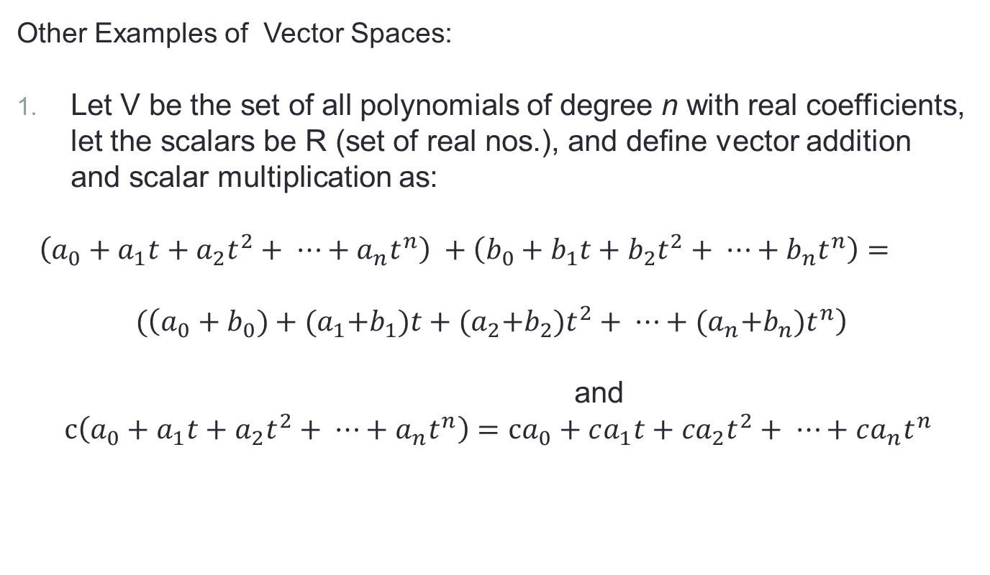
Vector Space Examples
Other Examples of Vector Spaces:
Let V be the set of all polynomials of degree n with real coefficients, let the scalars be R (set of real nos.), and deﬁne vector addition and scalar multiplication as:
$\left(a_{0}+a_{1}t+a_{2}t^{2}+ ⋯+a_{n}t^{n}\right) +\left(b_{0}+b_{1}t+b_{2}t^{2}+ ⋯+b_{n}t^{n}\right)=$
$$(\left(a_{0}+b_{0})+{(a}_{1}+b_{1})t+{(a}_{2}+b_{2})t^{2}+ ⋯+{(a}_{n}+b_{n})t^{n}\right)$$
and
$$c\left(a_{0}+a_{1}t+a_{2}t^{2}+ ⋯+a_{n}t^{n}\right)=ca_{0}+ca_{1}t+{ca}_{2}t^{2}+ ⋯+ca_{n}t^{n}$$

Slide 43


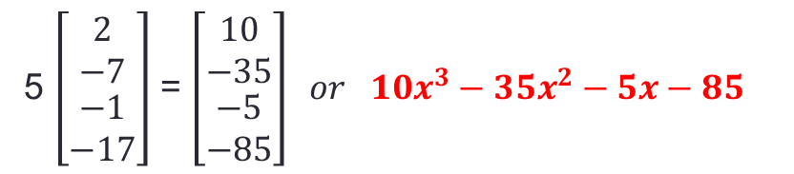
Vector Space Examples
_{Examples:}
_{1. Adding} 2$x^{3}−7x^{2}−x−17$ _{and} $x^{3}−4x+9$
_{2. Multiply} 2$x^{3}−7x^{2}−x−17$ _{by 5 .}
${2x}^{3}−7x^{2}−x−17 or \left[\begin{matrix}2 \\ −7 \\ \begin{aligned}−1 \\ −17\end{aligned}\end{matrix}\right] and{ x}^{3}−4x+9 \text{or} \left[\begin{matrix}1 \\ 0 \\ \begin{aligned}−4 \\ 9\end{aligned}\end{matrix}\right] thus$
$$\left[\begin{matrix}2 \\ −7 \\ \begin{aligned}−1 \\ −17\end{aligned}\end{matrix}\right] + \left[\begin{matrix}1 \\ 0 \\ \begin{aligned}−4 \\ 9\end{aligned}\end{matrix}\right]=\left[\begin{matrix}3 \\ −7 \\ \begin{aligned}−5 \\ −8\end{aligned}\end{matrix}\right] or {3x}^{3}−7x^{2}−5x−8$$
5 $\left[\begin{matrix}2 \\ −7 \\ \begin{aligned}−1 \\ −17\end{aligned}\end{matrix}\right]$ = $\left[\begin{matrix}10 \\ −35 \\ \begin{aligned}−5 \\ −85\end{aligned}\end{matrix}\right] or {10x}^{3}−35x^{2}−5x−85$

Slide 44
Subspaces
Definition:
A subspace of a vector V is a subset H of V that has three properties:
The zero vector of V is in H.
For each u and v are in H, u + v is in H. ( In this case we say that H is closed under vector addition.)
For each u in H and each scalar c, cu is in H. ( In this case we say that H is closed under scalar multiplication.)
If the subset H satisfies these three properties, then H itself is a vector.
Section 2.8 Subspace :https://www.youtube.com/watch?v=u4Og9zGParQes - YouTube

Slide 45
Spanning sets
Lesson 4

Slide 46
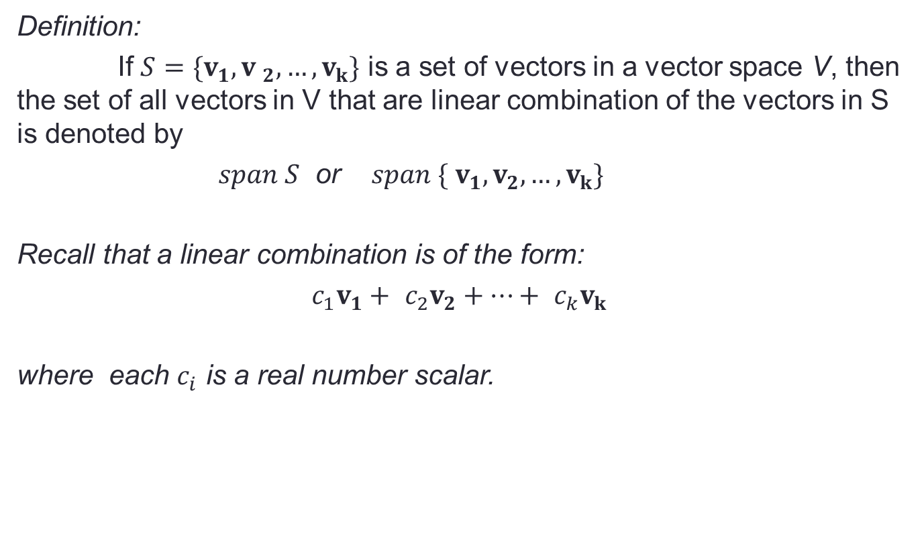
Spanning Sets
Definition:
If $S=\{v_{1}, {v }_{2}, …, v_{k}\}$ is a set of vectors in a vector space V, then the set of all vectors in V that are linear combination of the vectors in S is denoted by
$span S$ or $span \{ v_{1}, v_{2}, …,v_{k}\}$
Recall that a linear combination is of the form:
$c_{1}v_{1}+ c_{2}v_{2}+…+ c_{k}v_{k}$
where each $c_{i}$ is a real number scalar.

Slide 47
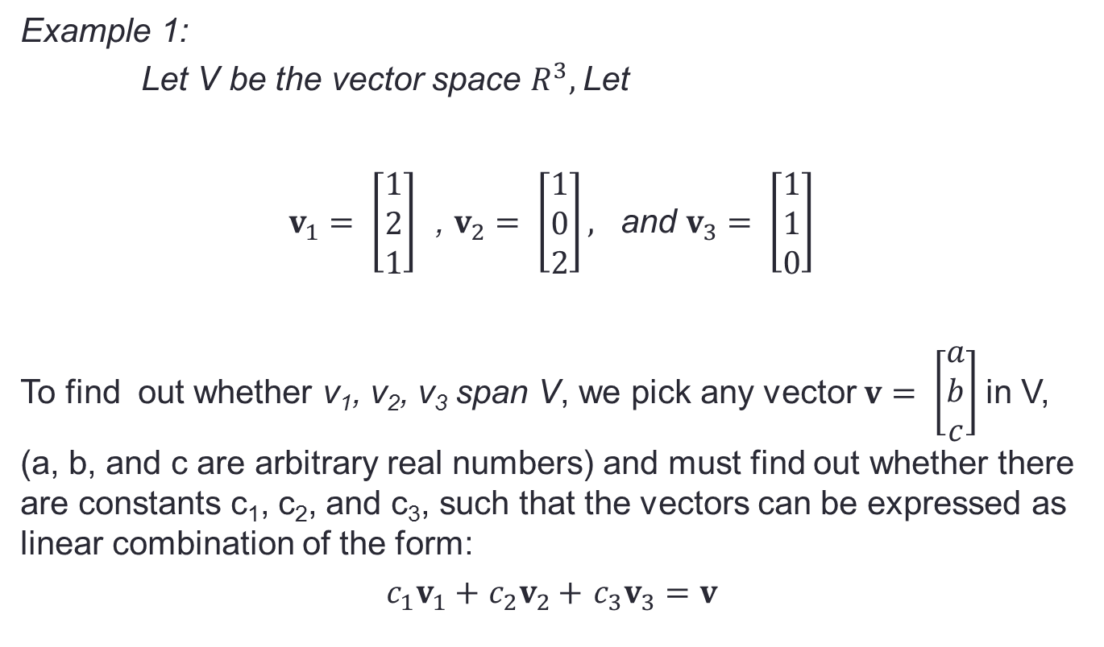
Spanning Sets
Example 1:
Let V be the vector space $R^{3},$Let
$v_{1}= \left[\begin{matrix}1 \\ 2 \\ 1\end{matrix}\right]$ , $v_{2}= \left[\begin{matrix}1 \\ 0 \\ 2\end{matrix}\right],$ and $v_{3}= \left[\begin{matrix}1 \\ 1 \\ 0\end{matrix}\right]$
To find out whether v₁, v₂, v₃ span V, we pick any vector $v= \left[\begin{matrix}a \\ b \\ c\end{matrix}\right]$in V, (a, b, and c are arbitrary real numbers) and must find out whether there are constants c₁, c₂, and c₃, such that the vectors can be expressed as linear combination of the form:
$c_{1}v_{1}+$ $c_{2}v_{2}+$ $c_{3}v_{3}=v$

Slide 48
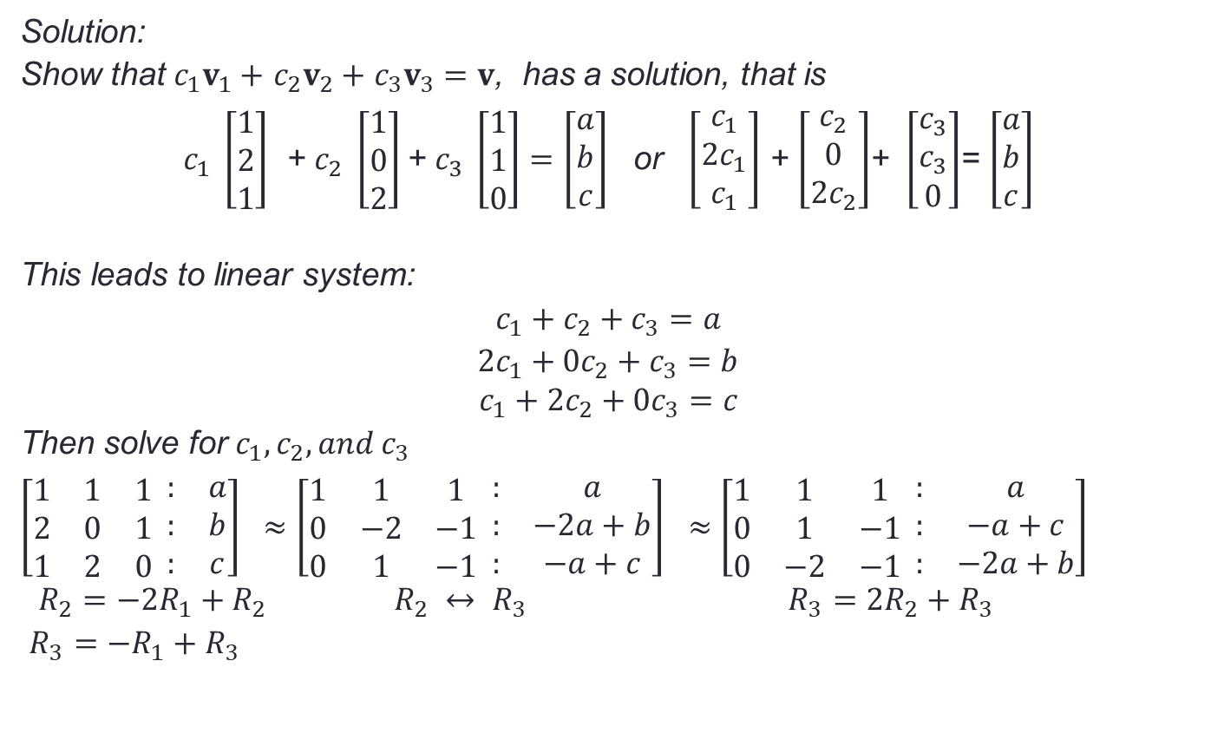
Spanning Sets
Solution:
Show that $c_{1}v_{1}+$ $c_{2}v_{2}+$ $c_{3}v_{3}=v$, has a solution, that is
$c_{1} \left[\begin{matrix}1 \\ 2 \\ 1\end{matrix}\right]$ + $c_{2} \left[\begin{matrix}1 \\ 0 \\ 2\end{matrix}\right]$+ $c_{3} \left[\begin{matrix}1 \\ 1 \\ 0\end{matrix}\right]=\left[\begin{matrix}a \\ b \\ c\end{matrix}\right]$ or $\left[\begin{matrix}c_{1} \\ 2c_{1} \\ c_{1}\end{matrix}\right]$ + $\left[\begin{matrix}c_{2} \\ 0 \\ 2c_{2}\end{matrix}\right]$+ $\left[\begin{matrix}c_{3} \\ c_{3} \\ 0\end{matrix}\right]$= $\left[\begin{matrix}a \\ b \\ c\end{matrix}\right]$
This leads to linear system:
$c_{1}+c_{2}+c_{3}=a$
${2c}_{1}+{0c}_{2}+c_{3}=b$
$$c_{1}+{2c}_{2}+0c_{3}=c$$
Then solve for $c_{1}, c_{2}, and c_{3}$
$\left[\begin{matrix}1 & 1 & 1 \\ 2 & 0 & 1 \\ 1 & 2 & 0\end{matrix} \begin{matrix}: & a \\ : & b \\ : & c\end{matrix}\right] ≈\left[\begin{matrix}1 & 1 & 1 \\ 0 & −2 & −1 \\ 0 & 1 & −1\end{matrix} \begin{matrix}: & a \\ : & −2a+b \\ : & −a+c\end{matrix}\right] ≈$ $\left[\begin{matrix}1 & 1 & 1 \\ 0 & 1 & −1 \\ 0 & −2 & −1\end{matrix} \begin{matrix}: & a \\ : & −a+c \\ : & −2a+b\end{matrix}\right]$
$R_{2}=−2R_{1}+R_{2}$ $R_{2} ↔ R_{3}$ $R_{3}=2R_{2}+R_{3}$
$R_{3}=−R_{1}+R_{3}$

Slide 49

Spanning Sets
Cont.
$≈$ $\left[\begin{matrix}1 & 1 & 1 \\ 0 & 1 & −1 \\ 0 & 0 & −3\end{matrix} \begin{matrix}: & a \\ : & −a+c \\ : & −4a+b+2c\end{matrix} \right] ≈ \left[\begin{matrix}1 & 1 & 1 \\ 0 & 1 & −1 \\ 0 & 0 & 1\end{matrix} \begin{matrix}: & a \\ : & −a+c \\ : & \frac{4a−b−2c}{3}\end{matrix} \right]$
$R_{3}=−\frac{1}{3}R_{3}$
Reduce to system of linear the resulting matrix
$c_{1}+c_{2}+c_{3}=a$
${ c}_{2}−c_{3}=−a$+c
$$c_{3}=\frac{4a−b−2c}{3}$$
Solve for c₂
${ c}_{2}−c_{3}=−a$+c
${ c}_{2}=−a$+c + $c_{3}=−a+c + \frac{4a−b−2c}{3} = \frac{−3a+3c+4a−b−2c}{3} = \frac{a−b+c}{3}$

Slide 50
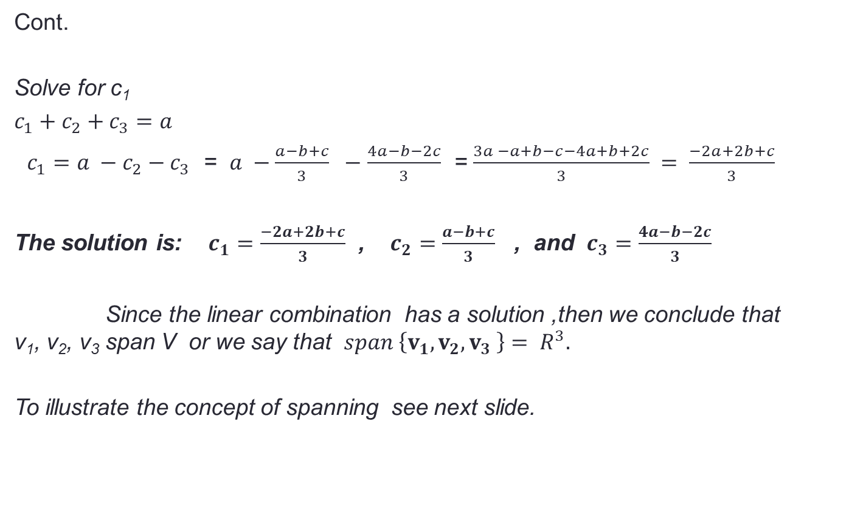
Spanning Sets
Cont.
Solve for c₁
$c_{1}+c_{2}+c_{3}=a$
$c_{1}=a −c_{2}−c_{3}$ = $a −\frac{a−b+c}{3} −$ $\frac{4a−b−2c}{3}$ = $\frac{3a −a+b−c−4a+b+2c}{3} = \frac{−2a+2b+c}{3}$
The solution is: $c_{1}=\frac{−2a+2b+c}{3}$ , $c_{2}=\frac{a−b+c}{3}$ , and $c_{3}=\frac{4a−b−2c}{3}$
Since the linear combination has a solution ,then we conclude that v₁, v₂, v₃ span V or we say that $span \left\{v_{1}, v_{2}, v_{3} \right\}= R^{3}.$
To illustrate the concept of spanning see next slide.

Slide 51
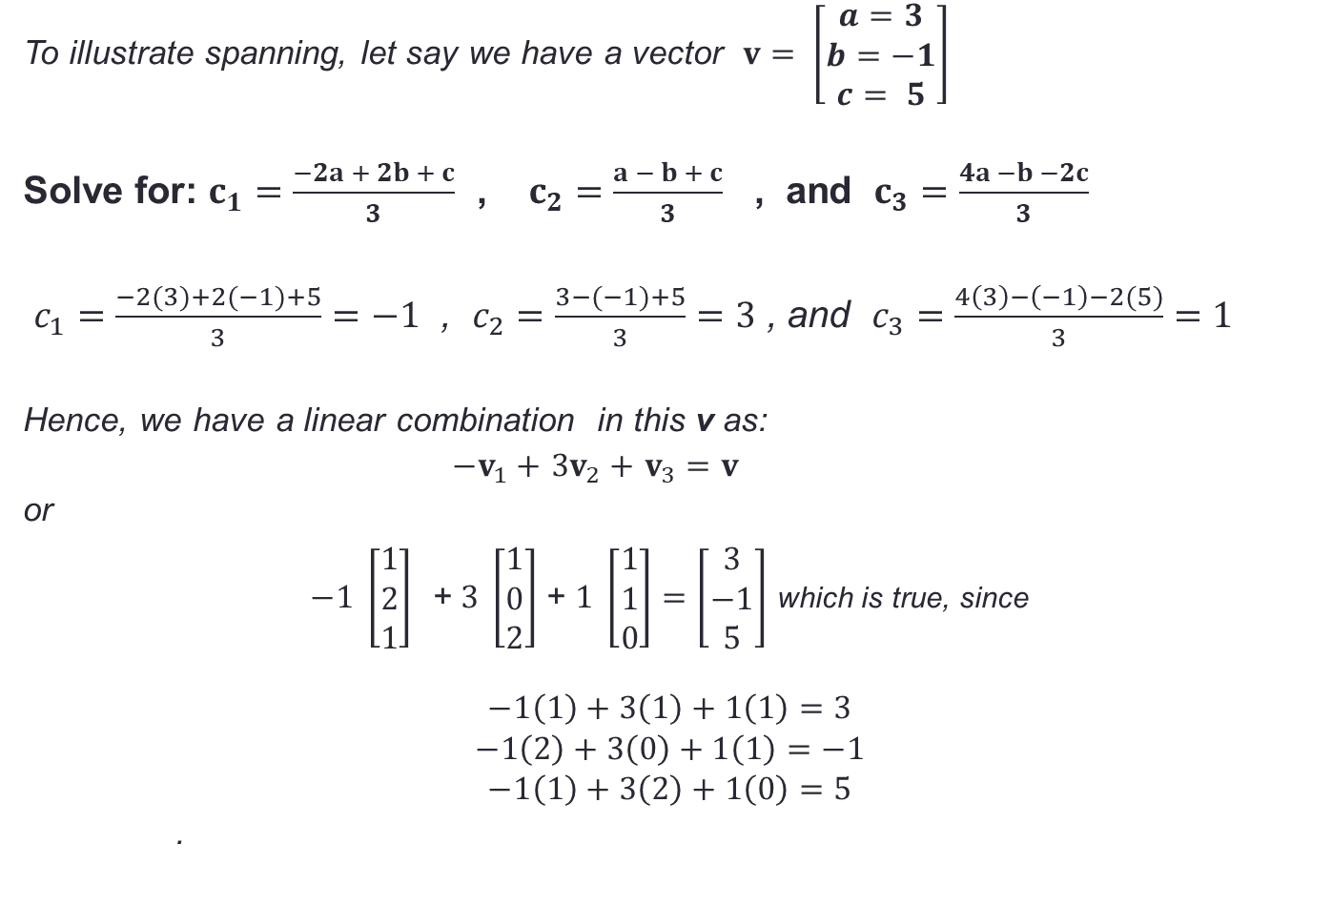
Spanning Sets
To illustrate spanning, let say we have a vector $v= \left[\begin{matrix}a=3 \\ b=−1 \\ c= 5\end{matrix}\right]$
Solve for: $c_{1}=\frac{−2a + 2b + c}{3}$ , $c_{2}=\frac{a − b + c}{3}$ , and $c_{3}=\frac{4a −b −2c}{3}$
$c_{1}=\frac{−2(3)+2(−1)+5}{3}=−1$ , $c_{2}=\frac{3−(−1)+5}{3}=3$ , and $c_{3}=\frac{4\left(3\right)−\left(−1\right)−2(5)}{3}=1$
Hence, we have a linear combination in this v as:
$−v_{1}+$ $3v_{2}+$ $v_{3}=v$
or
$−1 \left[\begin{matrix}1 \\ 2 \\ 1\end{matrix}\right]$ + $3 \left[\begin{matrix}1 \\ 0 \\ 2\end{matrix}\right]$+ $1 \left[\begin{matrix}1 \\ 1 \\ 0\end{matrix}\right]=\left[\begin{matrix}3 \\ −1 \\ 5\end{matrix}\right]$ which is true, since
$$−1\left(1\right)+3\left(1\right)+1\left(1\right)=3$$
$$−1\left(2\right)+3\left(0\right)+1\left(1\right)=−1$$
$$−1\left(1\right)+3\left(2\right)+1\left(0\right)=5$$
.

Slide 52

Spanning Sets
What is the linear combination if vector $v= \left[\begin{matrix}2 \\ 4 \\ −3\end{matrix}\right]$
Solve for $c_{1}=\frac{−2a+2b+c}{3}$ , $c_{2}=\frac{a−b+c}{3}$ , and $c_{3}=\frac{4a−b−2c}{3}$
$c_{1}=\frac{−2(2)+2(4)+(−3)}{3}=\frac{1}{3}$ , $c_{2}=\frac{2−4+(−3)}{3}=\frac{−5}{3}$ , and $c_{3}=\frac{4\left(2\right)−4−2(−3)}{3}=\frac{10}{3}$
Hence, we have a linear combination in this v as:
$\frac{1}{3}v_{1}−$ $\frac{5}{3}v_{2}+$ $\frac{10}{3}v_{3}=v$ ➔ $v_{1}−5v_{2}+10v_{3}=3v$
or
$\left[\begin{matrix}1 \\ 2 \\ 1\end{matrix}\right]$ - $5 \left[\begin{matrix}1 \\ 0 \\ 2\end{matrix}\right]$+ $10 \left[\begin{matrix}1 \\ 1 \\ 0\end{matrix}\right]=3\left[\begin{matrix}2 \\ 4 \\ −3\end{matrix}\right]$
To check $1\left(1\right)−5\left(1\right)+10\left(1\right)=3(2)$
$1\left(2\right)−5\left(0\right)+10\left(1\right)=3($4)
$1\left(1\right)−5\left(2\right)+10\left(0\right)=3(−$3)
.

Slide 53

Spanning Sets
Example 2:
Are vectors ${ v}_{1}=[1 , 0, 0]$, $v_{2}=[0 , 2, −1]$, $v_{3}=\left[3 , 4, 1\right]$and $v_{4}=\left[0 , 1, 0\right]$ spans $R^{3}$
Step 1: Express the given as linear combination and let the entry of vector v=[a, b, c].
$v=c_{1}v_{1}$+$c_{2}v_{2}+c_{3}v_{3}+c_{4}v_{4}$➔ $\left[\begin{matrix}a \\ b \\ c\end{matrix}\right]=c_{1}\left[\begin{matrix}1 \\ 0 \\ 0\end{matrix}\right]+c_{2}\left[\begin{matrix}0 \\ 2 \\ −1\end{matrix}\right]+c_{3}\left[\begin{matrix}3 \\ 4 \\ 1\end{matrix}\right]+c_{4}\left[\begin{matrix}0 \\ 1 \\ 0\end{matrix}\right]$
$\left[\begin{matrix}a \\ b \\ c\end{matrix}\right]=\left[\begin{matrix}c_{1} \\ 0 \\ 0\end{matrix}\right]+\left[\begin{matrix}0 \\ 2c_{2} \\ −c_{2}\end{matrix}\right]+\left[\begin{matrix}3c_{3} \\ 4c_{3} \\ c_{3}\end{matrix}\right]+\left[\begin{matrix}0 \\ c_{4} \\ 0\end{matrix}\right]$ or $\begin{matrix}a=c_{1}+3c_{3} \\ b=2c_{2}+4c_{3}+c_{4} \\ c=−c_{2}+c_{3}\end{matrix}$

Slide 54





Spanning Sets
Step 2: Provide the augmented form.
$$\left[\begin{matrix}1 & 0 & 3 \\ 0 & 2 & 4 \\ 0 & −1 & 1\end{matrix} \begin{matrix}0 \\ 1 \\ 0\end{matrix}\begin{matrix}: & a \\ : & b \\ : & c\end{matrix}\right]$$
Step 3: Reduce to ROW ECHELON FORM (triangular matrix).
$\left[\begin{matrix}1 & 0 & 3 \\ 0 & 2 & 4 \\ 0 & −1 & 1\end{matrix} \begin{matrix}0 \\ 1 \\ 0\end{matrix}\begin{matrix}: & a \\ : & b \\ : & c\end{matrix}\right]≈\left[\begin{matrix}1 & 0 & 3 \\ 0 & 1 & 2 \\ 0 & −1 & 1\end{matrix} \begin{matrix}0 \\ \frac{1}{2} \\ 0\end{matrix}\begin{matrix}: & a \\ : & \frac{b}{2} \\ : & c\end{matrix}\right]≈$ $\left[\begin{matrix}1 & 0 & 3 \\ 0 & 1 & 2 \\ 0 & 0 & 3\end{matrix} \begin{matrix}0 \\ \frac{1}{2} \\ \frac{1}{2}\end{matrix}\begin{matrix}: & a \\ : & \frac{b}{2} \\ : & \frac{b+2c}{2}\end{matrix}\right]≈$
$$\left[\begin{matrix}1 & 0 & 3 \\ 0 & 1 & 2 \\ 0 & 0 & 1\end{matrix} \begin{matrix}0 \\ \frac{1}{2} \\ \frac{1}{6}\end{matrix}\begin{matrix}: & a \\ : & \frac{b}{2} \\ : & \frac{b+2c}{6}\end{matrix}\right]$$
$$\frac{1}{2}R_{2}→R_{2}$$
$$R_{2}+R_{3}→R_{3}$$
$$\frac{1}{3}R_{3}→R_{3}$$

Slide 55

Spanning Sets
Step 4: Write as a system of linear equation and solve for the coefficients(a, b ,c and d).
$$\begin{matrix}c_{1}+3c_{3}=a \\ c_{2}+2c_{3}+\frac{1}{2}c_{4}=\frac{b}{2} \\ c_{3}+ \frac{1}{6}c_{4}=\frac{b+2c}{6}\end{matrix}$$
We have a free variable or floating variable.
Let $c_{4}=r, where r is any real number$
Solve for $c_{3}$:
$c_{3}+ \frac{1}{6}c_{4}=\frac{b+2c}{6}$ ➔$c_{3}=\frac{b+2c}{6} −\frac{1}{6}c_{4}$ , by substitution
$$=\frac{b+2c}{6} −\frac{1}{6}r=\frac{b+2c−r}{6}$$

Slide 56

Spanning Sets
Solve for $c_{2}$:
$c_{2}+2c_{3}+\frac{1}{2}c_{4}=\frac{y}{2}$ ➔$c_{2}=\frac{b}{2}−2c_{3}−\frac{1}{2}c_{4}$ , by substitution
$$c_{2} =\frac{b}{2}−2[\frac{b+2c−r}{6}]−\frac{1}{2}r$$
$c_{2}=\frac{3y}{6}−\left[\frac{2y+4z−2r}{6}\right]−\frac{3r}{6}=\frac{3y−2y−4z+2r−3r}{6}=\frac{y−4z−r}{6}$
Solve for $c_{1}$:
$c_{1}+3c_{3}=x$ ➔$c_{1}=a−3c_{3}$, by substitution
$$c_{1} =a−3\left[\frac{b+2c−r}{6}\right]=a−\left[\frac{3b+6c−3r}{6}\right]=\frac{6a−3b−6c+3r}{6}$$
$c_{1}=\frac{3(2a−b−2c+r)}{6}=$ $\frac{2a−b−2c+r}{2}$

Slide 57

Spanning Sets
Step 5: The values of the coefficients are:$c_{1}=\frac{2a−b−2c+r}{2}$; $c_{2}=\frac{b−4c−r}{6}$;
$c_{3}=\frac{b+2c−r}{6}$and $c_{4}=r$ , therefore $\left\{v_{1}, v_{2}, v_{3}, v_{4}\right\}spans R^{3}$
To Check: Let vector $v$ =$\left[\begin{matrix}1 \\ 2 \\ 3\end{matrix}\right]$ and r=4, thus${ c}_{1}=\frac{2\left(1\right)−2−2\left(3\right)+4}{2}=−1$;
$c_{2}=\frac{2−4(3)−4}{6}=\frac{−14}{6}=\frac{−7}{3}$ ;$c_{3}=\frac{2+2(3)−4}{6}=\frac{4}{6}=\frac{2}{3}$ ; and $c_{4}=4$
$−1$ $\left[\begin{matrix}1 \\ 0 \\ 0\end{matrix}\right]+\frac{−7}{3}\left[\begin{matrix}0 \\ 2 \\ −1\end{matrix}\right]+\frac{2}{3}\left[\begin{matrix}3 \\ 4 \\ 1\end{matrix}\right]+4 \left[\begin{matrix}0 \\ 1 \\ 0\end{matrix}\right]=\left[\begin{matrix}1 \\ 2 \\ 3\end{matrix}\right]$

Slide 58

Spanning Sets
$−1$ $\left[\begin{matrix}1 \\ 0 \\ 0\end{matrix}\right]+\frac{−7}{3}\left[\begin{matrix}0 \\ 2 \\ −1\end{matrix}\right]+\frac{2}{3}\left[\begin{matrix}3 \\ 4 \\ 1\end{matrix}\right]+4 \left[\begin{matrix}0 \\ 1 \\ 0\end{matrix}\right]=\left[\begin{matrix}1 \\ 2 \\ 3\end{matrix}\right]$
To verify:
$\begin{matrix}−1\left(1\right)+−\frac{7}{3}\left(0\right)+\frac{2}{3}\left(3\right)+4\left(0\right)=−1+0+2+0=1 \\ −1\left(0\right)−\frac{7}{3}\left(2\right)+\frac{2}{3}\left(4\right)+4=0+\frac{−14}{3}+\frac{8}{3}+\frac{12}{3}=2 \\ −1\left(0\right)+−\frac{7}{3}\left(−1\right)+\frac{2}{3}\left(1\right)+4\left(0\right)=0+\frac{7}{3}+\frac{2}{3}+0=3\end{matrix}$

Slide 59

Linear Combination
Example 1:
Write vector $v=[1 , −6, 5]$ as a linear combination of the vectors ${ v}_{1}=[1 , 2, 3]$, $v_{2}=[2 , 5, 8]$, and $v_{3}=[3 , 2, 3]$.
Step 1: Express the given as linear combination.
$v={xv}_{1}$+ $yv_{2}+zv_{3}$ ➔ $\left[\begin{matrix}1 \\ −6 \\ 5\end{matrix}\right]=x$ $\left[\begin{matrix}1 \\ 2 \\ 3\end{matrix}\right]+y\left[\begin{matrix}2 \\ 5 \\ 8\end{matrix}\right]+z\left[\begin{matrix}3 \\ 2 \\ 3\end{matrix}\right]$
$\left[\begin{matrix}1 \\ −6 \\ 5\end{matrix}\right]=\left[\begin{matrix}x \\ 2x \\ 3x\end{matrix}\right]+\left[\begin{matrix}2y \\ 5y \\ 8y\end{matrix}\right]+\left[\begin{matrix}3z \\ 2z \\ 3z\end{matrix}\right]$ or $\begin{matrix}1=x+2y+3z \\ −6=2x+5y+2z \\ 5=3x+8y+3z\end{matrix}$

Slide 60






Linear Combination
Step 2: Provide the augmented form.
$$\left[\begin{matrix}1 & 2 & 3 \\ 2 & 5 & 2 \\ 3 & 8 & 3\end{matrix}\begin{matrix}: & 1 \\ : & −6 \\ : & 5\end{matrix}\right]$$
Step 3: Reduce to ROW ECHELON FORM (triangular matrix).
$$\left[\begin{matrix}1 & 2 & 3 \\ 2 & 5 & 2 \\ 3 & 8 & 3\end{matrix}\begin{matrix}: & 1 \\ : & −6 \\ : & 5\end{matrix}\right]≈\left[\begin{matrix}1 & 2 & 3 \\ 0 & 1 & −4 \\ 0 & 2 & −6\end{matrix}\begin{matrix}: & 1 \\ : & −8 \\ : & 2\end{matrix}\right]≈\left[\begin{matrix}1 & 2 & 3 \\ 0 & 1 & −4 \\ 0 & 0 & 2\end{matrix}\begin{matrix}: & 1 \\ : & −8 \\ : & 18\end{matrix}\right]≈$$
$$\left[\begin{matrix}1 & 2 & 3 \\ 0 & 1 & −4 \\ 0 & 0 & 1\end{matrix}\begin{matrix}: & 1 \\ : & −8 \\ : & 9\end{matrix}\right]$$
$${−2R}_{1}+R_{2}→R_{2}$$
$${−2R}_{2}+R_{3}→R_{3}$$
$${−3R}_{1}+R_{3}→R_{3}$$
$$\frac{1}{2}R_{3}→R_{3}$$

Slide 61

Linear Combination
Step 4: Write as a system of linear equation and solve for the coefficients(x, y & z).
$$\begin{matrix}x+2y+3z=1 \\ y−4z=−8 \\ z=9\end{matrix}$$
Solve for b
$y=−8+4z=−8+4\left(9\right)=28$
Solve for a
$x+2y+3z=1$ ➔ $x=1−2y−3z=1−2\left(28\right)−3\left(9\right)=−82$

Slide 62

Linear Combination
Step 5: The values of the coefficients are: x= -82 ; y=28 and z=9 , therefore the linear combination is:
$$v=−82v_{1}+28v_{2}+9v_{3}$$
To Check:
$\left[\begin{matrix}1 \\ −6 \\ 5\end{matrix}\right]=x$ $\left[\begin{matrix}1 \\ 2 \\ 3\end{matrix}\right]+y\left[\begin{matrix}2 \\ 5 \\ 8\end{matrix}\right]+z\left[\begin{matrix}3 \\ 2 \\ 3\end{matrix}\right]=−82 \left[\begin{matrix}1 \\ 2 \\ 3\end{matrix}\right]+28\left[\begin{matrix}2 \\ 5 \\ 8\end{matrix}\right]+9\left[\begin{matrix}3 \\ 2 \\ 3\end{matrix}\right]$
$\begin{matrix}−82\left(1\right)+28\left(2\right)+9\left(3\right)=−82+83=1 \\ −82\left(2\right)+28\left(5\right)+9\left(2\right)=−164+158=−6 \\ −82\left(3\right)+28\left(8\right)+9\left(3\right)=−246+251=5\end{matrix}$
Note: If you cannot obtain values for the coefficients then the given vectors cannot be expressed as a linear combination.

Slide 63
Linear Independence
Lesson 5

Slide 64

Linear Independence
Definition:
The vectors$v_{1}, v_{2}, …, v_{k}$ in a vector space V are said to be linearly dependent if there exist constant $c_{1}, c_{2}, …,c_{k}$ , not all zero , such that
$c_{1}v_{1}+ c_{2}v_{2}+…+ c_{k}v_{k}=0$
Otherwise, $v_{1}, {v }_{2}, …, v_{k}$ are called linearly independent. That is $v_{1}, {v }_{2}, …, v_{k}$ are linearly independent if whenever
$c_{1}v_{1}+ c_{2}v_{2}+…+ c_{k}v_{k}=0$ ,
meaning we have a trivial solution or
$c_{1}= c_{2}=…= c_{k}=0$

Slide 65

Linear Independence

Slide 66

Linear Independence
Example #1
Are the vectors$v_{1}=\left[\begin{matrix}1 \\ 0 \\ \begin{aligned}1 \\ 2\end{aligned}\end{matrix}\right], v_{2 }=\left[\begin{matrix}0 \\ 1 \\ \begin{aligned}1 \\ 2\end{aligned}\end{matrix}\right], and v_{3}=\left[\begin{matrix}1 \\ 1 \\ \begin{aligned}1 \\ 3\end{aligned}\end{matrix}\right]$ in R⁴ linearly dependent or linearly independent?
Solution:
First, form the equation:
$c_{1}v_{1}+ c_{2}v_{2}+c_{3}v_{3}=0$
substitute $v_{1}$, $v_{2}$, $v_{3}$ and solve for c₁, c₂ and c₃.

Slide 67

Linear Independence
Cont.
$c_{1}\left[\begin{matrix}1 \\ 0 \\ \begin{aligned}1 \\ 2\end{aligned}\end{matrix}\right]+ c_{2}\left[\begin{matrix}0 \\ 1 \\ \begin{aligned}1 \\ 2\end{aligned}\end{matrix}\right]+c_{3}\left[\begin{matrix}1 \\ 1 \\ \begin{aligned}1 \\ 3\end{aligned}\end{matrix}\right]=0$
$$c_{1} + c_{3}=0$$
$$c_{2} + c_{3}=0$$
$$c_{1} + c_{2} + c_{3}=0$$
${2c}_{1}+2c_{2}+3c_{3}=0$
write its augmented matrix:
$$\left[\begin{matrix}1 & 0 & 1 \\ 0 & 1 & 1 \\ \begin{aligned}1 \\ 2\end{aligned} & \begin{aligned}1 \\ 2\end{aligned} & \begin{aligned}1 \\ 3\end{aligned}\end{matrix} \begin{matrix}: & 0 \\ : & 0 \\ : & \begin{aligned}0 \\ 0\end{aligned}\end{matrix}\right]$$

Slide 68

Linear Independence
Cont.
reduced to row echelon form:
$\left[\begin{matrix}1 & 0 & 1 \\ 0 & 1 & 1 \\ \begin{aligned}1 \\ 2\end{aligned} & \begin{aligned}1 \\ 2\end{aligned} & \begin{aligned}1 \\ 3\end{aligned}\end{matrix} \begin{matrix}: & 0 \\ : & 0 \\ : & \begin{aligned}0 \\ 0\end{aligned}\end{matrix}\right]≈ \left[\begin{matrix}1 & 0 & 1 \\ 0 & 1 & 1 \\ \begin{aligned}0 \\ 0\end{aligned} & \begin{aligned}1 \\ 2\end{aligned} & \begin{aligned}0 \\ 2\end{aligned}\end{matrix} \begin{matrix}: & 0 \\ : & 0 \\ : & \begin{aligned}0 \\ 0\end{aligned}\end{matrix}\right]≈ \left[\begin{matrix}1 & 0 & 1 \\ 0 & 1 & 1 \\ \begin{aligned}0 \\ 0\end{aligned} & \begin{aligned}0 \\ 0\end{aligned} & \begin{aligned}−1 \\ 0\end{aligned}\end{matrix} \begin{matrix}: & 0 \\ : & 0 \\ : & \begin{aligned}0 \\ 0\end{aligned}\end{matrix}\right]$ $≈ \left[\begin{matrix}1 & 0 & 1 \\ 0 & 1 & 1 \\ \begin{aligned}0 \\ 0\end{aligned} & \begin{aligned}0 \\ 0\end{aligned} & \begin{aligned}1 \\ 0\end{aligned}\end{matrix} \begin{matrix}: & 0 \\ : & 0 \\ : & \begin{aligned}0 \\ 0\end{aligned}\end{matrix}\right]$
$R_{3}=−1R_{1}+R_{3}$ $R_{3}=−1R_{2}+R_{3}$ $R_{3}=−1R_{3}$
$R_{4}=−2R_{1}+R_{4}$ $R_{4}=−2R_{2}+R_{4}$
$≈ \left[\begin{matrix}1 & 0 & 0 \\ 0 & 1 & 0 \\ \begin{aligned}0 \\ 0\end{aligned} & \begin{aligned}0 \\ 0\end{aligned} & \begin{aligned}1 \\ 0\end{aligned}\end{matrix} \begin{matrix}: & 0 \\ : & 0 \\ : & \begin{aligned}0 \\ 0\end{aligned}\end{matrix}\right]$
$R_{1}=−1R_{3}+R_{1}$
$$R_{2}=−1R_{1}+R_{2}$$
This indicate that c₁= c₂ = c₃ =0, has trivial solution, thus the given vectors are linearly independent.

Slide 69

Linear Independence
Example #2
Are the vectors $v_{1}= \left[\begin{matrix}1 \\ 1 \\ 2\end{matrix}\right], v_{2 }=\left[\begin{matrix}2 \\ 1 \\ 0\end{matrix}\right], and v_{3}=\left[\begin{matrix}3 \\ 2 \\ 2\end{matrix}\right]$ linearly dependent or linearly independent?
Solution:
Again, form the equation:
$c_{1}v_{1}+ c_{2}v_{2}+c_{3}v_{3}=0$
substitute $v_{1}$, $v_{2}$, $v_{3}$ and solve for c₁, c₂ and c₃.

Slide 70

Linear Independence
Cont.
$c_{1}\left[\begin{matrix}1 \\ 1 \\ 2\end{matrix}\right]+ c_{2}\left[\begin{matrix}2 \\ 1 \\ 0\end{matrix}\right]+c_{3}\left[\begin{matrix}3 \\ 2 \\ 2\end{matrix}\right]=0$
its augmented matrix: $\left[\begin{matrix}1 & 2 & 3 \\ 1 & 1 & 2 \\ 2 & 0 & 2\end{matrix}\right]$
$$\text{Reduce} \text{to} \text{row} \text{echelon} \text{form} \text{to} \text{solve} \text{for} c_{1}\text{, }c_{2}\text{ , }\text{and} c_{3}$$
$$\left[\begin{matrix}1 & 2 & 3 \\ 1 & 1 & 2 \\ 2 & 0 & 2\end{matrix}\right]≈ \left[\begin{matrix}1 & 2 & 1 \\ 0 & −1 & −1 \\ 0 & −4 & −4\end{matrix}\right] ≈ \left[\begin{matrix}1 & 2 & 1 \\ 0 & 1 & 1 \\ 0 & 4 & 4\end{matrix}\right] ≈ \left[\begin{matrix}1 & 2 & 3 \\ 0 & 1 & 1 \\ 0 & 0 & 0\end{matrix}\right]≈ \left[\begin{matrix}1 & 0 & 1 \\ 0 & 1 & 1 \\ 0 & 0 & 0\end{matrix}\right]$$
${ R}_{2}= {−1R}_{1}+ R_{2} R_{2}= {−1R}_{2} R_{3}= {−4R}_{2 }+R_{3} R_{1}= {−2R}_{2}$+ $R_{1}$
$R_{3}= {−2R}_{1}+ R_{3}$ $R_{3}= {−1R}_{3 }$

Slide 71

Linear Independence
Cont.
This is equivalent to linear System $c_{1} + c_{3}=0$ ➔ $c_{1}={−c}_{3}$
$c_{2}+ c_{3}=0$ ➔ ${ c}_{2}= {−c}_{3}$
let $c_{3}=r$ , where r ε ℛ (set of real nos.)
$c_{1}=−r$ ; ${and c}_{2}= −r$
This means that the vectors has infinitely many solution.
A particular solution is when r = -1 then c₁=1, c₂=1 and c₃=-1, then we have the linear combination: $v_{1}+v_{2}−v_{3}=0$
When r= 2, then c₁= -2, c₂=-2 and c₃=2, hence we have, ${ −2v}_{1}−2v_{2}+2v_{3}=0$
Therefore the vector is linearly dependent.
(Note: If we would observed the given vectors, we say that : ${ v}_{1}+v_{2}=v_{3}$)

Slide 72

Try This!
Determine whether the vectors $v_{1}= \left[\begin{matrix}1 \\ 1 \\ 1\end{matrix}\right], v_{2}= \left[\begin{matrix}2 \\ −1 \\ 3\end{matrix}\right], and v_{3}= \left[\begin{matrix}1 \\ −5 \\ 3\end{matrix}\right],$are linearly dependent or linearly independent.
Solution:
$\left[\begin{matrix}1 & 2 & 1 \\ 1 & −1 & −5 \\ 1 & 3 & 3\end{matrix}\right] \begin{matrix}1 & 2 \\ 1 & −1 \\ 1 & 3\end{matrix}$ = [-3 + (-10)+ 3] – [-1 + (-15) +6] = -10 +10 = 0
The determinant is zero, then the set of vectors are linearly dependent.

Slide 73

Try This!
Determine whether the vectors $v_{1}= \left[\begin{matrix}1 \\ 1 \\ 1\end{matrix}\right], v_{2}= \left[\begin{matrix}2 \\ −1 \\ 3\end{matrix}\right], and v_{3}= \left[\begin{matrix}1 \\ −5 \\ 3\end{matrix}\right],$are linearly dependent or linearly independent.
Solution: $c_{1}v_{1}$+ $c_{2}v_{2}+c_{3}v_{3}=0$
$\left[\begin{matrix}1 & 2 & 1 \\ 1 & −1 & −5 \\ 1 & 3 & 3\end{matrix}\right]≈$ $\left[\begin{matrix}1 & 2 & 1 \\ 0 & −3 & −6 \\ 0 & 1 & 2\end{matrix}\right] ≈\left[\begin{matrix}1 & 2 & 1 \\ 0 & 1 & 2 \\ 0 & −3 & −6\end{matrix}\right]$ $≈\left[\begin{matrix}1 & 2 & 1 \\ 0 & 1 & 2 \\ 0 & 0 & 0\end{matrix}\right]$ $≈\left[\begin{matrix}1 & 0 & −3 \\ 0 & 1 & 2 \\ 0 & 0 & 0\end{matrix}\right]$
$−1R_{1}+R_{2}$ $R_{2}↔R_{3}$ $3R_{2}+R_{3}$ $−2R_{2}+R_{1}$
$$−1R_{1}+R_{3}$$
$c_{1} −{3c}_{3}=0$ ➔ $c_{1}=3c_{3}$
$c_{2}+{2c}_{3}=0$ ➔ $c_{2}=−2c_{3}$
Let $c_{3}=r, r∈R$ ,then $c_{1}=3r$ and $c_{2}=−2$r
Let r=1 , then the linear combination is $3v_{1}$- $2 v_{2}+v_{3}=0$

Slide 74
Try This!
Determine whether the vectors $v_{1}= \left[\begin{matrix}1 \\ 1 \\ 1\end{matrix}\right], v_{2}= \left[\begin{matrix}2 \\ −1 \\ 3\end{matrix}\right], and v_{3}= \left[\begin{matrix}1 \\ −5 \\ 3\end{matrix}\right],$are linearly dependent or linearly independent.
Solution:
$\left[\begin{matrix}1 & 2 & 1 \\ 1 & −1 & −5 \\ 1 & 3 & 3\end{matrix}\right] \begin{matrix}1 & 2 \\ 1 & −1 \\ 1 & 3\end{matrix}$ = [-3 + (-10)+ 3] – [-1 + (-15) +6] = -10 +10 = 0
The determinant is zero, then the set of vectors are linearly dependent.

Slide 75

Try This!
1. Determine whether the vectors $v_{1} \left[\begin{matrix}1 \\ −2 \\ −3\end{matrix}\right], { v}_{2} \left[\begin{matrix}2 \\ 3 \\ −1\end{matrix}\right], and$
$v_{3}= \left[\begin{matrix}3 \\ 2 \\ 1\end{matrix}\right],$are linearly dependent or linearly independent.
2. 𝐯1 = [ 2 −1 1 ] , 𝐯2 = [ 4 −7 −1 ], and 𝐯3 = [ 1 2 2 ]
are linearly dependent or linearly independent.

Slide 76

Linear Independence
Another solution to determine the linear dependence or independence is through the use of determinants:
Condition:
If the determinants of the coefficient matrix is 0, then the vectors are linearly dependent, and if the determinant is non-zero then the vectors are linearly independent.
In example #2, write the coefficient matrix and compute the determinant:
$\left|\begin{matrix}1 & 2 & 3 \\ 1 & 1 & 2 \\ 2 & 0 & 2\end{matrix}\right| \begin{matrix}1 & 2 \\ 1 & 1 \\ 2 & 0\end{matrix}=$ $\left(2+8+0\right)−\left(6+0+4\right)=0$
Since the determinant is zero , then the vectors are linearly dependent.
Note that we cannot compute the determinants for example #1 since it is not a square matrix.

Slide 77
References:
Kolman B. and Hill D. (2002), Elementary Linear Algebra (7th Ed. O Pearson). New Jersey: Pearson Education Inc.
Scott, G. What is Vector Space? Retrieved from http://www.math.toronto.edu/gscott/WhatVS.pdf
Vector Spaces. Retrieved from
http://linear.ups.edu/html/section-VS.html
Videos:
Intro to Vector Spaces
(90) Vectors in Space - YouTube
https://www.youtube.com/watch?v=YnuB9hpq1sU
https://www.youtube.com/watch?v=gcRbNKMpnXc
https://www.youtube.com/watch?v=xo7NSDRt8HM
https://www.youtube.com/watch?v=kNO9wQhLsEA
Linear Independence
https://www.youtube.com/watch?v=9kDpbZCK62Y
https://www.youtube.com/watch?v=PDjkL3_N2bM

Slide 78
Thank you!

